Slide 1



IoT Data Prefetching in Indoor Navigation SOAs
Andreas Konstantinidis∗‡, Panagiotis Irakleous*, Zacharias Georgiou*, Demetrios Zeinalipour-Yazti∗ και Panos K. Chrysanthis§
∗ University of Cyprus, 1678 Nicosia, Cyprus
‡ Frederick University,1036 Nicosia, Cyprus
§University of Pittsburgh, 15260 Pittsburgh, PA, USA
Under publication (accepted) in ACM Transactions on Internet Technologies (ACM TOIT), 2018

Slide 2
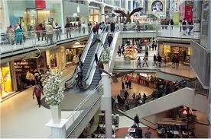







Motivation
People spend 80-90% of their time indoors – USA Environmental Protection Agency 2011.
>85% of data and 70% of voice traffic originates from within buildings – Nokia 2012.

Slide 3
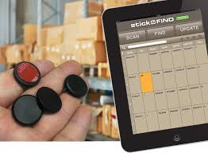
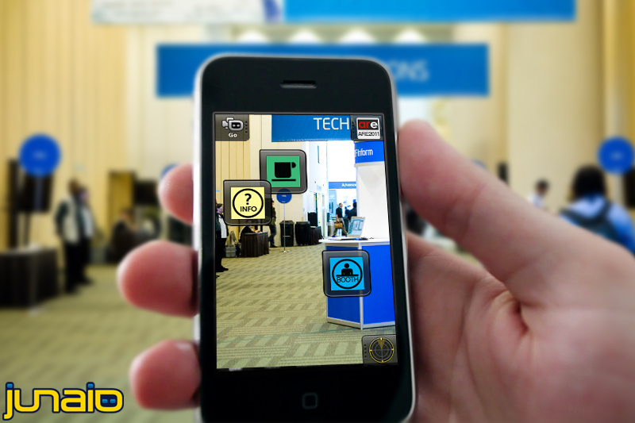
Localization and Navigation
Indoor Localization has still not reached its full potential.
Huge spectrum of indoor apps:
  Navigation, Manufacturing, Asset Tracking, Inventory Management
  Healthcare, Smart Houses, Elderly support, Fitness apps
  Augmented Reality and Indoor Games
Indoor Revenues expected reach 10B USD in 2020
  ABIresearch, “Retail Indoor Location Market Breaks US$10 Billion in 2020”’ Available at: https://goo.gl/ehPRMn, May 12, 2015.

Slide 4
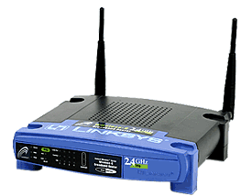
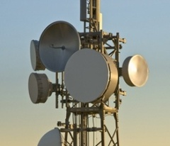

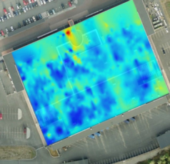


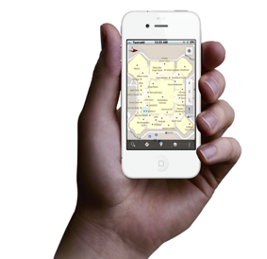
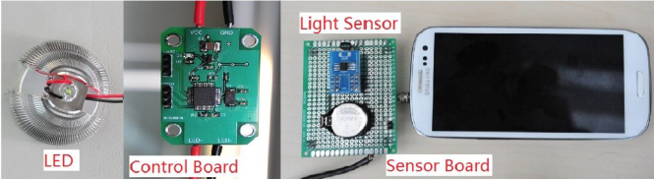
Internet-based Indoor Navigation
Enablers for Indoor have been Internet-based Indoor Navigation (IIN)* services founded on measurements collected by IoT devices.
  “IoT refers to the ever-growing network of physical objects that feature an IP address for internet connectivity”. – Wikipedia
enrich
IoT
IIN Service
navigate
“Internet-based Indoor Navigation Services”, Demetrios Zeinalipour-Yazti, Christos Laoudias, Kyriakos Georgiou and Georgios Chatzimiloudis, IEEE Internet Computing (IC'16), IEEE Computer Society, 2016.

Slide 5
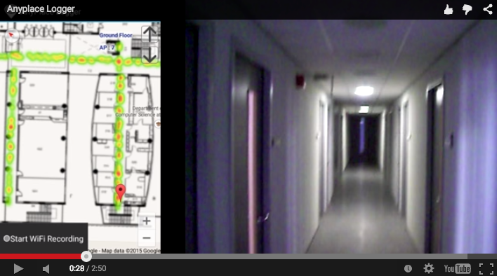
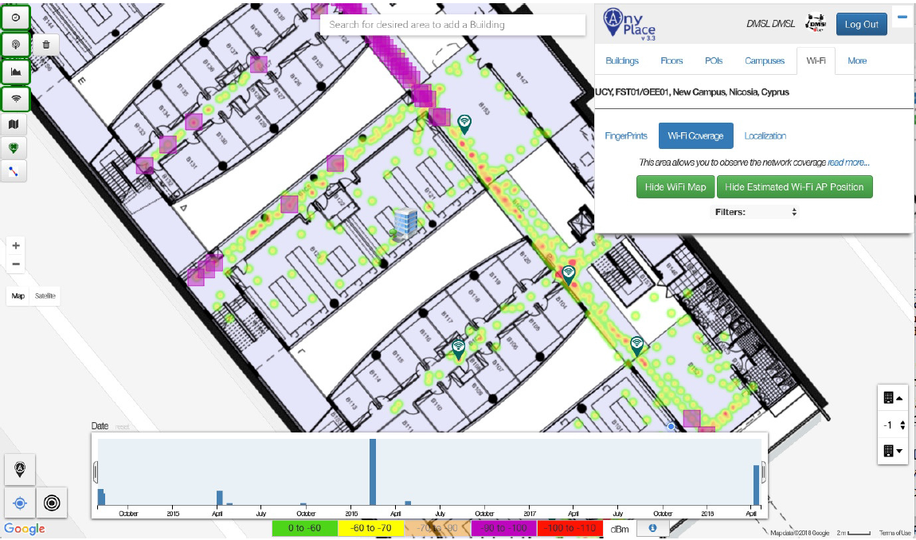


Anyplace IIN
Video
https://anyplace.cs.ucy.ac.cy/
"FMS: Managing Crowdsourced Indoor Signals with the Fingerprint Management Studio", Marileni Angelidou, Constantinos Costa, Artyom Nikitin and Demetrios Zeinalipour-Yazti "Proceedings of the 19th IEEE International Conference on Mobile Data Management" (MDM '18), IEEE Computer Society, Pages: 2 pages, June 25 - June 28, 2018, AAU, Aalborg, Denmark, 2018.

Slide 6
Talk Outline
Introduction
Background and Problem Formulation
Grap Framework
  Dependency Graph (DG) algorithm
  Graph Distance A* (GDA) algorithm
Experimental Evaluation
Conclusions

Slide 7
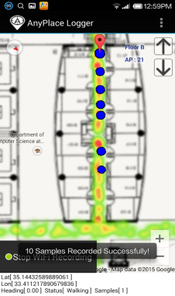
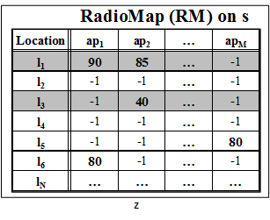
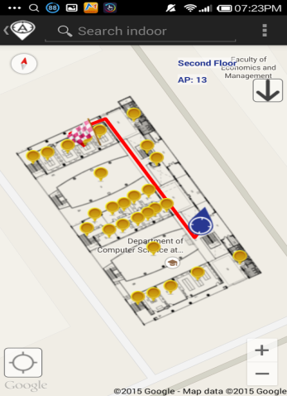
Background on IIN
Logger
IIN Service
a) Upload Measurements
b) Build RM (Radiomap)
c) Localize
fingerprint
SSA
Localizer
d) Localization Alternatives:
Client-Side-Approach (CSA)
Server-Side-Approach (SSA)
CSA

Slide 8
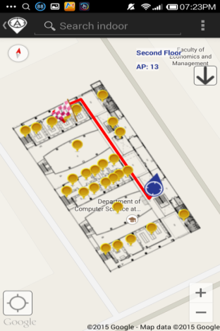
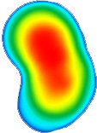
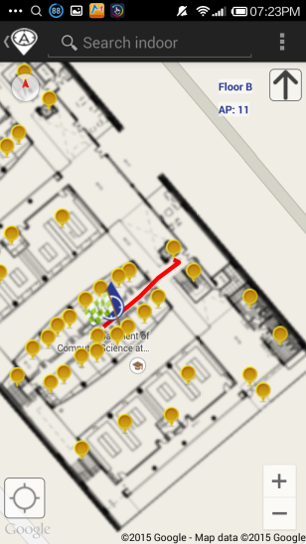
Intermittent Connectivity
IIN Service
Where-am-I?
No Navigation
Where-am-I?
X
Where-am-I?
☹ Intermittent Connectivity
Time

Slide 9

Solution: Grap Navigation
Localize from s
IIN Service
Prefetch K RM rows
Prefetch K RM rows
X
Localize from Cache
Prefetch K RM rows
Localize from s
☺ Intermittent Connectivity
Time

Slide 10
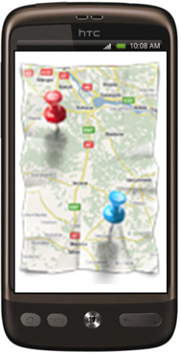

Grap Advantages & Challenges
IIN
AP1
Where am I?
fingerprint
RM
APm
(x,y) & Prefetch K RM rows (Partial RM)
Grap: Hybrid (CSA & SSA) solution
Fine Grain Localization Accuracy: RM-based approach
Network Independent: Use prefetched partial RM when disconnected
Cost-effective (user): request a much smaller (partial) RM from IIN
Challenge: Select K RM rows in a “target-less” manner (unknown user destination) and without any background knowledge about the users (no learning)

Slide 11

Problem Formulation
u enters an arbitrary B and moves towards an unknown destination.
B includes an area with intermittent connectivity:
  u with Vr at r is offline if maxVr received from any covering api is below θ. Formally, this is captured by the connected_{r} definition:
  $connected$_{r} = $\left\{\begin{aligned}0, if maxVr ≤θ \\ 1, if maxVr>θ\end{aligned}\right.$
While Connected: Grap responds with u’s location + as many RM entries as possible for prefetching - depends on the amount of time that u stays connected at r (i.e, dwell time => configured to K blocks for experimentation).
While Disconnected: Use prefetched RM for localization on the mobile device.

Slide 12
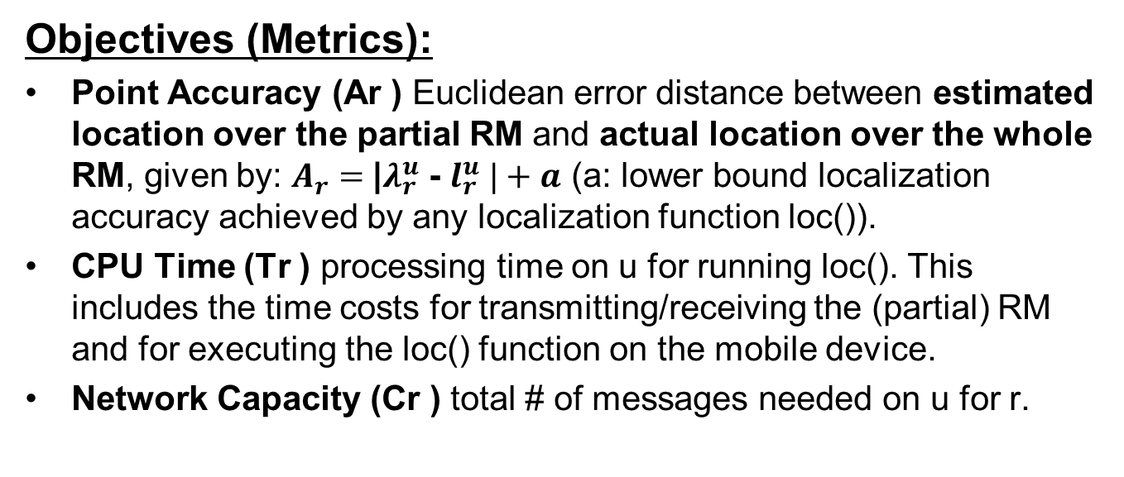
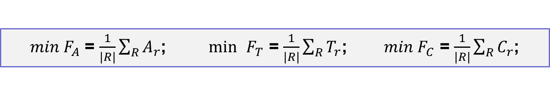
Problem Formulation
Research Goal: Enable a mobile user to consecutively localize itself accurately and efficiently in an indoor environment, where connectivity is intermittent, using an IIN-SOA holding RM.
Objectives (Metrics):
Point Accuracy (Ar ) Euclidean error distance between estimated location over the partial RM and actual location over the whole RM, given by: $A_{r}=$|$λ_{r}^{u}$ - $l_{r}^{u} |+a$ (a: lower bound localization accuracy achieved by any localization function loc()).
CPU Time (Tr ) processing time on u for running loc(). This includes the time costs for transmitting/receiving the (partial) RM and for executing the loc() function on the mobile device.
Network Capacity (Cr ) total # of messages needed on u for r.
$min{ F}_{A}$ = $\frac{1}{|R|}\sum_{R}{A_{r}}$; $\min{ }F_{T}$ = $\frac{1}{|R|}\sum_{R}{T_{r}}$; $min{ F}_{C}$ = $\frac{1}{|R|}\sum_{R}{C_{r}}$;

Slide 13
Talk Outline
Introduction
Background and Problem Formulation
Grap Framework
  Dependency Graph (DG) algorithm
  Graph Distance A* (GDA) algorithm
Experimental Evaluation
Conclusions

Slide 14
Grap Framework
B
DG & GDA
Partial RM
the actual plan B = ⟨N, E⟩ of the building.
use B to construct a Dependency Graph (DG).
explore DG using Graph Distance A* (GDA).
select partial Radiomap to prefetch.

Slide 15
Dependency Graph generation - DG
construct a DG - connects the nodes through physical transitions by consulting the actual plan B = ⟨N, E⟩ of the building
N-set contains the Points-Of-Interests (POIs: rooms, intersections, elevators, staircases.)
E-set contains the corridors, physical pathways, etc., as these are aligned to floors inside a building.
DG is defined as a weighted undirected graph DG = ⟨N ′, E′⟩
  N ′ = set of nodes, each corresponding to a POI along with a self-importance s (ni) weight indicating its probability to be visited by a random user.
  E′ = set of edges, each corresponding to an edge along with an edge-weight indicating the Lp-Norm distance between two connected nodes.

Slide 16
DG – Self Importance & Edge Weights
Definition of self-importance: how likely users pass from
a particular node (a.k.a. authority hub) to reach their destination.
iteratively calculated for each node n_{i}
depends on the degree (number of links) of n_{i} + how many n_{j} in N can be visited via n_{i} (i.e., horizon)
  favours nodes with low number of links but high betweenness (e.g., nodes that bridge two buildings or central corridors)
  variation of Page Rank
Also assigns weights (Euclidean distance) between all connected edges
u
8
8
2
5
2
1
6
4
2
2
3
4
10
11

Slide 17
Talk Outline
Introduction
Background and Problem Formulation
Grap Framework
  Dependency Graph (DG) algorithm
  Graph Distance A* (GDA) algorithm
Experimental Evaluation
Conclusions

Slide 18
Partial Radiomap selection - GDA
A* search algorithm comprises of an evaluation function f (a, z) = g(a, b) + h(b, z), where
  g(a,b): a cost function that gives the path cost from the start node a to intermediate node b and
  h(b, z): a heuristic function that estimates the cheapest path from b to the goal z.
  both g() and h() are calculated using graph-distance cost G2
    which reflects the topological constraints and physical entities of a building (e.g., elevators, corridors, walls, etc.,)
    Lp-norm distances (e.g., Euclidean, Manhattan) are unsuitable.
Recall Aim: find the best nodes to be prefetched in a target-less manner before u is disconnected from s
  therefore there is no goal state for h() to be calculated.

Slide 19
Partial Radiomap selection - GDA
In the absence of a target,
  GDA finds m virtual targets that represent the m most possible destinations of u, based on their self-importance, using u’s current location
  These m destinations are selected within w hops from u so that these are not very far destinations
A* calculates g() from u’s current location to each neighboring node n_{i} and calculates h() by running Dijkstra algorithm to find shortest path in terms of G2 from n_{i} to each potential target n_{j} , j = 1, ...,m
node n_{i} with the lowest f() is recorded
when K nodes are selected, u requests associated records from s to build a partial RM, which will be used for localization during disconnected states.

Slide 20
GDA - Example
Dependency Graph DG
Graph Distance A* (GDA)
10
10
Do A* on DG from A to {I, J , H};
Select K =5 nodes
From A to H
Round 1) f(D) = 21
Round 2) f(G) = 16
Round 3) f(H) = 7
From A to I
Round 1) f(F) = 22
Round 2) f(G) =17
Round 3) f(I) 8
From A to J
Round 1) f(F) = 7
Round 2) f(J) = 2
Round 3)
K nodes selected for prefetching
Round 1) D, F
Round 2) G, J
Round 3) H, I
1
B
A
C
1
5
5
2
F
15
K=5
D
F
8
D
1
E
9
2
9
J
15
J
12
G
J
G
K=5
8
7
16
Target
I
I
16
H
w = 3
H
H
Calculate: self_importance;
edge_weights
Set w = 3;
m =3;
find_m(w, m);
Result = {I, J , H}
Use K nodes to create partial RM

Slide 21
Talk Outline
Introduction
Background and Problem Formulation
Grap Framework
  Dependency Graph (DG) algorithm
  Graph Distance A* (GDA) algorithm
Experimental Evaluation
Conclusions

Slide 22
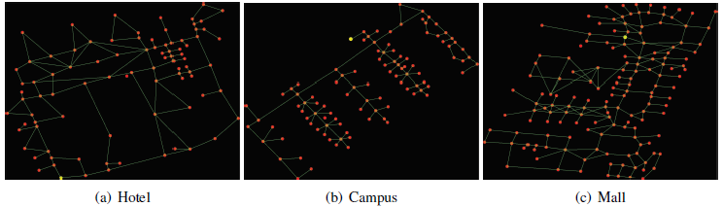
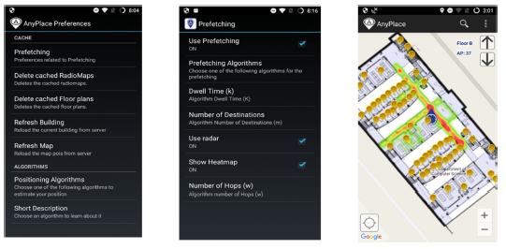
Grap Prototype System
allows evaluation and visualization through Anyplace IIN
evaluator includes: Data Connector, Simulator, Visualizer
navigator with intelligent prefetching and caching.

Slide 23
Experimental Evaluation
Datasets: real IoT-data obtained through the publicly available API of our Anyplace IIN-SOA
Algorithms: Grap+GDA compared against two baseline Anyplace (CS and SS) and two baseline Grap (BFS, RND) algorithms
Metrics: CPU Time (T), Accuracy (A) & Network Capacity (C)
Name | Collected | Finger. | APs | Covers
Hotel Pittsburgh | Wyndham Grand Pittsburgh Downtown Hotel, Pittsburgh, USA (Slide 29 – Figure (a) | 500 | 308 | 6,500 m², 201 POIs & 247 edges.
CSUCY | Typical building at CS, UCY (Slide 29 – Figure (b) | 5000 | 266 | 2,500 m², 397 POIs and 440 edges
Mall of Cyprus | Mall of Cyprus, Nicosia Cyprus (Slide 29 – Figure (c) | 800 | 279 | 18,500 m² , 214 POIs and 289 edges

Slide 24
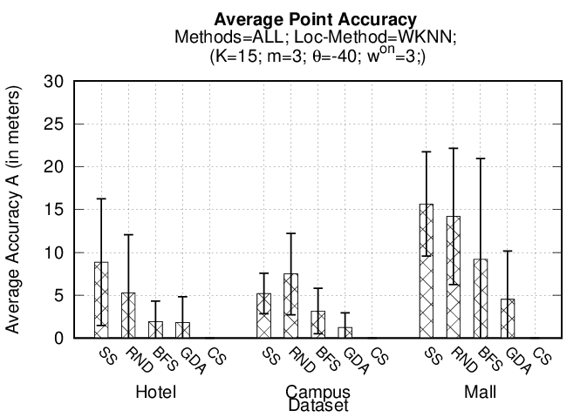
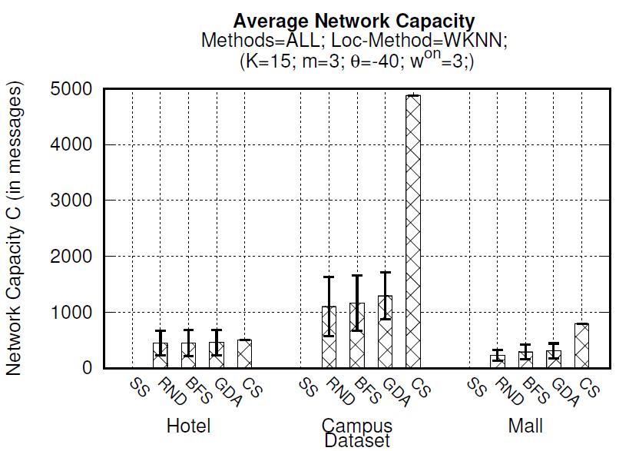
Experiment 1: Performance Evaluation
CS and SS are the extreme cases
CS – T & C affected by dataset size [NxM] (downloads whole RM a priori – localization on smartphone) – “Optimal” Accuracy
SS - T & C minimum – operations at server – but accuracy affected by intermittent connectivity
Grap (GDA) – improvement in A by 65%, 83%, 68% vs RND and 40%, 60%, 50% vs BFS / GDA sacrifices performance (T and C) for better quality (A) / GDA close to CS in A / GDA slightly worst performance (T and C)

Slide 25
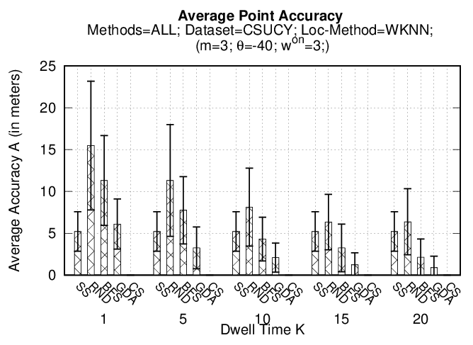
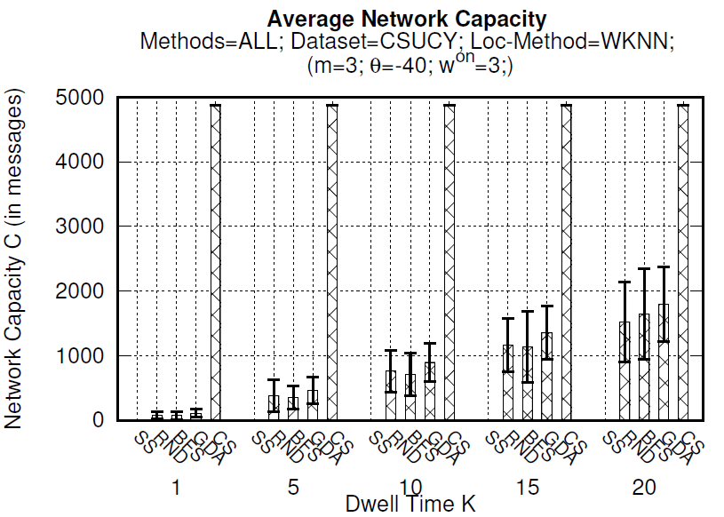
Experiment 2: Dwell Time (K)
K = time for downloading Vr associated to K nodes of DG - is the size of pRM downloaded by u when connected and processed by u when disconnected.
CS and SS are fixed – not affected by K – no prefetching
Grap (all): more K = better accuracy / worse performance (more downloading)
Grap (GDA) – always better quality (A) than RND and BFS in A
GDA less affected by K than RND & BFS: better selection of “useful” Vr in pRM

Slide 26
Conclusions and Future Work
Grap (DG+GDA) is found accurate while retaining high performance levels.
Grap prototype validates that our propositions are pragmatic & can be easily integrated into future IIN-SOA.
In the future we aim to,
  Investigate the trade-off between T/C and A objectives in the context of Multi-Objective Optimization.
  Extend our experimental evaluation into domain-specific field studies (e.g., involving health/hospitals, education/universities).

Slide 27
IoT Data Prefetching in Indoor Navigation SOAs
Thanks! Questions?
Andreas Konstantinidis∗‡, Panagiotis Irakleous*, Zacharias Georgiou*, Demetrios Zeinalipour-Yazti∗ και Panos K. Chrysanthis§
∗ University of Cyprus, 1678 Nicosia, Cyprus
‡ Frederick University,1036 Nicosia, Cyprus
§University of Pittsburgh, 15260 Pittsburgh, PA, USA
Under publication (accepted) in ACM Transactions on Internet Technologies (ACM TOIT), 2018

