Slide 1

Distributed In-Memory Processing of All k Nearest Neighbor Queries
Georgios Chatzimilioudis∗, Constantinos Costa∗,
Demetrios Zeinalipour-Yazti∗, Wang-Chien Lee‡, Evaggelia Pitoura§
∗
‡
§
University
of Ioannina
Accompanying Presentation for:
IEEE Transactions on Knowledge and Data Engineering (TKDE'16),
IEEE Computer Society, Vol. 28, Iss. 4, pp. 925-938, 2016.

Slide 2






Motivation
Rayzit: a crowd messaging system that instantly forms a dynamic social network based on user proximity
  Not location-based app but kNN-based!
Rayzit was funded by the Appcampus Program (Microsoft, Nokia & Aalto, Finland) in 2013.
  Ranked among 5 best apps of the program from 3500 apps.
  Few thousand downloads and active users after their marketing!
Research Problem: Big Data AkNN Query Processing
http://rayzit.com/

Slide 3
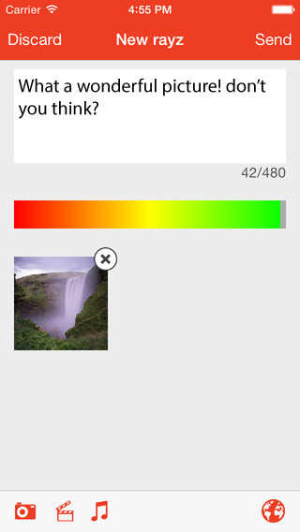
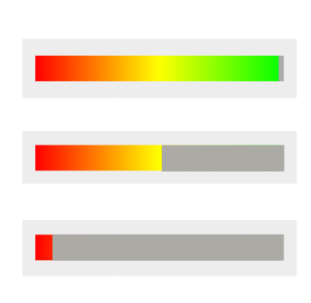
The Rayzit Application
A user can post a new Rayz (text, audio, video – shown as attachment).
To minimize spamming, each user has a powerbar that decreases on every action:
  Rayz, reply, re-rayz, power+/-
  When empty no more actions are possible until it gradually reloads.
  To reload faster, we provide the incentive to provide useful answers that will be starred by others.
A message can be bounded to a certain distance (kNN is default)
  0.5, 5, 50, 500, 5000 km

Slide 4

The Rayzit Application
Rayzit opens with a livefeed of messages from kNN neighbors (no login required / R17+)
A user can then:
  Star Rayz (continue to follow after leaving a neighborhood)
  Re Rayz (sent at new location)
  Remove Rayz (Hide It)
  Power + or – (help future filters)
  Report Rayz (automated community management technique: >3 reports and >30% of responses deletes rayz)

Slide 5
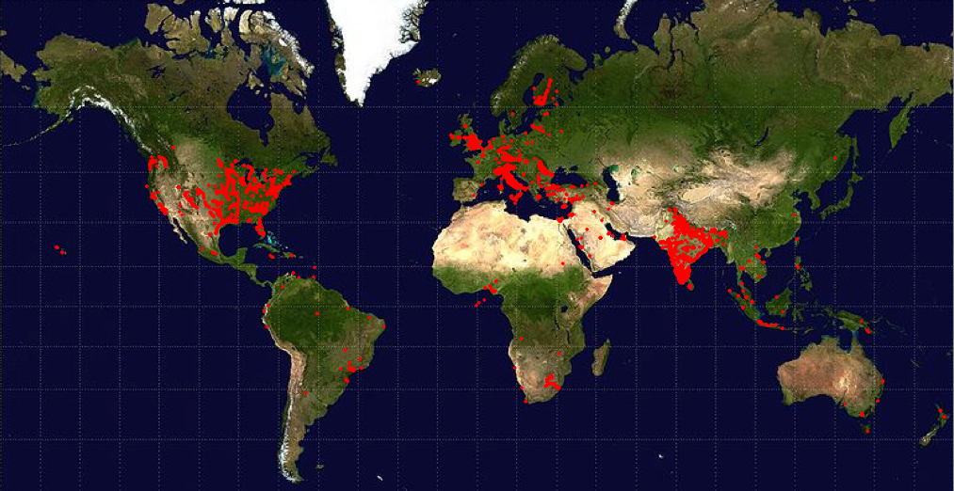
AkNN Motivating Scenario
Rayzit User Map
How to compute the kNN for millions of mobile users every few seconds?

Slide 6
Query Processing
“How a data management system evaluates and processes a query” - Wikipedia
In the RDBMS world:
  (Disk) Indexes: fast access to data records.
  Catalogs: data statistics, histograms, etc.
  Query Optimizers: determine most efficient way to execute a query using operators, indexes, catalogs
In the Big-Data world:
  There is not enough time (and space) to build heavy meta-data (indexes, catalogs)
  Some data might never actually be touched upon (e.g., one of hundreds of FLAGS in a telco setting)
Objective: Effective Operators for specific queries.

Slide 7
System Model
|O| = n objects report location to QP
QP computes AkNN query every few seconds.
QP
O
o₂
o₁
o₈
o₃
o₇
o₅
o₄
o₉
o₆
o₁₁
o₁₀

Slide 8
kNN Query Definition
kNN(q, O): Given a multi-dimensional query point q, find the k objects in O that have the smallest distance* to q.
  *e.g. Manhattan (L₁), Euclidean (L₂), Chebyshev(L∞)
o₁
o₂
O
q
2NN(q,O) = {o₁,o₂}
o₃
o₄
o₅

Slide 9
AkNN Query Definition
Find kNN for all objects in O!
AkNN(O): Given objects o_{a}≠ o_{b}≠ o_{c},
∀o_{b}∈ kNN(o_{a,}O) and ∀o_{c}∈ O - kNN(o_{a,}O)
it holds that dist(o_{a},o_{b}) ≤ dist(o_{a},o_{c})
o₂
O
o₁
AkNN = kNN Self-Join
kNN Self-Join Definition:
O ⋈ _{kNN} O =
{(o_{a}, o_{b}) | o_{a}, o_{b} ∈ O and o_{b} ∈ kNN(o_{a}, O)}
O(n²)-time search cost
o₈
o₃
o₇
o₅
o₄
o₆
o₉
o₁₁
o₁₀
Notes:
A left outer join B = { (a,b) | include al

Slide 10
Centralized AkNN
Classical problem with many centralized algorithms
Applications: computational geometry, image processing, data compression, clustering and spatial databases.
Basic Types of Algorithms:
  Memory-resident structures & algorithms (theory)
  Disk-resident structures & algorithms (databases)
  Parallel algorithms (Graphics)
Common Problem:
  Not designed for distributed Big Data Architectures (shared-nothing cloud infrastructure)

Slide 11
Outline
Introduction
Distributed AkNN
Spitfire Solution
Experimental Comparison
Conclusions

Slide 12
Distributed AkNN: Issues
2NN
s₁
o₂
s₂
Let us partition
11 objects over
4 servers {s₁,…,s₄}
o₁
o₃
Problems:
A) Communication Overhead
O₁: 2NN(o₁) are located on adjacent nodes s1 and s2
=> We need to minimize the replication (f) of objects among nodes!
B) Load Balancing
s₄: 15 distances among 6 objects (i.e., n(n-1)/2)
s_{3:} only 3 distances!
=> We need to yield a fair space partitioning!
o₈
o₅
o₇
o₄
o₆
o₉
o₁₀
o₁₁
s₃
s₄

Slide 13
Distributed AkNN
T: time needed to compute AkNN centrally
n: number of objects for the AkNN
m: number of servers available
Speedup for any distributed solution:
T_{distr} = load_balance * T/m + communication
  load_balance = [1,m] denotes how many times heavier than n/m the size of the heaviest server is
  communication denotes the extra time needed in order to guarantee correct results in a distributed env.

Slide 14
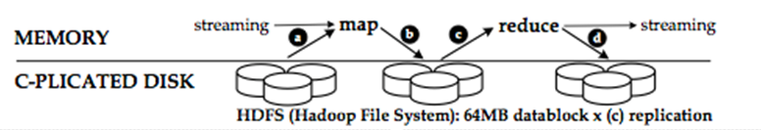
Hadoop Map Reduce
Map-Reduce (MR): a programming model for processing large data sets.
  Google paper @ USENIX OSDI’04
  Hadoop: Apache's open-source MR software.
  Commodity Hardware: 2-3 failures/1000 nodes/day
  ➔ Data Sharding (Data blocks replicated to 3 disks)
TACHYON Main Memory Caching
Processing Facts:
  1 TB on 1 PC = 2 hours!
  1 TB on 100 PCs = 1 min!
I/O tasks can be turned into Main-Memory (Tachyon)

Slide 15
H-NJ Algorithm
[1] Lu et al. VLDB’12
Hadoop Naïve kNN Join [1]:
  Map-job 1: Transfer O (|O|=n) to each server s_{i} (|S|=m) with n/m objects marked as subset O_{i} (disjoint subsets of O containing n/m objects)
  Reduce-job 1:
  execute O_{i} ⋈_{kNN} O on each s_{i}
  Distributed Brute Force (n²) solution
  Optimal Load Balancing = 1
  Speedup achieved = 1 * n² /m + m *n ☹
O
O₁ ⋈_{kNN} O
O₂ ⋈_{kNN} O
m
O₃ ⋈_{kNN} O
Replication Factor f_{H-NJ}=m
O₄ ⋈_{kNN} O

Slide 16
H-BNLJ Algorithm
[2] Zhang et. al EDBT’12
H. Block Nested Loop kNN Join [2]:
  Map-job 1: Partition O to √m sets,
  yielding m pairs of (O_{x},O_{y}), where x,y≤√m
  Reduce-job 1 (Local kNN): Each pair is mapped
  to single server s_{i}, which computes O_{x}⋈_{kNN}O_{y}
  Map-reduce 2 (Merge Local kNN): Hash √m
  local results of each object o to the same server
  Reduce-job 2 (Global kNN): top-k per object
  Distributed Brute Force (n²)
  Optimal Load Balancing = 1
  Speedup = 1 * n² /m + 2√m *n
  (each of the m server receives 2n/√m objects)
  ☹
MR1
MR2
(O_{x},O_{x})
o_{a}={ … }
o_{a}={ … }
O
(O_{y},O_{x})
o_{a}={ … }
…
m
O_{x}
O_{y}
(O_{x},O_{y})
√m
(O_{y},O_{y})
all
combos
Replication Factor: f_{H-BNLJ}= 2√m
o_{a}={ … }
…

Slide 17
H-BRJ Optimization
[2] Zhang et. al EDBT’12
H. Block R-tree Nested Loop kNN Join [2]:
  Optimizes Local kNN computation (Reduce-job1) in previous algorithm (H-BNLJ) by building an R-tree on O_{i}
  Distributed R-tree kNN ( n√mlog(n/√m) )
  Optimal Load Balancing = 1
  Speedup =
  1 * n√mlog(n/√m) /m + 2√m *n
MR1
MR2
(O_{x},O_{x})
o_{a}={ … }
o_{a}={ … }
O
(O_{y},O_{x})
o_{a}={ … }
…
m
O_{x}
O_{y}
(O_{x},O_{y})
√m
Replication Factor remains
f_{H-BRJ}= 2√m
(O_{y},O_{y})
all
combos
o_{a}={ … }
…
Notes:
Know how to compute the cpu time here nmlog(n/m)

Slide 18
PGBJ Algorithm
[1] Lu et al. VLDB’12
Partition Group Block kNN Join [1]:
  Preprocessing: Generate √n “pivot” points in space -- O(√n)
  Map-job 1: Split set O into m subsets O’_{i} and transfer each O’_{i} together with “pivot” points to server s_{i}. Map each object with its nearest “pivot” and store the minimum and maximum distance between “pivot” and mapped objects -- O(n√n/m)
  Midstep: Geographically cluster the √n groups into m clusters O_{i} (balancing) -- O(n)
  Map-job 2: Compute the candidate kNN set F_{i} for each cluster O_{i} based on statistical upper and lower bounds (correctness) -- O(n)
  Reduce-job 2: Execute O_{i}⋈_{kNN}F_{i} on each reducer locally -- O(f_{PGBJ}n²/m²)
√n
pivots &
statistics
only
O₁
O
O₂
m
O’₁
O’₂
O’₃
O’_{m}
O_{m}
O₃
geo-clustering

Slide 19
PGBJ Algorithm
[1] Lu et al. VLDB’12
Partition Group Block kNN Join [1]:
  Preprocessing: Generate √n “pivot” points in space -- O(√n)
  Map-job 1: Split set O into m subsets O’_{i} and transfer each O’_{i} together with “pivot” points to server s_{i}. Map each object with its nearest “pivot” and store the minimum and maximum distance between “pivot” and mapped objects -- O(√nn/m)
  Midstep: Geographically cluster the √n groups into m clusters O_{i} (balancing) -- O(n)
  Map-job 2: Compute the candidate kNN set F_{i} for each cluster O_{i} based on statistical upper and lower bounds (correctness) -- O(n)
  Reduce-job 2: Execute O_{i}⋈_{kNN}F_{i} on each reducer locally -- O(f_{PGBJ}n²/m²)
  Near-optimal Load Balancing
  Speedup = load_balancing_{PGBJ} * f_{PGBJ}n²/m /m + f_{PGBJ} *n
Replication Factor: f_{PGBJ}
(depends on distribution)

Slide 20
Theoretical Comparison
H-NJ → 1 * n² /m + m *n
H-BNLJ → 1 * n² /m + 2√m *n
  H-BRJ → 1 * n√mlog(n/√m) /m + 2√m *n
  PGBJ → lb_{PGBJ} * f_{PGBJ}n²/m /m + f_{PGBJ} *n
  Spitfire → lb_{Spitfire} * f_{Spitfire}n²/m /m + f_{Spitfire} *n

Slide 21
Theoretical Comparison
Map-job 1

Slide 22
Presentation Outline
Introduction
Distributed AkNN
Spitfire Solution
Experimental Comparison
Conclusions

Slide 23
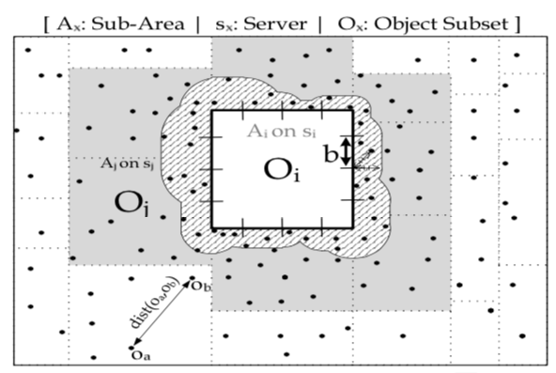
The Spitfire Algorithm
Execution Phases
  Partition problem space onto servers with load balancing
  Replicate border candidates minimally among servers
  Execute locally optimized AkNN
Distributed algorithm implemented in MPI
“Distributed In-Memory Processing of All k Nearest Neighbor Queries, Georgios Chatzimilioudis, Costantinos Costa, Demetrios Zeinalipour-Yazti, Wang-Chien Lee, Evaggelia Pitoura, IEEE TKDE’15

Slide 24
Spitfire - Outline
Partitioning (Geographical) – O(n)
  into m disjoint subareas with approx. equal number of objects (balancing)
  using hash-based equi-depth histograms
  each partition O_{i} is assigned to a server s_{i}
Replication -- O( √nn/m )
  server s_{i} computes minimum external cand. kNN set EC_{ij} from O_{i} and based on border segments B for each neighboring server s_{j}
  transmit each EC_{ij} from s_{i} to s_{j} achieving replication factor
Local Refinement -- O( f_{Spitfire} n²/m² )
  server s_{i} has candidate kNN set EC_{i} = ∪EC_{ij}
  each server executes locally O_{i} ⋈_{kNN} (O_{i}∪EC_{i})
  optimized by using bulk processing, heap structure, geographical grouping
Note: servers communicate in one single round
j

Slide 25
Spitfire - Partitioning
Partitioning (Geographical) – O(n)
  into m disjoint subareas with approx. equal number of objects (balancing)
  using hash-based equi-depth histograms
  each partition O_{i} is assigned to a server s_{i}
Steps:
Hash into equi-width buckets on x-axis
Group x-buckets into √m
approx. equi-depth groups
For each x-group do step 1 and 2 on y-axis
Result:
m approx. equi-depth groups
O(n) → assuming that number of buckets is less than √n

Slide 26
Spitfire - Replication
Replication -- O( √nn/m )
  each server s_{i} computes minimum external cand. kNN set EC_{ij} based on border and objects in O_{i} for each neighboring server s_{j}
  transmit each EC_{ij} from s_{i} to s_{j} achieving replication factor
Given a segment b between o₁ and o₃ and k objects closer to b than o₁ and o₃, then o₁ is guaranteed NOT to be a kNN of o₃ and vice versa.
Therefore on each server s_{i} it suffices to search in O_{i} for the kNNs to each border segment and transmit them to the neighboring server s_{j} as the external candidate kNN set EC_{ij}

Slide 27
Spitfire - Replication
Replication -- O( √nn/m )
  each server s_{i} computes minimum external cand. kNN set EC_{ij} based on border and objects in O_{i} for each neighboring server s_{j}
  transmit each EC_{ij} from s_{i} to s_{j} achieving replication factor
s_{i}
EC_{ij}
assume k=2
b
k closest objects to b
θ
to s_{j}
kth closest
upper bound distance θ between kth closest and border
θ

Slide 28
Spitfire - Replication
Replication -- O( √nn/m )
Steps:
  Divide border into border √n segments b to minimize candidates
  Compute candidates for each b:
    Construct a Floyd Min Heap H from O_{i} based on mindist to b -- O(n/m)
    Determine the kth closest object to b by popping k times from H
    Compute maxdist between kth closest and b called θ
    Scan O_{i} for objects that are closer than θ to border b
  Generate EC_{ij} from union of candidates for each neighboring s_{j}

Slide 29
Spitfire - Replication
Replication -- O( √nn/m )
  each server s_{i} will have all the needed candidates EC_{i} to compute the kNN of O_{i} ⋈_{kNN} (O_{i}∪EC_{i}) locally

Slide 30
Spitfire - Refinement
Local Refinement -- O( f_{Spitfire} n²/m² )
  each server executes locally O_{i} ⋈_{kNN} (O_{i}∪EC_{i})
  optimized by using bulk processing, heap structure, geographical grouping
s_{i}
  Same intuition:
  Partition using a grid
  Find candidates per cell
  Refinement per cell
⋈_{kNN}
EC_{i}

Slide 31
Presentation Outline
Introduction
Distributed AkNN
Spitfire Solution
Experimental Comparison
Conclusions

Slide 32
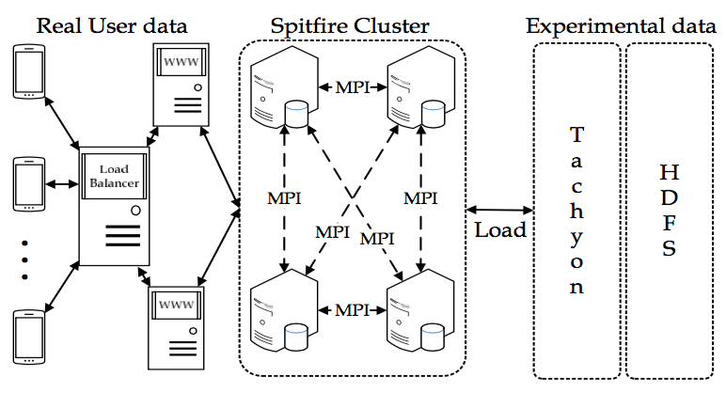
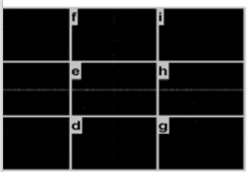
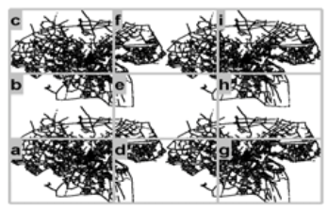
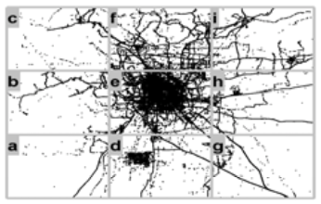
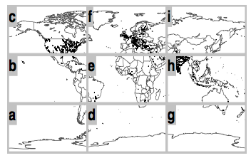
Evaluation Testbed
9 computing nodes
8 GB RAM
2 CPUs@2.40GHz
MapReduce overTachyon (memory-centric file system)
Datasets:
  Random (synthetic) – uniform distribution
  Oldenburg (realistic) – skewed distribution
  Geolife (realistic) – very skewed distribution
  Rayzit (real) – skewed distribution up to 2*104 users

Slide 33
Experimental Evaluation
Plot for most skewed dataset. Others have similar results
Spitfire outperforms
Spitfire and PGBJ scale better than H-BNLJ and H-BRJ
who run out of memory

Slide 34
Experimental Evaluation
Spitfire partitioning is much faster than PGBJ (PGBJ achieves better load balancing)
PGBJ is growing exponentially
H-BNLJ and H-BRJ do not use geographical partitioning → pay high price in refinement
Other datasets have the same response times → partitioning is independent of dataset

Slide 35
Experimental Evaluation
Plot for most skewed dataset. Others have similar results
f_{Spitfire} outperforms (optimal value for f is 1)
f_{Spitfire} drops as n increases (scalability)
f_{H-BNLJ} and f_{H-BRJ} = 2m^{0.5}, independent of n
Replication factor offers clear comparison independent of implementation

Slide 36
Experimental Evaluation
Spitfire outperforms
Spitfire scales much better as k increases, almost linearly
due to much smaller replication factor (not shown)

Slide 37
Experimental Evaluation
Spitfire outperforms
Spitfire scales much better as m increases
→ greater speed-up achieved as computational resources are added

Slide 38
Presentation Outline
Introduction
AkNN Query Processing
Spitfire Solution
Experimental Comparison
Future Work

Slide 39
Future Work
Temporal extension to answer continuous AkNN queries (e.g., streaming data)
Provide an approximate AkNN version
Develop online geographic hash-based partitioning

Slide 40
Distributed In-Memory Processing of All k Nearest Neighbor Queries
Georgios Chatzimilioudis∗, Constantinos Costa∗,
Demetrios Zeinalipour-Yazti∗, Wang-Chien Lee‡, Evaggelia Pitoura§
Thank You! Questions?
∗
‡
§
University
of Ioannina
Accompanying Presentation for:
IEEE Transactions on Knowledge and Data Engineering (TKDE'16),
IEEE Computer Society, Vol. 28, Iss. 4, pp. 925-938, 2016.

