Slide 1



Privacy-Preserving Indoor Localization on Smartphones
Andreas Konstantinidis∗, Georgios Chatzimilioudis∗, Demetrios Zeinalipour-Yazti∗, Paschalis Mpeis‡,
Nikos Pelekis§ and Yannis Theodoridis§
∗
‡
§
Slides accompanying paper:
IEEE Transactions on Knowledge and Data Engineering (TKDE'15), IEEE Computer Society, Vol. 27, Iss. 11, pp. 3042-3055, Los Alamitos, CA, USA, 2015.
+ Poster at IEEE ICDE’16, Helsinki, Finland.

Slide 2
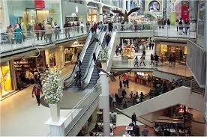
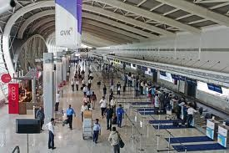

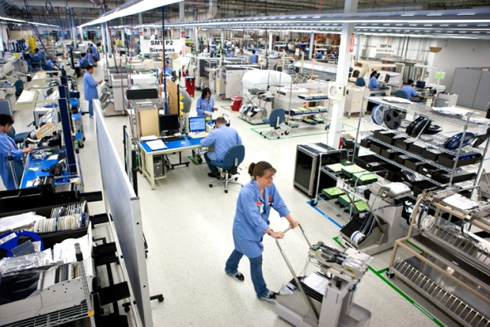
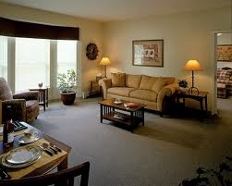
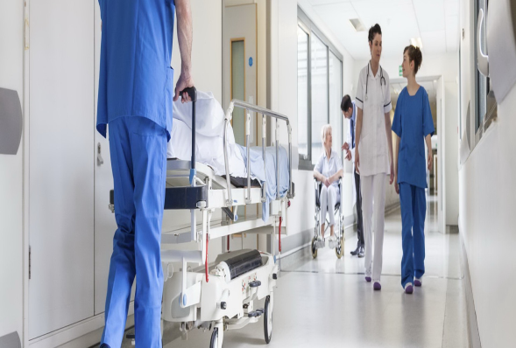
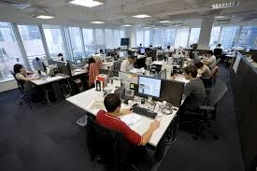

The Great Indoors
People spend 80-90% of their time indoors – USA Environmental Protection Agency 2011.
>85% of data and 70% of voice traffic originates from within buildings – Nokia 2012.

Slide 3
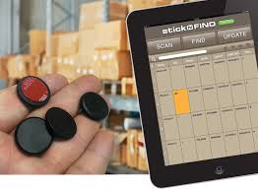
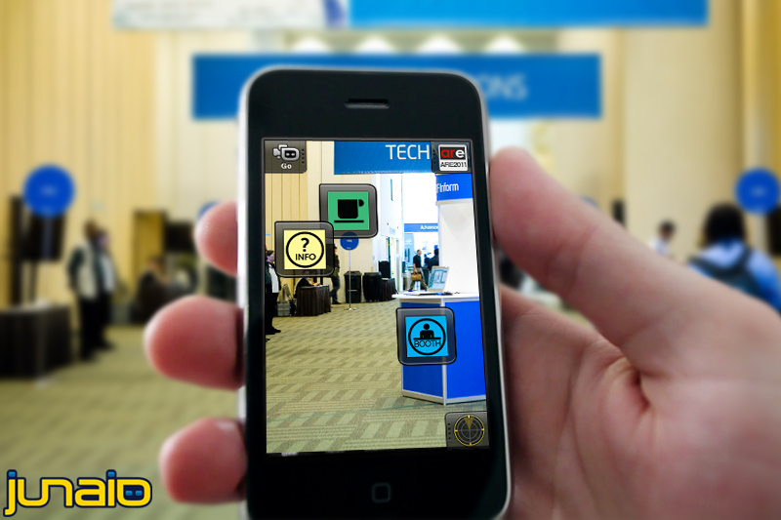
Indoor Localization
Indoor Localization has still not reached its full potential.
Huge spectrum of indoor apps:
  Navigation, Manufacturing, Asset Tracking, Inventory Management
  Healthcare, Smart Houses/Cities, Elderly support, Fitness apps
  Augmented Reality and Indoor Games
Indoor Revenues expected to reach 10B USD in 2020
  ABIresearch, “Retail Indoor Location Market Breaks US$10 Billion in 2020”’

Slide 4
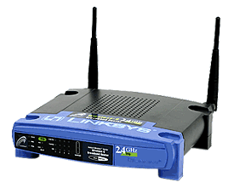
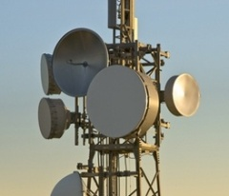
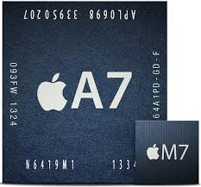
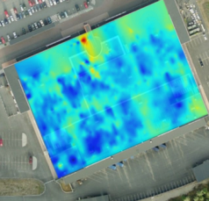
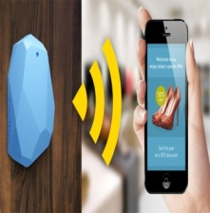

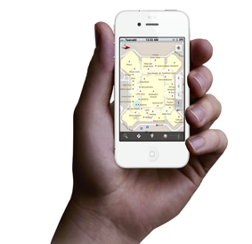
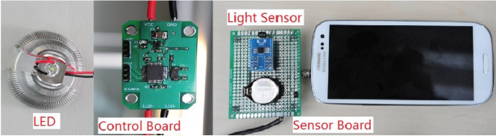
Internet-based Indoor Navigation
Enablers for Indoor apps have been Internet-based Indoor Navigation (IIN) services founded on measurements collected by IoT devices.
IoT
enrich
navigate
IIN Service
“Internet-based Indoor Navigation Services”, Demetrios Zeinalipour-Yazti, Christos Laoudias, Kyriakos Georgiou and Georgios Chatzimiloudis, IEEE Internet Computing (IC'16), IEEE Computer Society, 2016. (also IEEE MDM’15 tutorial available)

Slide 5


Anyplace IIN Service
A complete open-source IIN Service developed at the University of Cyprus.
  Aims to become the predominant open-source Indoor IIN Service.
  Active community: Germany, Russia,
  Canada, UK, etc. – Join today!
  Android, Windows, iOS, JSON API
http://anyplace.cs.ucy.ac.cy/

Slide 6
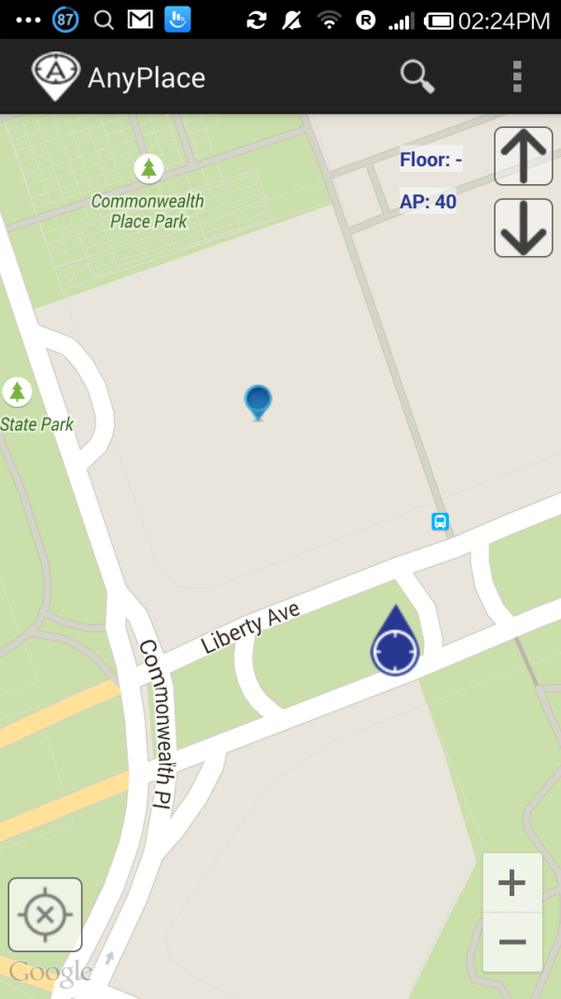
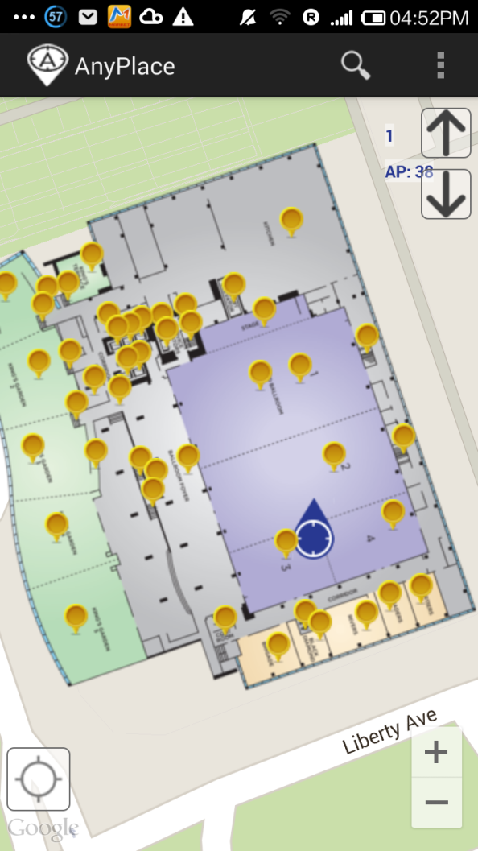
Anyplace IIN Service Accuracy
Before ☹
(using Google API Location)
After ☺
(using Anyplace Location & Indoor Models)

Slide 7
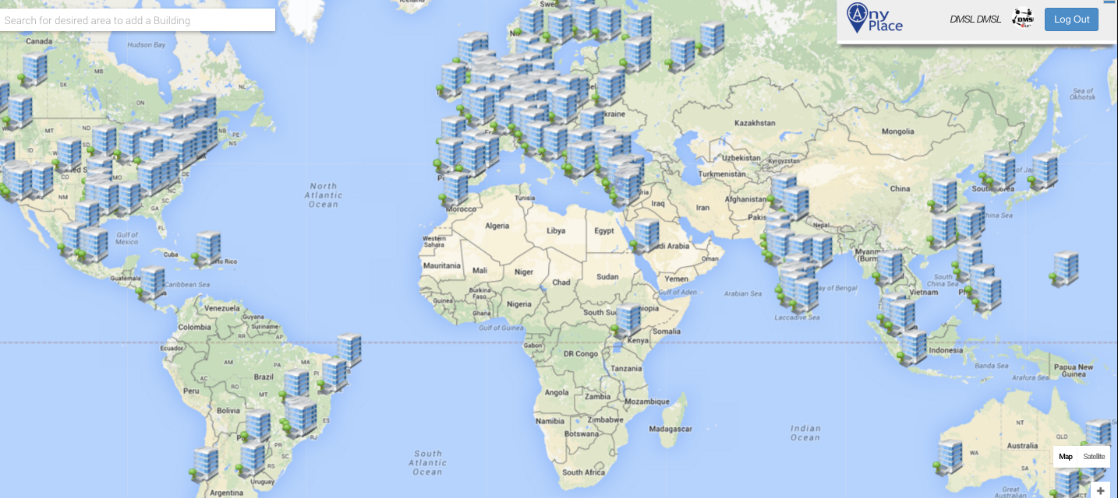
Anyplace IIN Service - Deployment
http://anyplace.cs.ucy.ac.cy/

Slide 8

Location Tracking Problem
An IIN Service can continuously “know” (surveil, track or monitor) the location of a user while serving them.
In indoor spaces location tracking can occur at a very fine granularity (cm to few meters)
Imminent threats:
  The stores / products of interest in a mall.
  The book shelves of interest in a library
  Artifacts observed in a museum, etc.
Location privacy: no one (neither the service nor a hijacker) should be able to associate a specific location with the corresponding mobile user.

Slide 9
Outline
Motivation
Background
Temporal Vector Map (TVM)
  Phase 1: Snapshot Localization
  Phase 2: Continuous Localization
Experimentation
Future Work

Slide 10
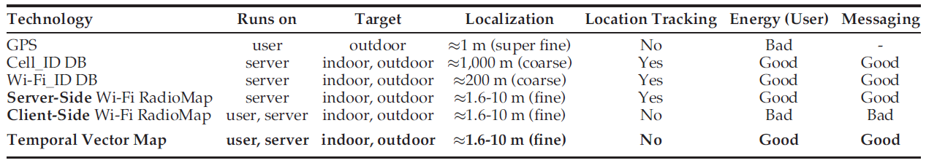
Indoor Localization
Inaccurate Localization Techniques:
  GPS offers privacy (terminal-based) but doesn’t work indoors ☹
  Mobile APIs (Cell-ID, WiFi-ID Geolocation DBs), not accurate and no privacy (server-based) ☹.
Accurate Localization Techniques:
  Radiomap-based techniques (explained next) either accurate or offer privacy (but not both) ☹
  TVM: A radiomap-based technique that offers Accuracy, Privacy and Performance ☺
Proposed Algorithm: Temporal Vector Map (TVM)

Slide 11
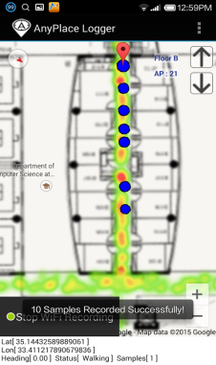
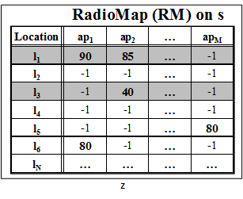
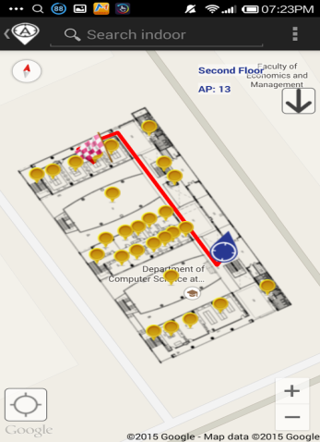
Radiomap-based Localization
Logger
IIN Service
a) Upload Measurements
b) Build RM (Radiomap)
c) Localize
fingerprint
SSA
User
d) Localization Alternatives:
Client-Side-Approach (CSA) – Privacy High Energy
Server-Side-Approach (SSA) – No Privacy Low Energy
CSA

Slide 12
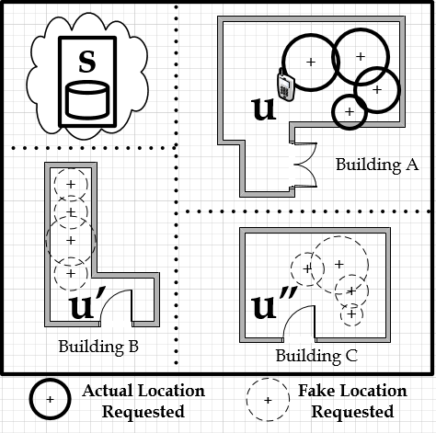
Problem Formulation
A mobile user u moves inside a building with Μ Access Points AP = {ap₁,…, ap_{Μ}}
RadioMap (RM) is available on Server (s)
u senses fingerprint V_{r} = [ap_{1r} ,…, ap_{Mr}] at its current location
p_{u} is the privacy preference of u (s should not identify the location of u with a probability higher than p_{u})
Objective: Provide continuous localization to u with minimum energy consumption on u under privacy preference p_{u}.

Slide 13
Outline
Motivation
Background
Temporal Vector Map (TVM)
  Phase 1: Snapshot Localization
  Phase 2: Continuous Localization
Experimentation
Future Work

Slide 14


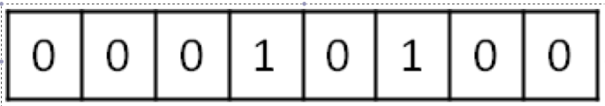
Phase 1 Outline
Temporal Vector Map (TVM)
kAB Filter (B_{u})
WiFi
Set Membership Queries
WiFi
...
IIN Service
User u
Localizes using V_{u} on pRM
Partial Radiomap (pRM)
Calculate
pRM based on k matched Access Points
WiFi

Slide 15
k-Anonymity Bloom (kAB)
Space-efficient probabilistic Bloom Filters
  allocate a vector of b bits, initially all set to 0, use h independent optimal hash functions to hash every Access Point seen by a user.
Tradeoff between b and probability of a false positive.
Given b, h and the total number M of APs, a user can calculate the amount of false positives of the Bloom filter:
False Positive Ratio Size of Bloom Filter
h3(AP)
h1(AP)
h2(AP)
b
0 | 1 | 0 | 0 | 1 | 0 | 0 | 1 | 0 | 0

Slide 16
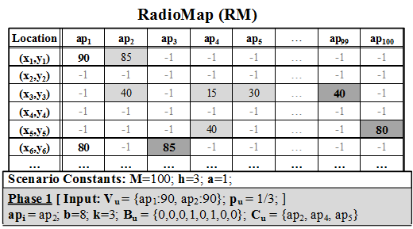
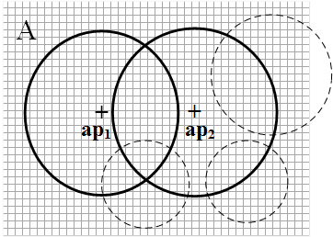
Phase 1 –Example
Real AP
Camouflaged APs
u
u has fingerprint V_{u}
1) User u knows M=100, h=3 and selects p_{u}=1/3 (i.e., k=3), ➔ this results in b = 8
2) Randomly select an AP from V_{u} , e.g., ap₂
3) Use h hash functions on ap₂ to create B_{u} + send B_{u} to s.
4) s compares B_{u} to all APs to find the ones that match C_{u} (real & camouflaged APs)
5) s generates pRM: includes all rows with non-negative entries for matched APs
6) u localizes using pRM

Slide 17
Outline
Motivation
Background
Temporal Vector Map (TVM)
  Phase 1: Snapshot Localization
  Phase 2: Continuous Localization
Experimentation
Future Work

Slide 18
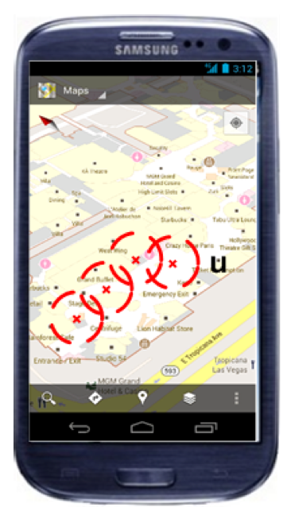
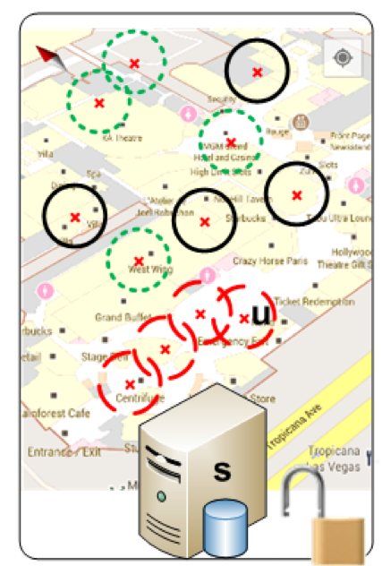
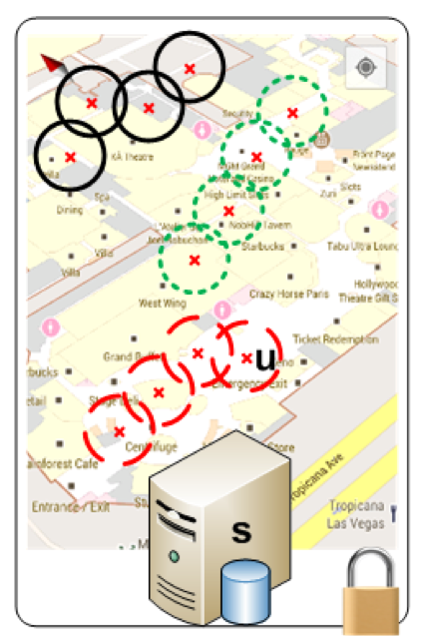
TVM Phase 2 – Continuous Localization
camouflaged APs
kAB filter of TVM-Phase 1 does not guarantee u’s privacy when applied in consecutive requests
→ s can eliminate camouflaged APs
Therefore Phase 2 evolves AP set at u’s side providing the illusion to s that there are k natural movement patterns at the same time.

Slide 19
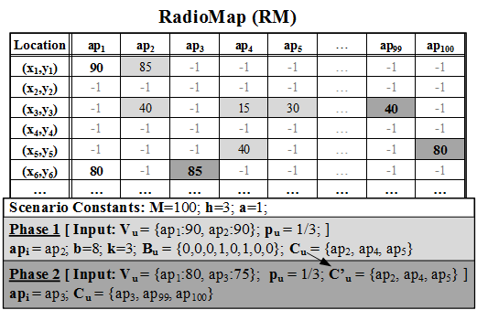
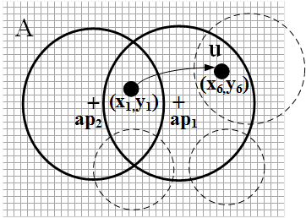
TVM Phase 2 – Continuous Localization
u has fingerprint V_{u}’
Δ_{u}
Δ_{u}
u exploits prior C_{u} (Phase 1)
to generate a new C_{u}’
‘
‘
u first computes a movement pattern Δ_{u} for the real movement between the last two locations
For each AP in C_{u} find a neighbor that creates the closest pattern to Δ_{u} - u creates new C_{u}’
(neighboring APs are known from the received pRM!)
u sends C_{u}’ to s
s generates new pRM based on APs in C_{u}’ and send it to u – u is still hidden among k areas
Note that no bloom filter is used in this Phase 2

Slide 20
When it Works
TVM is sound against a passive attacker with the following characteristics:
No low-level attacks (e.g., breach, man-in-the-middle)
  Can be prevented with secure channels.
No modified responses by service
  The integrity of the responses provided by the service can be verified through some auditing process.
No access to user identifier (e.g., IP, MAC, IMEI)
  Can be obfuscated through anonymizing proxies or changed by the user at any time.
No background knowledge (statistics about buildings, user movements, etc.)

Slide 21
Privacy Guarantees and Attacks
Privacy Guarantees of TVM:
  k-anonymity: a tuple indistinguishable among k other tuples in the k-anonymous set.
    TVM inherently k-anonymous, due to kAB filter size tuning.
  l-diversity: tuples in k-anonymous set are diverse by least l.
    TVM inherently l-diverse, because kAB generates camouflage requests that are random (over all APs).
  t-closeness: a further refinement of l-diversity
    Refinement: distance between the distribution of a sensitive attribute and the distribution of the attribute in the whole table is no more than a threshold t.
    TVM inherently t-close (similarly to l-diversity).
Attacks on TVM:
  Linking attack: the k-anonymity drawback solved by l-diversity.
  Homogeneity attack: the l-diversity drawback solved by the same l-diverse operation of TVM.

Slide 22
Outline
Motivation
Background
Temporal Vector Map (TVM)
  Phase 1: Snapshot Localization
  Phase 2: Continuous Localization
Experimentation
Future Work

Slide 23
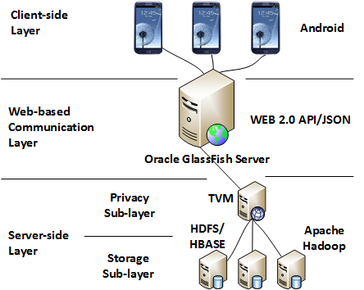
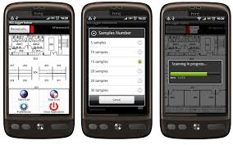
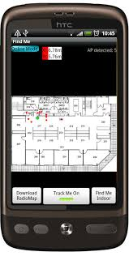

TVM Prototype System
Built around our open source Airplace + Anyplace systems

Slide 24
Experimental Evaluation – Datasets
Real Datasets:
Realistic Datasets (for generating large-scale RMs):
Name | Collected | Fingerprints | APs | Size
CSUCY | Typical building at CS, UCY using 3 Android | 2,900 | 11 | 2.6MBs
KIOSUCY | Typical office environment at KIOS Research center, UCY using 3 Android devices | 105 | 10 | 0.14MBs
CrawDad Data from Crowdad online archive | four areas in USA, Univ. of Dartmouth, building in Kirkland Washington DC, two buildings in Seattle | 6,870 | 1293 | 17MBs
Name | Collected | Size
Campus | Combines all real datasets once. | 20MB
Town | Replicates real datasets in various areas around a town. | 100MB
City | Replicates real datasets in various areas around a city. | 1 GB
Country | Replicates real datasets in various areas around a country. | 20 GB

Slide 25
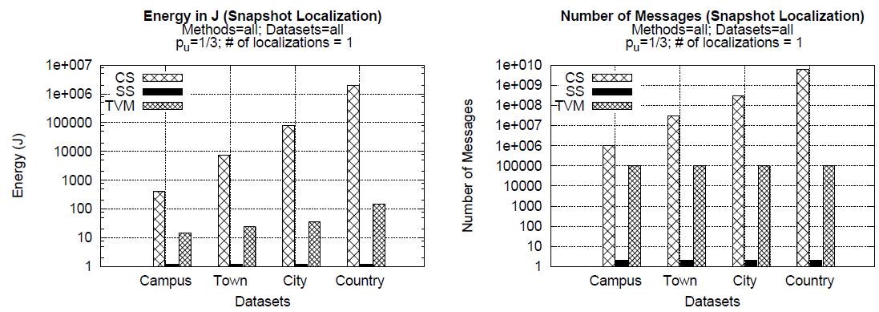
Series 1 – Performance Evaluation - Snapshot
CS – affected by dataset size – 100% privacy (p_{u}=0)
SS – minimum cost – but NO privacy
TVM – 1.5 - 4 orders of magnitude better than CS due to localization on smaller pRM – privacy 1-p_{u}
TVM – energy varies slightly with dataset size due to larger rows in pRM (more APs)

Slide 26
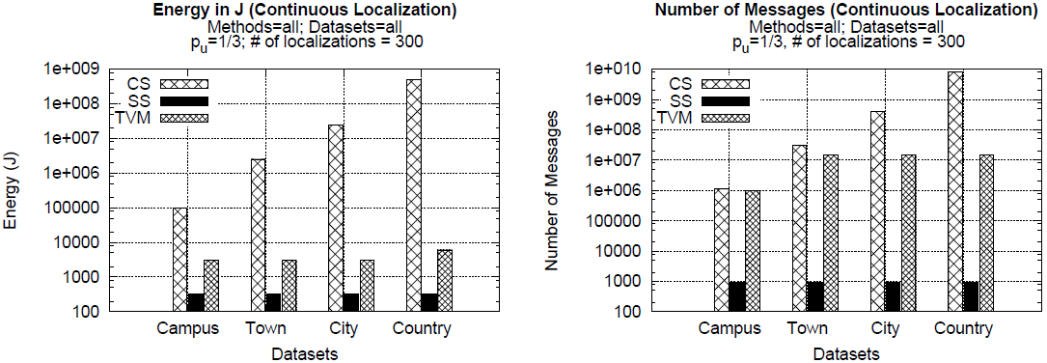
Series 1 – Performance Evaluation - Continuous
CS – more energy consumed since more computations have to take place on the device, but same message cost since the whole RM is transmitted once.
SS – minimum cost – NO privacy – higher values than snapshot due to more requests
TVM – energy 1.5 - 5 orders of magnitude better than CS
TVM – after a number of requests ends up downloading all needed rows
TVM – may end up downloading the whole RM in 300 consecutive localizations

Slide 27
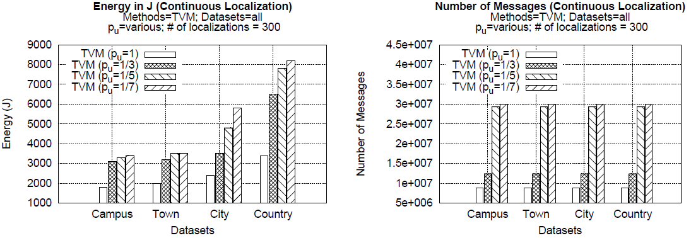
Series 3 – Varying Privacy Preference p_{u}
higher privacy
higher privacy
Clear trade-off between performance (energy) and privacy guarantees

Slide 28
Outline
Motivation
Background
Temporal Vector Map (TVM)
  Phase 1: Snapshot Localization
  Phase 2: Continuous Localization
Experimentation
Future Work

Slide 29
Future Work
Carry out a field study
Investigate server-side optimizations to boost performance
Investigate the applicability to more generalized sensor measurements
Datasets, Videos, Info @ http://tvm.cs.ucy.ac.cy/
Soon release on Github as part of Anyplace (https://github.com/dmsl/tvm)

Slide 30
Privacy-Preserving Indoor Localization on Smartphones
Andreas Konstantinidis∗, Georgios Chatzimilioudis∗, Demetrios Zeinalipour-Yazti∗, Paschalis Mpeis‡,
Nikos Pelekis§ and Yannis Theodoridis§
Thanks! Questions?
∗
‡
§
Slides accompanying papers:
IEEE Transactions on Knowledge and Data Engineering (TKDE'15), IEEE Computer Society, Vol. 27, Iss. 11, pp. 3042-3055, Los Alamitos, CA, USA, 2015.
+ Poster at IEEE ICDE’16, Helsinki, Finland.

