Slide 1


Building All k Nearest Neighbor Social Communities
Demetris Zeinalipour
Assistant Professor
Max Planck Institute for Informatics, Germany & Department of Computer Science, University of Cyprus, Cyprus
http://www.cs.ucy.ac.cy/~dzeina/
dzeina@cs.ucy.ac.cy
Paris Descartes University, Seminar Series on Data Analytics,
Paris, France, April 12, 2017

Slide 2
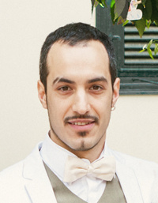
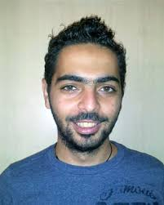
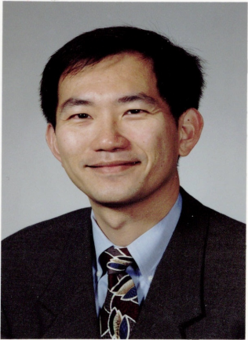
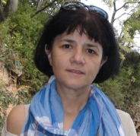




Acknowledgements
Joint work with:
"Distributed In-Memory Processing of All k Nearest Neighbor Queries", Georgios Chatzimilioudis, Constantinos Costa, Demetrios Zeinalipour-Yazti, Wang-Chien Lee and Evaggelia Pitoura, IEEE Transactions on Knowledge and Data Engineering (TKDE'16), IEEE Computer Society, Vol. 28, Iss. 4, pp. 925-938, 2016.
  Sources (GPL): https://github.com/dmsl/rayzit/tree/master/spitfire
"Rayzit: An Anonymous and Dynamic Crowd Messaging Architecture", Constantinos Costa, Chrysovalantis Anastasiou, Georgios Chatzimilioudis and Demetrios Zeinalipour-Yazti, in IEEE Mobisocial '15, Vol. 2, pp. 98-103, Pittsburgh, PA, USA, 2015.
  Sources (MIT): https://github.com/dmsl/rayzit/

Slide 3
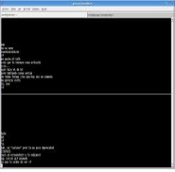
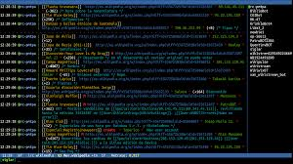









Online Social Communities
With the advent the Internet, microblogging chat tools have established new means for Online Social Networks:
  Content: Microblogging data (small elements of content such as short text, images, video.)
  Structure: Implicit Graph (address book) or Explicit Graph (followers, friends)
UNIX talk
SMS
IRC
MSN
Skype
Facebook
Twitter
Foursquare
Snapchat
Rayzit
‘88
‘99
‘03
‘04
‘06
‘08
‘11
‘13
‘70
‘80
‘90
‘00
‘10
‘15
Chat
Messaging
Social
Location
Forget
Anon. LBS

Slide 4
Online Social Communities
Benefits: avoid censorship and retain privacy
  “huge value for individuals … especially when they are working in far more difficult parts of the world.” J. Bartlett, dw.com, 25.7.2016.
  Apps: Games (MMOG), Education(MOOC), Crowdsourcing.
Drawbacks: accountability and traceability
  threats, rumor spreading and negative discourse (e.g., intimidate, control, manipulate, falsely discredit, or humiliate) leading to the shutdown of services (e.g., Secret)
  illegal content dissemination leading an ASN to a dark network (e.g., trade drugs, sex, cyber-arms, weapons, counterfeit currency).
  Topic to be revisited at the end of this talk.

Slide 5
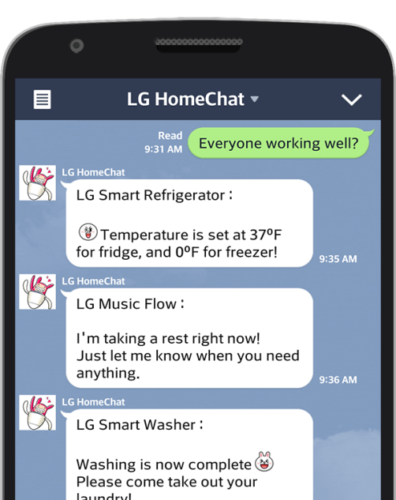
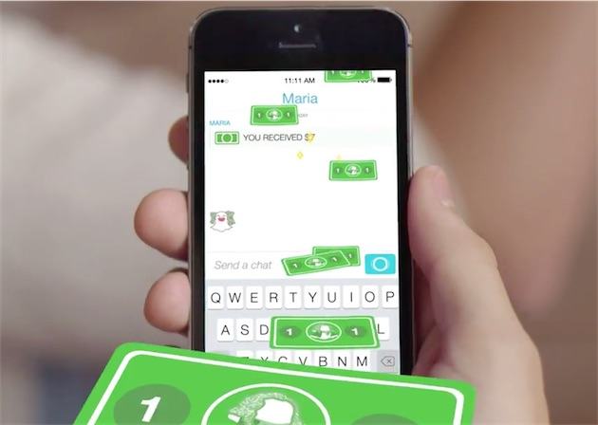


Socializing with People (and Bots)
The trends show that socialization will NOT be confined within specific social circles:
Smart-homes, smart cars, smart anything …
Personal assistants (e.g., siri, cortana) and Chatbots (skype) for Commerce and Q/A

Slide 6
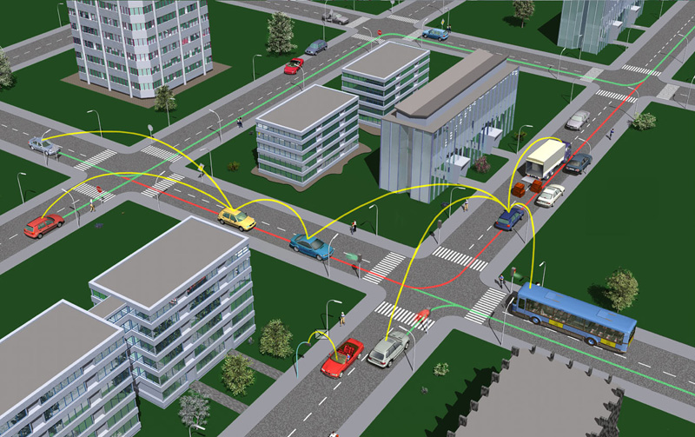
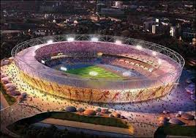

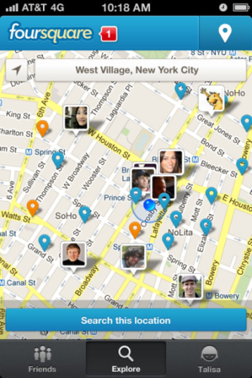
Problem 1: Lack of Proximity
Current Microblogging apps are unable to realize proximity-based applications, e.g., for:
  V2V communication scenarios
  Adhoc events
  Emergency response scenarios
Crowd around is not in your Social graph ☹
  #Hashtags not useful either (difficult to be discovered)

Slide 7
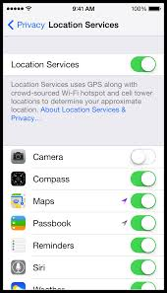

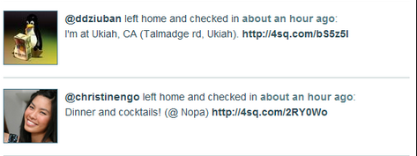
Problem 2: Location Privacy
LB apps can continuously “know” (surveil, track or monitor) the location of a user while serving them.
  Which Location settings to keep on?
“Please rob me” awareness project shows the impact of location release.
  Shows when users check-in somewhere that is not their home (Foursquare location updates).

Slide 8
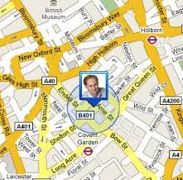
Problem 3: Boostrapping
LB apps suffer from bootstrapping issues
  “Bootstrapping refers to the starting of a self-sustaining community that is supposed to proceed without external input” wikipedia
Most LB apps don’t have enough users online upfront.
This gives the impression to new users that the app is deserted.
Consequently, many people don’t use it and the app gradually dies.

Slide 9

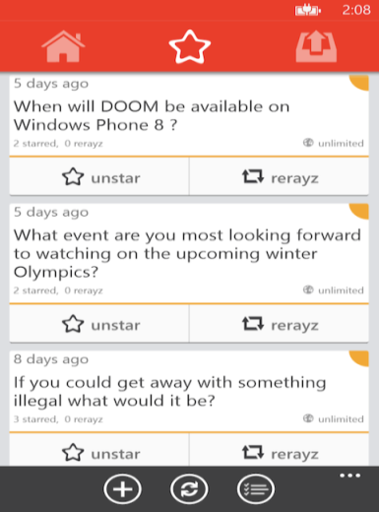
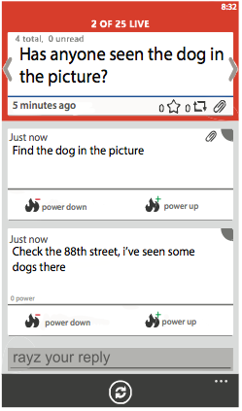



Rayzit Concept
Rayzit: a crowd messaging system that instantly forms a dynamic social network based on user proximity
  Not location-based app but kNN-based! (explained next)
Rayzit was funded by the Appcampus Program (Microsoft, Nokia & Aalto, Finland) in 2013.
  Ranked among 5 best apps of the program from 3500 apps.
  Over 45,000 user interactions from over 10,000 users!
Research Problem: Big Data AkNN Query Processing
http://rayzit.com/

Slide 10

AkNN Networks
Example Problem: Find 2 Closest Neighbors for ALL User
"Continuous all k-nearest neighbor querying in smartphone networks", Georgios Chatzimilioudis, Demetrios Zeinalipour-Yazti, Wang-Chien Lee, Marios D. Dikaiakos, In IEEE MDM'12.

Slide 11
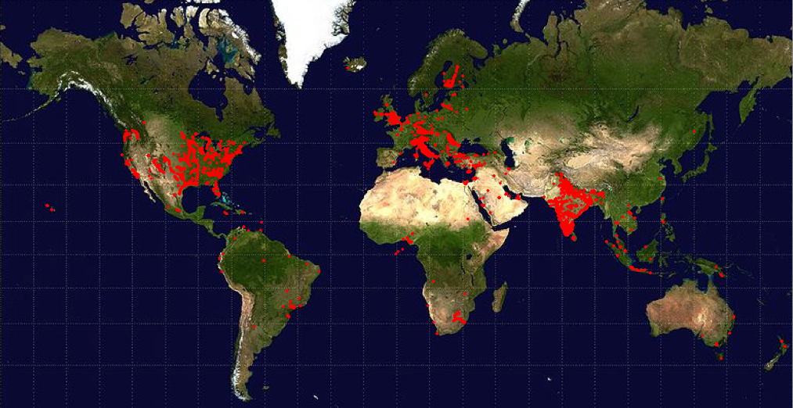
Large-scale AkNN Networks
Rayzit User Map
How to compute the kNN for millions of mobile users every few minutes?
… from scratch, without tracking (recording) the location of users

Slide 12
Presentation Outline
Introduction
AkNN Query Processing
  IEEE TKDE’16
Rayzit Crowd Messenger
  Mobisocial @ IEEE MDM’15
Future Challenges

Slide 13
System Model
|O| = n objects report location to QP
QP computes AkNN query every few minutes.
QP
O
o₂
o₁
o₈
o₃
o₇
o₅
o₄
o₉
o₆
o₁₁
o₁₀

Slide 14
kNN Query Definition
kNN(q, O): Given a multi-dimensional query point q, find the k objects in O that have the smallest distance* to q.
  *e.g. Manhattan (L₁), Euclidean (L₂), Geographical distance (earth surface distance)
o₁
o₂
O
q
2NN(q,O) = {o₁,o₂}
o₃
o₄
o₅

Slide 15
AkNN Query Definition
kNNs of o_{a}
Find kNN for all objects in O!
AkNN(O): Given objects o_{a}≠ o_{b}≠ o_{c},
∀o_{b}∈ kNN(o_{a,}O) and ∀o_{c}∈ O - kNN(o_{a,}O), it holds that dist(o_{a},o_{b}) ≤ dist(o_{a},o_{c})
not kNNs of o_{a}
o₂
O
o₁
AkNN = kNN Self-Join
kNN Self-Join Definition
O ⋈ _{kNN} O =
{(o_{a}, o_{b}) | o_{a}, o_{b} ∈ O and o_{b} ∈ kNN(o_{a}, O)}
O(n²)-time search cost
o₈
o₃
o₇
o₅
o₄
o₆
o₉
o₁₁
o₁₀

Slide 16
Centralized AkNN
Classical problem with many centralized algorithms
Applications: computational geometry, image processing, data compression, clustering and spatial databases.
Basic Types of Algorithms:
  Memory-resident structures & algorithms (theory)
  Disk-resident structures & algorithms (databases)
  Parallel algorithms (Graphics)
Common Problem:
  Not designed for distributed Big Data Architectures (shared-nothing cloud infrastructure)

Slide 17
Distributed AkNN: Issues
2NN
s₁
o₂
s₂
Let us partition the 11 objects over 4 servers {s₁,…,s₄}
o₁
Problems:
A) Communication Overhead
O₁: 2NN(o₁) are located on adjacent nodes s1 and s2
=> We need to minimize the replication (f) among nodes!
B) Load Balancing
s₄: 15 distances among 6 objects (i.e., n(n-1)/2)
s_{3:} only 3 distances!
=> We need to yield a fair space partitioning!
o₃
o₈
o₅
o₇
o₄
o₆
o₉
o₁₀
o₁₁
s₃
s₄

Slide 18
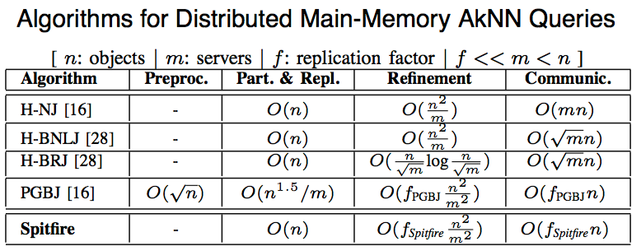
Other Hadoop AkNN
Bibliography included a few new distributed algorithms founded on the Map-Reduce model.
  n: number of nodes
  m: number of servers
  f: replication factor of an algorithm

Slide 19
H-NJ Algorithm
Hadoop Naïve kNN Join Algorithm [1]:
  M1: Transfer O (|O|=n) to all m servers
  R1: On each server, execute O_{i} ⋈_{kNN} O
    O_{i} contains n/m objects
  Communication Cost: O(mn) ☹
  CPU Cost: O(n²/m) ☹
O_{i}
⋈_{kNN}
O
n
n
Replication Factor
f_{H-NJ}=m
n
n
m
[1] Lu et. al VLDB’12

Slide 20
H-BNLJ Algorithm
H. Block Nested Loop kNN Join Algorithm [2]:
  M1 (Partition): Partition O to √m sets, yielding m (O_{i},O_{j})-pairs, where i,j≤√m
  R1 (Local kNN): Each unique pair (O_{x},O_{y}) is mapped to same server, which computes a distributed O_{x}⋈_{kNN}O_{y}
  M2 (Merge Local kNN): Hash √m local results of an object o_{a} to the same server (for all objects)
  R2 (Global kNN): Compute top-k for each object locally.
MR1:
(O_{x},O_{y})
o_{a}={ … }
…
o_{a}={ … }
…
m
MR2:
o_{a}={ … }
o_{a}={ … }
m
[2] Zhang et. al EDBT’12

Slide 21
H-BRJ Optimization
[2] Zhang et. al EDBT’12
H. Block R-tree Nested Loop kNN Join [2]:
  Optimizes Local kNN computation (Reduce-job1) in previous algorithm (H-BNLJ) by building an R-tree on O_{i}
  Distributed R-tree kNN ( n/√mlog(n/√m) )
  Optimal Load Balancing = 1
MR1
MR2
(O_{x},O_{x})
o_{a}={ … }
o_{a}={ … }
O
(O_{y},O_{x})
o_{a}={ … }
…
m
O_{x}
O_{y}
(O_{x},O_{y})
√m
Replication Factor remains
f_{H-BRJ}= 2√m
(O_{y},O_{y})
all
combos
o_{a}={ … }
…

Slide 22
PGBJ Algorithm
Partition Group Block kNN Join [1]:
  Preprocessing: Scatter √n pivot points in space (part.)
  Map1: Map each object to its nearest “pivot” and store
  min and max distances of mappings to pivots (for pruning)
  Midstep: Balance √n groups into m clusters O_{i} (balancing)
  Map2: Compute candidates F_{i} for O_{i} (correctness)
  Reduce2: O_{i}⋈_{kNN}F_{i} locally
[1] Lu et al. VLDB’12
pivots &
statistics
only
√n
O₁
O
O₂
m
O’₁
O’₂
O’₃
O’_{m}
O_{m}
O₃
geo-clustering
(voronoi partiotioning)
Workers
Workers

Slide 23
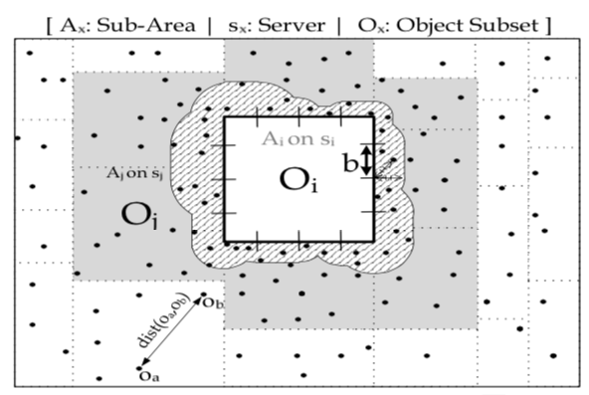
The Spitfire Algorithm
Spitfire Execution Phases
  1) Quick Partitioning (each cell at least k)
  2) Replication border cases minimally
  3) Perform local AkNN computation efficiently
Distributed Algorithm implemented in MPI

Slide 24
Spitfire - Partitioning
Partitioning (Geographical) – O(n)
  m disjoint, appr. equally populated subareas (balancing)
  Using equi-width and equi-depth histograms
Steps:
Hash into equi-width buckets on x-axis
Group x-buckets into √m
approx. equi-depth groups
For each x-group do step 1 and 2 on y-axis
Result:
m appr. equi-depth groups.
Each cell has at least k items
O(n) → assuming that number of buckets is less than √n

Slide 25
Spitfire - Replication
Replication Step
  In the partitioning step, we made sure that each neighboring cell to O_{i} contains k entries.
  Problem: O_{i} can’t complete the AkNN computation for its internal objects as there are objects (e.g., the red bullet) lying close to neighbors.
  Solution:
    Receive External Candidates (EC) from neighbors.
    If all nodes do this, each O_{i} can next perform a local AkNN computation!
  Next Problem: How to find EC?
O_{i}

Slide 26
Spitfire - Replication
Replication: How to derive EC?
  A) Segmenting Border into smaller “b” segments
  B) Apply Top-k “hiding” rule for each “b” to find which local objects are necessary for neighbor O_{j}.
  C) Ship those candidates over to O_{j} in batch mode
(A): Segmenting Border
(B): Top-k “hiding” rule
b
If k objects are closer to b than o₁ and o₃, then
o₁ is guaranteed NOT to be a kNN of o₃ and vice versa.

Slide 27
Spitfire - Refinement
Local Refinement -- O( f_{Spitfire} n²/m² )
  execute locally O_{i} ⋈_{kNN} (O_{i}∪EC_{i}) using any AkNN algorithm (we use a variant of Proximity IEEE MDM12)
s_{i}
  Same intuition:
  Partition using a grid
  Find candidates per cell
  Refinement per cell
⋈_{kNN}
EC_{i}

Slide 28
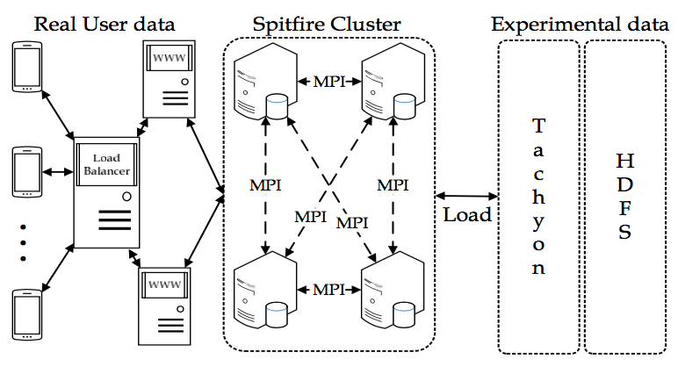
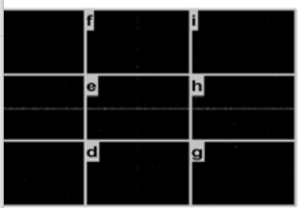
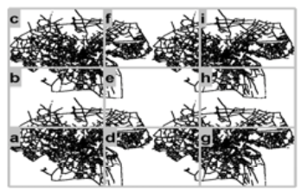
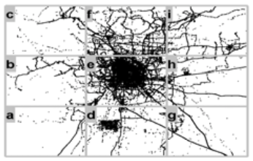
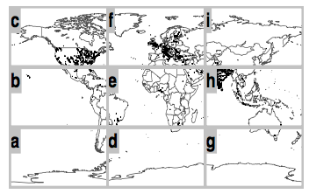
Evaluation Testbed
9 computing nodes
8 GB RAM
2 CPUs@2.40GHz
MapReduce over Tachyon (memory-centric file system)
Datasets:
  Random (synthetic) – uniform distribution
  Oldenburg (realistic) – skewed distribution
  Geolife (realistic) – very skewed distribution
  Rayzit (real) – skewed distribution up to 2x10000 users

Slide 29
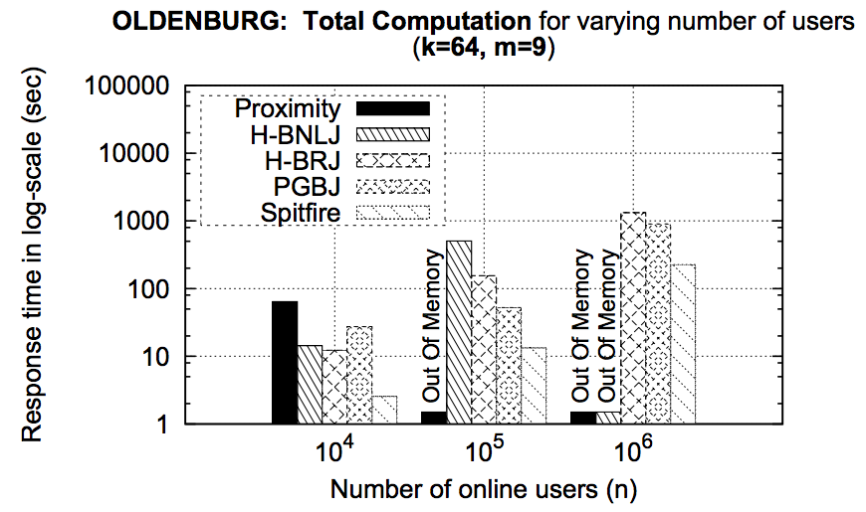
Response Time
Re-computation possible every 100 sec (~every few min)
Spitfire and PGBJ scale better than block algorithms H-BNLJ and H-BRJ that run out of memory!
Spitfire outperforms all other algorithms in all cases.
  Spitfire better than PGBJ on all datasets: (67%, 75%, 14% on Random, Oldenburg, Geolife).

Slide 30
Partitioning and Replication
Spitfire partitioning is much faster than PGBJ
PGBJ is growing exponentially
H-BNLJ and H-BRJ do not partition geographically → suffer in refinement
Same response times for all datasets → partitioning independent of dataset

Slide 31
Replication Factor (f)
Plot for most skewed dataset. Others have similar results
f_{Spitfire} outperforms (optimal value for f is 1)
f_{Spitfire} drops as n increases (scalability)
f_{H-BNLJ} and f_{H-BRJ} = 2m^{0.5}, independent of n
Replication factor offers clear comparison independent of implementation

Slide 32
Presentation Outline
Introduction
AkNN Query Processing
  IEEE TKDE’16
Rayzit Crowd Messenger
  Mobisocial @ IEEE MDM’15
Future Challenges

Slide 33
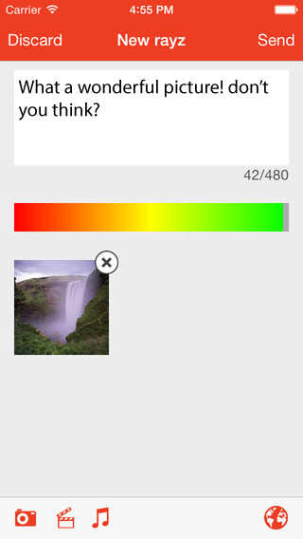
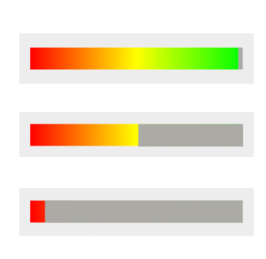
Rayzit Application
A user can post a new Rayz (text, audio, video – shown as attachment).
To minimize spamming, each user has a powerbar that decreases on every action:
  Rayz, reply, re-rayz, power+/-
  When empty no more actions are possible until it gradually reloads.
  To reload faster, we provide the incentive to provide useful answers that will be starred by others.
A message can be bounded to a certain distance (kNN is default)
  0.5, 5, 50, 500, 5000 km

Slide 34
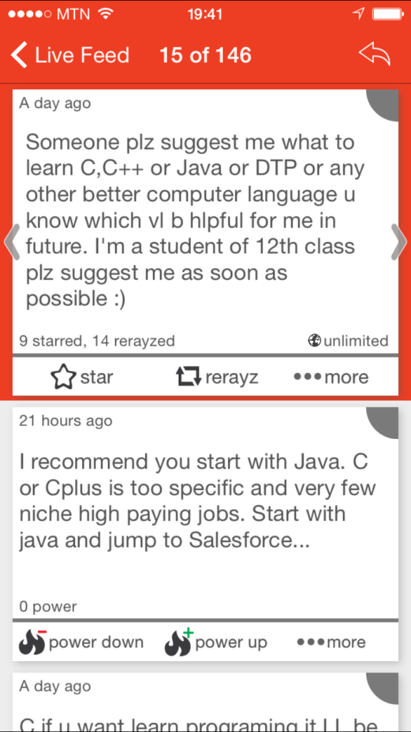
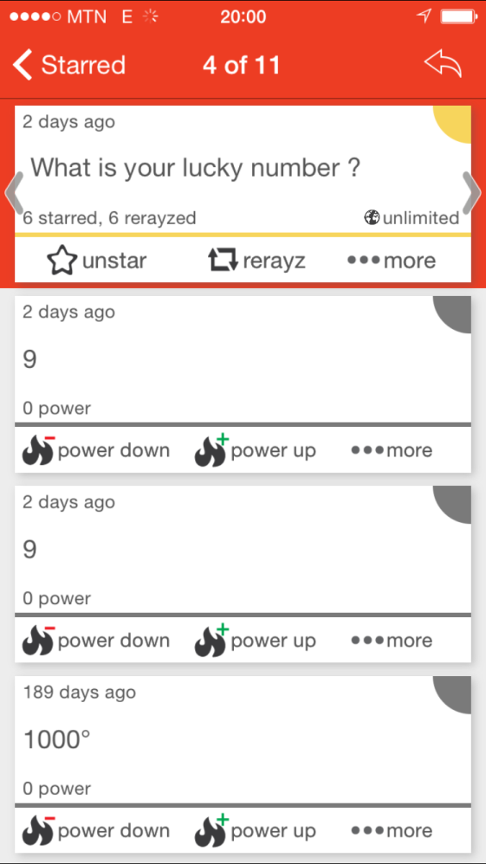
Example Conversations
General Advice & Crowd Casting

Slide 35
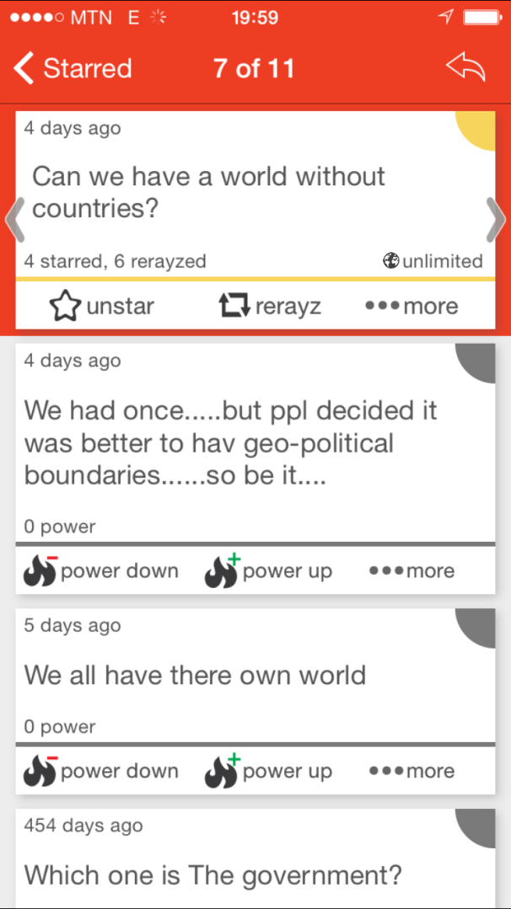
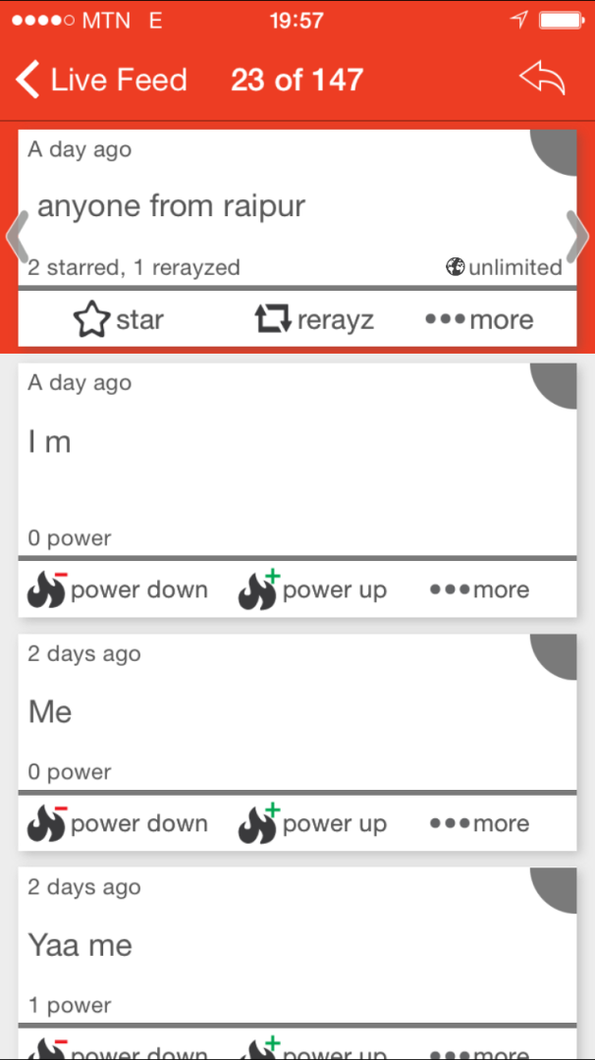
Example Conversations
Philosophical & Location-based Questions

Slide 36
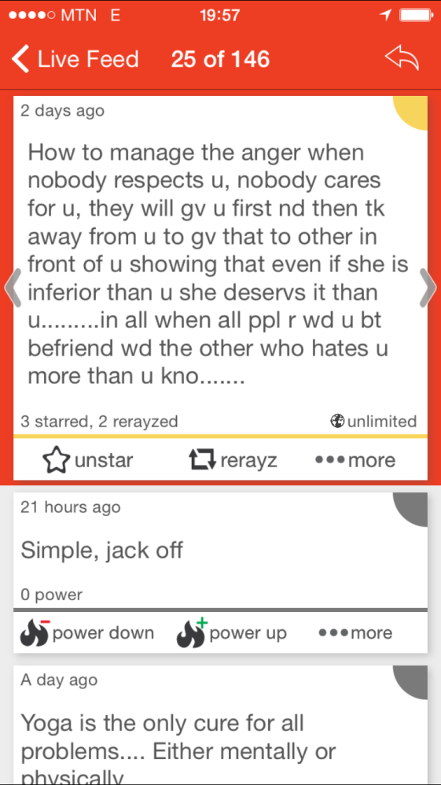
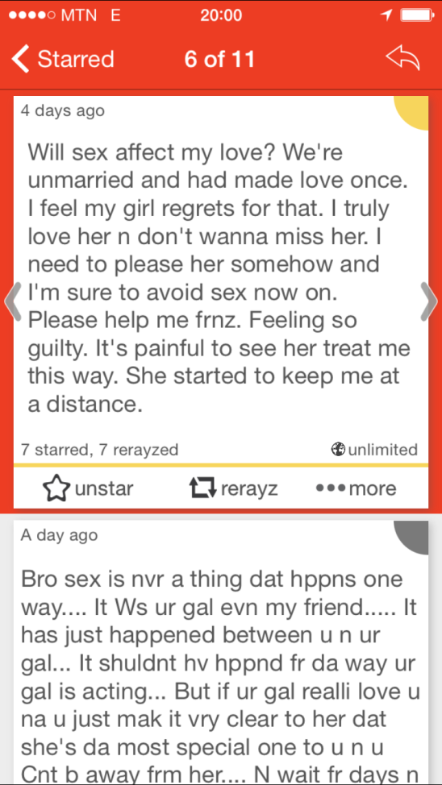
Example Conversations
Feelings Expression & Taboo Questions

Slide 37
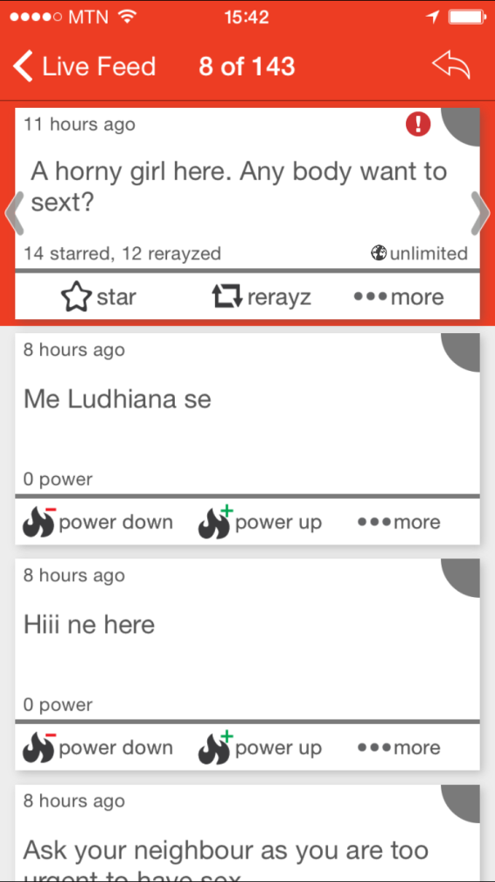
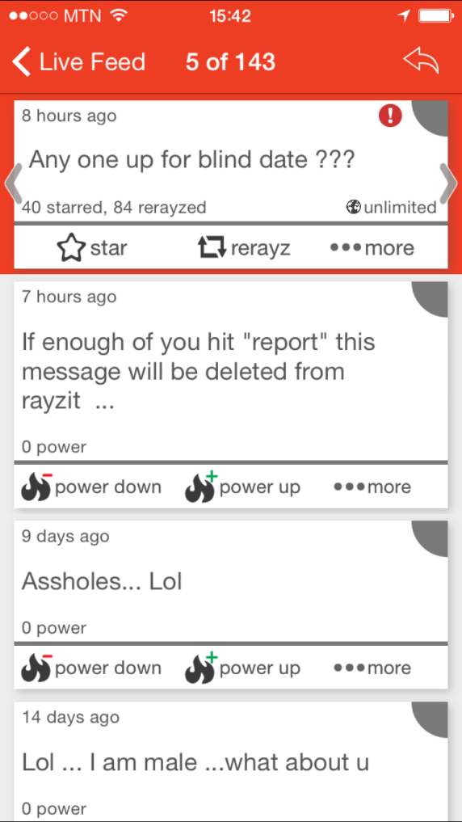
Example Conversations
Inappropriate Messages
(before installation of report filter)

Slide 38
More Topics on Rayzit
Topics: Location, Surveys, Thoughs, Feelings
Most answered rayz (responses)
  “Rain! Lovely.” (228)
  “Any good PGs near Avanshi RoadCBE?” (142)
  “Which windows phone do you have?” (119)
  “anyone around..???” (94)
  “Share a secret ..” (90)
  “Rayzit: What is the next feature you would like to see?” (81)
  “I love.... (continue)” (58)
  “Where are you from? I want to test Rayzit location.” (52)
  “Where to dine in Coimbatore if you want to have a dinner peacefully and by yourself?” (40)

Slide 39
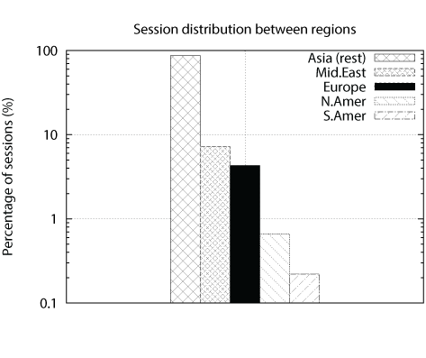
Analyzing the Rayzit Network
We used both Flurry App Analytics and Analytic queries on our NoSQL database
Interval of Analysis: Oct. 13 – Mar. 15
  32,762 Sessions
  5,062 New Users
  1.7 mins Median
  Session Length
Conclusion:
  App more popular in Asia, India particularly because of large Microsoft community and Microsoft Promotion)

Slide 40
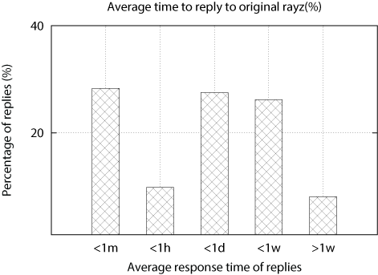
Average Reply Time
Online users
28%
Offline users
Sporadic users
Rest
28% of replies were recorded within 1 minute.
Crowd Volume creates quick response possibilities
Nearby users respond quickly (more interested in the discussion).

Slide 41
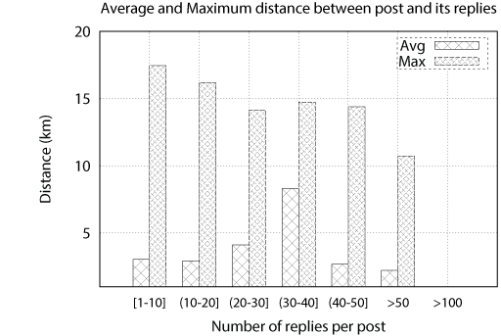
Average and Maximum
Distance (Rayz, Reply)
Hypothesis: Closer Geographic Users means More Replies
distance of rayz to replies ([1-50] replies) = 15km (max)
>50 replies
At 10km (max)
>100 replies
at 8 meters!
People in classroom, event?

Slide 42
Presentation Outline
Introduction
AkNN Query Processing
  IEEE TKDE’16
Rayzit Crowd Messenger
  Mobisocial @ IEEE MDM’15
Future Challenges

Slide 43

Future Challenges
Tools to handle lack of accountability have shown to encourage negative discourse, including personal attacks, threats or rumor spreading.
Introduce more automated and crowd management techniques (collaborative filtering):
  More intelligent Report Management
  Classify rayz threads to categories
  More detailed data analysis (interaction graphs, rerayz path length, community detection, chat groups vs. location, new vs. old users, ….

Slide 44
Future Challenges
Shallow syntax in messages: 2m, 2morrow, tmw, tomoz, tomz,all refer to tomorrow.
Off-the-shelf Part-of-Speech (POS) taggers (e.g., Stanford NLP or MPI AIDA) don’t work adequately on these messages.
Data contains many infrequent entity types (e.g., physicist) and capitalization (used for recognizing named entities, e.g., AlbertEinstein) is not there.
Might need to exploit spatial and temporal dimensions in data to understand what something refers to.

Slide 45
Future Challenges
Microblog NER
(T-POS, T-NER)
Temporal Tagging
(Heideltime)
Knowledge Base
(YAGO, Freebase)
Quantity Tagging
(QKB)
{ RQ1, RQ2, RQ3}

Slide 46
Building All k Nearest Neigbhor Social Communities
Demetris Zeinalipour
Thank You! Questions?
Max Planck Institute for Informatics, Germany & Department of Computer Science, University of Cyprus, Cyprus
http://www.cs.ucy.ac.cy/~dzeina/
dzeina@cs.ucy.ac.cy
Paris Descartes University Seminar Series on Data Analytics
in collaboration with the diNo group, April 12, 2017

