Slide 1
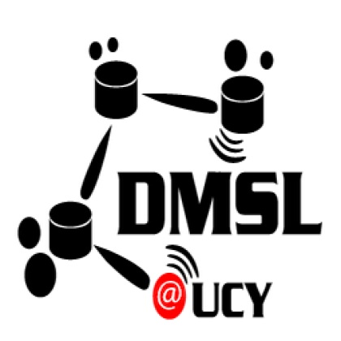
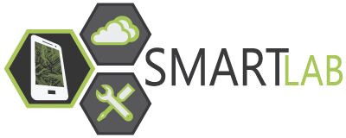
Smartphone Cloud Testbeds and Applications
Demetris Zeinalipour
Data Management Systems Laboratory
Department of Computer Science
University of Cyprus
http://dmsl.cs.ucy.ac.cy/
1st EIT ICTLabs Future Networking Solutions Outreach Workshop,
December 4, 2014, Budapest, Hungary
http://smartlab.cs.ucy.ac.cy/

Slide 2
About
Data Management Systems Laboratory (DMSL) is the newest laboratory of the CS/UCY department, established in 2010 (3 postdocs, 3 PhD students, 3 M.Sc student and 4 undergraduate assistants.)
Young dynamic team working on the crossroad of basic research / computer systems => innovation/startups
Funding
Industrial Funding & R&D : Cywee (Cywee/Taiwan), Appcampus (Nokia/Microsoft/Finland), Geomatic (Cyprus), MTN Telecom (South Africa/Cyprus/Middle East).
EU FP7: Modap, PlanetLab, CONET, Searchin (Marie Curie ToK & national projects

Slide 3
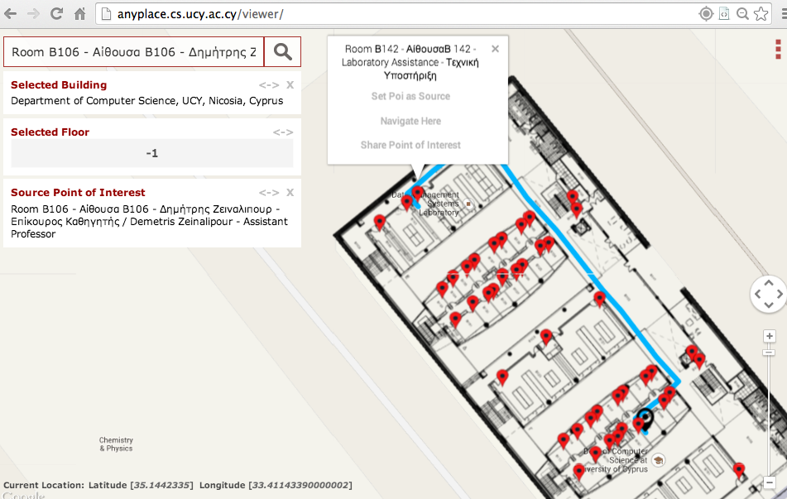
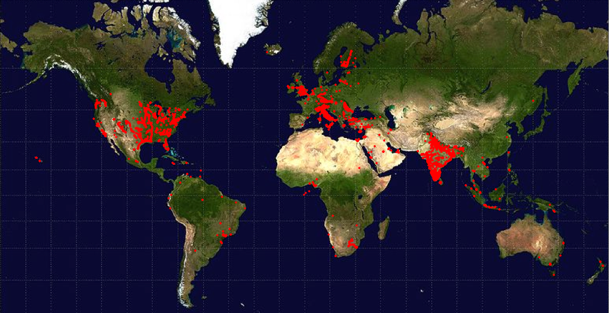
Preamble
The initial plan was to present 3 services we’ve developed and evolve:
Anyplace – Indoor Information Service.
3 Intl. awards (1.96m accuracy), Taiwan Collaboration.
http://anyplace.cs.ucy.ac.cy/
Rayzit – Crowd Messaging Service
1 Intl. award (Microsoft/Nokia), Active Community (Italy, India, US)
http://rayzit.com/

Slide 4
Objectives
Review abstractions comprising SmartLab, a Smartphone Cloud (IaaS) we have developed at the University of Cyprus since 2009.
Overview experiences from using SmartLab in a research-oriented setting:
"Demo: a programming cloud of smartphones”, In 10th ACM International Conference on Mobile Systems Applications and Services (Mobisys'12), Lake District, UK, 2012.
Managing Smartphone Testbeds with SmartLab, G. Larkou, C. Costa, P. Andreou, A. Konstantinidis, D. Zeinalipour-Yazti IN "Proceedings of the 27th USENIX Large Installation System Administration Conference" (LISA '13), Washington D.C., USA Pages: 115-132, ISBN: 978-1-931971-05-8, 2013.
“Sensor Mockup Experiments with SmartLab", Demo at 13th ACM Intl. Conference of Information Processing in Sensor Networks (IPSN'14), Berlin, Germany, 2014.
Tackle ideas for Future Directions & Proposals.

Slide 5
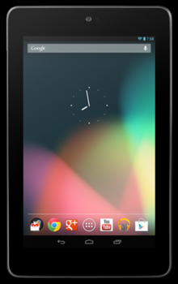
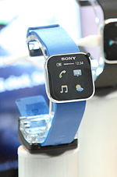
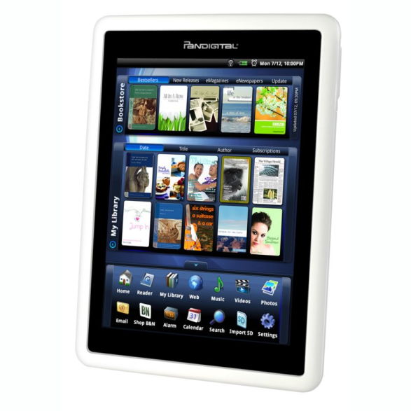
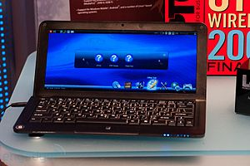
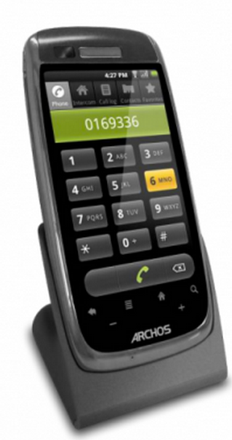
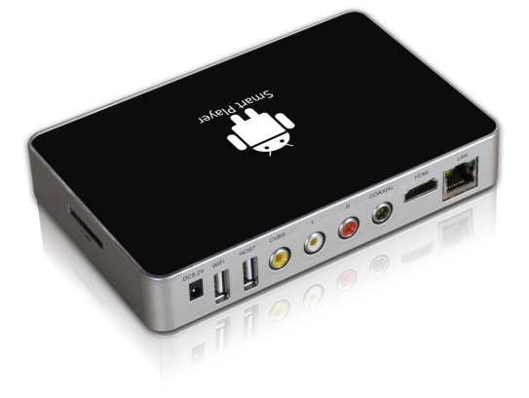
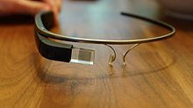
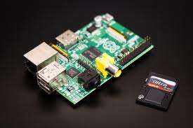
Hardware Fragmentation
Equipment running on Android
(based on Linux kernel 2.6.x and 3.x)
Smart Watches
SmartBooks
Tablets
eReaders
Smart Home Phones
Smart Glasses
Smart TVs
Rasperry PI

Slide 6
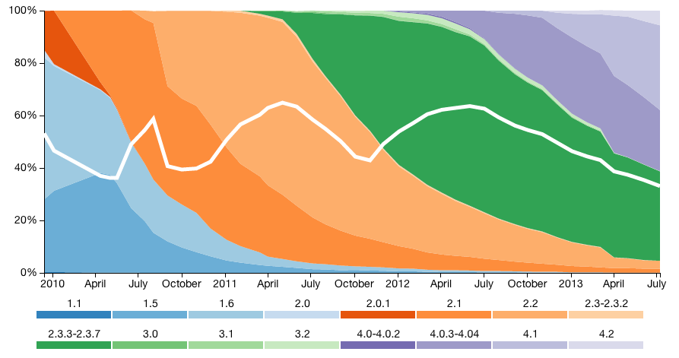
Software Fragmentation
Android Software Fragmentation
IDC projects that 53% of smartphones in 2016 will be running Android (19% iOS, 19% Win)
Source: OpenSignal, July 2013
￼
Smartphone OS landscape is fragmented!

Slide 7
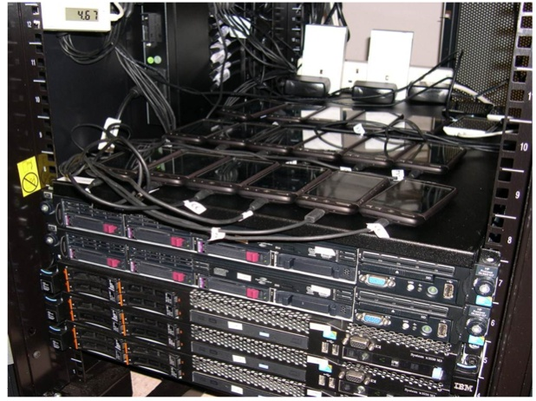
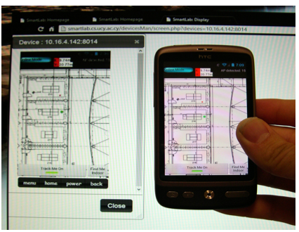
SmartLab: Smartphone Cloud
How can modern mobile research & development cope with the fragmented mobile ecosystem?
We developed a comprehensive architecture for managing stationary, mobile and virtual smartphones through a web browser.
￼
Stationary Devices
Mobile Devices

Slide 8
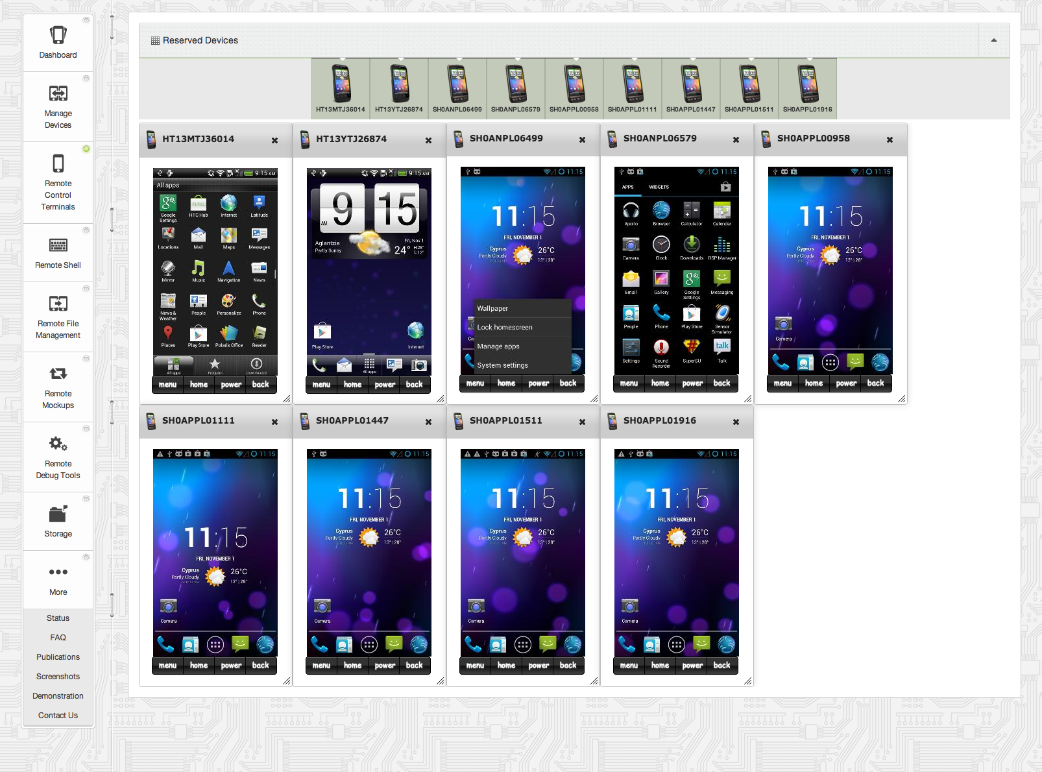
SmartLab: User Interface
Intuitive Web 2.0 GUI (Ajax, JSON, APIs)
Rent
Manage
See/Click
Shell
File Sys.
Automation
Debug
Data
Video!

Slide 9
SmartLab Device Service
WWW User
HTTPS / WSS
F I R E W A L L
S M A R T L A B
User Interface (UI) Layer (Web Server)
Data Layer
RFM
RCT
RDT
RS
RM
S S HF
S
SmartLab DB
ATP
Device Server (DS) Layer
File
System
RFM
RCT
RDT
RS
RM
S S HF
S
Android or Socket Debug Bridge (ADB | SDP)
JDWP
SSHFS
Hardware Layer / SmartPhones

Slide 10
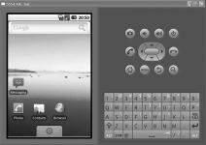
SmartLab: Device Server
Connection Modalities:
ARD-Local
ARD-Remote
ARD-WiFi
AVD
USB Hub
WiFi AP
1Gbps
VM
1Gbps
USB2.0 480Mbps
USB2.0 480Mbps
300Mbps
DS
DS
DS
DS
Datacenter
Datacenter
Datacenter
Datacenter
Emulator
wired
wireless
virtual
ARD-Local: Android Real Device (ARD) mounted locally to the Device Server (DS) through USB.
ARD-Remote: ARD mounted through a USB port on a gateway PC to DS through a wired network.
ARD-WiFi: ARD connected to DS through a WiFi AP.
AVD: Android Virtual Device running on DS.
ARD-3G

Slide 11
Presentation Outline
Introduction
Use Cases & Applications
Related Work
SmartLab Architecture
Future Directions

Slide 12
Use 1: Application Testing
How to test my app automatically on 50 different smartphones?
Smartphone App Developers are troubled with Quality Assurance on a fragmented ecosystem.
Users are frustrated by poorly tested applications, which result in poor ratings.
￼
(Enterprise) Industrial Interest: Mobile testing, quality monitoring, and security a $8-9B market!
Israeli Perfectomobile raised $35M, employs 130 people and expects $100M sales by 2016.
US Keynote Deviceanywhere, employs 119 people and integrates in HP’s Unified Functional Testing (UFT) regression testing tool.
Samsung Remote Test Lab (RTL), mainly for single device testing & those are simulated.
Source: PerfectoMobile.com

Slide 13
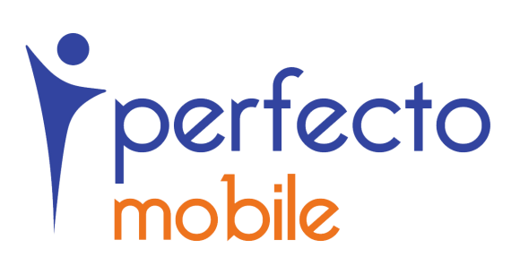
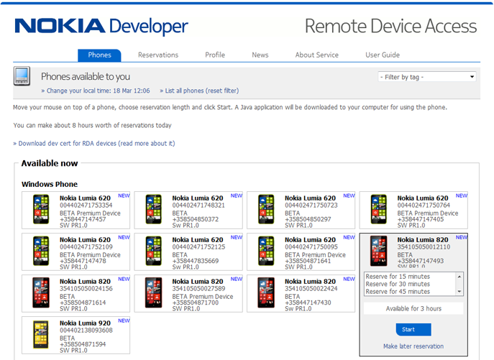
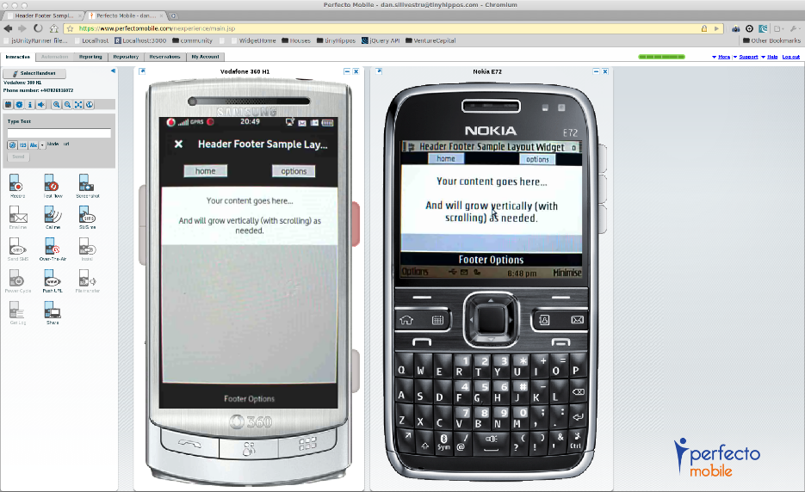
Use 1: Application Testing
Real Mobile Testbeds
e.g., Nokia RDA (only windows and symbian, real), PerfectoMobile (commercial, real), Keynote's Device Anyware (commercial, real)
￼
Geared towards individual device testing.
No insights into how these are developed!

Slide 14
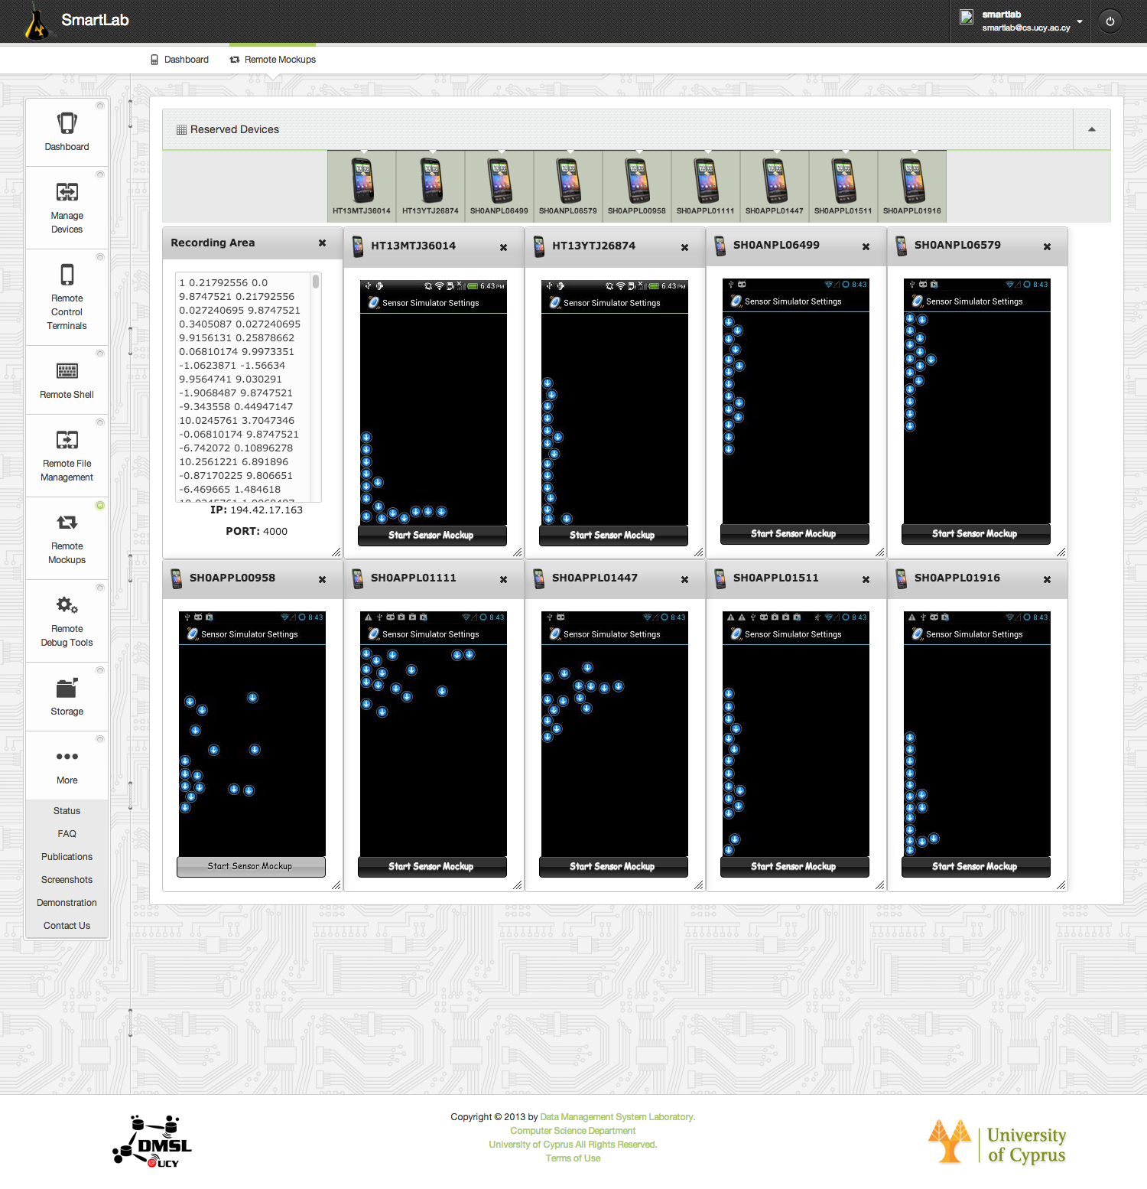
Use 1: Future Internet Experiments
SmartLab with Remote Sensor Mockups (RM)
VIDEO!
Mockup Sensors
GPS mockup
Accelerometer sensor
Compass sensor
Orientation sensor
Temperature sensor
Light sensor
Proximity sensor
Pressure sensor
Gravity sensor
“Sensor Mockup Experiments with SmartLab", Demo at 13th ACM Intl. Conference of Information Processing in Sensor Networks (IPSN'14), Berlin, Germany, 2014.
"Managing big data experiments on smartphones", Distributed and Parallel Databases (DAPD '14), Springer US, 2014 (accepted).

Slide 15
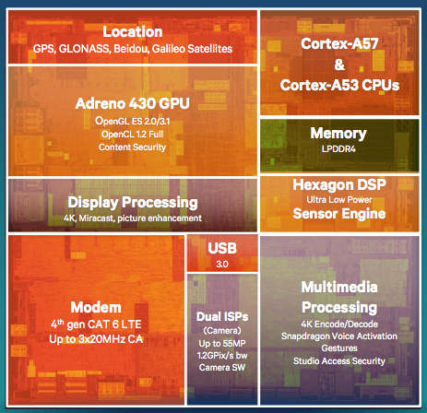
Use 2: Smartphone Cluster Computing
How to build beowulf-like clusters out of deprecated smartphones?
We tend to change smartphones faster than PCs.
The gap between x86 (still faster) and ARM architectures (greener) is slowly closing.
e.g., Latest Smartphone CPU (Qualcomm Snapdragon 810)
4 x A57 (faster) cores + 4 A53 (eco) cores with 64 bit support and 20nm device fabrication.
Indicative benchmark by Geekbench (4.5:1 ratio):
- Xeon X5650 Score (6-cores, 2.67GHz): 13,703
- Snapdragon 801 (4-cores, 2.45GHz): 2,924
Source: http://goo.gl/vYJZCJ

Slide 16
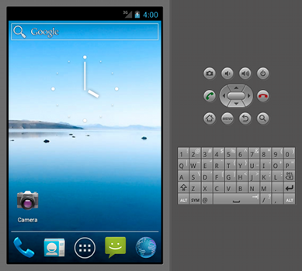
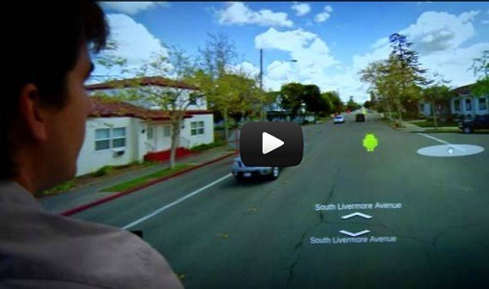
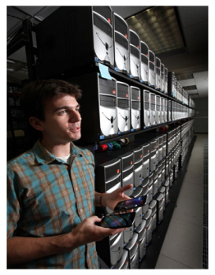
Use 2: Smartphone Cluster Computing
Emulated (on PCs) Mobile Testbeds
QEMU (Quick EMUlator) Clusters:
QEMU is a generic and open source machine emulator (e.g., run ARM-compiled code on x86)
Android-X86 Clusters:
The Android-X86 provides Android for x86 architectures, thus Android can run on an ordinary PC or in the Cloud.
The project was conceived when trying to offer Android on Asus Eee ultrabooks.
Both require a lot of RAM on the host!
No real computing stack, no sensors!
Besides Samsung RTL, Megadroid is a 520-node PC cluster, deployed by Sandia Labs (US) that deploys 300,000 Android Emulators.
Facilitates capacity-type cluster security simulations
QEMU Emulator in eClipse
￼

Slide 17
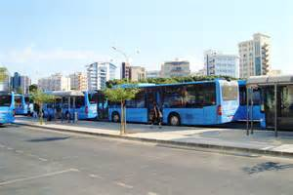
Use 3: City-scale Testbeds
How to handle a fleet of Android-powered equipment installed on 100 buses?
Experimentation & Applications: e.g., Smart Advertising Panels & TVs, WiFi/3G Hotspots, and TVs, Multimedia equipment, etc.

Slide 18
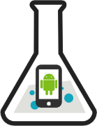
Use 4: People-centric Testbeds
People-centric Testbeds
PhoneLab (Univ. of Buffalo, USA with support by Google): allows data collection from real users.
Workflow:
Register Experiment
Upload Android Executable with Log.v(ID, “Something”)
Institutional Review Board Evaluation / Approval
Pre-deployment Testing (battery, storage, etc.)
Deployment (up to 152 participants)
PhoneLab returns Logcat trace containing ID.
https://www.phone-lab.org/
No fine-grain control over remote devices!

Slide 19
Smartphone Cloud Testbeds and Applications
Demetris Zeinalipour
Thanks! Questions?
Data Management Systems Laboratory
Department of Computer Science
University of Cyprus
http://dmsl.cs.ucy.ac.cy/
1st EIT ICTLabs Future Networking Solutions Outreach Workshop,
December 4, 2014, Budapest, Hungary
http://smartlab.cs.ucy.ac.cy/

