Slide 1






Data-Driven Localization with
Zero Infrastructure
Demetrios Zeinalipour-Yazti
University of Cyprus
dzeina@ucy.ac.cy
* Joint work with P. Mpeis (UCY) and Jaime Bleye Vicario (Integral Maritime Safety, Spain) based on paper at Royal Institute of Naval Architects ICCAS 2022 conference, Yokohama, Japan
https://anyplace.cs.ucy.ac.cy/ https://lashfire.eu/
Colloquium at Missouri University of Science and Technology (Missouri S&T),
October 17, 2022. (online) – Host: Sanjay Madria

Slide 2
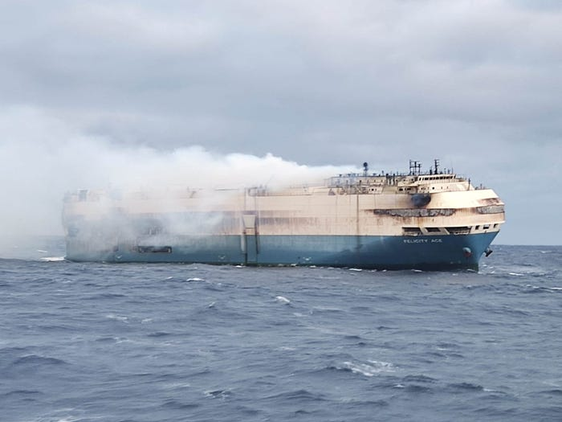
Motivation – Fires on Ro-Ro Vessels
Ro-Ro Vessel: Roll-On / Roll-Off Vessels carrying new and used vehicles across continents and countries.
February 20, 2022: Fire Aboard Burning Ro/Ro Felicity Ace operated by Mitsui OSK Lines (MOL), Tokyo, Japan
  Estimated losses: USD $ 500M => 4000 vehicles loss
Notes:
Ship carrying about 4,000 vehicles — including Porsches, Audis and Bentleys — catachecaught fire near the coast of the Azores

Slide 3

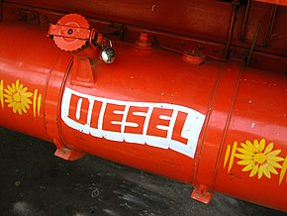
Motivation – Fires on Ro-Ro Vessels
The early suppression of fires on ro-ro vessels requires rapid fire identification
  a fire of medium growth exponentially reaches 1MW after only 5 minutes!
1 minute
50kW
3 minutes
400kW
5 minutes
1MW = 1 m2 diesel pool
7 minutes
2MW!
Exponential fire growth! – quick reaction is a must!

Slide 4


LASH FIRE
LASH FIRE is an international EU-funded research project aiming to significantly reduce the risk of fires on board ro-ro ships.
  A particular focus in the project is the development and validation of smart technical solutions for quick first response and effective fighting of fires in their initial stage.
  As part of this objective, we developed a “zero” infrastructure localization method for smartphones of first responders.
Focus of this talk!
This project has received funding from the European Union’s Horizon 2020 research and innovation programme under grant agreement No 814975

Slide 5
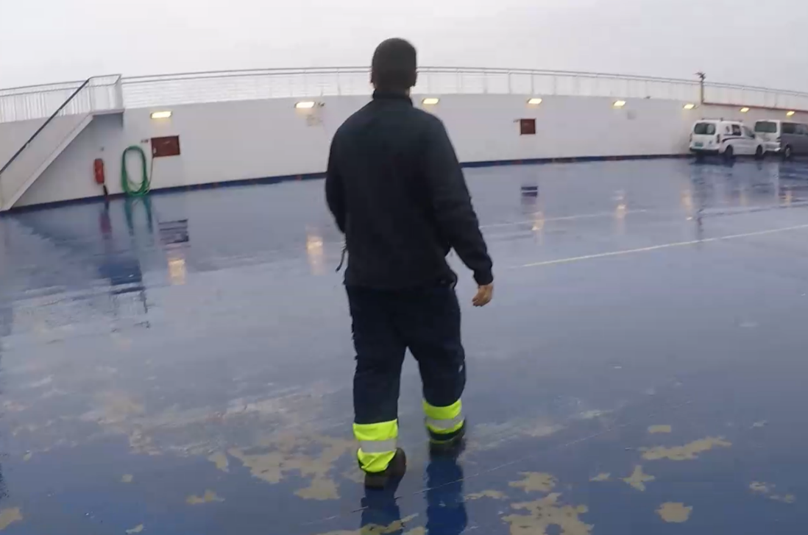
First Responder
Fire patrol members (able seamen) are asked to act as first responders in early stages of fires (or confirmation stage).
  Coordinate with the bridge and other crew
  Put out an early fire using a handheld fire extinguisher
First Responder

Slide 6
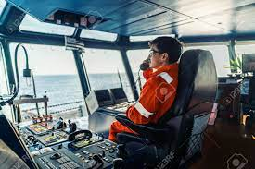
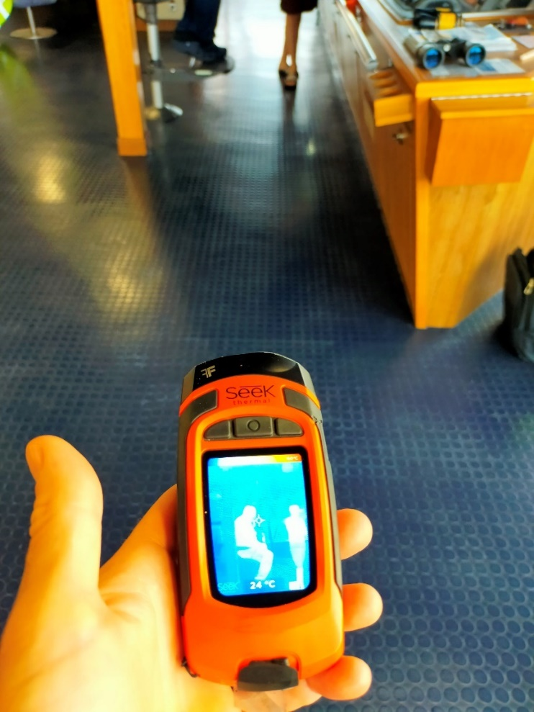
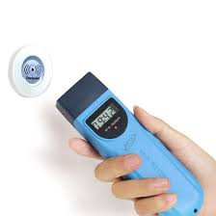
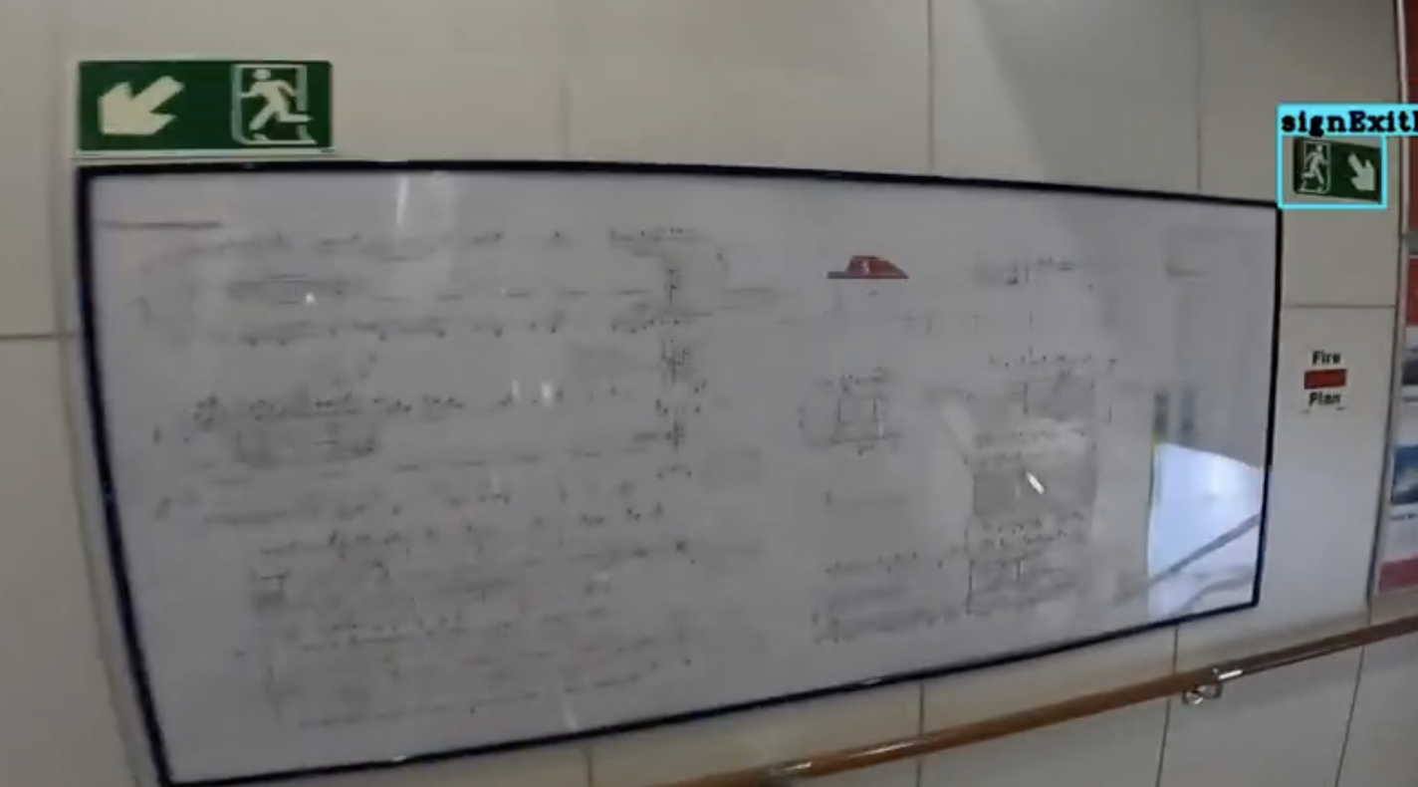
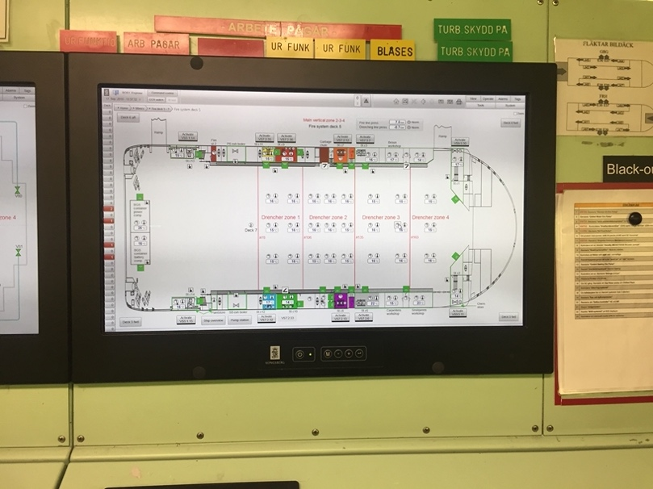
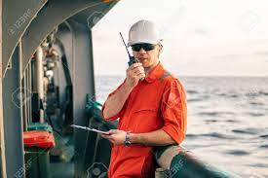
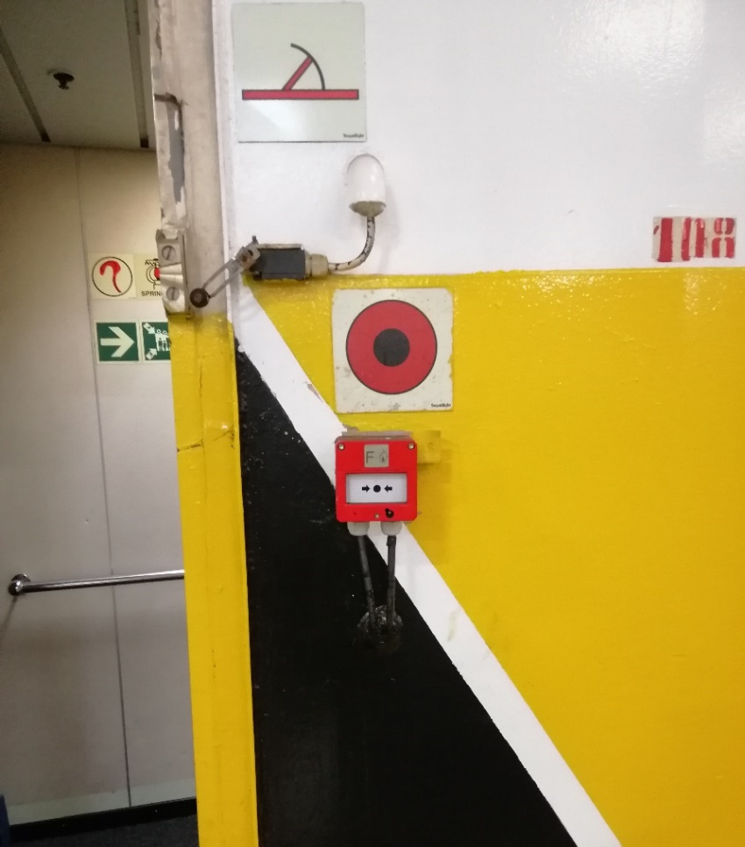
Current Technology State
Limited control and slow coordination in first minutes of incident.
Different technologies and interoperability issues.
Technology already on vessels
Check Point Readers
VHF/UHF Communication
Heat Scanning
Fire Safety Plan
Temp Status at Bridge and Drencher Knobs
Our aim is to make first respond more “integrated”, “quicker” and ”smarter”
Additional Gear and
Equipment
VHF/UHF Communication
Push Alarm Button
- Problem? Indoor Location !

Slide 7
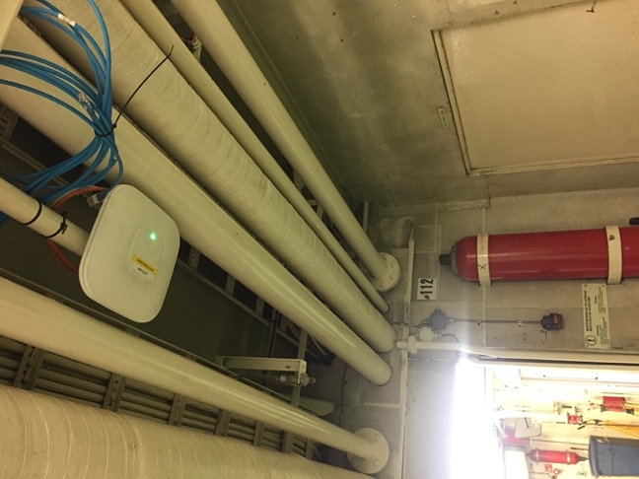
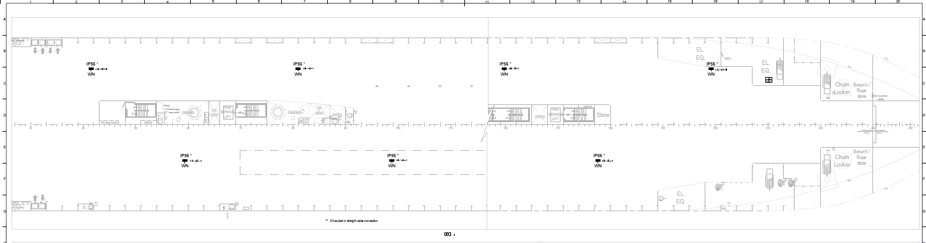
Location: Challenges on Vessels
Research Challenge: Dense Wi-Fi / 5G antennas, necessary for accurate indoor localization, not widely available on ro-pax vessels.
  Good for network connectivity, not for localization
Solution: Develop a “zero” infrastructure localization technology exploiting the static assets of a vessel.
  Reference points: floor patterns, wall patterns, hoses, drenches, signs, control buttons, OCR text on walls.

Slide 8
Outline
Introduction
Background & Related Work
Surface Algorithm
Experimental Evaluation
Conclusions and Future Work
Related Problems (Older Work)

Slide 9
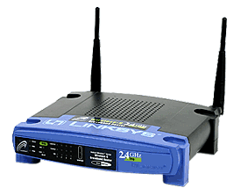
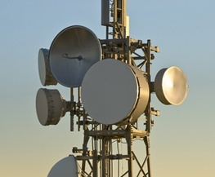
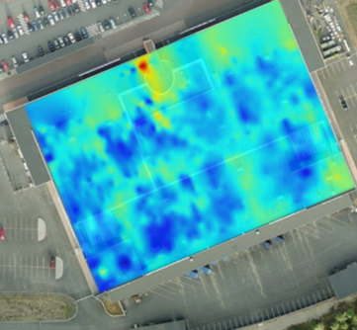
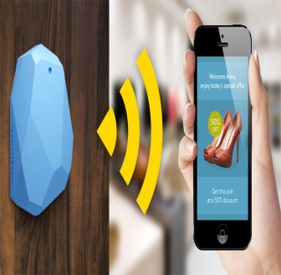

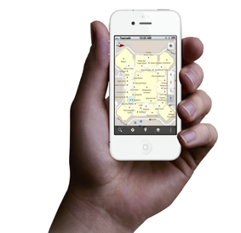
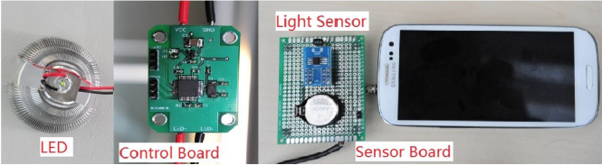
Indoor Localization
Smart Devices are becoming enablers for modern Internet-based Indoor Navigation (IIN) services founded on their measurements.
Technologies:
  Existing Infrastructure
  Wi-Fi APs, Cellular Towers
  New Infrastructure
  Beacons (BLE Beacons, RFID Active & Passive Beacons)
  Sound (Microphone), Light (Light Sensor)
  Stationary antennas, UWB, SLAM/LIDAR
  Zero Infrastructure
  IMU Data (Gyro, Acceler., Digital Comp)
  Magnetic Field Sensors
"Internet-Based Indoor Navigation Services", Demetrios Zeinalipour-Yazti, Christos Laoudias, Kyriakos Georgiou, Georgios Chatzimilioudis, IEEE Internet Computing (IC'17), vol. 21, no. 4, pp. 54-63, July 2017, doi:10.1109/MIC.2017.2911420, IEEE Computer Society, 2017.
Notes:
18 cores – a six-core CPU, four core GPU, and an eight-core Neural Engine processor

Slide 10
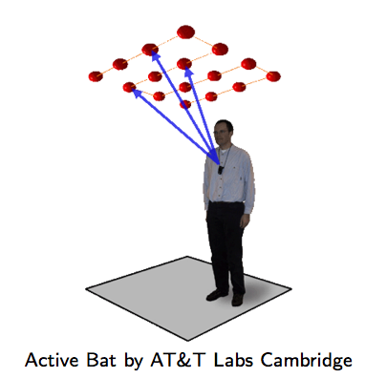
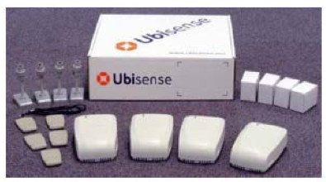
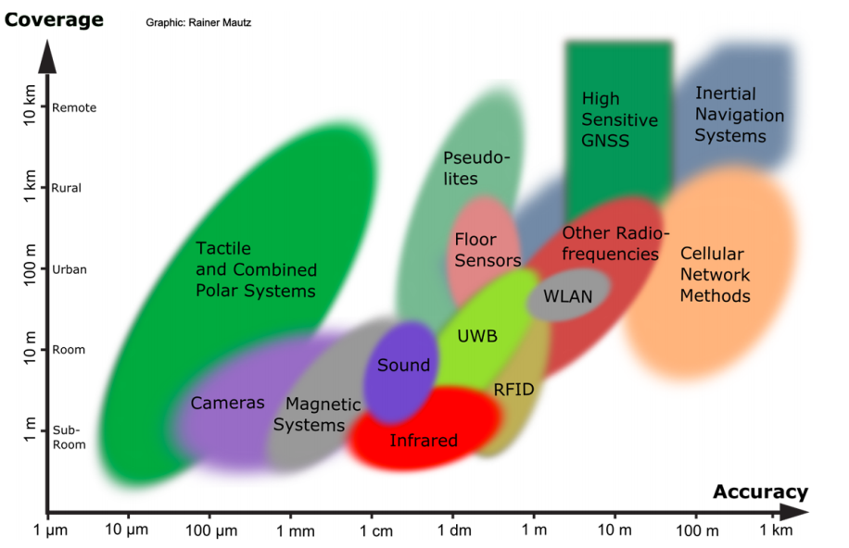
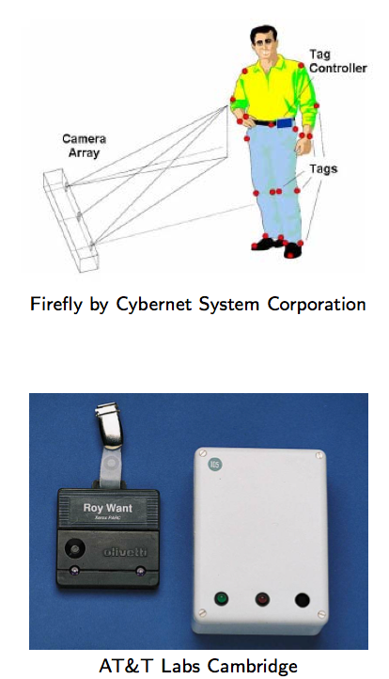
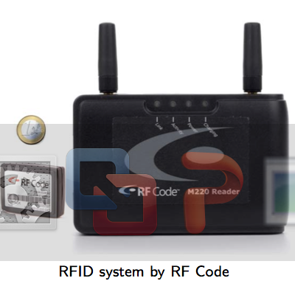
Indoor Localization
Ultrasound:
^{Ultra Wide Band (UWB)}
AOA, TOA, TDOA, signal reflection
: Spatial extension where system performance must be guaranteed
Our Focus: Room Level Accuracy
+ Infrastructure Free
^{Infrared (IR)}
^{TOA, TDOA}
Radio Frequency IDentification (RFID)
| Outdoor |
| Indoor |
^{Rainer Mautz, ETH Zurich, 2011}
Cell of Origin, Signal Strength
^{Firefly delivers 3mm accuracy}

Slide 11
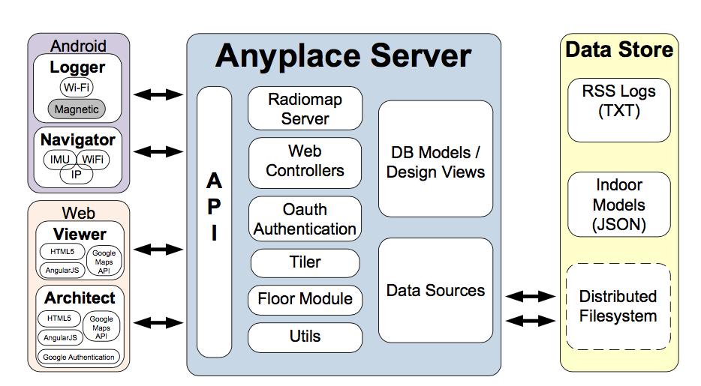
Anyplace
Localization
A complete open-source Internet-based Indoor Navigation (IIN) Service
predominant IoT open-source Indoor Localization Service - MIT License.
Modular Architecture: Web, Android, Windows, iOS, JSON API.
Multiple awards for accuracy & utility.
Supports only Wi-Fi + IMU localization on Android ☹
  “The Anatomy of the Anyplace Indoor Navigation Service”, Demetrios Zeinalipour-Yazti and Christos Laoudias, ACM SIGSPATIAL Special, Special Issue on Indoor Spatial Awareness II, Editor: Chi-Yin Chow, Vol. 9, No. 2, pp. 3-10, July 2017.

Slide 12
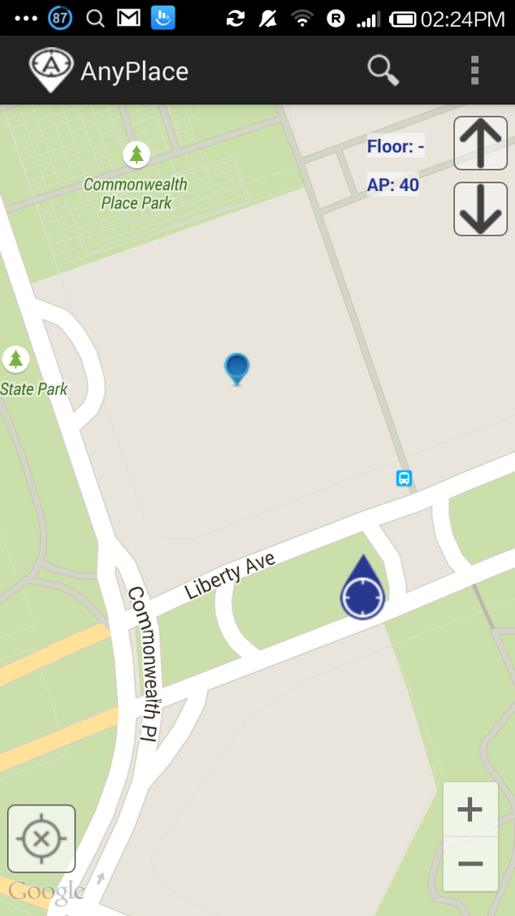
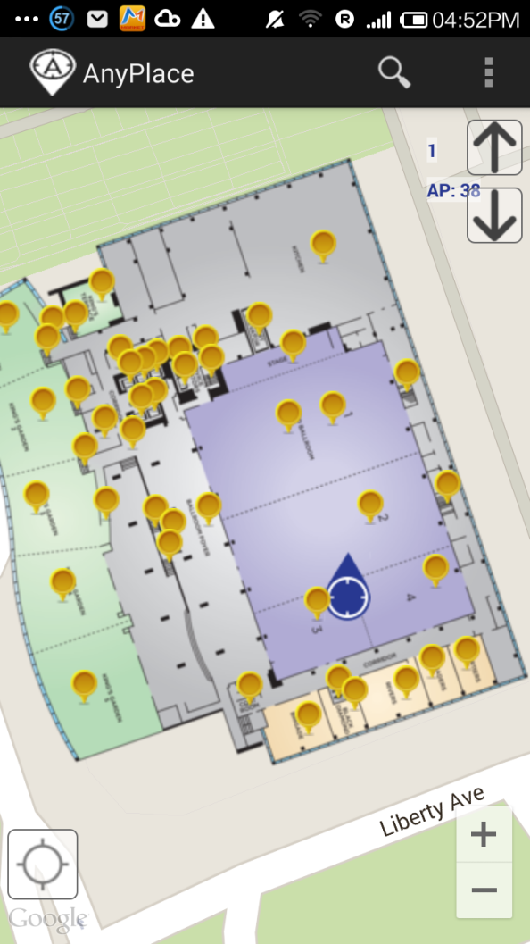
Anyplace: Before & After
Before ☹
(using Google API Location)
After ☺
(using Anyplace Location & Indoor Models)

Slide 13
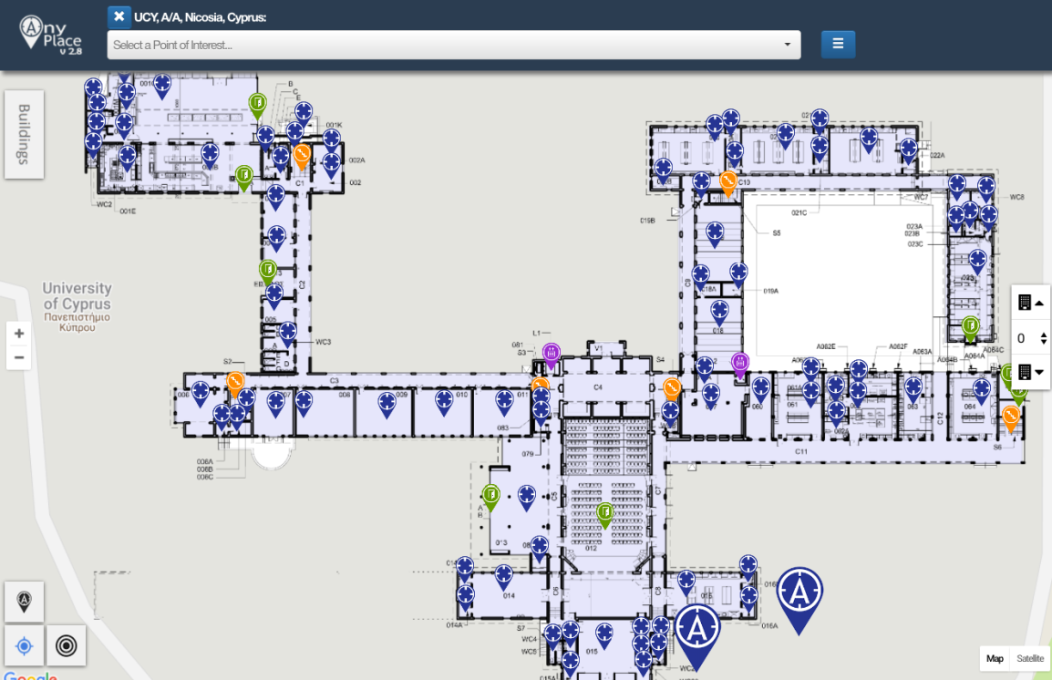
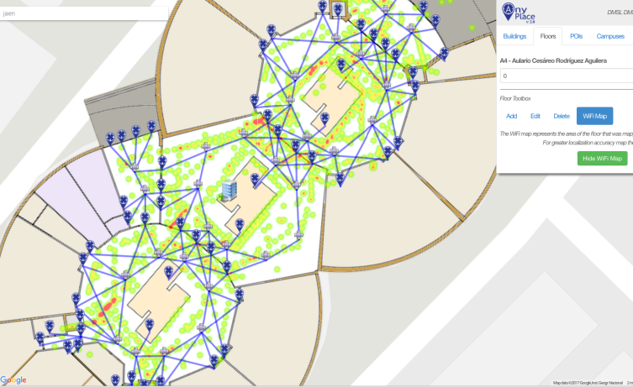
Anyplace (Building) Showcases
Campus @ Univ. of Cyprus
  60 Buildings mapped, Thousands of POIs
Campus @ Univ. of Jaen (Spain) - 9 buildings
Library @ Univ. of Mannheim (Germany) - Westflügel
Example:
Video:
https://goo.gl/4Z43Cv
https://youtu.be/8m-C2fx8prM?t=66
Video:
https://youtu.be/uMFnxXnm1yc?t=17

Slide 14
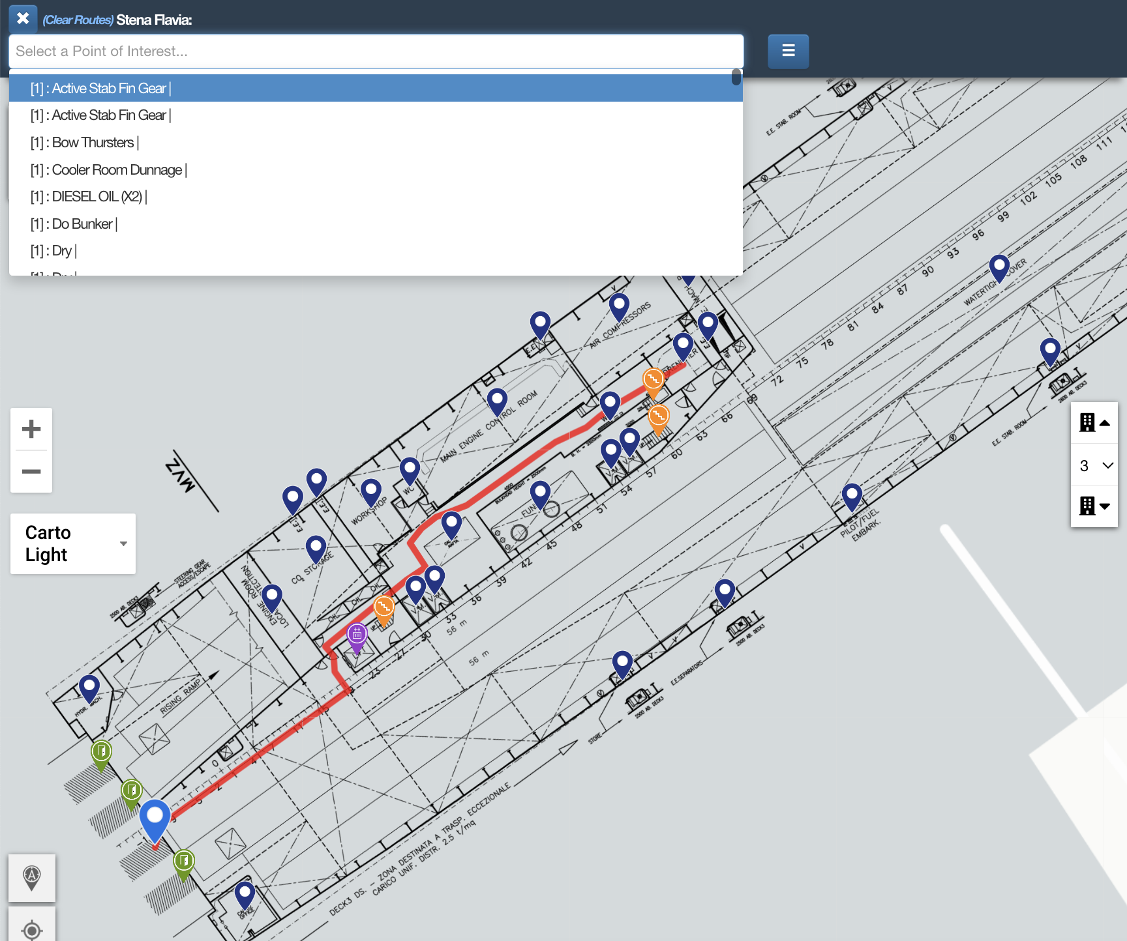
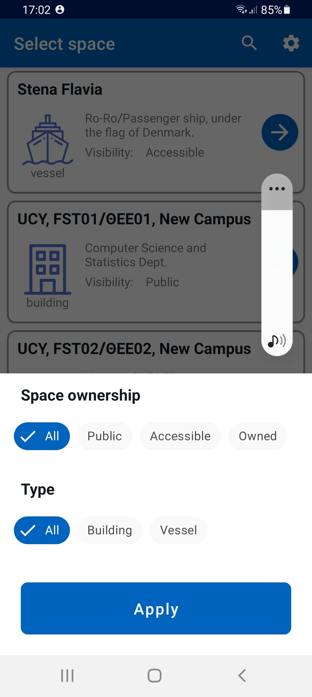
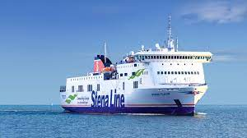
Anyplace (Vessel) Showcases
https://anyplace.cs.ucy.ac.cy/viewer/?cuid=lashfire

Slide 15
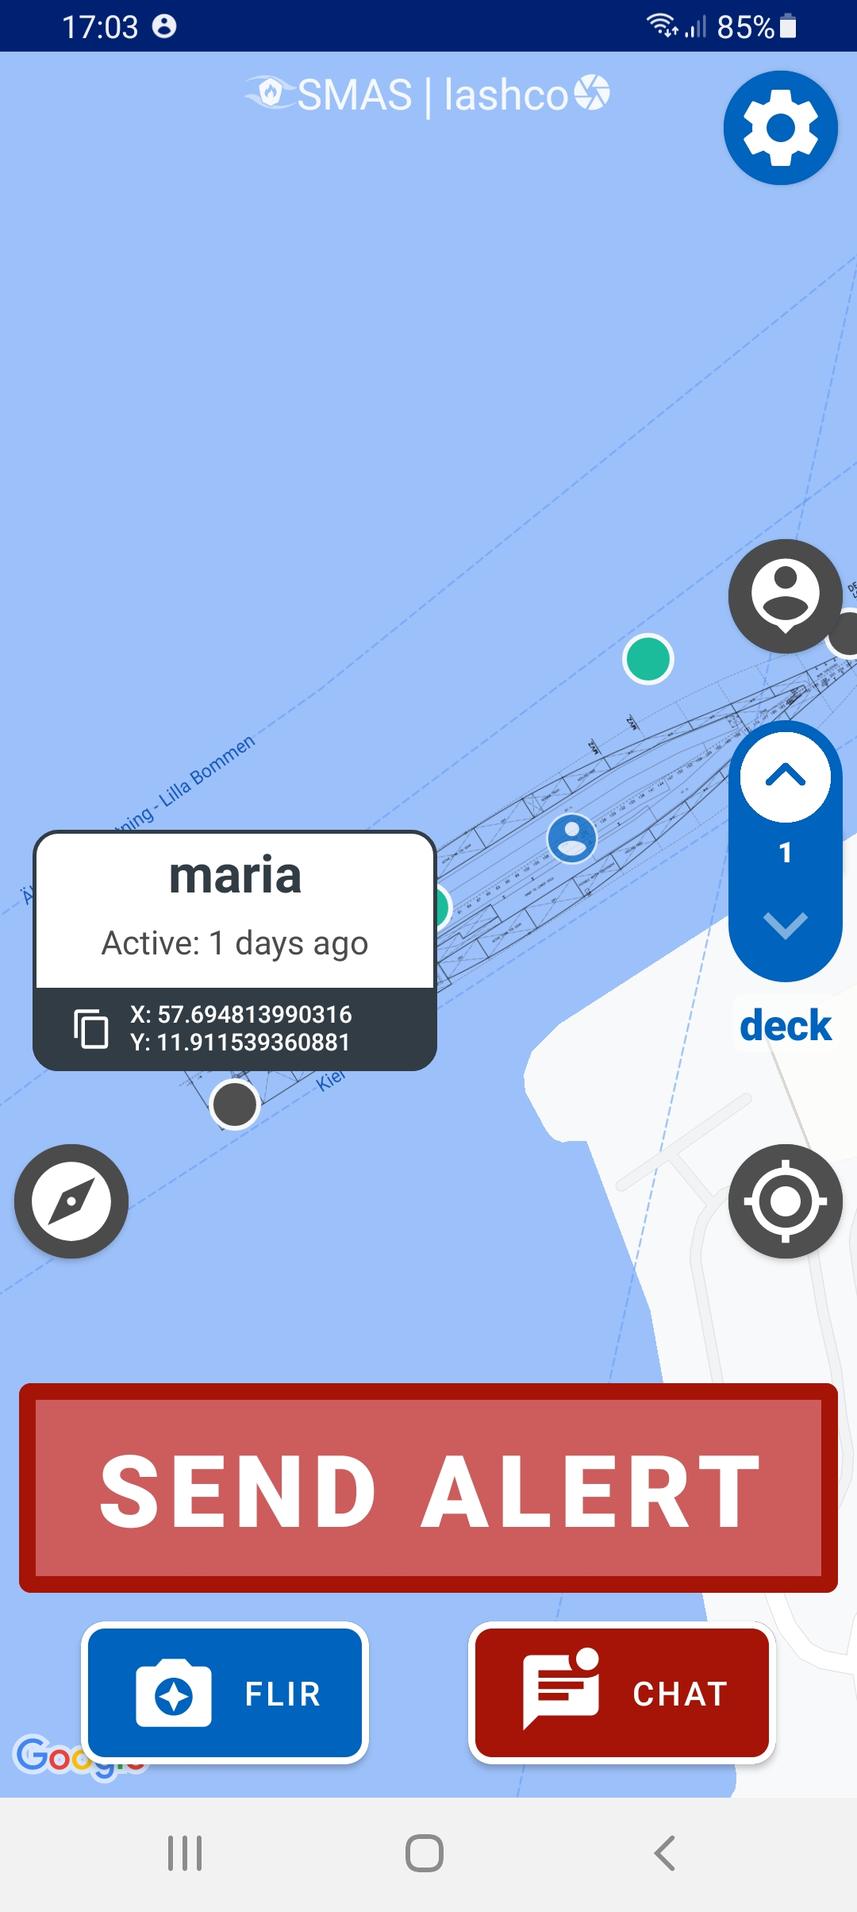
Smart Alert System (SMAS)
A mobile app for First Responders implementing “Zero Infrastructure” + Offline localization system.
  ➔ requires no localization infrastructure
  ➔ requires no network
  requires no video transfer
  ➔ only on-device computation
If network is available, then also supports chat and alert.
  Edge server on-premise (vessel)

Slide 16
Zero Infrastructure Localization in SMAS
ML Training: vessel owners provide video footage that we annotate and process on deep learning server – called training
  Once per vessel (family)
Logging: technology providers or vessel owners walk around collecting objects using mobile app – called fingerprinting
  Once per vessel
Localization: users use a mission-critical app to localize, geo-chat, geo-share data

Slide 17
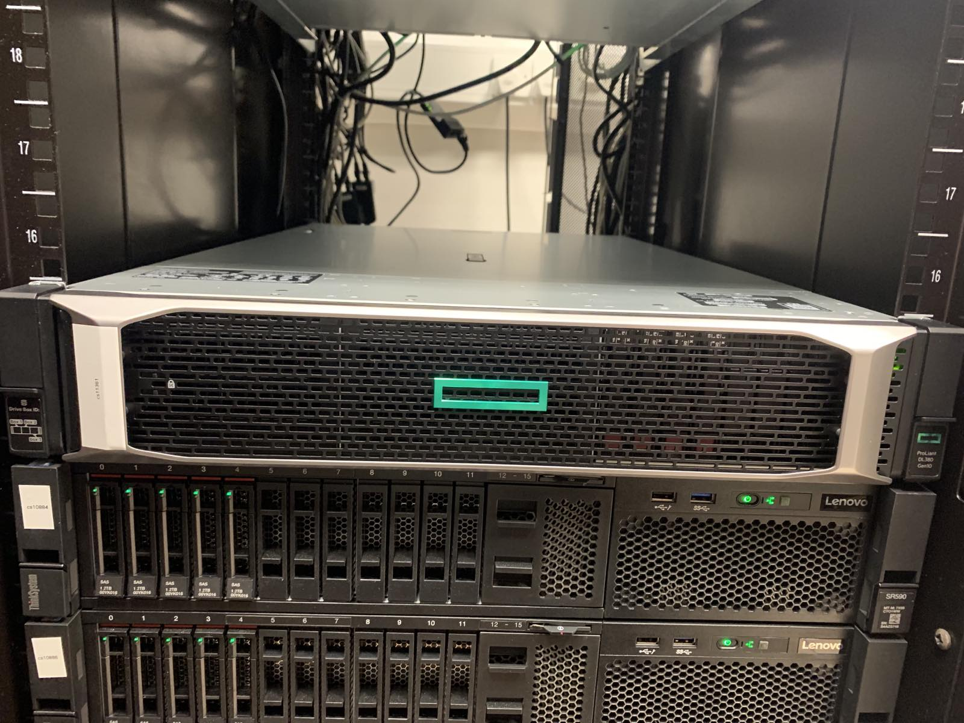
ML Training
Purpose: Train a Machine Learning model to recognize objects using Computer Vision and Deep Learning.
Computer Vision Annotation Tool (CVAT)
  a free, open source, web-based image and video annotation tool by Intel
  HP DL380 Gen10 with 80 logical processors and a powerful NVIDIA V100 card.
  Initial training on Google’s Colab.

Slide 18
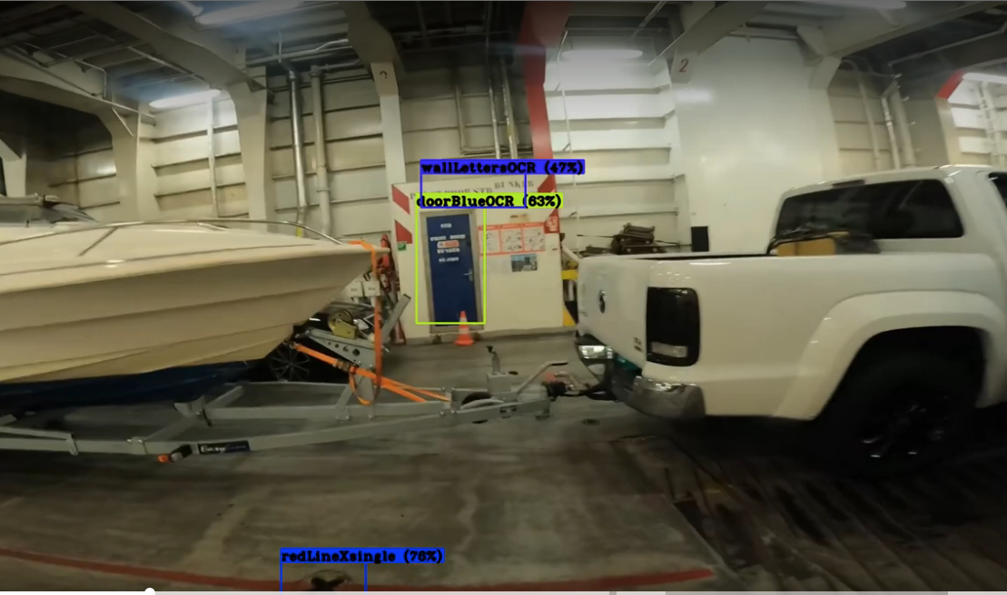
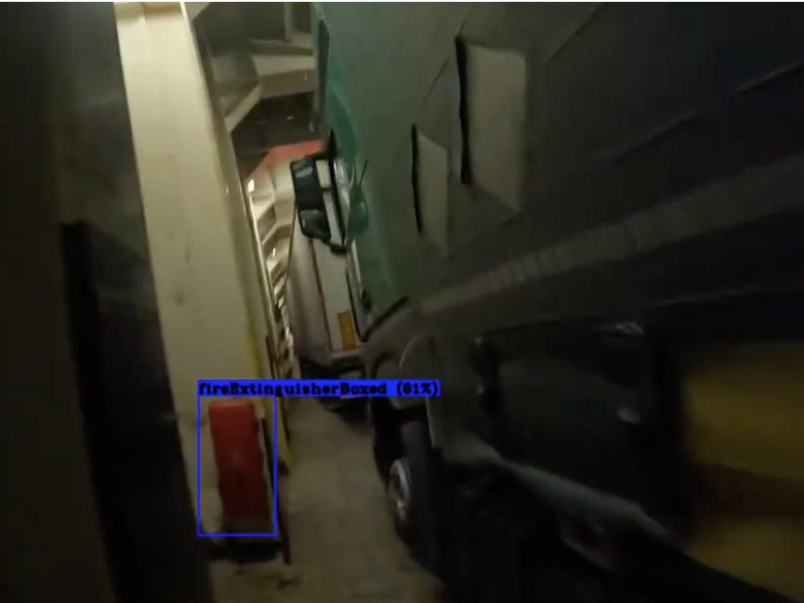
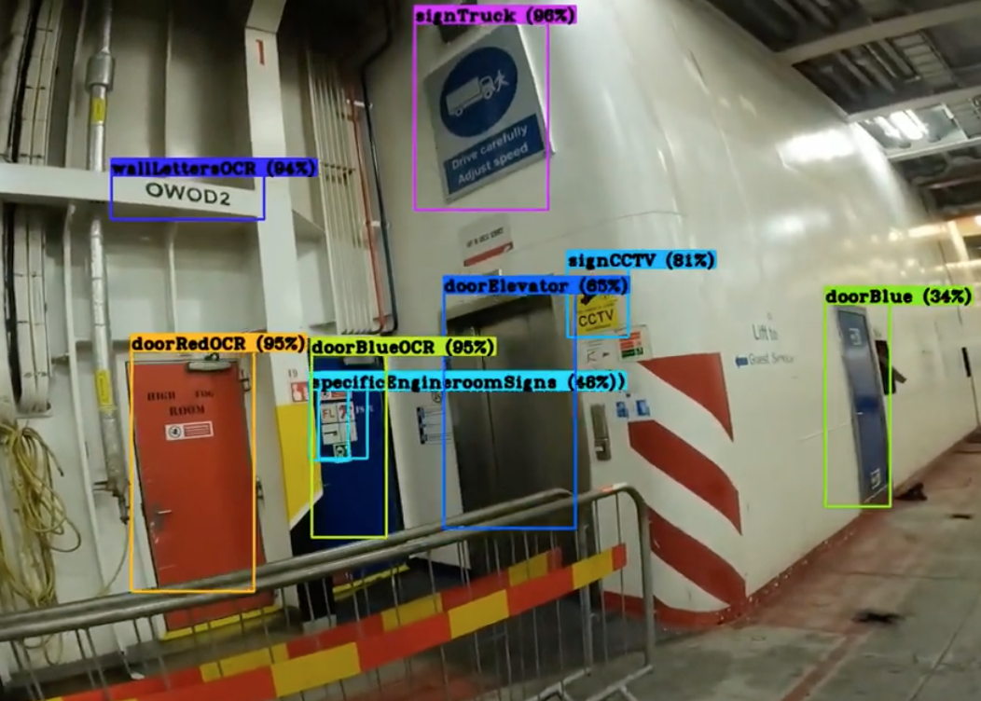
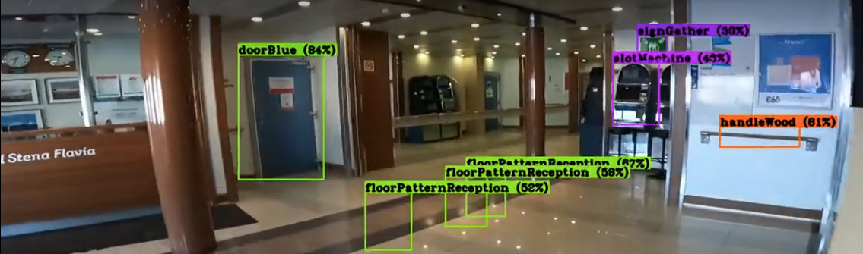
ML Training
VIDEOS
LASHCO: mid-scale object detection, segmentation and captioning dataset for a commercial vessel.
  99 classes, 24MB.
  deck patterns, bulkhead patterns, hoses, fixed installations, signs, control buttons …
Used Tensorflow Lite with 16-bit quantization on smartphone.
Used COCO (Common Objects in Context) and UCYCO (dept) for testing.
2:24
7:18

Slide 19
Training Videos

Slide 20
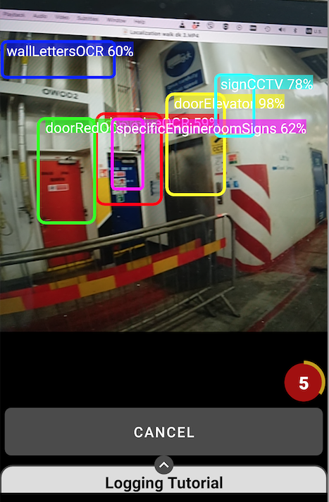
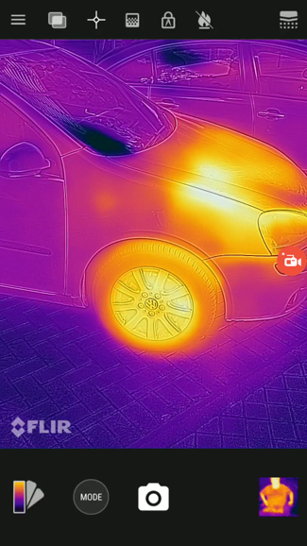
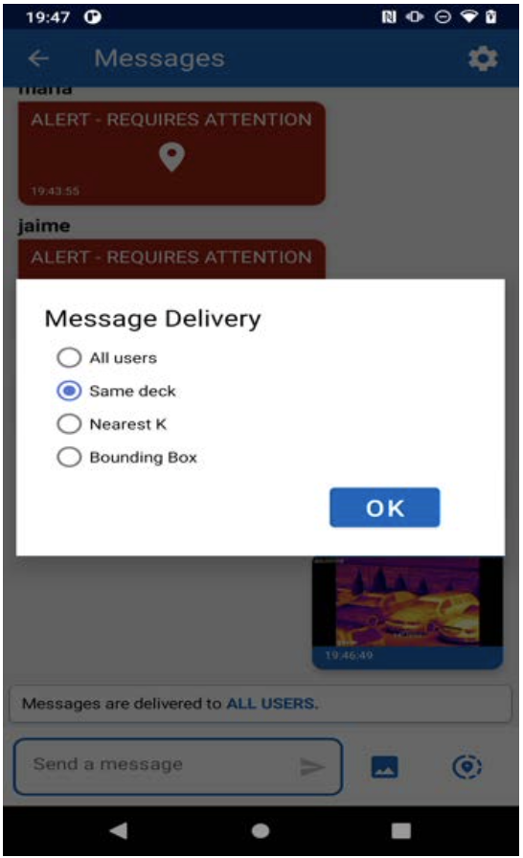
Logging & Localization
Logger
Localize
Heat Scan & Geo-Chat

Slide 21
Outline
Introduction
Background & Related Work
Surface Algorithm
Experimental Evaluation
Conclusions and Future Work
Related Problems (Older Work)

Slide 22
Surface Algorithm
Surface: Our data-driven localization algorithm using Computer Vision (CV).
Problem: How to rank objects in a way that the correct location is estimated?
Additional Challenges:
  How to filter out the proximity of similar fingerprints?
  How important objects can be ranked higher?
  How to support tracking (Continuous Localization)?
  How to reduce the quadratic lookup cost?
Fingerprint Database (FDB)
Record:
[x,y,deck,{drencher, charger, door}]
Query: Where am I?
I see the below objects …
{drencher, door}

Slide 23
Surface Algorithm
Surface (Data Management) Concepts
  Multiset Subtraction
  Spatial Partitioning of Fingerprints
  C) Global Partitioned Frequency Counting
  D) Bounding Box Filtering of Fingerprints
We devise two Surface variants:
  Surface Global (SG): used on first use without prior location (localization) – use ABC
  Surface Local (SL): used on subsequent localizations (tracking) – use ABCD

Slide 24
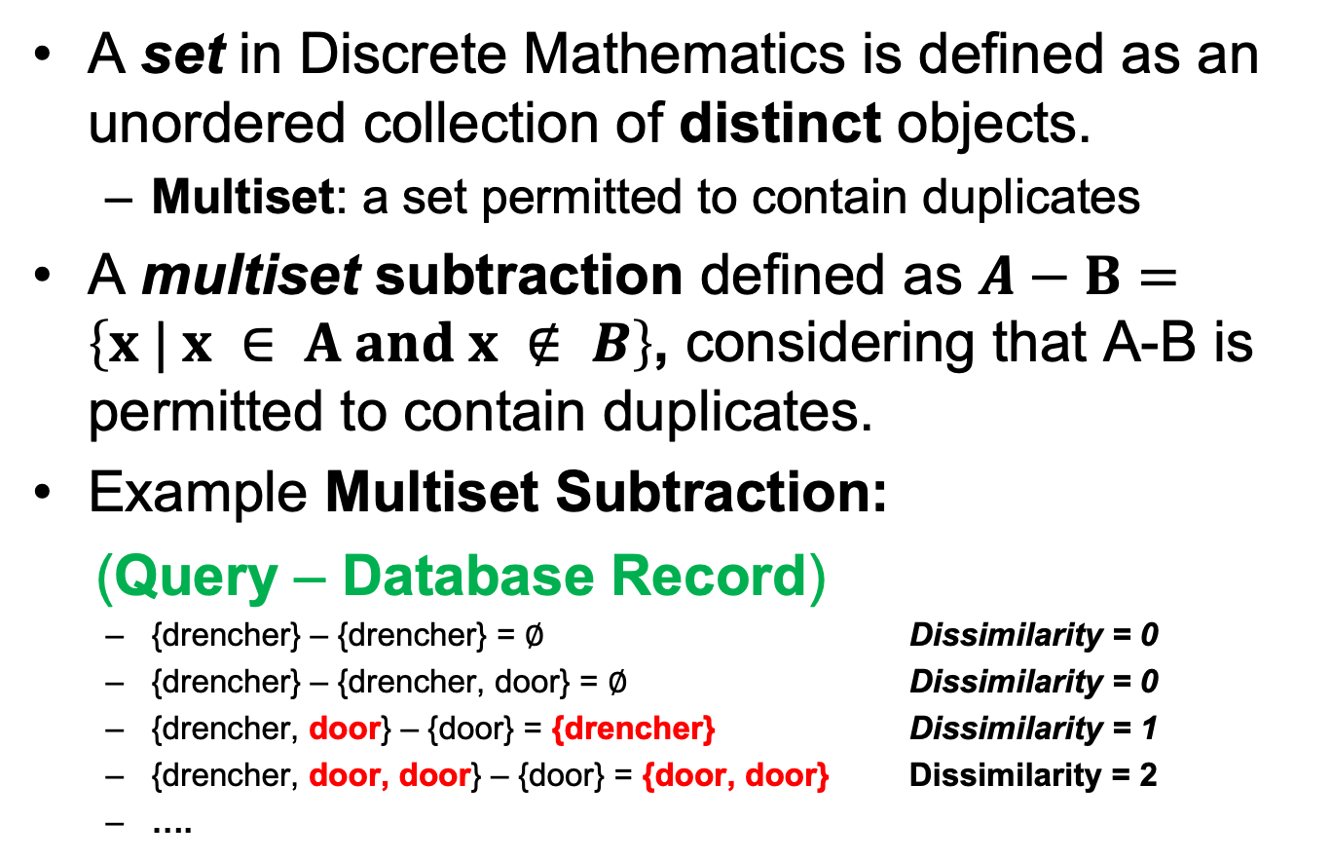
A) Multiset Subtraction
A set in Discrete Mathematics is defined as an unordered collection of distinct objects.
  Multiset: a set permitted to contain duplicates
A multiset subtraction defined as $A−B=\left\{x | x ∈ A and x ∉ B\right\}$, considering that A-B is permitted to contain duplicates.
Example Multiset Subtraction:
(Query – Database Record)
  {drencher} – {drencher} = ∅ Dissimilarity = 0
  {drencher} – {drencher, door} = ∅ Dissimilarity = 0
  {drencher, door} – {door} = {drencher} Dissimilarity = 1
  {drencher, door, door} – {door} = {door, door} Dissimilarity = 2
  ….
A-B
A
B

Slide 25
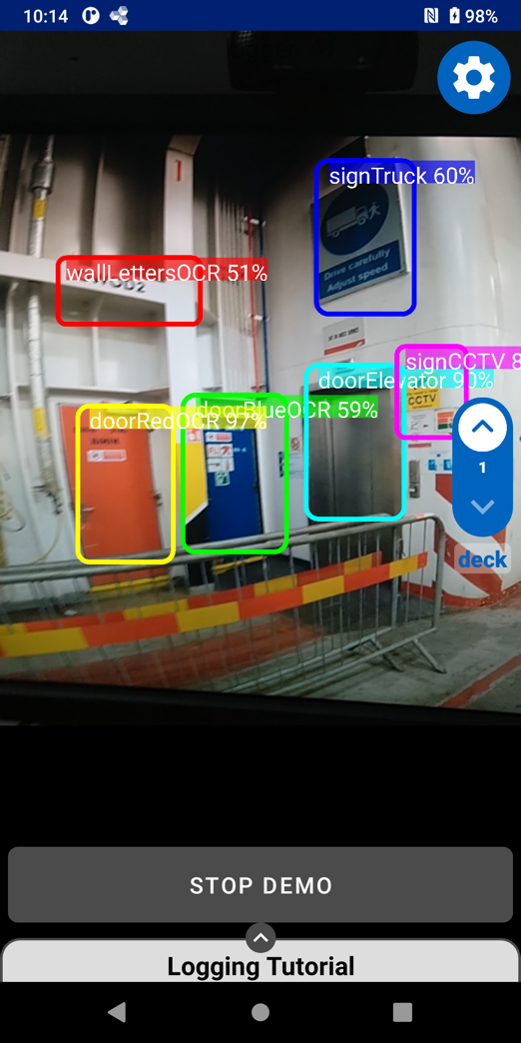
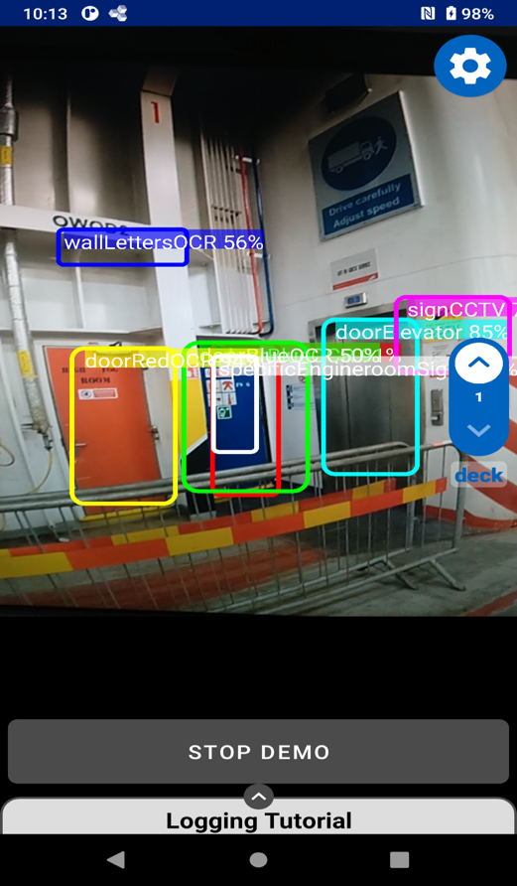
A) Multiset Subtraction
-
Dissimilarity is 1 (signTruck not found)

Slide 26
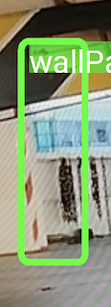
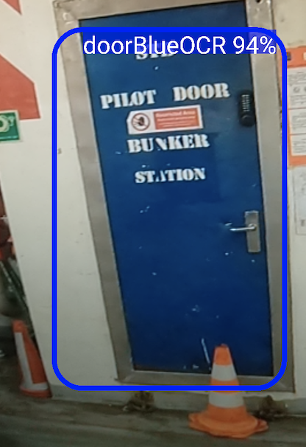
B) Spatial Partitioning (SP) of Fingerprints
Problem:
  Many fingerprints are close by.
Why:
  Consecutive logging in same area.
Solution:
  Partition Fingerprints based on location into the OBJECT_FREQ view.

Slide 27
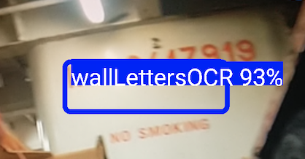
C) Global Partitioned Frequency Counting (GPFC)
Rare Objects => Good Location Indicators
  e.g., wallLettersOCR is always at very specific location => should be used as location estimate
Problem:
  Counting object frequencies globally is not correct, as an object might have been captured at the same location many times.
e.g.,
Solution:
  Build cluster-based histogram
  (OBJECT_COUNT)
  Normalize this into a global
  OBJECT_FREQUENCY
15
30
11
1
3
5

Slide 28
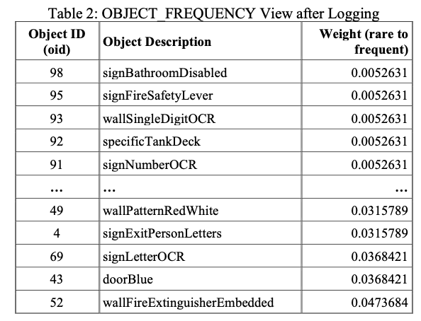
B-C) GPFC+SP Results
During Logging (see evaluation later), we populate the OBJECT_FREQUENCY views that are used by the ranking algorithms to rank higher infrequent objects.
rare
frequent

Slide 29
D) Bounding Rectangle Filtering of Fingerprints
During Localization, steps (a-c) sufficiently provide a global ranking of fingerprints to identify the best location estimate.
Problem:
  How to exploit the prior location during tracking?
Solution:
  Limit the ranking process within a bounding rectangle around the prior result.

Slide 30
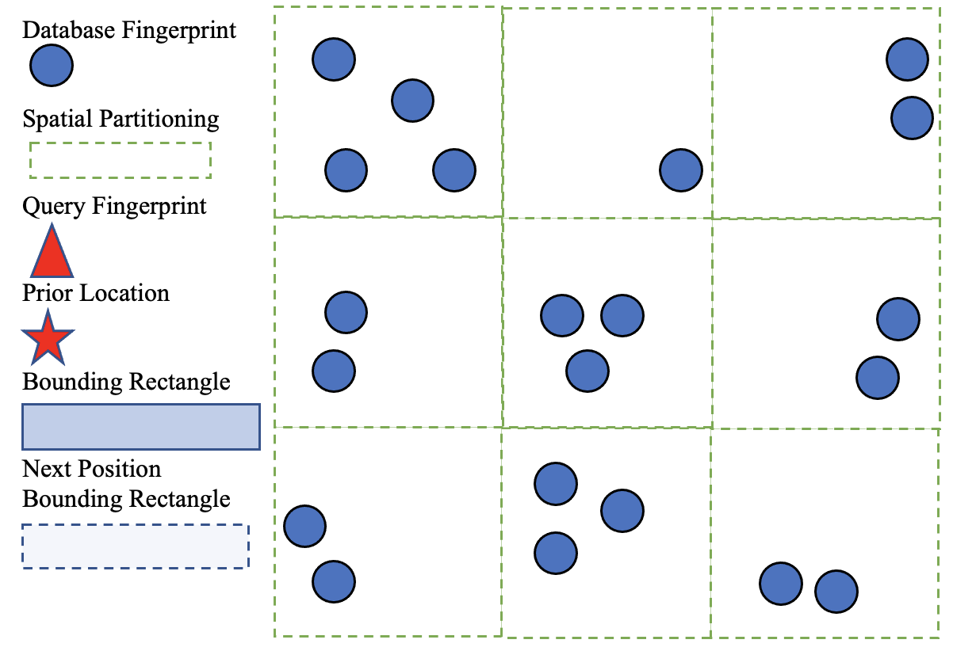
D) Bounding Rectangle Filtering of Fingerprints
SG Location

Slide 31
Outline
Introduction
Background & Related Work
Surface Algorithm
Experimental Evaluation
Conclusions and Future Work
Related Problems (Older Work)

Slide 32
Experimental Evaluation
We carried out two studies
  Remote Study: using video traces from a commercial ro-ro operator part of the project
  On-board Study: on a commercial line between 2 European cities with 26 first responders participating (August 2022).
We report the detailed results of the “Remote Study”
  On-board study results verify the remote study result in a real environment.
  Detailed paper to be published soon

Slide 33


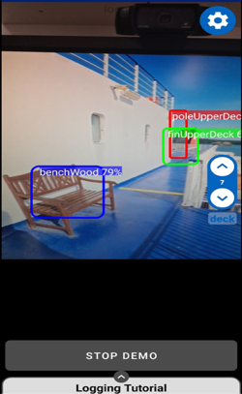
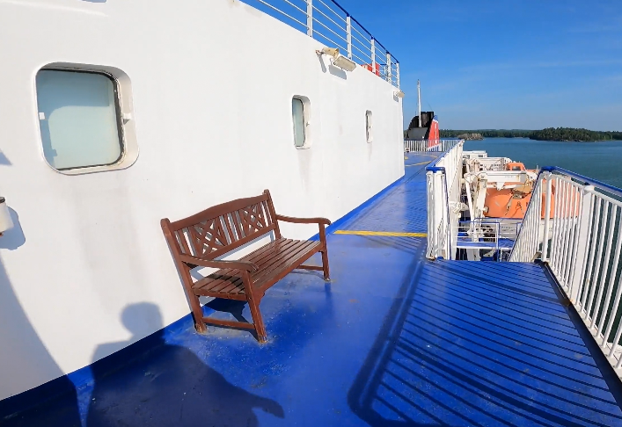

Remote Study
SMAS
Video casting
LED Reflection, Lighting Conditions
Onboard study shows even better object recognition
Expert

Slide 34








Onboard Study
future

Slide 35

Dataset
  Videos: 14 videos, 11GB, 800 MB / file
  Time: 1 hour and 30 minutes
  Areas: Closed ro-ro, Weather deck, PAX public areas, Cabin areas
  ~50% of videos used in training

Slide 36





1) Logging Screenshots
Google’s ML kit on-device Optical Character Recognition (OCR) library (available in multiple languages) can refine an object recognition. For example, for the last figure it reads “STB PILOT DOOR BUNKER TTION”

Slide 37


1) Logging: Results
Purpose: Observe the effort necessary to boostrap the localization system.
Metric: Time (wall clock)
Deck 5: about 2 hours!
Onboard study showed that we logged 2.5x more objects in same time!
A total of 460 objects were collected and organized in the surface geodb.
Our stress-testing (see next) pushes performance evaluation to 50K objects!

Slide 38





Logging Heatmaps
heatmaps show object collection
Estimations
(based on onboard study)
Logging 7 decks: 16-20 hours Objects 7 decks: 11K objects
Vessel Characteristics
Length overall (LOA): 186.42
Width: 25.6 meters.
Gross Tonnage: 26904
Draught: 6.4m
Notes:
480 x 2.5 x factor 9

Slide 39



2) Localization: Setup
Purpose: Find how accurate the Surface Global (SG) localization algorithm is.
Metric: Accuracy (A)
  n = 10 repetitions
  Expert judging if returned location within 10 meters from Correct
Scenes: 15 scenes (S1-S15) to capture variety of conditions in Closed ro-ro, Weather deck, PAX public areas, Cabin areas

Slide 40




2) Localization: Results
SG Average Localization Accuracy (A): 80%!
Additional Training necessary:
  S04 (walking between trucks)
  S09 (walking with left wall)
  S15 (cabin rooms)

Slide 41


3) Tracking: Setup
Purpose: Find how accurate the Surface Local (SL) localization algorithm is.
Metric: Accuracy (A)
Trajectories:
  T1: Video from Closed ro-ro
  T2: Video from Public PAX
VIDEOS
T1
T2

Slide 42
T1 Tracking Scenario

Slide 43
T2 Tracking Scenario

Slide 44



3) Tracking: Results
SL Average Localization Accuracy (A):
A=88%!
A=92%!
Building error. Error cleared when reaching hotspot.
Bootstrap
Missing
objects

Slide 45

4) Scalability: Setup & Result
Purpose: Find how Surface (SL & SG) Algorithm perform when the number of objects increases
  Metric: Time (wall clock)
  Dataset: Synthetic dataset with random objects uniformly distributed in OID ranges.
Remarks
Remote Study had only 0.5K objects => times were negligible
All times were within critical path of object capturing delay:
  Cat S61: 400-500ms
  Cat S62: 200-300ms
Linear increase of latency with object increase.
linear

Slide 46


5) Low Light Example
Torch OFF
Torch ON

Slide 47
Outline
Introduction
Background & Related Work
Surface Algorithm
Experimental Evaluation
Conclusions and Future Work
Related Problems (Older Work)

Slide 48
Conclusions
Data-driven localization with Computer Vision paves a new way in the localization domain.
Zero-infrastructure localization developments can impact the complete identification-tracking-positioning cycle on vessels:
  live fire detection and localization
  live monitoring and tactical support
  monitoring of cargo, quality control and optimization of cargo load and distribution

Slide 49

Future Work
Additional Field Studies
  Retraining Models (light, angles)
  Battery Efficiency (36% for 3.5 hour logging)
Hybridization of Surface Algorithm
  Currently IMU is a separate system but we aim to fuse the signals by the means of a particle filter.
Match Matching (to graph)
  To offer smoother tracking
OCR Inclusion in Ranking

Slide 50
Outline
Introduction
Background & Related Work
Surface Algorithm
Experimental Evaluation
Conclusions and Future Work
Related Problems (Older Work)

Slide 51

Anyplace History
  [Airplace] Best Demo Award at IEEE MDM'12, Bangalore, India. (Open Source!)
  [HybridCywee] "Indoor Geolocation on Multi-Sensor Smartphones", C.-L. Li, C. Laoudias, G. Larkou, Y.-K. Tsai, D. Zeinalipour-Yazti and C. G. Panayiotou, in ACM Mobisys'13, Tapei, Taiwan. Video at: http://youtu.be/DyvQLSuI00I
  [UcyCywee] IPSN’14 Indoor Localization Competition (Microsoft Research), Berlin, Germany, April 13-14, 2014. 2nd Position with 1.96m! http://youtu.be/gQBSRw6qGn4
    D. Lymberopoulos, J. Liu, X. Yang, R. R. Choudhury, ..., C. Laoudias, D. Zeinalipour-Yazti, Y.-K. Tsai, and et. al., “A realistic evaluation and comparison of indoor location technologies: Experiences and lessons learned”, In IEEE/ACM IPSN, pp. 178-189, Seattle, WA, USA, April 14-16, 2015.
  1st Position at EVARILOS Open Challenge, European Union (TU Berlin, Germany), 2014.
  [ACCES] Honorable Mention Award at IEEE MDM'17, S.Korea, Indoor Localization Accuracy Estimation
Localization
Cywee / Airplace

Slide 52

Anyplace Open Maps
Until relese 3.4
~200,000 user sessions
~70,000 users visited
~2,000 mapping attempts
229 forks, 500 stars on Github
http://anyplace.cs.ucy.ac.cy/

Slide 53



Anyplace Releases 3.5-4.0
Localization Accuracy Improvement
IoT Monitoring Integration (geofencing, monitoring, etc.)
Spatio-temporal database integration
Containerization with Docker
Many bug fixes, engagement of more community partners in the development process
[C81] "The Anyplace 4.0 IoT Localization Architecture", Paschalis Mpeis, Thierry Roussel, Manish Kumar, Constantinos Costa, Christos Laoudias, Denis Capot-Ray, Demetrios Zeinalipour-Yazti, Proceedings of the 21st IEEE International Conference on Mobile Data Management (MDM'20), IEEE Computer Society, ISBN:, pp. 218-225, June 30 - July 3, 2020, Versailles, France, DOI: 10.1109/MDM48529.2020.00045, 2020.

Slide 54

Fingerprint Management Studio
[C72] "FMS: Managing Crowdsourced Indoor Signals with the Fingerprint Management Studio", Marileni Angelidou, Constantinos Costa, Artyom Nikitin and Demetrios Zeinalipour-Yazti, Proceedings of the 19th IEEE International Conference on Mobile Data Management (MDM'18), IEEE Computer Society, ISBN: 978-1-5386-4133-0, pp. 288--289, June 25 - June 28, 2018, AAU, Aalborg, Denmark, DOI: 10.1109/MDM.2018.00054, 2018. [ Best Demo Award! ]
[J26] "Indoor Quality-of-Position Visual Assessment using Crowdsourced Fingerprint Maps", Christos Laoudias, Artyom Nikitin, Panagiotis Karras, Moustafa Youssef, Demetrios Zeinalipour-Yazti, ACM Transactions on Spatial Algorithms and Systems (TSAS'21), Association for Computing Machinery, Vol. 7, Iss. 2, New York, NY, USA, DOI: 10.1145/3433026, 2021.

Slide 55



WiFi Fingerprinting in Anyplace
Localization
Logger
IIN Service
a) Upload Measurements
b) Build RM (Radiomap)
c) Localize
Navigator

Slide 56


Wi-Fi Fingerprinting
Mapping Area with WiFi Fingerprints
  n APs deployed in the area
  Fingerprints r_{i} = [ r_{i1}, r_{i2}, …, r_{in}]
  M repetitions + averaging:
Localization
Automation with robots

Slide 57

Logging in Anyplace
Video
Localization
"Anyplace: A Crowdsourced Indoor Information Service", Kyriakos Georgiou, Timotheos Constambeys, Christos Laoudias, Lambros Petrou, Georgios Chatzimilioudis and Demetrios Zeinalipour-Yazti, Proceedings of the 16th IEEE International Conference on Mobile Data Management (MDM '15), IEEE Press, Volume 2, Pages: 291-294, 2015

Slide 58

Wi-Fi Positioning
Positioning with WiFi Fingerprint
  Collect Fingerprint s = [ s₁, s₂, …, s_{n}]
  Compute distance || r_{i} - s || and position user at:
    Nearest Neighbor (NN)
    K Nearest Neighbors (w_{i} = 1 / K) [convex combination of k loc]
    Weighted K Nearest Neighbors (w_{i} = 1 / || r_{i} - s || )
Localization
RadioMap
s = [ -70, -51]
r₁ = [ -71, -82, (x₁,y₁)]
r₂ = [ -65, -80, (x₂,y₂)]
…
r_{M’} = [ -73, -44, (x_{M’},y_{M’})]
NN, KNN, WKNN

Slide 59

Anyplace Navigation
Video
Localization
"Anyplace: A Crowdsourced Indoor Information Service", Kyriakos Georgiou, Timotheos Constambeys, Christos Laoudias, Lambros Petrou, Georgios Chatzimilioudis and Demetrios Zeinalipour-Yazti, Proceedings of the 16th IEEE International Conference on Mobile Data Management (MDM'15), IEEE Press, Vol. 2, pp. 291-294, DOI: 978-1-4799-9972-9/15, 2015.
"The Anyplace 4.0 IoT Localization Architecture", Paschalis Mpeis, Thierry Roussel, Manish Kumar, Constantinos Costa, Christos Laoudias, Denis Capot-Ray, Demetrios Zeinalipour-Yazti, Proceedings of the 21st IEEE International Conference on Mobile Data Management (MDM'20), IEEE Computer Society, ISBN:, pp. 218-225, June 30 - July 3, 2020, Versailles, France, DOI: 10.1109/MDM48529.2020.00045, 2020.

Slide 60




Location Privacy
Privacy
I can see these Reference Points, where am I?
...
(x,y)!
IIN Service
User u
Towards planet-scale localization on smartphones with a partial radiomap", A. Konstantinidis, G. Chatzimilioudis, C. Laoudias, S. Nicolaou and D. Zeinalipour-Yazti. In ACM HotPlanet'12, in conjunction with ACM MobiSys '12, ACM, Pages: 9--14, 2012.
Privacy-Preserving Indoor Localization on Smartphones, A. Konstantinidis, G. Chatzimilioudis, D. Zeinalipour-Yazti, P. Mpeis, N. Pelekis, Y. Theodoridis, in IEEE TKDE’15.

Slide 61


Temporal Vector Map (TVM)
Privacy
Bloom Filter (u's APs)
WiFi
Set Membership Queries
WiFi
...
IIN Service
K=3 Positions
User u
WiFi

Slide 62

TVM – Bloom Filters
Bloom filters – basic idea:
  allocate a vector of b bits, initially all set to 0
  use h independent hash functions to hash every Access Point seen by a user to the vector.
The IIN Service selects any RadioMap row that has an AP belonging to the query bloom filter and send it to the user.
Privacy
AP2
AP13
AP2
AP13
0 | 1 | 0 | 0 | 1 | 0 | 0 | 1 | 0 | 0
b

Slide 63
TVM – Bloom Filters
Privacy
The most significant feature of Bloom filters is that there is a clear tradeoff between b and the probability of a false positive.
  Small b: Too many false positives (too much hiding & cost)
  Large b: “No” false positives (no hiding & no cost)
Given h optimal hash functions, b bits for the Bloom filter, M the cardinality of the Access Point set we can estimate the amount of false positives produced by the Bloom filter:
  False Positive Ratio:
  Objective:
  Solving the above for b:
Sound under a passive attacker model

Slide 64


TVM Continuous
Privacy
Camouflage trajectories
IIN determines u’s location by exclusion
TVM Continuous
Fingerprints: V₁, V₂, V₃. V_{X}=[AP₁:val, AP₂:val, …AP_{m}:val]
As client moves to V₁:Ap_{k}, it evolves V₂ and V₃: choose V₂:Ap_{x} and V₃:Ap_{y} that have the least distance to V₁:Ap_{k} or aborts.
Notes:
Resilient to Homogeneity Attack (used in probabilistic privacy schemes … l-diversity, T-closeness and e-differential privacy) given that we use hashing that provides a uniform distribution of collisions.
Resilitent to Linking Attack (Sweeney): the attack where a person can still be identified by the so-called quasi-identifiers (non-sensitive and non-unique data) even though the keys are removed. y. In our case, the uniquely identifying attribute is the fingerprint of a user location. In fact, this is also the only attribute sent by the user to the server, therefore there are no other attributes that could link to the user’s fingerprint value.

Slide 65


Data Hoarding Challenge
Hoarding
Problem: Wi-Fi coverage might be irregularly available inside buildings due to poor WLAN planning or due to budget constraints.
A user walking inside a Mall in Cyprus
  Whenever the user enters a store the RSSI indicator falls below a connectivity threshold -85dBm. (-30dbM to -90dbM)
  When disconnected IIN can’t offer navigation anymore ☹
"Radiomap Prefetching for Indoor Navigation in Intermittently Connected Wi-Fi Networks", Andreas Konstantinidis, George Nikolaides, Georgios Chatzimilioudis, Giannis Evagorou, Demetrios Zeinalipour-Yazti and Panos K. Chrysanthis, Proceedings of the 16th IEEE International Conference on Mobile Data Management (MDM'15), IEEE Press, Vol.1, pp. 34-43, Pittsburgh, PA, USA, 2015.
"IoT Data Prefetching in Indoor Navigation SOAs", Andreas Konstantinidis, Panagiotis Irakleous, Zacharias Georgiou, Demetrios Zeinalipour-Yazti and Panos K. Chrysanthis, ACM Transactions on Internet Technology (TOIT '18), Vol. 19, Iss. 1, Article 10, pp. 21 pages, 2018.

Slide 66



Data Hoarding Challenge
Hoarding
IIN Service
Where-am-I?
No Navigation
Where-am-I?
X
Where-am-I?
☹ Intermittent Connectivity
Time

Slide 67

The Preloc Framework
Hoarding
IIN Service
Prefetch K RM rows
Prefetch K RM rows
X
Localize from Cache
Prefetch K RM rows
☺ Intermittent Connectivity
Time

Slide 68

PreLoc Overview
Hoarding
Preloc aims to sequence the retrieval of fingerprint clusters, such that the most important clusters are downloaded first.
Question: Which clusters should a user download at a certain position if Wi-Fi is not available next?
  PreLoc (MDM15) prioritizes the download of fingerprints using historic user traces in a Dependency Graph.
User Current Location

Slide 69
GraP (Graph Prefetching)
Hoarding
GraP is the refined Preloc framework
Challenges:
  Mobility Traces inside Buildings are hard to obtain.
  Also goes against our revised philosophy of privacy-by-design.
Solution:
  We have developed a framework that analyzes building blueprints (graphs / plots) to identify hotspots.
    createDG: introduces “horizon” to pagerank to favor nodes with low number of links but high betweenness (such as nodes that bridge two buildings or central corridors).
  These hotspots become virtual targets to an A* search algorithm we developed.
"IoT Data Prefetching in Indoor Navigation SOAs", Andreas Konstantinidis, Panagiotis Irakleous, Zacharias Georgiou, Demetrios Zeinalipour-Yazti and Panos K. Chrysanthis, ACM Transactions on Internet Technology (TOIT'18), Vol. 19, Iss. 1, Article 10, pp. 10:1-10:21, 2018.

Slide 70


GraP: Target-less A* Search
Hoarding
Multi-floor Hotspots
  Hotspots become “virtual” targets to a target-less A* prefetching (hoarding) algorithm we’ve developed.
Building Blueprint

Slide 71




MCSA ENDORSE/RESPECT Projects
ENDORSE: Safe, Efficient and Integrated Indoor Robotic Fleet for Logistic Applications in Healthcare and Commercial Spaces
  Period: 01/10/2018 - 01/10/2021
  Research Topic: Localizing with IoT Integration
RESPECT: Secure and Privacy-preserving Indoor Robotics for Healthcare Environments
  Period: 01/05/2021 – 30/04/2024
  Research Topic: Privacy Attacks in Localization
Mobile e-diagnostic

Slide 72
Data-Driven Localization with
Zero Infrastructure
Thanks! Questions?
Demetrios Zeinalipour-Yazti
University of Cyprus
dzeina@ucy.ac.cy
https://anyplace.cs.ucy.ac.cy/ https://lashfire.eu/
Colloquium at Missouri University of Science and Technology (Missouri S&T),
October 17, 2022. (online) – Host: Sanjay Madria

