Slide 1
Rayzit: An Anonymous and Dynamic Social Network Architecture
Constantinos Costa, Chrysovalantis Anastasiou, Georgios Chatzimilioudis and Demetrios Zeinalipour-Yazti
Data Management Systems Laboratory
Dept of Computer Science, University of Cyprus
The 3rd IEEE Intl. Workshop on Mobile Data Management, Mining and
Computing on Social Networks, with IEEE MDM '15,
June 15, 2015, Pittsburgh, PA, USA

Slide 2
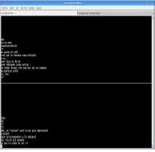
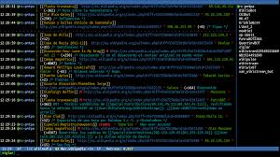
Microblogging
Microblogs are small elements of content such as short text, images, video.
Microblogging apps have played an important role in online socializing throughout the years.
Microblogging services are backed by an explicit (FB) or implicit (MSN) Social Graph.
Friends, Followers, SMS Contact list, Addressbook.
UNIX talk
SMS
IRC
MSN
Skype
Facebook
Twitter
Foursquare
Snapchat
Rayzit
‘88
‘99
‘03
‘04
‘06
‘08
‘11
‘13
‘70
‘80
‘90
‘00
‘10
‘15
Chat
Messaging
Social
Location
Forget
Anon. LBS

Slide 3
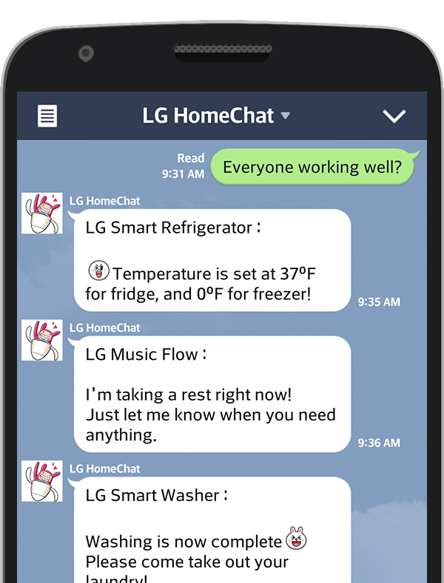
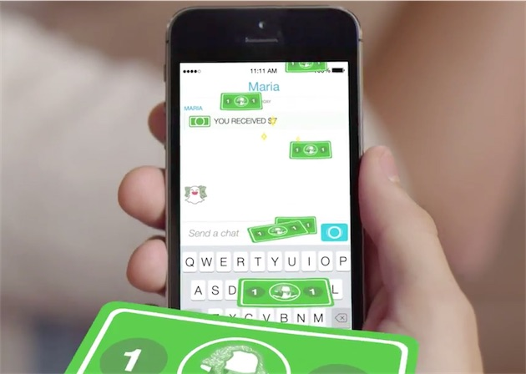
Microblogging
Chat is so popular that we will use it everywhere, e.g., smart-homes, mobile payments (order a pizza, pay for a coffee), etc.
LG
Snapcash
Viber allows sending paid stickers:

Slide 4
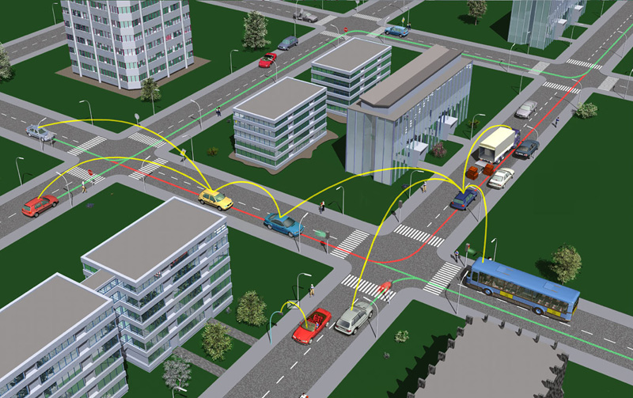
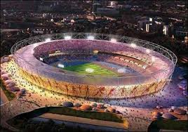
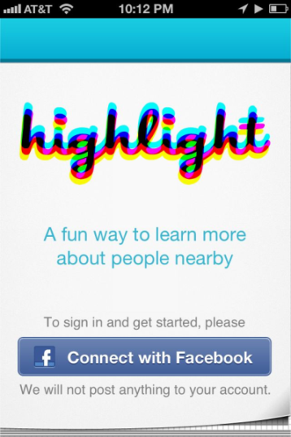
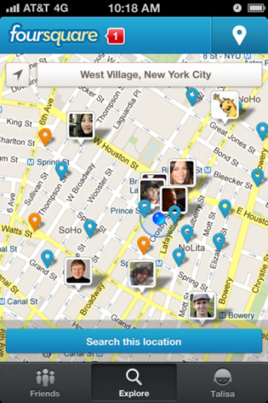
Problem 1: Lack of Proximity
Current Microblogging apps are unable to realize proximity-based applications, e.g., for:
V2V communication scenarios.
Adhoc events.
Emergency response scenarios.
Crowd around is not in your Social graph ☹

Slide 5
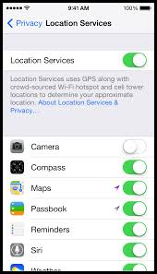
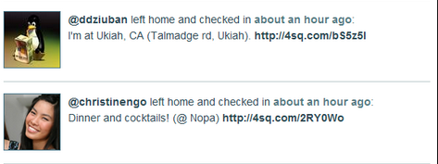
Problem 2: Location Privacy
LB apps can continuously “know” (surveil, track or monitor) the location of a user while serving them.
Which Location settings to keep on?
“Please rob me” awareness project shows the impact of location release.
Shows when users check-in somewhere that is not their home (Foursquare location updates).

Slide 6
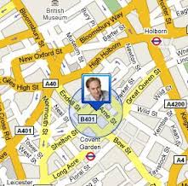
Problem 3: Boostrapping
LB apps suffer from bootstrapping issues
“Bootstrapping refers to the starting of a self-sustaining community that is supposed to proceed without external input” wikipedia
Most LB apps don’t have enough users online upfront.
This gives the impression to new users that the app is deserted.
Consequently, many people don’t use it and the app gradually dies.

Slide 7
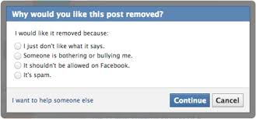
Problem 4: Cyberbulling
Social Identities* and (LB) chat apps encourage the usage of cyberbullying and retaliation.
“Cyberbullying is the use of social networks to repeatedly harm or harass other people in a deliberate manner.” wikipedia
Cyberbullying Examples: “communications that seek to intimidate, control, manipulate, put down, falsely discredit, or humiliate the recipient.” wikipedia
Social networks deploy community operation teams that attempt to correct and resolve disputes.
Won’t scale adequately.
Might be unfair
* Whispers in the dark: analysis of an anonymous social network, Wang et. al., UC Santa Barbara, in ACM IMC 2014.

Slide 8
Presentation Outline
Introduction
The Rayzit Concept
The Application
AKNN Query Engine
Architecture
Data Analysis and Evaluation
Conclusion

Slide 9
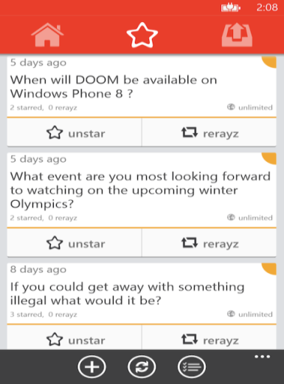
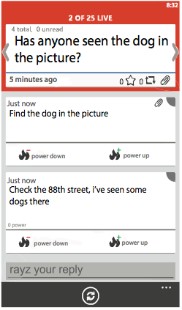
Rayzit Concept
Rayzit is a crowd messaging technology that delivers questions, inquiries and ideas to the KNN users.
Not location-based app (e.g., 5 km) but kNN-based!
Addresses: Proximity, Privacy, Bootstrapping and Cyberbullying
Rayzit was funded by the Appcampus Program (Microsoft, Nokia & Aalto, Finland).
Ranked among 5 best apps of the program from 3500 apps.
Few thousand downloads and active users after their marketing!
http://rayzit.com/

Slide 10
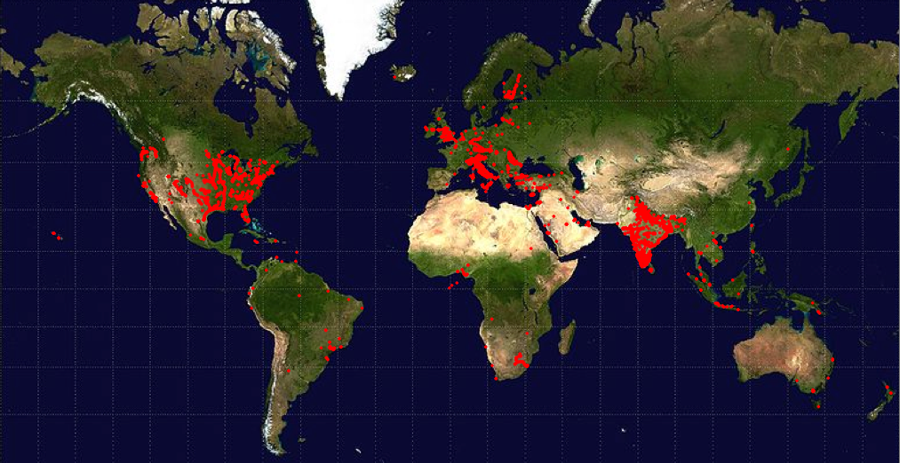
Crowd Micro-blogging
Rayzit User Map

Slide 11
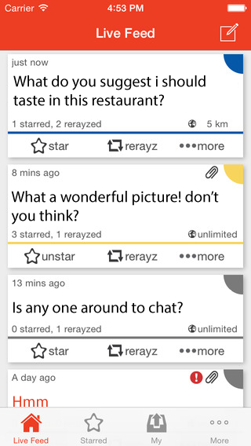
The Rayzit Application
Rayzit opens with a livefeed of messages from kNN neighbors (no login required / R17+)
A user can then:
Star Rayz (continue to follow after leaving a neighborhood)
Re Rayz (sent at new location)
Remove Rayz (Hide It)
Power + or – (help future filters)
Report Rayz (automated community management technique: >3 reports and >30% of responses deletes rayz)

Slide 12
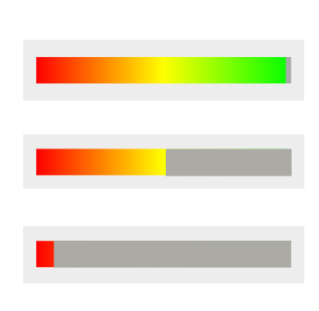
The Rayzit Application
A user can post a new Rayz (text, audio, video – shown as attachment).
To minimize spamming, each user has a powerbar that decreases on every action:
Rayz, reply, re-rayz, power+/-
When empty no more actions are possible until it gradually reloads.
To reload faster, we provide the incentive to provide useful answers that will be starred by others.
A message can be bounded to a certain distance (kNN is default)
0.5, 5, 50, 500, 5000 km

Slide 13
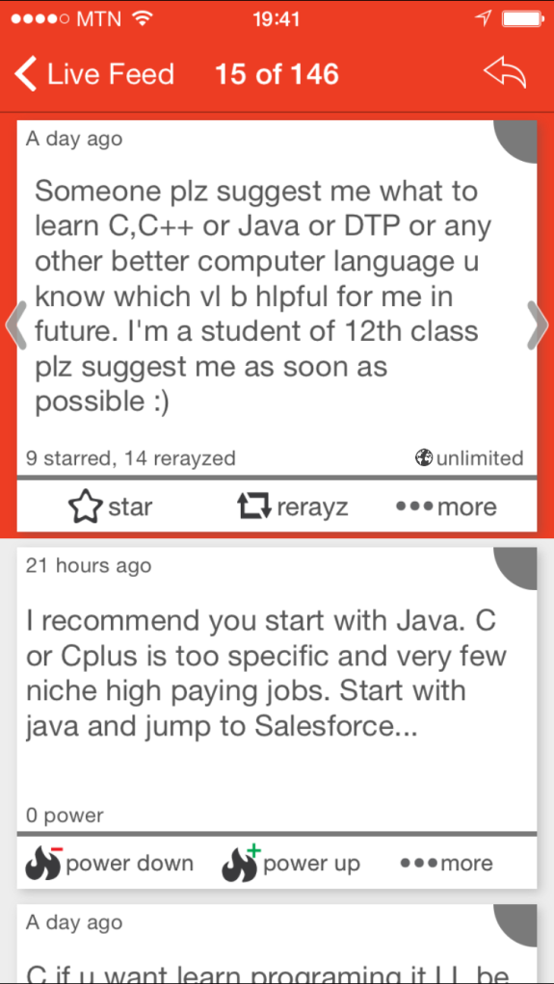
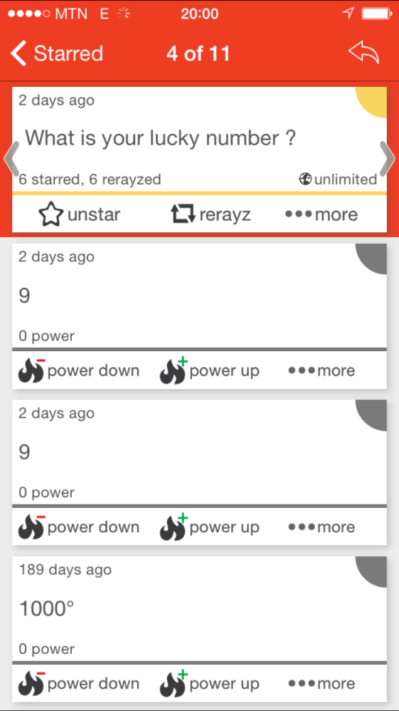
Example Conversations
General Advice & Crowd Casting

Slide 14
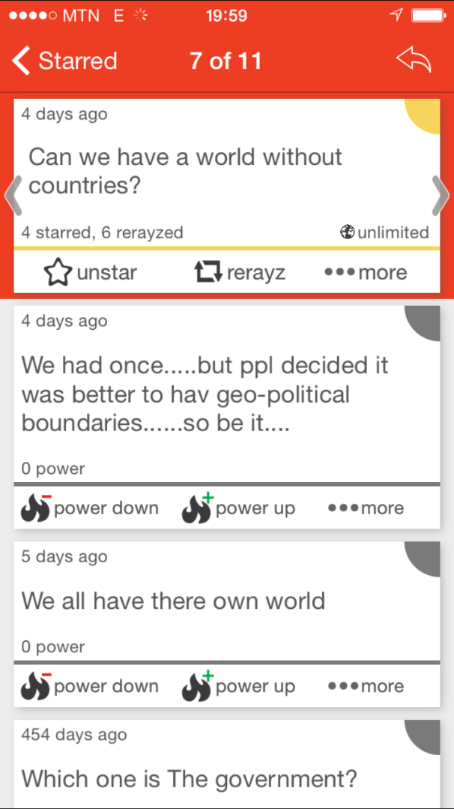
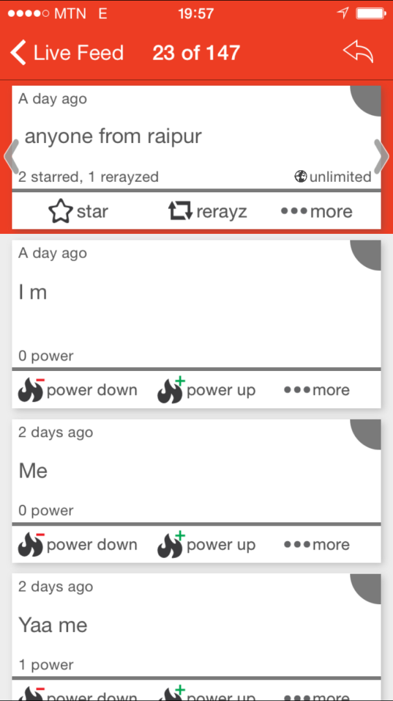
Example Conversations
Philosophical & Location-based Questions

Slide 15
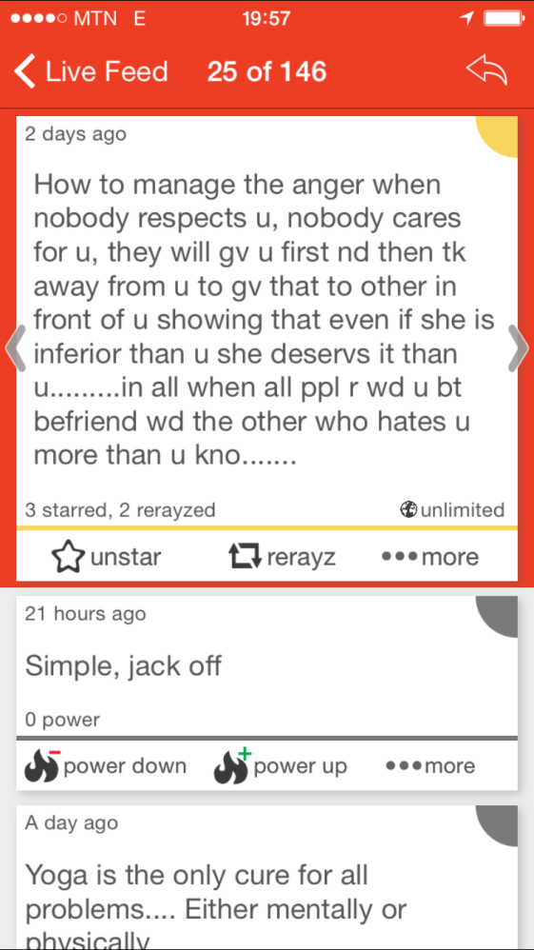
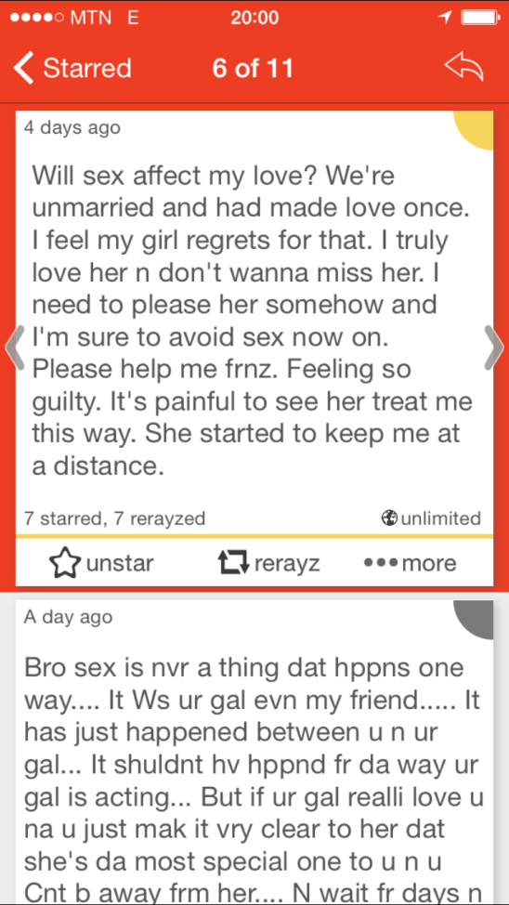
Example Conversations
Feelings Expression & Taboo Questions

Slide 16
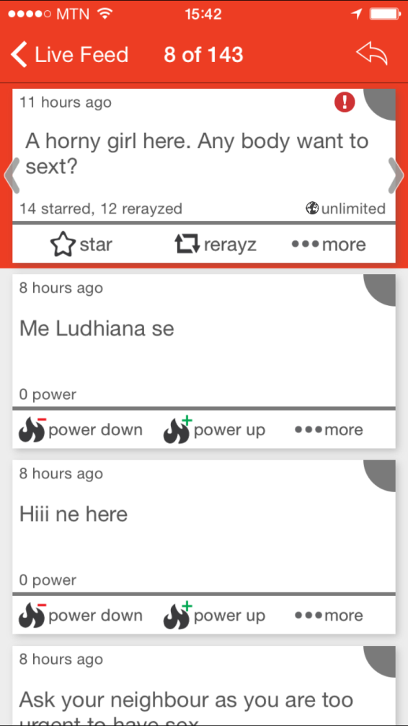
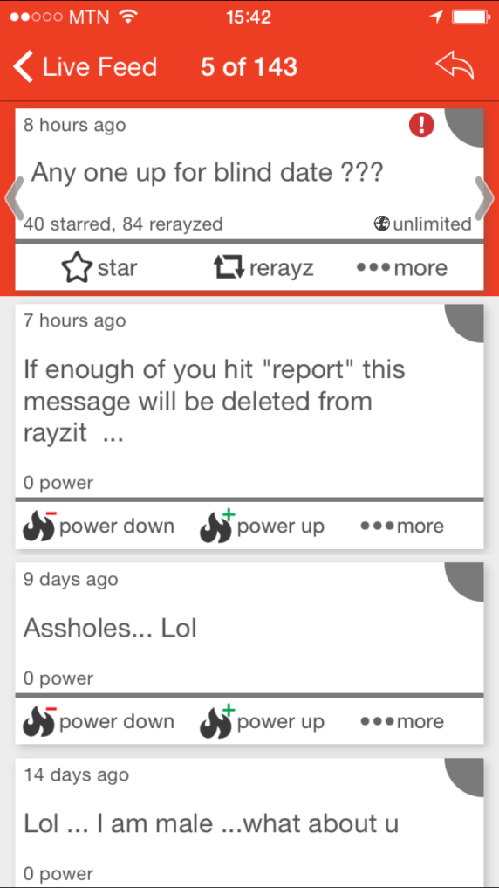
Example Conversations
Inappropriate Messages
(before installation of report filter)

Slide 17
More Topics on Rayzit
Topics: Location, Surveys, Thoughs, Feelings
Most answered rayz (responses)
“Rain! Lovely.” (228)
“Any good PGs near Avanshi RoadCBE?” (142)
“Which windows phone do you have?” (119)
“anyone around..???” (94)
“Share a secret ..” (90)
“Rayzit: What is the next feature you would like to see?” (81)
“I love.... (continue)” (58)
“Where are you from? I want to test Rayzit location.” (52)
“Where to dine in Coimbatore if you want to have a dinner peacefully and by yourself?” (40)

Slide 18
Presentation Outline
Introduction
The Rayzit Concept
The Application
AKNN Query Engine
Architecture
Analyzing the Rayzit Network
Conclusion

Slide 19
K Nearest Neighbor Networks
Find 2 Closest Neighbors for ALL User
"Continuous all k-nearest neighbor querying in smartphone networks", Georgios Chatzimilioudis, Demetrios Zeinalipour-Yazti, Wang-Chien Lee, Marios D. Dikaiakos, In IEEE MDM'12.

Slide 20
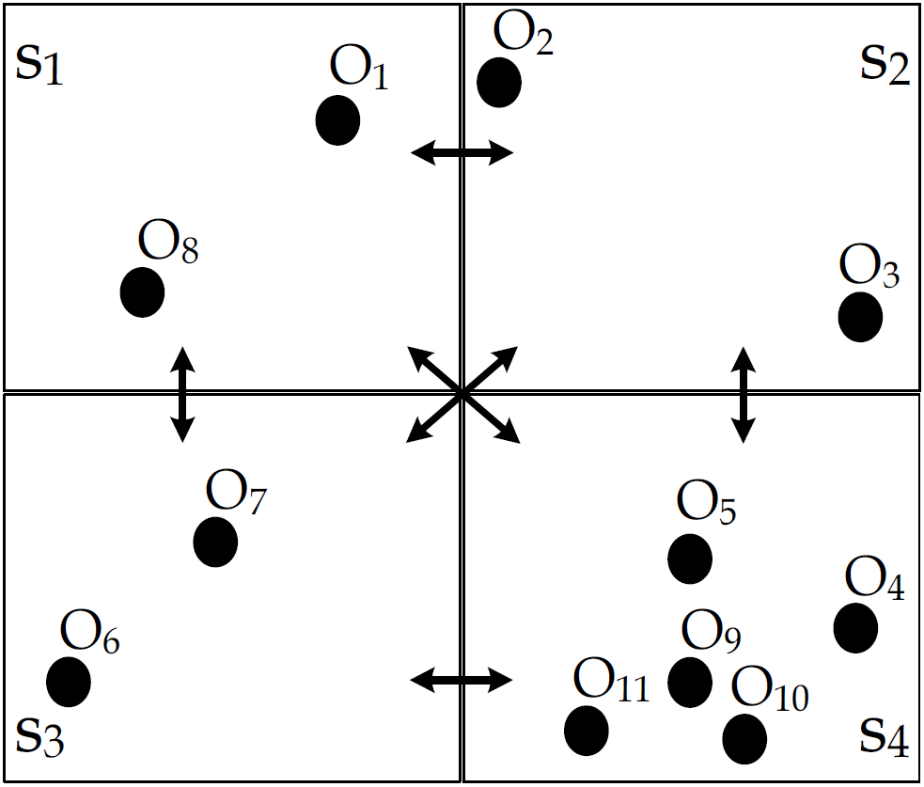
Distibuted AkNN Computation
Rayzit has been designed with the research hypothesis of million-kNN computations every few seconds.
Computing kNN for each O locally.
Wrong Result ☹
“Distributed In-Memory Processing of All k Nearest Neighbor Queries, Georgios Chatzimilioudis, Costantinos Costa, Demetrios Zeinalipour-Yazti, Wang-Chien Lee, Evaggelia Pitoura, under evaluation.

Slide 21
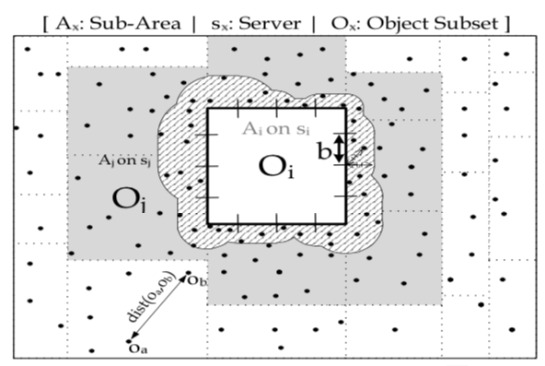
Urban Social (Crowd) Networks
Spitfire Execution Phases
Partition problem space (each cell at least k)
Replicate border cases minimally.
Perform local AkNN computation
Distributed Algorithm implemented in MPI

Slide 22
Presentation Outline
Introduction
The Rayzit Concept
The Application
AKNN Query Engine
Architecture
Analyzing the Rayzit Network
Conclusion

Slide 23
The Rayzit Architecture

Slide 24
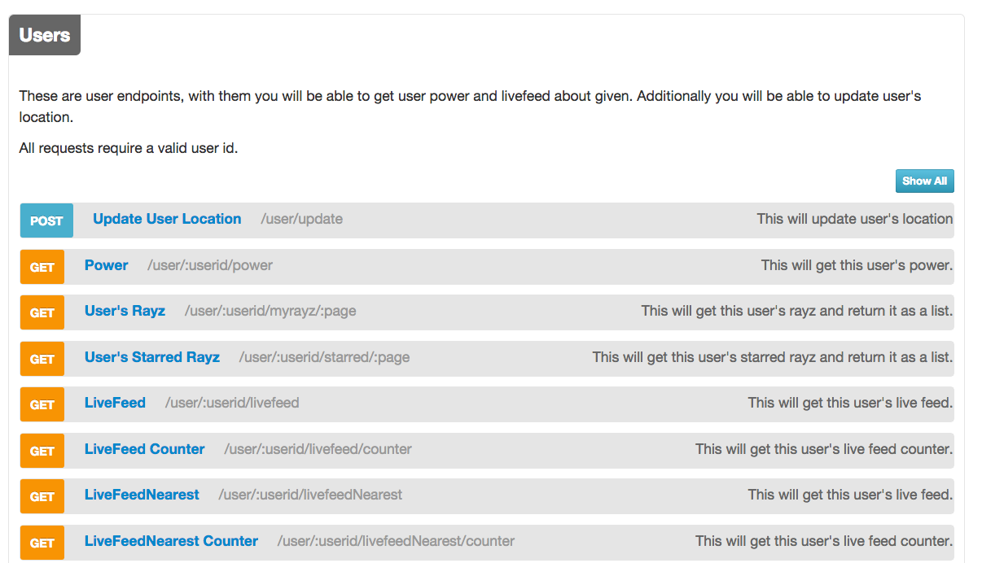
The Rayzit Architecture
Web 2.0 API has helped to build a modular architecture
Helped for building clients by different groups of people

Slide 25
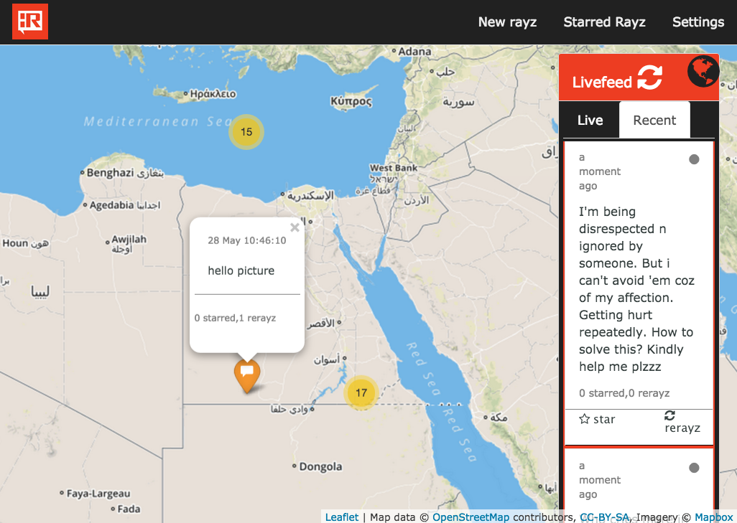
The Rayzit Architecture
Example Web App build by undergrad team:

Slide 26
Presentation Outline
Introduction
The Rayzit Concept
The Application
AKNN Query Engine
Architecture
Analyzing the Rayzit Network
Conclusion

Slide 27
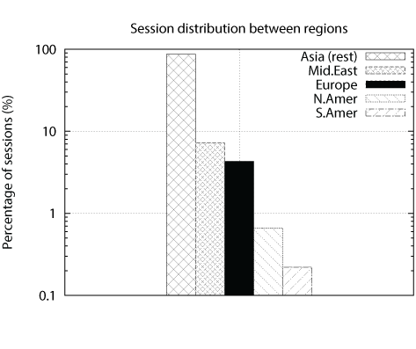
Analyzing the Rayzit Network
We used both Flurry App Analytics and Analytic queries on our NoSQL database
Interval of Analysis: Oct. 13 – Mar. 15
32,762 Sessions
5,062 New Users
1.7 mins Median
Session Length
Conclusion:
App more popular in Asia, India particularly because of large Microsoft community and Microsoft Promotion)

Slide 28
Session Duration
80% of sessions is between 30 sec. to 10 min.
Users find the Rayzit Experience interesting
Requirement: kNN graph must be recomputed quickly

Slide 29
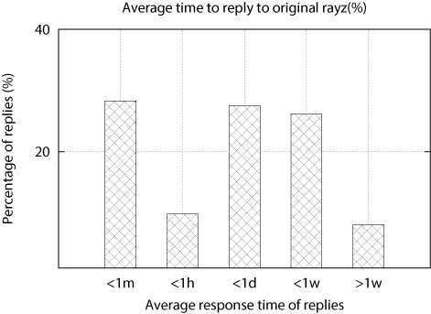
Average Reply Time
Online users
28%
Offline users
Sporadic users
Rest
28% of replies were recorded within 1 minute.
Crowd Volume creates quick response possibilities
Nearby users respond quickly (more interested in the discussion).

Slide 30
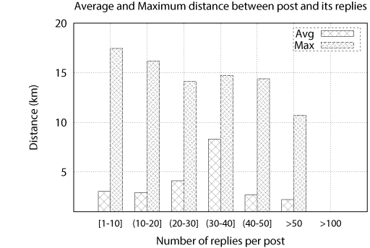
Average and Maximum Distance (Rayz, Reply)
Hypothesis: Closer Geographic Users means More Replies
distance of rayz to replies ([1-50] replies) = 15km (max)
>50 replies
At 10km (max)
>100 replies
at 8 meters!
People in classroom, event?

Slide 31
Future Challenges
Tools to handle lack of accountability that has shown to encourage negative discourse, including personal attacks, threats or rumor spreading [IMC’14]
Introduce more automated and crowd management techniques (collaborative filtering):
More intelligent Report Management
Classify rayz threads to categories
More detailed data analysis (interaction graphs, rerayz path length, community detection, chat groups vs. location, new vs. old users, ….
Comparison with other similar networks

Slide 32
Rayzit: An Anonymous and Dynamic Social Network Architecture
Thanks! Questions?
http://rayzit.com/
Contact: dzeina@cs.ucy.ac.cy
http://dmsl.cs.ucy.ac.cy/
The 3rd IEEE Intl. Workshop on Mobile Data Management, Mining, and
Computing on Social Networks, with IEEE MDM '15,
June 15, 2015, Pittsburgh, PA, USA

Slide 33
Summary of Microblogging Apps
Identity Chat
LB Identity Chat
LB Anonymous Chat

Slide 34
Related Work
Application | Distance | kNN | Anonymous | Location
Facebook | No | No | No | Yes
Twitter | No | No | No | Yes
Foursquare | Yes | No | No | Yes
Snapchat | No | No | No | Yes
Secret | No | No | Partial | Yes
Yik Yak | 10 miles | No | Yes | Yes
Whisper | No | No | Partial | Yes
Rayzit | Custom | Yes | Yes | Yes
Identities
Anonymous

