Slide 1
An IoT Data System for Solar Self-Consumption
Soteris Constantinou∗, Nicolas Polycarpou∗,
Constantinos Costa◊∗‡ , Andreas Konstantinidis$◎$∗,
Panos K. Chrysanthis‡∗, Demetrios Zeinalipour-Yazti∗
∗ Department of Computer Science, University of Cyprus, 1678 Nicosia, Cyprus
◊ Rinnoco Ltd, 3047 Limassol, Cyprus $◎$ Department of Computer Science & Engineering, Frederick University, 1036 Nicosia, Cyprus
‡ Department of Computer Science, University of Pittsburgh, PA 15260, USA
sconst01@ucy.ac.cy, npolyc03@ucy.ac.cy, costa.c@rinnoco.com,
com.ca@frederick.ac.cy, panos@cs.pitt.edu, dzeina@ucy.ac.cy
https://greencap.cs.ucy.ac.cy/
24th International Conference on Mobile Data Management
Singapore, July 3 - 6, 2023

Slide 2
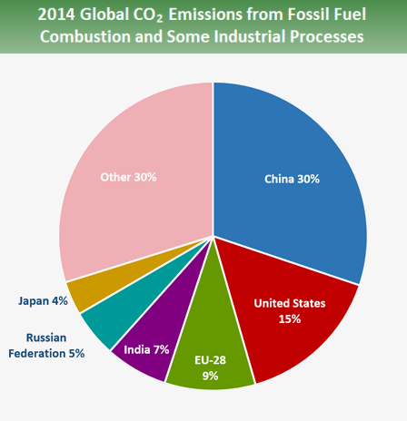
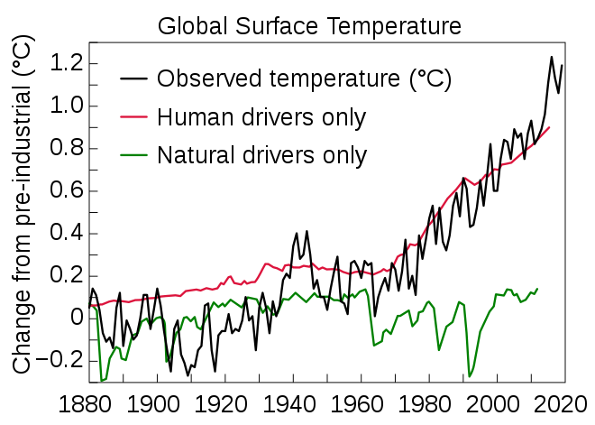
CO2 - Global Warming Culprit
CO₂ emerging in all sectors and rising economies
We are witnessing a steady increase in CO₂ since the Industrial Revolution (1760 – 1840 AD)
Global warming will continue if we don’t act promptly!
The Intergovernmental Panel on Climate Change (IPCC) is an intergovernmental body of the United Nations: World Meteorological Organization (WMO)
United Nations Environment Programme (UNEP)

Slide 3
CO2 by Information and Communic. Technology (ICT)
ICT contributes ~2-4% of world CO2 emissions and will increase to 8% by 2025!
Are we comfortable doing research that (allegedly) contributes to CO2 increase?
How much CO2 is technology saving anyway? (Teleconferencing vs. Physical Meetings?)
How to make impactful research to reduce this increase from 4% to 8%? (edge computing?, energy efficiency?, reusable systems?, transparency? )
55% use
45% manufacturing

Slide 4
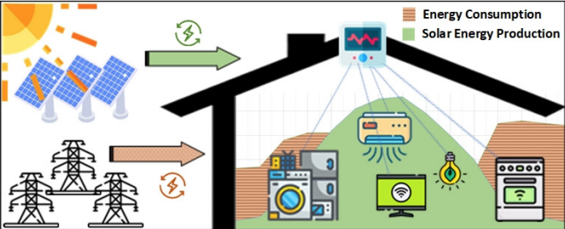
Problem: (Renewable) Self-Consumption
Renewable self-consumption is the act of using self-produced renewable energy at the time it is available.
Why?
=> Minimize Import of (dirty) Energy
=> Minimize CO2 Consumption
Problem:
- Alignment of Consumption with Production patterns…

Slide 5
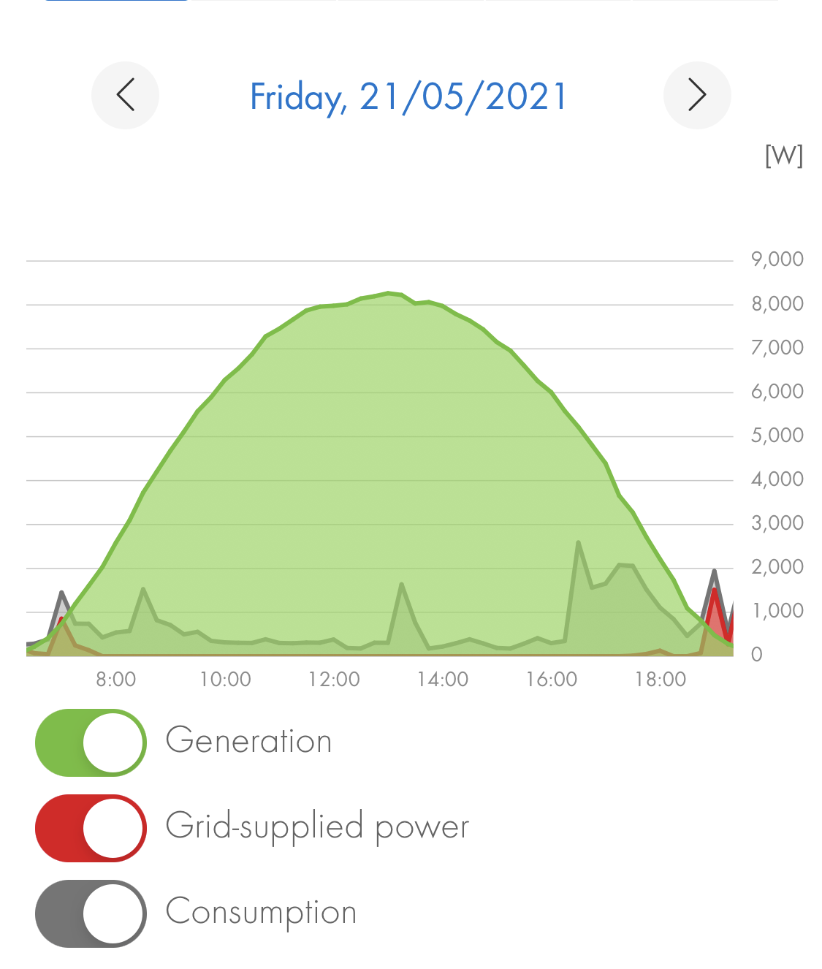
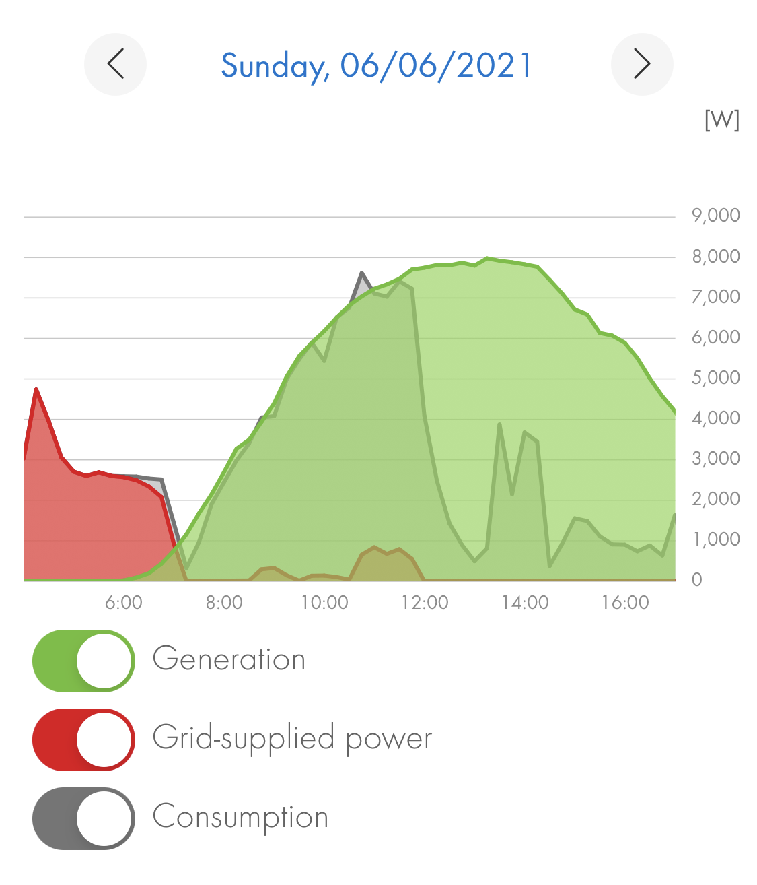
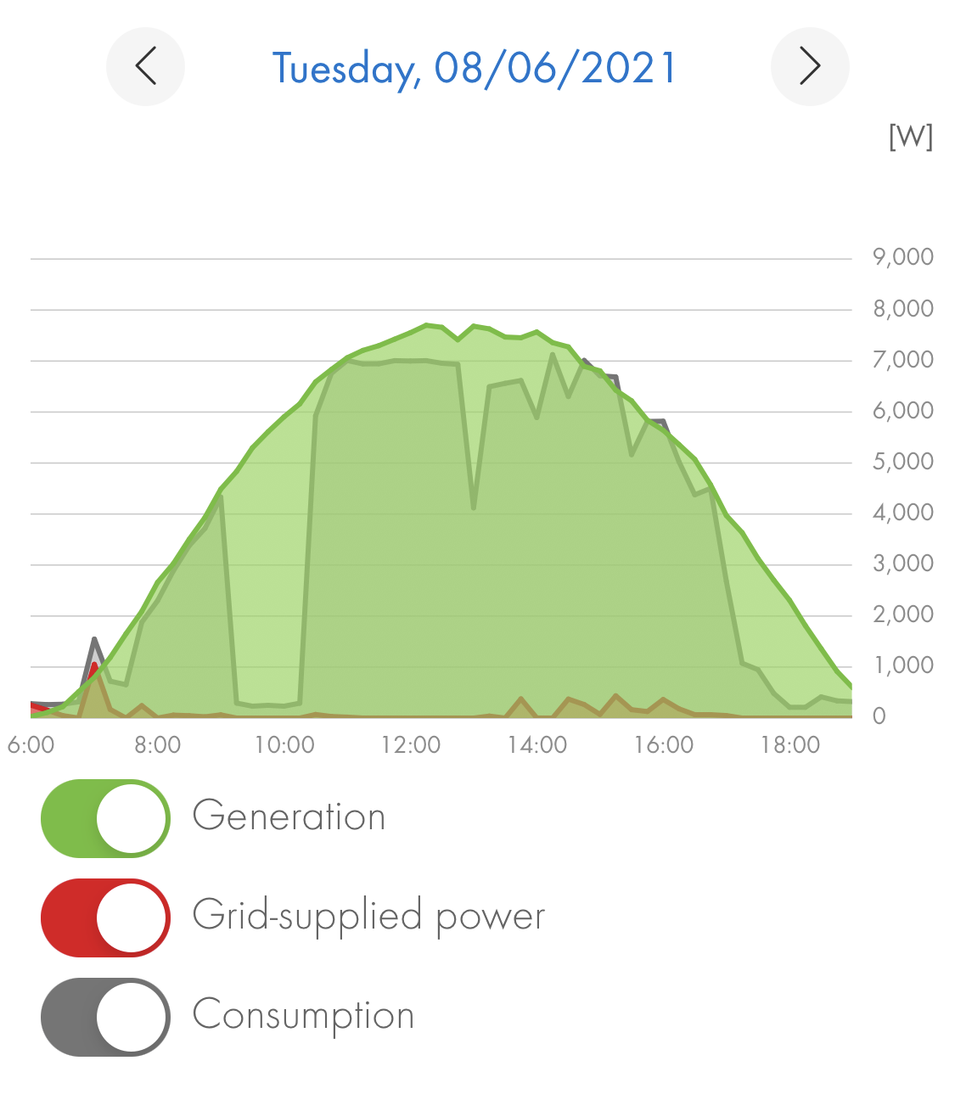
Self-Consumption Examples
Alignment of Consumption with Production patterns.
Laborious task that calls for automation and “smartness”!
12%
49%
73%

Slide 6
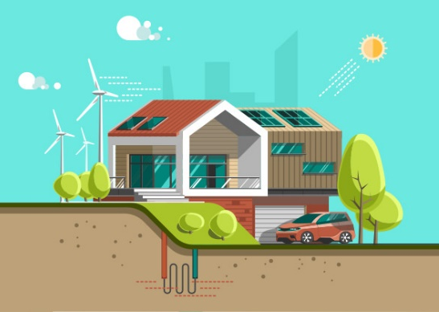
Green Planning
Computational approaches → improve environmental quality
Rapid progress towards sustainability through load shifting
Considering peak demand reduction
Self-consumption is more beneficial than energy storage in Batteries!
17% of the energy is lost in AC/DC conversion and heat dissipation
Self-consumption can make houses 70% CO₂ neutral without batteries!

Slide 7
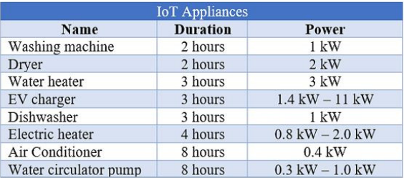
Problem
10 hours of solar radiation x 60 minutes = 600 time slots (x-axis)
Residential solar system: ~10kWp
Approximate the curve by 2 triangles (height x base) of size: height = 10kWp / 1kW = 10 and base = 5x60 = 300 minutes → a rectangle of 3000 cells to plan each day
Challenge: How to intelligently fill the cells with device operations considering that energy-demanding devices operate at various load levels?

Slide 8
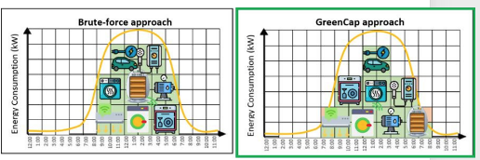
Algorithms
Standard: ignores imported energy and provides maximum user comfort.
Brute-Force: aims to find an optimal solution with the least imported energy from the grid and CO₂ emissions. Comfort levels are low and the execution is time consuming.
Random: provides better imported energy than the Standard method by sacrificing user comfort. It is much faster than Brute-Force.
GreenCap: aims for a sub-optimal solution, while considering renewable energy sources, multiple constraints, peak-demand times, and costs.

Slide 9
Presentation Outline
Introduction
GreenCap
Algorithm
System Architecture
Graphical User Interface
Experiments
Conclusions

Slide 10
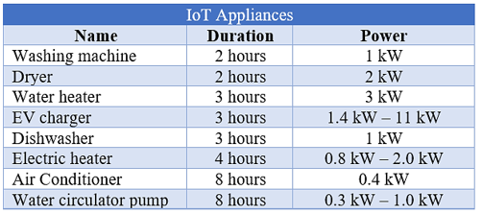
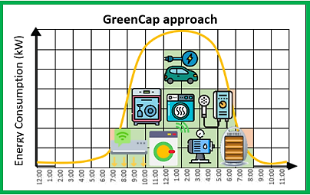
Solution: GreenCap

Slide 11
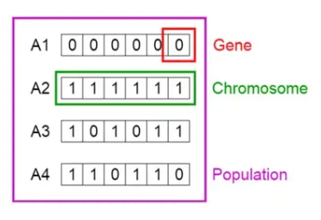
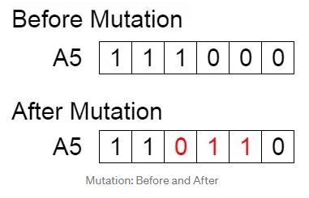
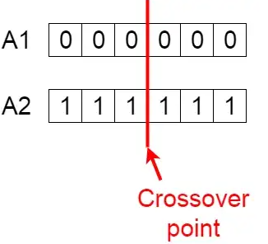
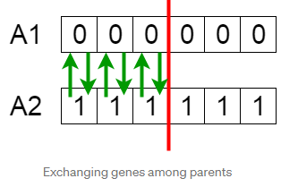
Memetic Algorithm

Slide 12
Memetic Algorithm (cont.)
The efficiency of the proposed technique is measured by:
Imported Energy: the energy retrieved from the grid at a particular time-slot so that appliances can complete the required operations set by residents. It is the difference of the consumption and the power generation
User Comfort: the sum of all executed rules defined by the user. Each rule PR_{i}=1 when successfully adapted and consequently executed, otherwise PR_{i}=0

Slide 13
Comfort Optimization Heuristic
Aims to retain the daily total consumption to its original state
considers users’ Residential Consumption Record (RCR)
fluctuations may occur from the MA procedures
Prioritizes users’ comfort
adapts corresponding Preference Rules
If (daily consumption < RCR state):
→ allocates operations (turns ON) in corresponding devices
considering power load bounds & highest production hours
else: → deallocates (turns OFF) corresponding devices
Goal: retain and balance energy consumption levels in case too many devices are turned on or off

Slide 14
Energy Optimization Heuristic
Shifts devices’ consumption, while considering:
peak production times
non-peak demand hours
If peak demand hours do not fall within production times
→ reallocation of devices occurs
Consumers receive financial incentives when:
reduce or shift energy usage during peak load times
resulting to the minimization of CO2 emissions
Goal: exploit Demand Response, i.e. shifts energy consumption from peak hours where the cost of electricity imported from the power grid is higher compared to non-peak hours where the cost is much lower.

Slide 15
GreenCap System Architecture
(Local) Control Unit → direct communication with the IoT devices
OpenHAB/Domoticz smartphone application
GreenCap Controller
GUI → enable users to configure/run custom rules

Slide 16
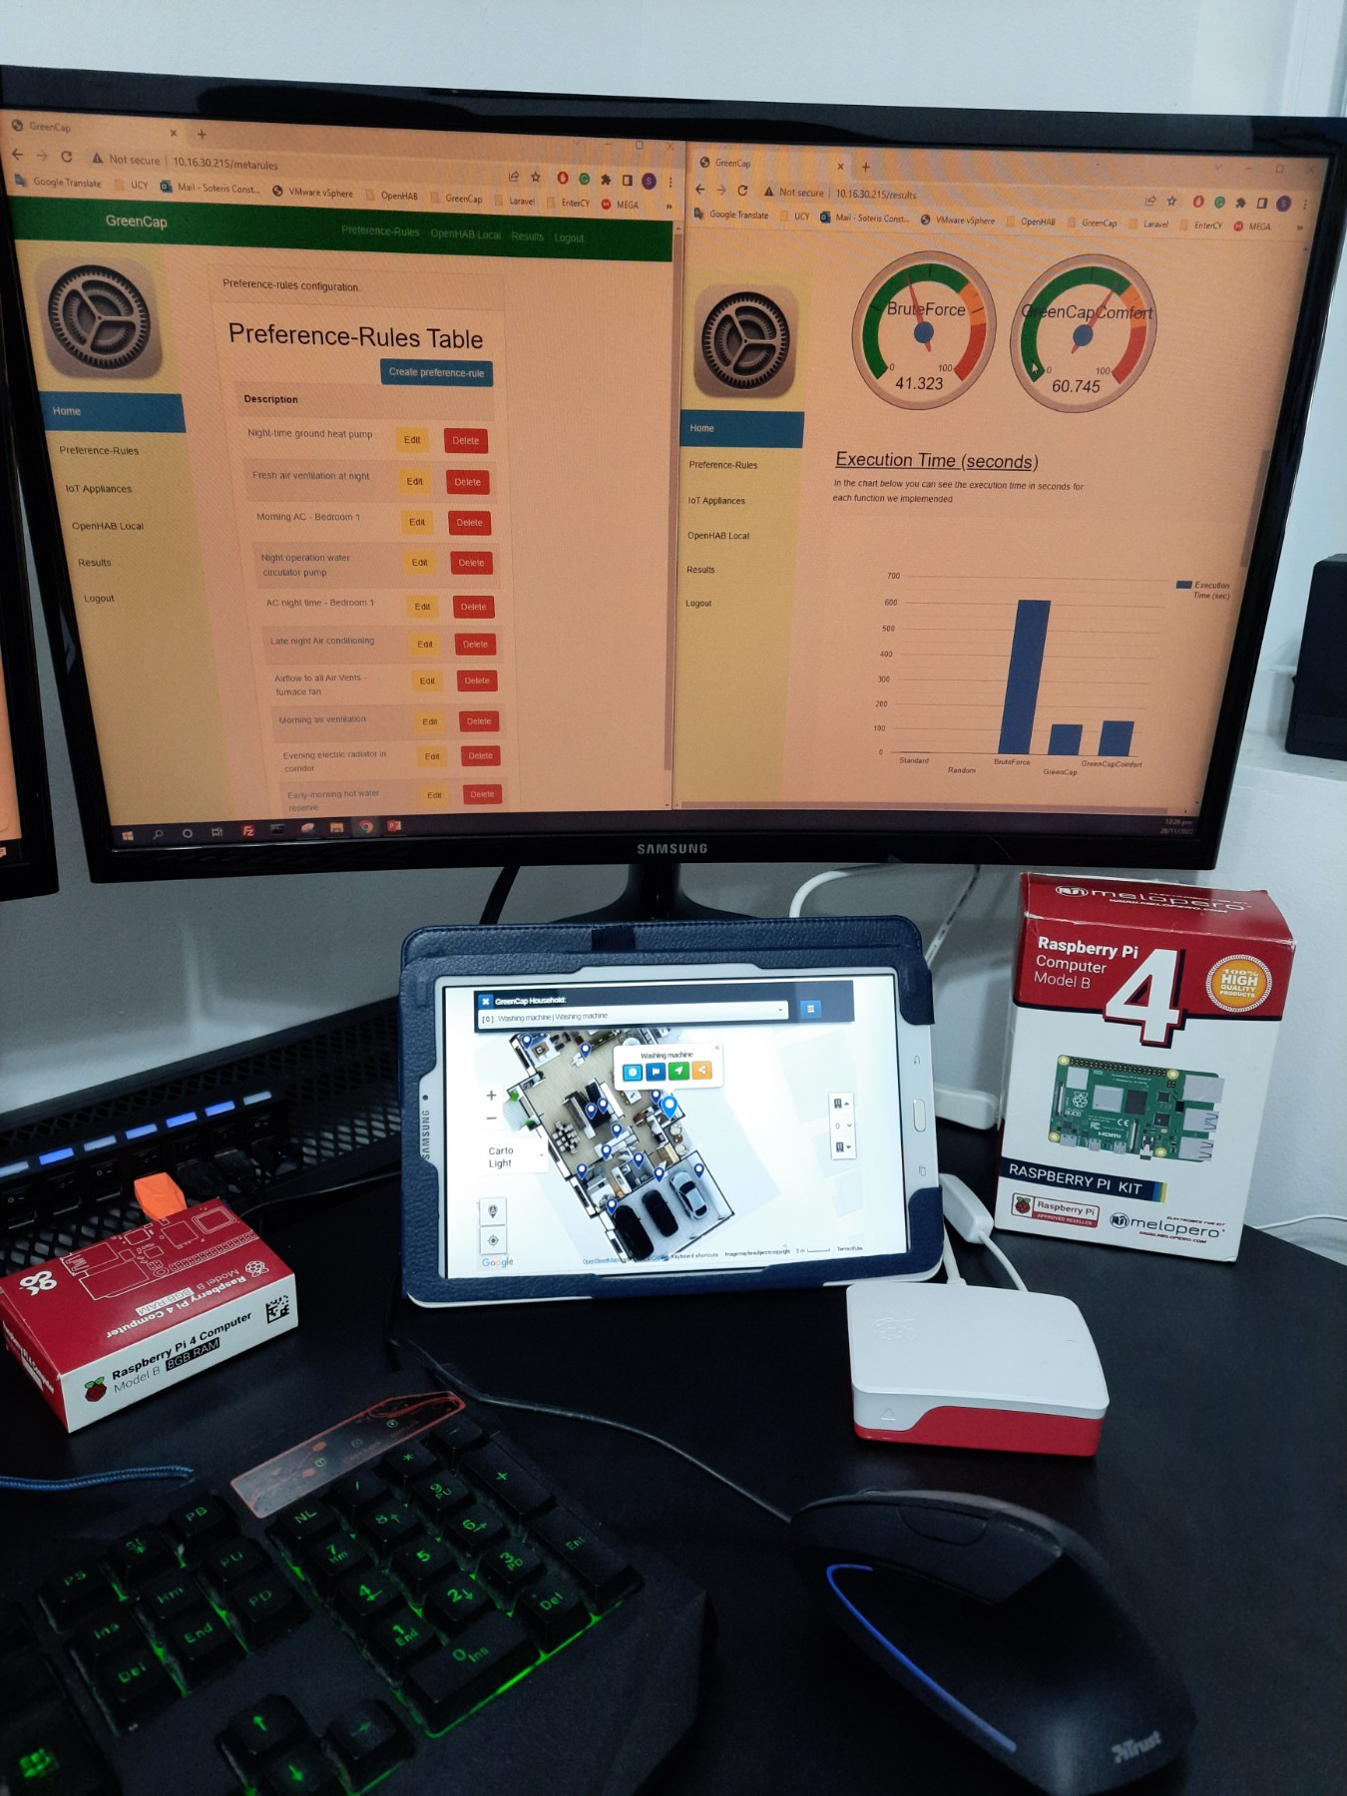
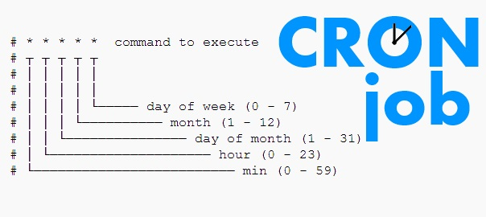
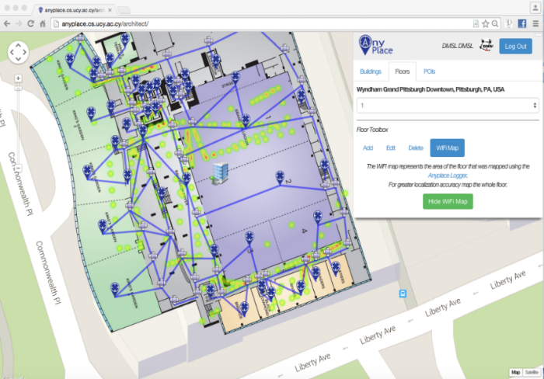
GreenCap Implementation
anyplace.cs.ucy.ac.cy

Slide 17
Graphical User Interface
Records OpenHAB’s smart device measurements on local storage
Configures various meta-rules related to the operation time of IoT devices
Demo 5th of July – Don’t miss it!!

Slide 18
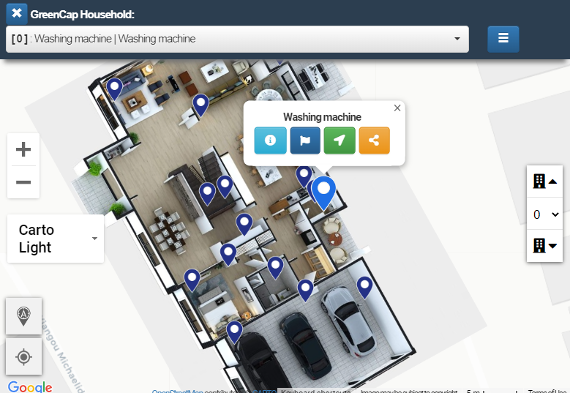
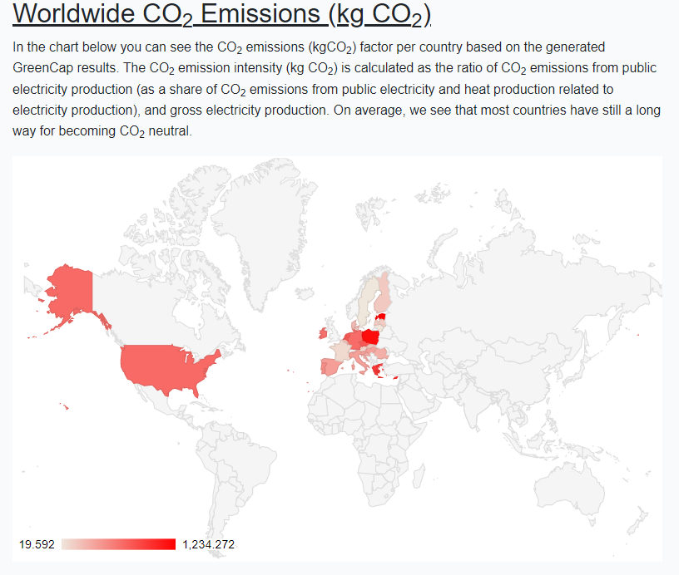
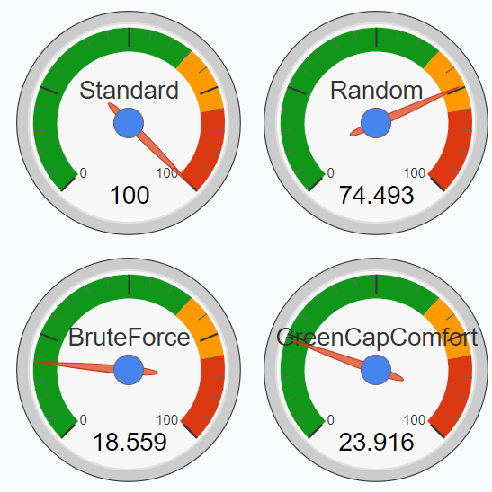
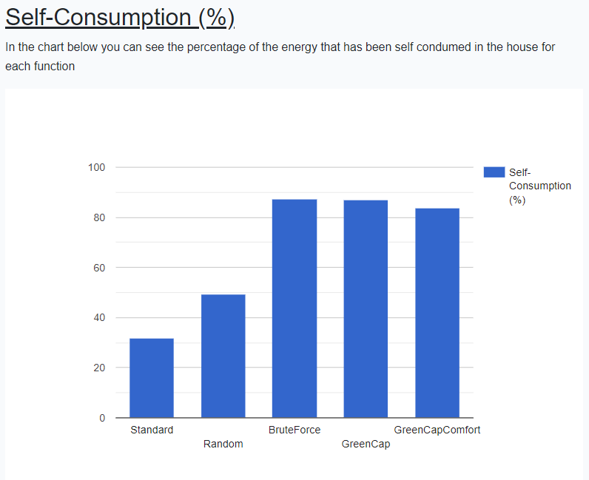
GreenCap GUI
Operates the GreenCap system
Gets an efficient execution considering user satisfaction
Demonstrates results on user friendly graphs

Slide 19
Presentation Outline
Introduction
Background
GreenCap
Algorithm
System Architecture
Graphical User Interface
Experiments
Conclusions

Slide 20
Experimental Methodology
Home Power Usage Dataset
Size: 408MB
527,040 measurements
Time-interval: minutely
01/01/2016 - 31/12/2016
Energy Production Dataset
Size: 50MB
65,741 measurements
Time-interval: hourly
31/12/2010 - 31/12/2017
Peak Demand Dataset
Size: 63.1MB
579,746 measurements
Time-interval: hourly
01/01/2016 - 31/12/2016
Metrics:
Imported Energy: the difference of the consumption and the power generation
User Comfort: the sum of all executed rules defined by the user
CPU Time: the processing time required by the controller for running the optimization function and calculating the output

Slide 21
Performance Evaluation
GreenCap (best overall performance): very high user comfort ≈ 92%, an impressive self-consumption ≈ 52%, and imported energy ≈ 48%
GreenCap’s execution (90 secs) is ≈16.5 times faster than Brute Force approach
Random: low in terms of user comfort (≈ 35%) and self-consumption (≈ 38%), and high in regards to the imported energy from the grid (≈ 61%)
Brute Force: Best self-consumption ≈ 67% and imported energy ≈ 32% retrieved, however user comfort ranges at only ≈ 40%

Slide 22
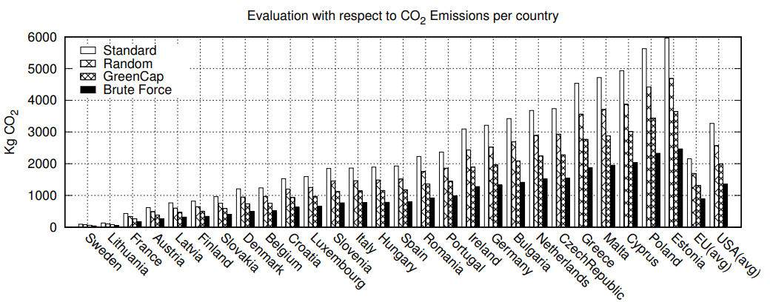
CO₂ Evaluation
In countries with high kg CO₂ per kWh factor, GreenCap can reduce up to ≈ 40% of the carbon dioxide emissions
Brute Force obtains better results → exhaustively searches space for an optimal solution
Random has the second worst emission levels out of all approaches

Slide 23
Presentation Outline
Introduction
Background
GreenCap
Algorithm
System Architecture
Graphical User Interface
Experiments
Conclusions

Slide 24
Conclusions
GreenCap considers:
reduction of CO₂ emissions
integration of renewable energy sources
multiple constraints
peak demand times & electricity costs
user comfort
utilizes the innovative smart metering infrastructure
Generates a sustainability-aware plan obtaining:
high levels of user comfort 92-99%
≈52% of self-consumption
reducing ≈35% of the imported energy from the grid
≈40% of CO₂ emissions
execution is fairly fast
Can be easily integrated in actuation platforms

Slide 25
An IoT Data System for Solar Self-Consumption
Thank you! - Questions?
Soteris Constantinou∗, Nicolas Polycarpou∗,
Constantinos Costa◊∗‡ , Andreas Konstantinidis $◎$∗,
Panos K. Chrysanthis‡∗, Demetrios Zeinalipour-Yazti∗
∗ Department of Computer Science, University of Cyprus, 1678 Nicosia, Cyprus
◊ Rinnoco Ltd, 3047 Limassol, Cyprus $◎$ Department of Computer Science & Engineering, Frederick University, 1036 Nicosia, Cyprus
‡ Department of Computer Science, University of Pittsburgh, PA 15260, USA
sconst01@ucy.ac.cy, npolyc03@ucy.ac.cy, costa.c@rinnoco.com,
com.ca@frederick.ac.cy, panos@cs.pitt.edu, dzeina@ucy.ac.cy
24th International Conference on Mobile Data Management
Singapore, July 3 - 6, 2023

Slide 26
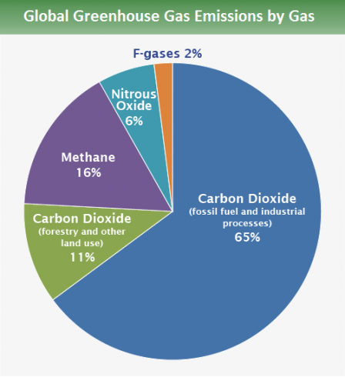
Global Warming
Why do we have Global Warming?
Current Human activity (coal, oil, gas) generates Carbon Dioxide (CO₂), the predominant Greenhouse Gas (76%)!
CO₂ traps Solar Radiation inside the atmosphere that eventually leads to Global Warming.
Oceans clean only ¼ of CO2 pollution while trees another ¼.
76%
4% ICT
10.5% ICE Cars
2.5% Aviation
US EPA: https://www.epa.gov/ghgemissions/global-greenhouse-gas-emissions-data

