Slide 1
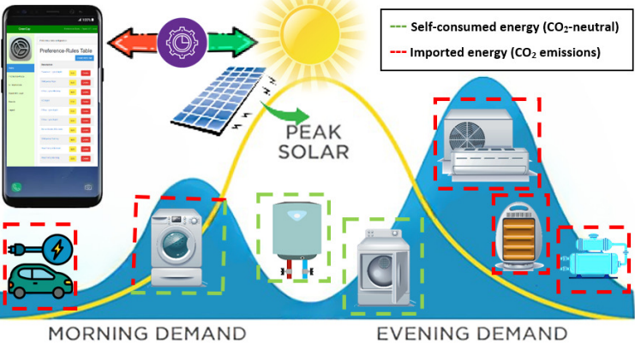
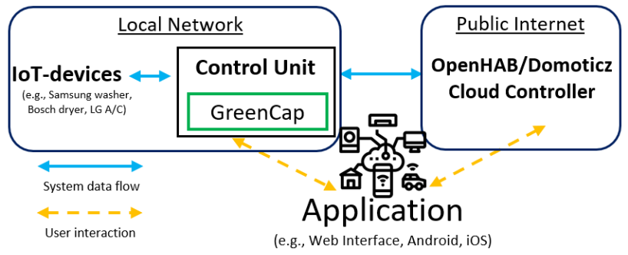
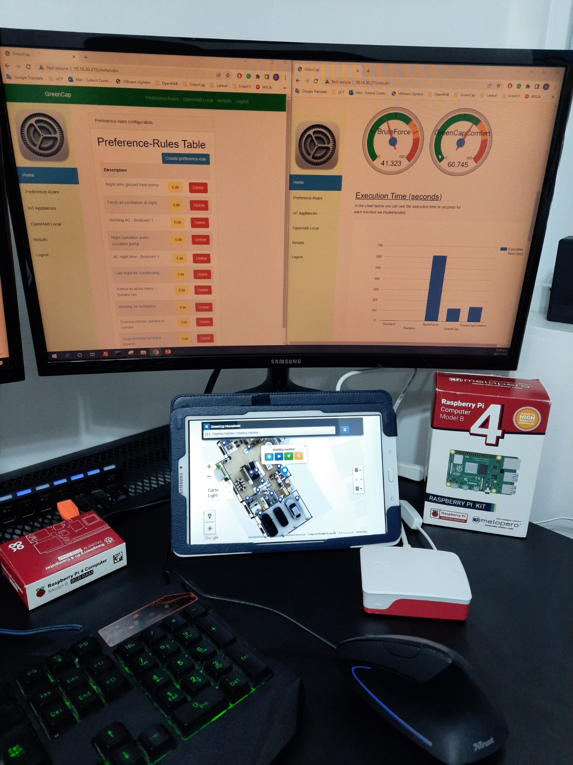
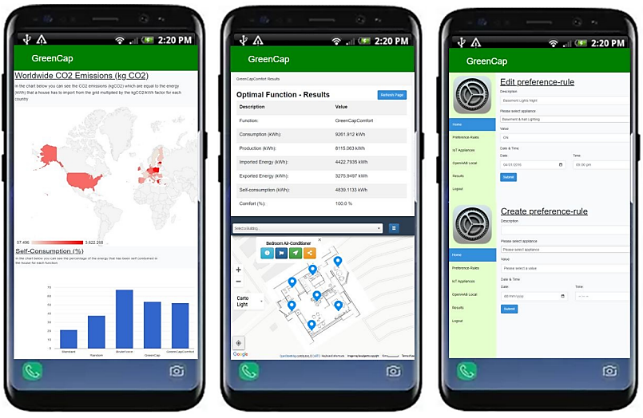
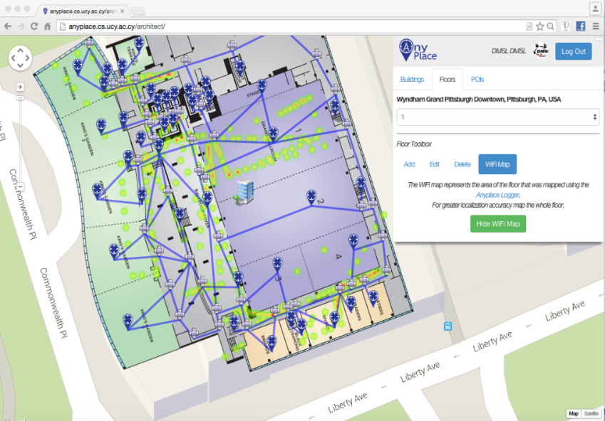
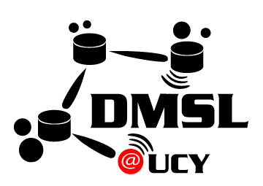
An IoT Data System for Solar Self-Consumption Soteris Constantinou ¹, Nicolas Polycarpou ¹, Constantinos Costa ^{2,1,4}, Andreas Konstantinidis ^{3,1}, Panos K. Chrysanthis ^{4,1}, Demetrios Zeinalipour-Yazti ¹ ¹ University of Cyprus, Cyprus | ² Rinnoco Ltd, Cyprus | ³ Frederick University, Cyprus | ⁴ University of Pittsburgh, USA
Motivation
Green Planning
Green Planning refers to computational approaches that aim to make rapid progress towards sustainability through load shifting considering peak demand reduction.
Benefits:
Self-consumption is more beneficial than energy storage in Batteries!
→ 17% of the energy is lost in AC/DC conversion and heat dissipation
Self-consumption can make houses 70% CO₂ neutral w/out batteries!
Load shifting to avoid peak-demand times (considers solar production)
Observations
Residential solar system: ~10kWp
10 hours of solar radiation x 60 minutes => 600 time slots (x-axis)
Approximate the curve by 2 triangles of size (3K cells to plan daily): [height = 10kWp / 1kW = 10] x [base = 5x60 = 300 minutes]
The global Home Energy Management Systems (HEMS) market
increased from USD 864.2 million in 2015 to USD 3.15 billion by 2022
European’s Commission calls for a climate-neutral Europe by 2050
Internet-connected smart devices worldwide
- 100B connected devices by 2030 - 30.9B units by 2025
[1] "An IoT Data System for Solar Self-Consumption", Soteris Constantinou, Nicolas Polycarpou, Constantinos Costa, Andreas Konstantinidis, Panos K. Chrysanthis, Demetrios Zeinalipour-Yazti, The 24th IEEE International Conference on Mobile Data Management (MDM'23), 2023.
[2] "Green Planning of IoT Home Automation Workflows in Smart Buildings", Soteris Constantinou, Andreas Konstantinides, Panos K. Chrysanthis and Demetrios Zeinalipour-Yazti, ACM Transactions on Internet of Things (TIOT'22), Vol. 3, Iss. 4, pp. 1--30,, 2022.
[3] "The IoT Meta-Control Firewall", Soteris Constantinou, Andreas Konstantinidis, Demetrios Zeinalipour-Yazti, Panos K. Chrysanthis, 37th IEEE Intl. Conference on Data Engineering (ICDE'21), pp. 2523-2534, 2021.
Challenge: How to intelligently schedule (i.e., fill the cells) with device operations considering that energy-demanding devices operate at various load levels?
GreenCap: Algorithm
GreenCap: System Architecture
Evolutionary algorithm: generates high-quality solution to a particular search problem by relying on bioinspired operators
Each IoT device is represented with a chromosome (i.e., IoT device ON = 1, IoT device OFF = 0)
Improves users’ comfort and provide high convergence by reducing the likelihood of trapping in local optima
Input parameters: - Residential Consumption Record (RCR) - Preference Rules (PR) user-configured - Weather Forecast
(Local) Control Unit: direct communication with the IoT devices
OpenHAB/Domoticz: residential management application
GUI: enable users to configure custom rules
GreenCap Controller: energy management framework
GreenCap: User Interface
GreenCap Performance
Records OpenHAB’s smart device measurements on local storage
Configures various meta-rules related to the operation time of IoT
Gets an efficient execution considering user satisfaction
Demonstrates results on user friendly graphs
GreenCap (best performance): very high user comfort ≈ 92%, an impressive self-consumption ≈ 52%, and imported energy ≈ 48%
Brute Force: best self-consumption ≈ 67% and imported energy ≈ 32% retrieved, however user comfort ranges at only ≈ 40%
In countries with high kg CO₂ per kWh factor, GreenCap can reduce up to ≈ 40% of the carbon dioxide emissions
GreenCap’s execution (90 secs) is ≈16.5 times faster than Brute Force approach
anyplace.cs.ucy.ac.cy
https://greencap.cs.ucy.ac.cy/
Contact: dmsl@ucy.ac.cy
https://dmsl.cs.ucy.ac.cy/

