Slide 1






EnterCY: A Virtual and Augmented
Reality Tourism Platform for Cyprus
Soteris Constantinou∗ , Andreas Pamboris†, Rafael Alexandrou†, Christoforos Kronis†, Demetrios Zeinalipour-Yazti∗, Harris Papadopoulos† and Andreas Konstantinidis†,∗
∗University of Cyprus, P.O. Box 20537, 1678 Nicosia, Cyprus
† Frederick University, 1036 Nicosia, Cyprus
constantinou.sotiris@cs.ucy.ac.cy, res.ap@frederick.ac.cy, res.ar@frederick.ac.cy, ad.kc@frederick.ac.cy, dzeina@cs.ucy.ac.cy, com.ph@frederick.ac.cy, com.ca@frederick.ac.cy
23rd IEEE International Conference on Mobile Data Management
6 - 9 June, 2022 Online

Slide 2

Enhancing Tourist Experience In CYprus
A novel integrated virtual and augmented reality platform
Enhance tourist experience before, during and after physical visit to Cyprus

Slide 3















EnterCY Platform Overview
Dreaming
Planning
Booking
Before Visit:
Trip Schedule
EnterCY platform
VR Content
VR Personalization
Tourists at home planning their next travel using EnterCY
Engages them in the rich CY culture and variety of activities
Personalized VR enhance their experience and facilitate their planning activities
Users can schedule and plan their trip based on their platform experience
During Visit:
Travel to Cyprus
Experiencing
AR through App
Storytelling through App
AR Recommendations
AR Guide
Download EnterCY app
Receive real-time, time\location-aware recommendations
Enhance their experience while visiting archeological and cultural monuments
Synch your trip schedule and content
After Visit:
Travel Home
Sharing
IR Memorabilia
Social Media Integration
Feedback
Platform
Personalized 360 videos for sharing their experience
Sharing their experience in social media
User feedback, ratings, likes
Continuous improvement.

Slide 4
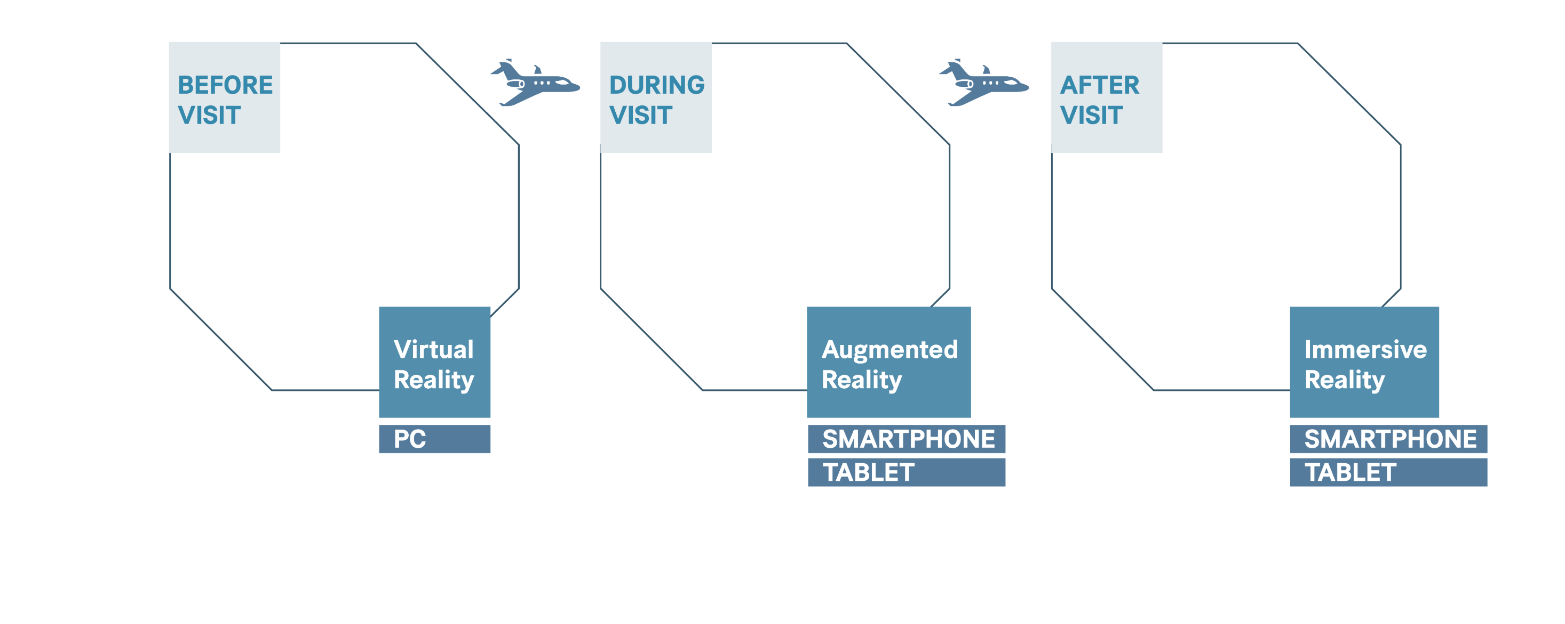



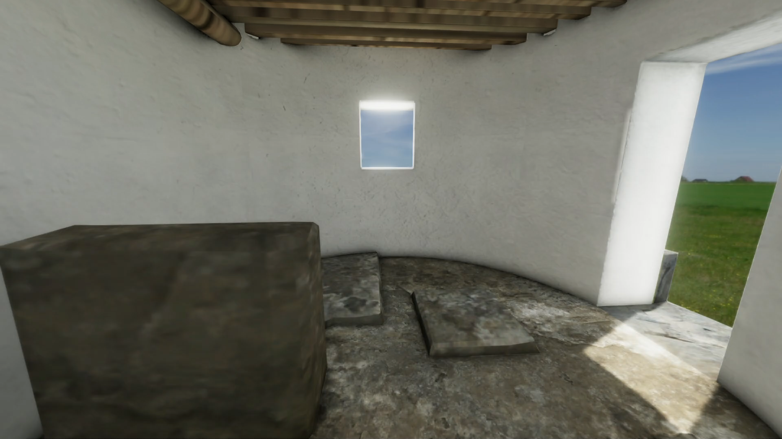
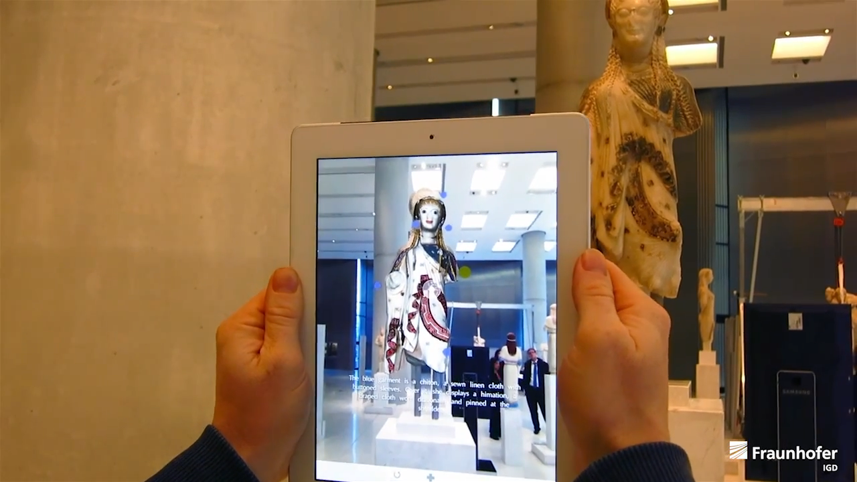
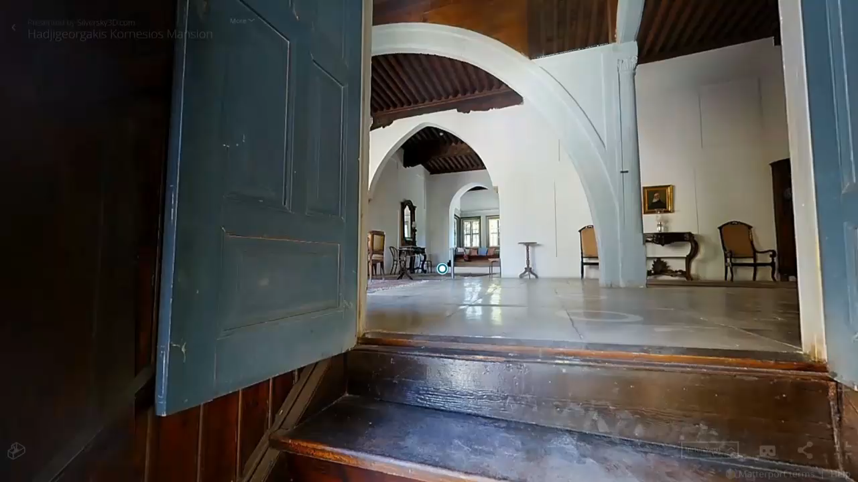



EnterCY Platform Overview

Slide 5
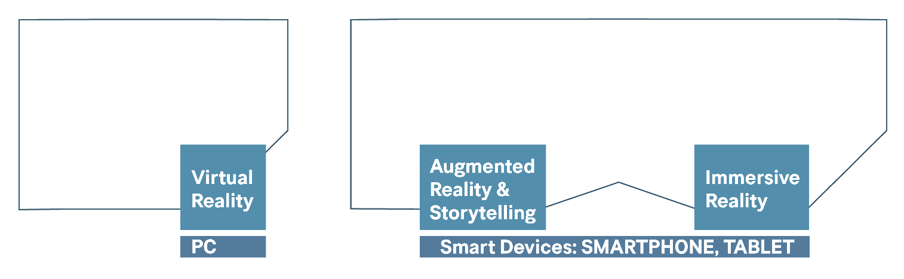
Integrated eCY Platform & Technological Innovations
Innovations
Combination of Technologies
sEMANTIC Data Management
Semantic annotation - NLP
Heterogeneous Sources
Automatic Video Generation
360 video on the fly
location data
Machine Learning
Person./Recom.
Conformal Prediction
Location-awareness
Fine-grain indoor localization
Additional sensor data
Navigational
Patterns
Mobile Data
(Location-aware)
Share
EnterCY Expertise
Tourism
Archaeology
Virtualization
3d – modeling
TOUR GUIDING
CULTURAL HERITAGE
MOBILE COMPUTING
MACHINE LEARNING
DATA MANAGEMENT
BUSINESS development
Marketing
Cognitive psychology

Slide 6
EnterCY: A Virtual and Augmented
Reality Tourism Platform for Cyprus
Thank you.
Soteris Constantinou∗ , Andreas Pamboris†, Rafael Alexandrou†, Christoforos Kronis†, Demetrios Zeinalipour-Yazti∗, Harris Papadopoulos† and Andreas Konstantinidis†,∗
∗University of Cyprus, P.O. Box 20537, 1678 Nicosia, Cyprus
† Frederick University, 1036 Nicosia, Cyprus
constantinou.sotiris@cs.ucy.ac.cy, res.ap@frederick.ac.cy, res.ar@frederick.ac.cy, ad.kc@frederick.ac.cy, dzeina@cs.ucy.ac.cy, com.ph@frederick.ac.cy, com.ca@frederick.ac.cy
23rd IEEE International Conference on Mobile Data Management
6 - 9 June, 2022 Online

