Slide 1
AnyplaceCV: Infrastructure-less Localization
in Anyplace with Computer Vision
Paschalis Mpeis*, Athina Hadjichristodoulou*, Ioannis Ioannidis*,
Demetrios Zeinalipour-Yazti*
∗Univ. of Cyprus, Cyprus
{pmpeis01, hadjichristodoulou.athina, iioann08, dzeina} @ucy.ac.cy
The 23rd IEEE International Conference on Mobile Data Management July 8, 2022, Paphos, Cyprus (virtual)

Slide 2
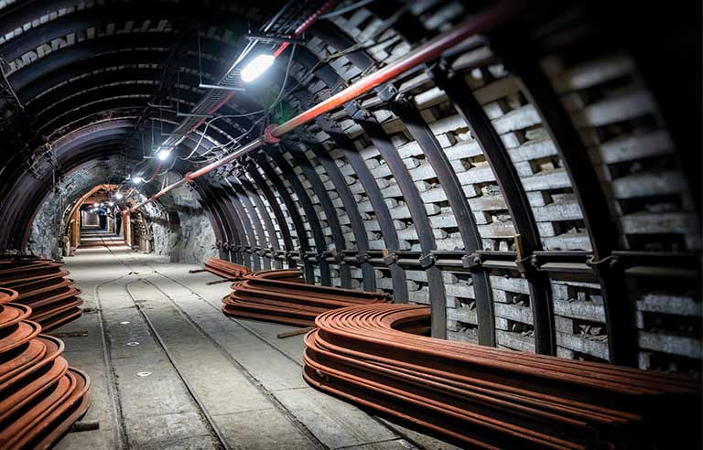
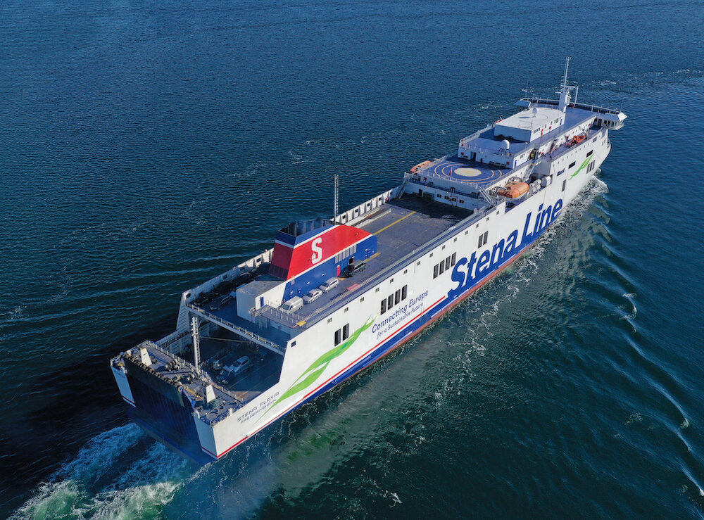
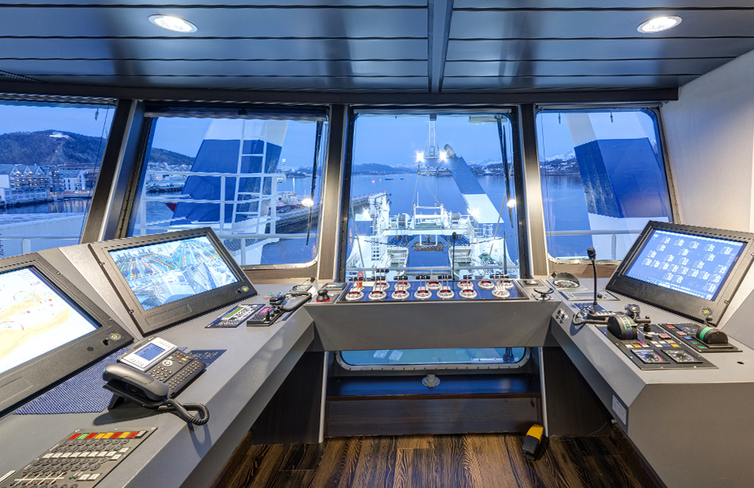
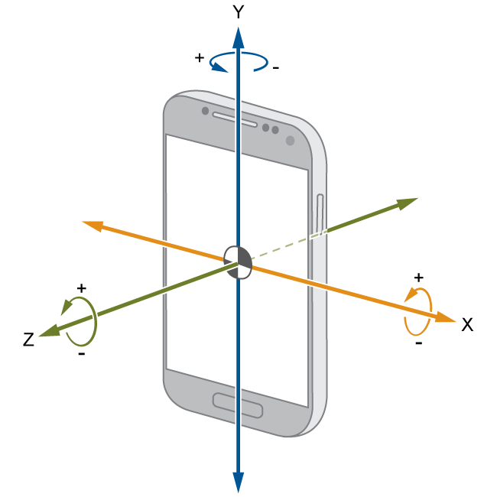
Motivation
There is a need for high-accuracy, infrastructure-less localization:
Harsh environments:
Complex industrial environments
Underground mines
Vessels
Magnetic Localization:
Limited accuracy
Requires stationary steel structures
Not applicable:
e.g., a vessel is a single, huge, steel structure that moves!
IMU Sensors:
Suffer from drifting
Over time the error increases
Require a signal correction every once in a while
-70 dBm

Slide 3
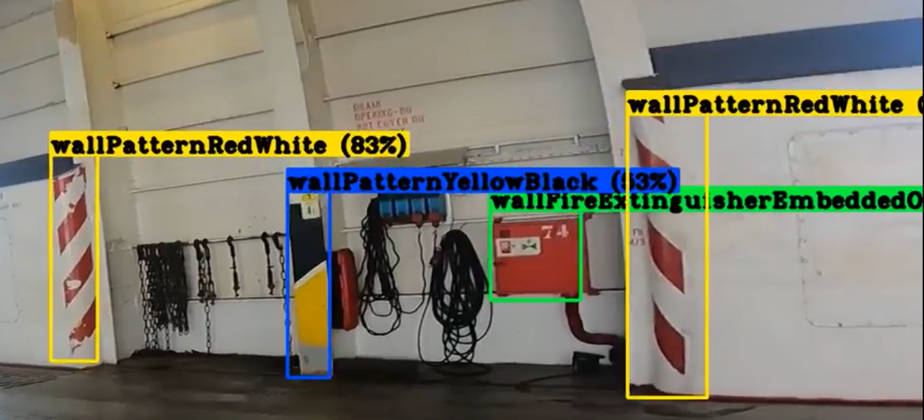
Computer Vision Based Solution
Computer Vision:
the scientific field that deals with how computers can gain high-level understanding from digital images or videos.
Solution Overview:
Generate Dataset
Create Deep Learning Model
Create Localization Database
Localize/Track location utilizing only a camera

Slide 4
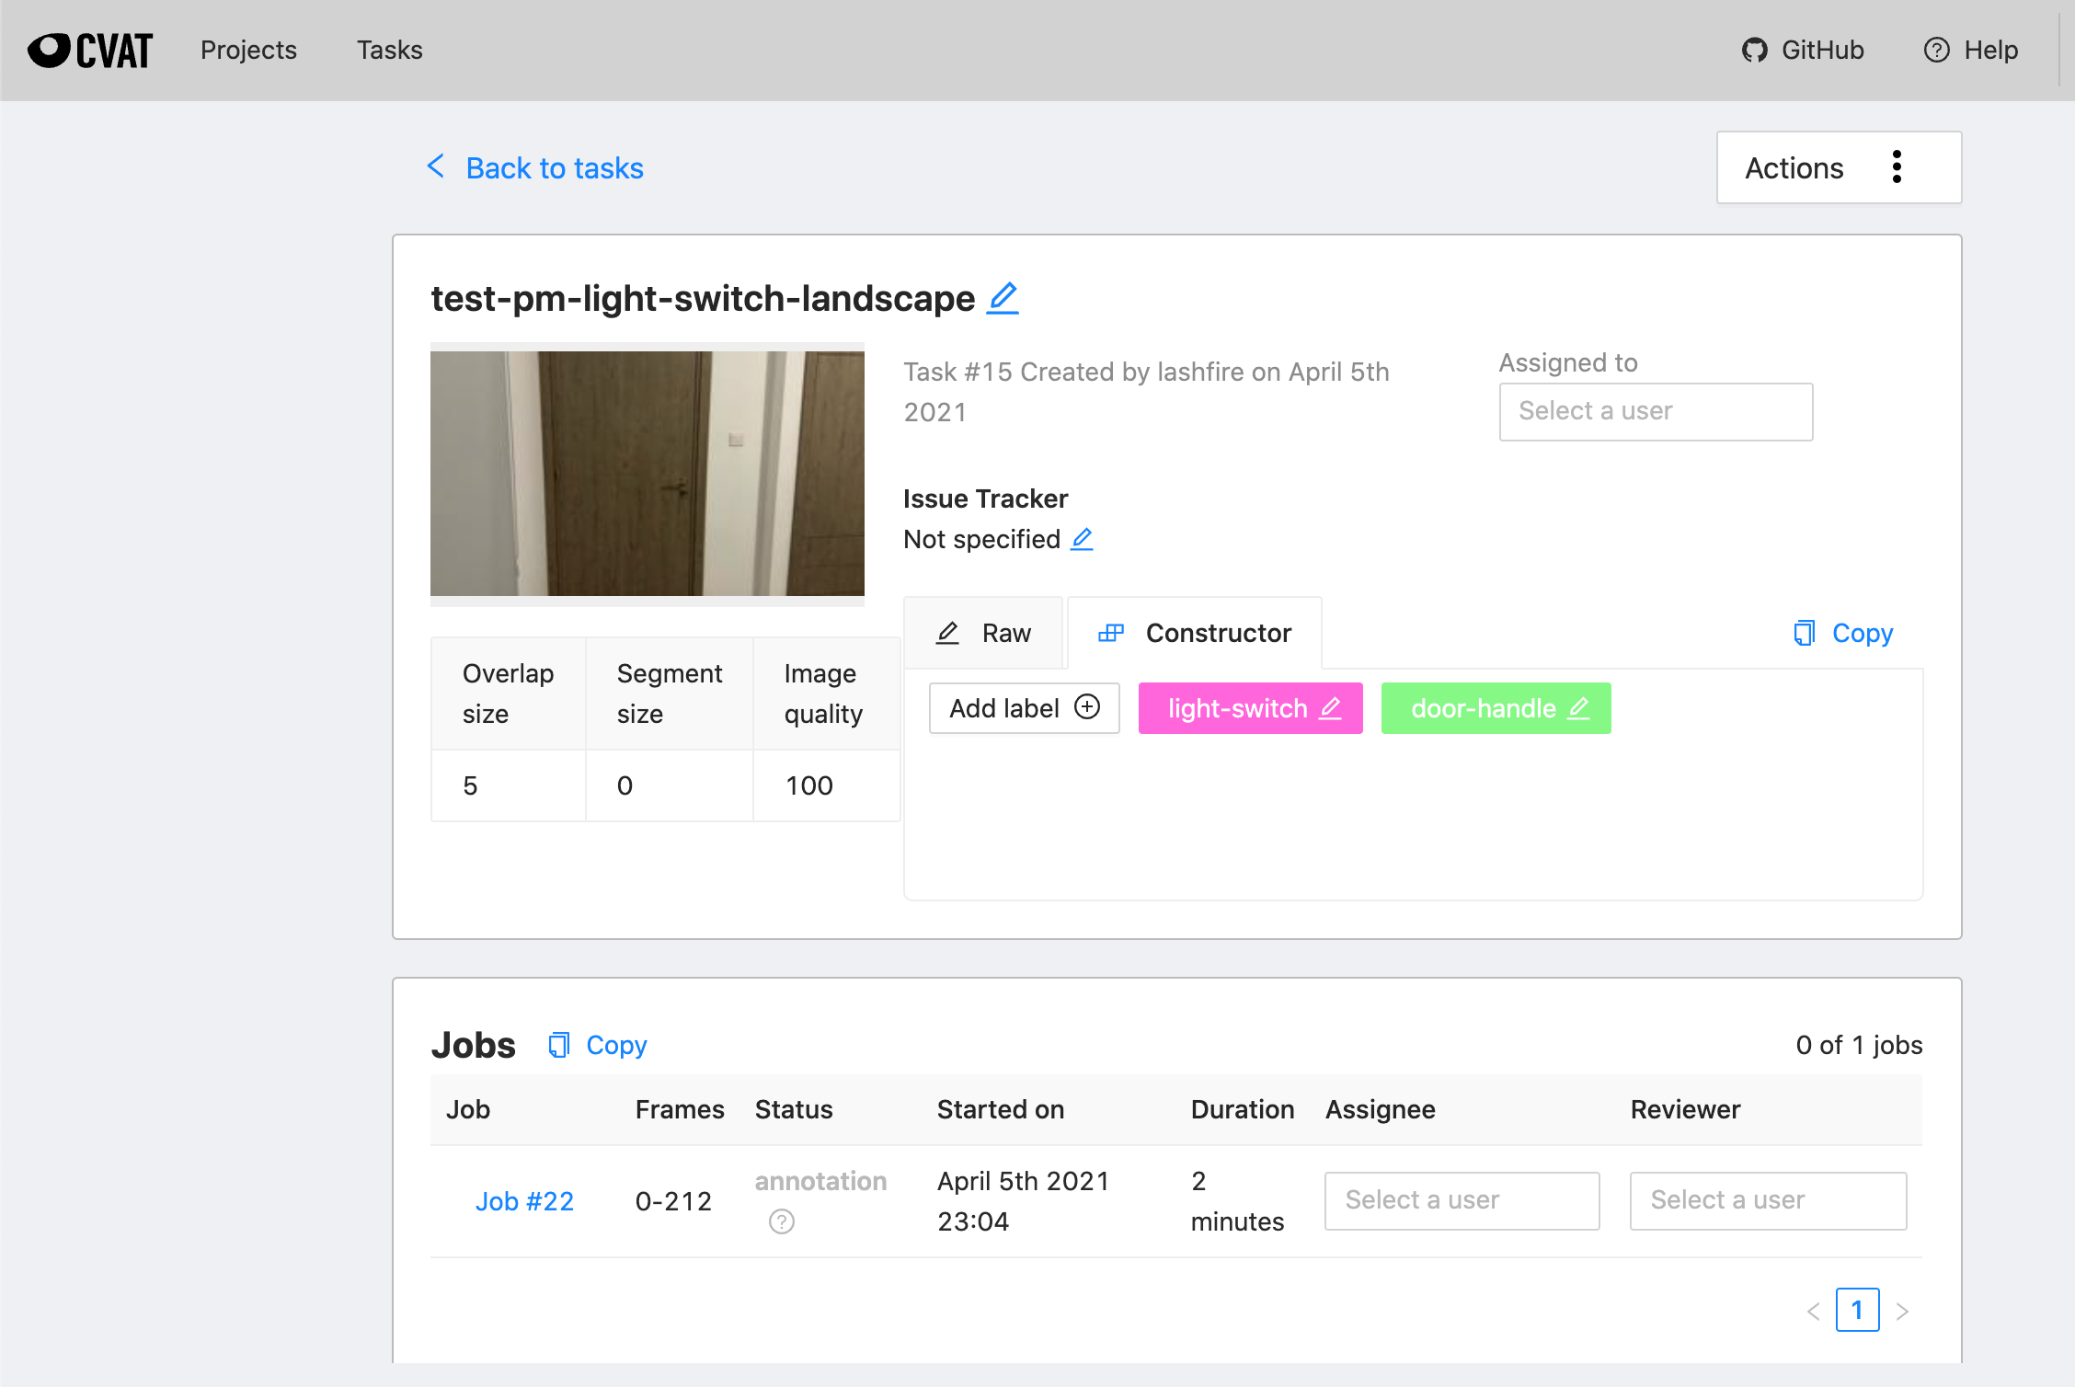
Deep Learning Training
Create a dataset
Users supply video input
Annotate frames with CVAT
2. Train a Deep Learning Model
Use YOLO (Darknet DNN)
Convert it to TensorflowLite
Deep Learning Models (3):
LASHCO: objects found in vessels (~100 classes)
UCYCO: objects found in a university campus (~30 classes)
COCO: common objects (80 classes)
- publicly available dataset
- used for spaces without a custom model
+

Slide 5
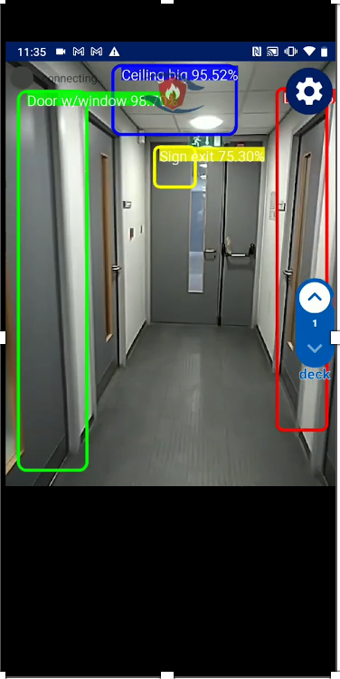
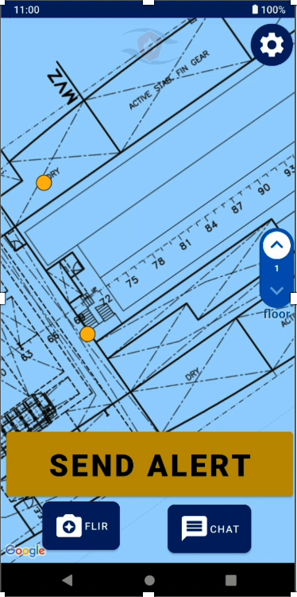
Logging + Localization
3. Create a Fingerprint Database
Utilizing the Anyplace CV Logger Application
Associate spatial coordinates with recognized objects
Utilize crowdsourcing from smartphones
This creates unique fingerprints per location
Visualize the density of the fingerprints
allow users to improve accuracy
can use QR Codes in special circumstances
4. Localizing or Tracking
Acquire physical location based on user surroundings
No infrastructure needed; Just a smartphone’s camera
Location-Aware Smart Alert System for LASHFIRE:
Communicate with nearby users
Chat or Alerts
Reach users: same vessel, deck, KNN, bounding box
Logger
Demo
Localization
Demo
lashfire.eu

Slide 6
AnyplaceCV: Infrastructure-less Localization in Anyplace with Computer Vision
Thank you.
Paschalis Mpeis*, Athina Hadjichristodoulou*, Ioannis Ioannidis*,
Demetrios Zeinalipour-Yazti*
∗Univ. of Cyprus, Cyprus
{pmpeis01, hadjichristodoulou.athina, iioann08, dzeina} @ucy.ac.cy
The 23rd IEEE International Conference on Mobile Data Management July 8, 2022, Paphos, Cyprus (virtual)

