Slide 1
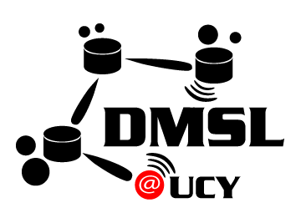




Triastore: A Web 3.0 Blockchain Datastore for
For Massive IoT Workloads
Panagiotis Drakatos∗, Erodotos Demetriou∗,
Stavroulla Koumou∗, Andreas Konstantinidis∗‡,
Demetrios Zeinalipour-Yazti∗
∗ University of Cyprus, 2109 Nicosia, Cyprus
‡ Frederick University, 1036 Nicosia, Cyprus
{pdraka01, edemet01, skoumo01, akonstan, dzeina}@cs.ucy.ac.cy
https://blockdb.cs.ucy.ac.cy/
(Short Paper)
The 22nd IEEE International Conference on Mobile Data Management
Virtual Conference, June 15 - June 18, 2021 Toronto | Canada (online)

Slide 2
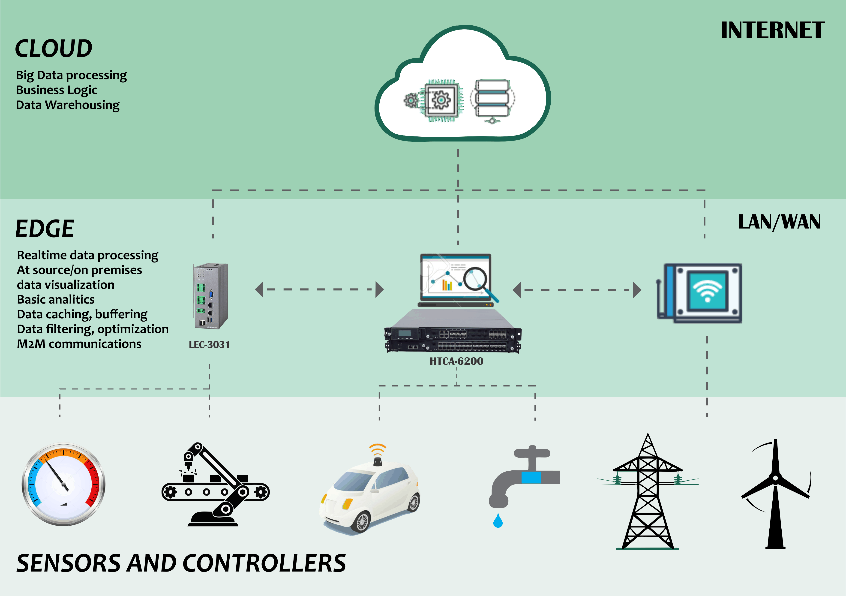
The IoT Revolution
Internet-connected smart devices will drastically increase to >500 for a typical family in the developed world by 2022.
  The IoT revolution is expected to bring the number of such devices close to a staggering 40 billion in 2022, more than double from 2021.
Massive IoT Workloads on the edge generate new business requirements (e.g., transparency)
  Relational (sequel), Document (mongodb), Temporal (influxdb), not ready for these type of workloads. ☹

Slide 3
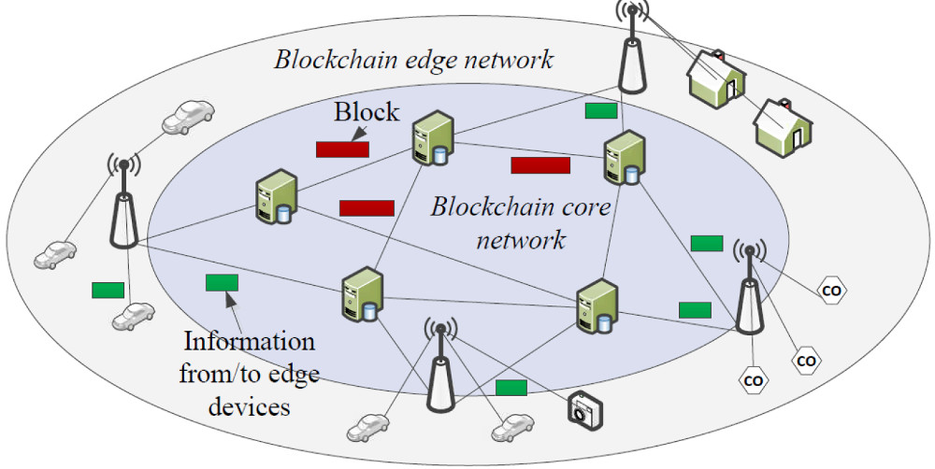
Blockchain Architectures
Blockchain Technology: storing transactional records in a distributed “database” / chain.
  characterized by decentralization and transparency.
  principally used in Cryptocurrencies, but potentially can be used in the IoT industry.
Problem: Transaction verification is expensive (e.g., bitcoin: 10 min / TX)
  Hyperledger Fabric: 3000 TX/sec
  Bitcoin Satoshi Vision (SV): 9000 TX/sec
➔ IoT ingestion still suffers with these throughputs ☹
Let’s see some examples …

Slide 4
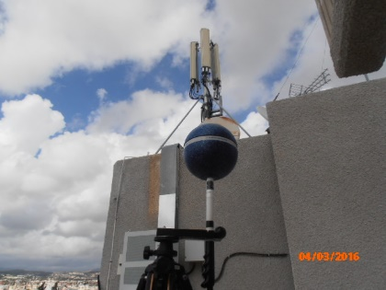
Scenario I: Telco Big Data Auditing System
Telco Big Data (TBD): Data generated at the cell towers with high velocity.
  e.g., signal strength, call drops, bandwidth measurements.
  Size: Huawei reports 5TBs/day for 10M clients (i.e., 2PB/year) for Shenzhen, China.
Web 3.0 TBD Auditing Scenario:
  Telcos report the signal strength of their antennas to authorities (for EMF-compliance).
  All telcos need to have access to measurements reported by other telcos.
Problem: How/Where to store this large velocity data?
https://tbd.cs.ucy.ac.cy/
"Telco Big Data Research and Open Problems", Constantinos Costa and Demetrios Zeinalipour-Yazti "Proceedings of the 35th IEEE International Conference on Data Engineering" (ICDE '19), IEEE Computer Society, Pages: 2056--2059, 8-12 April 2019, Macau SAR, China, 2019.

Slide 5
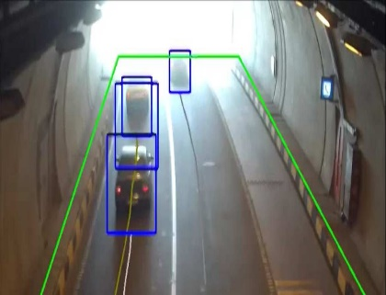
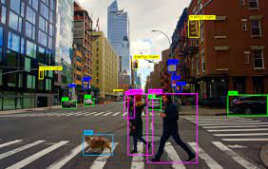
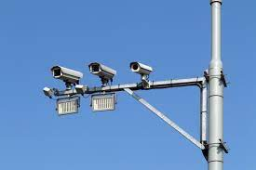
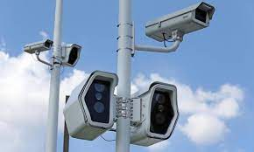
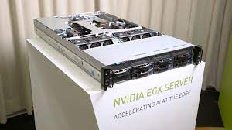
Scenario II: Edge Camera Network
Edge Camera Network (ECN): Cameras carrying out deep learning on the edge of the network.
  Feature extraction and vector generation using tools like YOLO Darknet, Tensorflow, Spark, CVAT.
  Industrial Examples: deep learning, NVIDIA EGX Edge Server, Huawei Smartcity Appliances
Web 3.0 Camera Scenario:
  Authorities need accurate city traffic models
    INRIX reports that congestion costs U.S. drivers nearly $300 Billion in 2016,which is an average of $1400 per driver per year.
  Current solutions (e.g., Google Traffic): using crowdsourcing with smartphones that has privacy issues.
Problem: How/Where to store this large velocity data on the edge?

Slide 6
Triastore Vision
Triastore (inspired by Greek “Tria”, meaning “three”, being a Database for the Web 3.0 era)
  a permissioned* blockchain database system that:
  carries out machine learning at the edge;
  abstracts machine learning in primitive blocks;
  blocks are subsequently stored and retrieved from the blockchain.
* Envisioning a permissioned architecture is somehow more straightforward (from a security standpoint) than a permission-less architecture, so this is our initial focus.

Slide 7
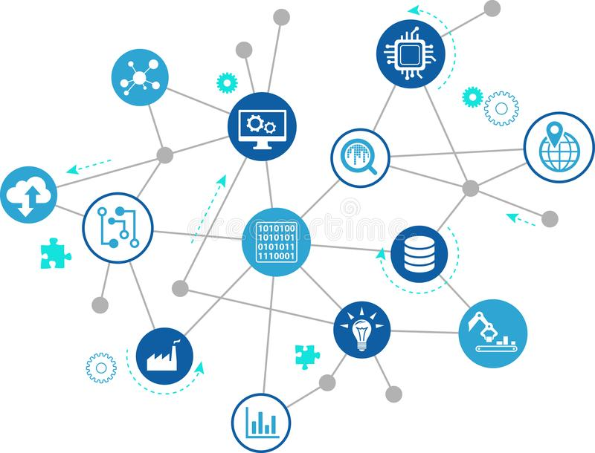
Presentation Outline
Motivation
Triastore
  Triastore Algorithm
  PoFL routine
  Consensus routine
Experiments
Conclusions & Future Work

Slide 8
Triastore Algorithm
Triastore algorithm has 2 internal routines:
  Step 1: Proof of Federated Learning (PoFL) routine
    Trains a global model in a distributed manner
  Step 2: Blockchain Consensus routine
    Commits this generated model data on permissioned blockchain database

Slide 9
Step 1: Proof of Federated Learning (PoFL) routine
Federated Learning (FL): a machine learning technique, which trains models across multiple decentralized edge devices or servers. Each edge device is holding a different dataset.
Advantages of FL with blockchain?
  Reduces data transmission load in the learning process;
  We achieve local training across multiple decentralized edge devices holding local data, without exchanging them;
  Protects data privacy, because distributed nodes do not have the complete data space;

Slide 10
Step 1: PoFL routine
Step 1
Step 2
Step 3
Step 4
s
s
s
s
average
Upload
w1
w2
w3
w1
w2
w3
w1
w2
w3
w1
w2
w3
S (server) chooses statistical model to be trained
S transmits the initial model to several nodes
Nodes train the model locally with their own (edge) data
Central server pools model results and generate one global model without accessing any data
Problem: Applying FL on Blockchain would result in expensive PoW (Proof-of-Work) computation ☹

Slide 11
Step 2: Blockchain Consensus routine
Consensus protocol: aims to minimize the expensive PoW computation by providing training coins to users that participate in the training process.
  Nodes receiving the most accuracy coupled with the difficulty of the block are recognized as the winner of the given round.
  In every training round the coins will be adjusted to the users depending on their work.
    Coins are mapped to physical application scenario semantics (e.g., Telco or Video Scenario coins are owned by Participating parties)
Step 4
s
average
Upload
w1
w2
w3

Slide 12
Step 2: Consensus Routine
Fabric Node
Pack into block B
Broadcast B
Consensus process
Retrieve models
Broadcast TS
Add Blocks
Add Blocks
Broadcast TS
Generate training model records
Transaction TS

Slide 13
Presentation Outline
Motivation
Triastore
  Triastore Algorithm
  PoFL routine
  Consensus routine
Experiments
Conclusions & Future Work

Slide 14
Experimental Methodology
To evaluate Triastore, we have implemented an experimental testbed evaluation of our data ingestion algorithm:
  CNN convolution layer:
    filters: two convolution layers with 32 and 64 filters, respectively - responsible for setting the communication channels dynamically based on the width and the height of the image.
    Pool Size: set dynamically (2,2)
    Kernel size: 5
    Dropout: Convolution layers followed by a dropout with a probability of 0.7
    Dense Layers: two fully connected layers with 512 units
    activated by ReLu and a softmax output layer.
  Metrics:
    CPU and GPU accuracy in terms of throughput: The total rate of the transactions that is proceed in the Triastore.
    CPU and GPU loss in terms of latency: The time taken to fit the actual blockchain data from PoFL routine to the blockchain consensus layer.

Slide 15
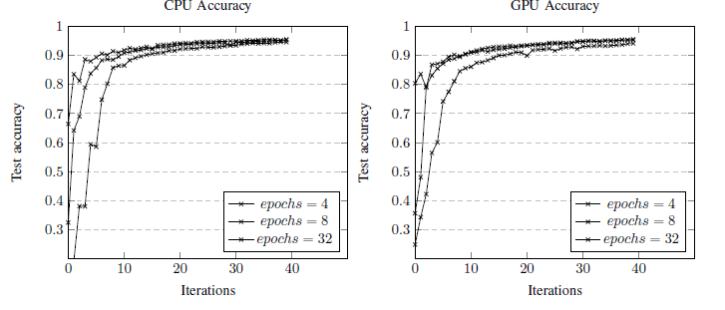
Experimental Study 1: Accuracy
Observations:
The proposed federated learning approach achieves high accuracy (95%) with a small set of iterations for both CPU and GPU metrics.
First 10 rounds, Fast Convergence for both CPU and GPU. The accuracy of the model increases with the increase of the epoch.
  Why? Fitness for the Federated learning method
After 35 rounds, the accuracy is slightly reduced (by 2-4%) or remains the same, especially for the models trained with larger epoch values.
  Why? Model overfitting after a certain epoch.

Slide 16
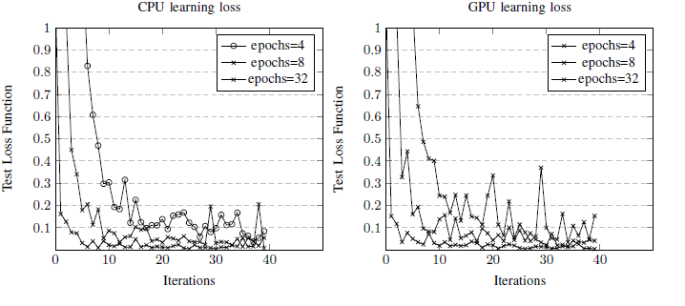
Experimental Study 2: Learning Loss
Observations:
The learning loss is generally high at the beginning, and it highly depends on the epoch value.
The results show that when the epoch value is 32, the learning loss is reduced to almost zero, after round 10.

Slide 17
Presentation Outline
Motivation
Triastore
  Triastore Algorithm
  PoFL routine
  Consensus routine
Experiments
Conclusions & Future Work

Slide 18
Conclusions and Future Work
Current Status:
  We have implemented Triastore, which is the storage/blockchain sub-system of Triabase.
  Additionally, Fabric Deployments on a 9-node configuration.
Future Work:
  Privacy needs to be carefully handled in IoT environments. (ε-differential, k-anonymity, l-diversity, etc.)
  Open-source and application-specific deployment of Triabase to some Web 3.0 scenario.

Slide 19

Triastore: A Web 3.0 Blockchain Datastore for
For Massive IoT Workloads
Thank you!
Panagiotis Drakatos∗, Erodotos Demetriou∗, Stavroulla Koumou∗,
Andreas Konstantinidis∗‡, Demetrios Zeinalipour-Yazti∗
∗ University of Cyprus, 2109 Nicosia, Cyprus
‡ Frederick University, 1036 Nicosia, Cyprus
{pdraka01, edemet01, skoumo01, akonstan, dzeina}@cs.ucy.ac.cy
https://blockdb.cs.ucy.ac.cy/
The 22nd IEEE International Conference on Mobile Data Management
Virtual Conference, June 15 - June 18, 2021 Toronto | Canada (online)

