Slide 1
COVID-19 Mobile Contact Tracing Apps (MCTA): A Digital Vaccine or a Privacy Demolition?
Demetris Zeinalipour Christophe Claramunt
University of Cyprus, Cyprus French Naval Academy, France
dzeina@cs.ucy.ac.cy christophe.claramunt@ecole-navale.fr
http://mdmconferences.org/mdm2020/panel.html
Panel Overview Paper: http://tiny.cc/cqioqz

Slide 2
IEEE MDM’20 Panelists
Vania Bogorny
Federal University of Santa Catarina, Brazil
Yannick Léo
Emerton Data, France
Stan Matwin
Dalhousie University, Canada
Thierry Roussel
Alstom SA, France
Moustafa Youssef
Alexandria University, Egypt
Demetris Zeinalipour
University of Cyprus, Cyprus
Co-Chair
Christophe Claramunt
French Naval Academy, France
Co-Chair

Slide 3
The COVID-19 Pandemic
COVID-19 global pandemic emerged in the late 2019 causing a massive global health disruption with many fatalities and huge economy impact, enforcing most if not all governments to an almost global lockdown.
Virus: SARS-CoV-2, Disease: COVID-19 (no treatment, vaccine: early 2021?, other pandemics?)
To this date, there have been around 10M confirmed cases, with 5.09M cases recovered and 500K deaths [Google].

Slide 4
COVID-19 Pandemic and MCTA
ICT contribution to Pandemic Management
Intelligence tracking, infection hotspots dashboards, AI-inspired Deep Learning self questionnaires, e-collaboration, faster/wider communication channels.
CT (Contact Tracing) by epidemiologist required massive human resources & collaboration
US estimates: between 100,000 and 300,000 manual CTs.
Desiderata: (i) Faster Process; (ii) Prevention vs. Intervention
Mobile Contact Tracing Apps (MCTA) have been on the frontline of these efforts.
Mobile apps exploiting the rich ecosystem of mobile sensors (e.g., location, proximity) and notification cues to enable CT.

Slide 5
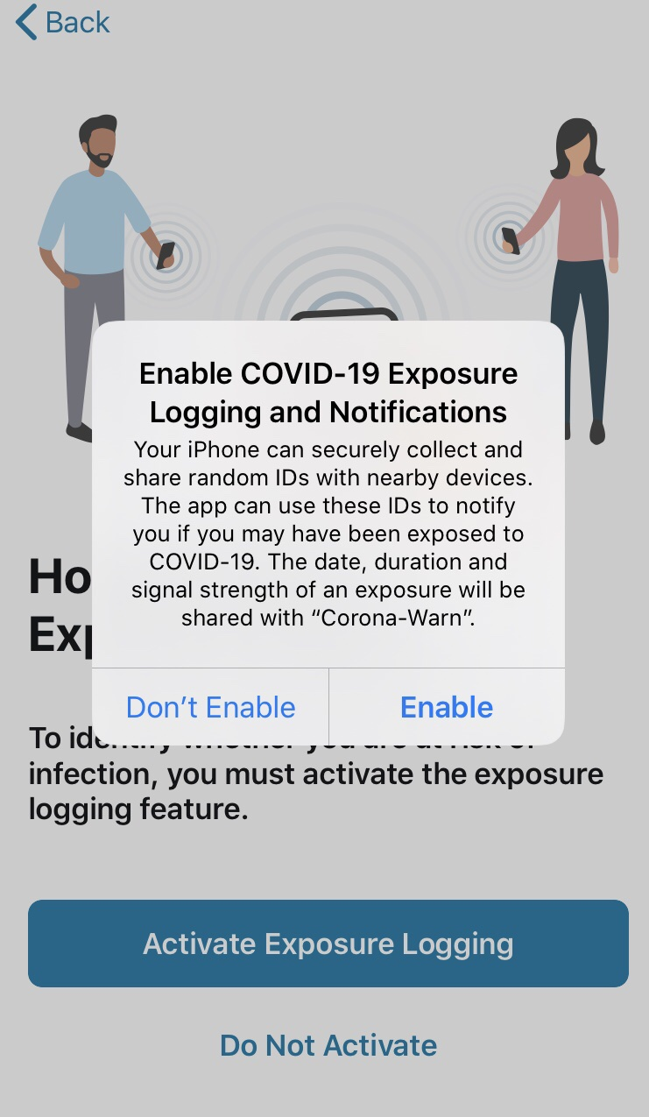
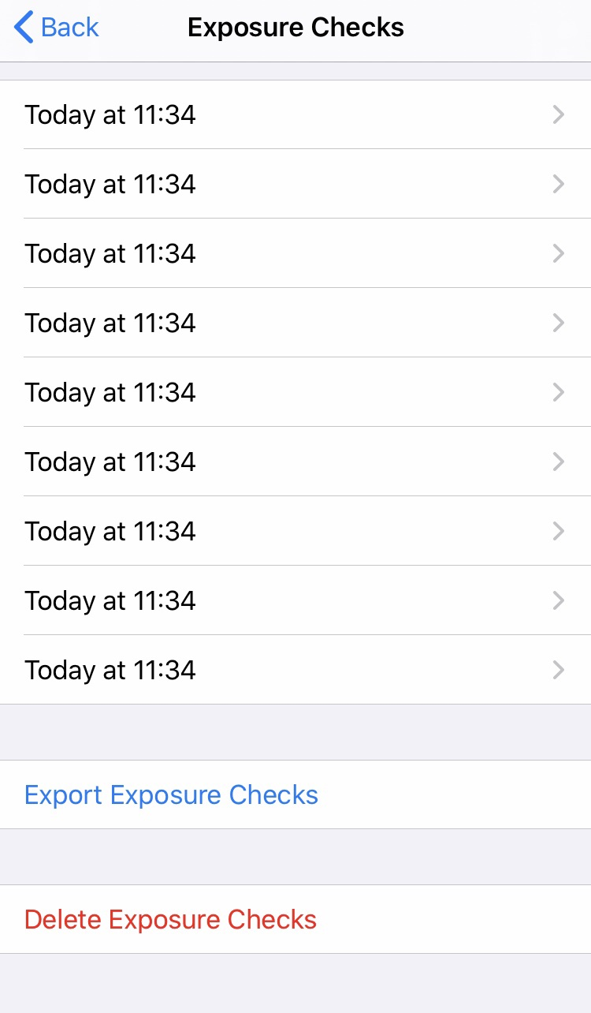
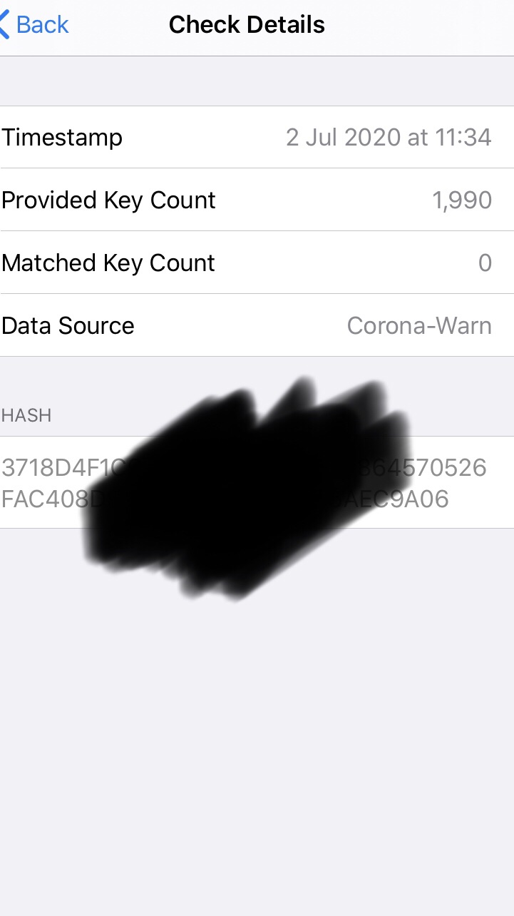
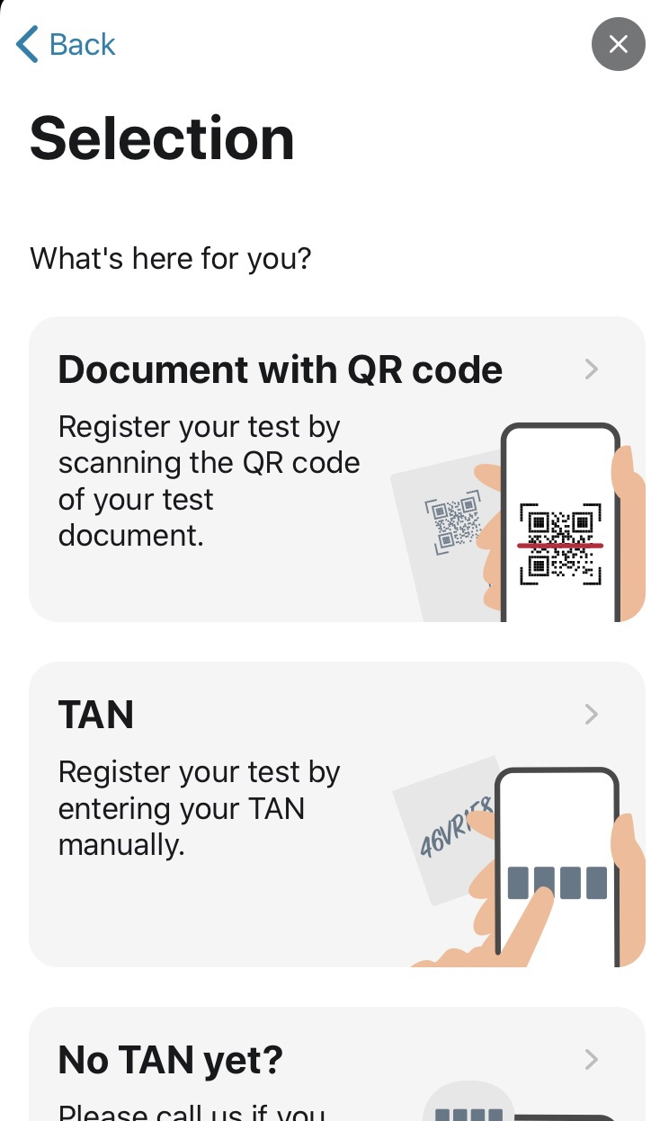
Current State of MCTA
MCTA Apps Centralized
No Privacy: India (Aarogya Setu), China (QR code),
Privacy: France (Stop-Covid/DESIRE), …
MCTA Apps Decentralized
Switzerland (DP-3T), Germany (Corona-Warn-App: on DP-3T + TCN protocols + Google/Apple GAEN), …
No MCTA?
Belgium, …“There is no need for an app for contact tracing, it can be done manually and it has been around for years,” Belgian Telecom Minister Philippe De Backer.
Notes:
DESIRE: https://hal.inria.fr/hal-02570382/document

Slide 6
MCTA Challenges
Privacy or Expectation Skeptism: Some custodians afraid of totalitarian regime formation or some just lack the information to install and use it (whether it works?) or rely on traditional distancing means.
France 1.9M/50M=3.8% (14 notifications!), Germany: 13-16%, generally 5-20%.
Socio-cultural differences on what costitutes a privacy violation. GDPR in EU.
Penetration Rate: More than 60% of population require MCTA installation for CT effectiveness (like real vaccines). 16+ age limit?
Technology: BLE didn’t initially worked as expected on various Mobile OSes
Battery drainage (singapore), device incompatibilities (older phones).
Google Apple Exposure Notification (GAEN) framework to rescue (GAEN cloud?)
Security Attacks: disinformation and malicious attacks remain an open issue (e.g., Exposure Log hacking / QR/TAN cracking).
Other: Cross-country (e.g., country, EU or US-wide), Domain-specific MCTA (e.g., general, beach, indoor/surface/indirect tracking?)
Notes:
https://techcrunch.com/2020/06/23/french-contact-tracing-app-stopcovid-has-been-activated-1-8-million-times-but-only-sent-14-notifications
https://en.wikipedia.org/wiki/List_of_countries_by_smartphone_penetration

Slide 7
Position Statement by Panelists

Slide 8
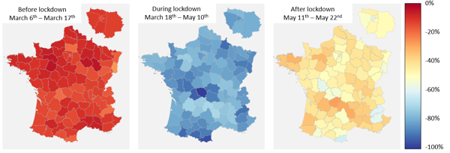
Evolution of departemental flows in France (see Face Au Virus report)
Yannick Léo
Data Scientist
yannick.leo@emerton-data.com
Data Scientist at Emerton Data ¹
Active research in Machine learning & Responsible AI
8 years of experience in Data Science
Former data scientist at Sodexo Digital Group team
PhD in computer science at ENS de Lyon/INRIA
Overall opinion about Mobile Contact Tracing Apps
I am, personally, in favour of developing MCTA to support the health authority strategy in order to fight against Covid. Yet, MCTA is not a magic solution but only a tool. Without any strong and clearly political strategy, the MCTA is useless (remember that with 10% of adoption, only 1% of contacts are detected…).
Yet, the development should be led by a trusted entity, like INRIA in France and not OS provider, in order to be confident on the way the data is stored and used. On data aspects, the key is to be aware on how the data is circulating very precisely and not only on a centralized/decentralized perspective.
Technically, MCTA can be based on bluetooth low energy and ultrasound that are complementary. For user interface, the ideal interaction with users is to activate it and hopefully nether have any alerts from it. MCTA should be simple and clear as in StopCovid.
Covid contributions related to MCTA
Public report –“The French have returned to their usual level of walking during confinement in collaboration with Startup Weward – May 2020
Public report – “Observations on mobility during Covid-19” in collaboration with INRIA, CNRS and PSL – May 2020
Face Au Virus project: gather several mobility data from Facebook, Roofstreet and other companies to measure the localized parameters of the spread and build a regional model. Collaboration with INRIA, CNRS & PSL (see figure top right)
SafeCityMap project: estimate the risk of spreading in each area of a city such as Paris. Collaboration with INRIA and IGN
1. Emerton Data is supporting companies to define a digital strategy, to implement the data transformation and to create industrialized data & AI products. It is the digital/data/AI entity of Emerton Strategy Consulting (see www.emerton-data.com).

Slide 9
Vania Bogorny
Head of the Computer Science Graduate Program at UFSC
Main research area: Mobility Data Analysis and Machine Learning, also interest in Privacy Issues in Mobility Data Analysis
Covid Contributions:
Member of the Covid Community Alert Contact Tracing (a global team) https://coronavirus-outbreak-control.github.io/web/
Project Privacy-aware Contact Tracing with Knowledge Mining Mechanisms to Monitor and Understand the COVID-19 Pandemic (HPC Consortium Financial Support)
MCTA will work with a strong political engagement for population adherence
MCTA should be defined by the scientific community, and not OS providers or companies
It is possible to have a balance between a Privacy-Aware MCTA and a directed quarantine
Analysis of anonymous contact data is crucial to learn more about the pandemic
The pandemic is leading to a change of paradigm, from individual to collective
Overall opinion about MCTA
Vania Bogorny
Federal University of Santa Catarina (UFSC), Brazil
vania.bogorny@UFSC.br

Slide 10
Stan Matwin
Stan Matwin, Canada Research Chair with longstanding interest in both data privacy and in mobility data analytics
To have “epidemiological teeth” fully distributed voluntary systems will not be sufficient
There is a basic antonymy between privacy and MCTA
Current privacy frameworks (e.g., differential privacy) are inadequate
We have to develop tech solutions for
Data autodestruction
Sunset clause guarantee
Use Limitation Principle guarantee
Stan Matwin
Dalhousie University, Canada

Slide 11
Thierry Roussel
Covid tracing and alerting
Should be managed at country level, rather than company level :
Require large coverage of population
Overlap Pro and Perso areas
Many existing country level initiatives and regulation
Many variations from country to country, regulation, habit, unions, health system, balance privacy vs safety
Ex : France => StopCovid app, India => Aarogya Setu
8.2B€ sales
9.9B€ orders
38 900 employees
105 sites in 60+ countries, offices, factories, depots
Just acquiring Bombardier transportation to reach roughly 75 000 people
Products:
Train, High Speed, Intercity, Regional, Tramways, metro
Train maintenance
Signaling systems
Infrastructure / tracks
Digital mobility solutions
Electric Bus
Moto :
Mobility by Nature
Facilities adjustment
Main focus is managing people density :
Low density in factory and depots => ok
Promote home office (our IT system allows everyone to work from home)
Keep max 15% of people at work
50% of seats and desks have been removed or banned
Short term :
We are considering apps to book when you plan to come to the office
Mid term to be investigated :
Flex offices, advanced home office management, eventually bringing office sharing (WeWork) into the game closer to where people are
Challenges for apps
Privacy vs Safety
If safety then who owns data? Country government? Country company? International company (Google, Apple)?
No one can anticipate how much cleverness we can get from data, cf Cambridge Analytica
Individual choice => What does it change for me?
Collective choice => Soft geopolitics?
In case of pandemic, times matter, safety is argument for everything
=> Let’s build respectful technologies much before
Thierry Roussel
Alstom SA, France

Slide 12
Moustafa Youssef
Location determination technologies from both academia and industry
GPS
Doesn’t work everywhere
Not accurate enough
Not ubiquitous – high-end phones only!
Need fine-grained accuracy indoors
Bluetooth (Apple and Google API)
Still, not fine-grained enough
Ubiquitous indoor localization – works on any phone, anywhere
Privacy concerns
Anonymizing, reusable IDs, etc
Trusted party
New approaches?
Moustafa Youssef
Alexandria University, Egypt

Slide 13
Questions / Answers & Audience Engagement 8 Questions to Panelists (5-8 minutes each) + 2 minutes Audience Q/A after each Question

Slide 14
Question 1
What are the most prominent Privacy and Ethical aspects you see with MCTA?
Tracking: MCTA can monitor custodians at a very fine resolution in real-time and in retrospective.
Re-identification: mobility traces are highly correlated and unique, as such, the re-identification privacy threat is imminent.
Pseudonymization vs. Anonymization: indirect tracking technologies (e.g., hashing of BLE, Wi-Fi MAC through temporal cryptographic functions yielding Ephemeral IDs), can eventually be attacked violating location privacy.

Slide 15
Question 2
Mobile Operating System vendors are developing their own MCTA. What are the pros and cons of this approach?
Google and Apple, as the predominant smartphone OS vendors, have a 99% market share
Temporary Exposure Key that is generated every 24 hours for privacy consideration and is used in local BLE broadcasts in the form of a Rolling Proximity Identifier that changes every 15 minutes.
Status: The Apple/Google Approach used by UK, Germany, France and other countries as part of open-source or custom-made solutions

Slide 16
Question 3
What is the role of coordinated open-* (open protocols, open data and open source) in MCTA advancement?
An issue is that even though the protocol might be open, the software and/or the deployment might eventually be closed
Replicating open-source developments is risky => lack of deep domain understanding can potentially undermine important aspects of application integrity, security and correctness of collected data.
promoting open data through crowdsourcing could promote awareness for common good.
New technical challenges: online entity disambiguation from streaming data as well as identification of false statements.

Slide 17
Question 4
What are the right architectures, functionalities and interfaces for MCTA?
Basic focus so far on Centralized vs. Decentralized.
However, privacy attacks have not been extensively studied
e.g., certain quasi-identifiers might be compromised in the future leading to privacy breaches (i.e., k-anonymity, l-diversity and t-closeness).
Are distributed approaches fundamentally more secure?
What happens if the cell phone is stolen or a malware installed on device stealing and linking the data?

Slide 18
Question 5
What are the technical challenges for MCTA?
The low installation penetration rate of MCTA apps (currently 5-20%) might constitute MCTA useless altogether, if these are not used by all users but there are also technical challenges.
Battery drainage of smartphones (Singapore’s TraceTogether app) or depletion of data plans.
possible malfunctioning of sensors on the smartphone
device diversity issues, where different vendors report signal measurements on different scales

Slide 19
Question 6
What are the correct localization/proximity technologies for MCTA given the wide spectrum of technologies?
localization and proximity literature is very broad and diverse:
GNSS, Infrared, Light, Bluetooth, visual or acoustic analysis, RFID, Inertial Measurement Units, Ultra-Wide-Band, Sensor Net- works, Wireless LANs, Computer-Vision-based, etc.; combinations into hybrid systems.
Do we actually need this type of accuracy in MCTAs or are semantic trajectories (and semantic proximity) sufficient to protect people with the right level of accuracy?
Shouldn’t MCTA contact/proximity tracing technology (i.e., BLE advertising) be more thoroughly tested before being deployed at such large scale (battery, reliability, compatibility)?

Slide 20
Question 7
What is the precise scope of MCTA?
Should MCTA be used to speed up the Contact Tracing Process by Epidemiologists (a posteriori?) only or should these also protext us (a priori? / GAEN Exposure Logging?)
Domain-specific Contact Tracing (e.g., beaches, like Belgian Flemish Region Beach Hotspot App)
How MCTA data could be made available across regions and countries for further epidemiology analysis and forecast?
Finally, might MCTA replace fully CT in the future?

Slide 21
Question 8
Is more legislative reform necessary before MCTA can be used with confidence?
EUs eHealth voluntary Network: Common EU Toolbox for Member States [23]
European Data Protection Board (EDPB) has also announced its own recommendations [24]
Professional bodies like ACM Europe [26]
Australia: Privacy Amendment of Public Health Contact Information [25]
Should legislation emerge after short term technical challenges are settled or the the other way around?
Are these centrally developed guidelines more effective than the open-* approaches?

Slide 22
Conclusion
There are ethical and technical concerns, problems and challenges with MCTA, as scientists we should be part of the game, as citizens we should think collectively!
Unclear whether current directions will lead to the uptake of MCTA in the next period as well as preparing us for the next pandemics.
The expectation (hope) that mobile phones and other means can help curb the panedemic still are there.
Shouldn’t we continue investigating and researching at full pace, to use the COVID-19 pandemic as a testbed to setup a global “digital vaccine”?
“Now this is not the end. It is not even the beginning of the end. But it is, perhaps, the end of the beginning.” - Winston Churchill

Slide 23
COVID-19 Contact Tracing Publication Deadlines
Prior Publication Efforts
IEEE Data Engineering Bulletin on Contact Tracing, Haixun Wang, June 2020, Vol. 43 No. 2
"COVID-19 Mobile Contact Tracing Apps (MCTA): A Digital Vaccine or a Privacy Demolition?", Demetrios Zeinalipour-Yazti and Christophe Claramunt, IEEE MDM’20. Slides
Ongoing Publication Efforts
KDD’20 Workshop: Challenge on Mobility Intervention for Epidemics, July 17, 2020.
Big Data Research Journal, SI on Big Data in Epidemics, Sep. 15, 2020.
Journal of Location Based Services, Georg Gartner, Nico Van de Weghe, Haosheng Huang, Deadline: 31 August 2020
ACM Transactions on Spatial Algorithms and System, Mohamed F. Mokbel, Li Xiong and Demetrios Zeinalipour-Yazti (TSAS), Deadline: October 2020 (TBA)
Tracing {
Contact

Slide 24
COVID-19 Mobile Contact Tracing Apps (MCTA): A Digital Vaccine or a Privacy Demolition?
Thank You!
Demetris Zeinalipour Christophe Claramunt
University of Cyprus, Cyprus French Naval Academy, France
dzeina@cs.ucy.ac.cy christophe.claramunt@ecole-navale.fr
http://mdmconferences.org/mdm2020/panel.html
Panel Overview Paper: http://tiny.cc/cqioqz
IEEE MDM 2020 - The 21st IEEE International Conference on Mobile Data Management, June 30 - July 3, 2020, Versailles, France (online)

