Slide 1







The Anyplace 4.0 IoT
Localization Architecture
Paschalis Mpeis∗, Thierry Roussel§, Manish Kumar⁺, Constantinos Costa‡, Christos Laoudias∗, Denis Capot-Ray§, Demetrios Zeinalipour-Yazti∗
∗Univ. of Cyprus, Cyprus §Alstom SA, France ⁺Infosys Ltd, India ‡ Univ. of Pittsburgh, USA
pmpeis01@cs.ucy.ac.cy, thierry.roussel@alstomgroup.com, manish.kumar156@infosys.com,
costa.c@cs.pitt.edu, laoudias@ucy.ac.cy, denis.capot-rey@alstomgroup.com, dzeina@cs.ucy.ac.cy
The 21st IEEE International Conference on Mobile Data Management
July 3, 2020, 12:45-13:00 CEST, Versailles, France

Slide 2
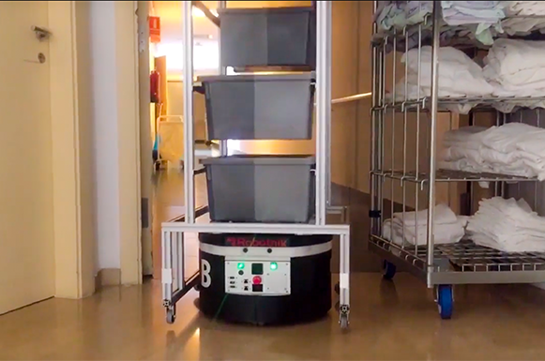
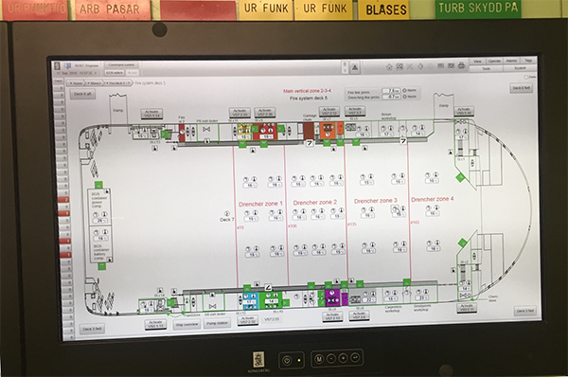
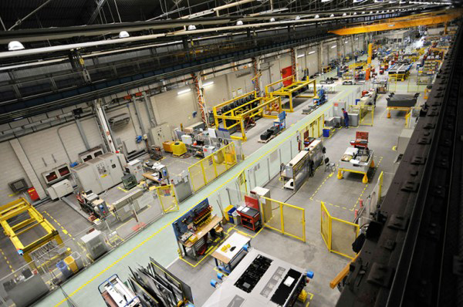
Motivation
There is an unprecedented demand for indoor-space localization and tracking in smart spaces
  Healthcare:
    Integrate with a fleet of robots
    Safe, efficient, logistic applications in care homes
  Emergency response:
    Provide 3D localization and guidance
    Increase fire safety in ro-ro cargo ships
  Alstom Smart factory:
    Rail manufacturer corporation
    Location awareness and asset tracking
      enhance guidance, optimizing routes, improve supply reliability
endorse-project.eu
lashfire.eu
*main focus of this paper*
alstom.com

Slide 3

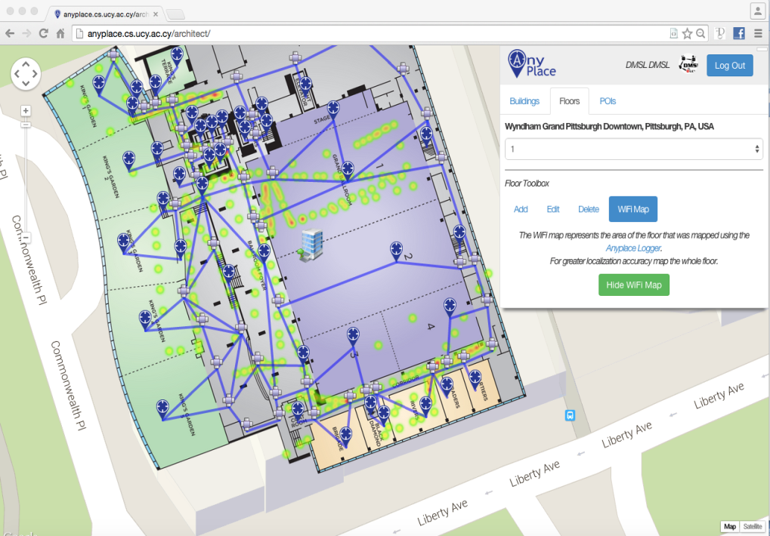
Anyplace
Compete Internet-based indoor navigation platform
  open source, active community github.com/dmsl/anyplace
  Accuracy: 1.96m (multiple awards)
  Crowdsourcing and Fingerprinting
Online modelling tool
  Takes a minute to model a building
  ~1 hour to offer navigation and search
  in a 2500sq meter indoor space
  270 forks & 500+ stars
  ~200,000 user sessions
  ~3800 service activations
anyplace.cs.ucy.ac.cy

Slide 4
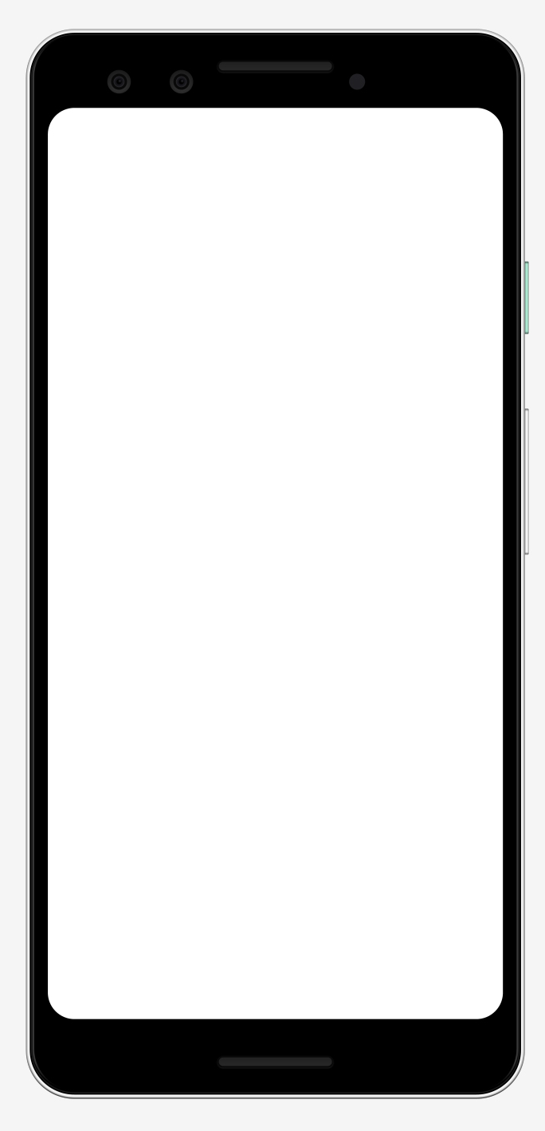
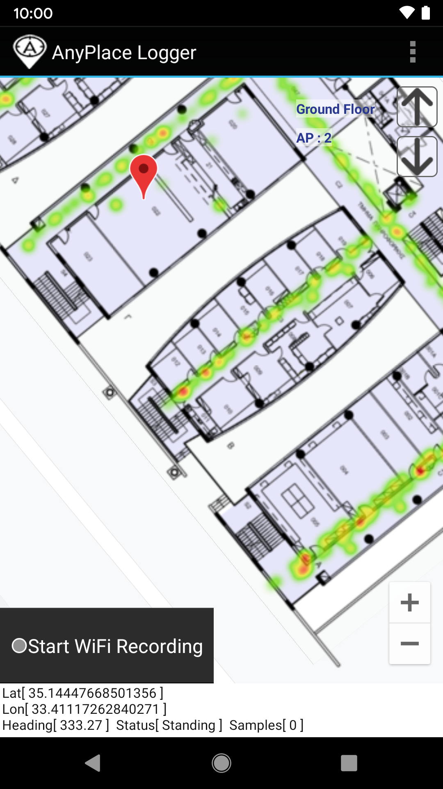


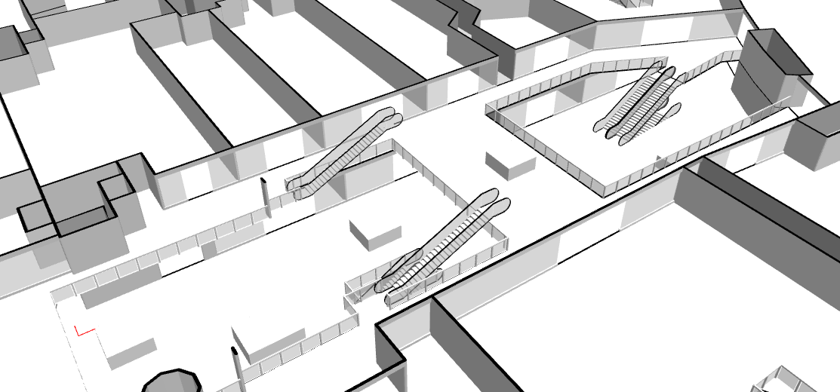
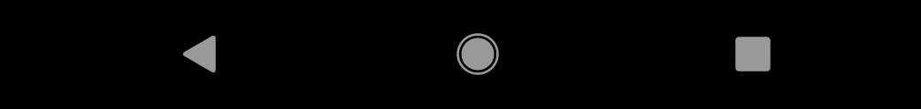
Anyplace: Logging
Wi-Fi fingerprinting
  Received Signal Strength Indicator (RSSI)
    Power measurement present in received
    radio signals (measured in dBm)
      Low-power 125 mW (RSSI probing) vs. 400 mW (transmit)
      Readily available in smartphones
Wi-Fi Mapping
  Collect measurements while walking
  in straight lines
  Heatmaps can guide crowdsourcers on the
  density of fingerprinting
Ground floor
AP: 2
-70 dBm
AP1
-51 dBm
AP2

Slide 5
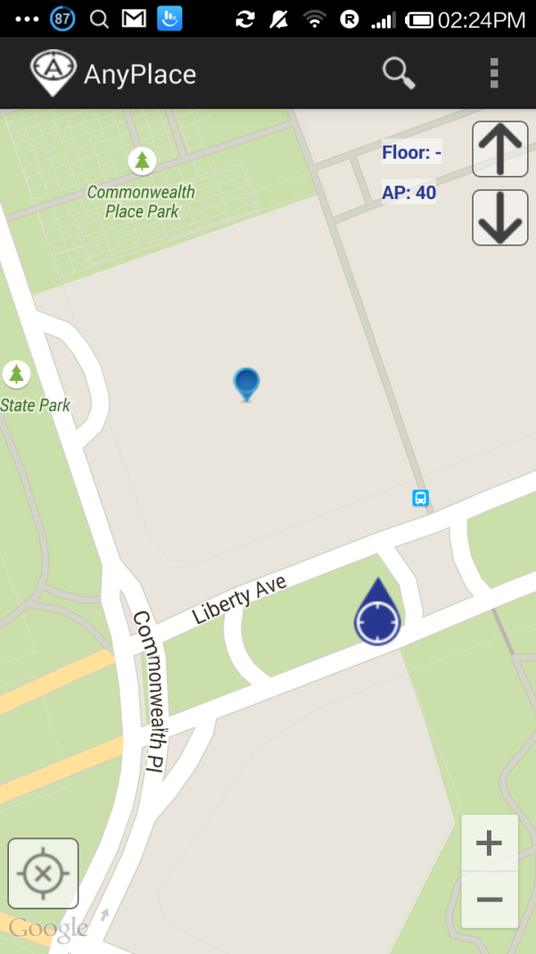
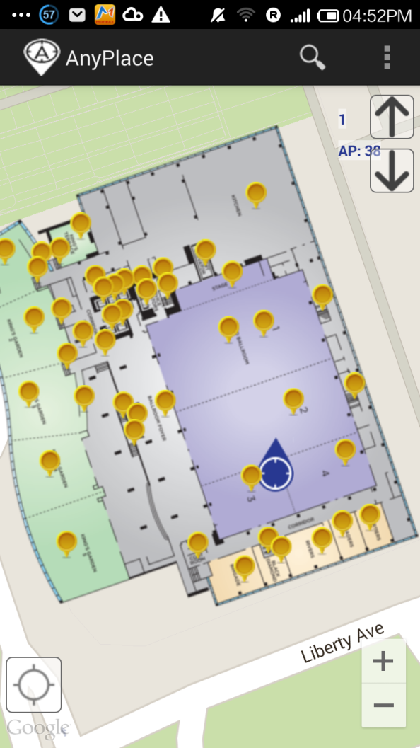


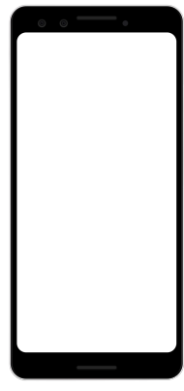


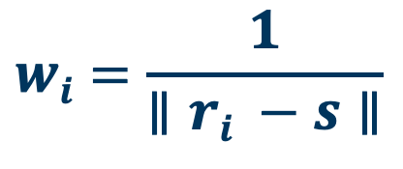
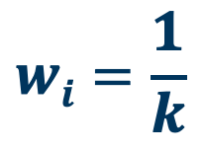
Anyplace: Localization
Wi-Fi positioning
  Collect fingeprints
  Compute distance and position user
    Nearest Neighbor (NN)
    K Nearest Neighbors
    Weighted K Nearest Neighbors
$$\text{s}\text{ = [ }\text{s}\text{1}\text{, }\text{s}\text{2}\text{, .., }\text{sn}\text{ ]}$$
$∥\text{r}\text{i}\text{ – }\text{s}$ $∥$
$$wi=\frac{1}{k}$$
$$wi=\frac{1}{∥ri −s∥}$$
-70 dBm
s = [ -70, -51]
Before
Google maps API
After
Anyplace Location &
Indoor models
NN/KNN/wKNN
AP1
-51 dBm
RadioMap
r₁ = [ -71, -82, (x₁,y₁) ]
r₂ = [ -65, -80, (x₂,y₂) ]
…
r_{n} = [ -70, -52, (x_{n},y_{n}) ]
AP2

Slide 6

















Anyplace: Shortcomings
Backend
  Elasticity:
    Server cannot run on the edge
      RISC architectures
      low-end devices (e.g., 1GB RAM)
  Ease of deployment
Frontend
  Portability
    Frontend cannot run on many environments
    Difficult to develop and maintain for many clients
      Robotic frameworks and emerging IoT OSes
      Existing desktop OSes

Slide 7
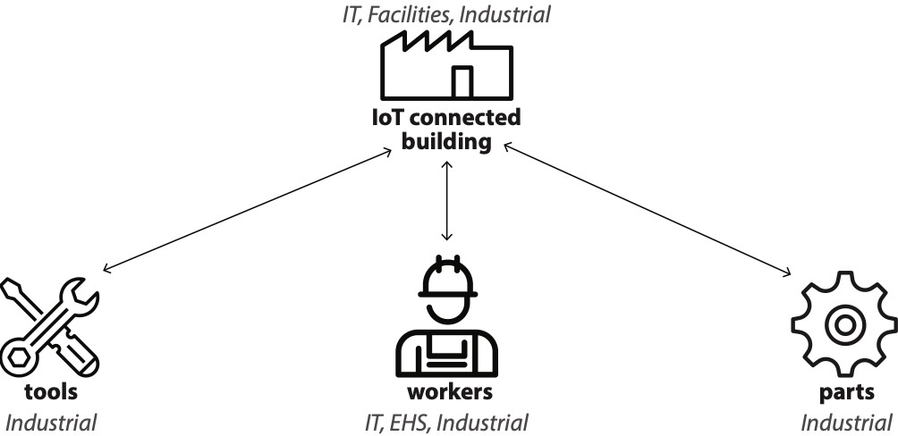
A4IoT Requirements: Alstom Smart Factory
Smart factory components:
  Multiple smart-buildings constitute a smart-factory
  Assets:
    interconnected within smart-buildings
    divided into 3 categories:

Slide 8
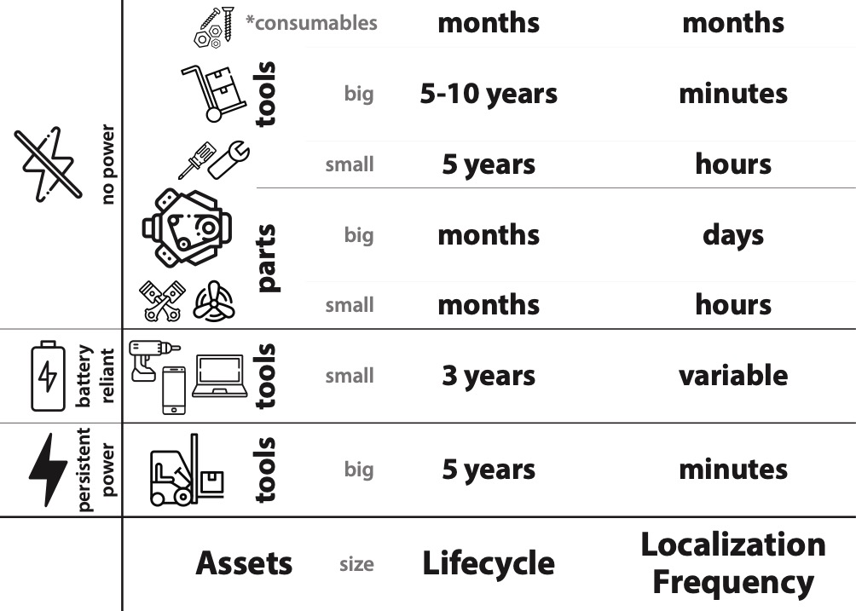
A4IoT Requirements
Smart factory: Localization Criteria

Slide 9
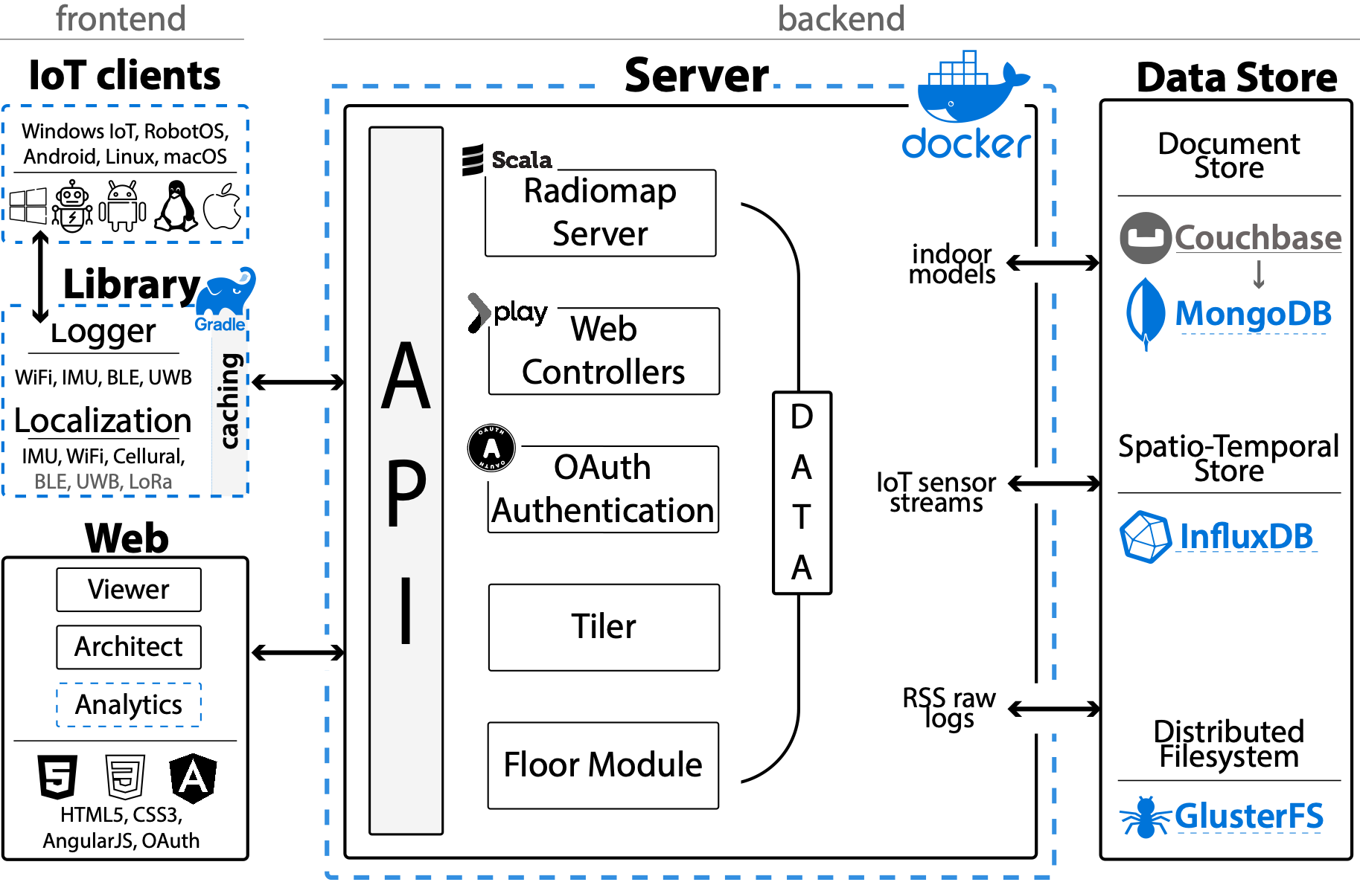
Anyplace Architecture

Slide 10




Containerization with Docker
Single-node deployment
  Configured with a single .env file
  Code: pulled from github.com/dmsl/anyplace, build with Jenkins
  Database initialization: creation of accounts, buckets, views, and tuning
  SSL encryption: automated even in internal networks
  Play framework setup
  Backend data mounted in ~/.anyplace/server
    Database internal data
    Filesystem data
    Other log files
Multi-node cluster
  Plug in external services
    Database clusters
    SSL certificates
    Distributed Filesystem
    Load Balancer

Slide 11
Library & Clients

Slide 12






Java Library
anyplace-core:
  Main functionality of anyplace
  Caching mechanism
  Modular design
    has a command line interface
    can be included as a Gradle Library

Slide 13




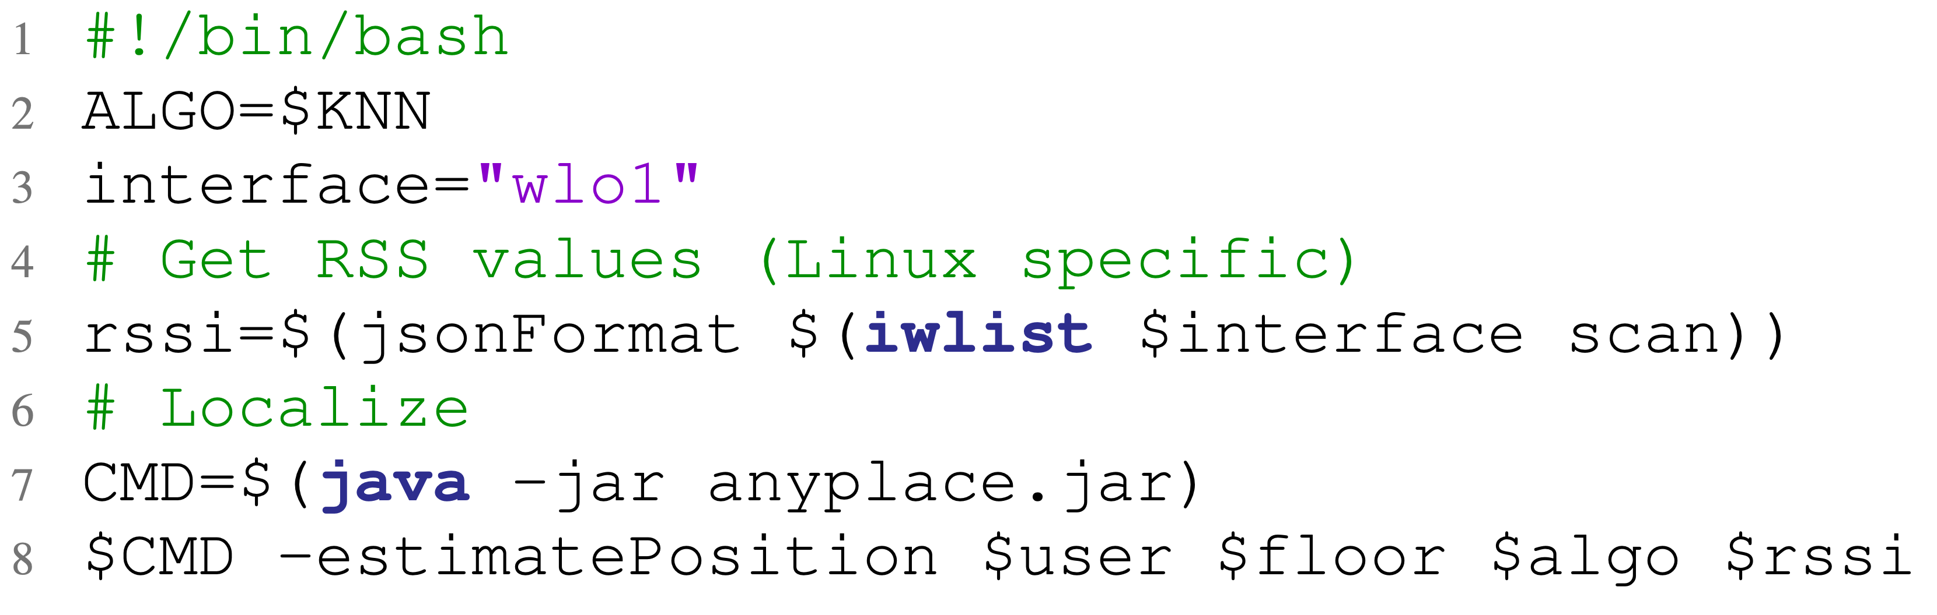
CLI tool
Command line tool:
  Easy creation of clients
  Supports major OSes
    Developed clients in: macOS, Linux, RobotOS
  Settings stored in ~/.anyplace/client
    oauth keys
    local cache
    backend settings

Slide 14

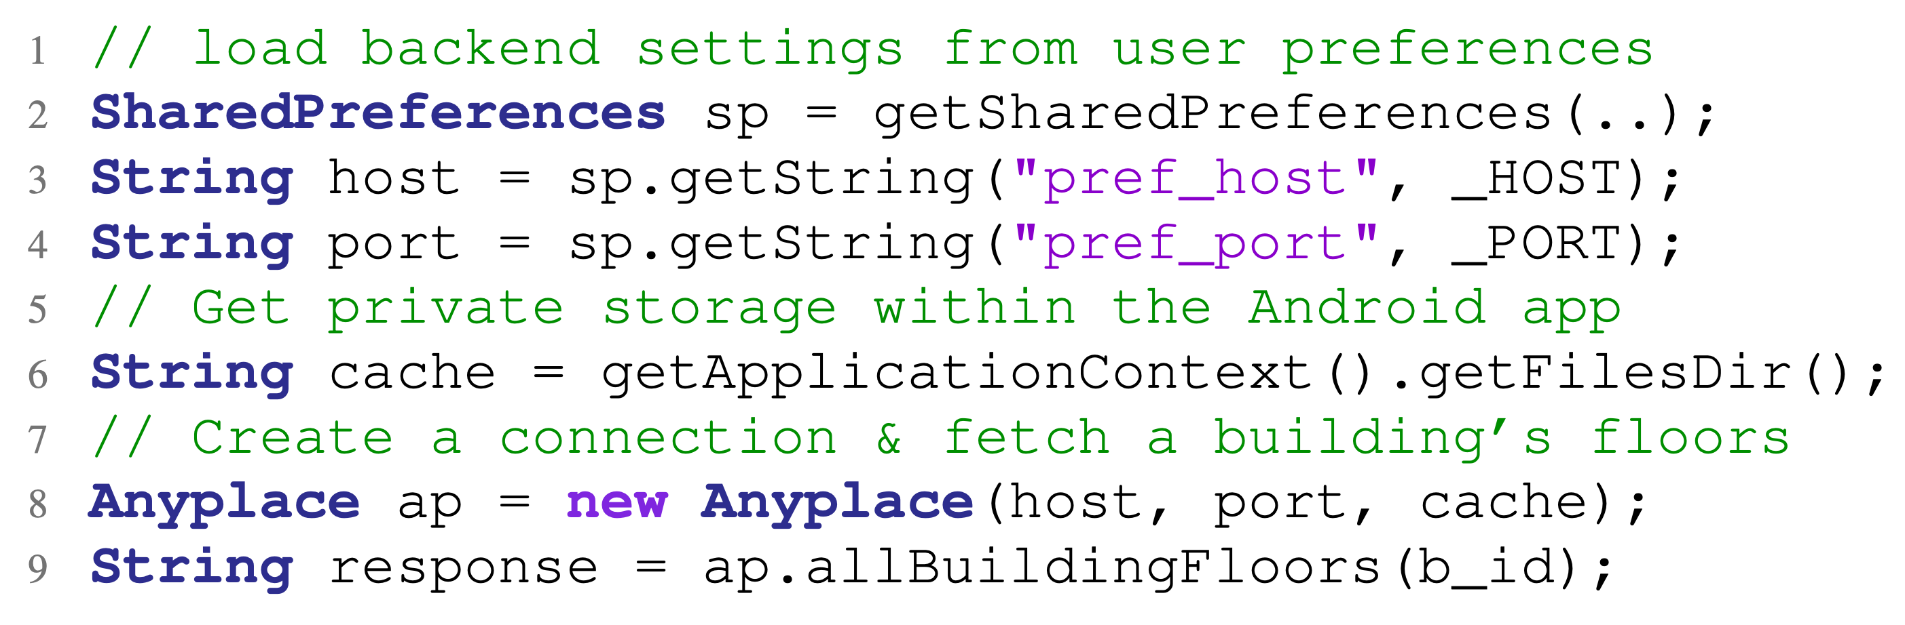
Android Library
anyplace-android:
  contains Android-specific utilities:
    Handles sensor data acquisition
    Sets relevant permissions
    Threading
    Caching mechanism
  Anyplace thin Android client

Slide 15
Datastore

Slide 16
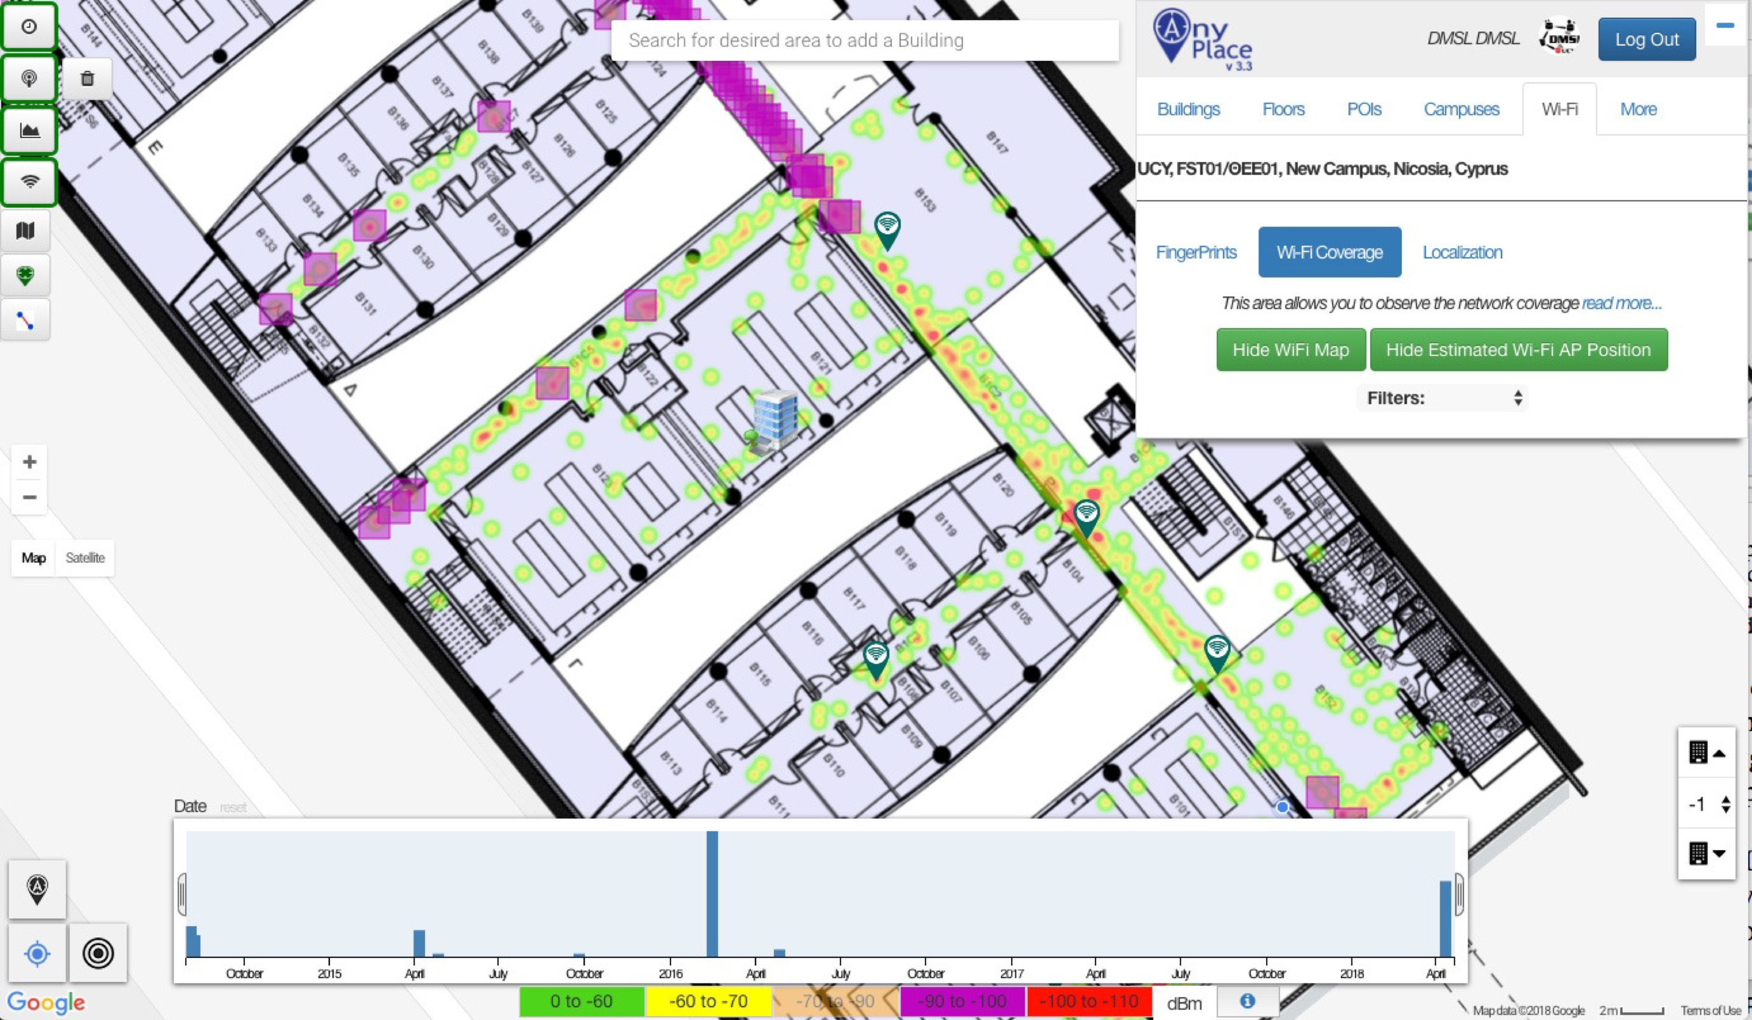
Datastore: InfluxDB
  Time series datastore
    Efficiently consume raw IoT data
    Support for spatio-temporal queries
      Geometric fence endpoints
        Between single point + radius
        Between two points
    Enables real-time operation:
      Visualizations & analytics.

Slide 17
Datastore: InfluxDB
Ingestion time
  Almost an order of magnitude less
    7x faster with 1 million entries
Faster Query execution
    filtering over a timeslice
    aggregating results
    fetching a tuple
    emitting all entries
7.x
1.2x
1.28x
2.3x
3.6x

Slide 18
Datastore

Slide 19
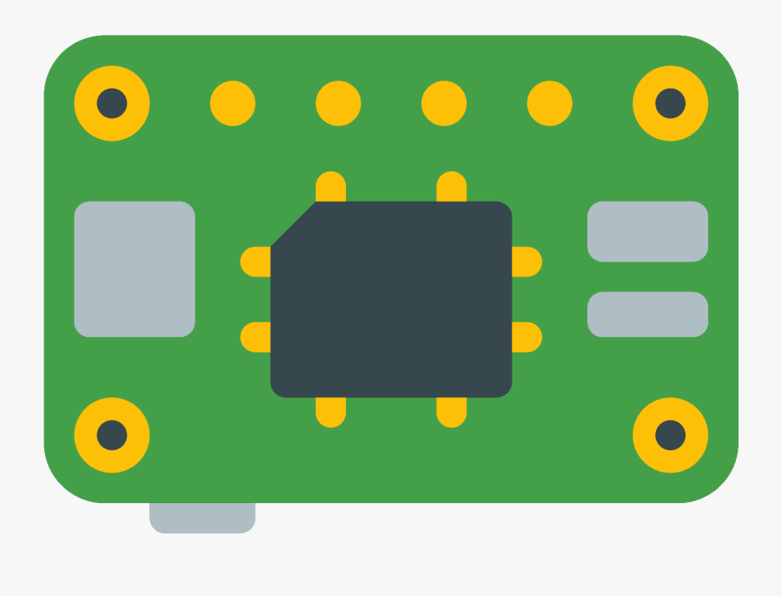

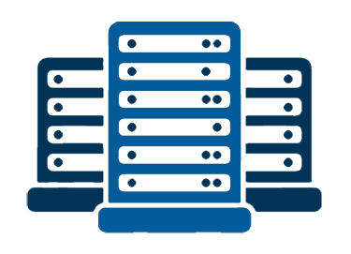
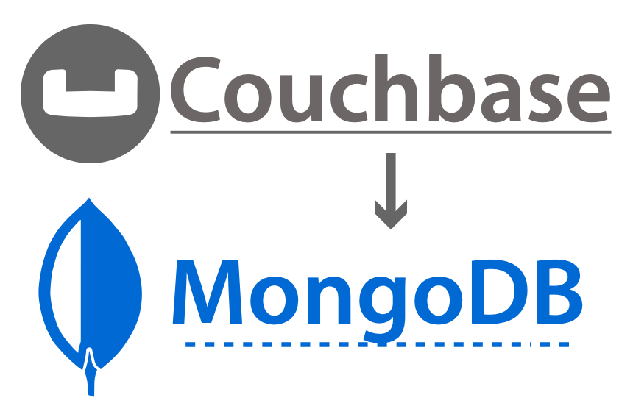
Datastore: MongoDB
Document Store:
  Lightweight:
    1GB of RAM
  Scalable:
    Low-end arm devices
    Multi-node clusters
  Will co-exist with Couchbase
    gradually phase-out Couchbase

Slide 20
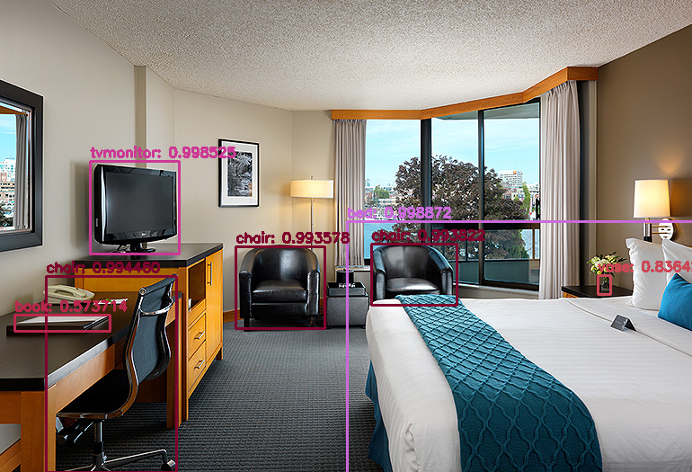
Conclusions and Future Work
  The requirement for integrated open-source localization architectures remains an open problem.
  We aim to support many different technologies under the same roof with the following characteristics:
    “Crowdsourcing”, “Fingerprinting”, “Infrastructure-free”
Future Work
  Computer Vision Localization with real-time object detection
  Implement Map-Matching algorithms to associate Fingerprints with underlying topology graph

Slide 21
The Anyplace 4.0 IoT
Localization Architecture
Thank you.
Paschalis Mpeis∗, Thierry Roussel§, Manish Kumar⁺, Constantinos Costa‡, Christos Laoudias∗, Denis Capot-Ray§, Demetrios Zeinalipour-Yazti∗
∗Univ. of Cyprus, Cyprus §Alstom SA, France ⁺Infosys Ltd, India ‡ Univ. of Pittsburgh, USA
pmpeis01@cs.ucy.ac.cy, thierry.roussel@alstomgroup.com, manish.kumar156@infosys.com,
costa.c@cs.pitt.edu, laoudias@ucy.ac.cy, denis.capot-rey@alstomgroup.com, dzeina@cs.ucy.ac.cy
The 21st IEEE International Conference on Mobile Data Management
June 30 - July 3, 2020, Versailles, France (online)

