Slide 1
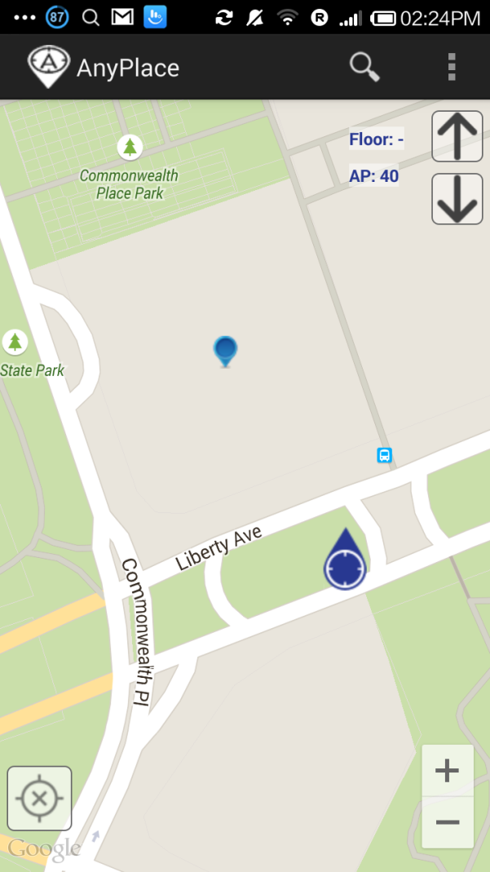
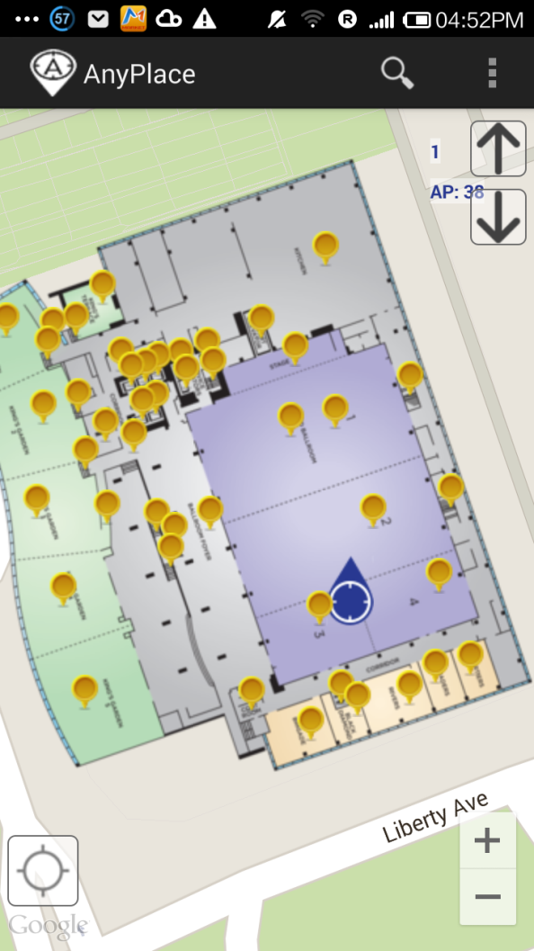
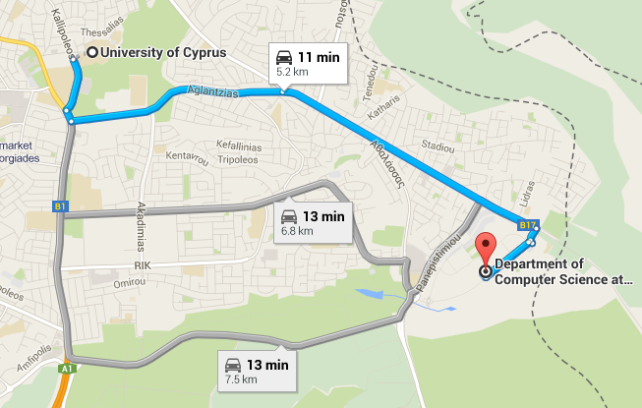
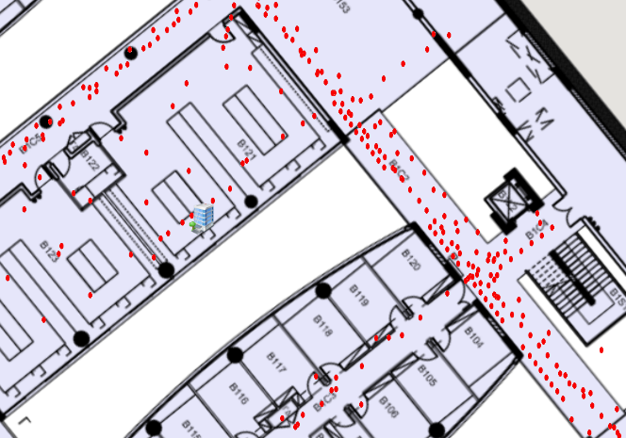
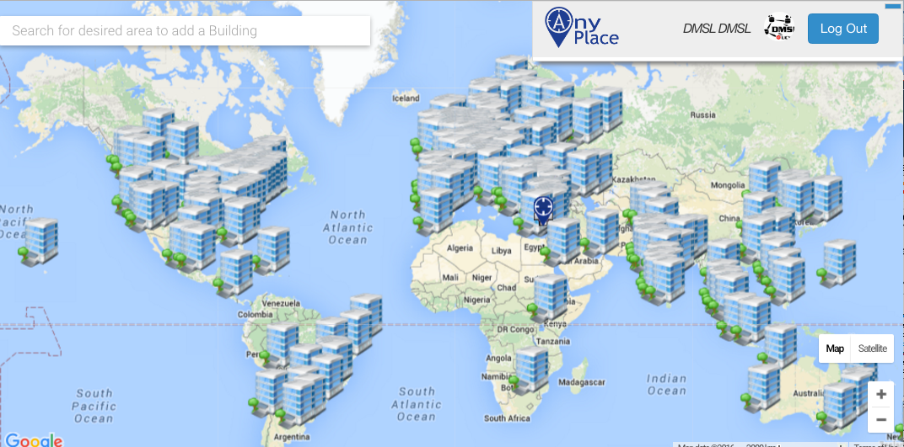
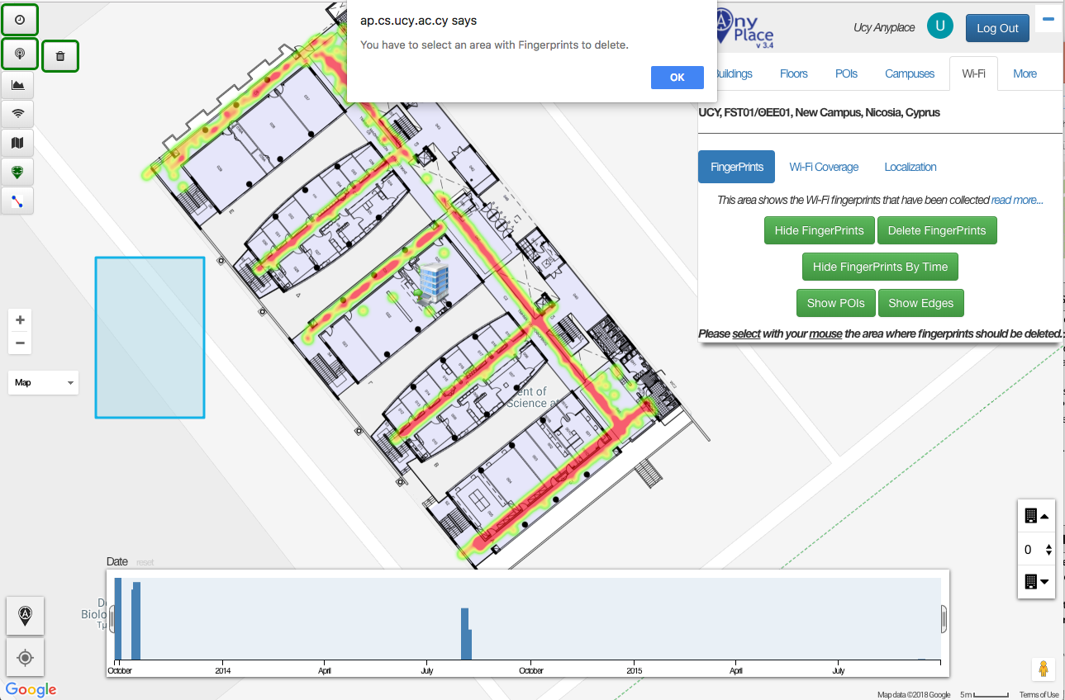
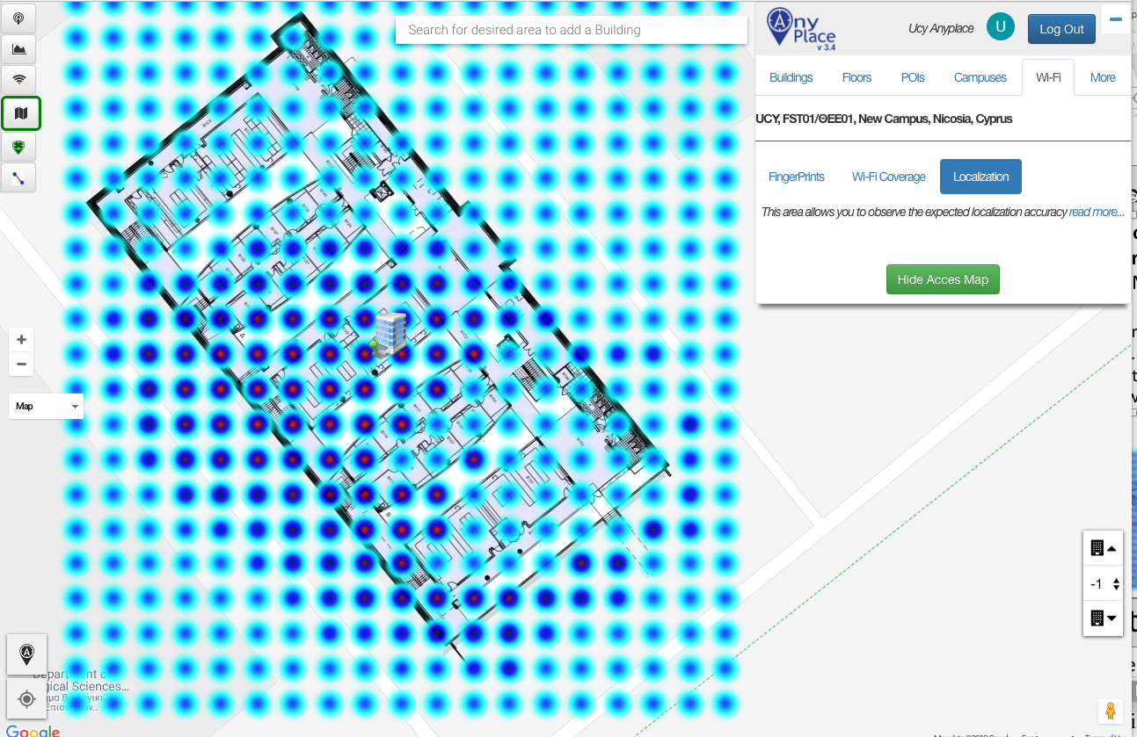
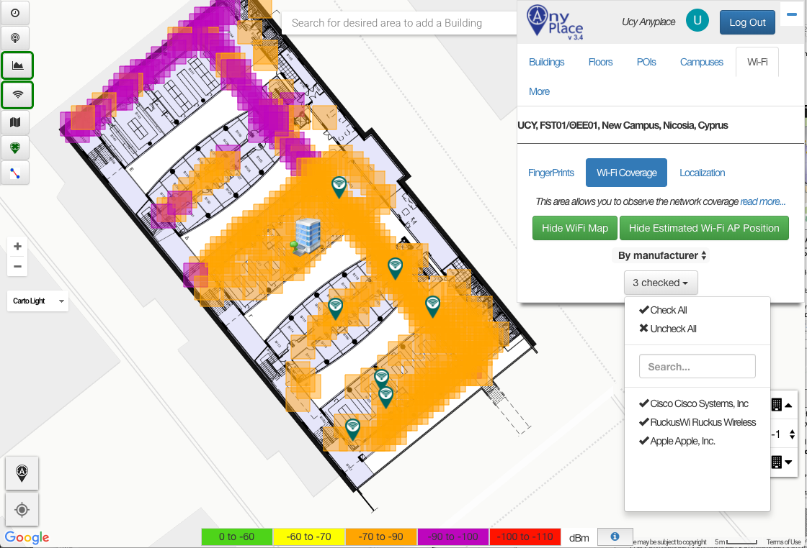
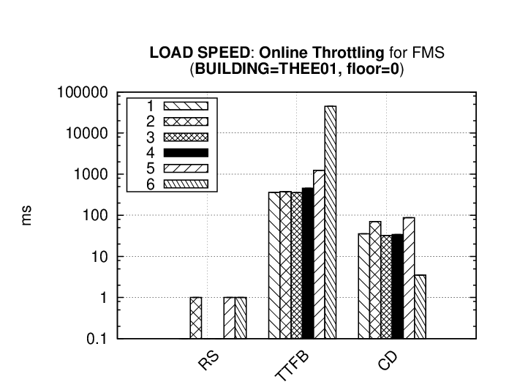
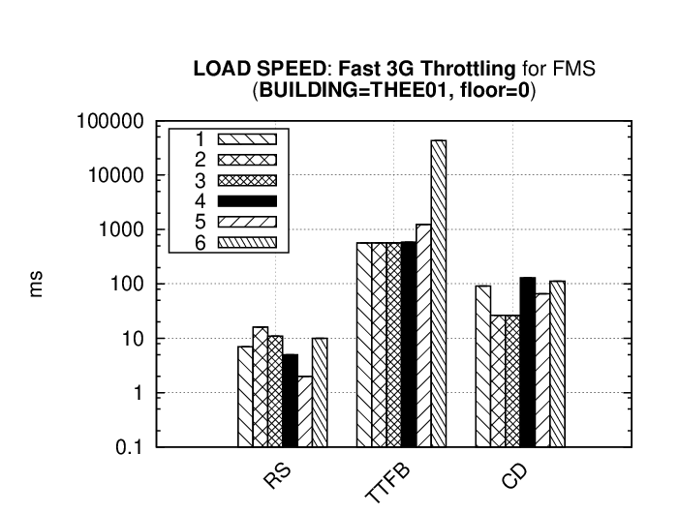
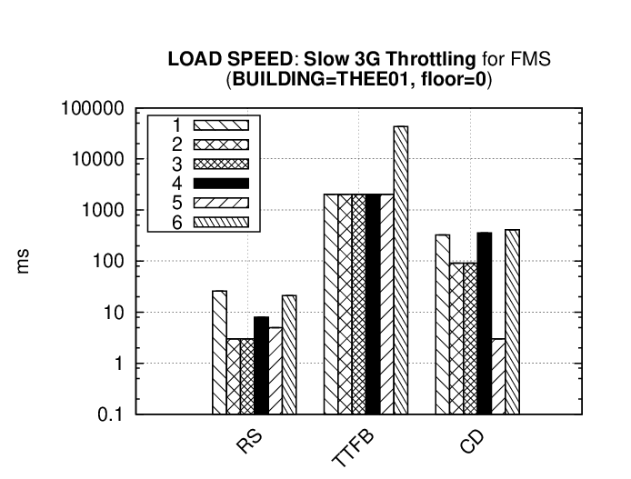
FMS: Managing Crowdsourced Indoor Signals with the Fingerprint Management Studio Marileni Angelidou¹, Constantinos Costa¹, Artyom Nikitin², Demetrios Zeinalipour-Yazti¹ University of Cyprus, Cyprus¹ Skolkovo Institute of Science and Technology, Russia²
Motivation
Anyplace
Most of our activities happen indoors (e.g., business, entertainment, socializing).
People spend 80-90% of their time indoors – USA Environmental Protection Agency 2011.
>85% of data and 70% of voice traffic originates from within buildings – Nokia 2012.
Growing need for effective Internet-based Indoor Navigation (IIN) services. [1]
Anyplace service has to this date obtained more than 145,000 real user interactions.
At the same time, however, it raises new challenges, such as, managing collected signals and inferring value out of it.
Currently, there is no other academic or industrial system that brings the location and Wi-Fi components of this demo under the roof of an open-source stack, which will be invaluable for researchers and practitioners.
[1] "Internet-based Indoor Navigation Services", Demetrios Zeinalipour-Yazti, Christos Laoudias, Kyriakos Georgiou and Georgios Chatzimiloudis, IEEE Internet Computing (IC '17), IEEE Computer Society, Vol. 21, Iss. 4, pp. 54-63, Los Alamitos, CA, USA, 2017.
Anyplace: An open-source Internet-based Indoor Navigation (IIN) Service developed at the University of Cyprus!
Achieves highest accuracy using Wi-Fi, IMU and Magnetic signals (1.96 meters), in real-time, while being energy-efficient and infrastructure-less.
[ 2nd @ Microsoft Indoor Comp. @ IPSN’14, 1st at EVARILOS by TU Berlin ]
Offers advanced search and navigation to various Points-of-Interests (POIs) in buildings and campus (e.g., 60 buildings at the University of Cyprus).
Aims to become the predominant open-source Indoor Localization Service.
soon
soon
anyplace.cs.ucy.ac.cy
State-of-the-Art
Anyplace!
Fingerprint Management Studio (FMS)
Crowd Signal Map (CSM)
Accuracy Estimation (ACCES)
An integrated indoor signal management studio, which provides a uniform platform to:
+ manage the collection of location-dependent sensor readings (ﬁngerprints) in indoor environments.
+ estimate the localization accuracy based on the collected ﬁngerprints.
+ assess Wi-Fi coverage and data rates.
FMS components:
+ CSM (Crowd Signal Map)
+ ACCES (Accuracy Estimation)
+ WS (Wi-Fi Surveying)
Map-based visual management environment that:
+ allows the crowdsourcing coordinators to have a clear understanding of where additional effort is necessary.
+ manages data in space and time by heatmap and coverage maps controls.
Offline positioning accuracy assessment at arbitrary locations (MDM’17 Honorable Mention Award!)
+ ﬁngerprints interpolation based on Gaussian Processes.
+ derives the localization error, in the form of a Cramer-Rao Lower Bound (CRLB).
Wi-Fi Surveying (WS)
Experimental Evaluation
Visual analytics to network architects for decision support that:
+ shows the reception quality of Wi-Fi in ﬁve classes, based on the RSS indicator of the MAC addresses.
Scenarios:
Online Throttling
Fast 3G Throttling
Slow 3G Throttling
Metrics:
Request Sent (RS)
Waiting (TTFirstByte)
Content Download (CD)
General GUI Guidelines:
- The average time required to fully load some arbitrary mobile landing page is 22 seconds ☹
- 53% of mobile site visitors will leave a page that takes longer than 3 seconds to load. ☹
Source: https://think.storage.googleapis.com/docs/mobile-page-speed-new-industry-benchmarks.pdf
+ maps the access points (APs) using the preﬁxes (3-Byte to 5-Byte) of the 6-Byte MAC addresses - Wireshark.org OUI database.
+ infers the APs location utilizing a weighted threshold algorithm.
milliseconds
1: CSM, 2: WS – clustering level 1 (high), 3: WS – clustering level 2, 4: WS – clustering level 3 (low), 5: WS – APs, 6: ACCES
Contact: dmsl@cs.ucy.ac.cy
https://dmsl.cs.ucy.ac.cy/

