Slide 1




Decaying Telco Big Data with
Data Postdiction
Constantinos Costa∗, Andreas Charalampous∗, Andreas Konstantinidis∗‡, Demetrios Zeinalipour-Yazti∗, Mohamed F. Mokbel§
∗ Dept. of Computer Science, Univ. of Cyprus, 1678 Nicosia, Cyprus
‡ Dept. of Computer Sc. & Engr., Frederick University, 1036 Nicosia, Cyprus
§Qatar Computing Research Institute, HBKU, Qatar and Univ. of Minnesota, Minneapolis, MN 55455, USA
{costa.c, achara28, akonstan, dzeina}@cs.ucy.ac.cy, mokbel@cs.umn.edu
The 19th IEEE International Conference on Mobile Data Management
Aalborg University, Aalborg, Denmark, June 27, 2018

Slide 2
Motivation
The expansion of mobile networks and IoT (IP-enabled hardware) have contributed to an explosion of data inside Telecommunication Companies (Telcos)

Slide 3
Telco Big Data (TBD)
Telco Data: Traditional source for OLAP Data Warehouses and Analytics.
  e.g., Accounting, Billing, Session data.
  Problem: Inadequate data resolution to address biggest challenges:
    e.g., churn prediction, 5G network optimization, user-experience assessment, traffic mapping.
Telco Big Data (TBD): Velocity data generated at the cell towers.
  e.g., signal strength, call drops, bandwidth measurements.
  Size: 5TBs/day for 10M clients (i.e., 2PB/year).
RDBMS
Data Store

Slide 4
Industry Perspective
TBD Investments projected to grow
  50% of Telcos will invest in TBD (only 30% have done it until recently)
    Source: McKinsey & Company Telecommunications “Telcos: The untapped promise of big data”, June 2016, https://goo.gl/mAHXib
The promise of unleashing the value of TBD has not been realized to this date!
  It merely focuses on some business/network cases:
Source: Key Big Data Use Cases for Telcos, Cloudera, 2015

Slide 5
Prior Work & Vision
"Towards Real-Time Road Traffic Analytics using Telco Big Data", Constantinos Costa, Georgios Chatzimilioudis, Demetrios Zeinalipour-Yazti, Mohamed F. Mokbel, Proceedings of the 11th Intl. Workshop on Real-Time Business Intelligence and Analytics, collocated with VLDB 2017 (BIRTE '17), ACM International Conference Proceedings Series, pp. 5:1--5:5, August 28, 2017, Munich, Germany, ISBN: 978-1-4503-5425-7/17/08, 2017.
"Efficient Exploration of Telco Big Data with Compression and Decaying", Constantinos Costa, Georgios Chatzimilioudis, Demetrios Zeinalipour-Yazti, Mohamed F. Mokbel, Proceedings of the IEEE 33rd International Conference on Data Engineering (ICDE '17), IEEE Computer Society, pp. 1332-1343, April 19-22, 2017, San Diego, CA, USA, ISBN: 978-1-5090-6543-1, 2017

Slide 6
Challenges
The Big data era lead us to a point where organizations collect more than they can!
  Scale:
    Global volume of stored data doubling every 2 years.
    44 zettabytes of data in 2020 (44 million PB of data)
  Costs:
    Costs for data storage decline only at a rate of less than 1/5 per year. Datacenter Journal, https://goo.gl/o4MnJp
    An 1 PB Hadoop cluster, using between 125 and 250 nodes, costs ~1M USD
  Time:
    A linear scan of 1PB would require ~15 hours
Source: 2016 Western Digital Corporation.

Slide 7
Presentation Outline
Introduction
Background
TBD-DP Operator
  Problem Formulation
  Construction Algorithm
  Recovery Algorithm
Experiments
Conclusions

Slide 8
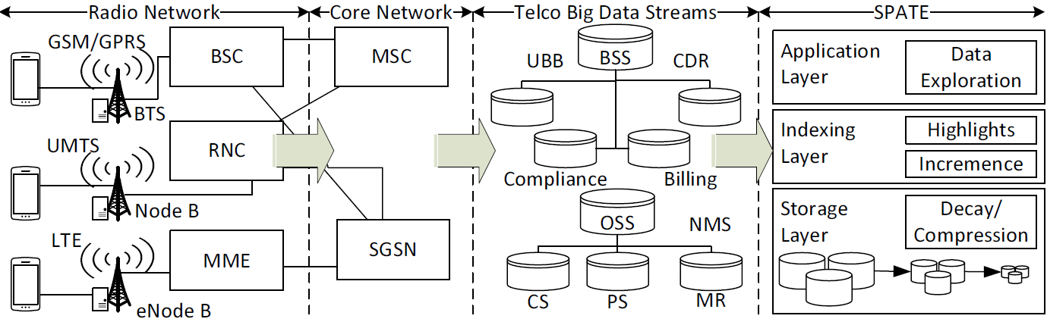
TBD Streams
Call Quality
Measurement Reports (can be used to localize users with triangulation ~50 meters)
Data quality (web speed, connection success rate)
Telco Big Data (TBD)
  Business Supporting Systems (BSS) data
    Tens of GB/day for a xM+ city
  Operating Supporting Systems (OSS) data
    Tens of TB/day for a xM+ city

Slide 9
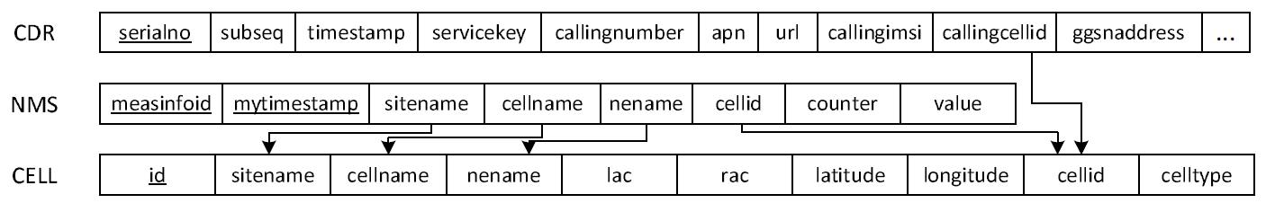
TBD Relational Diagram
TBD can logically be represented by a relational diagram.
  Hundreds of Attributes (e.g., 200) & Millions of Rows
  Foreign Keys enable join operations to yield answers to more complex queries
  Location of users is not in TBD (but can be triangulated from MR data ~ approx. 50m accuracy)
  Proprietary data formats make it difficult to expand the TBD schema (e.g., radio-propagation models)

Slide 10
How to Reduce Data ?
Data Sampling
  Uniform or Random Data < Original Data
Data Aggregation (Data Cubes)
  Query Result Data < Original Data
Data Reduction (SVD, DFT, DWT)
  Principal Components (Patterns) << Original Data
Data Synopsis (e.g. equi/depth histograms, Bloom filters, sketches)
  “Statistics” about Data << Original Data
Data Compression (lossless or lossy)
  Combination of techniques, e.g., GZIP=DEFLATE(LZ77+HUFF)
Problem: None of the above considers how to outdate (decay) data as time elapses.

Slide 11
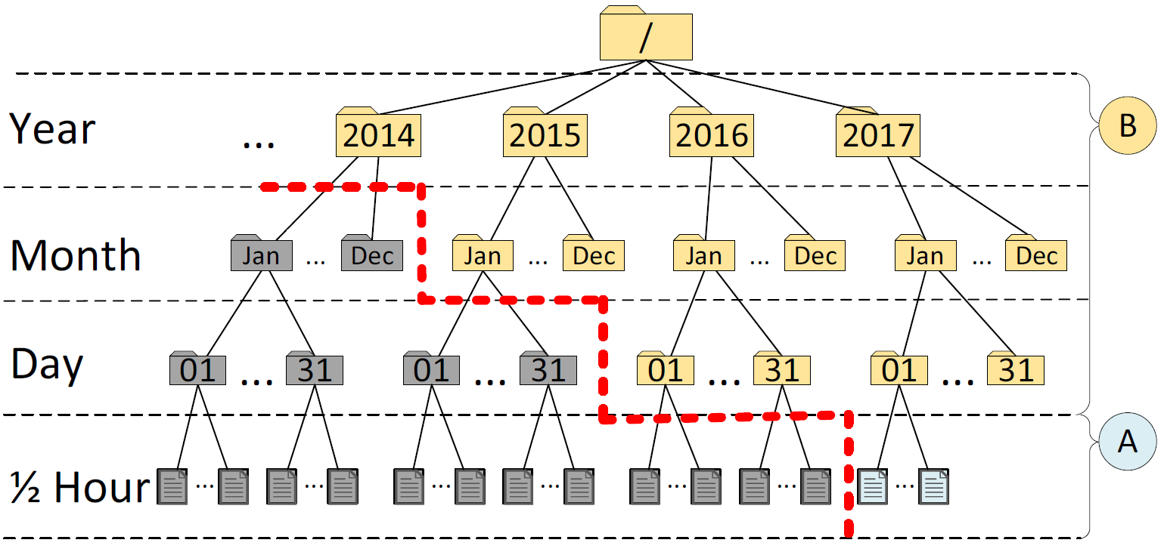
Data Decaying
Data Decaying refers to the “progressive loss of detail in information as data ages with time until it has completely disappeared.”
  M. L. Kersten, “Big data space fungus,” in CIDR’15
Benefits:
  Retain same data exploration capabilities.
  Save enormous amounts of storage and I/O.
Alternative definition referring to DB Schema Decay also exists, but is not applicable here.
  M. Stonebraker, R. Castro, F. Dong Deng, and M. Brodie, “Database decay and what to do about it.” 2016. [Online]. BLOG@CACM: https://goo.gl/tJNa9m.

Slide 12
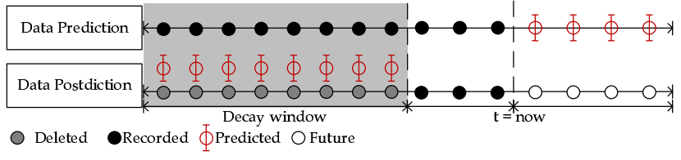
Data Postdiction
Data Postdiction (DP): aims to recover the past value of some tuple, which has been decayed for efficiency purposes, using a ML model.
  Data Prediction: aims to make a statement about the future value of some tuple using a ML model.
  Data Postdiction: a technique to carry out data decaying (other: FIFO-amnesia, UNIFORM-amnesia, Exponential-amnesia)
    Lossy compression cannot be reconstructed ☹, DP data can be ☺

Slide 13
Data Postdiction
Data Postdiction is a term that we have coined in this paper, especially for data recovery.
Our bibliography search exposes that Postdiction as a concept has its foundations in the Neuroscience, Psychiatry & Behavior Science domain:
  D. M. Eagleman and T. J. Sejnowski, "Motion Integration and Postdiction in Visual Awareness”, Science. 2000 Mar 17;287(5460):2036-8.
    “visual awareness is postdictive, so that the percept attributed to the time of an event is a function of what happens in the 80 ms following the event”

Slide 14
Presentation Outline
Introduction
Background
TBD-DP Operator
  Problem Formulation
  Construction Algorithm
  Recovery Algorithm
Experiments
Conclusions

Slide 15
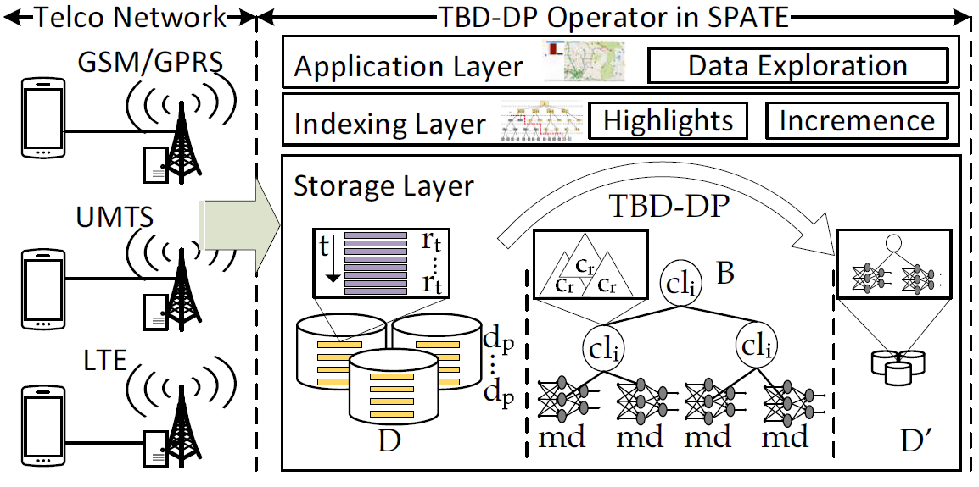
System Model
The data arrives at a data center in batches d_{p} within an ingestion period (e.g., every 30 min).
A snapshot d_{p} contains records r_{t} created at timestamp t.
Each record r_{t} maps to a cell tower id c_{r}
Spatially group r_{t} into clusters cl_{i}, 1 ≤ i ≤ k
c_{r}
Create a model md_{i,} i = i . . . K for each cl_{i}
  Each md_{i} can exploit spatio-temporal locality during the postdiction inference, rather than a monolithic global model.
  Will require enough data, which is possible in a Telco setting.

Slide 16
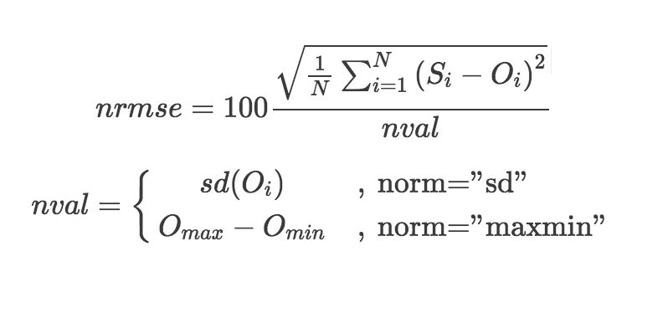

Problem Formulation
Research Goal: Given a Telco setting, we aim at achieving a pre-specified decaying of TBD with minimum additional storage space capacity and being able to recover the decayed data as accurately as possible and efficiently.
Objectives (Metrics):
  Storage Capacity (S): is the total storage space required for achieving decaying of data based on a decaying factor f.
  Accuracy (Norm. Root Mean Square Error - NRMSE): is the percentage of the correctly recovered decayed data.
    NRMSE is the normalized difference between the actual data (x₁,t) and the predicted data (x₂,t), where t is a discrete time point and y_{max}, y_{min} the maximum and minimum observed differences

Slide 17
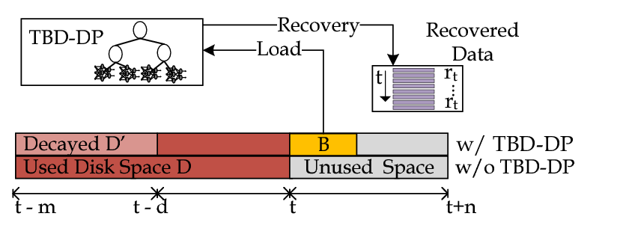
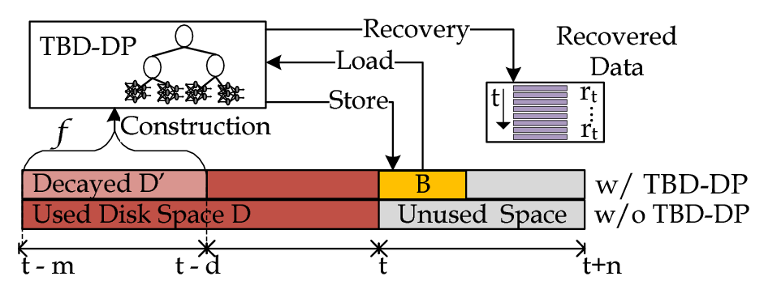
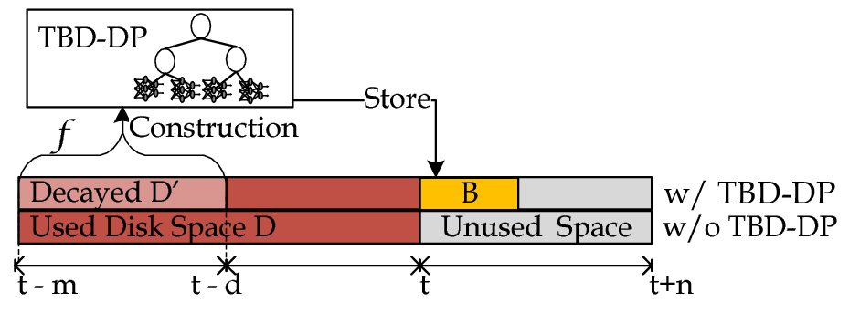
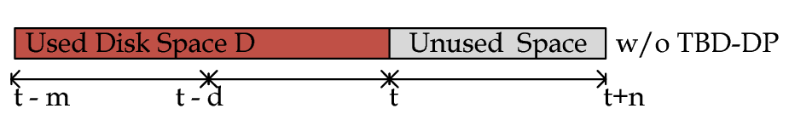
TBD-DP Operator
TBD-DP Operator Overview
  Construction algorithm: construct a DP-tree (B) for a percentage (f) of the historic data (D), denoted as D’.
    Delete D’ and retain B for data recovery.
  Recovery algorithm: use {B, D-D’} to recover any past data blocks, upon demand.
    D = full data resolution and B = model data resolution

Slide 18
DP Construction: Partitioning
Spatial Partitioning
  Use cell tower locations to create clusters using a conventional clustering algorithm (e.g., K-Means or BFR for large data)
  Associate records to clusters (MAP(r_{t}, cl_{i})|i = 1, . . . k)
Why?
  Allows constructing less models for very large data collections (rather than 1 model per cell tower).
  Results in less model building computations.
  Monolithic model still an option when not enough data.

Slide 19
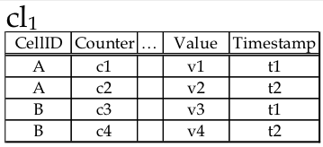
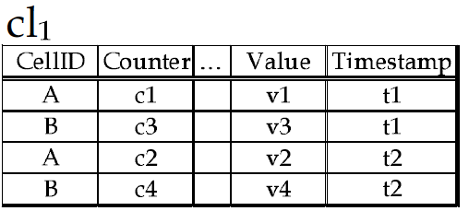
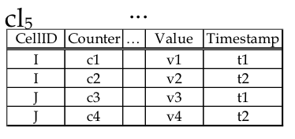
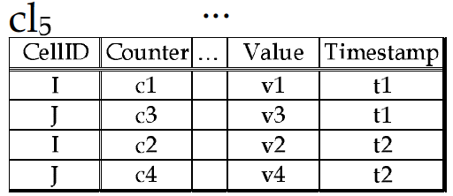
DP Construction: Ordering
TBD NMS Schema – antenna velocity data (e.g., call drops, handovers, calls normally ended, …)
Temporal Ordering
  Sort records in clusters based on timestamp (ORDER(cl_{i}))
Why?
  This allows for exploiting time domain in building the postdiction models (next slide)

Slide 20
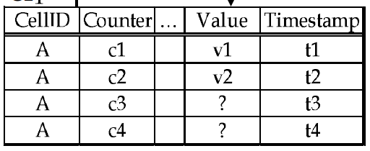
DP Construction: Learning
Goal: build postdiction models to efficiently recover missing values in the DP Recovery algorithm presented next.
Input:
Output:
Machine Learning
(LSTM)
V4
V9

Slide 21
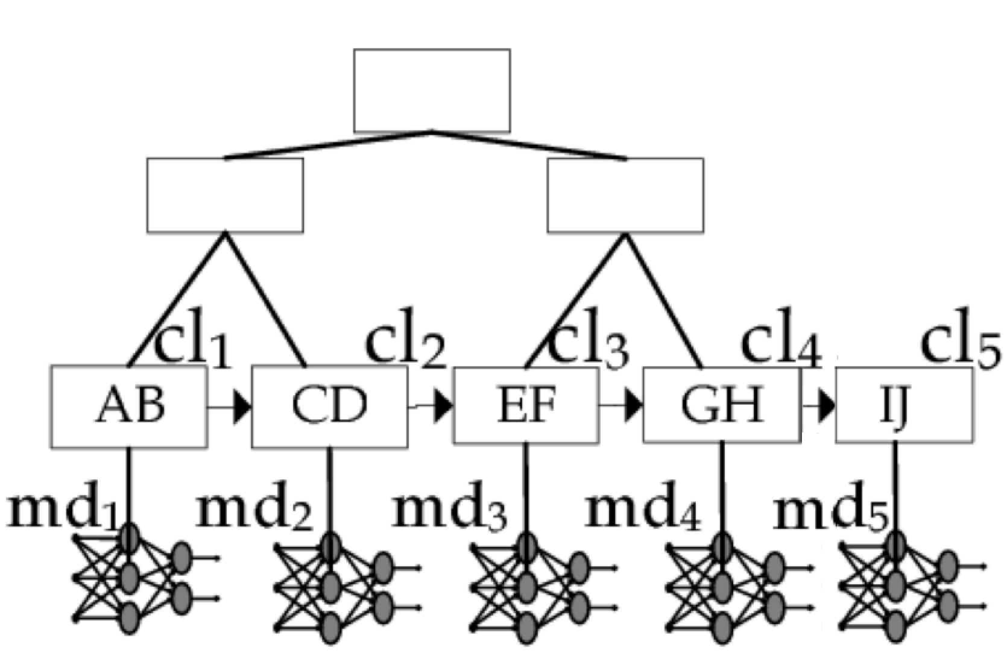
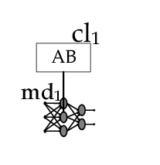
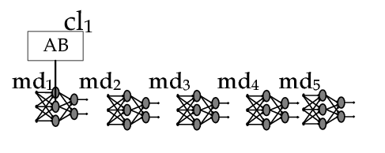
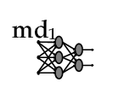
DP Construction: Hierarchical Model
DP-tree
  Create an index of LSTM models one for each cl_{i} (LEARNING(cli))
  Balanced spatial tree structure (R+-tree) where spatio-temporal learning data models become leaf nodes.
Why?
  The Recovery algorithm can utilize the DP-tree structure for retrieving a selected subset from the decayed data.
  Only necessary if enough data (e.g., global scale)
AJ
AD
EJ

Slide 22
ML, NN, RNN and LSTM
Machine Learning (ML): uses statistical techniques to give computers the ability to "learn" with data, without being explicitly programmed.
  Neural Network (NN): class of ML algorithms that model complex relationships between inputs & outputs in non-linear processes (e.g., classification, pattern/character recognition)
  Recurrent NN (RNN): directed graph along a sequence able to have short memory (e.g., timeseries, speech, text/spam)
  Long-Short Term Memory (LSTM): special type of RNN capable of having long memory, i.e., long-term dependencies (e.g., language modeling / autocompletion, machine translation)
output
output
output
output
output
output
output
output
output
output
Hidden nodes/ layers
tanh
input
input
input
input
input
input
input
input
input
NN
RNN
LSTM
input

Slide 23
ML, NN, RNN and LSTM
Hidden state output (ever since)
3 gates
2) Current state output:
(Short)
3) Update Gate
4)Output Gate
output
2) Forget
Gate
’
1) Hidden state output: (Long: ever since)
input
Hidden state output (ever since)
LSTM Outline:
Long Input (h_{t-1}) and Current Input (X_{t}) are combined and filtered by Sigmoid (σ) of gate 1.
The Forget Gate (X) combines the output of (1) with Short Input (A output – i.e., cell state).
Update Gate (x): decides values to be updated in this cell.
  tanh is Hyperbolic tangent function that helps in deriving the values to be updated
Output Gate (x): decides finally what the output will be.
Credit: Understanding LSTM Networks http://colah.github.io/posts/2015-08-Understanding-LSTMs/

Slide 24
Deep Neural Networks
Deep Neural Networks (DNN): A highly computational-intensive ANN (excessive hidden layers/nodes).
  Main Drawback: Very computational intensive => initially all GPU (Graphical Processing Unit)-based.
Micro (May/Jun 2018):
  If users searched by voice for 3 minutes per day using speech recognition DNNs, computation demands on Google’s datacenters would double!
  Tensor Processing Units (TPUs) will improve cost performance by 10x over CPUs (both inference and training)
Nevertheless, LSTM is readily available in many Deep Learning frameworks, e.g., Tensorflow, Spark, Flink.

Slide 25
DP Recovery
AJ
Step 1: Index Lookup
  Select a subset of postdiction models (B′←LOOKUP(L,B))
Step 2: Recreate Dataset
  Retrieve decayed data of specific time periods (pD′=RECREATE(B′, t))
AD
EJ
V4
V9

Slide 26
Presentation Outline
Introduction
Background
TBD-DP
  Construction Algorithm
  Recovery Algorithm
Experiments
Conclusions

Slide 27
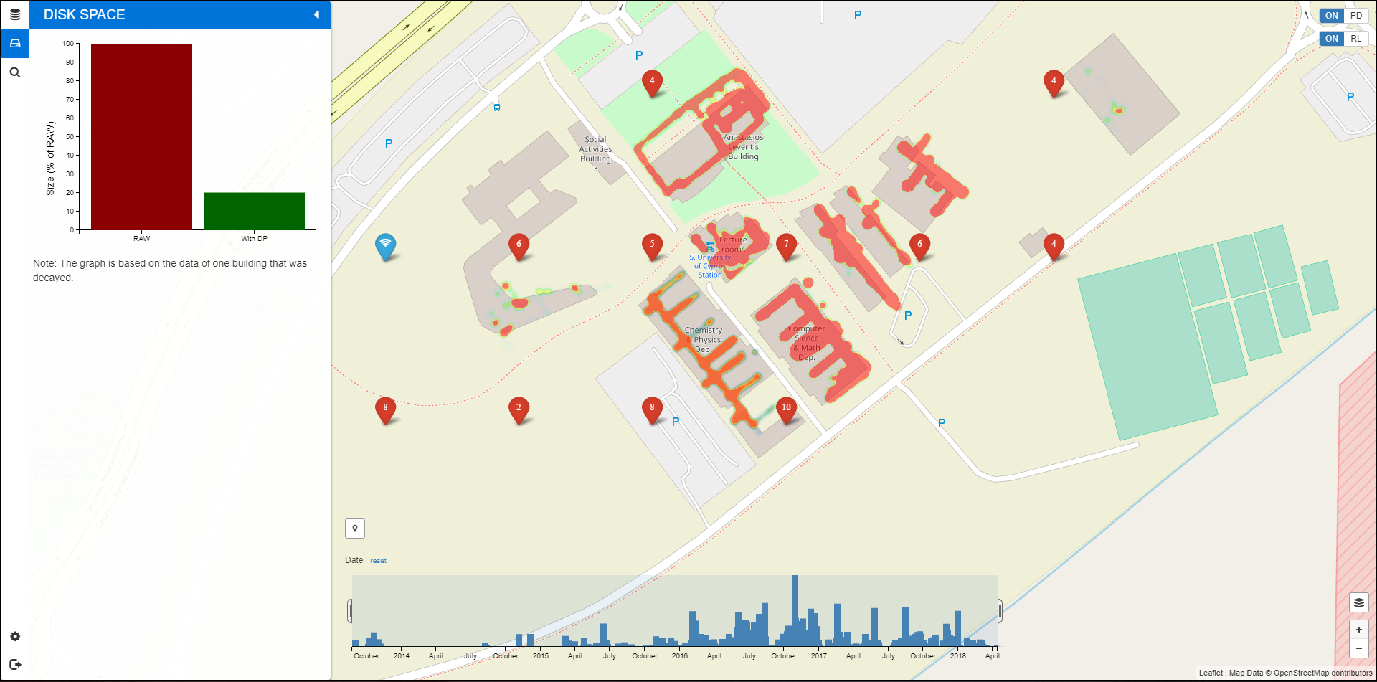
Data Postdiction in Action
Video
Don’t miss our Tutorial & Demo!
DP Demo: Wednesday, Jun 27, 16:45 - 18:00, Aalborg University
TBD Tutorial: Thursday, Jun 28, 13:15 - 14:15, Aalborg University

Slide 28
Experimental Methodology
To evaluate TBD-DP operator, we have implemented a trace-driven experimental testbed:
  Compared Approaches/Algorithms:
    RAW: does not apply any decaying.
    COMPRESSION: the decayed dataset is compressed with the GZIP library (used in SPATE @ ICDE’17)
    SAMPLING: a consecutive sampling algorithm used for achieving a 50% sample size on the decayed dataset.
    RANDOM: uniformly randomly select one record from the decayed dataset.
    TBD-DP: Models + (1-f)% of RAW dataset.
  Metrics:
    Storage Capacity(MB): the total space to store data and index
    Normalized Root Mean Square Error (MB): the error of the recovered data D′ using the well known NRMSE.

Slide 29
Experimental Datasets
We constructed 6 realistic KPI Queries based on an anonymized TBD dataset [ICDE17]:
  Dataset: 3660 cells (CELL) coming from 2G, 3G and LTE antennas,100M NMS records, 300K users, ~10GB.
  KPIs (Key Performance Indicators) Queries: Calls (CS), Call Drops (CSD), ThroughPut (TP), Handover Attempts (HA), Handovers (HS), Call Setup Attempts (CSA), Call Setups (CS)

Slide 30
Experimental Testbed
TBD Operating System Stack
  Datacenter: VMWare ESXi 5.0.0 Hosts
  VMs: 4 Ubuntu 14.04 server images, each featuring: 8GB of RAM with 2 virtual CPUs (2.40GHz)
  Storage Element: Slow 7.2K RPM RAID-5 SAS, 6 Gbps disks. Each disk formatted in VMFS 5.54 (1MB block)
TBD Framework Stack
  Hadoop Distributed File System (HDFS) v2.5.2
  Apache Hive 2.0 (online querying)
  Apache Spark 1.6.0 (offline data processing)
  Python 3.6.3
  Tensorflow 1.7 (LSTM, RNN, GRU)
SPARK Jobs
Apache HIVE Warehouse
Apache HDFS
Filesystem

Slide 31
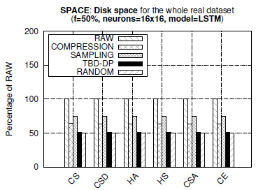
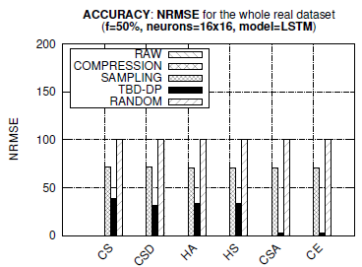
Space Capacity
Observations:
  TBD-DP provides 25%, 50% better space capacity than COMPRESSION and RAW, respectively.
  TBD-DP outperforms the SAMPLING approach by 50% in terms of NRMSE, on average, in all datasets.
  COMPRESSION approach provides an optimal NRMSE = 0 (GZIP is lossless, but requires more space)
  TBD-DP could have been configured with a decay factor f=100% rather than f=50%, yielding even less space (i.e., decay everything, retain only model approach)

Slide 32
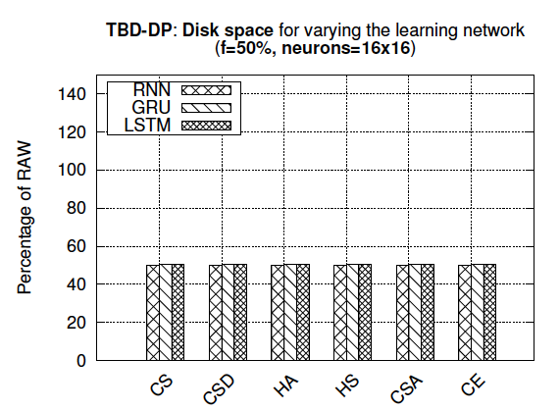
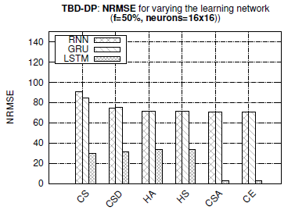
Control Experiments
GRU (Gated Recurrent Unit) vs. LSTM:
  GRUs use a similar but different architecture than LSTM. GRU has two gates (reset and update gates) whereas an LSTM has three gates (namely input, output and forget gates).
Observations:
  TBD-DP maintains a similar storage capacity for different learning models.
  TBD-DP w/ LSTM combination clearly outperforms the other two combinations providing around 75% less error, on average.

Slide 33
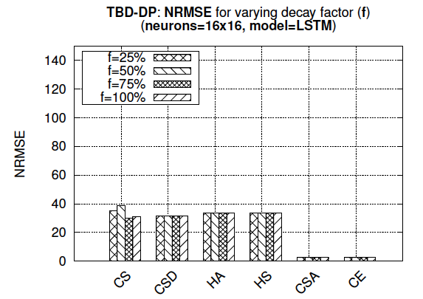
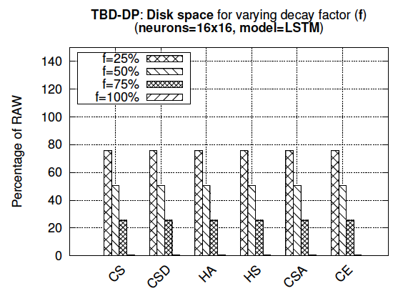
Decaying Factor - f
The Decay Factor (f) shows how aggressive the postdiction process should be
  F= 100% (100% of RAW data deleted - postdicted)
  F= 0% (No postdiction – same with RAW data)
Data Space decreasing for all counters
Accuracy still there!

Slide 34
Conclusions
Conclusions:
  TBD-DP decay operator saves an order of magnitude storage space using data decaying
  TBD-DP decay operator retains the accuracy high, by using data postdiction.
Future Work:
  Generalizing DP operator to other types of data (e.g., IoT, medical, text, images, videos).
  Improving computational time for learning postdiction models (e.g., by preprocessing data)
  Provide extensions to allow streaming computation and error bounds of TBD-DP learning with velocity data.
  Dear more with model data management (how to merge models, how to index them, new query operators)

Slide 35
Decaying Telco Big Data with Data Postdiction
Thanks! Questions?
Constantinos Costa∗, Andreas Charalampous∗, Andreas Konstantinidis∗‡, Demetrios Zeinalipour-Yazti∗, Mohamed F. Mokbel§
∗ Dept. of Computer Science, Univ. of Cyprus, 1678 Nicosia, Cyprus
§ Dept. of Computer Sc. & Engr., Frederick University, 1036 Nicosia, Cyprus
§Qatar Computing Research Institute, HBKU, Qatar and Univ. of Minnesota, Minneapolis, MN 55455, USA
{costa.c, achara28, akonstan, dzeina}@cs.ucy.ac.cy, mokbel@cs.umn.edu
The 19th IEEE International Conference on Mobile Data Management
Aalborg University, Aalborg, Denmark, June 27, 2018

