Slide 1
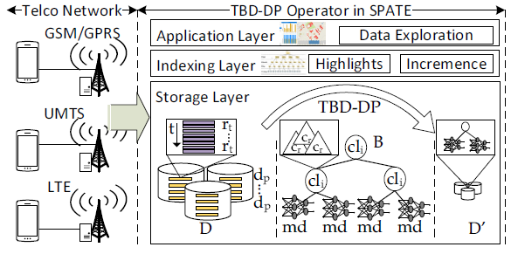
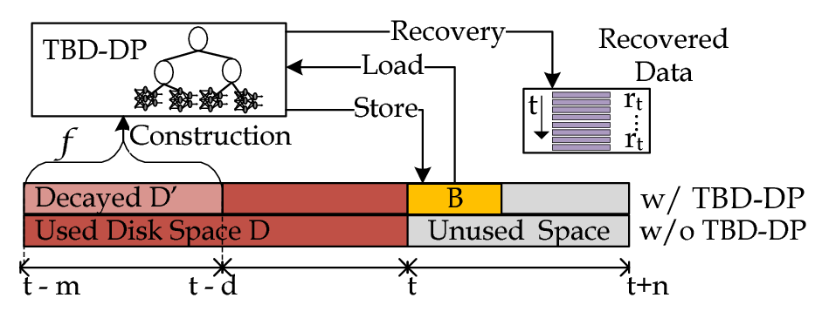
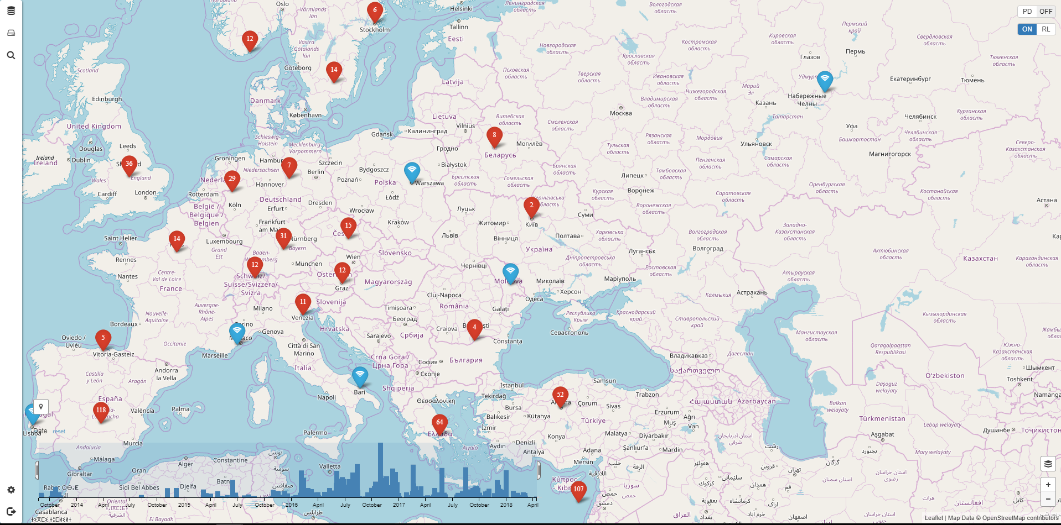
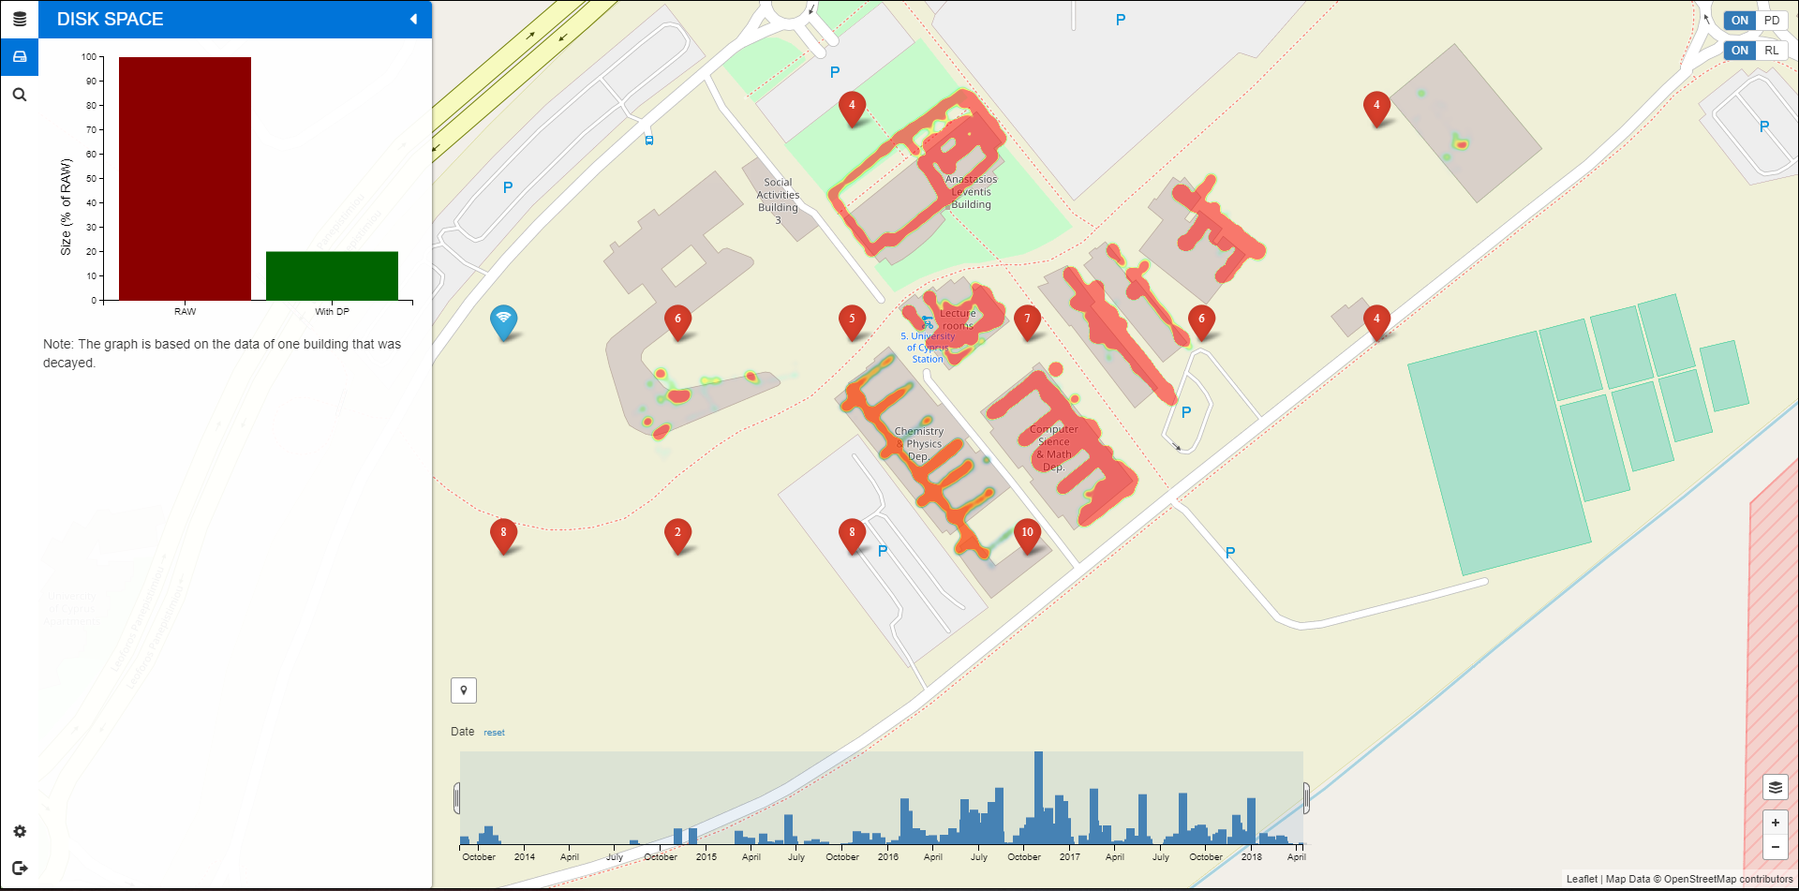
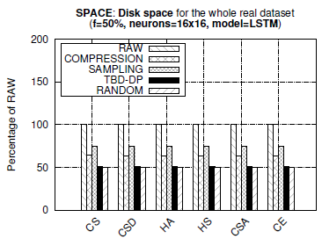
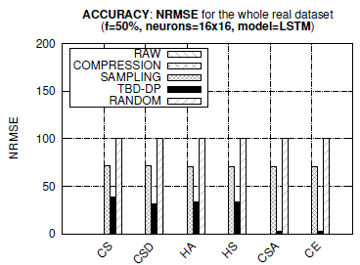
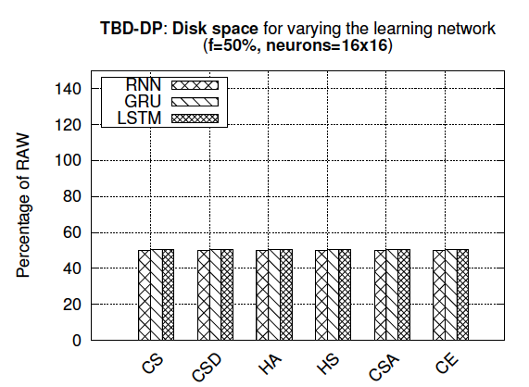
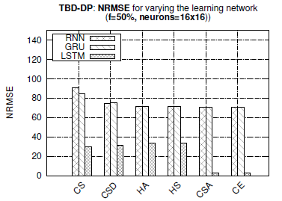
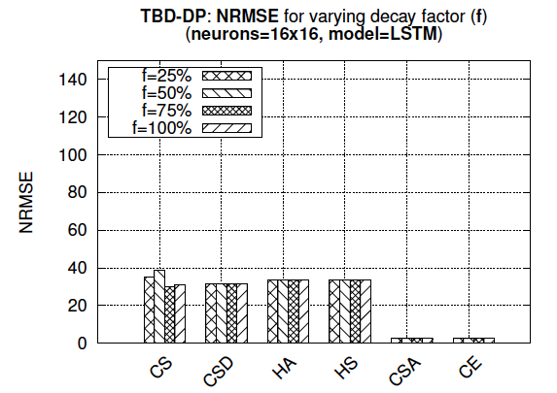
TBD-DP: Telco Big Data Visual Analytics with Data Postdiction Constantinos Costa¹, Andreas Charalampous¹, Andreas Konstantinidis^{1,2}, Demetrios Zeinalipour-Yazti¹ and Mohamed F. Mokbel³ University of Cyprus, Cyprus¹ | Frederick University, Cyprus² Qatar Computing Research Institute, Qatar and University of Minnesota, USA³
Motivation
Data Decay
The expansion of mobile networks and IoT (IP-enabled hardware) have contributed to an explosion of data inside Telecommunication Companies (Telcos)
Data Decaying refers to the “progressive loss of detail in information as data ages with time until it has completely disappeared”.
M. L. Kersten, “Big data space fungus,” in CIDR’15.
Benefits:
Retain same data exploration capabilities.
Save enormous amounts of storage and I/O.
Data Prediction: aims to make a statement about the future value of some tuple using a ML model.
Data Postdiction (DP): aims to recover the past value of some tuple, which has been decayed for efficiency purposes, using a ML model. Proposed in MDM’18*!
The Big data era lead us to a point where organizations collect more than they can!
Scale:
Global volume of stored data doubling every 2 years.
44 zettabytes of data in 2020 (44 billion TB of data).
Costs:
Costs for data storage decline only at a rate of less than 1/5 per year. Datacenter Journal, https://goo.gl/o4MnJp.
An 1 PB Hadoop cluster, using between 125 and 250 nodes, costs ~1M USD.
Time:
A linear scan of 1PB would require ~15 hours.
Data Postdiction (DP)
Telco Big Data (TBD) Example:
5TBs/day for 10M clients (i.e., 2PB/year)
soon
[1] "Efficient Exploration of Telco Big Data with Compression and Decaying", Constantinos Costa, Georgios Chatzimilioudis, Demetrios Zeinalipour-Yazti, Mohamed F. Mokbel, Proceedings of the IEEE 33rd International Conference on Data Engineering (ICDE '17), IEEE Computer Society, pp. 1332-1343, April 19-22, San Diego, CA, USA, ISBN: 978-1-5090-6543-1, 2017.
[2] "Towards Real-Time Road Traffic Analytics using Telco Big Data", Constantinos Costa, Georgios Chatzimilioudis, Demetrios Zeinalipour-Yazti, Mohamed F. Mokbel, Proceedings of the 11th Intl. Workshop on Real-Time Business Intelligence and Analytics, collocated with VLDB 2017 (BIRTE ‘17) , IEEE Computer Society, pp. 5:1--5:5, August 28, Munich, Germany, ISBN: 978-1-4503-5425-7/17/08, 2017.
TBD-DP: Operator Overview
TBD-DP: Graphical User Interface
The TBD-DP operator is implemented inside the spatio-temporal SPATE architecture [1].
The interface enables users to carry out high resolution visual analytics, without consuming enormous amounts of storage.
The savings are quantified numerically with bar charts and visually with heatmaps.
TBD-DP Operator Overview
Construction algorithm: construct a DP-tree (B), for a percentage (f) of the historic data (D), denoted as D’.
Delete D’ and retain B for data recovery.
Recovery algorithm: use {B, D-D’} to recover any past data blocks, upon demand.
D = full data resolution and B = model data resolution.
TBD-DP Video: https://tbd.cs.ucy.ac.cy/
TBD Evaluation: Space Capacity
TBD Evaluation: Control Experiments
Observations:
TBD-DP provides 25%, 50% better space capacity than COMPRESSION and RAW, respectively.
TBD-DP outperforms the SAMPLING approach by 50% in terms of NRMSE, on average, in all datasets.
COMPRESSION approach provides an optimal NRMSE = 0 (GZIP is lossless, but requires more space).
TBD-DP could have been configured with a decay factor f=100% rather than f=50%, yielding even less space (i.e., decay everything, retain only model approach).
Observations:
TBD-DP maintains a similar storage capacity for different learning models.
TBD-DP+LSTM combination clearly outperforms the other 2 combinations providing around 75% less error, on average.
The Decay Factor (f) shows how aggressive the postdiction process should be.
F=100% (100% of RAW data deleted - postdicted).
F=0% (No postdiction – same with RAW data).
Accuracy still there!
* "Decaying Telco Big Data with Data Postdiction", C. Costa, A. Charalampous, A. Konstantinidis, D. Zeinalipour-Yazti and M. F. Mokbel, Proceedings of the 19th IEEE International Conference on Mobile Data Management (MDM '18), June 25 - June 28, 2018, AAU, Aalborg, Denmark, 2018.
Contact: dmsl@cs.ucy.ac.cy
https://dmsl.cs.ucy.ac.cy/

