Slide 1
Mobile Data Management in Indoor Spaces
Christos Laoudias§ and Demetrios Zeinalipour-Yazti∗
§KIOS Research Center, University of Cyprus, 1678 Nicosia, Cyprus
∗Dept. of Computer Science, University of Cyprus, 1678 Nicosia, Cyprus
http://goo.gl/70JV4q
Advanced Seminar at 16th IEEE Int. Conference on Mobile Data Management (MDM’15), Pittsburgh, PA, USA, June 17, 2015

Slide 2
Disclaimer
Feel free to use any of the following slides for educational purposes, however kindly acknowledge the source.
We would also like to know how you have used these slides, so please send us an email with comments or suggestions.
This presentation is available at:
http://dmsl.cs.ucy.ac.cy/tutorials/mdm15/

Slide 3
About this Tutorial
The goal is to provide an overview of the emerging field of Indoor Data Management with a particular emphasis on Mobile Systems.
We tackle the topic from a wide range of perspectives:
Fundamentals, Definitions, Current State
Academic / Industrial Perspective
Reality / Visionary Scenarios, Future Challenges…
Lots of examples and illustrations to keep this presentation entertaining and educating.
The seminar captures the big picture, such that interested researchers/practitioners can expand their study by following the references.

Slide 4
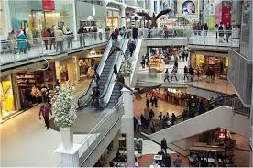
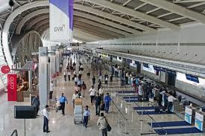
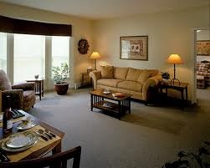
Motivation
People spend 80-90% of their time indoors – USA Environmental Protection Agency 2011.
>85% of data and 70% of voice traffic originates from within buildings – Nokia 2012.

Slide 5
Indoor Data Management
Indoor Data Management deals with all aspects of handling indoor data as a valuable resource:
Localization (tracking) from data
Modeling (symbolic vs. geometric)
Indexing
Query Processing & Privacy
Energy-aware processing
In this talk, we will attempt to cover the current state but also identify future challenges.
Christian S. Jensen, Hua Lu, Bin Yang: Indoor - A New Data Management Frontier. IEEE Data Eng. Bull. 33(2): 12-17 (2010)

Slide 6
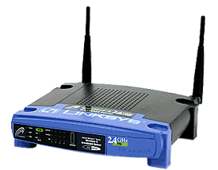
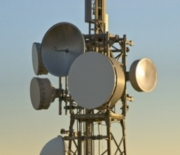
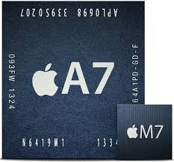
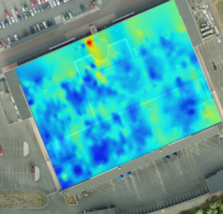
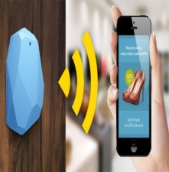
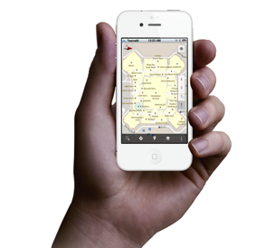
Internet-based Indoor Navigation
Enablers for Indoor have been Internet-based Indoor Navigation (IIN)* services founded on measurements collected by smart devices.
enrich
navigate
IIN Service
“Internet-based Indoor Navigation Services” Zeinalipour-Yazti, Laoudias, Georgiou and Chatzimilioudis, in submission (magazine article upon which this tutorial is founded)

Slide 7
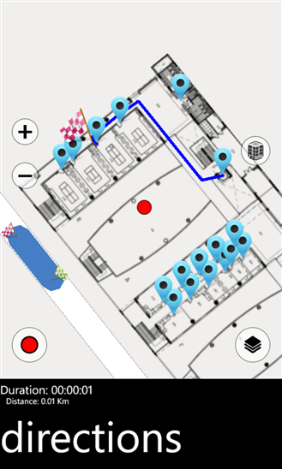
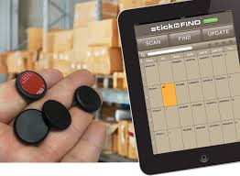
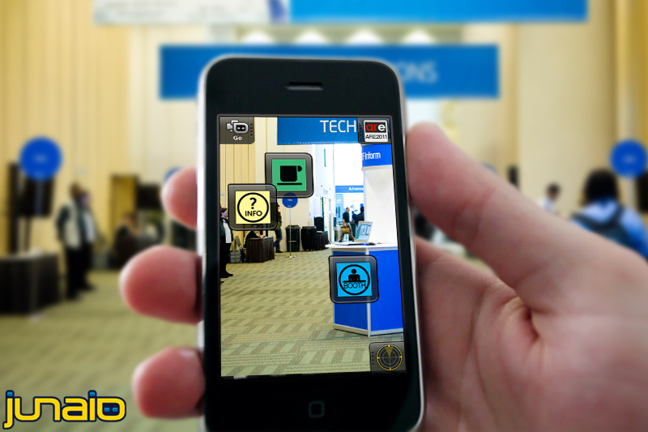
IIN Applications
IIN is bringing a wide range of Applications:
In-building Navigation: Museums, Airports, Malls
Asset Tracking and Hospital Inventory Managem.
Augmented Reality
Smart Houses and Elderly support.
More to be shown in subsequent slides.

Slide 8
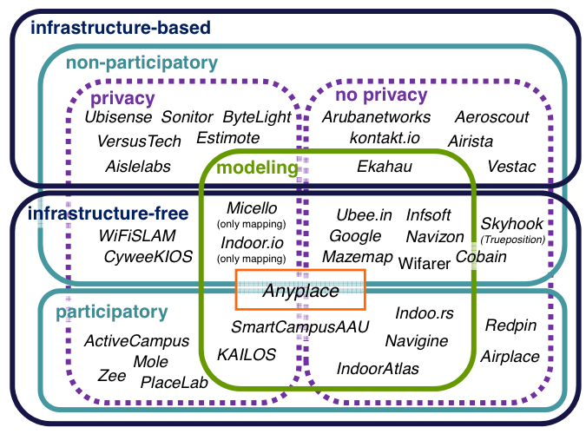
IIN Taxonomy
Explained Next

Slide 9
Anyplace IIN Service
Anyplace: A complete IIN Service open for research and development
Accuracy (1.96m [IPSN’15])
Crowdsourcing [IC’12]
Privacy [TKDE’15], Openness [MDM’12]
Other: Modeling, Modular, …
Model Your Building!
It takes 1 minute to get your model online – 1 hour to offer indoor navigation and search in a 2500 sq meter building!
Don’t miss our MDM’15 Demos of Anyplace!
Anyplace: A Crowdsourced Indoor Information Service , Kyriakos Georgiou Timotheos Constambeys, Christos Laoudias, Lambros Petrou, Georgios Chatzimilioudis and Demetrios Zeinalipour-Yazti
Tue. Jun 16, 15:30-17:00, Sterlings
Thu. Jun 18, 13:30-15:00, Sterlings
http://anyplace.cs.ucy.ac.cy/

Slide 10
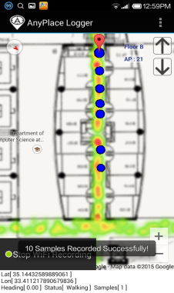
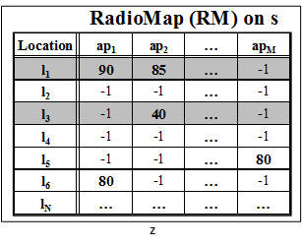
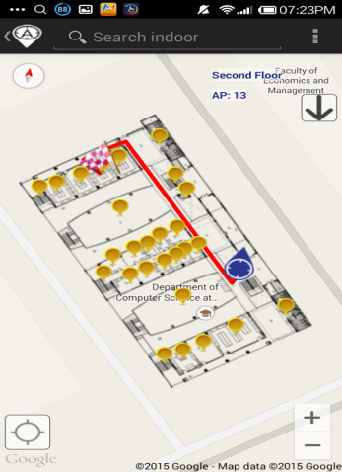
Anyplace IIN Workflow
Logger
IIN Service
a) Upload Measurements
b) Build RM (Radiomap)
c) Localize
fingerprint
Navigator

Slide 11
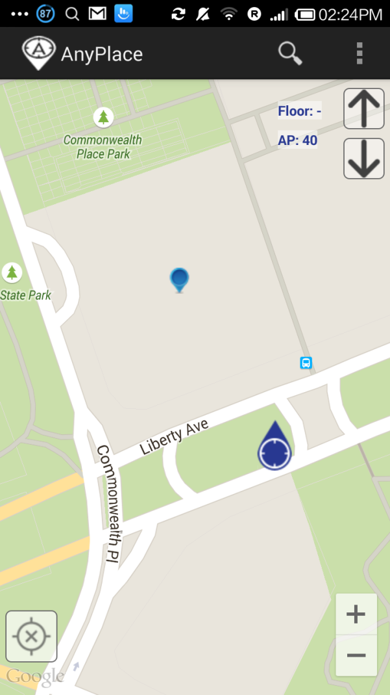
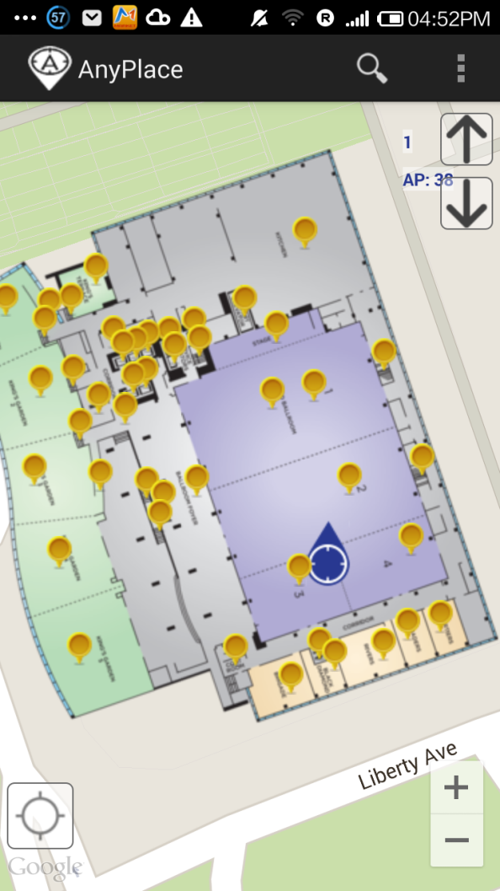
Anyplace @ MDM’15
Before ☹
(using Google API Location)
After ☺
(using Anyplace Location & Indoor Models)

Slide 12
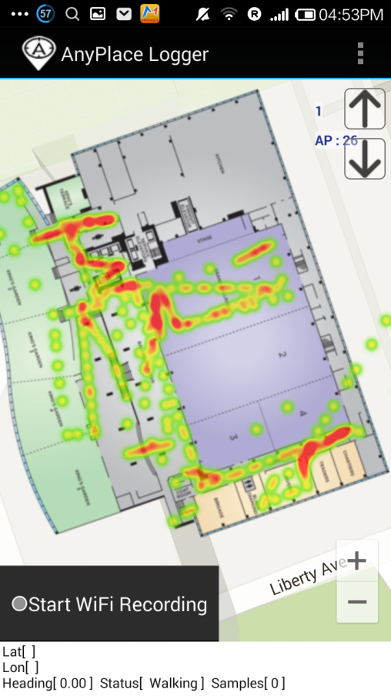
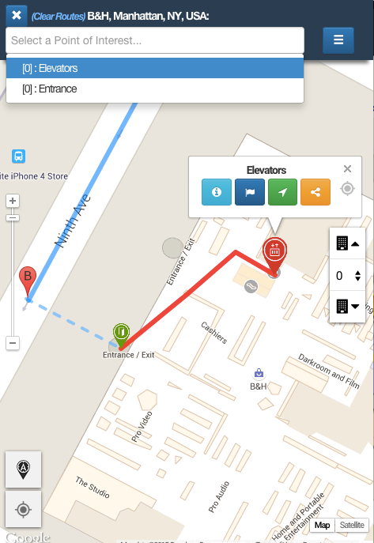
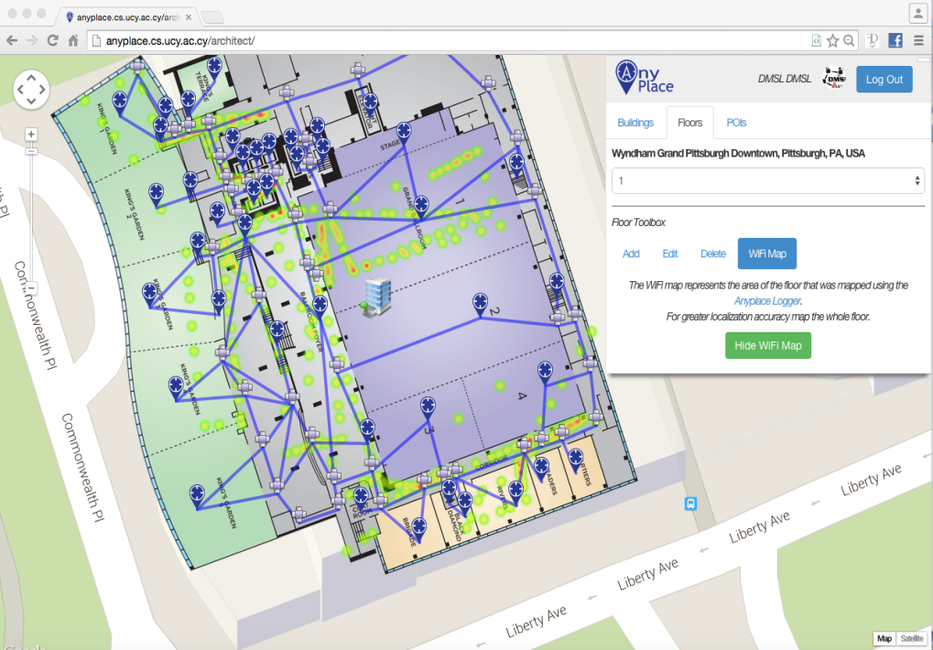
Anyplace @ MDM’15
Model: 1 hour (Image & POIs)
Radiomap: 10 minutes / floor
Could also use Google Indoor Maps (NOT frequently available and also NO fine location available! )

Slide 13
Tutorial Outline
Introduction
Location
Modeling
Crowdsourcing
Privacy
Open Challenges

Slide 14
Location
Location (position): identifies a point or an area on the Earth's surface.
Localization = Positioning = Tracking: identifying location.
Indoor Location: identifies a point located inside a building.
Developments for the last 15 years.
Specialized conferences (e.g., IPIN) & competitions (IPSN)
Expected Accuracy: cm - meters
Mobile-based Indoor Location: Indoor Location with the assistance of a mobile computing device (e.g., smartphone).
Remainder of the tutorial focuses on this category!

Slide 15
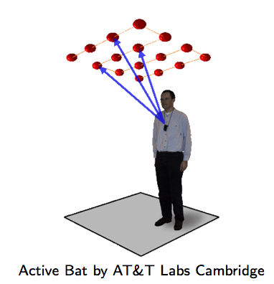
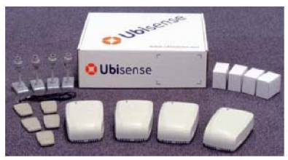
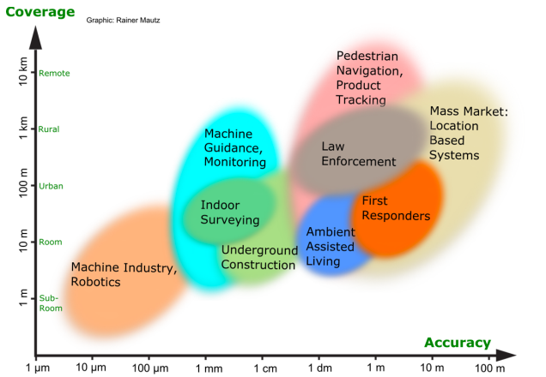
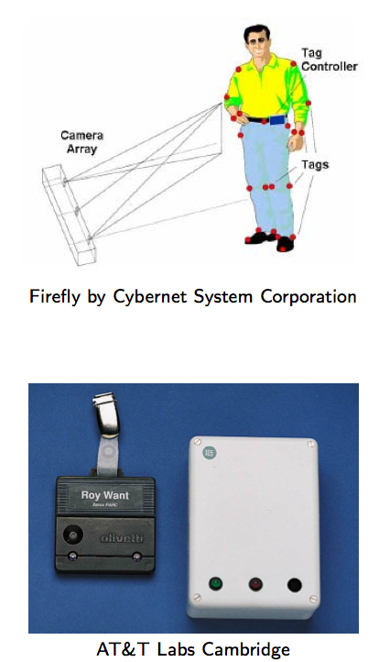
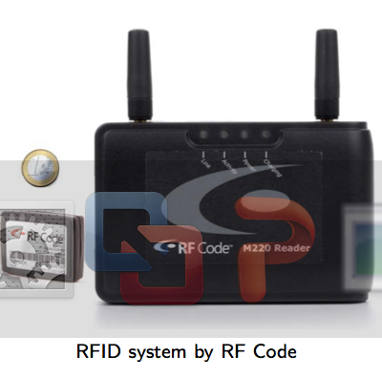
Location (Applications)
Ultrasound:
^{Ultra Wide Band (UWB)}
AOA, TOA, TDOA, signal reflection
: Spatial extension where system performance must be guaranteed
Tutorial Scope
^{Infrared (IR)}
^{TOA, TDOA}
| Outdoor |
Radio Frequency IDentification (RFID)
| Indoor |
^{Rainer Mautz, ETH Zurich, 2011}
Cell of Origin, Signal Strength
^{Firefly delivers 3mm accuracy}

Slide 16
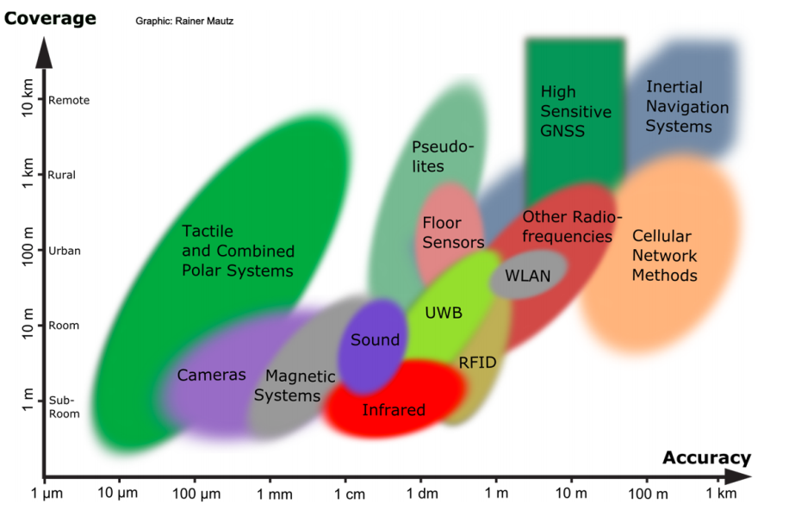
Location (Technologies)
Ultrasound:
^{Ultra Wide Band (UWB)}
AOA, TOA, TDOA, signal reflection
: Spatial extension where system performance must be guaranteed
^{Infrared (IR)}
^{TOA, TDOA}
Tutorial Scope
Radio Frequency IDentification (RFID)
| Outdoor |
| Indoor |
^{Rainer Mautz, ETH Zurich, 2011}
Cell of Origin, Signal Strength
^{Firefly delivers 3mm accuracy}

Slide 17
Localization
Infrastructure-free systems: don’t require dedicated equipment for the provisioning of location signals (e.g., GPS, Wi-Fi, Cellular, Magnetic, IMU)
Infrastructure-based systems: require dedicated equipment (e.g., proprietary transmitters, beacons, antennas and cabling)
Bluetooth Low Energy (BLE) beacons: iBeacons (Apple)
Ultrasound: ALPS (CMU)
Visible Light: EPSILON (Microsoft Research)
Ultra Wide Band (UWB): Decawave
Focus of next slides
Source: NASA

Slide 18
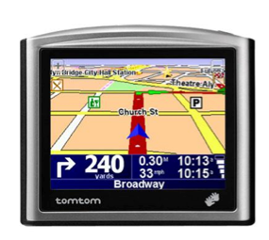
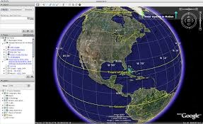
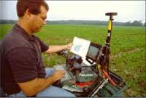
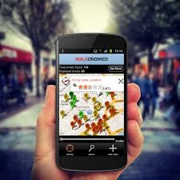
Location
Infrastructure-free
Global Navigation Satellite Systems (GNSS) have played an important role in Outdoor (Spatial) Data Management:
Current: Global Positioning System (US), GLONASS (Russian)
Upcoming: Galileo (European), Indian Regional Navigation Satellite System (IRNASS), BeiDou-2 (Chinese)
Many civilian uses with advent of GIS technologies since ‘70 (ESRI)
Navigation
Geographic Mapping
Precision Agriculture
Location-based Services

Slide 19
Location (Outdoor)
Infrastructure-free
GNSS Drawbacks for Indoor Location:
Low availability indoors due to the blockage or attenuation of the satellite signals.
High start-up time.
Power Demanding (continuously receive signals).

Slide 20
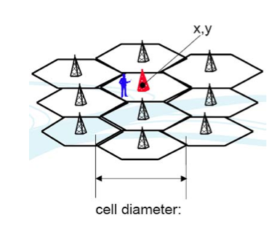
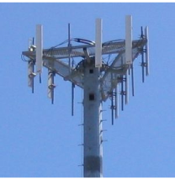
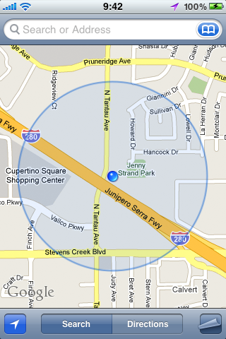
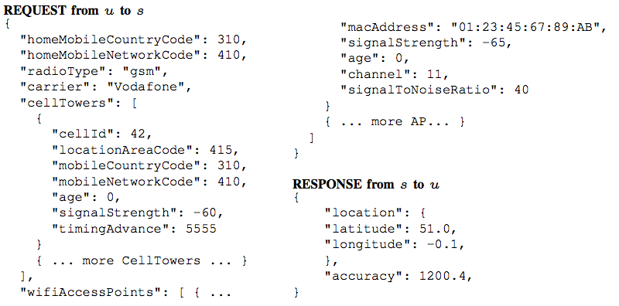
Location (Outdoor/Indoor)
Infrastructure-free
Cell ID:
Cell ID is the Unique Identifier of Cellular Towers.
Cell ID Databases
Skyhook Wireless (2003), MA, USA (Apple, Samsung): 30 million+ cell towers, 1 Billion Wi-Fi APs, 1 billion+ geolocated IPs, 7 billion+ monthly location requests and 2.5 million geofencable POIs.
Google Geolocation “Big” Database (similar)
Disadvantages:
Low accuracy: 30-50m (indoor) to 1-30km (outdoor).
Serving cell is not always the nearest.

Slide 21
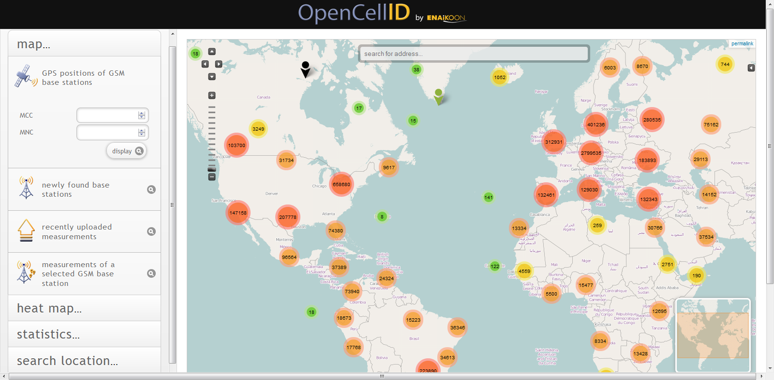
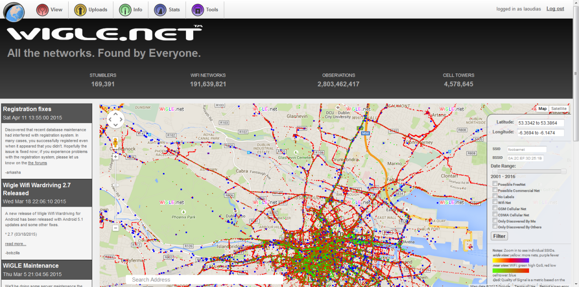
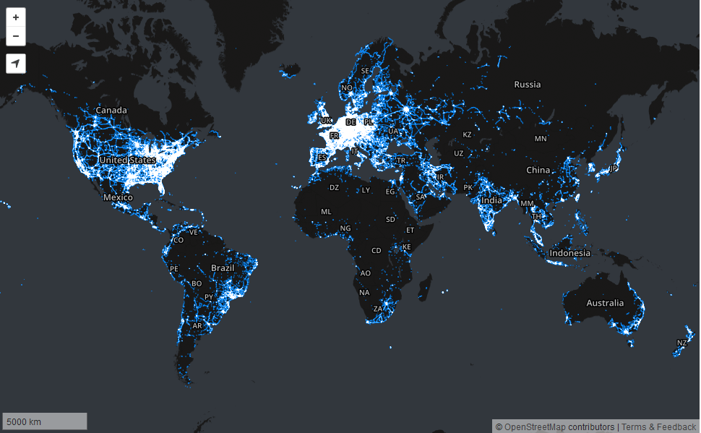
Public Cell ID Databases
Basic Operation on Smartphone Power(mW=mJ/s)
CPU Minimal use (just OS running) 35mW
CPU Standard use (light processing) 175mW
CPU Peak (heavy processing) 469mW
WiFi Idle (Connected) 34mW
WiFi Localization (avg/minute) 125mW
WiFi Peak (Uplink 123Kbps, -58dBm) 400mW
3G Localization (avg/minute) 300mW
3G Busy 900mW
GPS On (steady) 275mW
OLED Economy Mode 300mW
OLED Full Brightness 676mW
Infrastructure-free
Wigle.net API
2.8+ billion raw observations, 191+ million WiFi APs, 4.5+ M cell towers, 170.000 “stumblers” (wardrivers), leaderboards, access to raw data
Open Cell ID API
7 million cell towers, access to raw data
Mozilla Location Service API
8.5 million cell towers, 210+ million WiFi APs, 856+ million cell and 3.4+ billion WiFi observations, leader board, no access to raw data

Slide 22
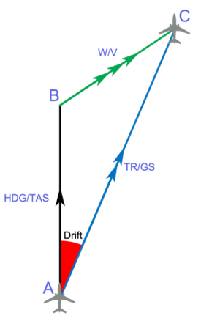
Location (Indoor)
Infrastructure-free
Inertial Measurement Units (IMU)
3D acceleration, 3D gyroscope, digital compass using dead reckoning (calculate next position based on prior).
Disadvantages
Suffers from drift (difference between where the system thinks it is located, and the actual location)
Advantages
Sensors are available on smartphones.
Newer smartphones (iphone 5s) have motion co-processors always-on reading sensors and even providing activitity classifiers (driving, walking, running, or sleeping, etc.)

Slide 23
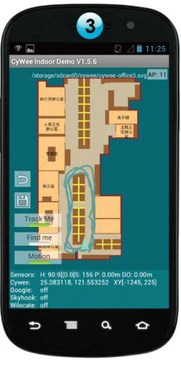
Infrastructure-free
WiFi Fingerprinting in Anyplace
References
[Airplace] "The Airplace Indoor Positioning Platform for Android Smartphones", C. Laoudias et. al., Best Demo Award at IEEE MDM'12. (Open Source!)
[HybridCywee] "Indoor Geolocation on Multi-Sensor Smartphones", C.-L. Li, C. Laoudias, G. Larkou, Y.-K. Tsai, D. Zeinalipour-Yazti and C. G. Panayiotou, in ACM Mobisys'13. Video at: http://youtu.be/DyvQLSuI00I
[UcyCywee] IPSN’14 Indoor Localization Competition (Microsoft Research), Berlin, Germany, April 13-14, 2014. 2nd Position with 1.96m! http://youtu.be/gQBSRw6qGn4
D. Lymberopoulos, J. Liu, X. Yang, R. R. Choudhury, ..., C. Laoudias, D. Zeinalipour-Yazti, Y.-K. Tsai, and et. al., “A realistic evaluation and comparison of indoor location technologies: Experiences and lessons learned”, In IEEE/ACM IPSN 2015.
1st Position at EVARILOS Open Challenge, European Union (TU Berlin, Germany).
Cywee / Airplace

Slide 24
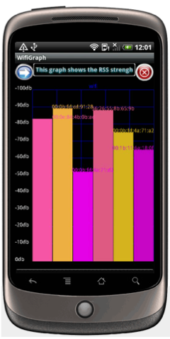
WiFi Fingerprinting
Infrastructure-free
Received Signal Strength Indicator (RSSI)
Power measurement present in a received radio signal measured in [ dBm, Decibel-milliwatts ]
80 dBm = 100 kW Transmission power of FM radio (50 km)
0 dBm = 1 mW
-80dBm = 10 pW | Max RSSI (-30dBm) to Min RSSI: (−90 dBm)
-110dBm = 0.01 pW | WiFi AP is visible but out of data range.
Advantages
Readily provided by smartphone APIs .
Low power 125mW (RSSI) vs. 400 mW (transmit)
Disadvantages
Complex propagation conditions (multipath, shadowing) due to wall, ceilings.
RSS fluctuates over time at a given location (especially in open spaces).
Unpredictable factors (people moving, doors, humidity)

Slide 25
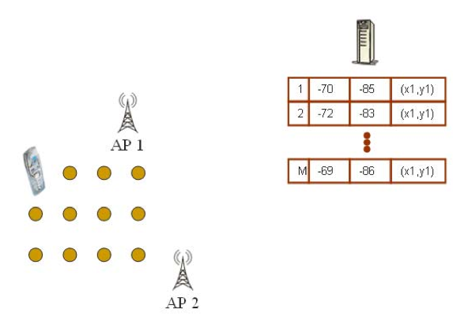
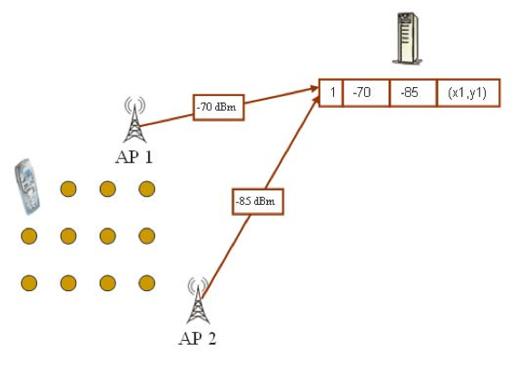
WiFi Fingerprinting
Infrastructure-free
Mapping Area with WiFi Fingerprints
n APs deployed in the area
Fingerprints r_{i} = [ r_{i1}, r_{i2}, …, r_{in}]
Averaging

Slide 26
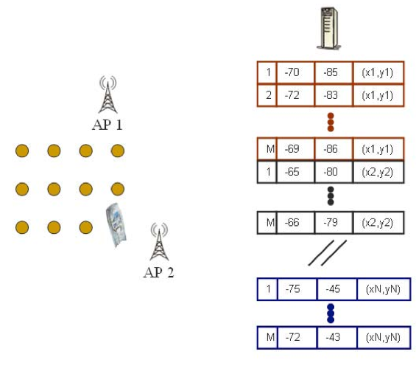
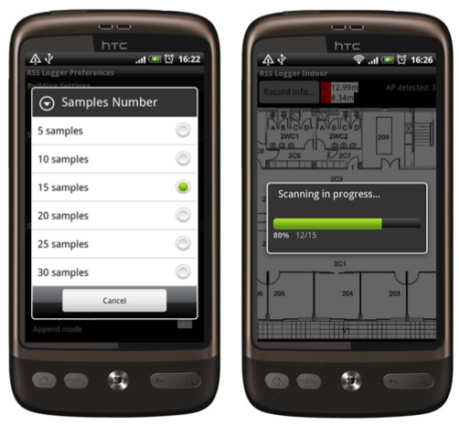
WiFi Fingerprinting
Infrastructure-free
Mapping Area with WiFi Fingerprints
Repeat process for rest points in building. (IEEE MDM’12)
Use 4 direction mapping (NSWE) to overcome body blocking or reflecting the wireless signals.
Collect measurements while walking in straight lines (IPIN’14)

Slide 27
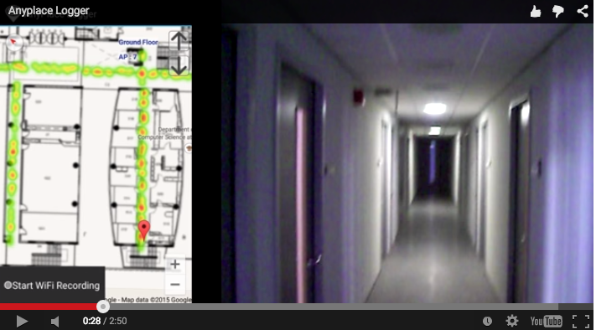
Logging in Anyplace
Infrastructure-free
Video
"Anyplace: A Crowdsourced Indoor Information Service", Kyriakos Georgiou, Timotheos Constambeys, Christos Laoudias, Lambros Petrou, Georgios Chatzimilioudis and Demetrios Zeinalipour-Yazti, Proceedings of the 16th IEEE International Conference on Mobile Data Management (MDM '15), IEEE Press, Volume 2, Pages: 291-294, 2015

Slide 28
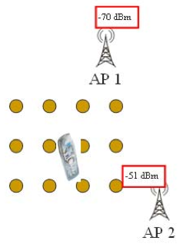
WiFi Positioning
Infrastructure-free
Positioning with WiFi Fingerprint
Collect Fingerprint s = [ s₁, s₂, …, s_{n}]
Compute distance || r_{i} - s || and position user at:
Nearest Neighbor (NN)
K Nearest Neighbors (w_{i} = 1 / K)
Weighted K Nearest Neighbors (w_{i} = 1 / || r_{i} - s || )
RadioMap
s = [ -70, -51]
r₁ = [ -71, -82, (x₁,y₁)]
r₂ = [ -65, -80, (x₂,y₂)]
…
r_{N} = [ -73, -44, (x_{N},y_{N})]
NN, KNN, WKNN

Slide 29
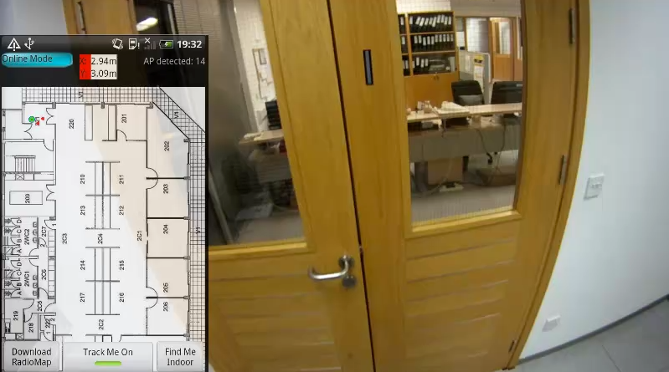
WiFi Positioning Demo
Infrastructure-free
Video
"The Airplace Indoor Positioning Platform for Android Smartphones", C. Laoudias, G. Constantinou, M. Constantinides, S. Nicolaou, D. Zeinalipour-Yazti, C. G. Panayiotou, Best Demo Award at IEEE MDM'12. (Open Source!)

Slide 30
Hybrid IMU/WiFi Positioning
Infrastructure-free
We engaged in an Industrial NRE contract with Cywee Taiwan Ltd, a hardware/software motion processing company (ACM Mobisys’13)
The result was a Hybrid IMU/WiFi Positioning system with the following additional features:
Location Fusion: WiFi / IMU (3-axis accelerometer, gyroscope, and digital compass) using a particle filter.
MapMatching: to handle inaccurate IMU location estimates (e.g., void passing through walls).
Magnetic Mapping: detect and handle magnetic abnormalities due to electrical appliances and refining the orientation.

Slide 31
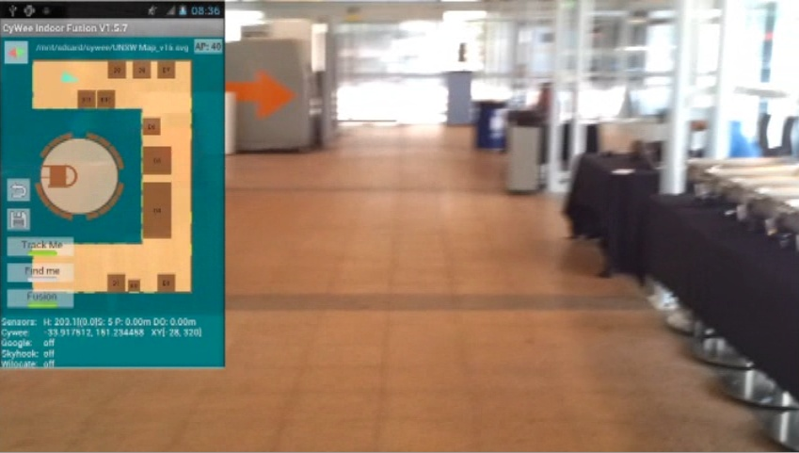
Hybrid WiFi/IMU Positioning Demo
Infrastructure-free
“Indoor Geolocation on Multi-Sensor Smartphones", C.-L. Li, C. Laoudias, G. Larkou, Y.-K. Tsai, D. Zeinalipour-Yazti and C. G. Panayiotou, in ACM Mobisys'13.
Video at: http://youtu.be/DyvQLSuI00I

Slide 32
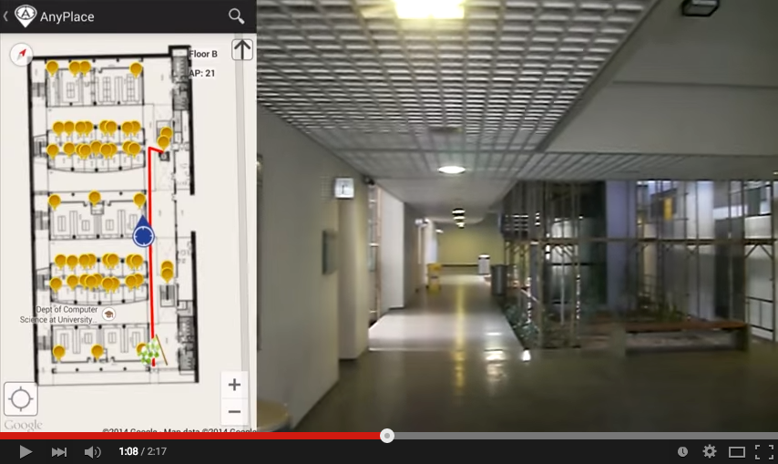
Hybrid Wi-Fi/IMU/Outdoor Anyplace
Infrastructure-free
Video
"Anyplace: A Crowdsourced Indoor Information Service", Kyriakos Georgiou, Timotheos Constambeys, Christos Laoudias, Lambros Petrou, Georgios Chatzimilioudis and Demetrios Zeinalipour-Yazti, Proceedings of the 16th IEEE International Conference on Mobile Data Management (MDM '15), IEEE Press, Volume 2, Pages: 291-294, 2015

Slide 33
Magnetic-based
Infrastructure-free
Earth’s magnetic field
Exploit indoor disturbances: power cables, elevators, metal surfaces, electrical appliances.
Alternative for iOS and Windows phones where WiFi RSS is not available for fingerprinting (IndoorAtlas)
Source: Wikipedia
Source: wired.co.uk

Slide 34
Localization Outline
Infrastructure-free systems: don’t require dedicated equipment for the provision of location signals on a modern smartphone (e.g., GPS, Wi-Fi, Cellular, Magnetic, IMU)
Infrastructure-based systems: require dedicated equipment (e.g., proprietary transmitters, beacons, antennas and cabling)
Bluetooth Low Energy (BLE) beacons: iBeacons
Ultrasound: ALPS (CMU)
Visible Light: EPSILON (Microsoft Research)
Ultra Wide Band (UWB): Decawave
Focus of next slides
Source: NASA

Slide 35
RFID Tags
Infrastructure-based
Passive RFID
Tag collects energy from transmitter to respond with a Unique ID.
Range: 10cm to few meters
Indicative Price: 0.25 cents / tag
Active RFID
Tag is battery-powered (larger size), thus can transmit UID autonomously.
Range: Hundreds of meters.
Indicative Price: 10-50 USD / tag
Older Trend

Slide 36
Beacons
Infrastructure-based
iBeacon: Bluetooth Low Energy protocol by Apple (2013).
Beacon is a tiny battery powered devices that emits BLE signals.
Transmits unique (changeable) identifiers that can be picked up by any Linux Bluetooth stack (iPhone-Android-Windows).
e.g., UUID f7826da6-4fa2-4e98-8024-bc5b71e0893e (beacon set), Major 1 and 65535 (e.g., floor), Minor 1 and 65535 (e.g., room)
Can also pick up periodical broadcasting packets (Probe Requests) made by smartphones to actively seek Wi-Fi Access Points (tracking usages).
Source: NASA

Slide 37
Beacons
Infrastructure-based
Beacon Facts
$5-$50 USD, Frequencies: 1Hz to 10Hz (1s to 100ms)
Cell, AAA batteries (4-6 months) or USB powered
Transmission Range: 1m to 50 m (-30dbm – 0dbm)
Might contain sensors: temperature, motion (estimote)
(e.g., open fitness app when bicycle starts moving)
Which beacon to use?
AisleLabs, May 4, 2015.
http://goo.gl/ej9P0n
Indoo.rs SF Airport deploy:
300 StickNFind (15K USD)
60,000 m²
Source: NASA

Slide 38
Beacons
Infrastructure-based
Source: NASA

Slide 39
Ultrasound
Infrastructure-based
Ultrasound transceivers
Active Bat, AT&T Labs Cambridge
Cricket system, MIT
Smartphone-based (integrated mic)
Acoustic Location Processing System (ALPS), CMU: 31cm avg. positioning error (winners of Microsoft Contest 2015)

Slide 40
LED Visible Light
Infrastructure-based
LED light bulbs can switch on/off at high frequency (not visible to human eye) transmitting their ID.
Light sensor decodes light signal intensities and estimates distances from LEDs to get user location
Academic: Epsilon (Microsoft Research)
Industrial: ByteLight.com
Similar ideas for Data Transm (LiFi) – Gbps already!
L. Li et al., "Epsilon: A Visible Light Based Positioning System", 11th USENIX Symposium on Networked Systems Design and Implementation (NSDI), 2014, pp. 331-343.

Slide 41
Ultra Wide Band (UWB)
Infrastructure-based
Measures the time (nanosec) it takes for brief bursts of radio energy (pulses) to travel between radios using a large portion of the radio spectrum.
Pros: Accuracy (Decawave reports 10cm accuracy!)
Cons: Short range, computational cost, expensive equipment [Zebra demo kit costs $12,000 (2014)]
Driven by several players
Ubisense (UK), Decawave (IE), Nanotron (GE), Time Domain (US), Zebra (US)

Slide 42
IIN Taxonomy
Infrastructure-based

Slide 43
Industrial Solutions
Infrastructure-based
Ekahau RTLS: WiFi/RFID tags, Healthcare, 300+hospitals
Asset tracking, ​staff safety & workflow optimization, patient safety & throughput, ​temperature monitoring. [ Active-RFID-over-WiFi ]
Aislelabs: WiFi/iBeacon, Cloud-based retail analytics
Customer behavior, personalized marketing, enterprise mobile wallet, indoor navigation, geofencing, in-store promotions [ BLE ]

Slide 44
Beacon (Applications)
Infrastructure-based
Shopping Analytics with Aislelabs

Slide 45
Tutorial Outline
Introduction
Location
Modeling
Crowdsourcing
Privacy
Open Challenges

Slide 46
Modeling
Indoor spaces exhibit complex topologies. They are composed of entities that are unique to indoor settings:
e.g., rooms and hallways that are connected by doors.
Conventional Euclidean distances are inapplicable in indoor space, e.g., NN of p1 is p2 not p3.
Jensen et. al. 2010

Slide 47
Modeling
Geometric Model: uses points in N-dimensional space, allowing the calculation of Lp-norm distances.
Symbolic Model: uses reference points (e.g., rooms) to establish a structure for distance computation.
Graph-based model for indoor G(V,E), V={rooms} E={doors,corridors,stairs,elevators} - Becker 2005.
This allows direct usage of graph algorithms (shortest path, connectivity, traversals, etc.)
To provide spatial queries, we additionally need to a complementary geometric extend to V.

Slide 48
Modeling
Technology roadmap is towards indoor GIS integration
GeoJson.org (not specifically for indoor)
IndoorGML.net
Source: NASA

Slide 49
GeoJson
GeoJSON is a format for encoding a variety of geographic data structures (not only indoor)
Not a formal GIS standard (i.e., OGC standard)
Convenient for Web 2.0 APIs
Support: Micello Web Maps
Supports multiple geometry types
Point, LineString, Polygon,
MultiPoint, MultiLineString, and MultiPolygon
Source: NASA

Slide 50
IndoorGML
Standard supported by Open Geospatial Consortium (OGC)
Defined as an application schema of OGC Geographic Markup Language (GML) 3.2.1.
IndoorOSM (another older effort by Open Street Map) is deprecated
Source: NASA

Slide 51
IndoorGML – How It Works
Source: NASA

Slide 52
Modeling in Anyplace
Multi-layered space (sensor + semantics)
Demo

Slide 53
i-locate EU Project
Indoor counterpart to OSM
Source: NASA
G. Conti, Keynote at International Conference on Indoor Positioning and Indoor Navigation (IPIN), Busan, S. Korea, 2014

Slide 54
i-locate Open Geodata Project
Indoor/outdoor location and asset management through open geodata (EU ICT 2014-2016)
Main objectives
Create a public geoportal for open indoor Geographical Information
Extend current open standards (OSM) to support indoor and outdoor LBS
Develop an open source “toolkit” for indoor and outdoor LBS
Source: NASA
http://www.i-locate.eu/

Slide 55
IIN Taxonomy

Slide 56
Industrial Solutions
Basic Operation on Smartphone Power(mW=mJ/s)
CPU Minimal use (just OS running) 35mW
CPU Standard use (light processing) 175mW
CPU Peak (heavy processing) 469mW
WiFi Idle (Connected) 34mW
WiFi Localization (avg/minute) 125mW
WiFi Peak (Uplink 123Kbps, -58dBm) 400mW
3G Localization (avg/minute) 300mW
3G Busy 900mW
GPS On (steady) 275mW
OLED Economy Mode 300mW
OLED Full Brightness 676mW
Mazemap: Service for indoor maps (Needs Cisco CMX)
Universities, hospitals, conference venues and shopping malls
Timetable, mobile app, SMS notification, reserve room integration
Micello: Indoor maps,15,000+ venues, 50,000+ buildings
Map integration, 3rd party navigation engine, multiple data formats
49 USD / building / month (Jun. 2015)

Slide 57
Google Indoor
Free to enrich Google Maps
Not clear how mapping is priortized by Google
No control over model
No fine location
Anyplace works over Google Indoor as a Map Layer!

Slide 58
Tutorial Outline
Introduction
Location
Modeling
Crowdsourcing
Privacy
Open Challenges

Slide 59
Crowdsourcing
A smartphone crowd is constantly moving and sensing providing large amounts of sensor data enabling new applications
“Crowdsourcing with Smartphones”, Georgios Chatzimiloudis, Andreas Konstantinidis, Christos Laoudias, Demetrios Zeinalipour-Yazti, IEEE Internet Computing, Special Issue: Sep/Oct 2012 - Crowdsourcing, May 2012. IEEE Press, Volume 16, pp. 36-44, 2012.

Slide 60
Non-Participatory vs. Participatory
Basic Operation on Smartphone Power(mW=mJ/s)
CPU Minimal use (just OS running) 35mW
CPU Standard use (light processing) 175mW
CPU Peak (heavy processing) 469mW
WiFi Idle (Connected) 34mW
WiFi Localization (avg/minute) 125mW
WiFi Peak (Uplink 123Kbps, -58dBm) 400mW
3G Localization (avg/minute) 300mW
3G Busy 900mW
GPS On (steady) 275mW
OLED Economy Mode 300mW
OLED Full Brightness 676mW
Non-participatory systems: Paid professionals (Micello, Mazemap, Ekahau) or a team of trained volunteers (KAILOS project) undertake the data collection
Participatory systems: employ feedback from regular users to expand a core signal database created by trained contributors or regular users.
Source: NASA

Slide 61
Non-Participatory
Basic Operation on Smartphone Power(mW=mJ/s)
CPU Minimal use (just OS running) 35mW
CPU Standard use (light processing) 175mW
CPU Peak (heavy processing) 469mW
WiFi Idle (Connected) 34mW
WiFi Localization (avg/minute) 125mW
WiFi Peak (Uplink 123Kbps, -58dBm) 400mW
3G Localization (avg/minute) 300mW
3G Busy 900mW
GPS On (steady) 275mW
OLED Economy Mode 300mW
OLED Full Brightness 676mW
Non-Participatory
Non-participatory systems
Pros
Collected data span the entire area (no black holes)
Sufficient data to build reliable signal maps
Cons
Laborious and time consuming:
15 collectors for 2 weeks, 200,000 WiFi readings at 10,000 locations to cover 450,000 m² shopping mall in S. Korea
High costs
0.17 USD per m2 in Mazemap (only the map – no signals)
Older versions of Ekahau system installation costed $10,000 for a large office building (no maintenance included)
Source: NASA

Slide 62
KAILOS Academic Project
Basic Operation on Smartphone Power(mW=mJ/s)
CPU Minimal use (just OS running) 35mW
CPU Standard use (light processing) 175mW
CPU Peak (heavy processing) 469mW
WiFi Idle (Connected) 34mW
WiFi Localization (avg/minute) 125mW
WiFi Peak (Uplink 123Kbps, -58dBm) 400mW
3G Localization (avg/minute) 300mW
3G Busy 900mW
GPS On (steady) 275mW
OLED Economy Mode 300mW
OLED Full Brightness 676mW
Non-Participatory
Source: NASA
KAIST(S. Korea) http://kailos.io

Slide 63
Active Campus (UCSD)
Participatory
Dating back to 2004 …
When a user’s location is displayed incorrectly, the user clicks on the map to correct location
Source: NASA

Slide 64
Place Lab (Intel)
Basic Operation on Smartphone Power(mW=mJ/s)
CPU Minimal use (just OS running) 35mW
CPU Standard use (light processing) 175mW
CPU Peak (heavy processing) 469mW
WiFi Idle (Connected) 34mW
WiFi Localization (avg/minute) 125mW
WiFi Peak (Uplink 123Kbps, -58dBm) 400mW
3G Localization (avg/minute) 300mW
3G Busy 900mW
GPS On (steady) 275mW
OLED Economy Mode 300mW
OLED Full Brightness 676mW
Participatory
Microsoft Research
Among the first systems in 2005 (IEEE Pervasive) promoting user collaboration.
http://www.placelab.org
AP
Source: NASA

Slide 65
Zee (Microsoft Research)
Basic Operation on Smartphone Power(mW=mJ/s)
CPU Minimal use (just OS running) 35mW
CPU Standard use (light processing) 175mW
CPU Peak (heavy processing) 469mW
WiFi Idle (Connected) 34mW
WiFi Localization (avg/minute) 125mW
WiFi Peak (Uplink 123Kbps, -58dBm) 400mW
3G Localization (avg/minute) 300mW
3G Busy 900mW
GPS On (steady) 275mW
OLED Economy Mode 300mW
OLED Full Brightness 676mW
Participatory
Zero-effort fingerprint collection
WiFi Data are crowdsourced without explicit user participation (app runs in the background)
Leverages smartphone IMU sensors (direction, step counting, stride length estimation)
Source: NASA
Rai et. al., “Zee: zero-effort crowdsourcing for indoor localization”. In ACM Mobicom '12

Slide 66
SmartCampusAAU (Aalborg)
Basic Operation on Smartphone Power(mW=mJ/s)
CPU Minimal use (just OS running) 35mW
CPU Standard use (light processing) 175mW
CPU Peak (heavy processing) 469mW
WiFi Idle (Connected) 34mW
WiFi Localization (avg/minute) 125mW
WiFi Peak (Uplink 123Kbps, -58dBm) 400mW
3G Localization (avg/minute) 300mW
3G Busy 900mW
GPS On (steady) 275mW
OLED Economy Mode 300mW
OLED Full Brightness 676mW
Participatory
Open-source system
Features both terminal and network-based localization to support all three major mobile OS platforms (Android, iOS, Windows)
Source: NASA

Slide 67
IIN Taxonomy

Slide 68
Tutorial Outline
Introduction
Location
Modeling
Crowdsourcing
Privacy
Open Challenges

Slide 69
Location Privacy Threat
Location tracking is unethical and can even be illegal if it is carried out without the explicit user consent.
Imminent privacy threat, with greater impact that other location tracking concerns, as it can occur at a very fine granularity. It reveals:
The stores / products of interest in a mall.
The book shelves of interest in a library
Artifacts observed in a museum, etc.

Slide 70
Location Privacy
Users don’t know where IPS operate their data and whether these conform or not to latest legislative efforts and reforms:
EU Data Protection Directive
US White House consumer Privacy Bill of Rights
US-EU Safe Harbor guidelines
US Do-Not-Track Online Act
IPS might become attractive targets for hackers, aiming to steal location data and carry out illegal acts (e.g., break into houses).
IPS should be considered as fundamentally untrusted entities, so we aim to devise techniques that are exploit IPS utility with controllable privacy to the user.

Slide 71
Privacy vs No Privacy
Basic Operation on Smartphone Power(mW=mJ/s)
CPU Minimal use (just OS running) 35mW
CPU Standard use (light processing) 175mW
CPU Peak (heavy processing) 469mW
WiFi Idle (Connected) 34mW
WiFi Localization (avg/minute) 125mW
WiFi Peak (Uplink 123Kbps, -58dBm) 400mW
3G Localization (avg/minute) 300mW
3G Busy 900mW
GPS On (steady) 275mW
OLED Economy Mode 300mW
OLED Full Brightness 676mW
Network-based geolocation systems can always “know” the location of users while serving them.
Privacy (terminal-based) solutions
Calculate location directly at the user-carried device
Use sensor readings produced or downloaded locally
No Privacy (network-based) solutions
Rely continuously on the service for user geolocation
Use location-dependent observations
monitored by the network infrastructure
collected by mobile devices (terminal-assisted mode)
Source: NASA

Slide 72
Location Privacy
I can see these Reference Points, where am I?
...
(x,y)!
RadioMap Service
User u
Privacy-Preserving Indoor Localization on Smartphones, Andreas Konstantinidis, Paschalis Mpeis, Demetrios Zeinalipour-Yazti and Yannis Theodoridis, in IEEE TKDE’15
Towards planet-scale localization on smartphones with a partial radiomap", A. Konstantinidis, G. Chatzimilioudis, C. Laoudias, S. Nicolaou and D. Zeinalipour-Yazti. In ACM HotPlanet'12, in conjunction with ACM MobiSys '12, ACM, Pages: 9--14, 2012.

Slide 73
Temporal Vector Map (TVM)
Bloom Filter (u's APs)
WiFi
Set Membership Queries
Contains false positives
Doesn’t contain false negatives
WiFi
...
RadioMap (server-side)
K=3 Positions
User u
WiFi

Slide 74
Tutorial Outline
Introduction
Location
Modeling
Crowdsourcing
Privacy
Open Challenges

Slide 75
Localization Challenges
Basic Operation on Smartphone Power(mW=mJ/s)
CPU Minimal use (just OS running) 35mW
CPU Standard use (light processing) 175mW
CPU Peak (heavy processing) 469mW
WiFi Idle (Connected) 34mW
WiFi Localization (avg/minute) 125mW
WiFi Peak (Uplink 123Kbps, -58dBm) 400mW
3G Localization (avg/minute) 300mW
3G Busy 900mW
GPS On (steady) 275mW
OLED Economy Mode 300mW
OLED Full Brightness 676mW
Fuse multi-modal location-dependent sensing data
coming from highly diverse, low-cost and error-prone smartphone sensors
Provide seamless indoor/outdoor transition
switch from GPS geolocation in open sky to indoor solutions when the quality of satellite signals degrades
transparent cross-floor movement
timely detecting elevation changes
identify the correct floor and display the corresponding map
Intelligent switching among indoor systems
Ubiquity of indoor solutions will lead to overlaps
Diverse application requirements: availability, power consumption, accuracy, precision.
Source: NASA

Slide 76
Localization Challenges
Problem: When a users moves inside an indoor space connectivity might be lost
intermittent connectivity.
WiFi AP out of range.
As such, continuous localization with input from the IPS is a challenging task.
Preloading the complete building or area map (like in GPS) is difficult due to scale and due to frequently updated data (by crowdsourcers)

Slide 77
Intermittent Connectivity
IIN Service
Where-am-I?
No Navigation
Where-am-I?
X
Where-am-I?
☹ Intermittent Connectivity
Time

Slide 78
PreLoc Navigation
IIN Service
Prefetch K RM rows
Prefetch K RM rows
X
Localize from Cache
Prefetch K RM rows
☺ Intermittent Connectivity
Time

Slide 79
Modeling Challenges
Basic Operation on Smartphone Power(mW=mJ/s)
CPU Minimal use (just OS running) 35mW
CPU Standard use (light processing) 175mW
CPU Peak (heavy processing) 469mW
WiFi Idle (Connected) 34mW
WiFi Localization (avg/minute) 125mW
WiFi Peak (Uplink 123Kbps, -58dBm) 400mW
3G Localization (avg/minute) 300mW
3G Busy 900mW
GPS On (steady) 275mW
OLED Economy Mode 300mW
OLED Full Brightness 676mW
Advanced graph automation tasks
Check the indoor model (graph connectivity, automatically connect overlapping stairs and elevators)
Algorithms to handle click-streams of error reports and dispute resolution techniques
Majority voting algorithms
Integration to open standards
Boost openness and data portability among different geolocation services
Facilitate easier data entry
Source: NASA

Slide 80
Crowdsourcing Challenges
Logging “big” quantities of RSSI fingerprints in the cloud, calls for scalable processing architectures.
Historic RSSI for buildings (Offline Data)
Online RSSI that arrive from Crowdsourcers (Online Data)
Apache Hadoop is nowadays widely endorsed by the industry and academia for offline processing of data using the Map/Reduce programming paradigm.
Newer trends provide:
performance abstractions.
In-Memory processing concepts

Slide 81
Crowdsourcing Challenges
Massively process RSS log traces to generate a valuable Radiomap
Processing current logs in Anyplace for a single building takes several minutes!
Challenges in MapReduce:
Collect Statistics (count, RSSI mean and standard deviation)
Remove Outlier Values.
Handle Diversity Issues

Slide 82
Crowdsourcing Challenges
Quality: Unreliable Crowdsourcers, Multi-device Issues, Hardware Outliers, Temporal Decay, etc.
Remark: There is a Linear Relation between RSS values of devices.
Challenge: Can we exploit this to align reported RSS values?
"Crowdsourced Indoor Localization for Diverse Devices through Radiomap Fusion", C. Laoudias, D. Zeinalipour-Yazti and C. G. Panayiotou, "Proceedings of the 4th Intl. Conference on Indoor Positioning and Indoor Navigation" (IPIN '13), Montbeliard-Belfort France, 2013.

Slide 83
Mobile Data Management in Indoor Spaces
Christos Laoudias§and Demetrios Zeinalipour-Yazti∗
Thank You! Questions?
Contact: laoudias@ucy.ac.cy; dzeina@cs.ucy.ac.cy
http://goo.gl/70JV4q
Advanced Seminar at 16th IEEE Int. Conference on Mobile Data Management (MDM’15), Pittsburgh, PA, USA, June 17, 2015

