Slide 1
Indoor Navigation Services from Mobile Data
Demetris Zeinalipour
Assistant Professor
Department of Computer Science
University of Cyprus, Cyprus
http://www.cs.ucy.ac.cy/~dzeina/
dzeina@cs.ucy.ac.cy
21st European Conference on Advances in Databases and Information Systems (ADBIS’17) Hilton Cyprus Hotel, Nicosia, Cyprus, September 25, 2017.

Slide 2
Welcome
Welcome to Cyprus!
I hope you will have an enjoyable and productive time!
University of Cyprus:
Founded in 1989, 350 Faculty, 7000 Stud, 22 Departments
Ranked 52nd in top-200 Young Univ. by the Times.
Dept. of Computer Science – 22 Faculty Members
Data Management Systems Laboratory (DMSL) Scope:
Mobile and Sensor Data Management
Big Data Management (Parallel and Distributed)
Spatio-Temporal Data Management
Network and Telco Data Management
Crowd, Web 2.0 and Indoor Data Management
Data Privacy Management

Slide 3
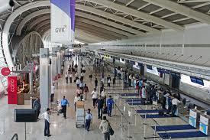
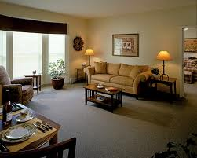
Motivation
People spend 80-90% of their time indoors – USA Environmental Protection Agency 2011.
This is the place where most human activity, commerce, transactions, etc happen!
>85% of data and 70% of voice traffic originates from within buildings – Nokia 2012.

Slide 4
Motivation
1977: "There is no reason anyone would want a computer in their home."
Ken Olsen, founder of Digital Equipment Corporation, 1977
2017: Current studies show that a typical family im the developed world owns about 5-10 internet-connected devices
Smartphone, Tablet, SmartTV, SmartDevices, …
Not to add the 60 MCUs per US house + 60 MCUs in a luxury car!
Future: “Gartner Says a Typical Family Home Could Contain More Than 500 Smart Devices by 2022”!
https://goo.gl/c6VTWG
Lots of IoT for sensing and control
Notes:
"I think there is a world market for maybe five computers."
Thomas Watson, president of IBM, 1943
http://web.sonoma.edu/users/f/farahman/sonoma/courses/es310/resources/aboutmicro.htm

Slide 5
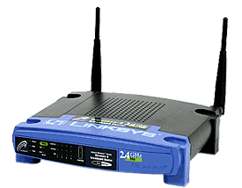
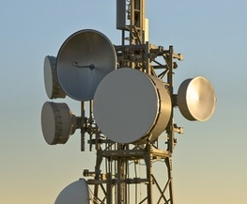
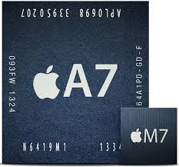
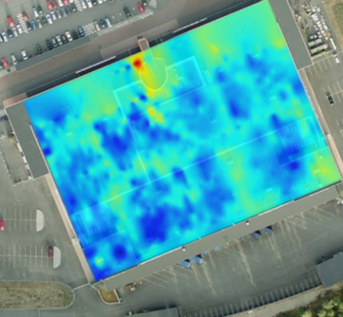
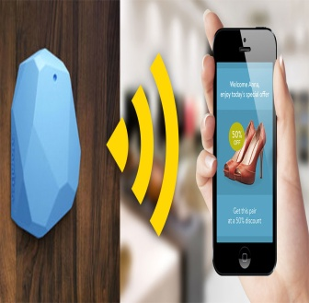
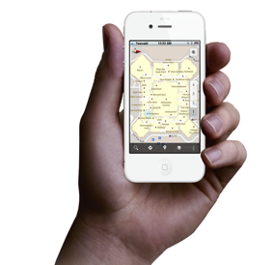
Indoor Location
Smart Devices are becoming enablers for modern Internet-based Indoor Navigation (IIN) services founded on their measurements.
Technologies:
Wi-Fi APs, Cellular Towers, other stationary antennas
IMU Data (Gyroscope, Accelerometers, Digital Compass)
Magnetic Field Sensors
Beacons (BLE Beacons, RFID Active & Passive Beacons)
Sound (Microphone), Light (Light Sensor), …

Slide 6
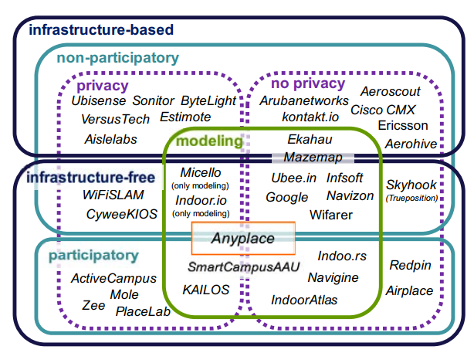
Indoor Applications
Taxonomy of Indoor Technologies and Projects
"Internet-Based Indoor Navigation Services", Demetrios Zeinalipour-Yazti, Christos Laoudias, Kyriakos Georgiou, Georgios Chatzimilioudis, IEEE Internet Computing (IC'17), vol. 21, no. 4, pp. 54-63, July 2017, doi:10.1109/MIC.2017.2911420, IEEE Computer Society, 2017.

Slide 7
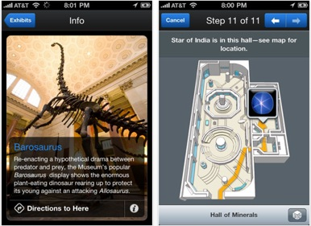
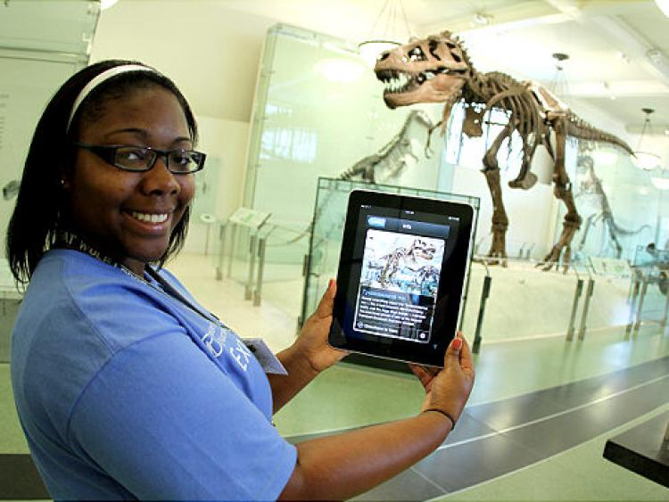
“Smart”-phone Navigation
New York Museum of Natural History uses a Bluetooth-based localization system.
Content is available through the app.

Slide 8
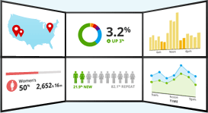
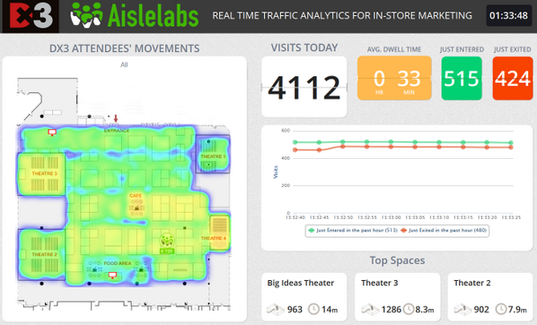
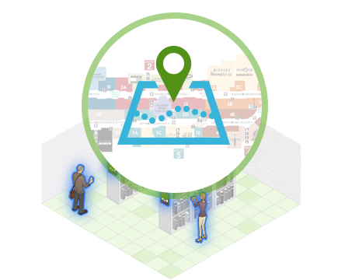
“Smart” Retail
Aislelabs: Cloud-based retail analytics using WiFi/iBeacon
Customer behavior, personalized marketing, enterprise mobile wallet, indoor navigation, geofencing, in-store promotions [ BLE ]

Slide 9
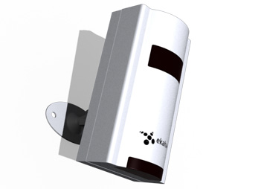
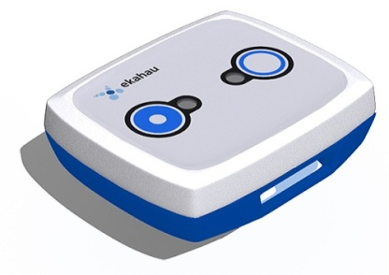
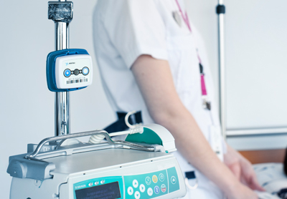
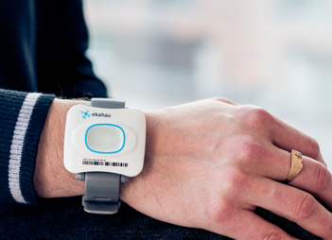
“Smart” Hospitals
Ekahau RTLS: Tracks appliance and doctors in the indoor spaces of healthcare enterprises.
Asset tracking, ​staff safety & workflow optimization, patient safety & throughput, ​temperature monitoring. [ Active-RFID-over-WiFi ]
Location Beacons: 1 meter accuracy that complements their Wi-Fi-only RTLS architecture

Slide 10
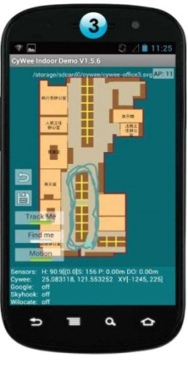
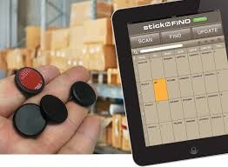
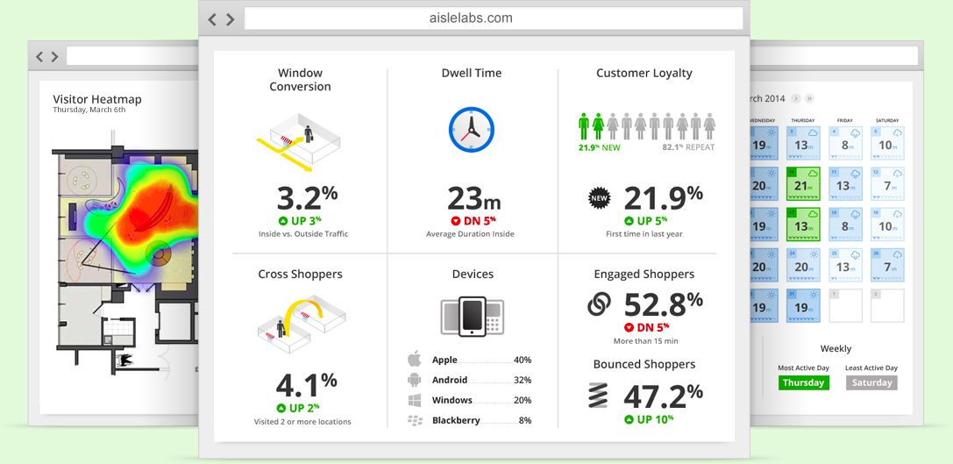
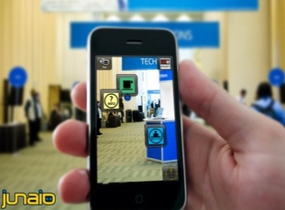
Indoor Applications
Huge spectrum of indoor apps
Navigation, Manufacturing, Asset Tracking, Inventory Management
Healthcare, Smart Houses, Elderly support, Fitness apps
Augmented Reality and many more.
Indoor Revenues expected to reach 10B USD in 2020
ABIresearch, “Retail Indoor Location Market Breaks US$10 Billion in 2020”’ Available at: https://goo.gl/ehPRMn, May 12, 2015.
Indoor Revenues expected to reach 23B USD in 2021
Economist, “New industry has sprung up selling “indoor-location” services to retailers”, https://goo.gl/jL5MwQ, Dec 24th 2016.

Slide 11
Anyplace
A complete open-source Internet-based Indoor Navigation (IIN) Service
Aims to become the predominant open-source Indoor Localization Service.
Active community: Germany, Russia,
Australia, Canada, UK, etc. – Join today!
Web, Android, Windows, iOS, JSON API
http://anyplace.cs.ucy.ac.cy/

Slide 12
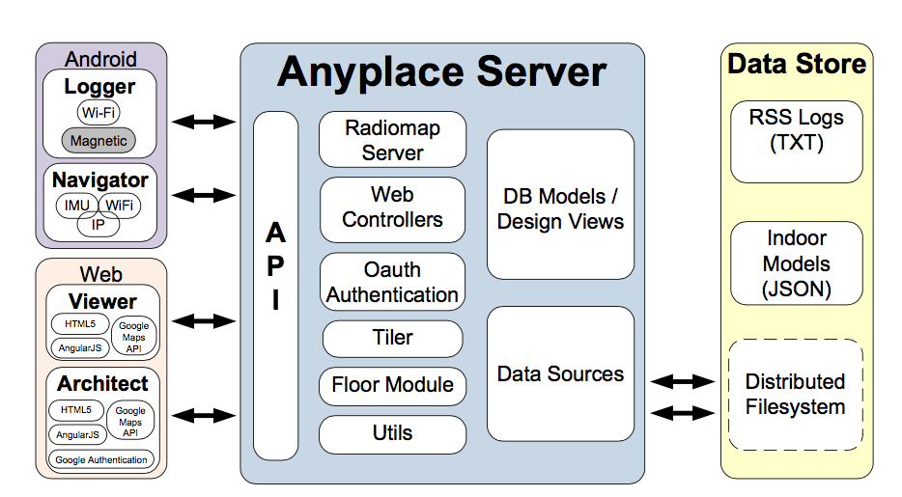
Anyplace Open Source Stack
MIT-licensed Open Source Code!
Allows many groups around the world to answer their research questions!
“The Anatomy of the Anyplace Indoor Navigation Service”, Demetrios Zeinalipour-Yazti and Christos Laoudias, ACM SIGSPATIAL Special, Special Issue on Indoor Spatial Awareness II, Editor: Chi-Yin Chow, Vol. 9, No. 2, pp. 3-10, July 2017.

Slide 13
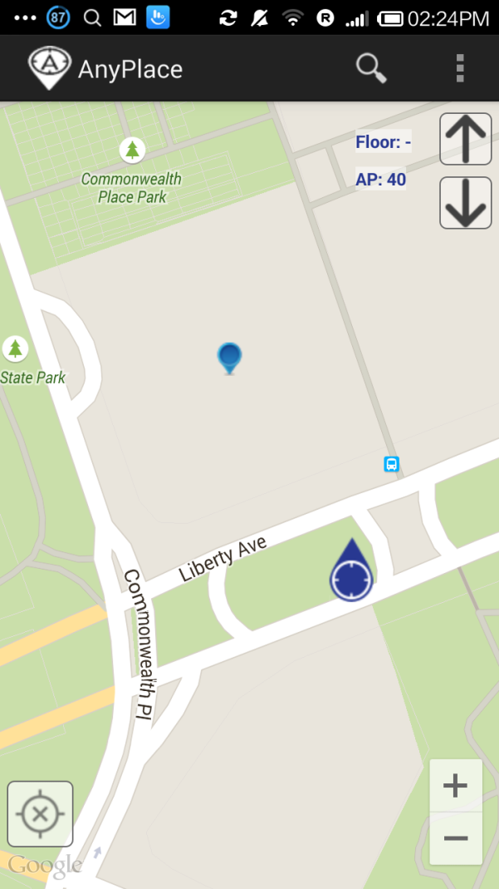
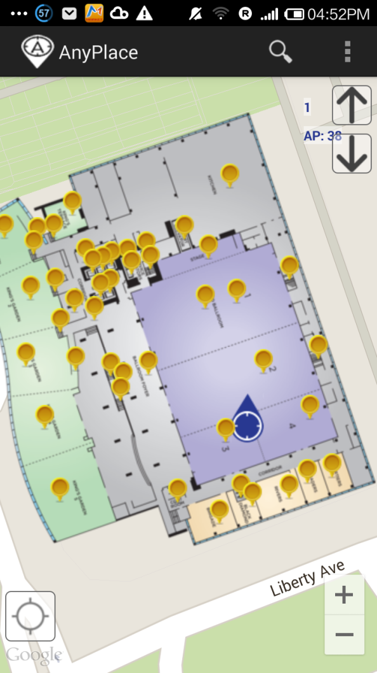
Anyplace: Before & After
Before ☹
(using Google API Location)
After ☺
(using Anyplace Location & Indoor Models)

Slide 14
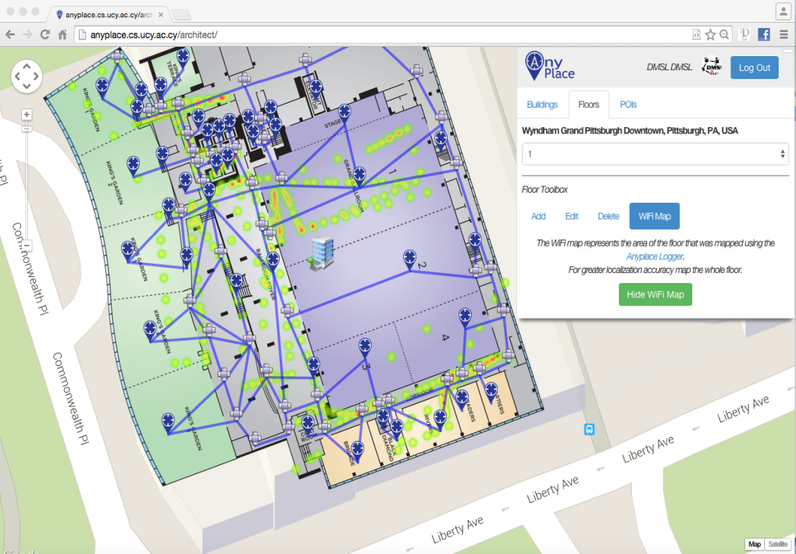
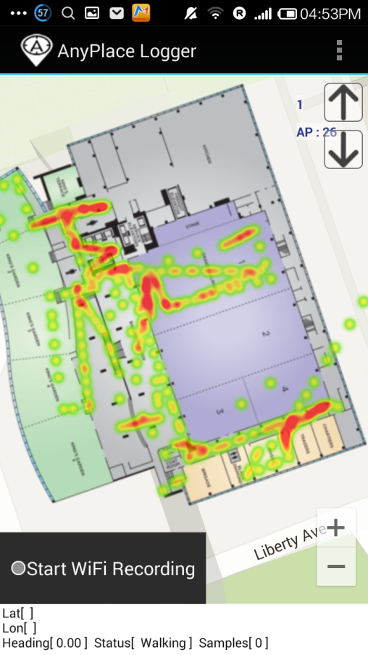
Anyplace Methodology
Modeling + Crowdsourcing

Slide 15
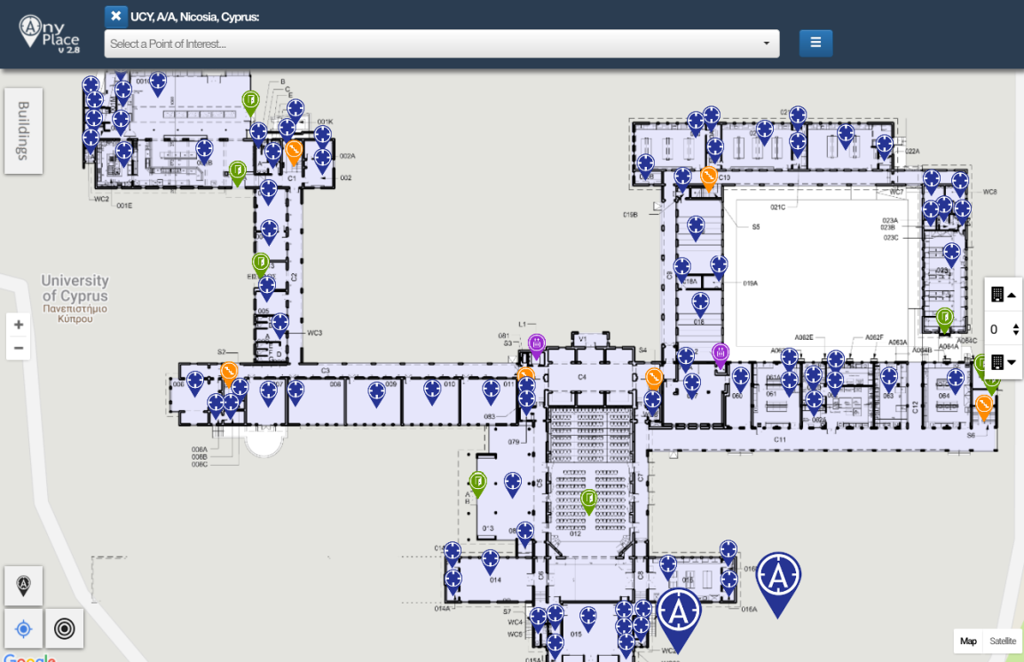
Showcase: Univ. of Cyprus
Office Navigation @ Univ. of Cyprus
Outdoor-to-Indoor Navigation through URL.
60 Buildings mapped, Thousands of POIs (stairways, WC, elevators, equipment, etc.)
Example:
https://goo.gl/4Z43Cv
Video:
https://youtu.be/uMFnxXnm1yc?t=17

Slide 16
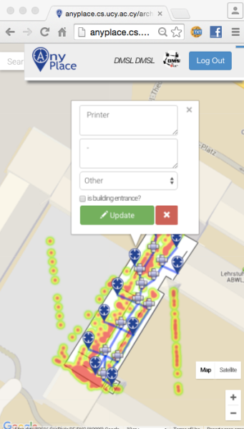
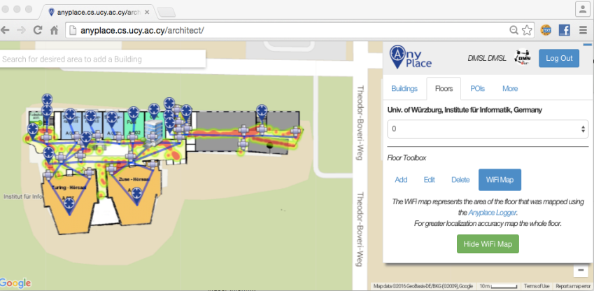
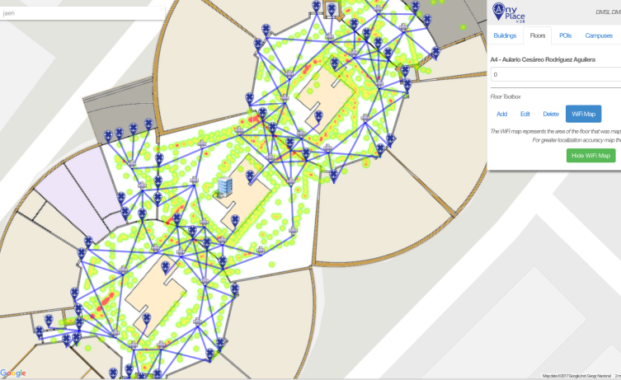
Campus and Library Navigation
Univ. of Würzburg, Institut für Informatik
Mapped in about 1 hour
Universidad de Jaén, Spain - Campus
Campus Navigation (9 Buildings)
Univ. of Mannheim, Library
Aim: book navigation in Westflügel

Slide 17
Anyplace Open Maps
>1,000 mapping attempts
>100,000 user interactions
>25,000 users visited
>100 forks on Github
http://anyplace.cs.ucy.ac.cy/

Slide 18
Presentation Outline
Introduction
Location Accuracy
MDM’12, IPSN’14, IPSN’15
Location Privacy
HotPlanet’12, IEEE TKDE’15
Radiomap Prefetching
MDM’15
Future Challenges
MDM’17, ICDE’17, SIGSPATIAL’17

Slide 19
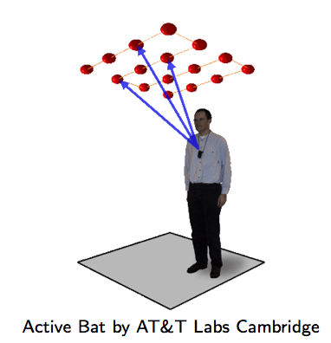
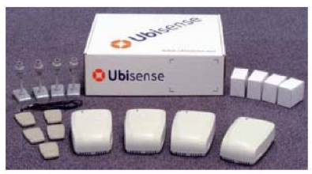
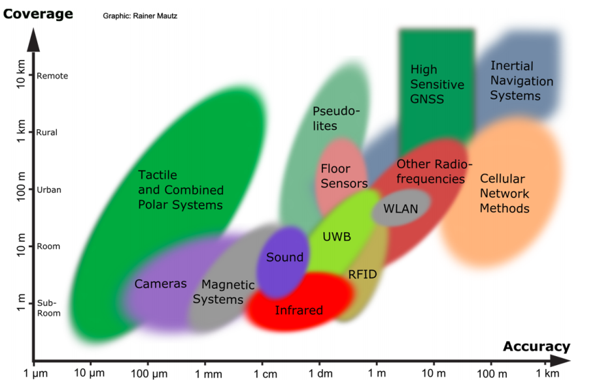
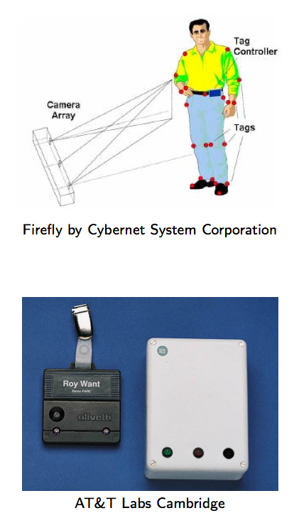
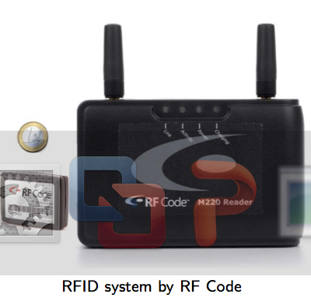
Location Accuracy
Ultrasound:
^{Ultra Wide Band (UWB)}
AOA, TOA, TDOA, signal reflection
: Spatial extension where system performance must be guaranteed
Our Focus: Room Level Accuracy
+ Infrastructure Free
^{Infrared (IR)}
^{TOA, TDOA}
Radio Frequency IDentification (RFID)
| Outdoor |
| Indoor |
^{Rainer Mautz, ETH Zurich, 2011}
Cell of Origin, Signal Strength
^{Firefly delivers 3mm accuracy}

Slide 20
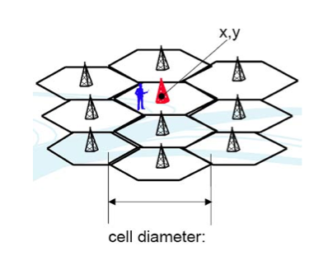
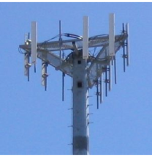
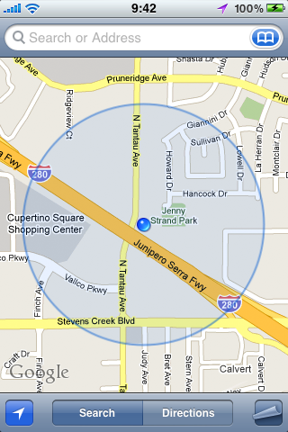
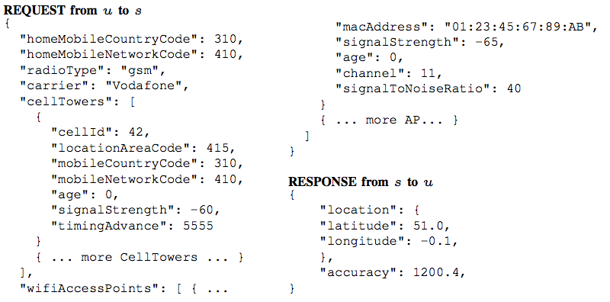
Location (Outdoor/Indoor)
GPS: Power hungry, not available indoors
Cell ID / MAC ID Databases
Cell ID is the unique Identifier of Cellular Towers.
Skyhook Wireless (2003), MA, USA (Apple, Samsung): 30 million+ cell towers, 1 Billion Wi-Fi APs, 1 billion+ geolocated IPs, 7 billion+ monthly location requests and 2.5 million geofencable POIs.
Google Geolocation “Big” Database (similar)
Disadvantages:
Low accuracy: 30-50m (indoor) to 1-30km (outdoor).
Serving cell is not always the nearest.

Slide 21
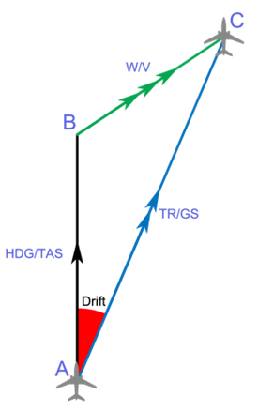
Location (Indoor)
Inertial Measurement Units (IMU)
3D acceleration, 3D gyroscope, digital compass using dead reckoning (calculate next position based on prior).
Disadvantages
Suffers from drift (difference between where the system thinks it is located, and the actual location)
Advantages
Sensors are available on smartphones.
Newer smartphones (iphone 5s) have motion co-processors always-on reading sensors and even providing activitity classifiers (driving, walking, running, etc.)

Slide 22
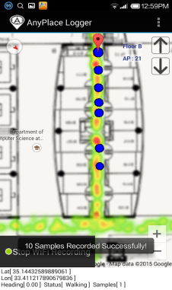
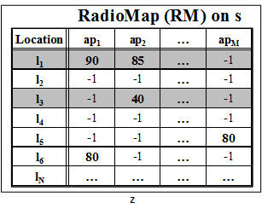
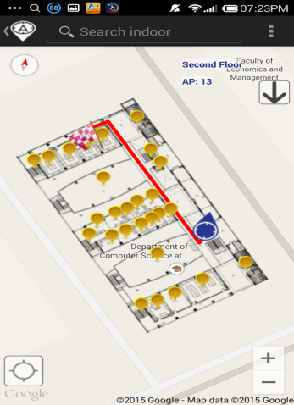
WiFi Fingerprinting in Anyplace
Logger
IIN Service
a) Upload Measurements
b) Build RM (Radiomap)
c) Localize
fingerprint
Navigator

Slide 23
WiFi Fingerprinting in Anyplace
References
[Airplace] "The Airplace Indoor Positioning Platform for Android Smartphones", C. Laoudias et. al., Best Demo Award at IEEE MDM'12. (Open Source!)
[HybridCywee] "Indoor Geolocation on Multi-Sensor Smartphones", C.-L. Li, C. Laoudias, G. Larkou, Y.-K. Tsai, D. Zeinalipour-Yazti and C. G. Panayiotou, in ACM Mobisys'13. Video at: http://youtu.be/DyvQLSuI00I
[UcyCywee] IPSN’14 Indoor Localization Competition (Microsoft Research), Berlin, Germany, April 13-14, 2014. 2nd Position with 1.96m! http://youtu.be/gQBSRw6qGn4
D. Lymberopoulos, J. Liu, X. Yang, R. R. Choudhury, ..., C. Laoudias, D. Zeinalipour-Yazti, Y.-K. Tsai, and et. al., “A realistic evaluation and comparison of indoor location technologies: Experiences and lessons learned”, In IEEE/ACM IPSN 2015.
1st Position at EVARILOS Open Challenge, European Union (TU Berlin, Germany), 2014.
Cywee / Airplace

Slide 24
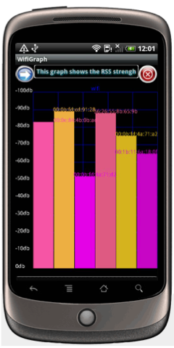
WiFi Fingerprinting
Received Signal Strength indicator (RSSI)
Power measurement present in a received radio signal measured in dBm (Decibel-milliwatts)
Max RSSI (-30dBm) to Min RSSI: (−90 dBm)
’00
Advantages
Readily provided by smartphone APIs
Low power 125mW (RSSI) vs. 400 mW (transmit)
Disadvantages
Complex propagation conditions (multipath, shadowing) due to wall, ceilings.
RSS fluctuates over time at a given location (especially in open spaces).
Unpredictable factors (people moving, doors, humidity)

Slide 25
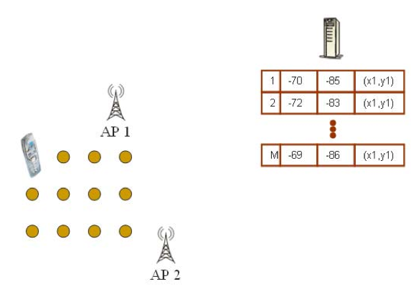
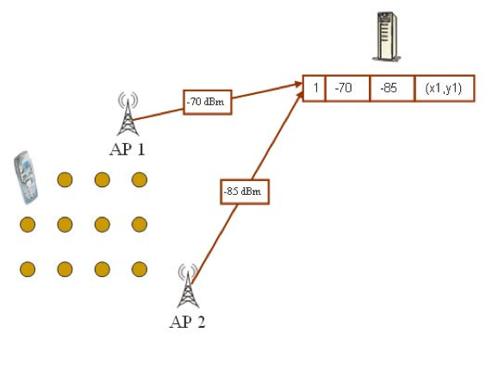
WiFi Fingerprinting
Mapping Area with WiFi Fingerprints
n APs deployed in the area
Fingerprints r_{i} = [ r_{i1}, r_{i2}, …, r_{in}]
Averaging

Slide 26
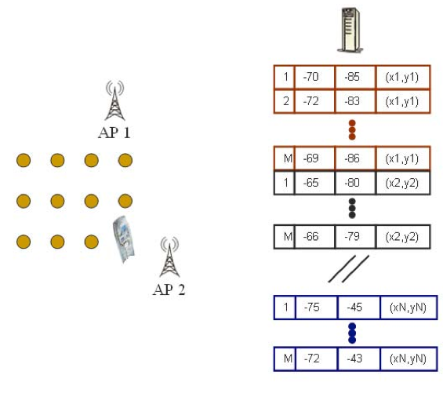
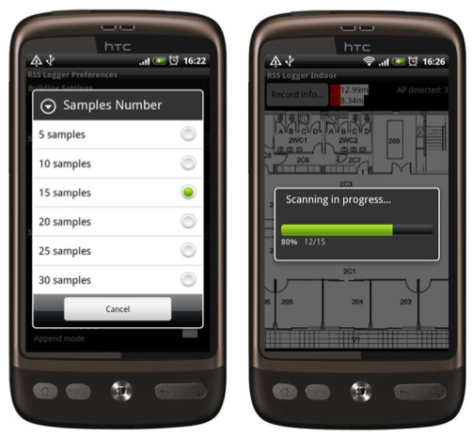
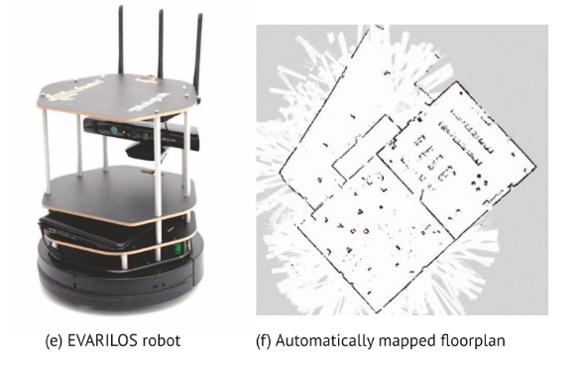
WiFi Fingerprinting
Mapping Area with WiFi Fingerprints
Repeat process for rest points in building. (IEEE MDM’12)
Use 4 direction mapping (NSWE) to overcome body blocking or reflecting the wireless signals.
Collect measurements while walking in straight lines (IPIN’14)

Slide 27
Logging in Anyplace
Video
"Anyplace: A Crowdsourced Indoor Information Service", Kyriakos Georgiou, Timotheos Constambeys, Christos Laoudias, Lambros Petrou, Georgios Chatzimilioudis and Demetrios Zeinalipour-Yazti, Proceedings of the 16th IEEE International Conference on Mobile Data Management (MDM '15), IEEE Press, Volume 2, Pages: 291-294, 2015

Slide 28
WiFi Positioning
Positioning with WiFi Fingerprint
Collect Fingerprint s = [ s₁, s₂, …, s_{n}]
Compute distance || r_{i} - s || and position user at:
Nearest Neighbor (NN)
K Nearest Neighbors (w_{i} = 1 / K) [convex combination of k loc]
Weighted K Nearest Neighbors (w_{i} = 1 / || r_{i} - s || )
RadioMap
s = [ -70, -51]
r₁ = [ -71, -82, (x₁,y₁)]
r₂ = [ -65, -80, (x₂,y₂)]
…
r_{N} = [ -73, -44, (x_{N},y_{N})]
NN, KNN, WKNN

Slide 29
WiFi Positioning Demo
Video
Works best in confined areas
"The Airplace Indoor Positioning Platform for Android Smartphones", C. Laoudias, G. Constantinou, M. Constantinides, S. Nicolaou, D. Zeinalipour-Yazti, C. G. Panayiotou, Best Demo Award at IEEE MDM'12. (Open Source!)

Slide 30
Hybrid Wi-Fi/IMU/Outdoor Anyplace
Video
"Anyplace: A Crowdsourced Indoor Information Service", Kyriakos Georgiou, Timotheos Constambeys, Christos Laoudias, Lambros Petrou, Georgios Chatzimilioudis and Demetrios Zeinalipour-Yazti, Proceedings of the 16th IEEE International Conference on Mobile Data Management (MDM '15), IEEE Press, Volume 2, Pages: 291-294, 2015

Slide 31
Presentation Outline
Introduction
Location Accuracy
MDM’12, IPSN’14, IPSN’15
Location Privacy
HotPlanet’12, IEEE TKDE’15
Radiomap Prefetching
MDM’15
Future Challenges
MDM’17, ICDE’17, SIGSPATIAL’17

Slide 32
Location Privacy
An IIN Service can continuously “know” (surveil, track or monitor) the location of a user while serving them.
Location tracking of known individuals is unethical and can even be illegal if it is carried out without the explicit user consent.
Imminent privacy threat, with greater impact that other privacy concerns, as it can occur at a very fine granularity. It reveals:
The stores / products of interest in a mall.
The book shelves of interest in a library
Artifacts observed in a museum, etc.

Slide 33
Location Privacy
IIN services might become attractive targets for hackers, aiming to steal location data and carry out illegal acts (e.g., break into houses).
IIN should be considered as fundamentally untrusted entities, so we aim to devise techniques that allow the exploitation of IIN utility with controllable privacy to the user.
Privacy vs. No Privacy
Location Privacy: when location estimated by user device (current Anyplace) – data is outdated ☹
No Location Privacy: when the location is derived continuously by the IIN (most IIN services)

Slide 34
Location Privacy
I can see these Reference Points, where am I?
...
(x,y)!
IIN Service
User u
Towards planet-scale localization on smartphones with a partial radiomap", A. Konstantinidis, G. Chatzimilioudis, C. Laoudias, S. Nicolaou and D. Zeinalipour-Yazti. In ACM HotPlanet'12, in conjunction with ACM MobiSys '12, ACM, Pages: 9--14, 2012.
Privacy-Preserving Indoor Localization on Smartphones, A. Konstantinidis, G. Chatzimilioudis, D. Zeinalipour-Yazti, P. Mpeis, N. Pelekis, Y. Theodoridis, in IEEE TKDE’15.

Slide 35
Temporal Vector Map (TVM)
Bloom Filter (u's APs)
WiFi
Set Membership Queries
WiFi
...
IIN Service
K=3 Positions
User u
WiFi

Slide 36
TVM – Bloom Filters
Bloom filters – basic idea:
allocate a vector of b bits, initially all set to 0
use h independent hash functions to hash every Access Point seen by a user to the vector.
The IIN Service selects any RadioMap row that has an AP belonging to the query bloom filter and send it to the user.
AP2
AP13
AP2
AP13
0 | 1 | 0 | 0 | 1 | 0 | 0 | 1 | 0 | 0
b

Slide 37
TVM – Bloom Filters
The most significant feature of Bloom filters is that there is a clear tradeoff between b and the probability of a false positive.
Small b: Too many false positives (too much hiding & cost)
Large b: “No” false positives (no hiding & no cost)
Given h optimal hash functions, b bits for the Bloom filter, M the cardinality of the Access Point set we can estimate the amount of false positives produced by the Bloom filter:
False Positive Ratio:
Objective:
Solving the above for b:

Slide 38
TVM Evaluation
Energy required for 300 localization tasks (CPU+Wi-Fi) using PowerTutor on Android
Campus (20MB)
Town (100MB)
City (1GB)
Country (20GB)

Slide 39
TVM Continuous
Camouflage trajectories
IIN determnines u’s location by exclusion

Slide 40
Presentation Outline
Introduction
Location Accuracy
MDM’12, IPSN’14, IPSN’15
Location Privacy
HotPlanet’12, IEEE TKDE’15
Radiomap Prefetching
MDM’15
Future Challenges
MDM’17, ICDE’17, SIGSPATIAL’17

Slide 41
Intermittent Connectivity
Problem: Wi-Fi coverage might be irregularly available inside buildings due to poor WLAN planning or due to budget constraints.
A user walking inside a Mall in Cyprus
Whenever the user enters a store the RSSI indicator falls below a connectivity threshold -85dBm. (-30dbM to -90dbM)
When disconnected IIN can’t offer navigation anymore ☹

Slide 42
Intermittent Connectivity
IIN Service
Where-am-I?
No Navigation
Where-am-I?
X
Where-am-I?
☹ Intermittent Connectivity
Time

Slide 43
PreLoc Navigation
IIN Service
Prefetch K RM rows
Prefetch K RM rows
X
Localize from Cache
Prefetch K RM rows
☺ Intermittent Connectivity
Time

Slide 44
Intermittent Connectivity
Why not fallback from Wi-Fi to Mobile Internet (2G-4G) when Wi-Fi is not available?
Mobile Internet Limitations:
Coverage: blockage or attenuation of signals in indoor spaces.
Slow fallback between outdated Mobile Internet and Wi-Fi infrastructures.
Lack of ubiquitous 802.11k, 802.11r (fast roaming) and 4G infrastructure.
Limited Quota: mobile users have limited mobile internet plans.
Unavailability due to Roaming: when traveling and needing indoor navigation at most.

Slide 45
PreLoc Partitioning Step
Why? RM might contain many points (45K in example).
Action: The objective of this step is to cluster these into groups so that they are easier to prefetch.
K-Means simple well-established clustering algorithm.
Operation: Random Centroids (C), Add to Closest C, Re-adjust C
Re-adjusting Centroids expensive quadratic complexity ☹

Slide 46
PreLoc Partitioning Step
We use the Bradley-Fayyad-Reina (BFR)* algorithm
A variant of k-means designated for large datasets.
Instead of computing L₂ distance of point p against centroid, as in k-means, it computes the Mahalanobis distance (dist_{Mah}) against some set statistics (μ, σ).
In BFR if dist_{Mah} is less than a threshold add to set, else retain to possibly shape new clusters.
Advantage: Less centroid computations! Points are traversed only once which is fast for big data!
μ
dist_{Mah}
σ
Point (p)
Scaling Clustering Algorithms to Large Databases.. PS Bradley, UM Fayyad, C Reina - KDD, 1998

Slide 47
PreLoc Selection Step
The Selection Step aims to sequence the retrieval of clusters, such that the most important clusters are downloaded first.
Question: Which clusters should a user download at a certain position if Wi-Fi not available next?
PreLoc prioritizes the download of RM entries using historic traces of users inside the building.
User Current Location

Slide 48
PreLoc Selection Step
PreLoc relies on the Probabilistic Group Selection (PGS) heuristic to determine the RM entries to prefetch next.
Probabilistic k=3 Group Selection
Historic Traces
Dependency Graph
(DG)
Do Best First Search Traversal of DG from A:
follow the most promising option using priority queue.
P(A,B)=1.0
P(A,B,D)=0.66
P(A,B,D,C)=0.66*0.5=0.33
P(A,B,D,A) => cycle
P(A,B,D,C,D)=> cycle
P(A,B,C)=0.33
Empty queue – finished!
User Current Location
A
B
D
0.5
0.5
1.0
C
A
0.66
Early stop!
C
D
1.0
0.33
B
(statistically independent transitions between vertices + no stationary transitions in historic traces)

Slide 49
GraP (Graph Prefetching)
Mobility Traces inside Buildings are hard to obtain.
Also goes against our revised philosophy of privacy-by-design.
Preloc+ = GraP (under evaluation)
We have developed a framework that analyzes building blueprints to identify hotspots.
Hotspots become “virtual” targets to a target-less A* prefetching algorithm we have developed.

Slide 50
GraP: Target-less A* Search

Slide 51
Presentation Outline
Introduction
Location Accuracy
MDM’12, IPSN’14, IPSN’15
Location Privacy
HotPlanet’12, IEEE TKDE’15
Radiomap Prefetching
MDM’15
Future Challenges
MDM’17, ICDE’17, SIGSPATIAL’17

Slide 52
Crowdsourcing Challenges
Problem: There is a mismatch between the density of fingerprints and the RM accuracy.
Solution: We use generic interpolation and a tool from estimation statistics to identify an accuracy estimator (lower bound)
RM Density
RM Accuracy
"Indoor Localization Accuracy Estimation from Fingerprint Data", Artyom Nikitin, Georgios Chatzimilioudis, Christos Laoudias, Panagiotis Karras and Demetrios Zeinalipour-Yazti,
In IEEE MDM’17, Daejeon, South Korea, 2017 (Honorable Mention Award!)

Slide 53
Crowdsourcing Challenges
Video
"Indoor Localization Accuracy Estimation from Fingerprint Data", Artyom Nikitin, Georgios Chatzimilioudis, Christos Laoudias, Panagiotis Karras and Demetrios Zeinalipour-Yazti,
In IEEE MDM’17, Daejeon, South Korea, 2017 (Honorable Mention Award!)

Slide 54
Crowdsourcing Challenges
Quality: Unreliable Crowdsourcers, Multi-device Issues, Hardware Outliers, Temporal Decay, etc.
Remark: There is a Linear Relation between RSS values of devices.
Challenge: Can we exploit this to align reported RSS values?
"Crowdsourced Indoor Localization for Diverse Devices through Radiomap Fusion", C. Laoudias, D. Zeinalipour-Yazti and C. G. Panayiotou, "Proceedings of the 4th Intl. Conference on Indoor Positioning and Indoor Navigation" (IPIN '13), Montbeliard-Belfort France, 2013.

Slide 55
Big-Data Challenges
Massively process RSS log traces to generate a valuable Radiomap
Processing current logs in Anyplace for a single building takes several minutes!
Challenges in MapReduce:
Collect Statistics (count, RSSI mean and standard deviation)
Remove Outlier Values.
Handle Diversity Issues

Slide 56
Modeling Challenges
Indoor spaces exhibit complex topologies. They are composed of entities that are unique to indoor settings:
e.g., rooms and hallways that are connected by doors.
Conventional Euclidean distances are inapplicable in indoor space, e.g., NN of p1 is p2 not p3.
Christian Becker, Frank Dürr, Personal and Ubiquitous Computing, 2005 => Jensen (2010)

Slide 57
Modeling Challenges
Technology roadmap is towards indoor GIS integration
GeoJson.org (not specifically for indoor)
IndoorGML.net
Source: NASA

Slide 58
GeoJson
GeoJSON is a format for encoding a variety of geographic data structures (not only indoor)
Not a formal GIS standard (i.e., OGC standard)
Convenient for Web 2.0 APIs
Support: Micello Web Maps
Supports multiple geometry types
Point, LineString, Polygon,
MultiPoint, MultiLineString, and MultiPolygon
Source: NASA

Slide 59
IndoorGML – How It Works
Source: NASA

Slide 60
IndoorGML
Standard supported by Open Geospatial Consortium (OGC)
Defined as an application schema of OGC Geographic Markup Language (GML) 3.2.1.
IndoorOSM (another older effort by Open Street Map) is deprecated
Source: NASA

Slide 61
Telco Big Data
Femtocells (small, low-power cellular base stations) will provide new means for indoor location accuracy.
Standard (<35km), Microcell (<2km), Picocell (<200m), Femtocells (<10m).
We already started to take a closer look at Telco Big Data:
"Efficient Exploration of Telco Big Data with Compression and Decaying", Constantinos Costa, Georgios Chatzimilioudis, Demetrios Zeinalipour-Yazti, Mohamed F. Mokbel, Proceedings of the 33rd IEEE International Conference on Data Engineering (ICDE'17), IEEE Computer Society, pp. 1332--1343, April 19-22, 2017, San Diego, CA, USA, ISBN: 978-1-5090-6543-1, 2017.
"Towards Real-Time Road Traffic Analytics using Telco Big Data", Constantinos Costa, Georgios Chatzimilioudis, Demetrios Zeinalipour-Yazti, Mohamed F. Mokbel, Proceedings of the 11th Intl. Workshop on Real-Time Business Intelligence and Analytics, collocated with VLDB 2017 (BIRTE '17), ACM International Conference Proceedings Series, pp. 5 pages, August 28, 2017, Munich, Germany, ISBN: 978-1-4503-5425-7/17/08, 2017.

Slide 62
Telco Big Data Analytics
The SPATE UI over the San Diego area with data from https://www.cellmapper.net/map
Demo!

Slide 63
Acknowledgments
People:
4 Researchers (Faculty + Postdocs)
2 PhD Students + MSc Students
BSc. (USC, UCLA/R, UoT, Oxford, UCL, Imperial)
External Collaborators
Panos K. Chrysanthis (U of Pittsburgh, USA)
Christian S. Jensen (Aalborg, Denmark)
Wang-Chien Lee (Penn State, USA)
Mohamed F. Mokbel (U of Minnesota, USA)
Evaggelia Pitoura (U of Ioannina, Greece)
Yannis Theodoridis (U of Pireaus, Greece)
Gerhard Weikum (MPI, Germany)
Funding: EU, National & Industry

Slide 64
Indoor Navigation Services from Mobile Data
Demetris Zeinalipour
Thanks! Questions?
Department of Computer Science
University of Cyprus, Cyprus
http://www.cs.ucy.ac.cy/~dzeina/
dzeina@cs.ucy.ac.cy
21st European Conference on Advances in Databases and Information Systems (ADBIS’17) Hilton Cyprus Hotel, Nicosia, Cyprus, September 25, 2017.

Slide 65
Industrial Solutions
Basic Operation on Smartphone Power(mW=mJ/s)
CPU Minimal use (just OS running) 35mW
CPU Standard use (light processing) 175mW
CPU Peak (heavy processing) 469mW
WiFi Idle (Connected) 34mW
WiFi Localization (avg/minute) 125mW
WiFi Peak (Uplink 123Kbps, -58dBm) 400mW
3G Localization (avg/minute) 300mW
3G Busy 900mW
GPS On (steady) 275mW
OLED Economy Mode 300mW
OLED Full Brightness 676mW
Mazemap: Service for indoor maps (Needs Cisco CMX)
Universities, hospitals, conference venues and shopping malls
Timetable, mobile app, SMS notification, reserve room integration
Micello: Indoor maps,15,000+ venues, 50,000+ buildings
Map integration, 3rd party navigation engine, multiple data formats
49 USD / building / month (Jun. 2015)

Slide 66
Google Indoor
Free to enrich Google Maps
Not clear how mapping is priortized by Google
No control over model
No fine location
Anyplace works over Google Indoor as a Map Layer!

Slide 67
Google Indoor
Free to enrich Google Maps
Not clear how mapping is prioritized by Google
No control over model
No fine location
Anyplace works over Google Indoor as a Map Layer!

Slide 68
Location Accuracy
Infrastructure-free systems: don’t require dedicated equipment for the provisioning of location signals (e.g., GPS, Wi-Fi, Cellular, Magnetic, IMU)
Infrastructure-based systems: require dedicated equipment (e.g., proprietary transmitters, beacons, antennas and cabling)
Bluetooth Low Energy (BLE) beacons: iBeacons (Apple)
Ultrasound: ALPS (CMU)
Visible Light: EPSILON (Microsoft Research)
Ultra Wide Band (UWB): Decawave
Anyplace Focus
Source: NASA

Slide 69
Hardware Revolution
Computers are more
Smartphone SOC (Qualcomm Snapdragon 810 / 2015) features 4 x A57 (faster) cores + 4 A53 (eco) cores with 64 bit support and 20nm device fabrication
Indicative benchmark score:
Intel Xeon X5650 (6-cores, 2.67GHz): 13,703
Snapdragon 801 (4-cores, 2.45GHz): 2,924
Source: http://goo.gl/vYJZCJ

Slide 70
Computing Shift
Power-efficient Von-Neumann Architecture Artifacts
Latest Smartphone SOC (Qualcomm Snapdragon 835) features 4 x A73 (faster) cores + 4 A53 (eco) cores with 64 bit support and 10nm device fabrication
Indicative benchmark:
Intel Xeon X5650 (6-cores, 2.67GHz): 13,703
Snapdragon 801 (4-cores, 2.45GHz): 2,924
Source: http://goo.gl/vYJZCJ

Slide 71
Location Revolution
Global Navigation Satellite Systems (GNSS) have played an important role for the uptake of GIS
Current: Global Positioning System (US), GLONASS (Russian)
Upcoming: Galileo (European, fully operational by 2020), Indian Regional Nav. Sat. Sys. (IRNASS), BeiDou-2 (Chinese)
Why not GNSS Indoors?
Low availability indoors due to the blockage or attenuation of the satellite signals + High start-up time.
Power Demanding (continuously receive signals).
Navigation
Geographic Mapping
Precision Agriculture
Location-based Services

Slide 72
Crowdsourcing
A smart device is constantly moving and sensing providing large amounts of sensor data enabling new applications
“Crowdsourcing with Smartphones”, Georgios Chatzimiloudis, Andreas Konstantinidis, Christos Laoudias, Demetrios Zeinalipour-Yazti, IEEE Internet Computing, Special Issue: Sep/Oct 2012 - Crowdsourcing, May 2012. IEEE Press, Volume 16, pp. 36-44, 2012.

Slide 73
“Smart” Homes
Smart Houses have so far mainly focused on:
Sustainable Automation: lighting, heating, ventilation, air conditioning (HVAC), smart appliance operation (e.g., PVC Self-consumption or location-based)
Security: remote surveillance, leak detection, smoke and CO detectors
New research focuses on exploitation of Indoor location: Ambient Assisted Living (robots for elderly care, drone butlers or mobile house cameras, etc.)
Turtlebot @ EVARILOS (TU Berlin)

