Slide 1
IoT-enabled Localization and Navigation
Demetris Zeinalipour
Assistant Professor
Data Management Systems Laboratory
Department of Computer Science
University of Cyprus
http://www.cs.ucy.ac.cy/~dzeina/
http://goo.gl/70JV4q
Invited Talk at PERCCOM (Pervasive Computing & COMmunications for sustainable development) Summer School, Erasmus Mundus, Nancy, France, June 16, 2016

Slide 2
Disclaimer
Feel free to use any of the following slides for educational purposes, however kindly acknowledge the source.
We would also like to know how you have used these slides, so please send us an email with comments or suggestions.
The full version of this tutorial is available at:
http://dmsl.cs.ucy.ac.cy/tutorials/mdm15/
"Internet-based Indoor Navigation Services", Demetrios Zeinalipour-Yazti, Christos Laoudias, Kyriakos Georgiou and Georgios Chatzimiloudis, IEEE Internet Computing (IC'16), IEEE Computer Society, 2016. http://www.cs.ucy.ac.cy/~dzeina/papers/ic16-iin.pdf

Slide 3
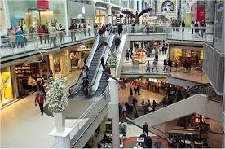
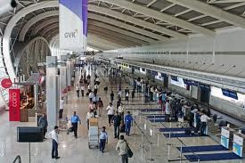
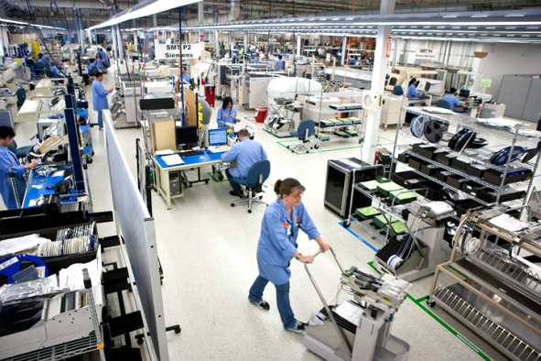
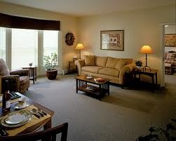
Motivation
People spend 80-90% of their time indoors – USA Environmental Protection Agency 2011.
>85% of data and 70% of voice traffic originates from within buildings – Nokia 2012.

Slide 4
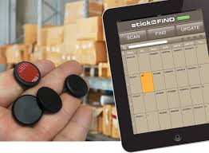
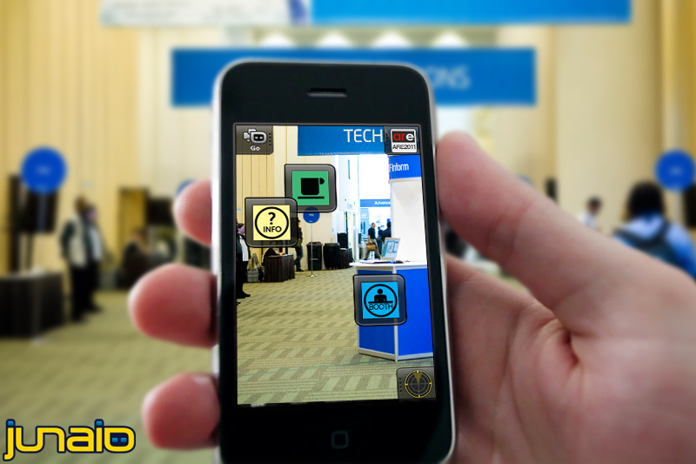
Localization and Navigation
Indoor Localization has still not reached its full potential.
Huge spectrum of indoor apps:
Navigation, Manufacturing, Asset Tracking, Inventory Management
Healthcare, Smart Houses, Elderly support, Fitness apps
Augmented Reality and Indoor Games
Indoor Revenues expected reach 10B USD in 2020
ABIresearch, “Retail Indoor Location Market Breaks US$10 Billion in 2020”’ Available at: https://goo.gl/ehPRMn, May 12, 2015.

Slide 5
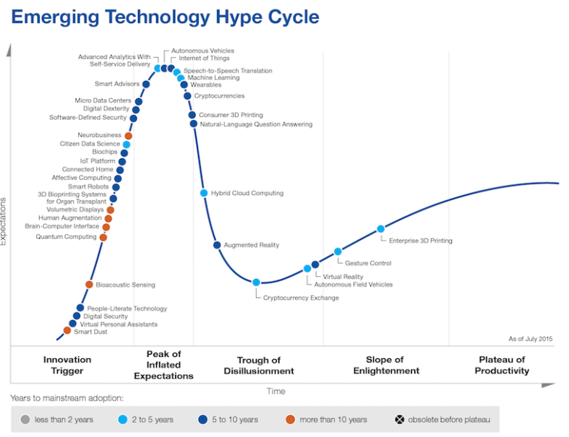
Internet of Things (IoT)
“IoT refers to the ever-growing network of physical objects that feature an IP address for internet connectivity”. – Wikipedia
Maybe just a hype – Gartner.
Nevertheless, the stack entails:
Identify/Sense: MAC, EPC, sensors
Transmit: using IP (MAC Standards, Protocols, Interoperability, etc.)
Store/Middleware: Big Data Processing / Cloud, Monitor, Visualize, DSS, Analytics
Actuate: Autonomic “smart” behavior, Machine Learning, Artificial Intelligence, etc.
Gartner Hype Cycle
Internet of Things: A Survey on Enabling Technologies, Protocols, and Applications , IEEE Communications Surveys & Tutorials, Volume:17, Issue: 4, July 2015.

Slide 6
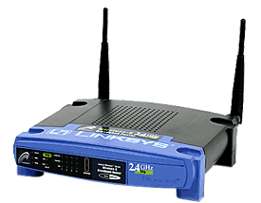
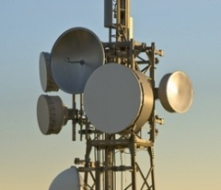
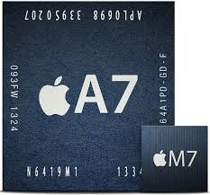
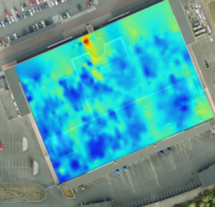
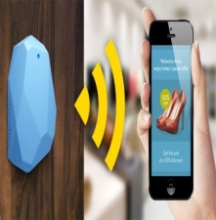
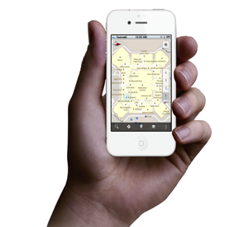
Internet-based Indoor Navigation
Enablers for Indoor have been Internet-based Indoor Navigation (IIN)* services founded on measurements collected by IoT devices.
IoT
enrich
navigate
IIN Service
“Internet-based Indoor Navigation Services”, Demetrios Zeinalipour-Yazti, Christos Laoudias, Kyriakos Georgiou and Georgios Chatzimiloudis, IEEE Internet Computing (IC'16), IEEE Computer Society, 2016.

Slide 7
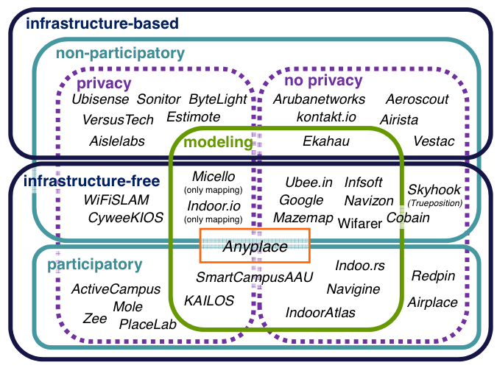
Talk Objective
The goal of this talk is to survey (indoor) localization founded on IoT technology from an industrial and academic perspective.
Full version of the talk (covering crowdsourcing, privacy, modeling and localization) available at the following URL:
IEEE MDM’15 Tutorial, Pittsburgh, PA, USA (http://dmsl.cs.ucy.ac.cy/tutorials/mdm15/)
“Internet-based Indoor Navigation Services”, Demetrios Zeinalipour-Yazti, Christos Laoudias, Kyriakos Georgiou and Georgios Chatzimiloudis, IEEE Internet Computing (IC'16), IEEE Computer Society, 2016.

Slide 8
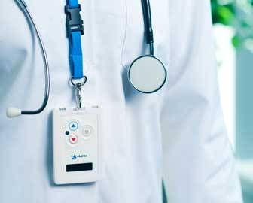
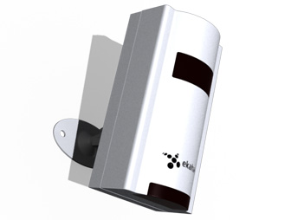
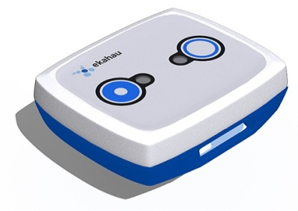
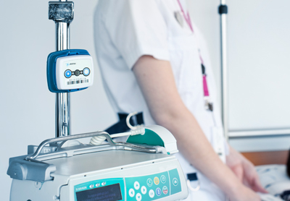
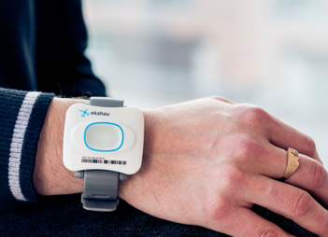
“Smart” Hospitals
Ekahau RTLS: Tracks appliance and doctors in the indoor spaces of healthcare enterprises.
Asset tracking, ​staff safety & workflow optimization, patient safety & throughput, ​temperature monitoring. [ Active-RFID-over-WiFi ]
Location Beacons: 1 meter accuracy that complements thei Wi-Fi-only RTLS architecture

Slide 9
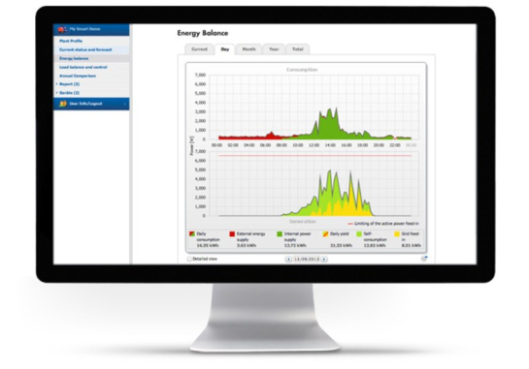
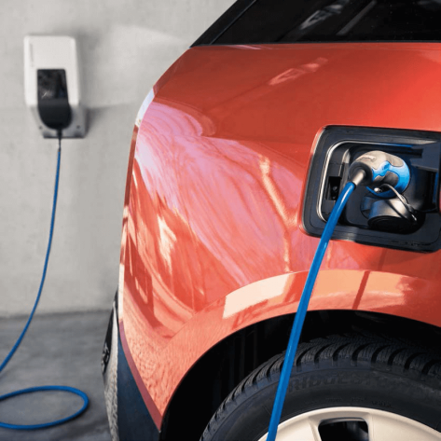
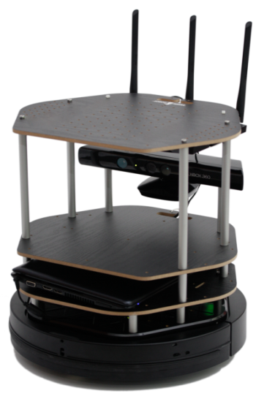
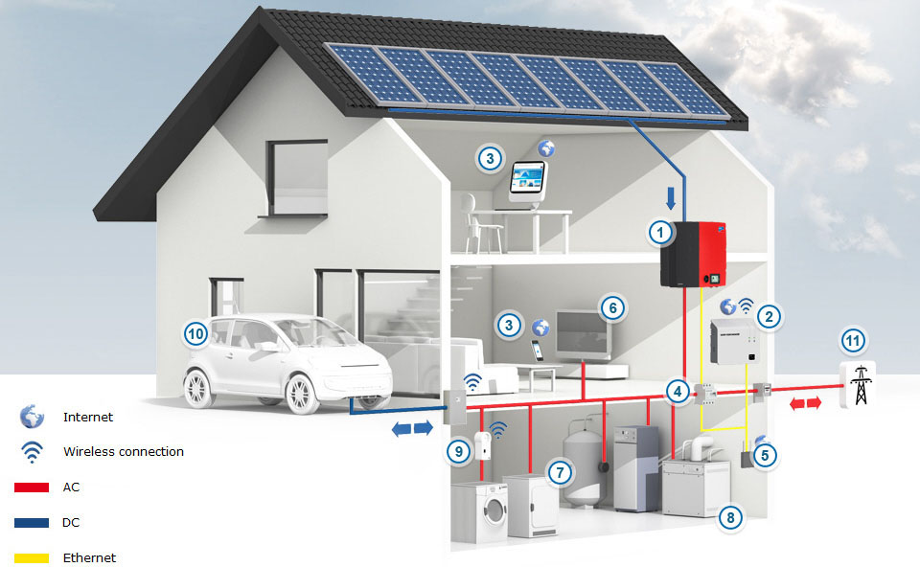
“Smart” Homes
Smart Houses have so far mainly focused on:
Sustainable Automation: lighting, heating, ventilation, air conditioning (HVAC), smart appliance operation (e.g., PVC Self-consumption or location-based)
Security: remote surveillance, leak detection, smoke and CO detectors
New research focuses on exploitation of Indoor location: Ambient Assisted Living (robots for elderly care, drone butlers or mobile house cameras, etc.)
Turtlebot @ EVARILOS (TU Berlin)

Slide 10
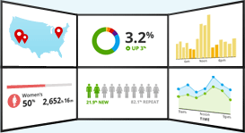
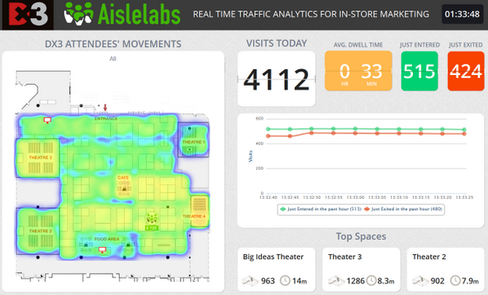
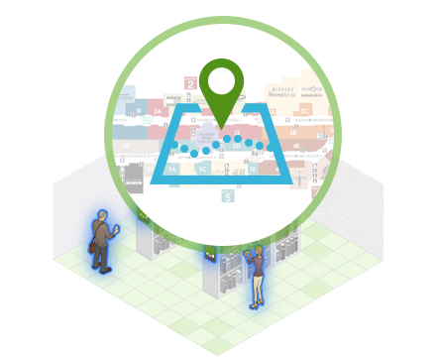
“Smart” Retail
Aislelabs: Cloud-based retail analytics using WiFi/iBeacon
Customer behavior, personalized marketing, enterprise mobile wallet, indoor navigation, geofencing, in-store promotions [ BLE ]

Slide 11
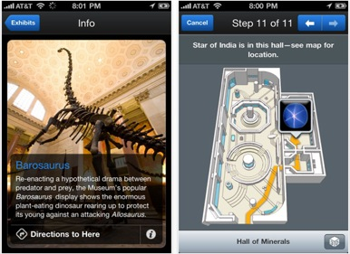
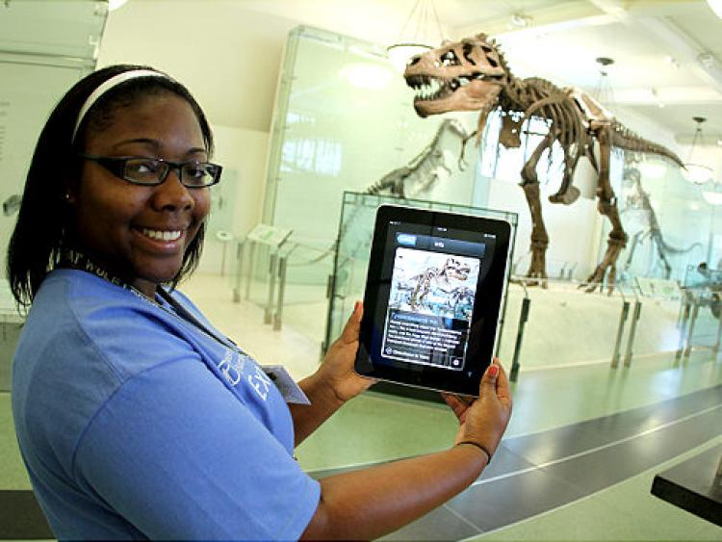
“Smart”-phone Navigation
New York Museum of Natural History uses a Bluetooth-based localization system.
Content is available through the app.

Slide 12
Anyplace IIN Service
A complete open-source IIN Service developed at the University of Cyprus.
Aims to become the predominant open-source Indoor IIN Service.
Active community: Germany, Russia,
Canada, UK, etc. – Join today!
Android, Windows, iOS, JSON API
http://anyplace.cs.ucy.ac.cy/

Slide 13
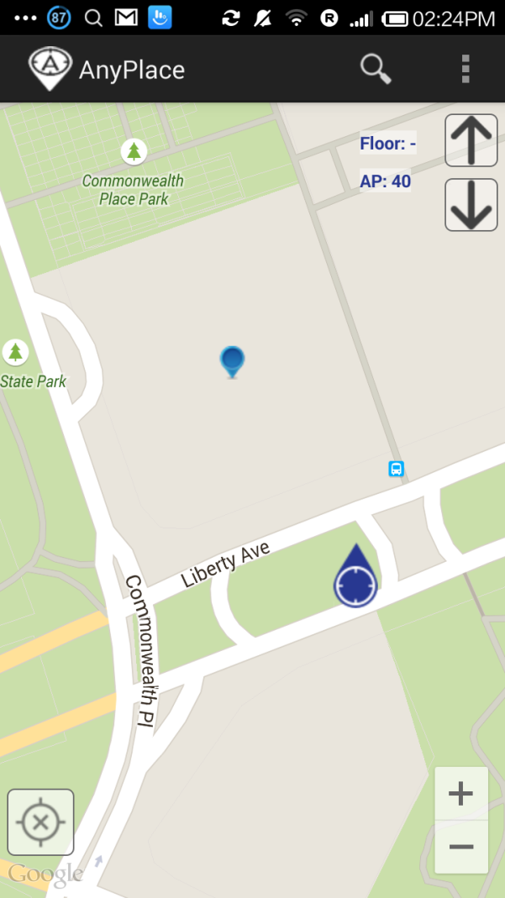
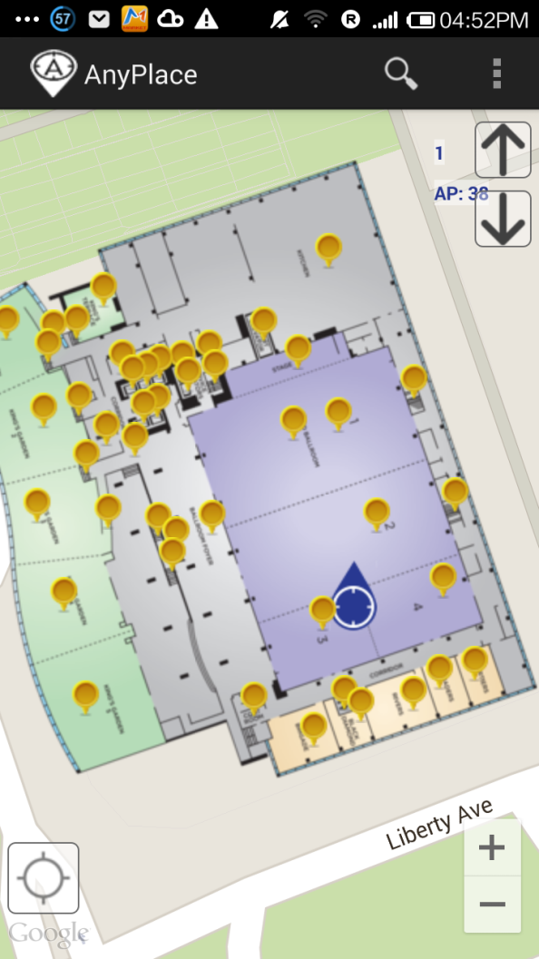
Showcase: Hotel in Pittsburgh, USA
Before ☹
(using Google API Location)
After ☺
(using Anyplace Location & Indoor Models)

Slide 14
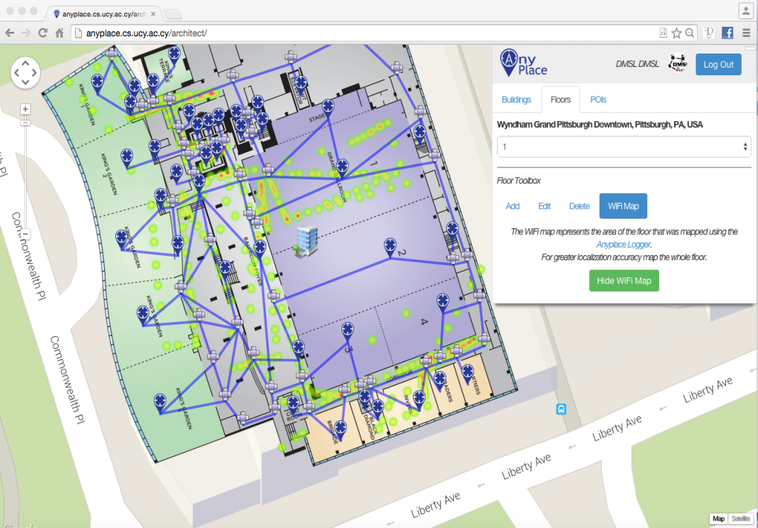
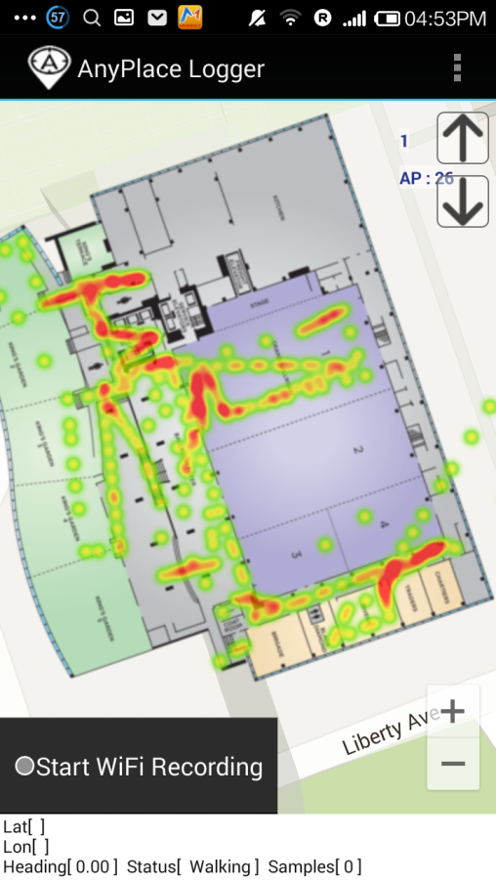
Showcase: Hotel in Pittsburgh, USA
Modeling + Crowdsourcing

Slide 15
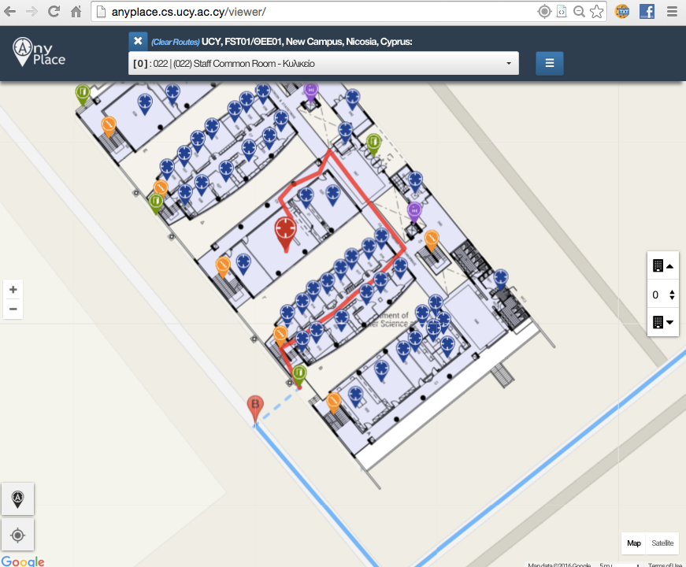
Showcase: Univ. of Cyprus
Office Navigation @ Univ. of Cyprus
Outdoor-to-Indoor Navigation through URL.
60 Buildings mapped, Thousands of POIs (stairways, WC, elevators, equipment, etc.)
Example:
http://goo.gl/ns3lqN

Slide 16
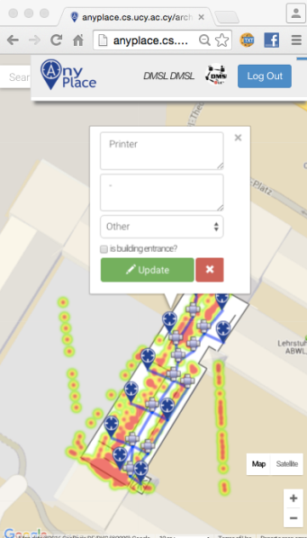
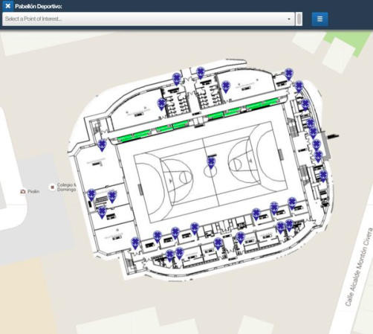
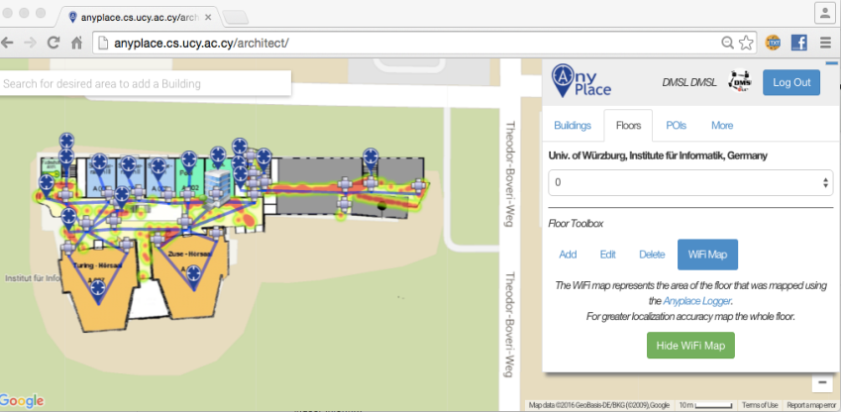
Campus and Library Navigation
Univ. of Würzburg, Institut für Informatik
Mapped in about 1 hour
Universidad de Jaén, Spain - Campus
Campus Navigation (9 Buildings)
Univ. of Mannheim, Library
Aims to offer Navigation-to-Shelf

Slide 17
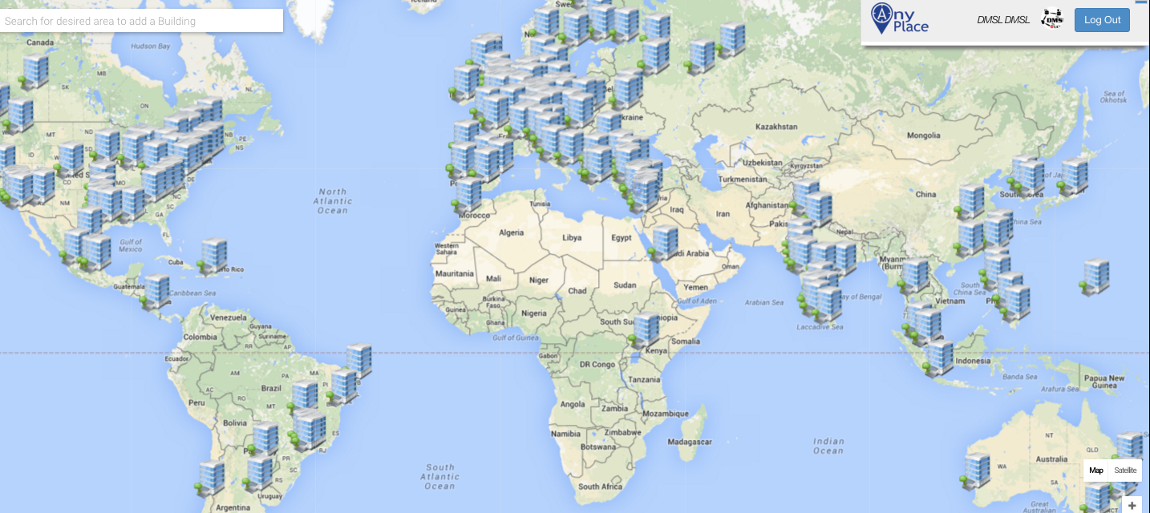
Anyplace Open Maps
http://anyplace.cs.ucy.ac.cy/

Slide 18
Location
Location (position): identifies a point or an area on the Earth's surface.
Localization = Positioning = Tracking: identifying location.
Indoor Location: identifies a point located inside a building.
Developments for the last 15 years.
Specialized conferences (e.g., IPIN) & competitions (IPSN)
Expected Accuracy: cm - meters
Mobile-based Indoor Location: Indoor Location with the assistance of a mobile computing device (e.g., smartphone).
Remainder of the talk focuses on this category!

Slide 19
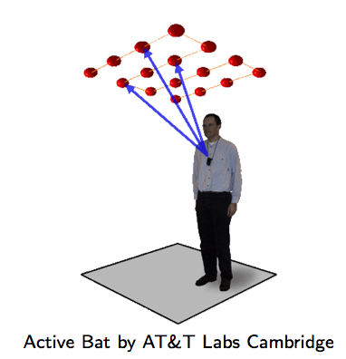
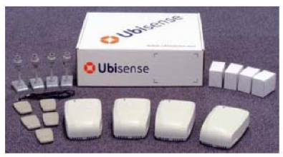
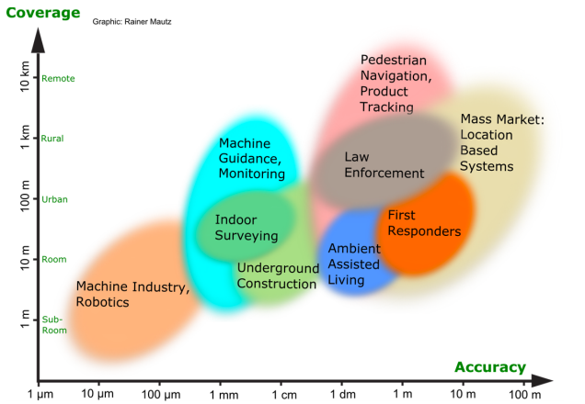
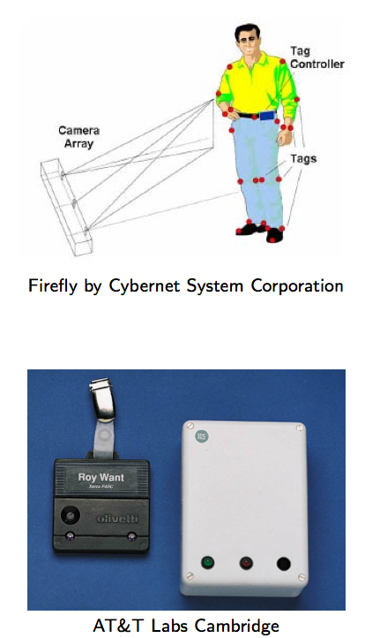
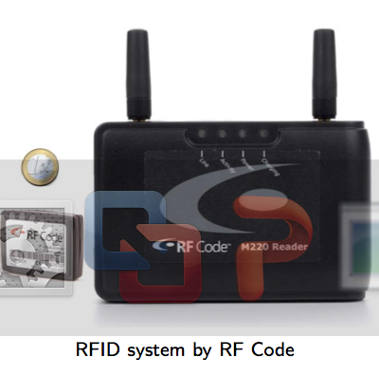
Location (Applications)
Ultrasound:
^{Ultra Wide Band (UWB)}
AOA, TOA, TDOA, signal reflection
: Spatial extension where system performance must be guaranteed
Talk Scope
^{Infrared (IR)}
^{TOA, TDOA}
| Outdoor |
Radio Frequency IDentification (RFID)
| Indoor |
^{Rainer Mautz, ETH Zurich, 2011}
Cell of Origin, Signal Strength
^{Firefly delivers 3mm accuracy}

Slide 20
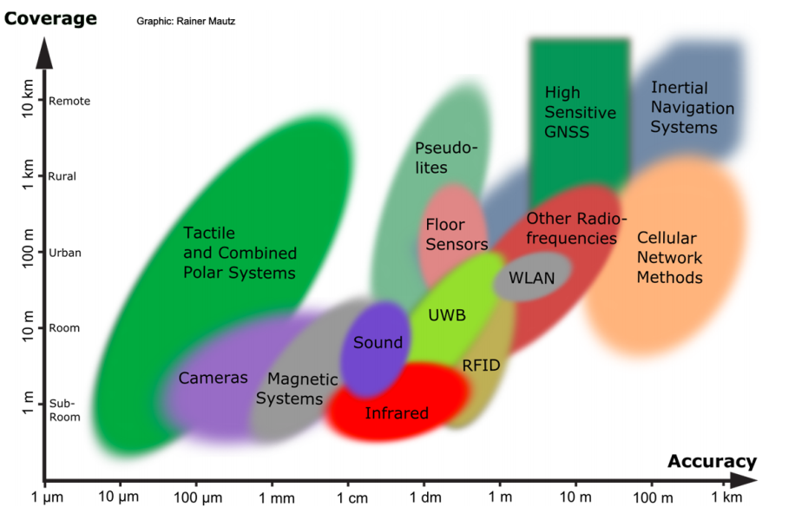
Location (Technologies)
Ultrasound:
^{Ultra Wide Band (UWB)}
AOA, TOA, TDOA, signal reflection
: Spatial extension where system performance must be guaranteed
^{Infrared (IR)}
^{TOA, TDOA}
Talk Scope
Radio Frequency IDentification (RFID)
| Outdoor |
| Indoor |
^{Rainer Mautz, ETH Zurich, 2011}
Cell of Origin, Signal Strength
^{Firefly delivers 3mm accuracy}

Slide 21
Localization
Infrastructure-free systems: don’t require dedicated equipment for the provisioning of location signals (e.g., GPS, Wi-Fi, Cellular, Magnetic, IMU)
Infrastructure-based systems: require dedicated equipment (e.g., proprietary transmitters, beacons, antennas and cabling)
Bluetooth Low Energy (BLE) beacons: iBeacons (Apple)
Ultrasound: ALPS (CMU)
Visible Light: EPSILON (Microsoft Research)
Ultra Wide Band (UWB): Decawave
Focus of next slides
Source: NASA

Slide 22
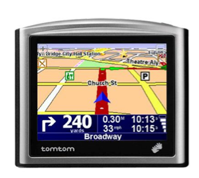
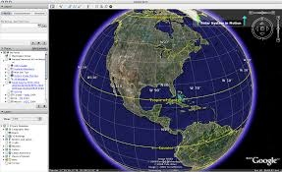
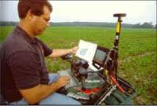
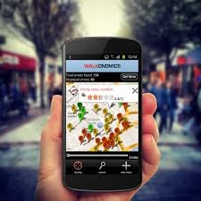
Location (Outdoor)
Infrastructure-free
Global Navigation Satellite Systems (GNSS) have played an important role in Outdoor
Current: Global Positioning System (US), GLONASS (Russian)
Upcoming: Galileo (European), Indian Regional Navigation Satellite System (IRNASS), BeiDou-2 (Chinese)
GNSS Drawbacks for Indoor Location:
Low availability indoors due to the blockage or attenuation of the satellite signals.
High start-up time & Power Demanding
Geographic Mapping
Precision Agriculture
Location-based Services

Slide 23
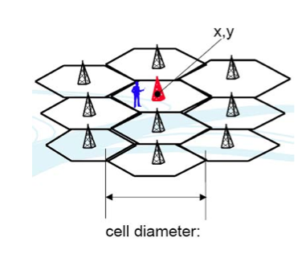
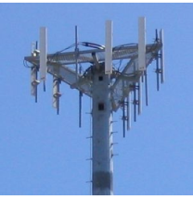
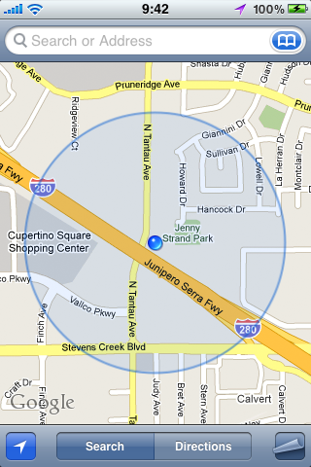
Location (Outdoor/Indoor)
Infrastructure-free
Cell ID:
Cell ID is the Unique Identifier of Cellular Towers.
Cell ID Databases
Skyhook Wireless (2003), MA, USA (Apple, Samsung): 30 million+ cell towers, 1 Billion Wi-Fi APs, 1 billion+ geolocated IPs, 7 billion+ monthly location requests and 2.5 million geofencable POIs.
Google Geolocation “Big” Database (similar)
Disadvantages:
Low accuracy: 30-50m (indoor) to 1-30km (outdoor).
Serving cell is not always the nearest.

Slide 24
Location (Indoor)
Infrastructure-free
Inertial Measurement Units (IMU)
3D acceleration, 3D gyroscope, digital compass using dead reckoning (calculate next position based on prior).
Disadvantages
Suffers from drift (difference between where the system thinks it is located, and the actual location)
Advantages
Sensors are available on smartphones.
Newer smartphones (iphone 5s) have motion co-processors always-on reading sensors and even providing activitity classifiers (driving, walking, running, or sleeping, etc.)

Slide 25
Infrastructure-free
WiFi Fingerprinting in Anyplace
References
[Airplace] "The Airplace Indoor Positioning Platform for Android Smartphones", C. Laoudias et. al., Best Demo Award at IEEE MDM'12. (Open Source!)
[HybridCywee] "Indoor Geolocation on Multi-Sensor Smartphones", C.-L. Li, C. Laoudias, G. Larkou, Y.-K. Tsai, D. Zeinalipour-Yazti and C. G. Panayiotou, in ACM Mobisys'13. Video at: http://youtu.be/DyvQLSuI00I
[UcyCywee] IPSN’14 Indoor Localization Competition (Microsoft Research), Berlin, Germany, April 13-14, 2014. 2nd Position with 1.96m! http://youtu.be/gQBSRw6qGn4
D. Lymberopoulos, J. Liu, X. Yang, R. R. Choudhury, ..., C. Laoudias, D. Zeinalipour-Yazti, Y.-K. Tsai, and et. al., “A realistic evaluation and comparison of indoor location technologies: Experiences and lessons learned”, In IEEE/ACM IPSN 2015.
1st Position at EVARILOS Open Challenge, European Union (TU Berlin, Germany).
Cywee / Airplace

Slide 26
WiFi Fingerprinting
Infrastructure-free
Received Signal Strength Indicator (RSSI)
Power measurement present in a received radio signal measured in [ dBm, Decibel-milliwatts ]
0 dBm = 1 mW
-80dBm = 10 pW | Max RSSI (-30dBm) to Min RSSI: (−90 dBm)
-110dBm = 0.01 pW | WiFi AP is visible but out of data range.
Advantages
Readily provided by smartphone APIs .
Low power 125mW (RSSI) vs. 400 mW (transmit)
Disadvantages
Complex propagation conditions (multipath, shadowing) due to wall, ceilings.
RSS fluctuates over time at a given location (especially in open spaces).
Unpredictable factors (people moving, doors, humidity)

Slide 27
WiFi Fingerprinting
Infrastructure-free
Mapping Area with WiFi Fingerprints
n APs deployed in the area
Fingerprints r_{i} = [ r_{i1}, r_{i2}, …, r_{in}]
Averaging

Slide 28
Logging in Anyplace
Infrastructure-free
Video
"Anyplace: A Crowdsourced Indoor Information Service", Kyriakos Georgiou, Timotheos Constambeys, Christos Laoudias, Lambros Petrou, Georgios Chatzimilioudis and Demetrios Zeinalipour-Yazti, Proceedings of the 16th IEEE International Conference on Mobile Data Management (MDM '15), IEEE Press, Volume 2, Pages: 291-294, 2015

Slide 29
WiFi Positioning
Infrastructure-free
Positioning with WiFi Fingerprint
Collect Fingerprint s = [ s₁, s₂, …, s_{n}]
Compute distance || r_{i} - s || and position user at:
Nearest Neighbor (NN)
K Nearest Neighbors (w_{i} = 1 / K)
Weighted K Nearest Neighbors (w_{i} = 1 / || r_{i} - s || )
RadioMap
s = [ -70, -51]
r₁ = [ -71, -82, (x₁,y₁)]
r₂ = [ -65, -80, (x₂,y₂)]
…
r_{N} = [ -73, -44, (x_{N},y_{N})]
NN, KNN, WKNN

Slide 30
Hybrid Wi-Fi/IMU/Outdoor Anyplace
Infrastructure-free
Video
"Anyplace: A Crowdsourced Indoor Information Service", Kyriakos Georgiou, Timotheos Constambeys, Christos Laoudias, Lambros Petrou, Georgios Chatzimilioudis and Demetrios Zeinalipour-Yazti, Proceedings of the 16th IEEE International Conference on Mobile Data Management (MDM '15), IEEE Press, Volume 2, Pages: 291-294, 2015

Slide 31
Magnetic-based
Infrastructure-free
Earth’s magnetic field
Exploit indoor disturbances: power cables, elevators, metal surfaces, electrical appliances.
Alternative for iOS and Windows phones where WiFi RSS is not available for fingerprinting (IndoorAtlas)
Source: Wikipedia
Source: wired.co.uk

Slide 32
Localization
Infrastructure-free systems: don’t require dedicated equipment for the provisioning of location signals (e.g., GPS, Wi-Fi, Cellular, Magnetic, IMU)
Infrastructure-based systems: require dedicated equipment (e.g., proprietary transmitters, beacons, antennas and cabling)
Bluetooth Low Energy (BLE) beacons: iBeacons (Apple)
Ultrasound: ALPS (CMU)
Visible Light: EPSILON (Microsoft Research)
Ultra Wide Band (UWB): Decawave
Focus of next slides
Source: NASA

Slide 33
RFID Tags
Infrastructure-based
Passive RFID
Tag collects energy from transmitter to respond with a Unique ID.
Range: 10cm to few meters
Indicative Price: 0.25 cents / tag
Active RFID
Tag is battery-powered (larger size), thus can transmit UID autonomously.
Range: Hundreds of meters.
Indicative Price: 10-50 USD / tag
Older Trend
Toll lane

Slide 34
Beacons
Infrastructure-based
iBeacon: Bluetooth Low Energy protocol by Apple (2013).
Beacon is a tiny battery powered devices that emits BLE signals.
Transmits unique (changeable) identifiers that can be picked up by any Linux Bluetooth stack (iPhone-Android-Windows).
e.g., UUID f7826da6-4fa2-4e98-8024-bc5b71e0893e (beacon set), Major 1 and 65535 (e.g., floor), Minor 1 and 65535 (e.g., room)
Can also pick up periodical broadcasting packets (Probe Requests) made by smartphones to actively seek Wi-Fi Access Points (tracking usages).
Source: NASA

Slide 35
Beacons
Infrastructure-based
Beacon Facts
$5-$50 USD, Frequencies: 1Hz to 10Hz (1s to 100ms)
Cell, AAA batteries (4-6 months) or USB powered
Transmission Range: 1m to 50 m (-30dBm – 0dBm)
Might contain sensors: temperature, motion (estimote)
(e.g., open fitness app when bicycle starts moving)
Which beacon to use?
AisleLabs, May 4, 2015.
http://goo.gl/ej9P0n
Indoo.rs SF Airport deploy:
300 StickNFind (15K USD)
60,000 m²
Source: NASA

Slide 36
Beacons
Infrastructure-based
Source: NASA

Slide 37
Ultrasound
Infrastructure-based
Ultrasound transceivers
Active Bat, AT&T Labs Cambridge
Cricket system, MIT
Smartphone-based (integrated mic)
Acoustic Location Processing System (ALPS), CMU: 31cm avg. positioning error (winners of Microsoft Contest 2015)

Slide 38
LED Visible Light
Infrastructure-based
LED light bulbs can switch on/off at high frequency (not visible to human eye) transmitting their ID.
Light sensor decodes light signal intensities and estimates distances from LEDs to get user location
Academic: Epsilon (Microsoft Research)
Industrial: ByteLight.com
Similar ideas for Data Transm (LiFi) – Gbps already!
L. Li et al., "Epsilon: A Visible Light Based Positioning System", 11th USENIX Symposium on Networked Systems Design and Implementation (NSDI), 2014, pp. 331-343.

Slide 39
Ultra Wide Band (UWB)
Infrastructure-based
Measures the time (nanosec) it takes for brief bursts of radio energy (pulses) to travel between radios using a large portion of the radio spectrum.
Pros: Accuracy (Decawave reports 10cm accuracy!)
Cons: Short range, computational cost, expensive equipment [Zebra demo kit costs $12,000 (2014)]
Driven by several players
Ubisense (UK), Decawave (IE), Nanotron (GE), Time Domain (US), Zebra (US)

Slide 40
Additional References
[Privacy] "Privacy-Preserving Indoor Localization on Smartphones", Andreas Konstantinidis, Georgios Chatzimilioudis, Demetrios Zeinalipour-Yazti, Paschalis Mpeis, Nikos Pelekis, Yannis Theodoridis, IEEE Transactions on Knowledge and Data Engineering (TKDE'15), IEEE Computer Society, Vol. 27, Iss. 11, pp. 3042-3055, Los Alamitos, CA, USA, 2015.
[Prefetching] "Radiomap Prefetching for Indoor Navigation in Intermittently Connected Wi-Fi Networks", Andreas Konstantinidis, George Nikolaides, Georgios Chatzimilioudis, Giannis Evagorou, Demetrios Zeinalipour-Yazti and Panos K. Chrysanthis, Proceedings of the 16th IEEE International Conference on Mobile Data Management (MDM'15), IEEE Press, Vol.1, pp. 34-43, Pittsburgh PA USA, 2015.
[Survey] “Internet-based Indoor Navigation Services”, Demetrios Zeinalipour-Yazti, Christos Laoudias, Kyriakos Georgiou and Georgios Chatzimiloudis, IEEE Internet Computing (IC'16), IEEE Computer Society, 2016.

Slide 41
IIN Taxonomy

Slide 42
IoT-enabled Localization and Navigation
Demetris Zeinalipour
Thanks! Questions?
Assistant Professor
Data Management Systems Laboratory
Department of Computer Science
University of Cyprus
http://www.cs.ucy.ac.cy/~dzeina/
http://goo.gl/70JV4q
Invited Talk at PERCCOM (Pervasive Computing & COMmunications for sustainable development) Summer School, Erasmus Mundus Nancy, France, June 16, 2016

