Slide 1
A Framework for Continuous kNN Ranking of EV Chargers with Estimated Components
Soteris Constantinou∗, Constantinos Costa⋄∗, Andreas Konstantinidis•∗, Mohamed F. Mokbel‡, Demetrios Zeinalipour-Yazti∗
∗ Department of Computer Science, University of Cyprus, 1678 Nicosia, Cyprus
⋄ Rinnoco Ltd., 3047 Limassol, Cyprus • Department of Computer Science & Engineering, Frederick University, 1036 Nicosia, Cyprus ‡ Department of Computer Science and Engineering, University of Minnesota, MN 55455 Minneapolis, USA
sconst01@ucy.ac.cy; costa.c@rinnoco.com; com.ca@frederick.ac.cy; mokbel@umn.edu; dzeina@ucy.ac.cy
https://ecocharge.cs.ucy.ac.cy/
40th IEEE International Conference on Data Engineering
13 - 17 May, 2024 Utrecht | Netherlands

Slide 2
Presentation Outline
Introduction
EcoCharge
Algorithm
System Architecture
Graphical User Interface
Experiments
Conclusions

Slide 3
Global Warming & Climate Change
B) Climate Change: new weather patterns that remain for an extended time having an impact on human health and the environment.
brings
A) Global Warming: human-caused increase in global surface temperatures.
Rising Temperatures: a) dryness, wildfires; b) tornadoes, hurricanes, earthquakes, tsunamis; c) ice-melting, sea-level risings, floodings, …
Notes:
One of the most critical problems in our time and age is the global warming
Which causes climate change with new weather patterns that remain ….
The rising temperatures result in dryness,…..

Slide 4
CO₂ - Global Warming Culprit
Why do we have Global Warming?
Current Human activity (coal, oil, gas) generates Carbon Dioxide (CO₂), the predominant Greenhouse Gas!
CO₂ traps Solar Radiation inside the atmosphere that eventually leads to Global Warming.
Oceans clean only ¼ of CO₂ pollution while trees another ¼.
US EPA: https://www.epa.gov/ghgemissions/global-greenhouse-gas-emissions-data
4% ICT
10.5% ICE Cars
2.5% Aviation
Notes:
The graph represents Global greenhouse gas emissions by economic sector
Internal Combustion Engine

Slide 5
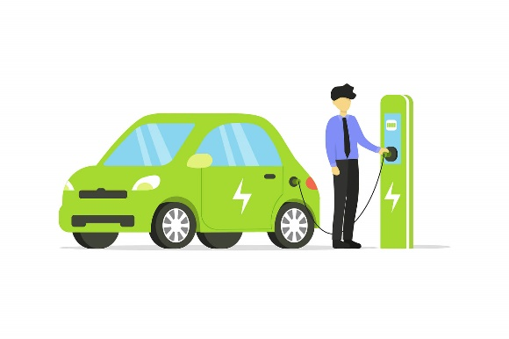
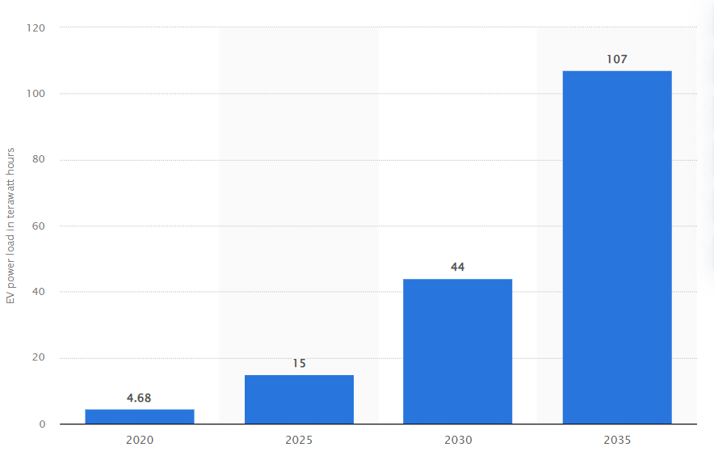
Motivation - Electric Vehicle Charging
Electric Vehicles (EVs):
Improve the environment
Reduce greenhouse gas emissions
~ 4.7 terawatt hours were attributed in U.S. to electric vehicle charging in 2020
Expected increase to about 107 terawatt hours by 2035

Slide 6
Motivation - Electric Vehicle Charging
Energy Hoarding: people tend to charge their EVs during idle times
even when battery is not substantially depleted
to ensure the vehicle will be sufficiently charged
Energy hoarding with NON-renewable energy is negating environmental benefits
Current applications focus on allowing users know where to recharge but do not list the environmental impact of the charging process
Notes:
This is due to Energy Hoarding: where people tend to charge EV during idle times, even when the battery is not substantially depleted to ensure that the EV will be charged when needed
(e.g., Plugshare, Ionity, Tesla’s supercharger, EnBW, Shell recharge)
(i.e., energy might come from fossil fuel burning).

Slide 7
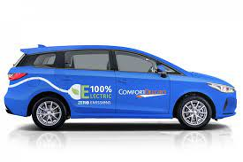
Case Scenario
EV charging during idle times:
Electric taxis (e.g., Lyft, Uber, Bolt) during idle periods are waiting to be called or booked online
Parents waiting in their idle EVs while their children attend after-school activities
EV user going for groceries or clothing shopping
EV users are engaged in activities that require idle time, such as attending meetings, events, or conferences
Notes:
A hoarding technique can be applicable in scenarios with idle time: (i.e., while an EV user is waiting or parked).
Consequently, in all aforementioned scenarios users could stop at some nearby charging
station to efficiently charge their EVs using power generated from RES, thus, reduce the
carbon footprint of their daily routine.

Slide 8
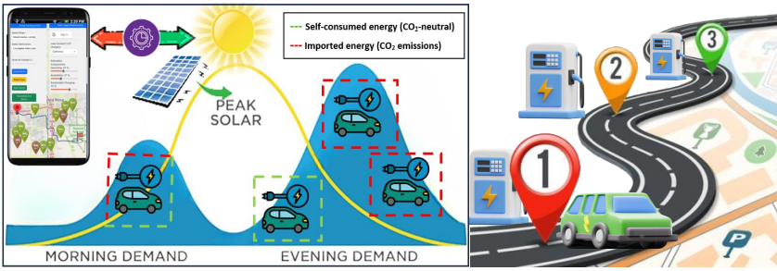
Problem Statement
Sustainable hoarding depends on various Estimated Components (ECs) on where and when to charge
How can we identify among thousands of charging stations the ones who will provide the most green energy through charging at a given time?
Notes:
For example minimizig derouting traveling and maximizing sustainable charging level.

Slide 9
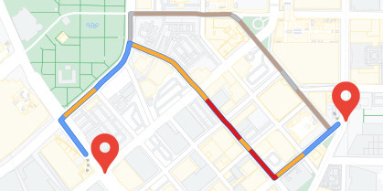
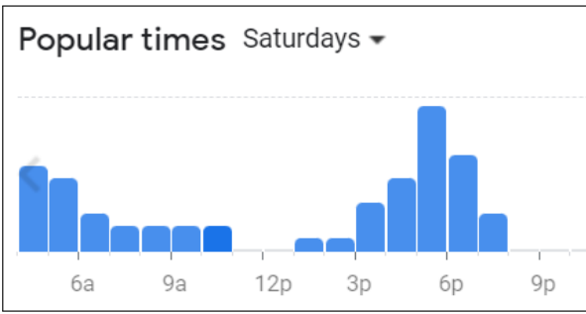
Estimated Components (ECs)
Derouting Cost (D): The path distance needed from a starting point to target charger in terms of CO₂ emissions. Estimated traffic is considered
Sustainable Charging Level (L): The available green power of a charger at a given time and location, considering the charging rate and weather conditions
Availability (A): Each EV charger’s availability is estimated using some third-party service (e.g., Google Maps POI busy timetables), enabling the determination of real-time accessibility on a given time
Notes:
Remember to explain min max intervals

Slide 10
Presentation Outline
Introduction
EcoCharge
Algorithm
System Architecture
Graphical User Interface
Experiments
Conclusions

Slide 11
EcoCharge Overview
p4
b1
p3
b3
p3
p2
b5
p6
p1
p5
b4
Time(t): 10:15
D=1
b2
D=2
(x_{e},y_{e})
b6
(x_{s},y_{s})
D=3
Estimated Components (low to high)
Sustainable Charging
Derouting
Availability
p6
b6
5
p5
b1
b2
b3
p4
p3
b4
p2
p1
b5
1 2 3 4 5 6 7 8 9 10 11 12
User plans a trip
EcoCharge splits path into segments
For each segment a ranking is produced using CkNN-EC
Estimated time of arrival (ETA) & return trip time
Sustainable Charging
Charger’s availability
Traffic congestion
Notes:
The ranking selection is derived from each EV charger’s solar production curve at a certain time (weather conditions)
User-configured boundaries-radius
Remember to explain min max intervals
Ecfocharge considers a set of weights which are considered in a weighted sum function

Slide 12
EcoCharge Metrics
Sustainability Score (SC)
Weighted sum function
w1 represents the weight of Derouting Cost objective
w2 the weight of Sustainable Charging Level objective
w3 the weight of Availability objective
w1 = w2 = w3 & w1 + w2 + w3 = 1
Notes:
we evaluate the Sustainability Score (SC)..
…EcoCharge produces two result-sets, one based on SCmin and another on SCmax, and the final output is their intersection, which contains k chargers.
For each segment set we find the CkNN chargers

Slide 13
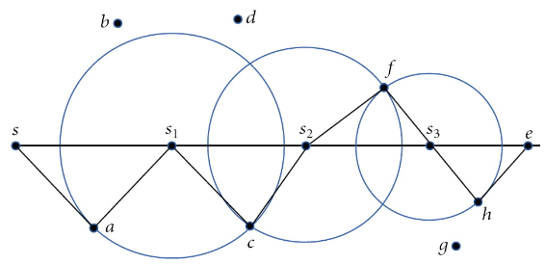
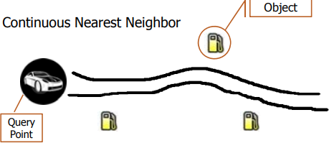
Continuous k-Nearest Neighbor (CkNN)
CkNN spatio-temporal query
Data: a set of points P={a, b, c, d, f, g, h}
Query: a line segment q=[s, e]
Result: The nearest neighbor (NN) of every point on q
Result representation: { <a, [s,s1]>, <c, [s1, s2]>, <f, [s2,s3]>, <h, [s3,e]> }

Slide 14
EcoCharge Algorithm
Filtering Phase: ensures that only the k most suitable chargers are considered, using Continuous k-Nearest Neighbor query with ECs (i.e., a query we term CkNN-EC)
Refinement Phase: utilizes an intersection of the minimum and maximum interval values of Sustainability Score SC.
Notes:
filtering phase includes the scmin and scmax scores as previously mentioned.
The refinement phase follows which computes the final ranking result..it utilizes an intersection…
This process it continuously executed until we have at least k nearest chargers (basically we expand k iteratively)

Slide 15
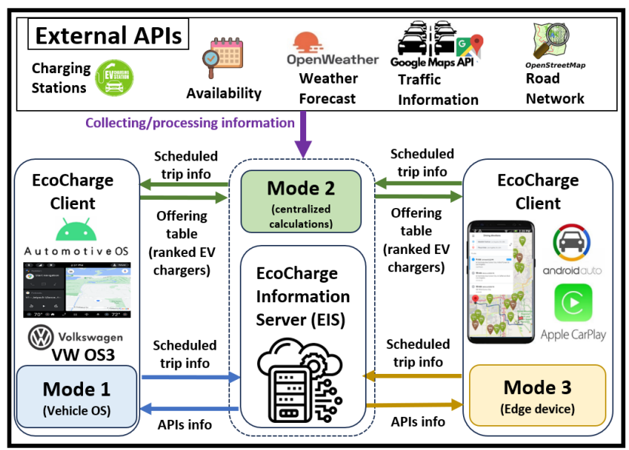
EcoCharge Architecture
Notes:
The service can be provided to the users with three modes of operation: (i) Mode 1, where EcoCharge operates in a vehicle’s embedded operating system (e.g., Automotive OS, Volkswagen OS3); (ii) Mode 2, where EIS takes over calculations centrally; and (iii) Mode 3, where EcoCharge functionalities are managed by an edge device (e.g., smart phone using Android Auto or Apple CarPlay).

Slide 16
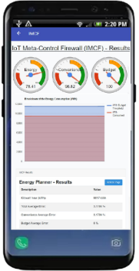
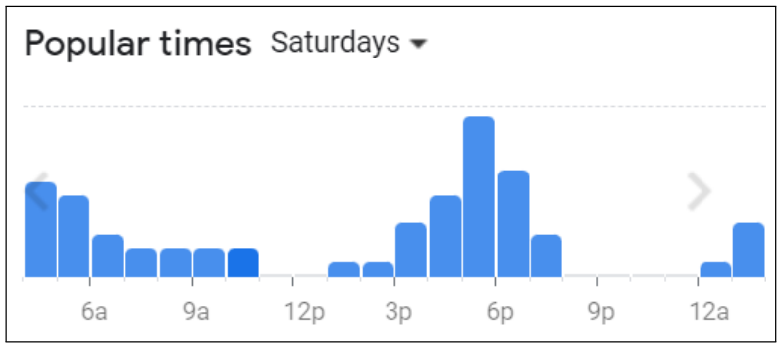
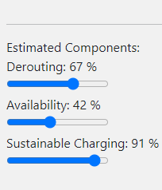
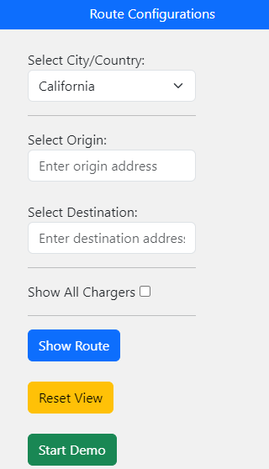
EcoCharge Framework
Preferences Configuration
Info retrieval from EIS
Origin/Destination Configuration
EcoCharge Client

Slide 17
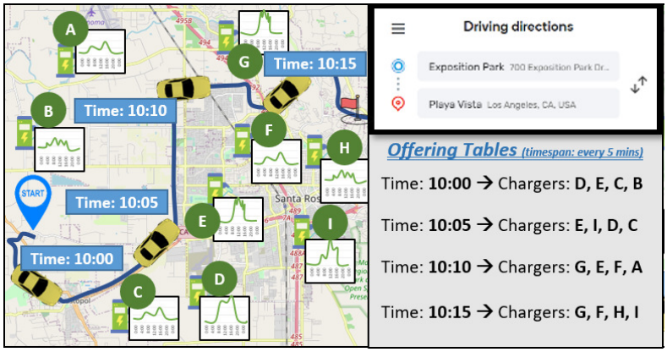
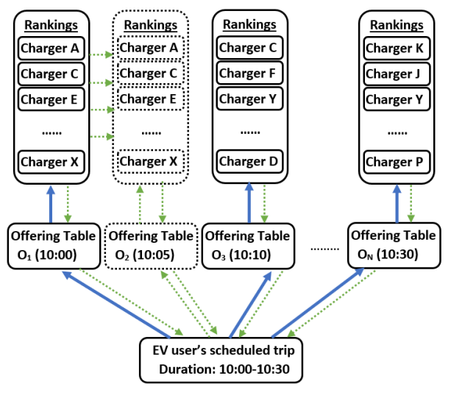
EcoCharge Framework (cont.)
EV location considered
Generates solution
utilizing CkNN-EC
Produces two result-sets (i.e., SC_{min}, SC_{max}), and the final output is their intersection, which contains k chargers.
Optimization
Dynamic Caching
Adapted Solution
Notes:
Examines previous & current location to decide whether to re-generate a new solution or apply the previous one.
This is an iterative process which also exploits dynamic caching

Slide 18
Graphical User Interface

Slide 19
Presentation Outline
Introduction
EcoCharge
Algorithm
System Architecture
Graphical User Interface
Experiments
Conclusions

Slide 20
Experimental Methodology
Real & synthetic road network trajectories
Oldenburg:
4,000 vehicle trajectories (45km x 35km area)
California:
7,000 vehicle trajectories (1,220 km x 400 km area)
T-drive:
10,357 GPS taxi trajectories (9 million km area)
Geolife:
17,621 vehicle trajectories (1,292,951 km area)
Datasets of EV charging stations and their production data based on weather forecast:
Plugshare: 1,000 EV charging stations
CDGS: solar generation data (15-minute time-interval)
Notes:
“California Distributed Generation Statistics”

Slide 21
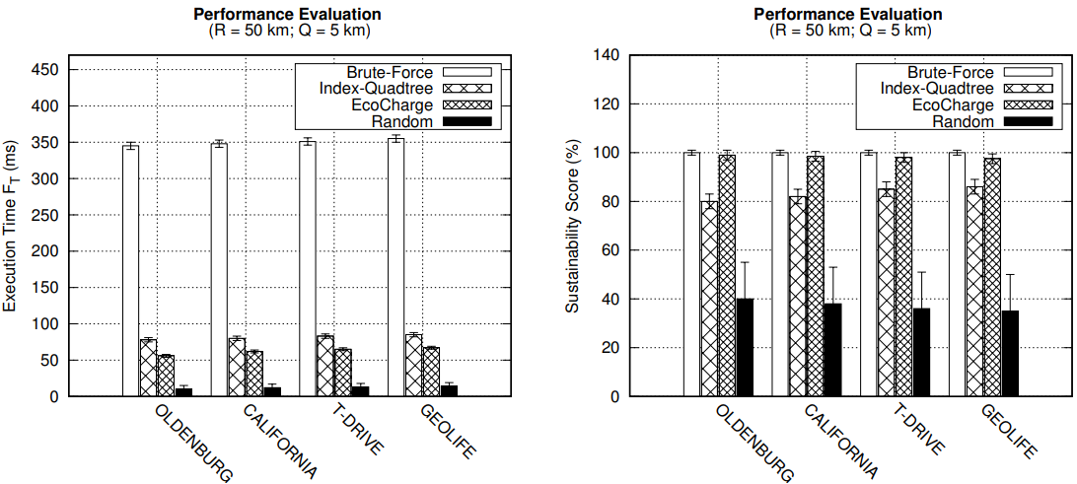
Performance Evaluation
Brute Force achieves the best SC = 100%, but the worst Ft
Index-Quadtree provides reasonable SC ≈ 80-85% and faster Ft than Brute Force Ft ≈ 78-85 ms
Random has the worst SC ≈ 30-40% and Ft ≈ 10-15 ms
EcoCharge achieves great performance with Ft ≈ 56-67 ms and SC ≈ 97.5-99%

Slide 22
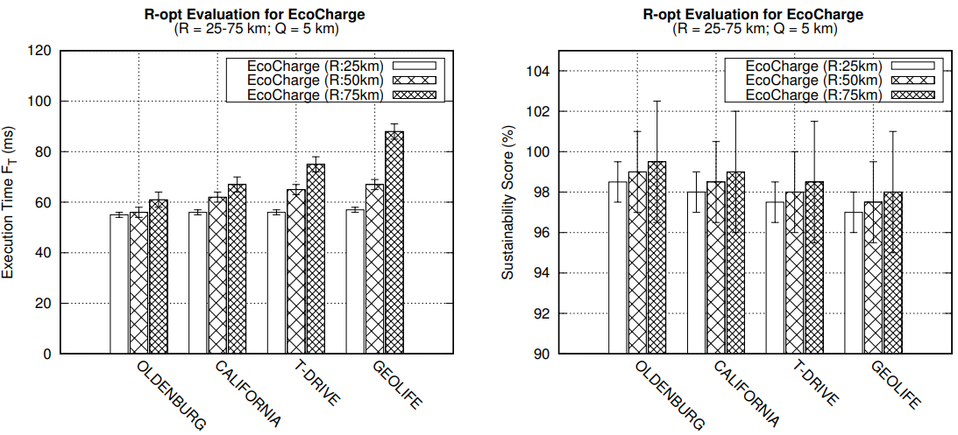
R-opt Evaluation
Fastest execution Ft ≈ 55-57 ms in all datasets when R = 25 km, however with the worst SC ≈ 97-98.5%
Slowest execution Ft ≈ 61-88 ms in all datasets when R = 75 km, however with the best SC ≈ 98-99.5%
Increasing radius means more chargers are identified, hence, more time is needed for generating Offering Tables
Notes:
As expected, the results retrieved for all datasets when R is configured to 50 km are somewhere in between the two aforementioned cases.

Slide 23
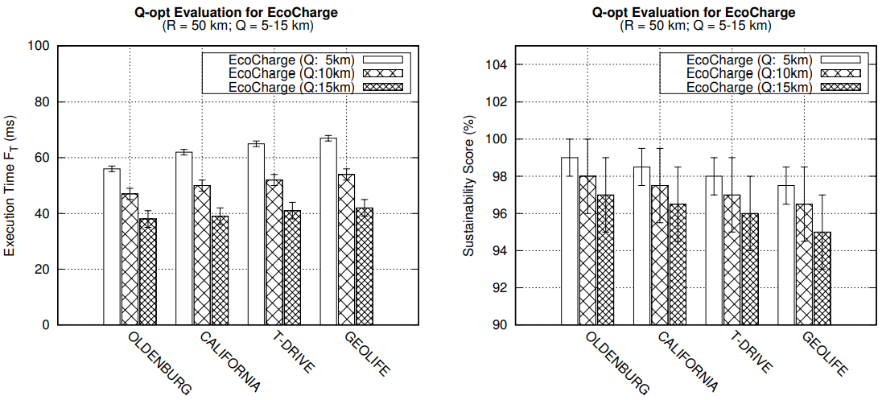
Q-opt Evaluation
Fastest execution Ft ≈ 38-42 ms in all datasets when Q = 15 km, however with the worst SC ≈ 95-97%
Slowest execution Ft ≈ 61-67 ms in all datasets when Q = 5 km, however with the best SC ≈ 97.5-99%
Increasing range distance parameter Q causes decrease in execution time and Sustainability Score
Notes:
This is due to the fact that the farther previous EV location is from current, the less accurate the previous generated results are, since chargers’ production data might change and a recalculation of SC is required.

Slide 24
Ablation Study
AWE: considers all weights equally (i.e., w1=w2=w3)
w1 ≈ 31.5-35%, w2 ≈ 32-40%, w3 ≈ 26.5-31%
OSC: considers only Sustainable Charging Level (w1)
Increase: w1 ≈ 2-3%, Decrease: w2 ≈ 9-12%, w3 ≈ 5-6%
OA: considers only Availability (w2)
Increase: w2 ≈ 6-9%, Decrease: w1 ≈ 13-15%, w3 ≈ 16-22%
ODC: considers only Derouting Cost (w3)
Increase: w3 ≈ 2-4%, Decrease: w1 ≈ 5-7%, w2 ≈10-13%
Notes:
We conducted an ablation study to find out th best ratio of the weights allocation.
The findings reveal a distinct interplay between these parameters, showing for example that focusing only on Derouting could affect Charging Level or disregarding Availability could also have an impact on Derouting.
Our experiments revealed that the balance between w1, w2, and w3 is key to the system’s overall efficiency.

Slide 25
Presentation Outline
Introduction
EcoCharge
Algorithm
System Architecture
Graphical User Interface
Experiments
Conclusions

Slide 26
Conclusion
EcoCharge framework
Sustainable EV charging
Considers ECs (e.g., sustainable charging level, availability, derouting costs)
Leverages renewable energy sources
Optimizes charging strategies
Reduces operational costs and CO₂ emissions
CkNN-EC query & Dynamic Caching method:
Efficient computation
Optimization of the renewable hoarding process
Significant speedups
Minimizing CPU execution time
Accurate results close to an exhaustive search method

Slide 27
A Framework for Continuous kNN Ranking of EV Chargers with Estimated Components
Thank you! Questions?
Soteris Constantinou∗, Constantinos Costa⋄∗, Andreas Konstantinidis•∗, Mohamed F. Mokbel‡, Demetrios Zeinalipour-Yazti∗
∗ Department of Computer Science, University of Cyprus, 1678 Nicosia, Cyprus
⋄ Rinnoco Ltd., 3047 Limassol, Cyprus • Department of Computer Science & Engineering, Frederick University, 1036 Nicosia, Cyprus ‡ Department of Computer Science and Engineering, University of Minnesota, MN 55455 Minneapolis, USA
sconst01@ucy.ac.cy; costa.c@rinnoco.com; com.ca@frederick.ac.cy; mokbel@umn.edu; dzeina@ucy.ac.cy
40th IEEE International Conference on Data Engineering
13 - 17 May, 2024 Utrecht | Netherlands

