Slide 1







IMCF: The IoT Meta-Control Firewall
Soteris Constantinou∗, Andreas Konstantinidis∗‡,
Panos K. Chrysanthis†∗, Demetrios Zeinalipour-Yazti∗
∗ University of Cyprus, 2109 Nicosia, Cyprus
‡ Frederick University, 1036 Nicosia, Cyprus
† University of Pittsburgh, Pittsburgh, PA 15260, USA
constantinou.sotiris @cs.ucy.ac.cy, com.ca@frederick.ac.cy,
panos@cs.pitt.edu, dzeina@cs.ucy.ac.cy
https://imcf.cs.ucy.ac.cy/
37th IEEE International Conference on Data Engineering
19 - 22 April, 2021 Chania | Crete | Greece
Notes:
Hello everyone, I am Sotiris Constantinou from UCY and I welcome you to the presentation of The IoT Meta-Control Firewall.

Slide 2
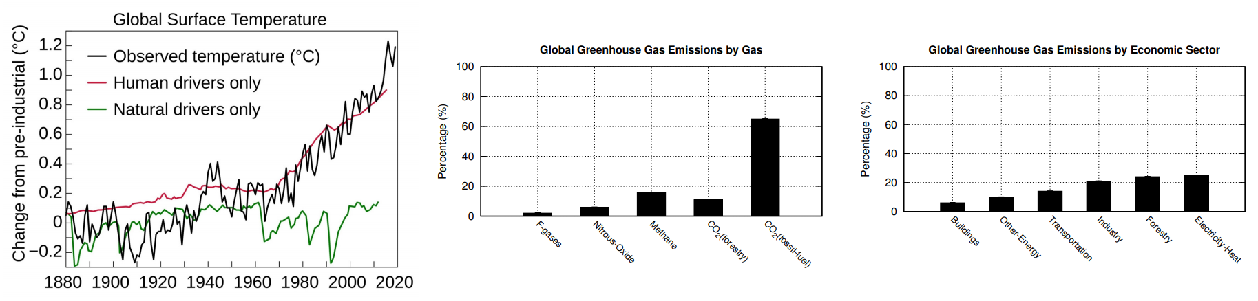
Climate Change
Internet-connected smart devices will drastically increase to more than 500 for each typical family in the developed world by 2022.
European’s Commission calls for a climate-neutral Europe by 2050.
The CO₂ pollution of ICT is expected to rise from 4% to 8% by 2025.
Notes:
According to studies , it is expected that the number of IoT devices per house will drastically increase to more than 500 smart devices by 2022.
The EU aims to be climate-neutral by 2050 – an economy with net-zero greenhouse gas emissions. This objective is at the heart of the European Green Deal and in line with the EU’s commitment to global climate action under the Paris Agreement.
Unfortunately, the CO2 pollution of Information and communications technology is expected to rise from 4% to 8% by 2025.

Slide 3
Presentation Outline
Introduction
Background
IMCF
  Algorithm
  System Architecture
  Graphical User Interface
Experiments
Conclusions

Slide 4
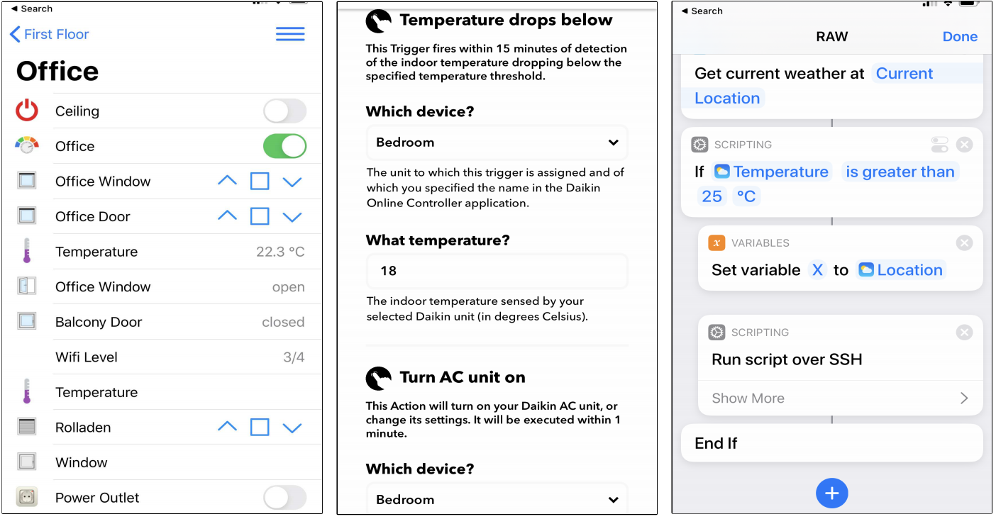

Rule Automation Workflows (RAW)
Span from simple predicate statements to procedural workflows capturing a smart actuation pipeline.
None of these supports
the expression
of long-term objectives
(e.g., energy consumption)
Notes:
Many IoT devices enable the execution of Rule Automation Workflows, which span from simple predicate statements to procedural workflows
capturing a smart actuation pipeline in tools like IFTTT, Apilio, or Apple Automation.
The Rule Automation Workflows aim to meet the convenience level of users under specific conditions.

Slide 5



Problem
None of the above technologies enable users to achieve some long-term objectives.
How to utilize RAW pipelines to meet an annual energy consumption target?
  For example consume only 8000 kWh per year.
Optimize various objectives:
  Convenience
  Energy consumption
  At the same time
Notes:
However, none of the above RAW technologies enables individuals or group of users to express their convenience or comfort preferences while achieving some long-term objectives.
Consider for example a family with a yearly budget of 8000 kWh that aims to spend this energy budget through Rule Automation Workflows based on their configured energy consumption preferences.
The family is willing to adapt its desired interior temperature preferences according to production patterns, but has no clue how the RAW pipelines contribute to the target of using only 8000 kWh per year.
Our aim is to optimize both , Convenience and Energy consumption objectives at the same time.

Slide 6
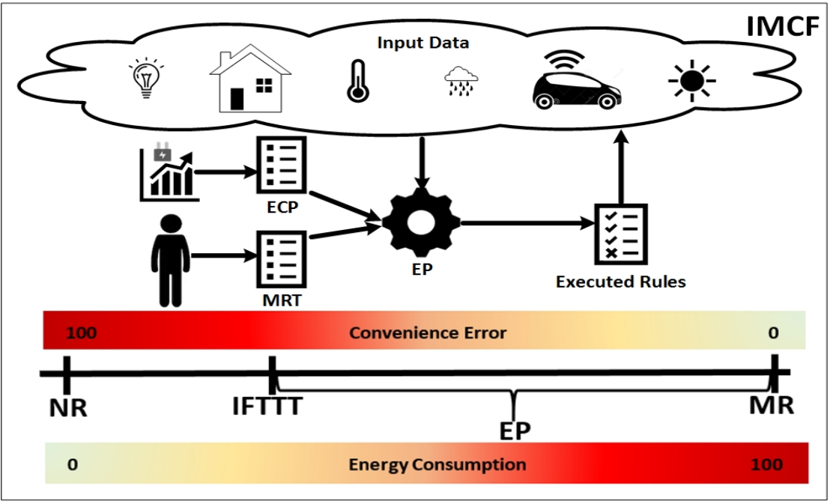
Algorithms
  No-Rule (NR) [Baseline Approach]:
  Ignores all rules in the Meta-Rule-Table.
  Meta-Rule (MR) [Baseline Approach]:
  Ignores the energy consumption and executes
  all rules (greedily) in the Meta-Rule-Table.
  If-This-Then-That (IFTTT):
  Executes the IFTTT preferences configured by the users.
  Energy Planner (EP) :
  Executes meta-rules considering the trade-off between convenience and
  energy consumption.
Notes:
Here we see a breakdown of our applied algorithms.
The No-Rule approach does not modify the behavior of the autonomous devices, therefore the energy consumption is minimum and the convenience error is maximum.
The Meta-Rule algorithm satisfies all rules set by the user by completely ignoring the energy consumption, therefore the energy consumption is maximum and the convenience error is minimum.
Furthermore, The IFTTT approach executes the IFTTT preferences configured by the users.
..and finally, The Energy Planner algorithm executes rules considering the trade-off between convenience and energy consumption.

Slide 7
Presentation Outline
Introduction
Background
IMCF
  Algorithm
  System Architecture
  Graphical User Interface
Experiments
Conclusions

Slide 8
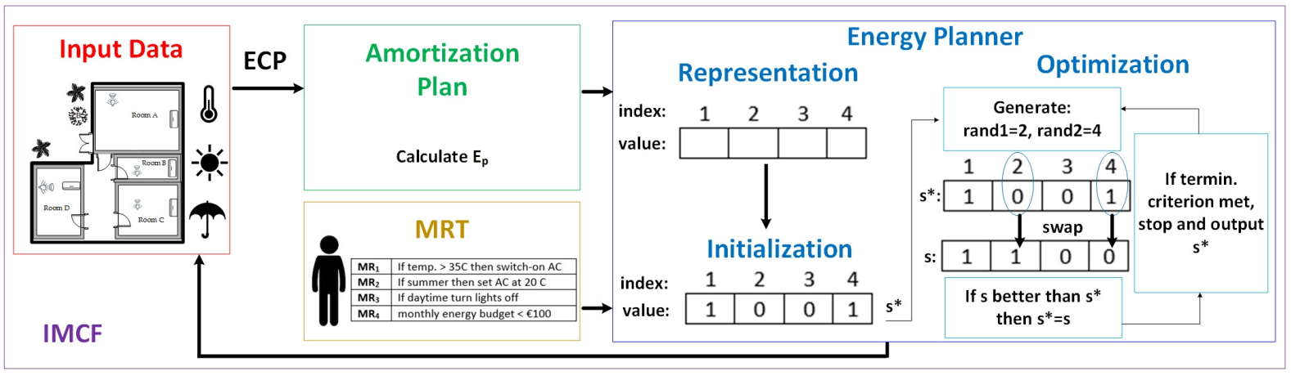
Solution: The IoT Meta-Control Firewall Framework
    Input data:
      IoT data
      Weather Forecast data
    Meta-Rule-Table (MRT):
      Vector of RAW rules
    Energy Consumption Profile (ECP)
    Amortization Plan (AP) algorithm:
      Calculates the maximum energy budget constraint.
    Energy Plan (EP) algorithm:
      Executed in fixed time slots for generating an energy plan solution.
Notes:
The IMCF utilizes IoT data and adopts the Amortization and the Energy Plan algorithms to meet the convenience level of users under specific conditions, and at the same time meet some long-term target also configured by users.
It internally deploys an Artificial intelligent algorithm that exploits domain-specific operators in order to optimize the convenience and energy consumption objectives.
Our framework filters the rules of users in a way that these do not collide with the configured long-term objectives (like an actual network firewall).

Slide 9
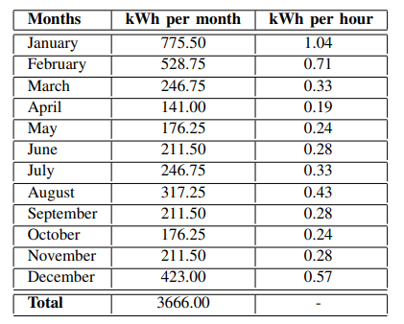





Amortization Plan Algorithm
Calculates the energy budget constraint → subject to a monthly residence Energy Consumption Profile
  Linear Amortization Formula (LAF)
  Balloon Linear Amortization Formula (BLAF)
  ECP-based Amortization Formula (EAF)
Notes:
Specifically, The Amortization Plan is initially executed for calculating the energy budget constraint, subject to a monthly residence Energy Consumption Profile. There are several amortization strategies that can be used, such as the Linear, Balloon Linear and the ECP based amortization formula.

Slide 10


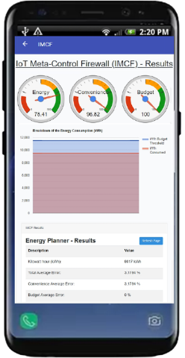

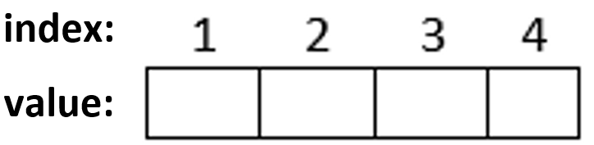
Energy Plan Algorithm
Utilizes the hill climbing approach
  Searches decision space for a solution
  Optimize users’ convenience
  Satisfy energy constraint
value = 0 at position i, ignores meta-rule at position i
Sets four meta-rules in MRT
Converts the MRT to a binary vector
value = 1 at position i, adopts meta-rule at position i
Notes:
The Energy Planner Utilizes the well known hill climbing approach, searches the decision space for a solution that will optimize the user’s convenience and satisfy the energy constraint, at the same time.
However, any kind of heuristic or meta-heuristic approach can be utilized in the EP optimization step.
Consider the simplified scenario in which a user sets four meta-rules in the MetaRule table, which along with some input data from the house’s sensors as well as some online web services are forwarded to the IMCF. Then, the IMCF converts the MetaRrule Table to a binary vector, in which each position of the vector represents a meta-rule. Where the value is equal to zero at a position i means ignoring meta-rule on that specific position. And where the value is equal to one at a position i means adopting meta-rule on that particular position.

Slide 11
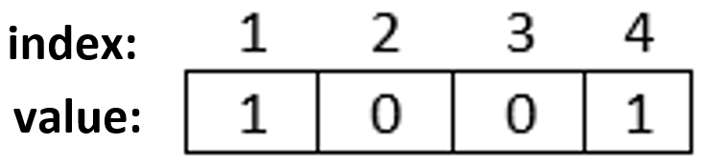

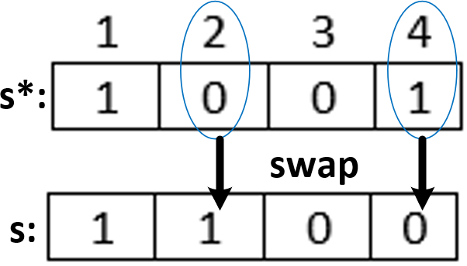
Energy Plan Algorithm (cont.)
Generates the first solution s*
Random
initialization process
Meta-rules 1 and 4 will be triggered
Meta-rules 2 and 3 will be ignored
Optimization
A solution s is considered better and replaces the current
best solution s* if
(F_{E}(s) <= E_{p}) &&
(F_{CE}(s) < F_{CE}(s*))
New generated
solution s →compared
with the current best solution s*
Random Generator
k=2 vector components
Notes:
A random initialization process generates the first solution, which means that meta-rules 1 and 4 will be triggered and meta-rules 2 and 3 will be ignored. The Solution is evaluated using the performance metrics of Energy Consumption and Convenience Error. During the optimization, 2 vector components are modified using a uniform random generator. In this example, the value of vector component 2 is swapped from 0 to 1 and the value of component 4 is swapped from 1 to 0. The new generated solution is again evaluated and compared with the current best solution. At each iteration, when solution s is better than solution s*, then s becomes the s*. A solution is considered better and replaces the current one WHEN the energy consumption is less or equal to the energy budget constraint and also WHEN the convenience error is less thaN the previous best solution. The energy planner stops when the configured number of iterations are completed.

Slide 12
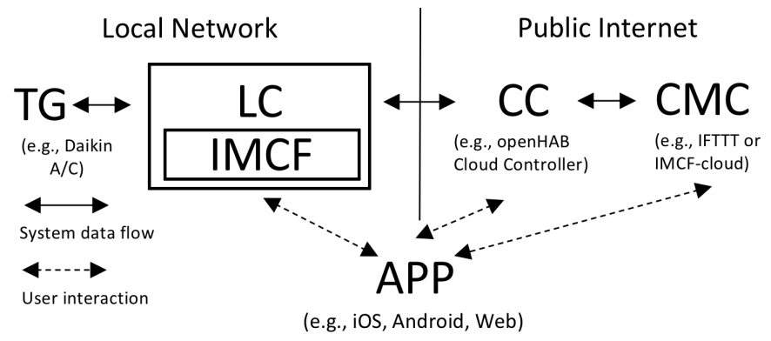
IMCF System Architecture
Local Controller → direct communication with the IoT devices
OpenHAB smartphone application
APP connects to the Cloud Controller
Cloud Meta-Controller → enable users to configure/run custom rules
Notes:
Our system architecture comprises of a full-fledge local controller implemented inside the openHAB stack, which is a smart home management software; and IMCF, which is the software system that encapsulates the complete application logic of the energy management stack we propose along with the respective user interfaces.
The Local Controller is a java-based system installed on a micro device, running on the local network of a user, that will be in direct communication with the IoT devices through the Openhab smartphone Application.
The complete picture can tentatively be complemented by a Cloud Meta-Controller, which can enable the user to configure and run various custom rules.

Slide 13




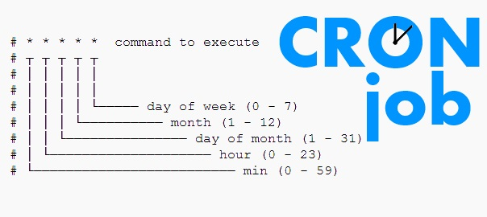






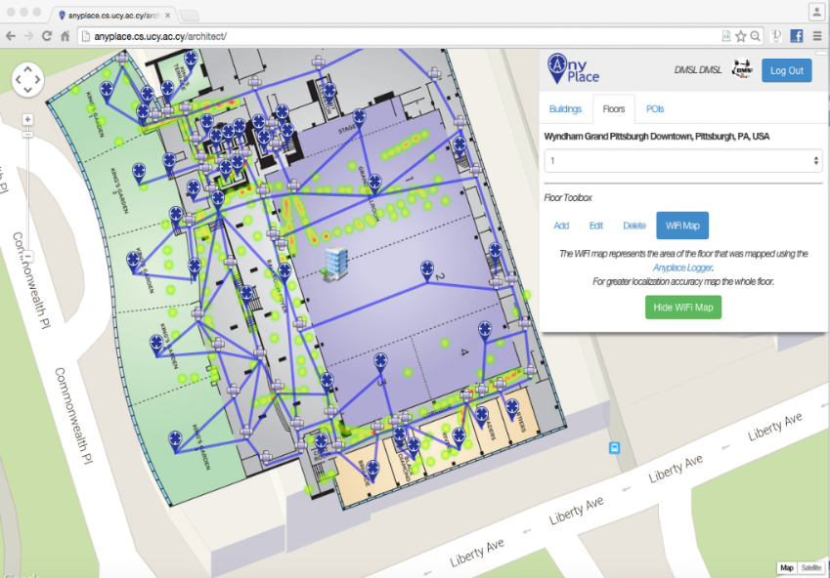




IMCF Implementation
anyplace.cs.ucy.ac.cy
Notes:
The IMCF has been implemented using the open Home Automation Bus , the Linux crontab daemon, the Anyplace for building modeling, as well as the Laravel PHP web framework following the model–view–controller architectural pattern.

Slide 14
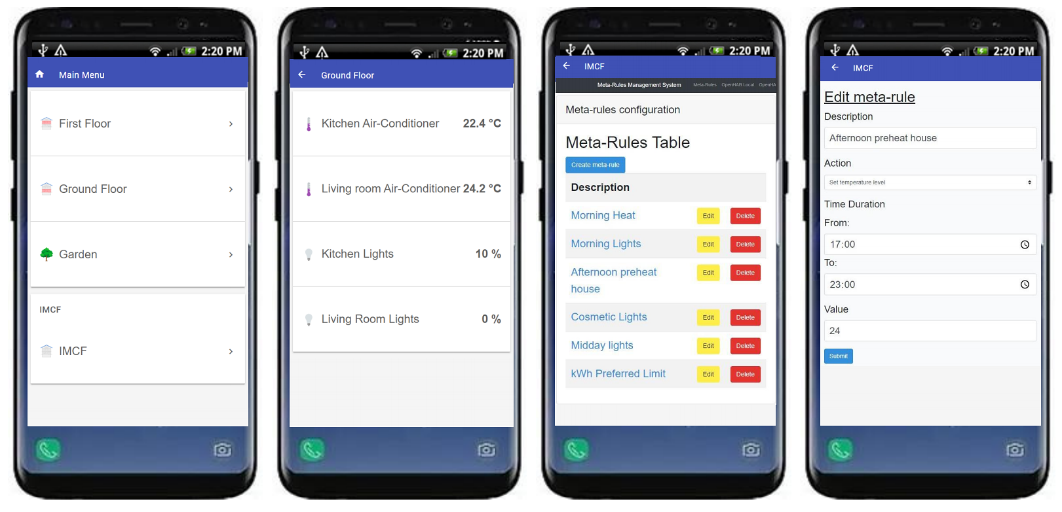

IMCF Graphical User Interface
Full Demo Available!
https://imcf.cs.ucy.ac.cy/
  Records OpenHAB’s smart device measurements on local storage
  Configures various meta-rules in regards to kWh limit, temperature and light values
Notes:
-The Graphical User Interface records OpenHAB’s smart device measurements on local storage and presents them on a table
-It allow users to Configure various meta-rules in regards to killowatHour limit, temperature and light values

Slide 15
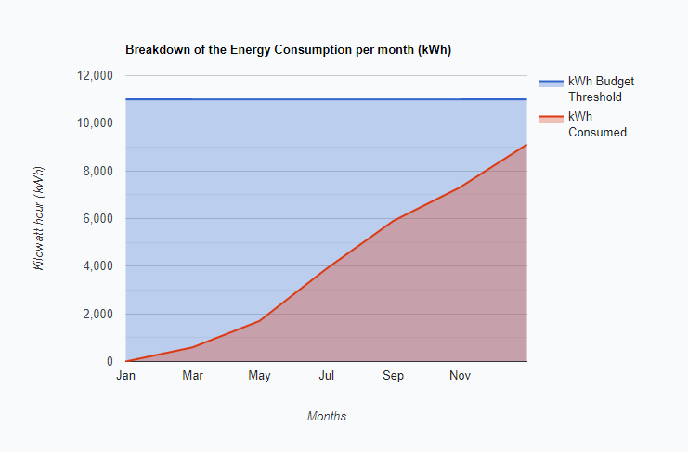
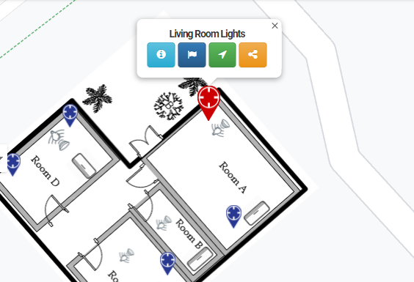
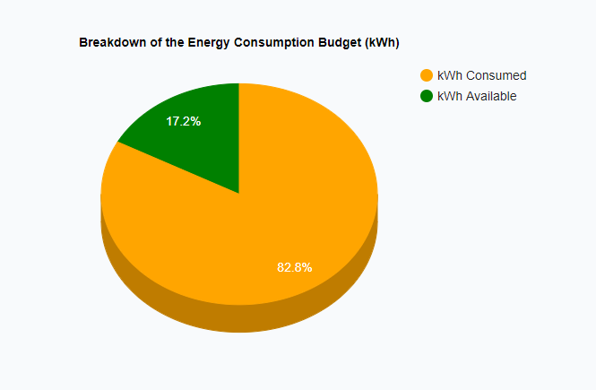
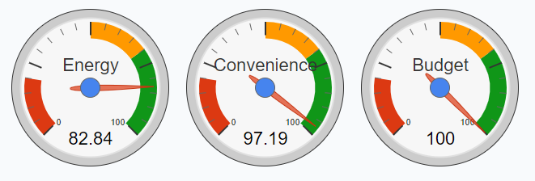
IMCF Graphical User Interface
  Operates the IMCF framework
  Gets an efficient execution considering user satisfaction
  Demonstrates results on user friendly graphs
Notes:
-It also Operates the IMCF framework and gets an efficient execution considering user satisfaction along with balanced Convenience Error and Energy Consumption
-finally it Demonstrates the results on user friendly graphs

Slide 16
Presentation Outline
Introduction
Background
IMCF
  Algorithm
  System Architecture
  Graphical User Interface
Experiments
Conclusions

Slide 17
Experimental Methodology
  Anonymized measurements from a real residential apartment that comprises of a variety of sensors, submeters and ≈ 5,668,878 readings (1.09 GB in total), collected by the “CASAS” at Washington State University.
  Metrics:
  Convenience Error: the difference between the desired output value and the actual value.
  Energy Consumption: the energy consumption of a device.
  CPU Time: the processing time required by the controller for running the optimization function and calculating the output for all meta-rules.
Flat Dataset
House Dataset
Dorms Dataset
Notes:
We have evaluated our design with extensive experimentation on real datasets with anonymized measurements from a real residential apartment that comprises of a variety of sensors, submeters and approximately 5 Million readings, collected by the “Center for Advanced Studies in Adaptive Systems” at Washington State University.
To evaluate the scalability of our propositions for residential buildings of various scales, we have generated three realistic datasets by replicating the above onto various building sizes. A flat, a house and a dorms datasets.
Our cost metrics for each meta-rule are the..

Slide 18
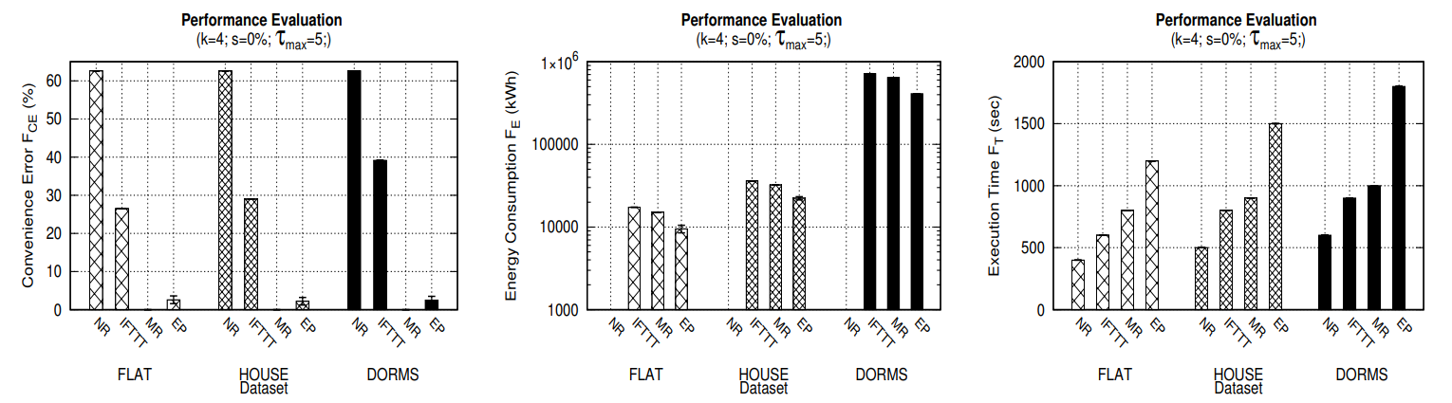
Performance Evaluation
  NR obtained the worst F_{CE} = 62% and the best F_{E} = 0 kWh.
  EP obtained an impressive F_{CE} of around 2%-4% and the second lowest F_{E}
  IFTTT & MR are greedy in regards of Energy Consumption
  MR satisfies all the meta-rules, thus its F_{CE} is 0% → best possible obtained
  The energy consumption difference between MR and EP is relatively high
Notes:
In this experimental series, we evaluated the performance of the proposed EP framework against all algorithms over all datasets introduced, with respect to Energy Consumption, Convenience Error, and CPU Execution Time.
-The No-Rule approach obtained the worst convenience error of 62% and the best energy consumption.
-The energy planner obtained an impressive convenience error of around 2-4% and the second lowest energy consumption.
-…
The fastest execution time was achieved by NR since it simply executes an error calculation ignoring all rules. The EP hill climbing approach, searches the decision space for a solution that will optimize the user’s convenience and satisfy the energy constraint, at the same time, which is a much more time-consuming process. Finally, the MR greedy approach focuses only on minimizing the Convenience Error, which means executing all meta-rules without any iterative processes or calculations, since the convenience error is 0%.

Slide 19
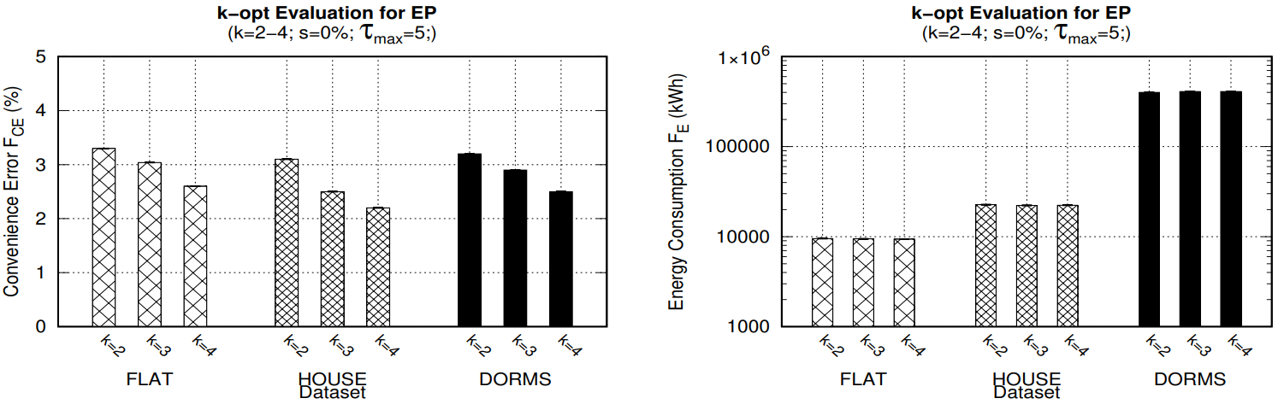
k-opt Evaluation
  Using 4 activation/deactivation rule modifications in each iteration we obtain the best F_{CE}
  Worst F_{CE} occurred on two rule modifications
  F_{CE} decreased as we increased the rule modifications in each iteration
Notes:
In the second experiment, we evaluated the performance of the proposed EP framework against different ks (rule modifications), with respect to Energy Consumption and the Convenience Error.
The Figure illustrates that by using four activation/deactivation rule modifications in each iteration we obtain the best convenience error. The worst FCE occurred when we used two rule modifications.
F_{CE} decreased as we increased the activation/deactivation rule modifications in each iteration.
This is due to the hill climbing approach performing bigger “jumps” towards the local optimum at each step and thus searching the solution space more effectively. As the number of rule modifications increases, the FCE is decreasing gradually while the FE is approximately at the same level.

Slide 20
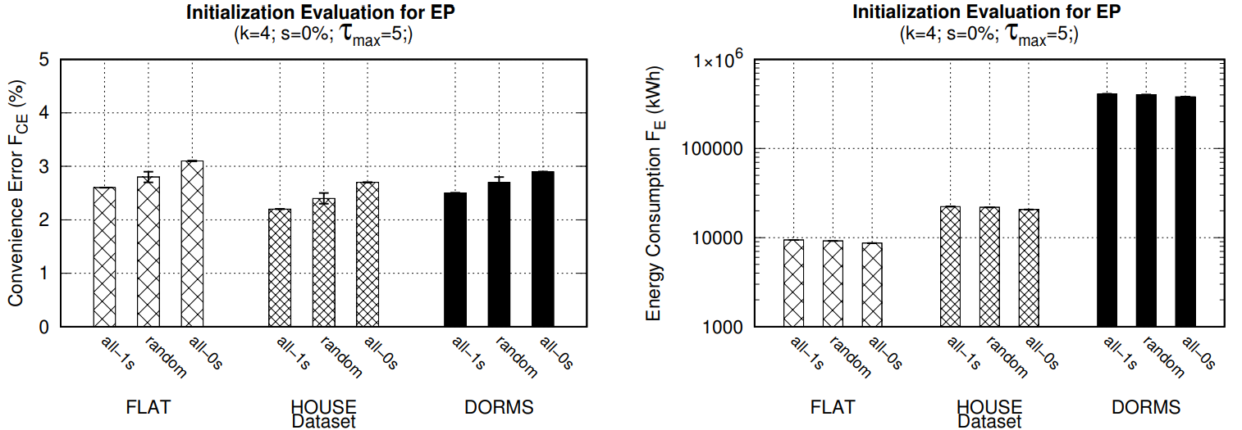
Initialization Evaluation
  F_{CE} increases by using the “all-deactivated” rules strategy, hence consuming less energy
    In contrast to the “all-activated” and the “random” rule strategies
  Hill climbing performs more iterations to find the local optimum, and consequently an optimal energy plan, when all rules are deactivated
Notes:
In the third experimental series, we evaluate the performance of the proposed EP framework using different initialization strategies.
In the first case, we have initially activated and applied all rules. In the second case, we have uniformly randomly activated some rules and in the last case, we have initially deactivated all rules. The Figure presents the FCE that increases by using the “all-deactivated” rules strategy, hence consuming less energy , in contrast to the “all-activated” and the “random” rule strategies.
The hill climbing approach needs to perform more iterations in the solution space to find the local optimum, and consequently an optimal energy plan, when all rules are deactivated.

Slide 21
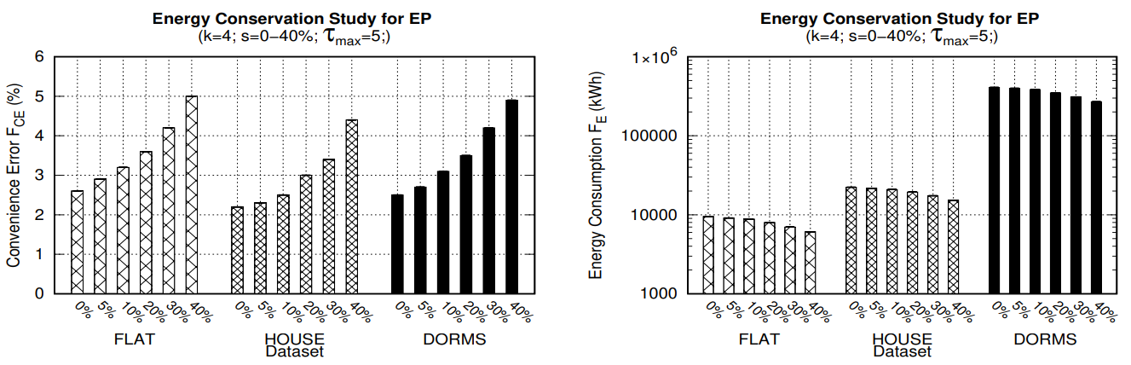
Energy Conservation Study
  Inspired by the SAVES project
    aimed at delivering 8% average electricity savings in the participating dormitories
  Increasing the potential energy savings causes a slight increase on the F_{CE}
Notes:
In the fourth experimental series, we evaluate the performance of the proposed EP approach over various savings percentages.
-This evaluation is inspired by the SAVES project, an inter-dormitory energy-saving competition that took place on 2014 – 2016.
-SAVES aimed at delivering 8% average electricity savings in participating dormitories.
-The Figure shows that by increasing the potential energy savings there is a slight increase on the FCE clearly demonstrating the trade-off between those two objectives.

Slide 22

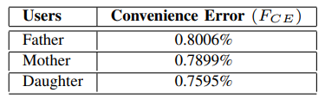
Prototype Evaluation
  Performs in 4 seconds on average with an Average Convenience Error ≈ 2.35%
  Energy Consumption ≈ 130.64 kWh is within the preferred budget limit (165kWh)
  Individual residents’ Average Convenience Error values in respect with their configured meta-rules
  Consistent and high satisfaction close to 97.6% for all residents
Notes:
In the final experimental series, we deployed an instance of our real prototype system for a family of three persons for one week.
Each person configured their personal preferences using the Mobile APP that interacts with an IMCF-LC node on a Linux VM on our datacenter.
In order to measure the environmental parameters we used data from the open weather API.
In respect to FCE our observation is that EP is indeed an efficient approach for retrieving great user satisfaction, as it performs in 4 seconds on average with an Average Convenience Error of 2.35%. The Energy Consumption is within the preferred budget limit as pre-configured by the user, and the system behaves correspondingly.
The second Table demonstrates for each individual resident their own Average Convenience Error values in respect with their configured meta-rules, showing both a consistent and high satisfaction close to 97.6% for all residents.

Slide 23
Presentation Outline
Introduction
Background
IMCF
  Algorithm
  System Architecture
  Graphical User Interface
Experiments
Conclusions

Slide 24


Conclusions
IoT Meta-Control Firewall (IMCF):
  AI-inspired Energy-Planner algorithm
  balances the trade-off between convenience & energy consumption
  manages RAW pipelines of users
10% energy savings at only 2-4% decrease in the user’s convenience
Energy Planner execution is fairly fast
  computation in about 4 seconds for the largest datasets
Requires no training data and only a primitive preference profile
Can be easily integrated in actuation platforms
Notes:
the IoT Meta-Control Firewall (IMCF), is an innovative system architecture and application, which internally deploys an AI-inspired Energy-Planner (EP) algorithm that exploits domain-specific operators to balance the trade-off between convenience and energy consumption while managing RAW pipelines of users
Using extensive real traces from an apartment, a house, and a campus, IMCF shows that a user can have 10% energy savings at only 2-4% decrease in the user’s convenience.
The execution of Energy Planner is fairly fast, carrying out the computation in about 4 seconds for the largest datasets
Our approach requires no training data and only a primitive preference profile

Slide 25


IMCF: The IoT Meta-Control Firewall
Thank you!
Soteris Constantinou∗, Andreas Konstantinidis∗‡,
Panos K. Chrysanthis†∗, Demetrios Zeinalipour-Yazti∗
∗ University of Cyprus, 2109 Nicosia, Cyprus
‡ Frederick University, 1036 Nicosia, Cyprus
† University of Pittsburgh, Pittsburgh, PA 15260, USA
constantinou.sotiris @cs.ucy.ac.cy, com.ca@frederick.ac.cy,
panos@cs.pitt.edu, dzeina@cs.ucy.ac.cy
https://imcf.cs.ucy.ac.cy/
37th IEEE International Conference on Data Engineering
19 - 22 April, 2021 Chania | Crete | Greece
Notes:
This is the end of the presentation, thank you very much for watching.

Slide 26


Internet of Things
Smart home - Interconnected appliances
Autonomous farming equipment
Wearable health monitors
Smart factory equipment
Wireless inventory trackers
Ultra-high speed wireless internet
Biometric cybersecurity scanners
Shipping container and logistics tracking
Impact
Growth of the economy
Quality of life
Security improvement
Notes:
IoT enables the development of smart applications in various domains, such as transportation, healthcare, industrial automation, emergency response and business, having significant impact on the quality of people’s life, the growth of the world’s economy, and security

Slide 27
Amortization Plan & Energy Plan Algorithms
AP: Calculates the energy budget constraint → subject to a monthly residence Energy Consumption Profile
  Balloon Linear Amortization Formula (BLAF)
  ECP-based Amortization Formula (EAF)
  Linear Amortization Formula (LAF)
EP: Utilizes the hill climbing approach
  Searches decision space for a solution
  Optimize users’ convenience
  Satisfy energy constraint
Notes:
Specifically, The Amortization Plan is initially executed for calculating the energy budget constraint, subject to a monthly residence Energy Consumption Profile. There are several amortization strategies that can be used, such as the Linear, Balloon Linear and the ECP based amortization formula.
The Energy Planner Utilizes the well known hill climbing approach, searches the decision space for a solution that will optimize the user’s convenience and satisfy the energy constraint, at the same time.
However, any kind of heuristic or meta-heuristic approach can be utilized in the EP optimization step.

Slide 28

System Architecture – Local Controller
A full-fledge local controller implemented inside the openHAB stack→ a smart home management software
Java-based system installed on a micro device running on user’s local network
Rich ecosystem bridges → users can interact directly with IoT devices locally/remotely
In case a user’s APP is outside a smart space
→ User’s APP connects to the Cloud Controller
→a server on the public Internet that communicates/controls LC remotely

Slide 29
System Architecture – The IMCF Component
A software system that encapsulates the complete application logic of the energy management stack.
Extension to LC → enables adaptation of convenience preferences
  meets long-term energy planning targets of users
Implemented as a JAVA library
  takes user configurations from a local MariaDB persistency layer
Cron job daemon executes EP every few minutes
IMCF turns on/off devices
  Binding-mode
  Extended mode

Slide 30
Experimental Datasets
  Anonymized measurements from a real residential apartment that comprises of a variety of sensors, submeters and ≈ 5,668,878 readings (1.09 GB in total), collected by the “Center for Advanced Studies in Adaptive Systems” at Washington State University.
  Flat Dataset: A single user flat/apartment dataset consisted of one bedroom, a bathroom and a kitchen. The apartment has a single split unit to warm/cool an area size of 50 m² .
  House Dataset: A residential house dataset generated by replicating, mixing up the readings and multiplying the real dataset by a factor of four. It has three bedrooms and four split units used by four residents. The area size is ≈200 m² .
  Dorms Dataset: A University Campus dataset (dorms) generated synthetically from the initial datasets. We have generated 50 dorm apartments consisting of two bedrooms (10 m² / room) with a shared bathroom, a kitchen and two split units. The total area size of the dorms is ≈ 2000 m².

Slide 31
Metrics
  Convenience Error: the difference between the desired output value and the actual value.
  Energy Consumption: the energy consumption of a device.
  CPU Time: the processing time required by the controller for running the optimization function and calculating the output for all meta-rules.

Slide 32
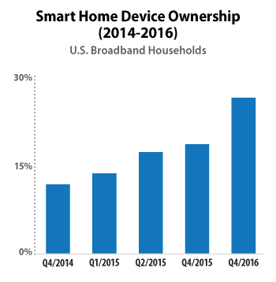
Introduction
It is expected that internet-connected smart devices will drastically increase to more than 500 for each typical family in the developed world by 2022.

Slide 33

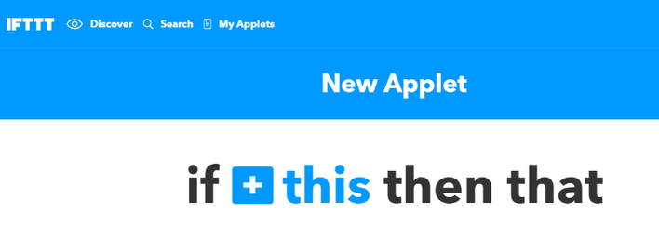

Rule Automation Workflows (RAW)
The trigger-action model - “If This Then That” (IFTTT)
Apilio →expanded RAW expressiveness with Boolean predicates (e.g., conjunctions)
Apple Automation → procedural programming constructs, like variables, while loops, if statements and functions

Slide 34
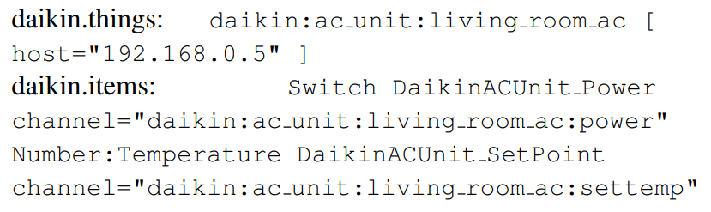
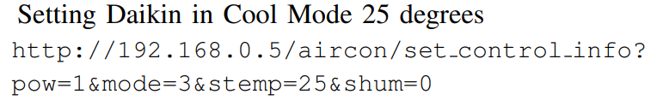
System Architecture – The IMCF Component
  Binding-mode example:
  Extended mode example:

Slide 35

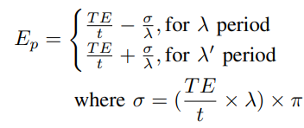
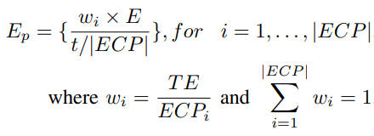
The IMCF algorithm - Amortization Plan
  Calculates the energy budget constraint → subject to a monthly residence Energy Consumption Profile
  Linear Amortization Formula (LAF)
  Balloon Linear Amortization Formula (BLAF)
  ECP-based Amortization Formula (EAF)

Slide 36
The IMCF algorithm - Energy Plan
  An energy plan solution is a vector s =< s₁, . . . , s_{N} >
  A vector component s_{i} represents a meta-rule in MRT
    s_{i} = 0 → ignoring meta-rule at position i
    s_{i} = 1 → adopting meta-rule at position i
  At the beginning of the local search heuristic an initial solution is developed
    specifies the initial state of the algorithm randomly/deterministically
  Optimization: a hill-climbing local search heuristic is utilized for local optimization with neighborhoods (k-opt).
  Each solution is evaluated using the performance metrics Energy Consumption (F_{E}) and Convenience Error (F_{CE}).
  A solution is considered better and replaces the current best solution
    if (F_{E}(solution) ≤ E_{p}) && (F_{CE}(solution) < F_{CE}(solution ∗ )).
    The energy planner stops when maximum iterations are completed.
    Alternatively, the algorithm can iterate until ∉ solution| F_{CE}(solution) < F_{CE}(solution ∗ ).

Slide 37
The IMCF algorithm
  The IMCF algorithm is composed of two subroutines:
  the Amortization Plan (AP):
    Calculates the maximum energy budget constraint through a preselected amortization formula.
  the Energy Plan (EP):
    Executed every few seconds over a time period for generating an energy plan solution for optimizing Convenience Error and satisfying Energy Consumption.
  A hill-climbing algorithm has been adopted → iterative local search heuristic
  Doesn’t require a learning history
  Doesn’t require a target function
  Straightforward to be implemented in a resource-constraint setting

Slide 38
IMCF: The IoT Meta-Control Firewall for Smart Buildings
Energy Planner (EP):
AI-inspired algorithm → finds the best possible energy consumption strategy
Considers user convenience by using:
  Meta-Rule-Table (MRT) profile
  Energy Consumption Profile (ECP)

Slide 39
Our Approach
The IoT Meta-Control Firewall (IMCF):
  internally deploys an AI-inspired Energy-Planner algorithm
  exploits domain-specific operators
  balances the trade-off between convenience and
  energy consumption in satisfying the RAW pipelines of users.

Slide 40
The IMCF algorithm - Amortization Plan
  Calculates the energy budget constraint → subject to a monthly residence Energy Consumption Profile
  Linear Amortization Formula (LAF)
  Balloon Linear Amortization Formula (BLAF)
  ECP-based Amortization Formula (EAF)

Slide 41
Prototype System
The IoT Meta-Control Firewall (IMCF) system:
Open Home Automation Bus (OpenHAB)
Linux crontab daemon
Laravel PHP web framework (model–view–controller architectural pattern)
NGINX webserver
Energy Planner → implemented as a JAVA library
MariaDB - relational database management system
Anyplace - Navigation Service

Slide 42
Future Work
Multiple energy planners with conflicting interests
IMCF-Cloud extensions that will enable IMCF to operate as a CMC controller in the cloud
CO₂ reductions methods with algorithms geared towards the environment
Power workload identification methods for power-hungry devices and how to reschedule those workloads in a environmental friendly manner

Slide 43
Related Work
IoT Data Management
Green Data Management
Smart Energy Management Systems
  Photovoltaic Home Energy Management
  Smart Thermostats
Rule Automation Workflows (RAW)
  Real-time IFTTT
  RAW Informed Search Methods

