Slide 1



Efficient Exploration of Telco Big Data with Compression and Decaying
Constantinos Costa∗, Georgios Chatzimilioudis∗, Demetrios Zeinalipour-Yazti‡∗ Mohamed F. Mokbel§
∗ University of Cyprus, Cyprus
‡ Max Planck Institute for Informatics, Germany
§ University of Minnesota, MN, USA
{costa.c, gchatzim, dzeina}@cs.ucy.ac.cy
dzeinali@mpi-inf.mpg.de, mokbel@cs.umn.edu
The 33rd IEEE International Conference on Data Engineering
San Diego, CA, USA, April 19-22, 2017

Slide 2
Motivation
The expansion of mobile networks and IoT (IP-enabled hardware) have contributed to an explosion of data inside Telecommunication Companies (Telcos)

Slide 3
Telco Big Data (TBD)
Telco Data: Traditional source for OLAP Data Warehouses and Analytics.
  e.g., Accounting, Billing, Session data.
  Problem: Inadequate data resolution to address biggest challenges:
    e.g., churn prediction, 5G network optimization, user-experience assessment, traffic mapping.
Telco Big Data (TBD): Velocity data generated at the cell towers.
  e.g., signal strength, call drops, bandwidth measurements.
  Size: 5TBs/day for 10M clients (i.e., 2PB/year).
RDBMS
Data Store

Slide 4
Industry Perspective
TBD Investments projected to grow
  50% of Telcos will invest in TBD (only 30% have done it so far)
    Source: McKinsey & Company Telecommunications “Telcos: The untapped promise of big data”, June 2016, https://goo.gl/mAHXib
The promise of unleashing the value of TBD has not been realized to this date!
  It merely focuses on some business/network cases:
Source: Key Big Data Use Cases for Telcos, Cloudera, 2015

Slide 5
Challenge
The Big data era lead us to a point where organizations collect more than they can!
  Global volume of stored data doubling every 2 years.
  Costs for data storage decline only at a rate of less than 1/5 per year. Datacenter Journal, https://goo.gl/o4MnJp
TBD is straining telco datacenters that can not benefit from economies-of-scale available on public clouds (due to confidentiality/security).
Our Approach: Introduce a complete TBD analytic stack that makes Compression and Decaying a first class citizen.

Slide 6
Presentation Outline
Introduction
Background
SPATE
  Storage Layer
  Indexing Layer
  Application Layer
Experiments
Conclusions

Slide 7
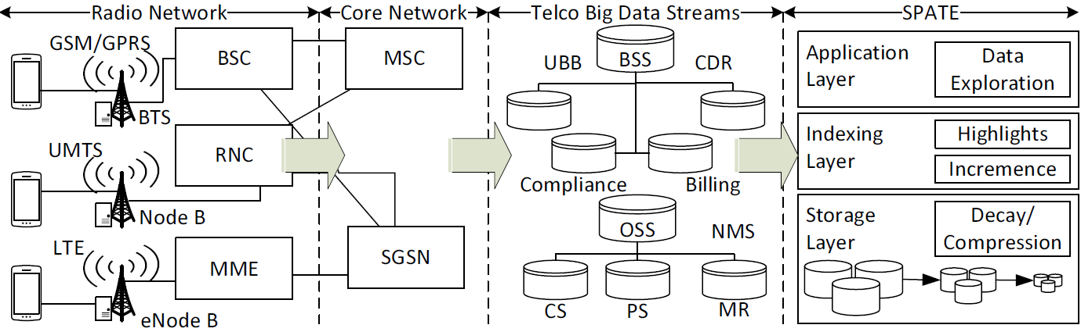
TBD Network
Radio & Core Network
  Generate Streams of IP packets from the GSM/GPRS (2G), UMTS (3G), LTE (4G) antennas.

Slide 8
TBD Streams
Call Quality
Measurement Reports (can be used to localize users with triangulation ~50 meters)
Data quality (web speed, connection success rate)
Telco Big Data (TBD)
  Business Supporting Systems (BSS) data
    Tens of GB/day for a xM+ city
  Operating Supporting Systems (OSS) data
    Tens of TB/day for a xM+ city

Slide 9
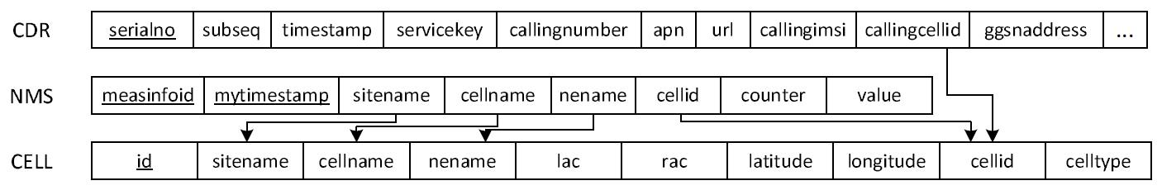
TBD Relational Diagram
TBD can logically be represented by a relational diagram.
  Hundreds of Attributes (e.g., 200) & Millions of Rows
  Foreign Keys enable join operations to yield answers to more complex queries
  Location of users is not in TBD (but can be triangulated from MR data ~ approx. 50m accuracy)
  Proprietary data formats make it difficult to expand the TBD schema (e.g., radio-propagation models)

Slide 10
Presentation Outline
Introduction
Background
SPATE
  Storage Layer
  Indexing Layer
  Application Layer
Experiments
Conclusions

Slide 11
SPATE: Overview
SPATE has 3 layers:
  Storage layer
    compression logic
  Indexing layer
    minimizing the query response time for data exploration queries
    gradual decay the data
  Application layer
    querying module
    user interface

Slide 12
Storage Layer: Compression
Compression refers to the encoding of data using fewer bits than the original representation
Benefits:
  Shifts the resource bottlenecks from storage- and network-I/O to CPU (cycles increasing faster).
  Save enormous amounts of storage and I/O on subsequent analytic tasks!
Desiderata: Given a setting where TBD arrives periodically in batches, we want to:
  minimize the space needed to store/archive data
  minimize response time for spatiotemporal data exploration queries

Slide 13
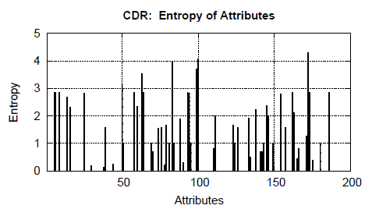
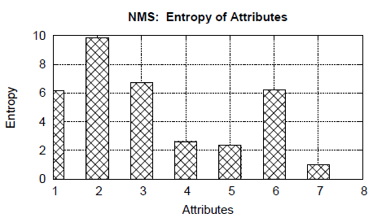
Storage Layer: Compression
We analyzed an anonymized real TBD dataset to understand what compression ratios can be achieved?
  Dataset: 1 week, 1.7M CDR, 21M NMS, 300K users
  Tool: Shannon’s entropy (typical measure for the maximum compressibility of a dataset)
  Observation: TBD contains significant redundancy (Entropy close to 0)!

Slide 14
Storage Layer: Compression
Our next aim was to empirically identify appropriate compression libraries for TBD.
Our microbenchmark is performed:
  Dataset: 200 snapshots from the 5GB anonymized and uncompressed TBD dataset presented earlier.
  Filesystem: On top of an HDFS v2.5.2
Three important metrics in compression:
  compression ratio r_{c}
  compression time T_{c1}
  decompression time T_{c2}

Slide 15
Storage Layer: Compression
Lossless compression libraries:
  GZIP based on DEFLATE algorithm (Lempel-Ziv and Huffman) – r_{c}, T_{c1,} T_{c2 ,} compat. ☺
  7z is compression tool based on the LZMA and LZMA2 – r_{c}, T_{c1,} T_{c2 ,} compat. ☹
  SNAPPY, by Google, aims for maximum compression speed – r_{c}, T_{c1,} T_{c2 ,} compat. ☹
  ZSTD, by Facebook, uses new generation entropy coders HUFF0 (Huffman) and FSE (Fine State Entropy) – r_{c}, T_{c1,} T_{c2 ,} compat. ☹

Slide 16
Storage Layer: Compression
Libraries\ Objectives | GZIP | 7z | SNAPPY | ZSTD
Compression Ratio (r_{c}) | 9.06 | 11.75 | 4.94 | 9.72
Compression Time (T_{c1}) in sec | 21.37 | 20.99 | 21.39 | 21.07
Decompr. Time (T_{c2}) in sec | 0.11 | 0.12 | 0.13 | 0.11
* GZIP also readily available by most Stream I/O libraries & application layer (e.g., HIVE, HUE)

Slide 17
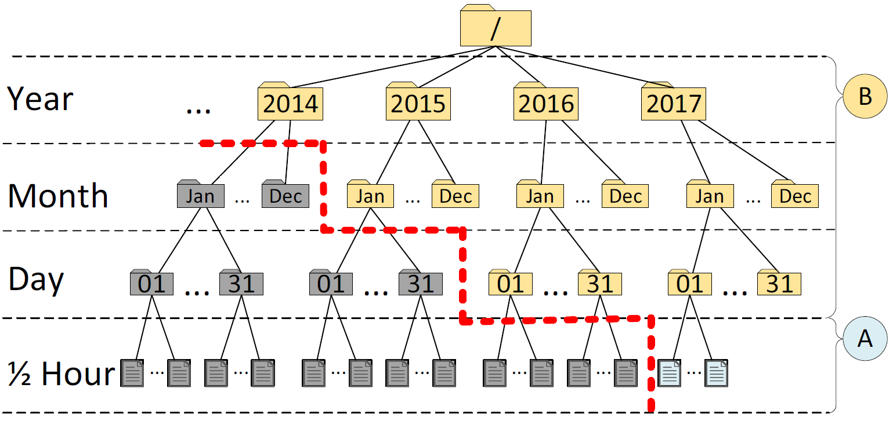
Indexing Layer: Modules
Our spatio-temporal index has 4 levels of temporal resolutions
  epoch (30 minutes), day, month, year.
A) Incremence Module
  Add compressed snapshots on the right-most path

Slide 18
Indexing Layer: Modules
B) Highlights Module
  materialized views to long-standing queries of users (e.g., the drop-call counters, bandwidth statistics, etc.)
  essential for multi-granular visual analytics!

Slide 19
Indexing Layer: Decaying
Decaying refers to the “progressive loss of detail in information as data ages with time until it has completely disappeared.”
  M. L. Kersten, “Big data space fungus,” in CIDR’15
Benefits:
  Retain aggregate data exploration capabilities.
  Save enormous amounts of storage and I/O.
Alternative definition referring to DB Schema Decay also exists, but is not applicable here.
  M. Stonebraker, R. Castro, F. Dong Deng, and M. Brodie, “Database decay and what to do about it.” 2016. [Online]. BLOG@CACM: https://goo.gl/tJNa9m.

Slide 20
Indexing Layer: Modules
C) Decaying Module
  Data Fungus: “Evict Oldest Individuals”
  More Data Fungus to be investigated in the future

Slide 21
Application Layer: SPATE-UI
The SPATE UI over the San Diego area with data from https://www.cellmapper.net/map
Demo!
Full Demo Available! – Be there!
Session 3: Apps, Data Visualization, Text Analytics,
Data Integration 1:30PM-3:00PM, Thursday, April 20, Riviera!

Slide 22
Presentation Outline
Introduction
Background
SPATE
  Storage Layer
  Indexing Layer
  Application Layer
Experiments
Conclusions

Slide 23
Experimental Methodology
To evaluate SPATE, we have implemented a trace-driven experimental testbed:
Compared Frameworks:
  RAW: stores the snapshot on disk without compression or indexing
  SHAHED: stores the snapshot using a quad-tree index (part of the offlline analytic SpatialHadoop 2.4 framework @ ICDE’15) .
  SPATE: the proposed framework in this work.
Metrics:
  Ingestion Time (sec): time cost to store a 30-min TBD snapshot
  Space (MB): space cost to store a 30-min TBD snapshot
  Response Time (sec): time to answer a query.

Slide 24
Experimental Testbed
TBD Operating System Stack
  Datacenter: VMWare ESXi 5.0.0 Hosts
  VMs: 4 Ubuntu 14.04 server images, each featuring: 8GB of RAM with 2 virtual CPUs (2.40GHz)
  Storage Element: Slow 7.2K RPM RAID-5 SAS, 6 Gbps disks. Each disk formatted in VMFS 5.54 (1MB block)
TBD Framework Stack
  Hadoop Distributed File System (HDFS) v2.5.2
  Apache Hive 2.0 (online querying)
  Apache Spark 1.6.0 (offline data processing)
    Individual Scala programs submitted directly to the Spark computation master
SPARK Jobs
Apache HIVE Warehouse
Apache HDFS
Filesystem

Slide 25
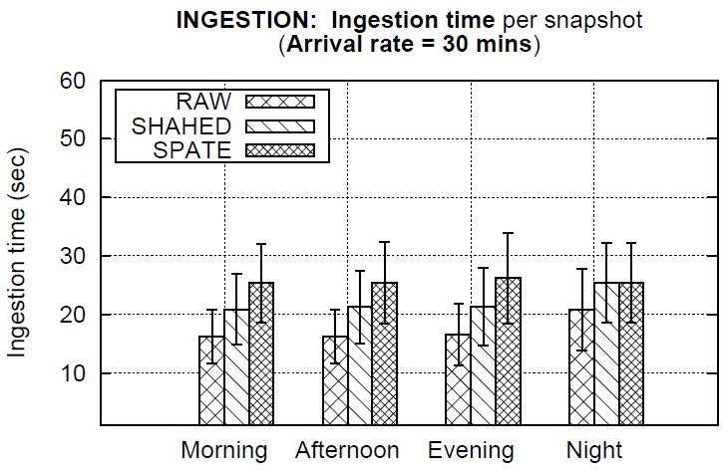
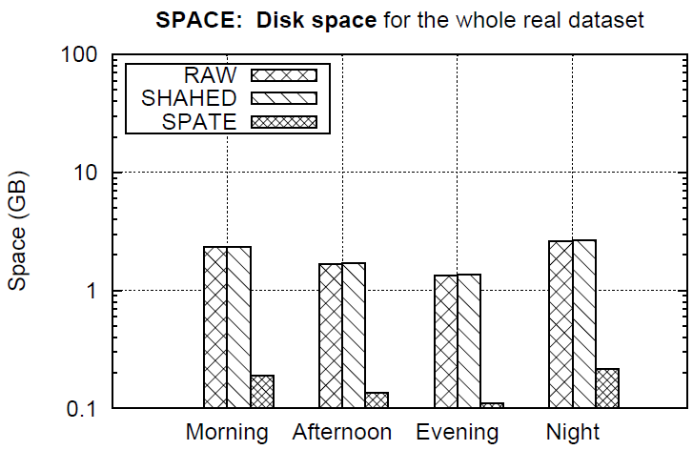
Ingestion Time and Space
Ingestion time (left) and Space (right) of methods over different time windows within a day.
Observation: SPATE 1.25x slower in ingestion but needs 1 order of magnitude less storage space!
  Ingestions are separated by 30 minute windows, so this is acceptable.

Slide 26
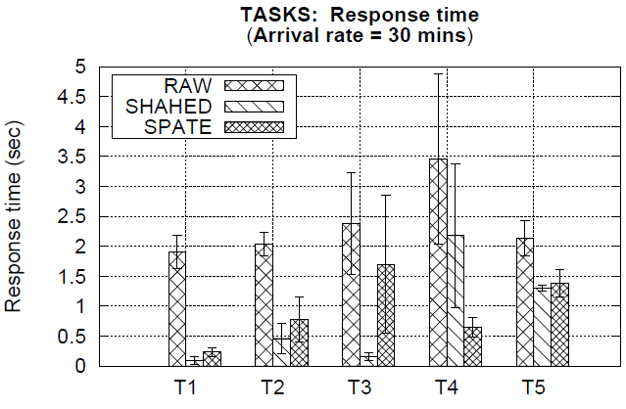
(Basic) Data Exploration Tasks
T1. Equality
SELECT upfx,downfx FROM CDR WHERE ts=‘‘201601221530’’;
T2. Range
SELECT upfx, downfx FROM CDR WHERE ts>=‘‘2015’’ AND ts<=‘‘2016’’;
T3. Aggregate
SELECT cellid, SUM(val) FROM NMS WHERE …GROUP BY cellid;
T4. Join
Self-join on CDR table
T5. Privacy
K-anonymity obfuscation using the ARX Java library
Observations:
For single scan queries T1-T3 & T5 SPATE only slightly slower than SHAHED (due to decompression)
For nested-loop T4, SPATE faster as input streams are compressed

Slide 27
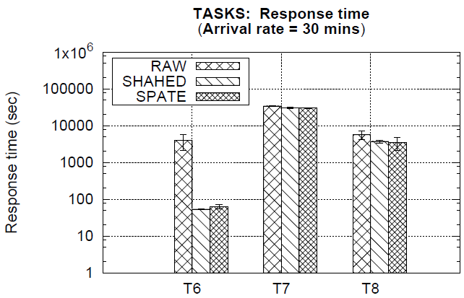
Data Exploration Tasks
Observation:
CPU intensive tasks: SPATE = RAW = SHAHED even though we use 1 order of magnitude less disk space!
Multivariate Statistics
(SparkML)
Kmeans clustering
(SparkML)
Linear Regression
(SparkML)

Slide 28
Conclusions
Conclusions:
  SPATE allows using 1 order of magnitude less space
  SPATE retains the query response time for a variety of data exploration queries
Future Work:
  Smart city applications with SPATE:
    automated car traffic mapping system
    emergency recovery system after natural disasters

Slide 29
Efficient Exploration of Telco Big Data with Compression and Decaying
Thanks! Questions?
Constantinos Costa∗, Georgios Chatzimilioudis∗, Demetrios Zeinalipour-Yazti‡∗ Mohamed F. Mokbel§
∗ University of Cyprus, Cyprus
‡ Max Planck Institute for Informatics, Germany
§ University of Minnesota, MN, USA
{costa.c, gchatzim, dzeina}@cs.ucy.ac.cy
dzeinali@mpi-inf.mpg.de, mokbel@cs.umn.edu
The 33rd IEEE International Conference on Data Engineering
Mission Bay, San Diego, CA, USA, April 19-22, 2017

Slide 30
Related Work
Telco Big Data Research
  Real-time Analytics and Detection
    OceanRT: Real time telco big data analytic system (Zhang et al. SIGMOD’14)
    OceanST: Loading mechanism and spatiotemporal index (Yuan et al. VLDB’14, vol. 7)
    CellIQ: Cellular network as graphs (Iyer et al. NSDI’15)
  Predicting User Behavior
    Customer churn prediction (Huang et al. SIGMOD’15)
    User activity prediction Luo et al. TIST’16, vol. 7
  Privacy
    Differential privacy Hu et al. VLDB’15, vol. 8

Slide 31
Related Work
Compressing Incremental Archives
  Domain-specific compression techniques
    Bicer et al. IPDPS’13, Yan et al. WWW ’09, Ross at al. ECPP’11, Schendel et al. ICDE’12, Jenkis et al. LNCS’13, Soroush et al. ICDE’13, Burscher et al. ITC’09
  Differential compression techniques
    Douglis et al. ATC’13
    Bhagwat at al. MASCOTS’09
    You et al. TOS’11
    Bhattacherjee et al. VLDB’15, vol. 8

