Slide 1
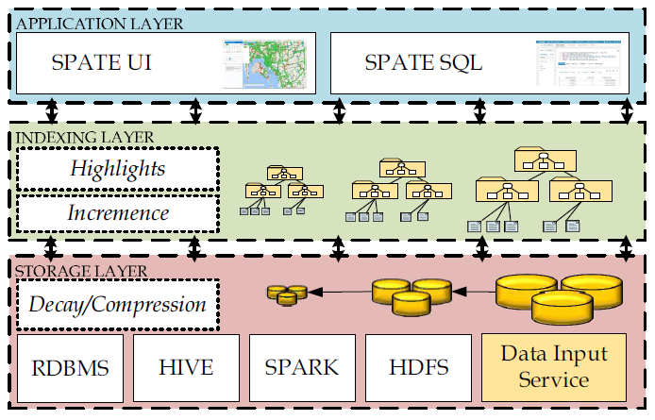
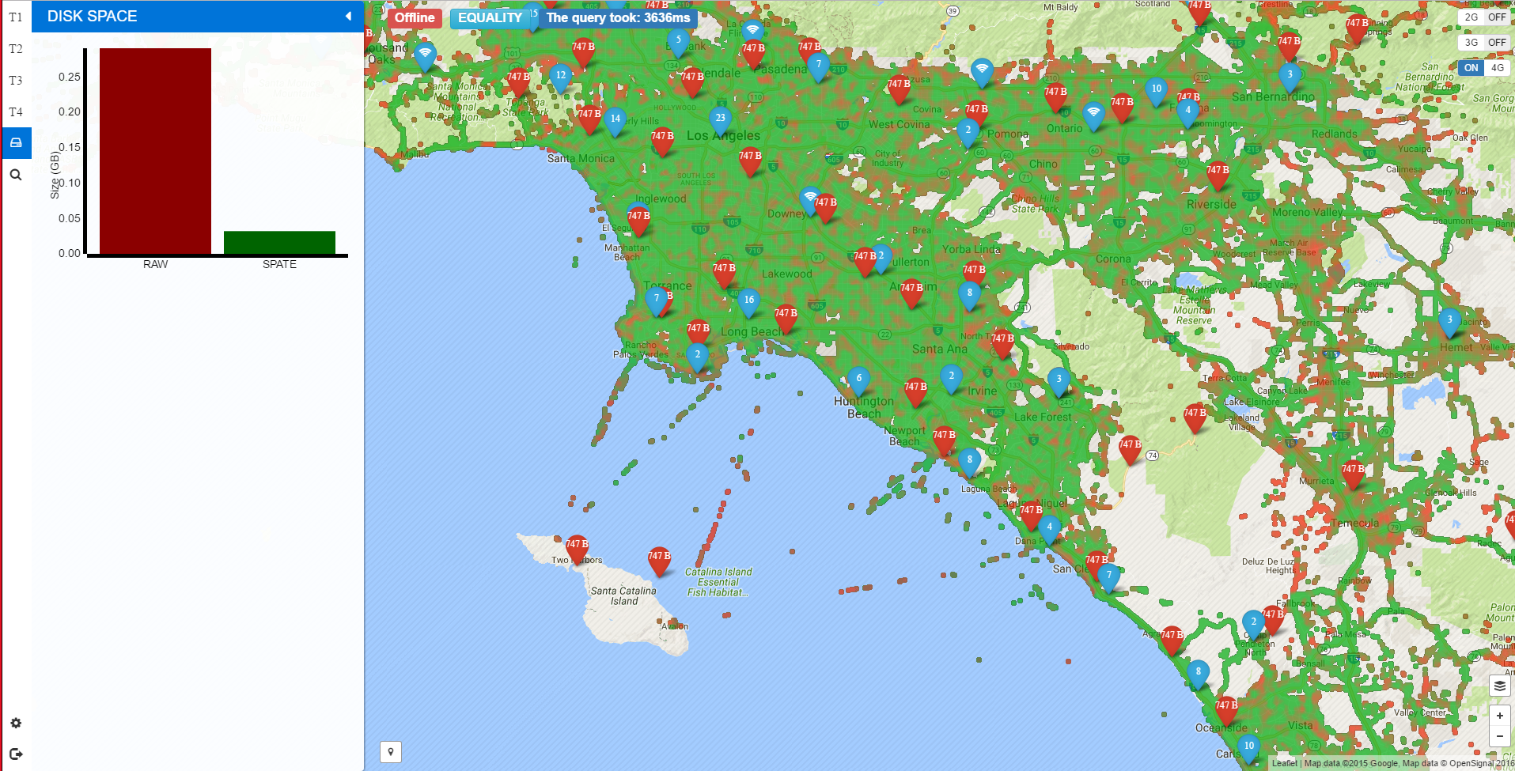
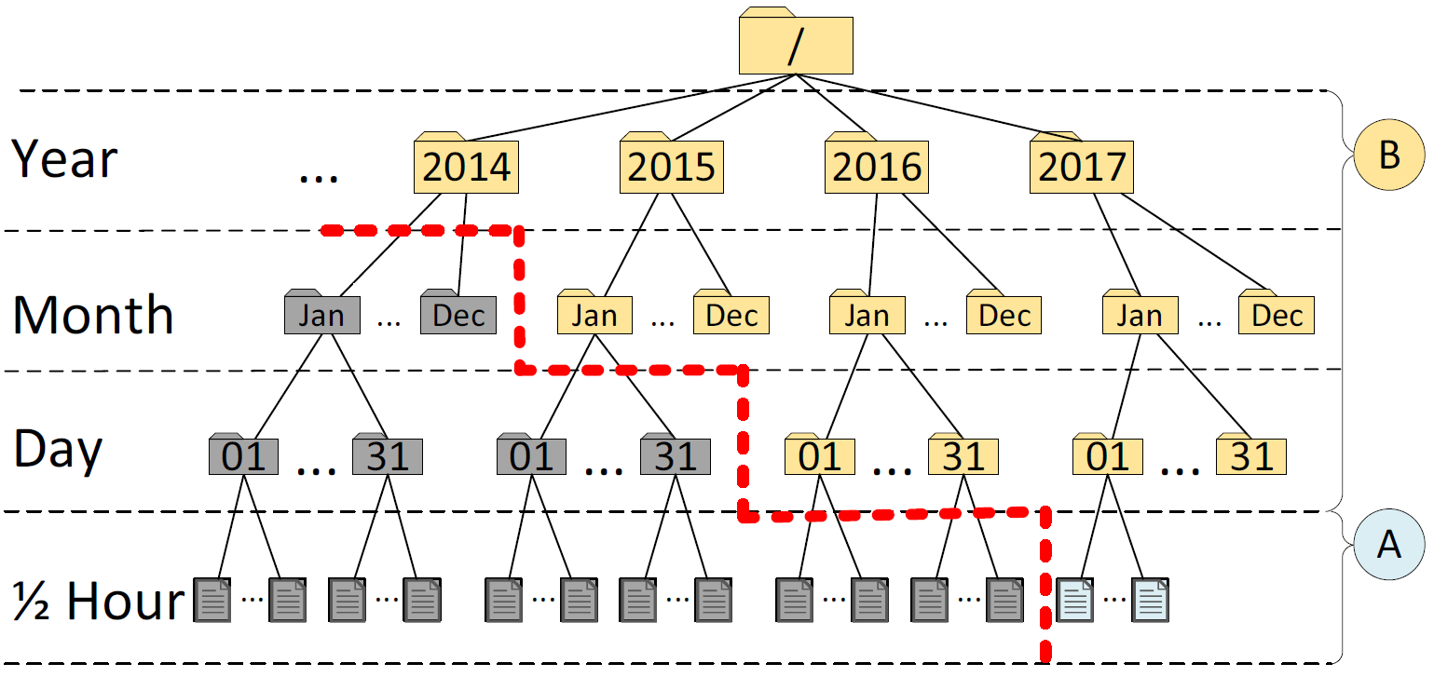
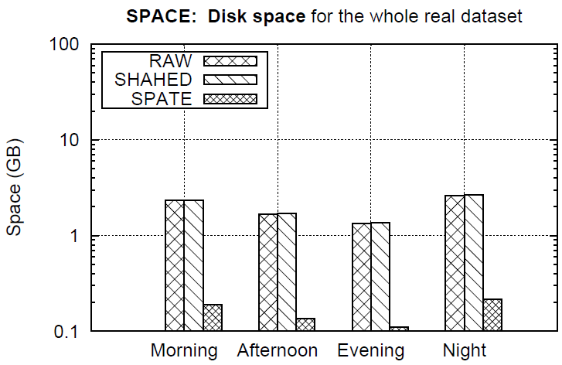
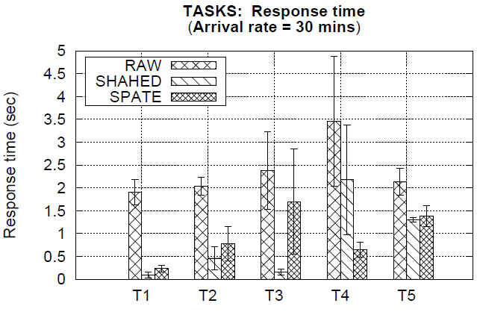
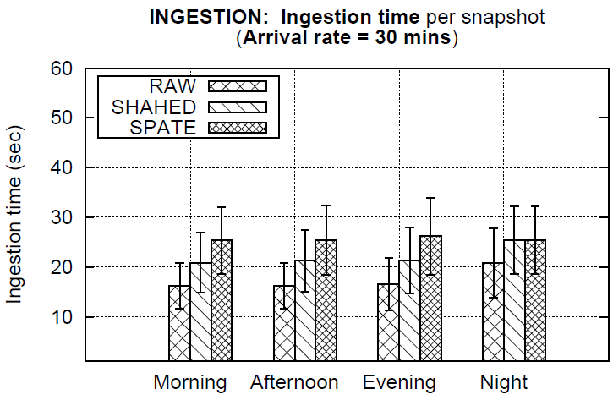
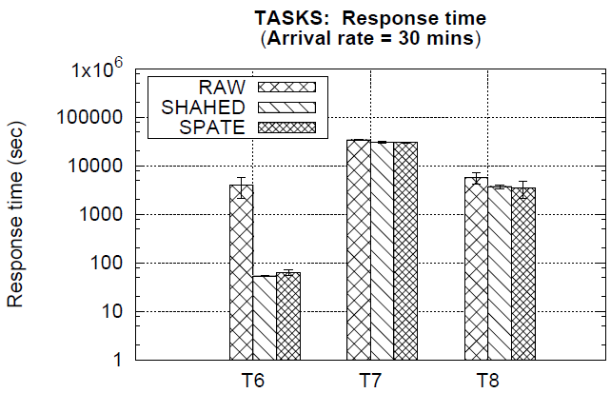
S SPATE: Compacting and Exploring Telco Big Data Constantinos Costa¹ , Georgios Chatzimilioudis¹, Demetris Zeinalipour-Yazti^{2,1}, Mohamed F. Mokbel³ University of Cyprus¹ Max Planck Institute for Informatics² University of Minnesota³
Motivation
SPATE Architecture
The expansion of mobile networks and IoT (IP-enabled hardware) have contributed to an explosion of data inside Telecommunication Companies (Telcos)
Storage layer
Compression logic
Indexing layer
Minimizing the query response time
Gradual decay of the data
Application layer
Querying module (SQL-LIKE)
User interface (Interactive Map)
Telco Data: Traditional source for OLAP Data Warehouses / Analytics. e.g., Accounting, Billing, Session data.
Problem: Not enough resolution for enabling next generation applications: e.g., churn prediction, 5G network optimization, user-experience assessment, traffic mapping.
Telco Big Data (TBD): Velocity data generated at the cell towers. e.g., signal strength, call drops, measurements.
Size: ~5TBs/day for a 10M clientele (i.e., 2PB/year).
Storage layer
Indexing layer
Application layer
We empirically assessed appropriate compression libraries for TBD.
Microbenchmark Setting:
Anonymized Real Telco Trace 5GB (1.7M CDR and 21M NMS from 300K users)
On top of an HDFS v2.5.2 filesystem
Our index has 4 levels of temporal resolutions
epoch (30 minutes), day, month, year), with
The decaying process retains predefined aggregates for:
extremely long time windows
small amounts of storage
SPATE UI: A spatio-temporal telco data exploration user interface we developed on top of Google Maps.
SPATE UI Video : https://goo.gl/BNqHFV
Libraries\ Objectives | GZIP | 7z | SNAPPY | ZSTD
Compression Ratio (r_{c}) | 9.06 | 11.75 | 4.94 | 9.72
Compress. Time (T_{c1}) in sec | 21.37 | 20.99 | 21.39 | 21.07
Decompr. Time (T_{c2}) in sec | 0.11 | 0.12 | 0.13 | 0.11
Experimental Evaluation
Conclusions
Compared Frameworks:
RAW: stores snapshots on disk w/out compression or decay
SHAHED: stores the snapshot using a ST-index [ICDE’15]
SPATE: the proposed framework in this work.
Tasks:
T1: Equality
T2: Range
T3: Aggregate
T4: Join
T5: Privacy
T6: Multivariate Statistics
T7: Clustering
T8: Linear Regression
Conclusion:
SPATE retains comparative query response time with 1 order less data!
We proposed SPATE:
SPATE allows using 1 order of magnitude less storage space.
SPATE retains the query response time for a variety of data exploration queries.
In the future:
Event detection mechanism .
Smart city applications on top of the SPATE instrument.
Reference: "Efficient Exploration of Telco Big Data with Compression and Decaying", C. Costa, G. Chatzimilioudis, D. Zeinalipour-Yazti, M. F. Mokbel, Proceedings of the 33rd IEEE International Conference on Data Engineering (ICDE'17), San Diego, CA, USA, April 19-22, 2017.
Contact: dmsl@cs.ucy.ac.cy
http://dmsl.cs.ucy.ac.cy/

