Slide 1
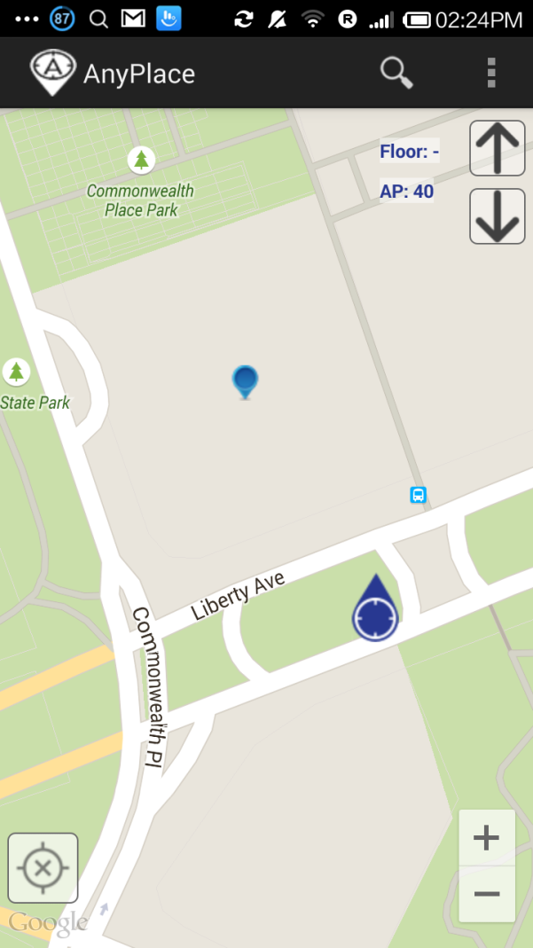
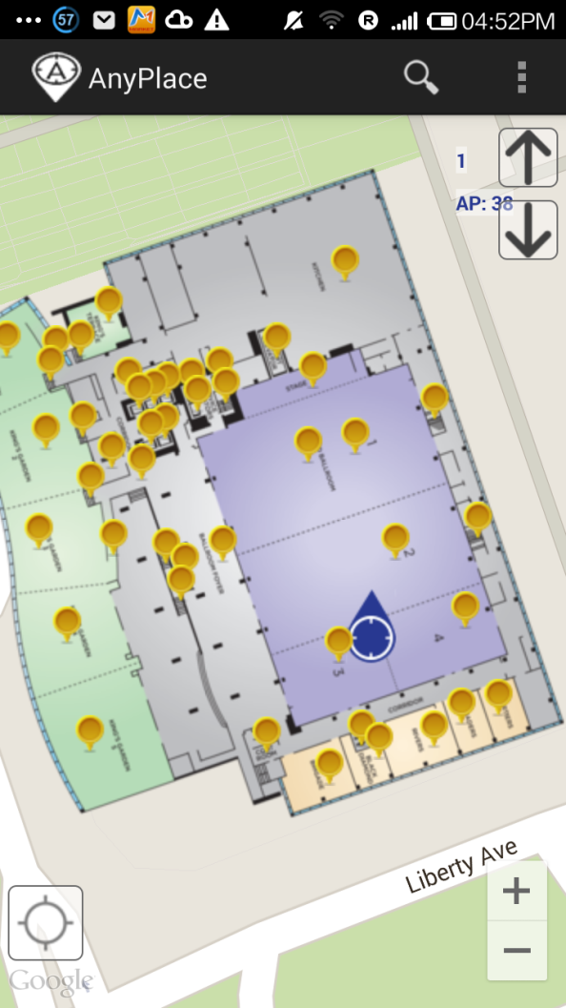
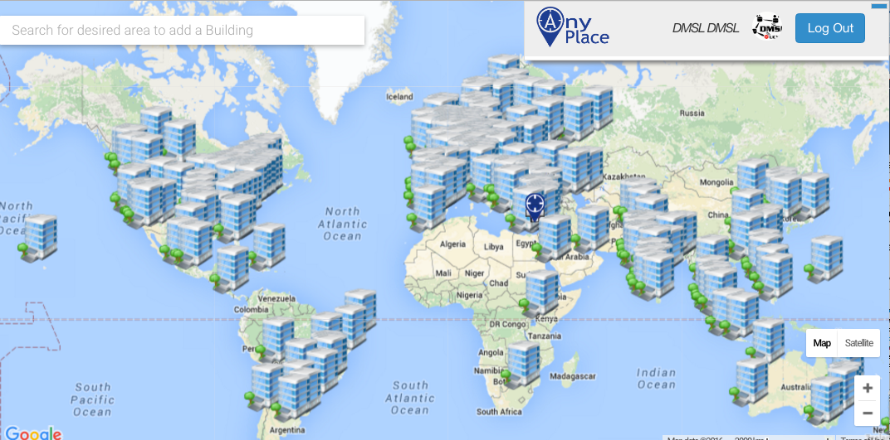
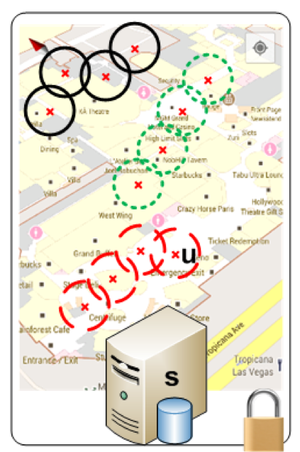
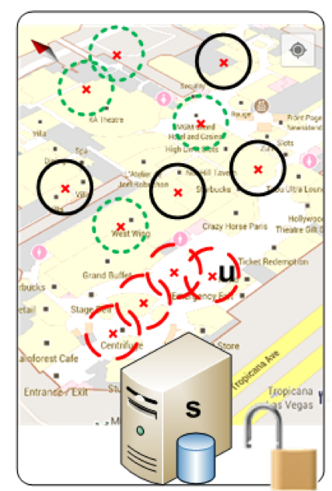
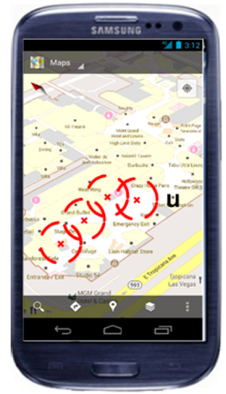
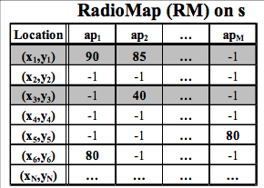
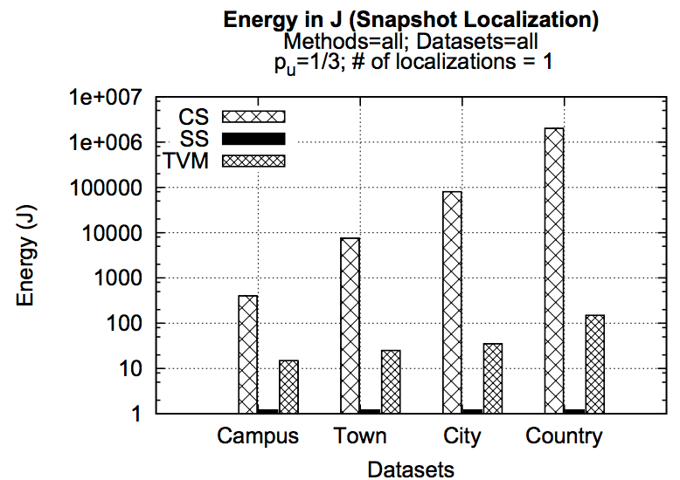
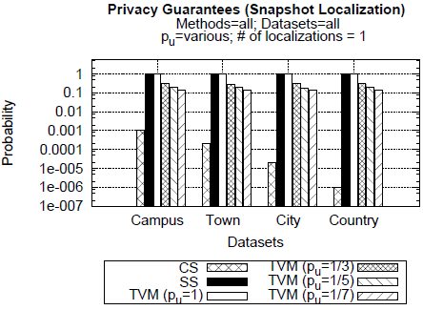
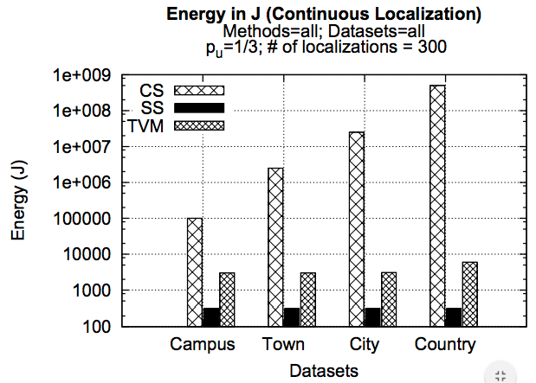
Privacy-Preserving Indoor Localization on Smartphones A. Konstantinidis¹, G. Chatzimilioudis¹, D. Zeinalipour-Yazti¹, Paschalis Mpeis², Nikos Pelekis³, Yannis Theodoridis³ University of Cyprus¹ University of Edinburgh² University of Piraeus³
Motivation
Anyplace
Most of our activities happen indoors (e.g., business, entertainment, socializing).
People spend 80-90% of their time indoors – USA Environmental Protection Agency 2011.
>85% of data and 70% of voice traffic originates from within buildings – Nokia 2012.
Growing need for effective Internet-based Indoor Navigation (IIN) services. [1]
IINs might continuously “know” (surveil, track or monitor) the location of a user while serving them. [2]
Location tracking is unethical and can even be illegal if it is carried out without the explicit consent of a user.
[1] "Internet-based Indoor Navigation Services", Demetrios Zeinalipour-Yazti, Christos Laoudias, Kyriakos Georgiou and Georgios Chatzimiloudis, IEEE Internet Computing (IC'16), IEEE Computer Society, 2016. (in press)
[2] "Privacy-Preserving Indoor Localization on Smartphones", Andreas Konstantinidis, Georgios Chatzimilioudis, Demetrios Zeinalipour-Yazti, Paschalis Mpeis, Nikos Pelekis, Yannis Theodoridis, IEEE Transactions on Knowledge and Data Engineering (TKDE'15), IEEE Computer Society, Vol. 27, Iss. 11, pp. 3042-3055, Los Alamitos, CA, USA, 2015.
Anyplace: An open-source Internet-based Indoor Navigation (IIN) Service developed at the University of Cyprus!
Achieves highest accuracy using Wi-Fi, IMU and Magnetic signals (1.96 meters), in real-time, while being energy-efficient and infrastructure-less.
[ 2st @ Microsoft Indoor Comp. @ IPSN’14, 1st at EVARILOS by TU Berlin ]
Offers advanced search and navigation to various Points-of-Interests (POIs) in buildings and campus (e.g., 60 buildings at the University of Cyprus).
Aims to become the predominant open-source Indoor Localization Service.
soon
soon
anyplace.cs.ucy.ac.cy
State-of-the-Art
Anyplace!
Privacy + IIN Localization
Temporal Vector Map
TVM Continuous
Client-Side Approach (CSA)
+ Preserves Location Privacy!
- Bad Energy and Messaging (Radiomaps are big and have to be downloaded by u)!
Server-Side Approach (SSA) => the opposite.
TVM is a complete framework guaranteeing that the IIN server (s) can NOT identify u’s location with a probability higher than a user-defined threshold (p_{u}), e.g, p_{u}=1/3
bestNeighbors is an auxiliary function that generates camouflaged localization requests for preserving privacy during navigation.
I can see these Reference Points, where am I?
1
Bloom Filter (u's APs)
...
2
(x,y)!
IIN Service
3
K=3 Positions
IIN s
IIN determnines u’s location by exclusion
User u
User u
TVM kAB Filter
Experimental Evaluation
k-Anonymity Bloom (kAB) filter is the communication structure of TVM that allows privacy in localization.
Founded on Bloom Filters, which are space-efficient probabilistic data structures for set membership queries.
allocate a vector of b bits, initially all set to 0, use h independent hash functions to hash every Access Point seen by a user to the vector.
Tradeoff between b and the probability of a false positive.
Given h optimal hash functions, b bits for the Bloom filter and the number M of elements we can calculate the amount of false positives produced by the Bloom filter:
False Positive Ratio Size of Bloom Filter
Realistic Datasets:
Campus(20 MB), Town (100 MB)
City (1GB), Country (20GB)
Metrics:
Privacy and Performance
Performance (Energy):
CS (worst, best privacy), SS (best but no privacy), TVM (good trade-off
AP1
AP1
AP2
AP2
b
TVM: Low Probability for IIN to identify the user.
CS: lowest probability but worst performance
0 | 1 | 0 | 0 | 1 | 0 | 0 | 1 | 0 | 0
Similar

