Slide 1
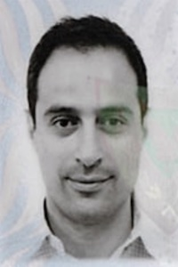






Zero Infrastructure Geolocation Of Nearby First Responders On Ro-Ro Vessels
Paschalis Mpeis∗, Jaime Bleye Vicario‡,
Demetrios Zeinalipour-Yazti∗
∗ University of Cyprus, 2109 Nicosia, Cyprus
‡ Integral Maritime Safety Centre Jovellanos, 33393 Gijón, Asturias, Spain
mpeis.paschalis@ucy.ac.cy, jaimebv@centrojovellanos.es, dzeina@cs.ucy.ac.cy
https://anyplace.cs.ucy.ac.cy/ https://lashfire.eu/
The 20th International Conference on Computer Applications in Shipbuilding (ICCAS),
Royal Institution of Naval Architects, Yokohama, Japan, September 14, 2022.

Slide 2

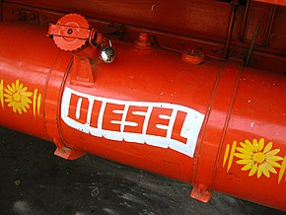
Motivation – Fires on Ro-Ro Vessels
The early suppression of fires on ro-ro vessels requires rapid fire identification
  a fire of medium growth exponentially reaches 1MW after only 5 minutes!
1 minute
50kW
3 minutes
400kW
5 minutes
1MW = 1 m2 diesel pool
7 minutes
2MW!
Exponential fire growth! – quick reaction is a must!

Slide 3
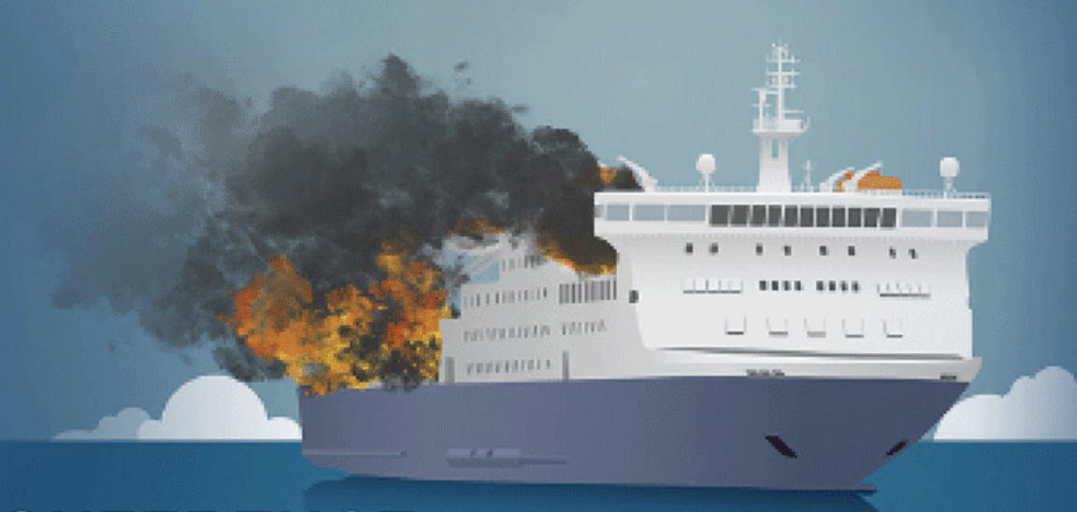

LASH FIRE
LASH FIRE is an international EU-funded research project aiming to significantly reduce the risk of fires on board ro-ro ships.
  A particular focus in the project is the development and validation of smart technical solutions for quick first response and effective fighting of fires in their initial stage.
  As part of this objective, we developed a “zero” infrastructure localization method for smartphones of first responders.
This project has received funding from the European Union’s Horizon 2020 research and innovation programme under grant agreement No 814975

Slide 4
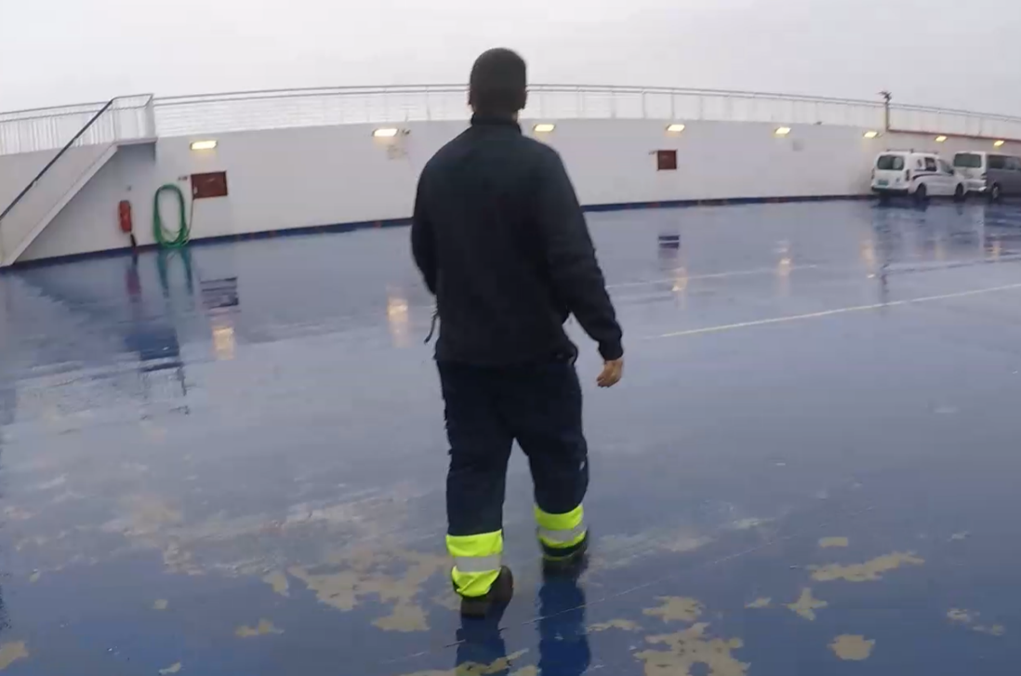
First Responder
Fire patrol members (able seamen) are asked to act as first responders in early stages of fires (or confirmation stage).
  Coordinate with the bridge and other crew
  Put out an early fire using a handheld fire extinguisher
First Responder

Slide 5
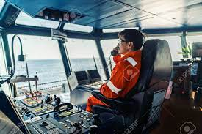
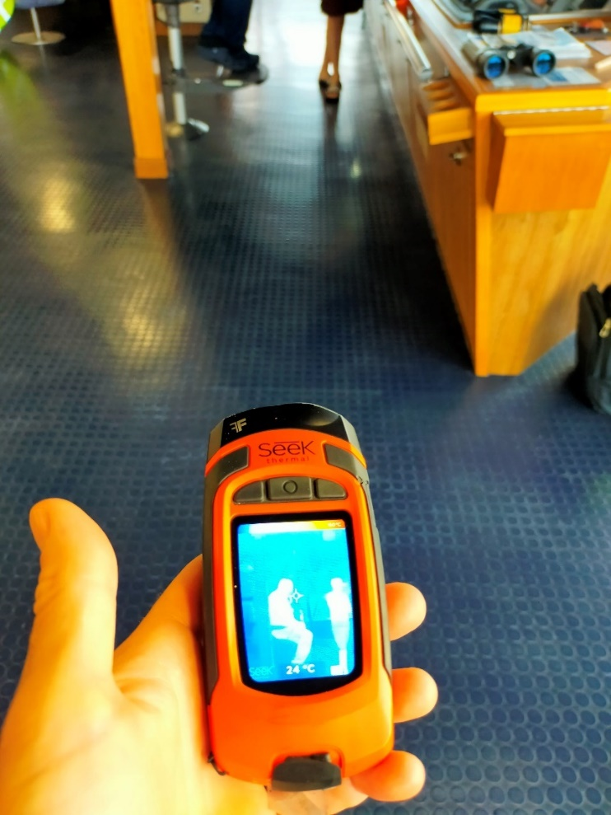
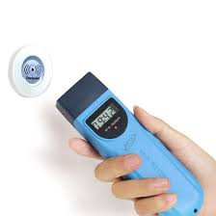
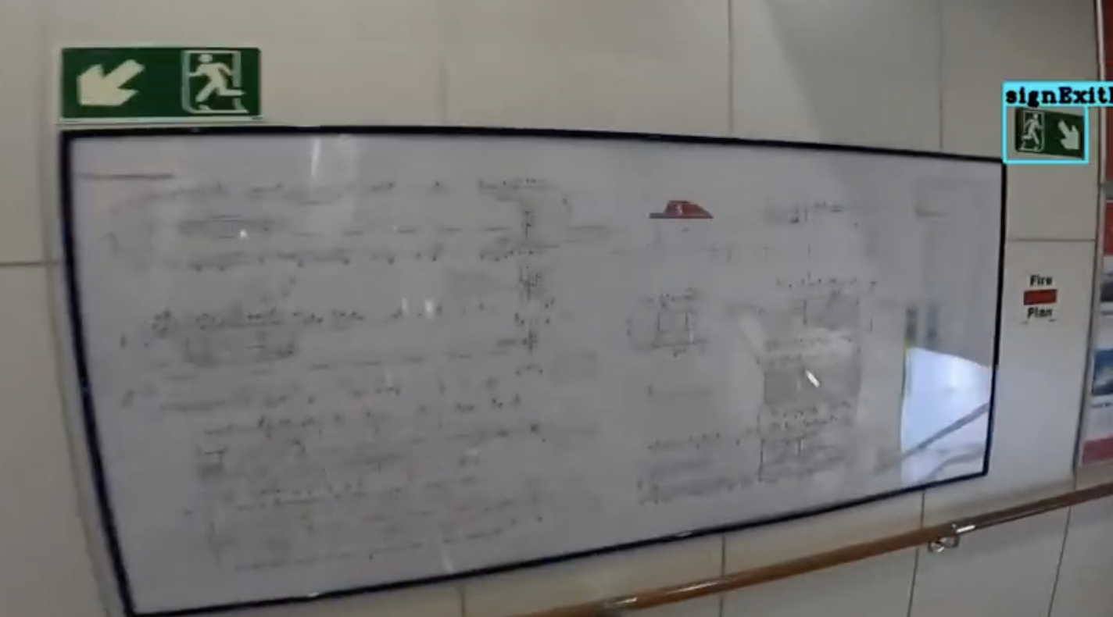
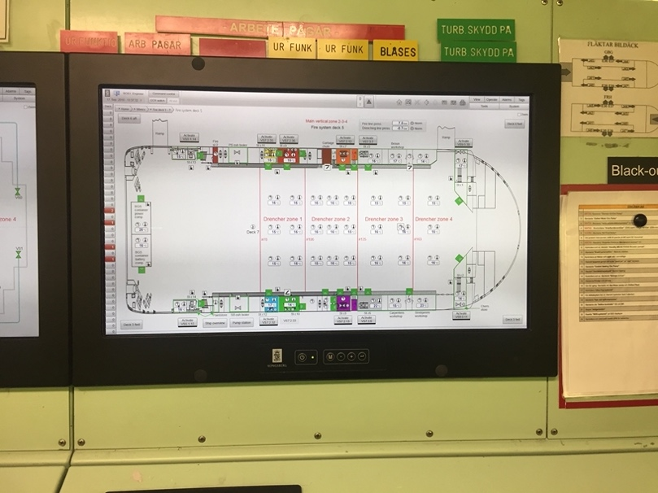
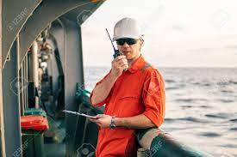
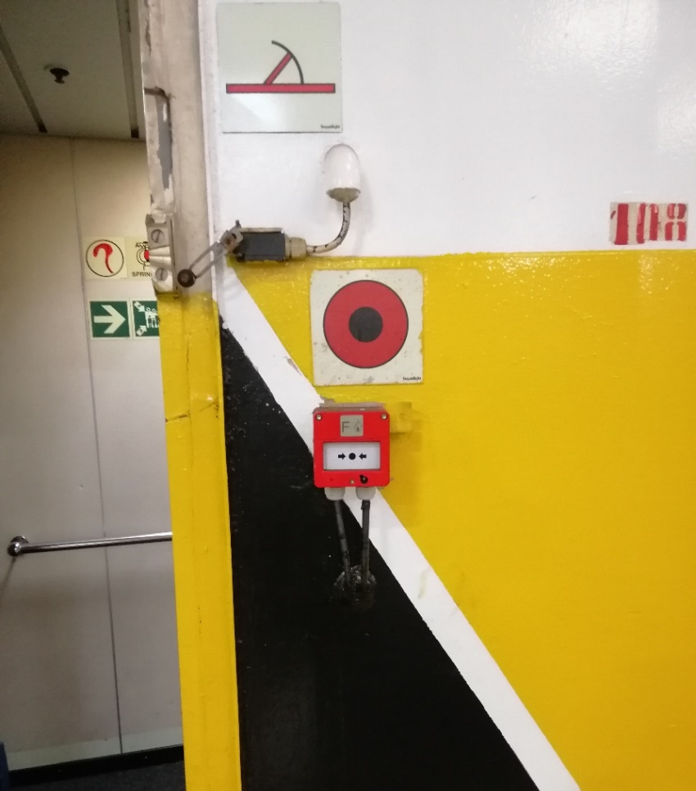
Current Technology State
Limited control and slow coordination in first minutes of incident.
Different technologies and interoperability issues.
Technology already on vessels
Check Point Readers
VHF/UHF Communication
Heat Scanning
Fire Safety Plan
Temp Status at Bridge and Drencher Knobs
Our aim is to make first respond more “integrated”, “quicker” and ”smarter”
Additional Gear and
Equipment
VHF/UHF Communication
Push Alarm Button
- Problem? Indoor Location !

Slide 6
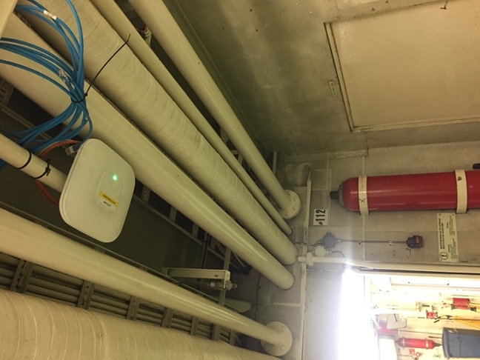
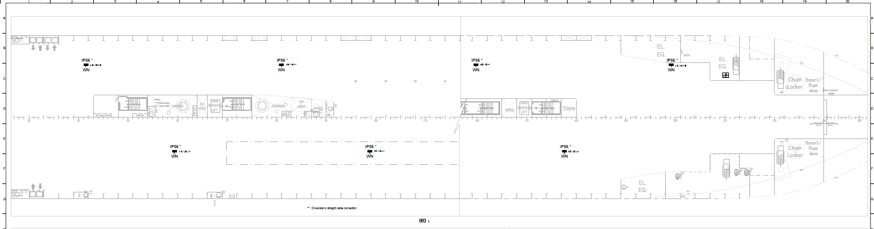
Location: Challenges on Vessels
Research Challenge: Dense Wi-Fi / 5G antennas, necessary for accurate indoor localization, not widely available on ro-pax vessels.
  Good for network connectivity, not for localization
Solution: Develop a “zero” infrastructure localization technology exploiting the static assets of a vessel.
  Reference points: floor patterns, wall patterns, hoses, drenches, signs, control buttons, OCR text on walls.

Slide 7
Outline
Introduction
Background & Related Work
Surface Algorithm
Experimental Evaluation
Conclusions and Future Work

Slide 8
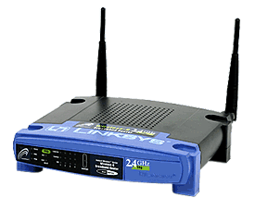
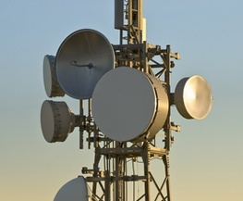
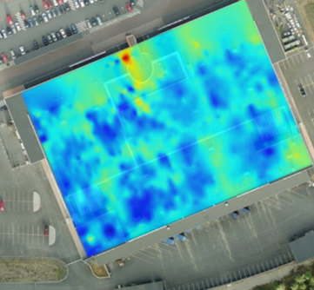
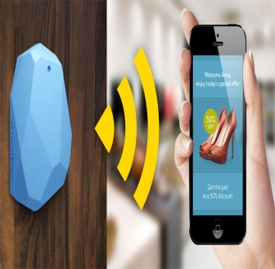

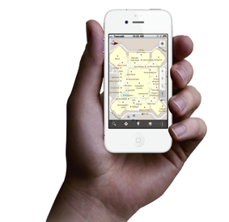
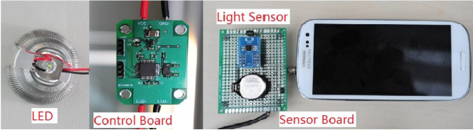
Indoor Localization
Smart Devices are becoming enablers for modern Internet-based Indoor Navigation (IIN) services founded on their measurements.
Technologies:
  Existing Infrastructure
  Wi-Fi APs, Cellular Towers
  New Infrastructure
  Beacons (BLE Beacons, RFID Active & Passive Beacons)
  Sound (Microphone), Light (Light Sensor)
  Stationary antennas, UWB, SLAM/LIDAR
  Zero Infrastructure
  IMU Data (Gyro, Acceler., Digital Comp)
  Magnetic Field Sensors
"Internet-Based Indoor Navigation Services", Demetrios Zeinalipour-Yazti, Christos Laoudias, Kyriakos Georgiou, Georgios Chatzimilioudis, IEEE Internet Computing (IC'17), vol. 21, no. 4, pp. 54-63, July 2017, doi:10.1109/MIC.2017.2911420, IEEE Computer Society, 2017.

Slide 9
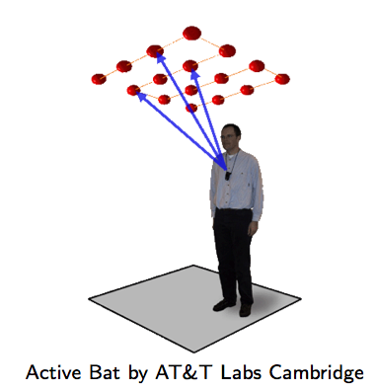
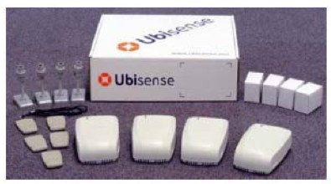
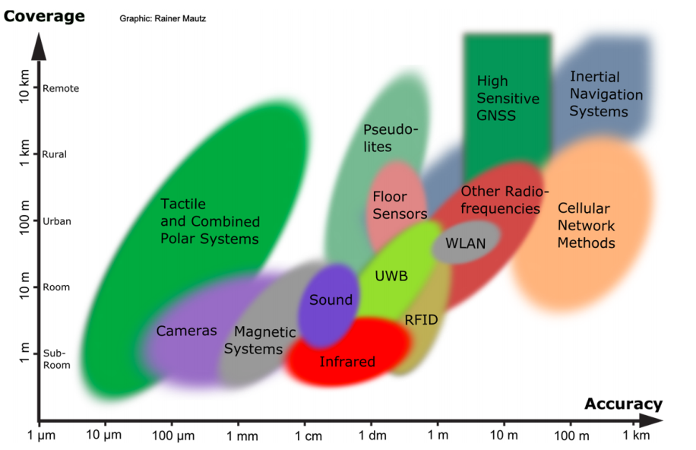
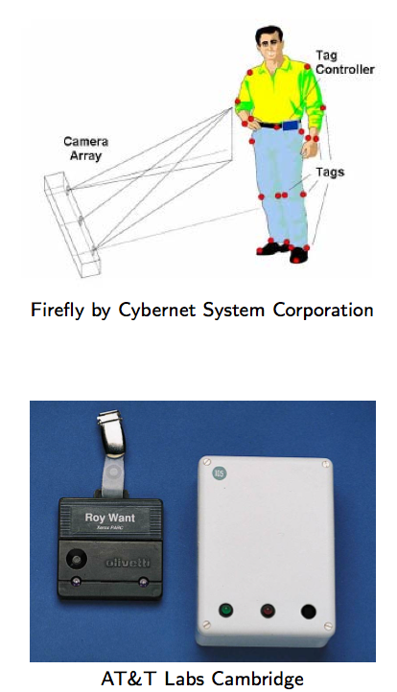
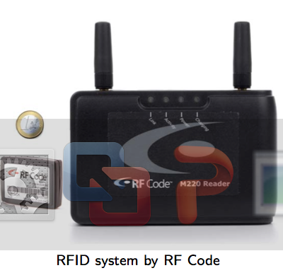
Indoor Localization
Ultrasound:
^{Ultra Wide Band (UWB)}
AOA, TOA, TDOA, signal reflection
: Spatial extension where system performance must be guaranteed
Our Focus: Room Level Accuracy
+ Infrastructure Free
^{Infrared (IR)}
^{TOA, TDOA}
Radio Frequency IDentification (RFID)
| Outdoor |
| Indoor |
^{Rainer Mautz, ETH Zurich, 2011}
Cell of Origin, Signal Strength
^{Firefly delivers 3mm accuracy}

Slide 10
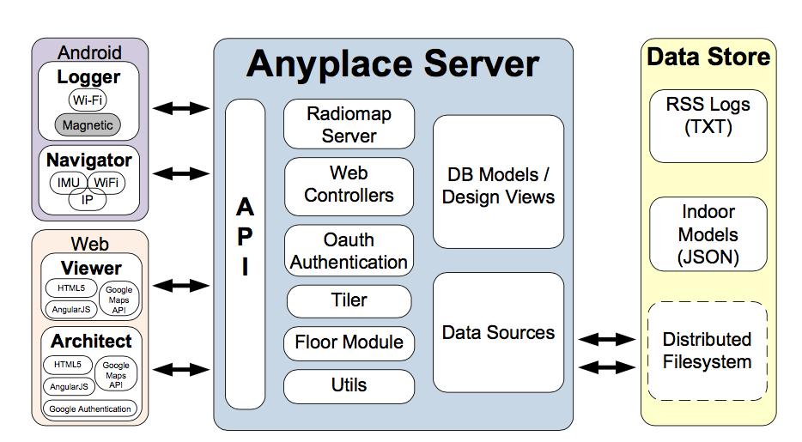
Anyplace
Localization
A complete open-source Internet-based Indoor Navigation (IIN) Service
predominant IoT open-source Indoor Localization Service - MIT License.
Modular Architecture: Web, Android, Windows, iOS, JSON API.
Multiple awards for accuracy & utility.
Supports only Wi-Fi + IMU localization on Android ☹
  “The Anatomy of the Anyplace Indoor Navigation Service”, Demetrios Zeinalipour-Yazti and Christos Laoudias, ACM SIGSPATIAL Special, Special Issue on Indoor Spatial Awareness II, Editor: Chi-Yin Chow, Vol. 9, No. 2, pp. 3-10, July 2017.

Slide 11
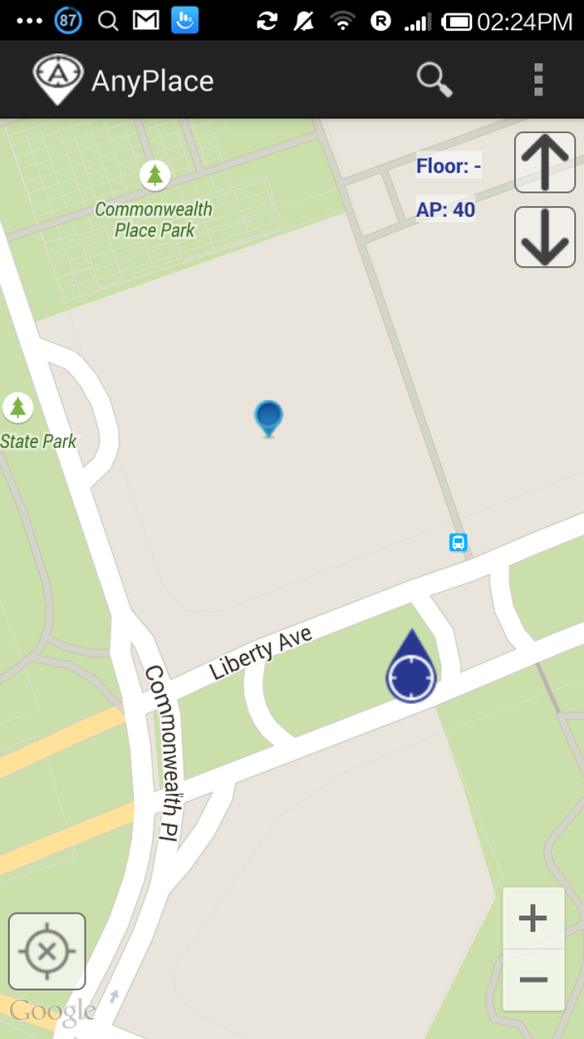
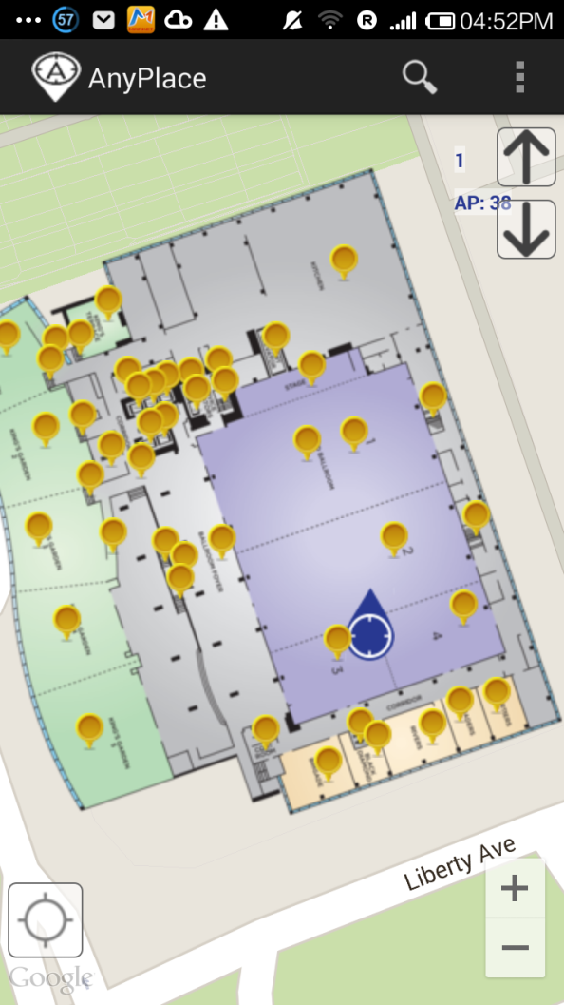
Anyplace: Before & After
Before ☹
(using Google API Location)
After ☺
(using Anyplace Location & Indoor Models)

Slide 12
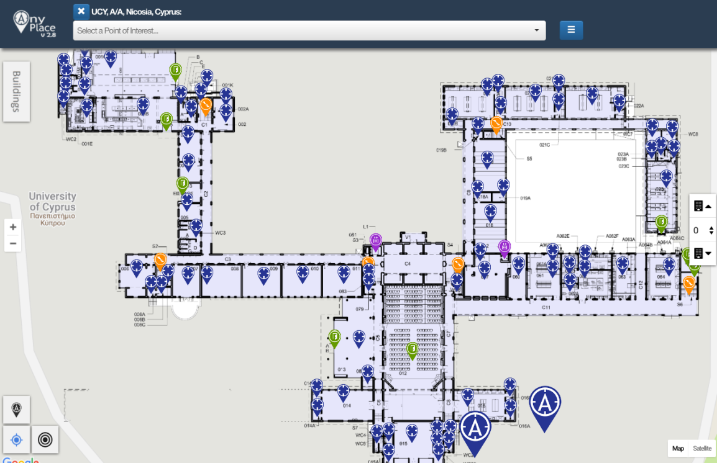
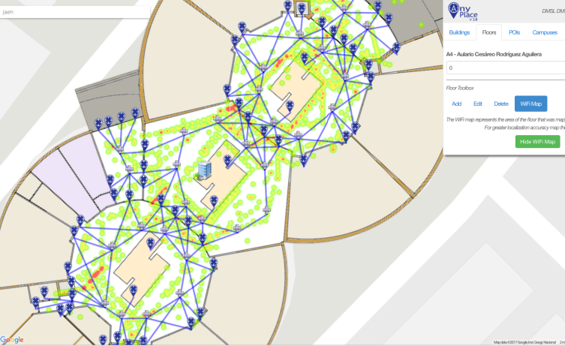
Anyplace (Building) Showcases
Campus @ Univ. of Cyprus
  60 Buildings mapped, Thousands of POIs
Campus @ Univ. of Jaen (Spain) - 9 buildings
Library @ Univ. of Mannheim (Germany) - Westflügel
Example:
Video:
https://goo.gl/4Z43Cv
https://youtu.be/8m-C2fx8prM?t=66
Video:
https://youtu.be/uMFnxXnm1yc?t=17

Slide 13
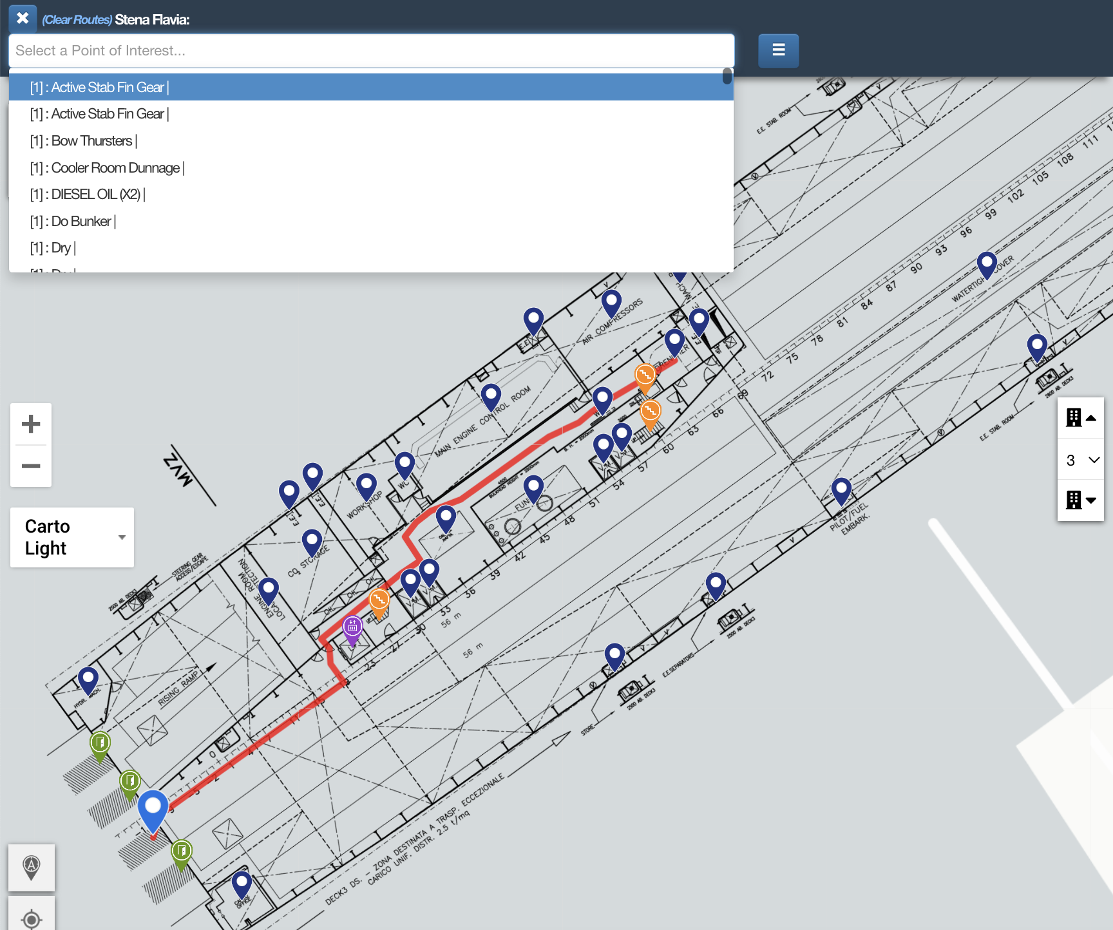
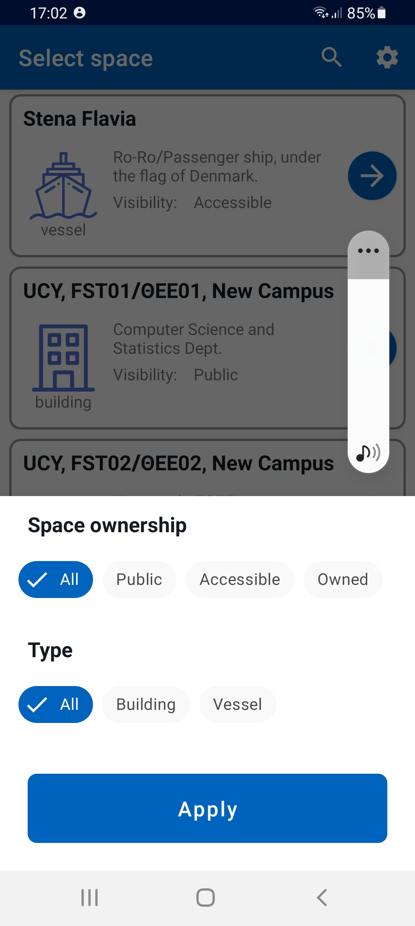
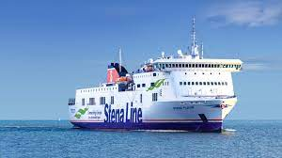
Anyplace (Vessel) Showcases
https://anyplace.cs.ucy.ac.cy/viewer/?cuid=lashfire

Slide 14
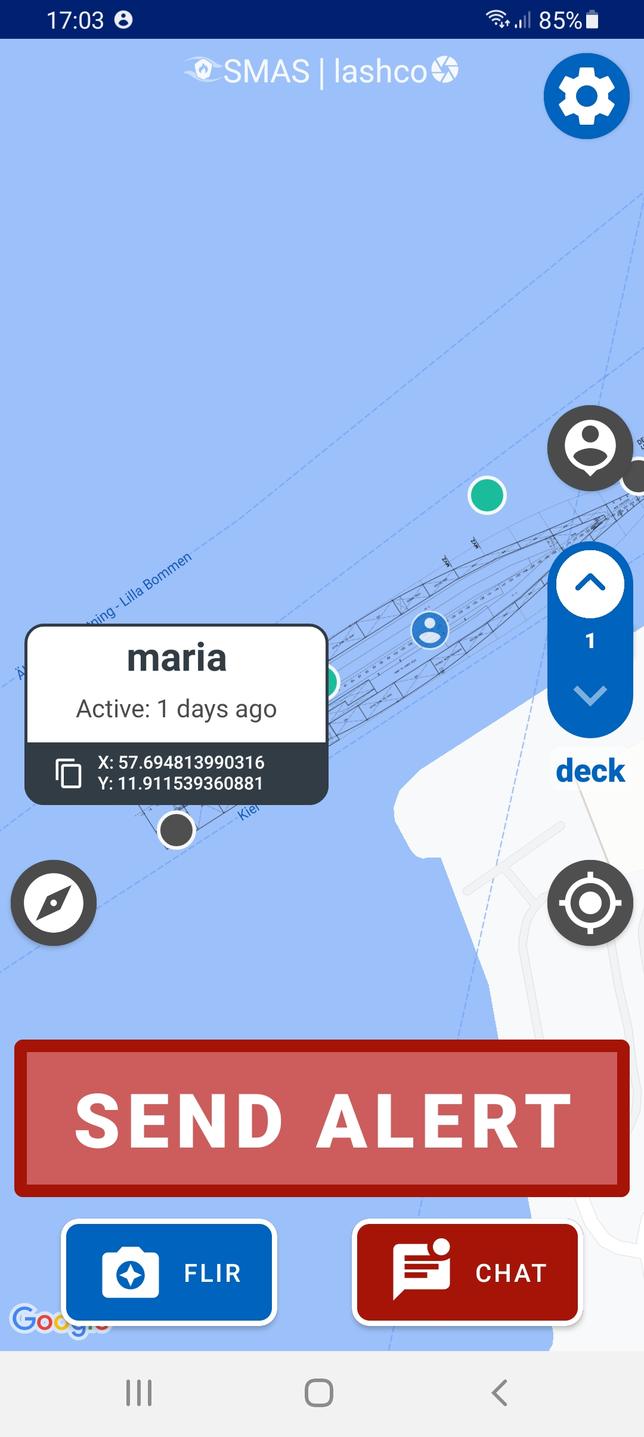
Smart Alert System (SMAS)
A mobile app for First Responders implementing “Zero Infrastructure” + Offline localization system.
  ➔ requires no localization infrastructure
  ➔ requires no network
  requires no video transfer
  ➔ only on-device computation
If network is available, then also supports chat and alert.
  Edge server on-premise (vessel)

Slide 15
Zero Infrastructure Localization in SMAS
ML Training: vessel owners provide video footage that we annotate and process on deep learning server – called training
  Once per vessel (family)
Logging: technology providers or vessel owners walk around collecting objects using mobile app – called fingerprinting
  Once per vessel
Localization: users use a mission-critical app to localize, geo-chat, geo-share data

Slide 16
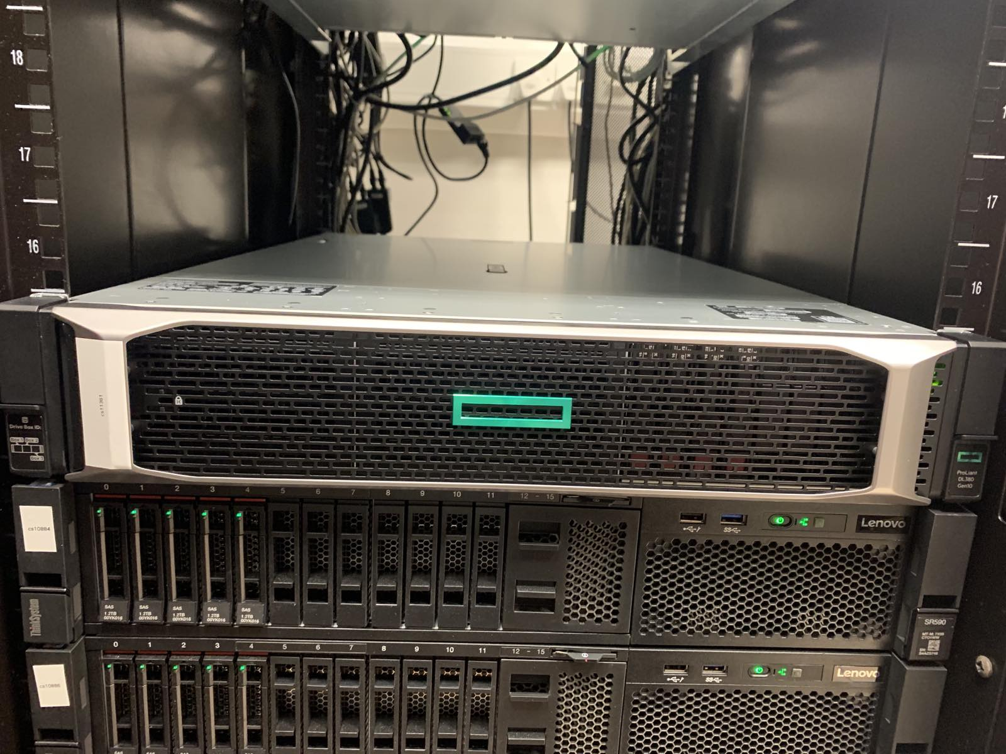
ML Training
Purpose: Train a Machine Learning model to recognize objects using Computer Vision and Deep Learning.
Computer Vision Annotation Tool (CVAT)
  a free, open source, web-based image and video annotation tool by Intel
  HP DL380 Gen10 with 80 logical processors and a powerful NVIDIA V100 card.
  Initial training on Google’s Colab.

Slide 17
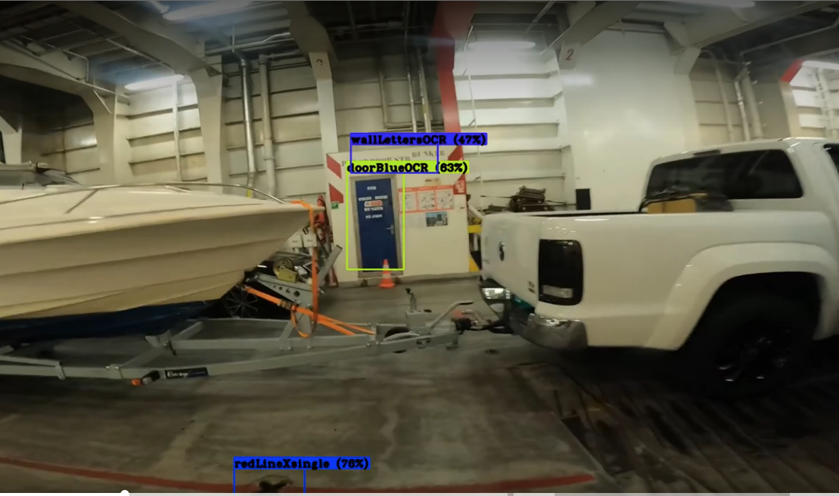
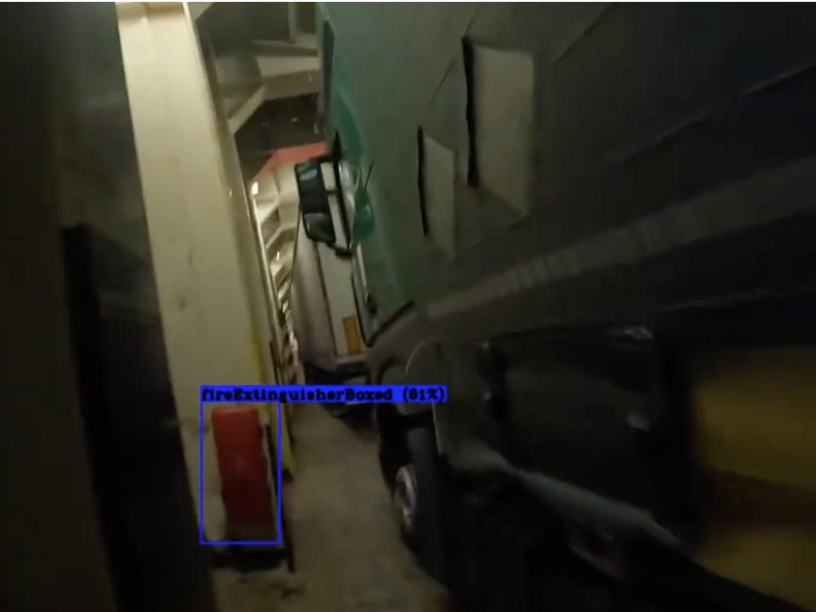
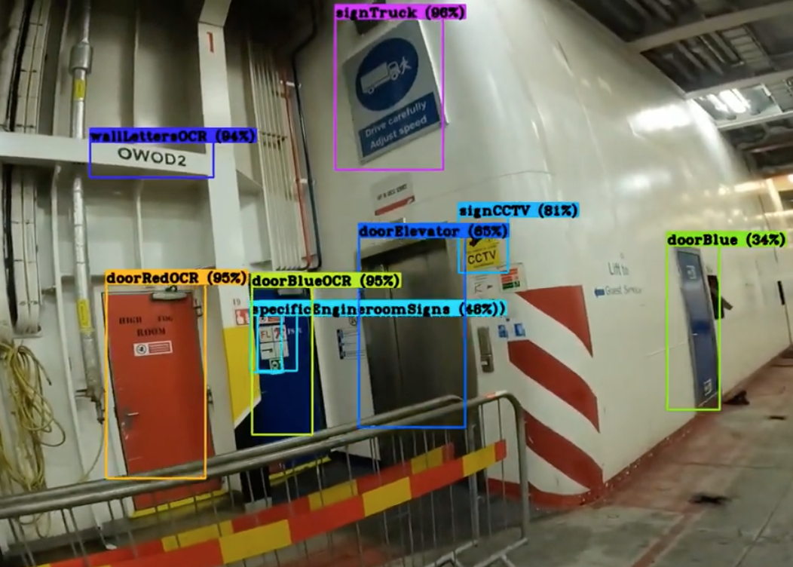
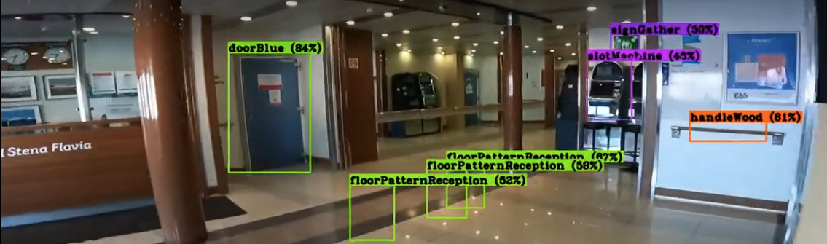
ML Training
VIDEOS
LASHCO: mid-scale object detection, segmentation and captioning dataset for a commercial vessel.
  99 classes, 24MB.
  deck patterns, bulkhead patterns, hoses, fixed installations, signs, control buttons …
Used Tensorflow Lite with 16-bit quantization on smartphone.
Used COCO (Common Objects in Context) and UCYCO (dept) for testing.
2:24
7:18

Slide 18
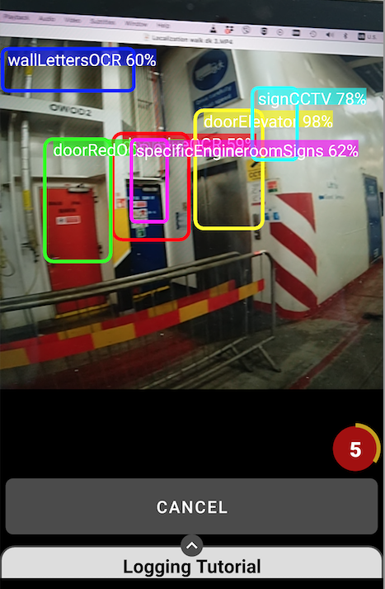
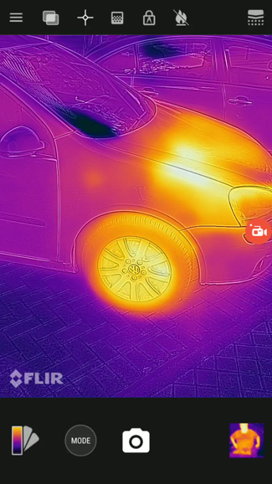
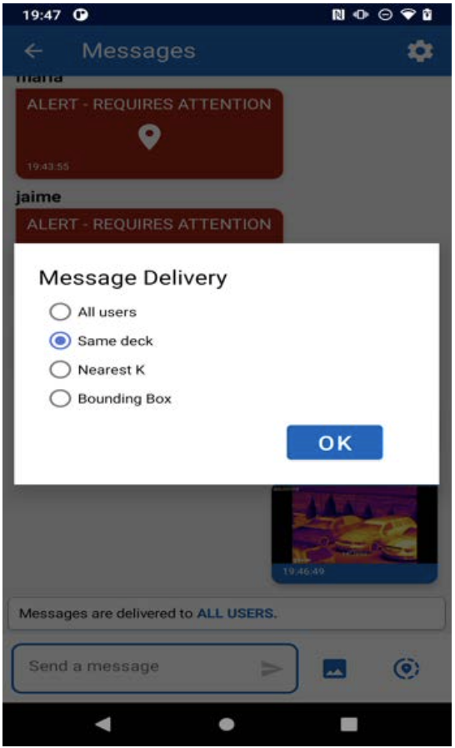
Logging & Localization
Logger
Localize
Heat Scan & Geo-Chat

Slide 19
Outline
Introduction
Background & Related Work
Surface Algorithm
Experimental Evaluation
Conclusions and Future Work

Slide 20
Surface Algorithm
Surface: Our data-driven localization algorithm using Computer Vision (CV).
Problem: How to rank objects in a way that the correct location is estimated?
Additional Challenges:
  How to filter out the proximity of similar fingerprints?
  How important objects can be ranked higher?
  How to support tracking (Continuous Localization)?
  How to reduce the quadratic lookup cost?
Fingerprint Database (FDB)
Record:
[x,y,deck,{drencher, charger, door}]
Query: Where am I?
I see the below objects …
{drencher, door}

Slide 21
Surface Algorithm
Surface (Data Management) Concepts
  Multiset Subtraction
  Spatial Partitioning of Fingerprints
  C) Global Partitioned Frequency Counting
  D) Bounding Box Filtering of Fingerprints
We devise two Surface variants:
  Surface Global (SG): used on first use without prior location (localization) – use ABC
  Surface Local (SL): used on subsequent localizations (tracking) – use ABCD

Slide 22
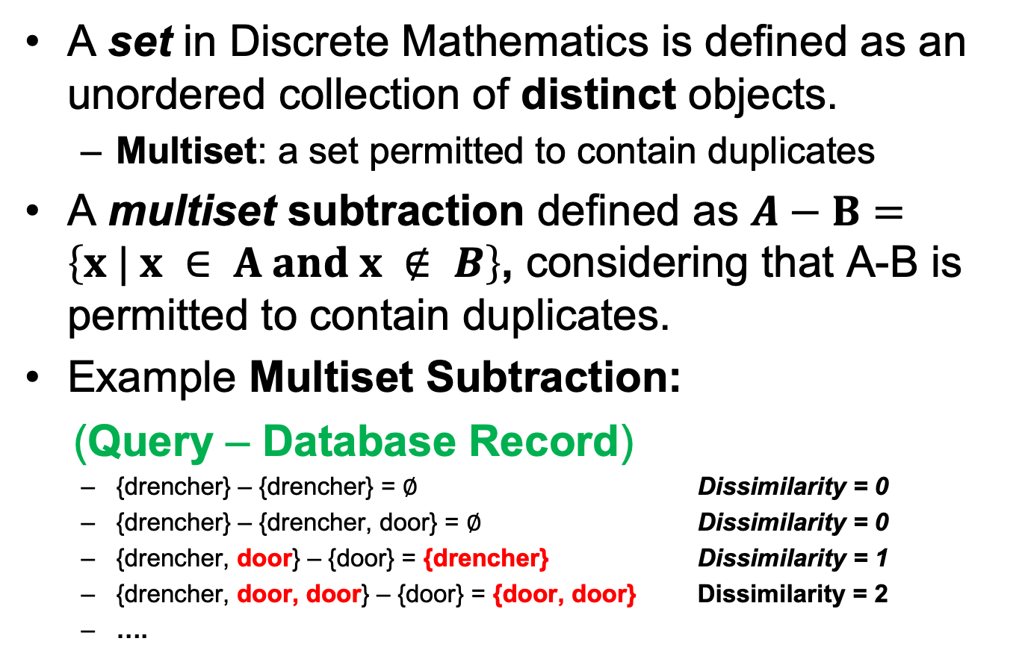
A) Multiset Subtraction
A set in Discrete Mathematics is defined as an unordered collection of distinct objects.
  Multiset: a set permitted to contain duplicates
A multiset subtraction defined as $A−B=\left\{x | x ∈ A and x ∉ B\right\}$, considering that A-B is permitted to contain duplicates.
Example Multiset Subtraction:
(Query – Database Record)
  {drencher} – {drencher} = ∅ Dissimilarity = 0
  {drencher} – {drencher, door} = ∅ Dissimilarity = 0
  {drencher, door} – {door} = {drencher} Dissimilarity = 1
  {drencher, door, door} – {door} = {door, door} Dissimilarity = 2
  ….
A-B
A
B

Slide 23
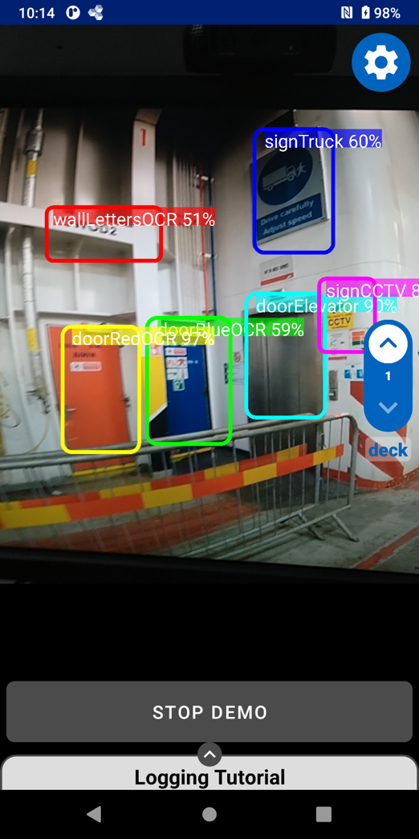
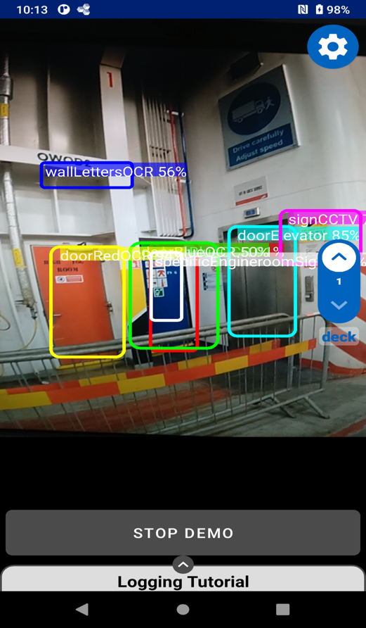
A) Multiset Subtraction
-
Dissimilarity is 1 (signTruck not found)

Slide 24
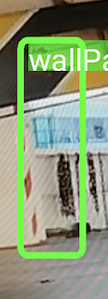
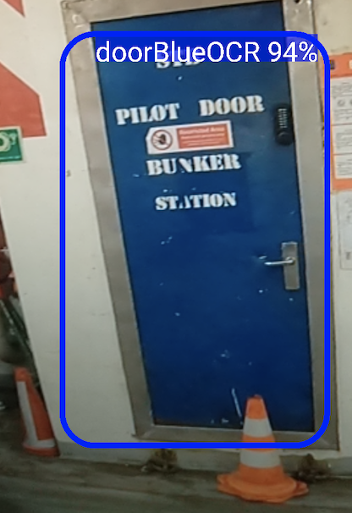
B) Spatial Partitioning (SP) of Fingerprints
Problem:
  Many fingerprints are close by.
Why:
  Consecutive logging in same area.
Solution:
  Partition Fingerprints based on location into the OBJECT_FREQ view.

Slide 25
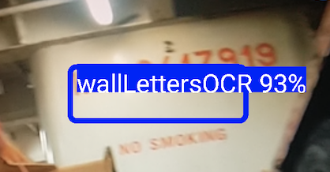
C) Global Partitioned Frequency Counting (GPFC)
Rare Objects => Good Location Indicators
  e.g., wallLettersOCR is always at very specific location => should be used as location estimate
Problem:
  Counting object frequencies globally is not correct, as an object might have been captured at the same location many times.
e.g.,
Solution:
  Build cluster-based histogram
  (OBJECT_COUNT)
  Normalize this into a global
  OBJECT_FREQUENCY
15
30
11
1
3
5

Slide 26
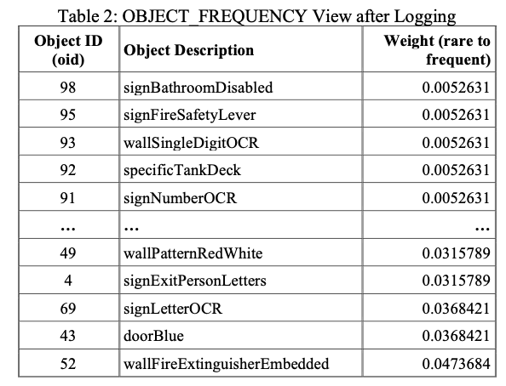
B-C) GPFC+SP Results
During Logging (see evaluation later), we populate the OBJECT_FREQUENCY views that are used by the ranking algorithms to rank higher infrequent objects.
rare
frequent

Slide 27
D) Bounding Rectangle Filtering of Fingerprints
During Localization, steps (a-c) sufficiently provide a global ranking of fingerprints to identify the best location estimate.
Problem:
  How to exploit the prior location during tracking?
Solution:
  Limit the ranking process within a bounding rectangle around the prior result.

Slide 28
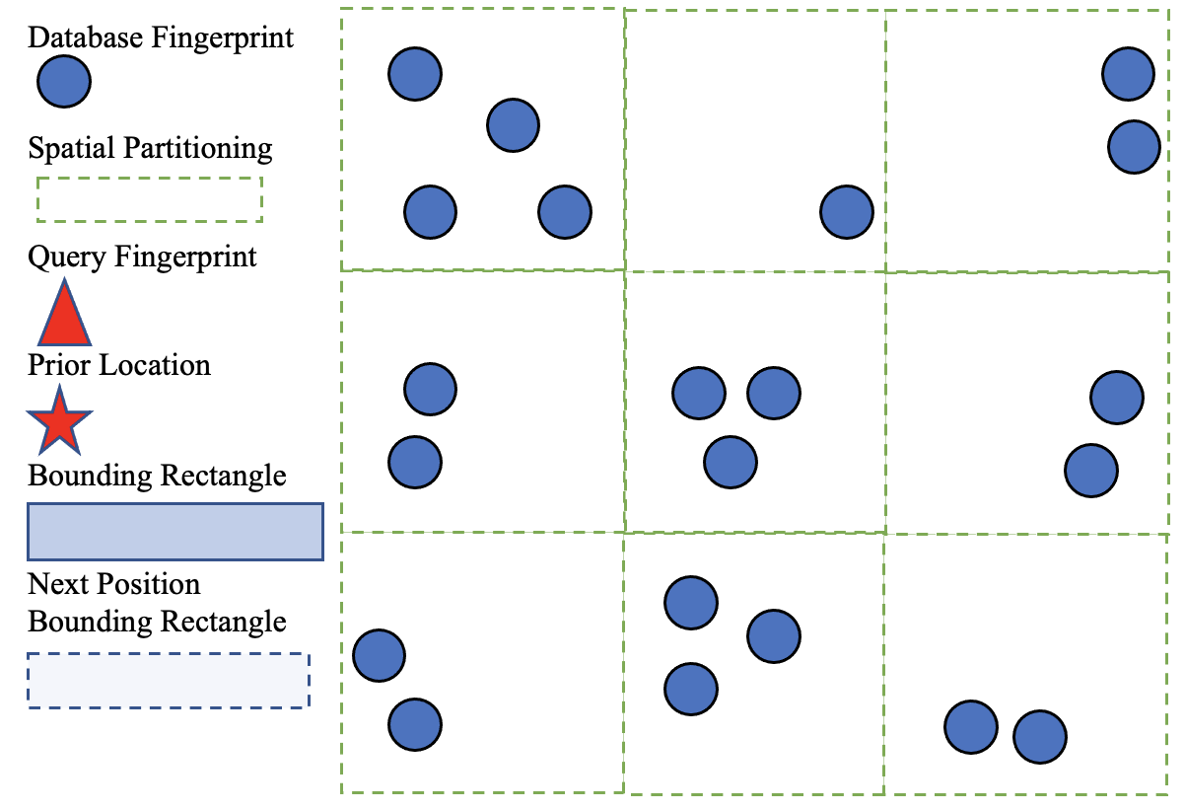
D) Bounding Rectangle Filtering of Fingerprints
SG Location

Slide 29
Outline
Introduction
Background & Related Work
Surface Algorithm
Experimental Evaluation
Conclusions and Future Work

Slide 30
Experimental Evaluation
We carried out two studies
  Remote Study: using video traces from a commercial ro-ro operator part of the project
  On-board Study: on a commercial line between 2 european cities with 26 first responders participating (August 2022).
We report the detailed results of the “Remote Study” (part of this ICCAS 2022 paper.)
  On-board study results verify the remote study result in a real environment.

Slide 31


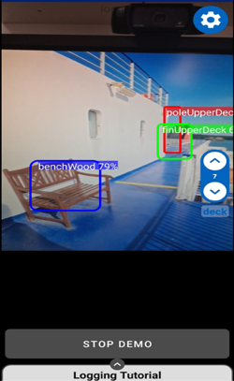


Remote Study
SMAS
Video casting
LED Reflection, Lighting Conditions
Onboard study shows even better object recognition
Expert

Slide 32








Onboard Study
future

Slide 33

Dataset
  Videos: 14 videos, 11GB, 800 MB / file
  Time: 1 hour and 30 minutes
  Areas: Closed ro-ro, Weather deck, PAX public areas, Cabin areas
  ~50% of videos used in training

Slide 34





1) Logging Screenshots
Google’s ML kit on-device Optical Character Recognition (OCR) library (available in multiple languages) can refine an object recognition. For example, for the last figure it reads “STB PILOT DOOR BUNKER TTION”

Slide 35


1) Logging: Results
Purpose: Observe the effort necessary to boostrap the localization system.
Metric: Time (wall clock)
Deck 5: about 2 hours!
Onboard study showed that we logged 2.5x more objects in same time!
A total of 460 objects were collected and organized in the surface geodb.
Our stress-testing (see next) pushes performance evaluation to 50K objects!

Slide 36





Logging Heatmaps
heatmaps show object collection
Estimations
(based on onboard study)
Logging 7 decks: 16-20 hours Objects 7 decks: 11K objects
Vessel Characteristics
Length overall (LOA): 186.42
Width: 25.6 meters.
Gross Tonnage: 26904
Draught: 6.4m
Notes:
480 x 2.5 x factor 9

Slide 37



2) Localization: Setup
Purpose: Find how accurate the Surface Global (SG) localization algorithm is.
Metric: Accuracy (A)
  n = 10 repetitions
  Expert judging if returned location within 10 meters from Correct
Scenes: 15 scenes (S1-S15) to capture variety of conditions in Closed ro-ro, Weather deck, PAX public areas, Cabin areas

Slide 38




2) Localization: Results
SG Average Localization Accuracy (A): 80%!
Additional Training necessary:
  S04 (walking between trucks)
  S09 (walking with left wall)
  S15 (cabin rooms)

Slide 39


3) Tracking: Setup
Purpose: Find how accurate the Surface Local (SL) localization algorithm is.
Metric: Accuracy (A)
Trajectories:
  T1: Video from Closed ro-ro
  T2: Video from Public PAX
VIDEOS
T1
T2

Slide 40



3) Tracking: Results
SL Average Localization Accuracy (A):
A=88%!
A=92%!
Building error. Error cleared when reaching hotspot.
Bootstrap
Missing
objects

Slide 41

4) Scalability: Setup & Result
Purpose: Find how Surface (SL & SG) Algorithm perform when the number of objects increases
  Metric: Time (wall clock)
  Dataset: Synthetic dataset with random objects uniformly distributed in OID ranges.
Remarks
Remote Study had only 0.5K objects => times were negligible
All times were within critical path of object capturing delay:
  Cat S61: 400-500ms
  Cat S62: 200-300ms
Linear increase of latency with object increase.
linear

Slide 42


5) Low Light Example
Torch OFF
Torch ON

Slide 43
Outline
Introduction
Background & Related Work
Surface Algorithm
Experimental Evaluation
Conclusions and Future Work

Slide 44
Conclusions
Data-driven localization with Computer Vision paves a new way in the localization domain.
Zero-infrastructure localization developments can impact the complete identification-tracking-positioning cycle on vessels:
  live fire detection and localization
  live monitoring and tactical support
  monitoring of cargo, quality control and optimization of cargo load and distribution

Slide 45

Future Work
Additional Field Studies
  Retraining Models (light, angles)
  Battery Efficiency (36% for 3.5 hour logging)
Hybridization of Surface Algorithm
  Currently IMU is a separate system but we aim to fuse the signals by the means of a particle filter.
Match Matching (to graph)
  To offer smoother tracking
OCR Inclusion in Ranking

Slide 46

Fingerprint Management Studio
Supporting management of fingerprints

Slide 47
Zero Infrastructure Geolocation Of Nearby First Responders On Ro-Ro Vessels
Thanks! Questions?
Paschalis Mpeis∗, Jaime Bleye Vicario‡,
Demetrios Zeinalipour-Yazti∗
∗ University of Cyprus, 2109 Nicosia, Cyprus
‡ Integral Maritime Safety Centre Jovellanos, 33393 Gijón, Asturias, Spain
mpeis.paschalis@ucy.ac.cy, jaimebv@centrojovellanos.es, dzeina@cs.ucy.ac.cy
https://anyplace.cs.ucy.ac.cy/ https://lashfire.eu/
The 20th International Conference on Computer Applications in Shipbuilding (ICCAS),
Royal Institution of Naval Architects, Yokohama, Japan, September 14, 2022.

