Slide 1



Προ-φόρτωση Δεδομένων IoT σε Υπηρεσίες Πλοήγησης
Εσωτερικών Χώρων
Ανδρέας Κωνσταντινίδης∗‡, Παναγιώτης Ηρακλέους*, Ζαχαρίας Γεωργίου*, Δημήτρης Ζεϊναλιπούρ∗ και Πάνος Χρυσάνθης§
∗ Πανεπιστήμιο Κύπρου, 1678 Λευκωσία, Κύπρος
‡ Πανεπιστήμιο Frederick,1036 Λευκωσία, Κύπρος
§ University of Pittsburgh, 15260 Pittsburgh, PA, USA
Υπο-δημοσίευση (accepted) στο ACM Transactions on Internet Technologies (ACM TOIT), 2018
16o Ελληνικό Συμπόσιο Διαχείρισης Δεδομένων (ΕΣΔΔ’18)
2 Ιουλίου - 4 Ιουλίου 2018, Λάρνακα, Κύπρος

Slide 2
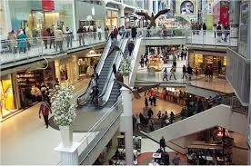



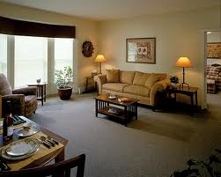



Motivation
People spend 80-90% of their time indoors – USA Environmental Protection Agency 2011.
>85% of data and 70% of voice traffic originates from within buildings – Nokia 2012.

Slide 3
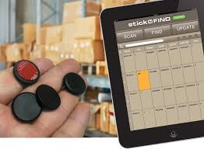
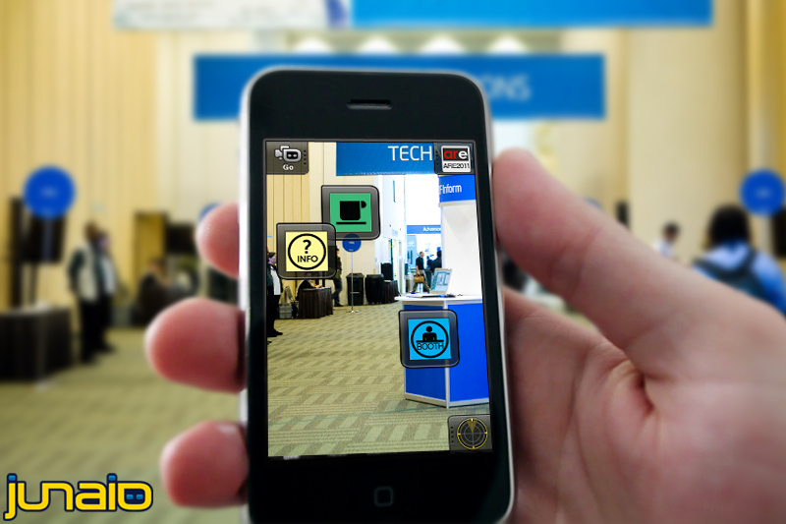
Localization and Navigation
Indoor Localization has still not reached its full potential.
Huge spectrum of indoor apps:
  Navigation, Manufacturing, Asset Tracking, Inventory Management
  Healthcare, Smart Houses, Elderly support, Fitness apps
  Augmented Reality and Indoor Games
Indoor Revenues expected reach 10B USD in 2020
  ABIresearch, “Retail Indoor Location Market Breaks US$10 Billion in 2020”’ Available at: https://goo.gl/ehPRMn, May 12, 2015.

Slide 4
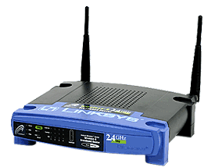
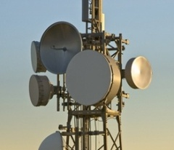

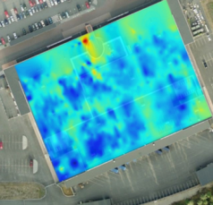


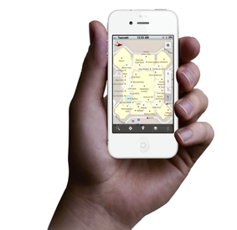
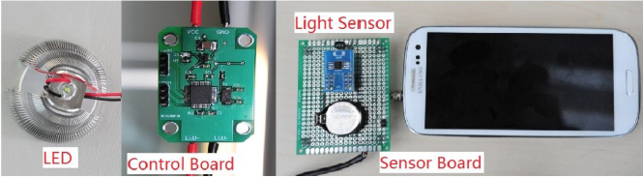
Internet-based Indoor Navigation
Enablers for Indoor have been Internet-based Indoor Navigation (IIN)* services founded on measurements collected by IoT devices.
  “IoT refers to the ever-growing network of physical objects that feature an IP address for internet connectivity”. – Wikipedia
enrich
IoT
IIN Service
navigate
“Internet-based Indoor Navigation Services”, Demetrios Zeinalipour-Yazti, Christos Laoudias, Kyriakos Georgiou and Georgios Chatzimiloudis, IEEE Internet Computing (IC'16), IEEE Computer Society, 2016.

Slide 5
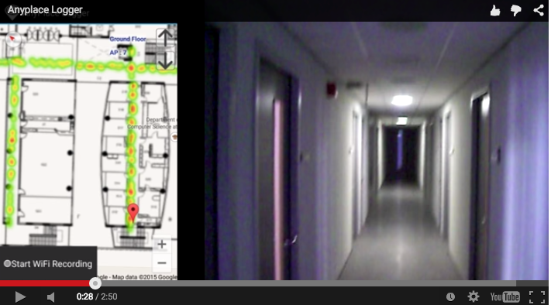
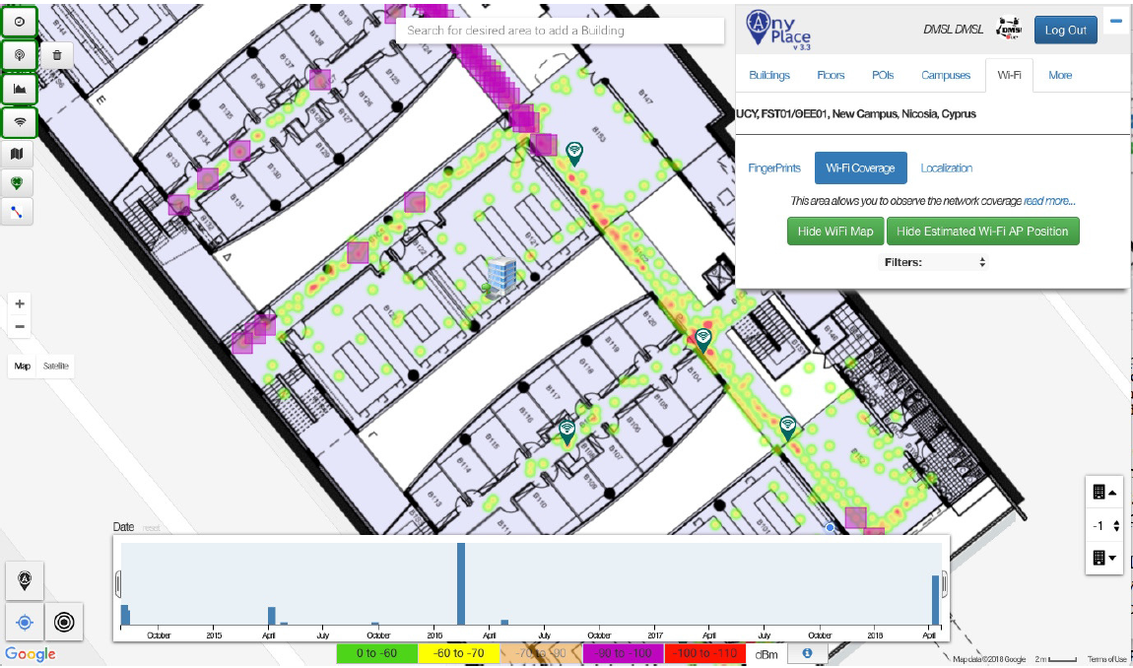


Anyplace IIN
Video
https://anyplace.cs.ucy.ac.cy/
"FMS: Managing Crowdsourced Indoor Signals with the Fingerprint Management Studio", Marileni Angelidou, Constantinos Costa, Artyom Nikitin and Demetrios Zeinalipour-Yazti "Proceedings of the 19th IEEE International Conference on Mobile Data Management" (MDM '18), IEEE Computer Society, Pages: 2 pages, June 25 - June 28, 2018, AAU, Aalborg, Denmark, 2018.

Slide 6
Talk Outline
Introduction
Background and Problem Formulation
Grap Framework
  Dependency Graph (DG) algorithm
  Graph Distance A* (GDA) algorithm
Experimental Evaluation
Conclusions

Slide 7
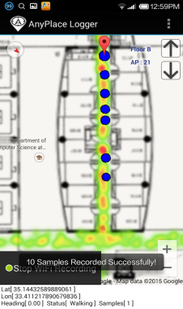
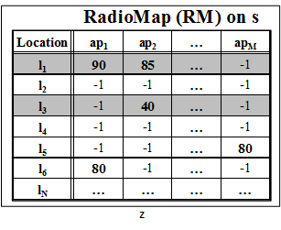
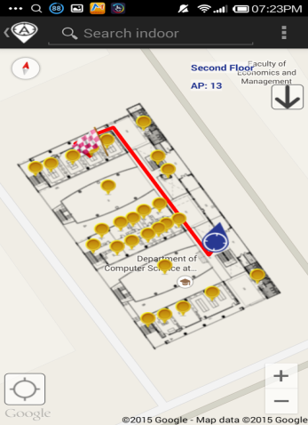
Background on IIN
Logger
IIN Service
a) Upload Measurements
b) Build RM (Radiomap)
c) Localize
fingerprint
SSA
Localizer
d) Localization Alternatives:
Client-Side-Approach (CSA)
Server-Side-Approach (SSA)
CSA

Slide 8
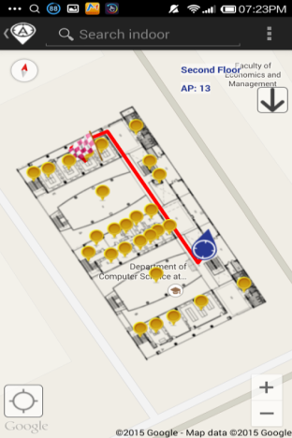
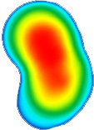
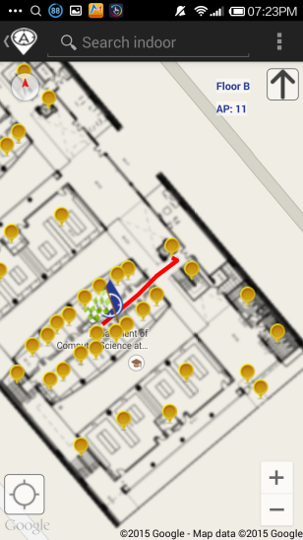
Intermittent Connectivity
IIN Service
Where-am-I?
No Navigation
Where-am-I?
X
Where-am-I?
☹ Intermittent Connectivity
Time

Slide 9

Solution: Grap Navigation
Localize from s
IIN Service
Prefetch K RM rows
Prefetch K RM rows
X
Localize from Cache
Prefetch K RM rows
Localize from s
☺ Intermittent Connectivity
Time

Slide 10
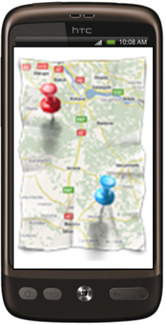

Grap Advantages & Challenges
IIN
AP1
Where am I?
fingerprint
RM
APm
(x,y) & Prefetch K RM rows (Partial RM)
Grap: Hybrid (CSA & SSA) solution
Fine Grain Localization Accuracy: RM-based approach
Network Independent: Use prefetched partial RM when disconnected
Cost-effective (user): request a much smaller (partial) RM from IIN
Challenge: Select K RM rows in a “target-less” manner (unknown user destination) and without any background knowledge about the users (no learning)

Slide 11

Problem Formulation
u enters an arbitrary B and moves towards an unknown destination.
B includes an area with intermittent connectivity:
  u with Vr at r is offline if maxVr received from any covering api is below θ. Formally, this is captured by the connected_{r} definition:
  $connected$_{r} = $\left\{\begin{aligned}0, if maxVr ≤θ \\ 1, if maxVr>θ\end{aligned}\right.$
While Connected: Grap responds with u’s location + as many RM entries as possible for prefetching - depends on the amount of time that u stays connected at r (i.e, dwell time => configured to K blocks for experimentation).
While Disconnected: Use prefetched RM for localization on the mobile device.
Notes:
u enters an arbitrary building and moves towards an unknown destination.
the building includes an area with intermittent connectivity:
u with a fingerprint Vr at time step of request r is practically offline if the maximum signal strength maxVr it receives from any covering api is below threshold θ, i.e., maxVr < θ. Formally, this is captured by the connected_{r} definition:

Slide 12
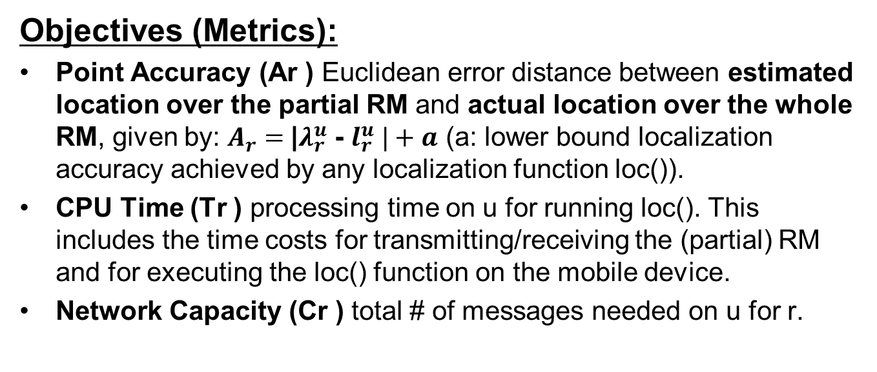
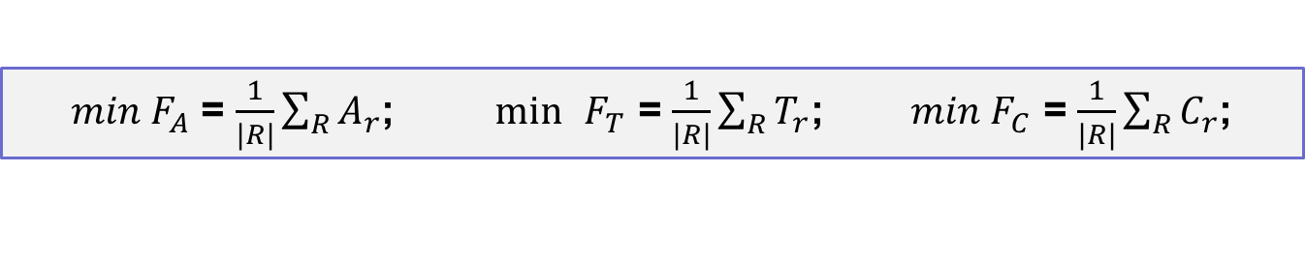
Problem Formulation
Research Goal: Enable a mobile user to consecutively localize itself accurately and efficiently in an indoor environment, where connectivity is intermittent, using an IIN-SOA holding RM.
Objectives (Metrics):
Point Accuracy (Ar ) Euclidean error distance between estimated location over the partial RM and actual location over the whole RM, given by: $A_{r}=$|$λ_{r}^{u}$ - $l_{r}^{u} |+a$ (a: lower bound localization accuracy achieved by any localization function loc()).
CPU Time (Tr ) processing time on u for running loc(). This includes the time costs for transmitting/receiving the (partial) RM and for executing the loc() function on the mobile device.
Network Capacity (Cr ) total # of messages needed on u for r.
$min{ F}_{A}$ = $\frac{1}{|R|}\sum_{R}{A_{r}}$; $\min{ }F_{T}$ = $\frac{1}{|R|}\sum_{R}{T_{r}}$; $min{ F}_{C}$ = $\frac{1}{|R|}\sum_{R}{C_{r}}$;

Slide 13
Talk Outline
Introduction
Background and Problem Formulation
Grap Framework
  Dependency Graph (DG) algorithm
  Graph Distance A* (GDA) algorithm
Experimental Evaluation
Conclusions

Slide 14
Grap Framework
B
DG & GDA
Partial RM
the actual plan B = ⟨N, E⟩ of the building.
use B to construct a Dependency Graph (DG).
explore DG using Graph Distance A* (GDA).
select partial Radiomap to prefetch.
Notes:
(i) it structurally analyzes building topologies yielding a Dependency Graph (DG) that represents the probability/likeliness of users visiting other nodes in the building. This can be calculated using problem-specific information such as structural information of a buildings or even historical traces as we used in [13]; (ii) a proposed GDA algorithm then finds the nodes with the highest probability to be visited from the current location of u; (iii) the fingerprints falling within the selected nodes form a partial RadioMap
Rmur ; and (iv) in connected operation, u forwards its fingerprint Vr to server s and receives its location λur and Rmu r while in disconnected operation, u calculates λur
locally using only the prefetched Rmu r .

Slide 15
Dependency Graph generation - DG
construct a DG - connects the nodes through physical transitions by consulting the actual plan B = ⟨N, E⟩ of the building
N-set contains the Points-Of-Interests (POIs: rooms, intersections, elevators, staircases.)
E-set contains the corridors, physical pathways, etc., as these are aligned to floors inside a building.
DG is defined as a weighted undirected graph DG = ⟨N ′, E′⟩
  N ′ = set of nodes, each corresponding to a POI along with a self-importance s (ni) weight indicating its probability to be visited by a random user.
  E′ = set of edges, each corresponding to an edge along with an edge-weight indicating the Lp-Norm distance between two connected nodes.

Slide 16
DG – Self Importance & Edge Weights
Definition of self-importance: how likely users pass from
a particular node (a.k.a. authority hub) to reach their destination.
iteratively calculated for each node n_{i}
depends on the degree (number of links) of n_{i} + how many n_{j} in N can be visited via n_{i} (i.e., horizon)
  favours nodes with low number of links but high betweenness (e.g., nodes that bridge two buildings or central corridors)
  variation of Page Rank
Also assigns weights (Euclidean distance) between all connected edges
u
8
8
2
5
2
1
6
4
2
2
3
4
10
11
Notes:
uses a damping factor (d f ) to capture a probability of a random user to continue navigating at any step of the iterative computation

Slide 17
Talk Outline
Introduction
Background and Problem Formulation
Grap Framework
  Dependency Graph (DG) algorithm
  Graph Distance A* (GDA) algorithm
Experimental Evaluation
Conclusions

Slide 18
Partial Radiomap selection - GDA
A* search algorithm comprises of an evaluation function f (a, z) = g(a, b) + h(b, z), where
  g(a,b): a cost function that gives the path cost from the start node a to intermediate node b and
  h(b, z): a heuristic function that estimates the cheapest path from b to the goal z.
  both g() and h() are calculated using graph-distance cost G2
    which reflects the topological constraints and physical entities of a building (e.g., elevators, corridors, walls, etc.,)
    Lp-norm distances (e.g., Euclidean, Manhattan) are unsuitable.
Recall Aim: find the best nodes to be prefetched in a target-less manner before u is disconnected from s
  therefore there is no goal state for h() to be calculated.

Slide 19
Partial Radiomap selection - GDA
In the absence of a target,
  GDA finds m virtual targets that represent the m most possible destinations of u, based on their self-importance, using u’s current location
  These m destinations are selected within w hops from u so that these are not very far destinations
A* calculates g() from u’s current location to each neighboring node n_{i} and calculates h() by running Dijkstra algorithm to find shortest path in terms of G2 from n_{i} to each potential target n_{j} , j = 1, ...,m
node n_{i} with the lowest f() is recorded
when K nodes are selected, u requests associated records from s to build a partial RM, which will be used for localization during disconnected states.

Slide 20
GDA - Example
Dependency Graph DG
Graph Distance A* (GDA)
10
10
Do A* on DG from A to {I, J , H};
Select K =5 nodes
From A to H
Round 1) f(D) = 21
Round 2) f(G) = 16
Round 3) f(H) = 7
From A to I
Round 1) f(F) = 22
Round 2) f(G) =17
Round 3) f(I) 8
From A to J
Round 1) f(F) = 7
Round 2) f(J) = 2
Round 3)
K nodes selected for prefetching
Round 1) D, F
Round 2) G, J
Round 3) H, I
1
B
A
C
1
5
5
2
F
15
K=5
D
F
8
D
1
E
9
2
9
J
15
J
12
G
J
G
K=5
8
7
16
Target
I
I
16
H
w = 3
H
H
Calculate: self_importance;
edge_weights
Set w = 3;
m =3;
find_m(w, m);
Result = {I, J , H}
Use K nodes to create partial RM
Notes:
Use B to create a DG
Calculate self-importance and edge weights.
Use Self-importance to select m nodes from u’s current location.
Use A* to find K nodes towards m
Use K nodes to create partial RM
Use partial RM during disconnected state

Slide 21
Talk Outline
Introduction
Background and Problem Formulation
Grap Framework
  Dependency Graph (DG) algorithm
  Graph Distance A* (GDA) algorithm
Experimental Evaluation
Conclusions

Slide 22
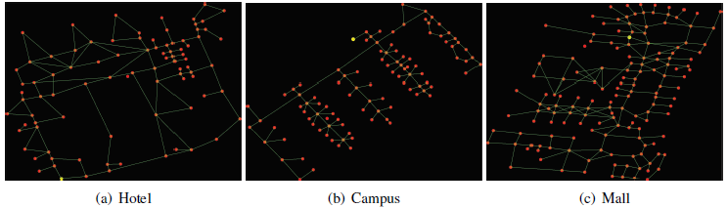
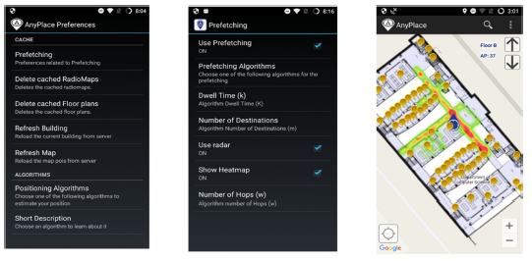
Grap Prototype System
allows evaluation and visualization through Anyplace IIN
evaluator includes: Data Connector, Simulator, Visualizer
navigator with intelligent prefetching and caching.
Notes:
The evaluator comprises of:
Data Connector:connects to Anyplace and downloads IoT-data available through its open API
Simulator: implements all algorithms along with the evaluation metrics
Visualizer:shows the graph generated by various building plans but also allows tracing the presented algorithms to understand their behaviour

Slide 23
Experimental Evaluation
Datasets: real IoT-data obtained through the publicly available API of our Anyplace IIN-SOA
Algorithms: Grap+GDA compared against two baseline Anyplace (CS and SS) and two baseline Grap (BFS, RND) algorithms
Metrics: CPU Time (T), Accuracy (A) & Network Capacity (C)
Name | Collected | Finger. | APs | Covers
Hotel Pittsburgh | Wyndham Grand Pittsburgh Downtown Hotel, Pittsburgh, USA (Slide 29 – Figure (a) | 500 | 308 | 6,500 m², 201 POIs & 247 edges.
CSUCY | Typical building at CS, UCY (Slide 29 – Figure (b) | 5000 | 266 | 2,500 m², 397 POIs and 440 edges
Mall of Cyprus | Mall of Cyprus, Nicosia Cyprus (Slide 29 – Figure (c) | 800 | 279 | 18,500 m² , 214 POIs and 289 edges

Slide 24
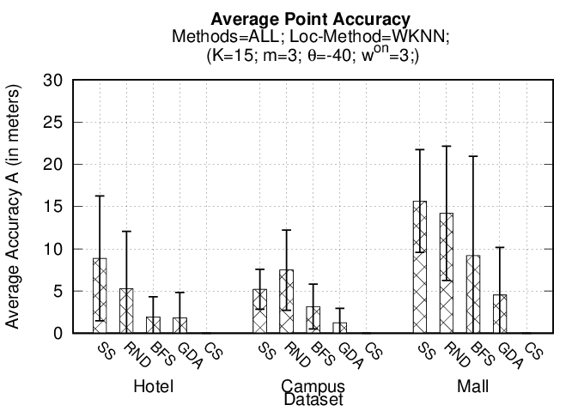
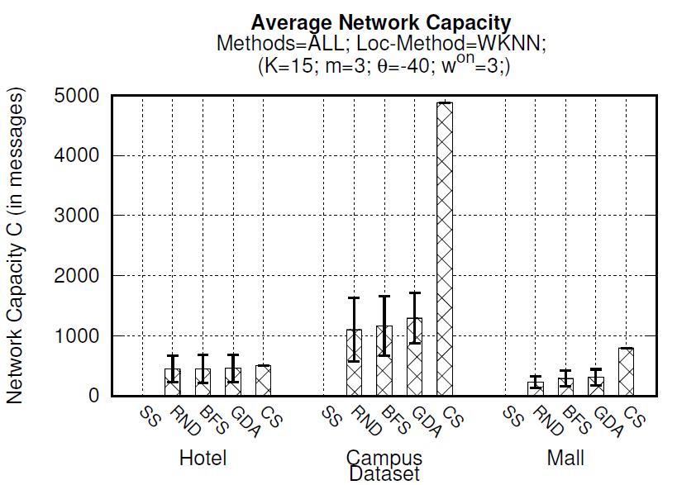
Experiment 1: Performance Evaluation
CS and SS are the extreme cases
CS – T & C affected by dataset size [NxM] (downloads whole RM a priori – localization on smartphone) – “Optimal” Accuracy
SS - T & C minimum – operations at server – but accuracy affected by intermittent connectivity
Grap (GDA) – improvement in A by 65%, 83%, 68% vs RND and 40%, 60%, 50% vs BFS / GDA sacrifices performance (T and C) for better quality (A) / GDA close to CS in A / GDA slightly worst performance (T and C)
Notes:
GDA more T and C due to more sophisticated computations and better selection of partial RM (with more fingerprints etc.)

Slide 25
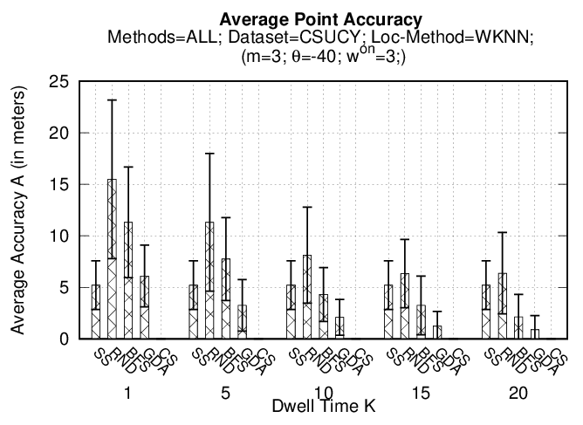
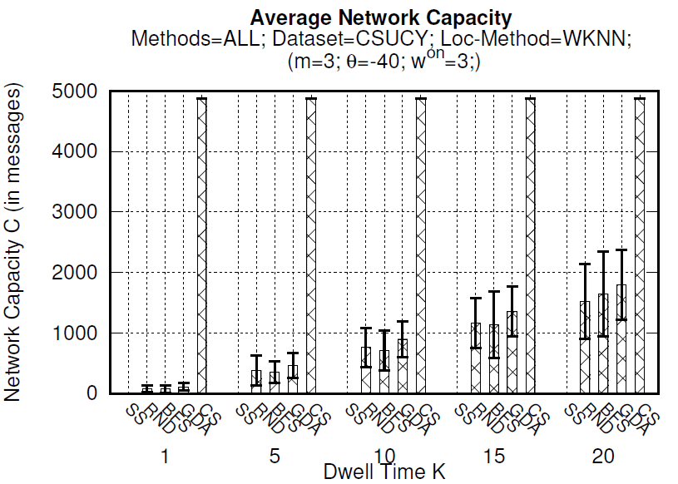
Experiment 2: Dwell Time (K)
K = time for downloading Vr associated to K nodes of DG - is the size of pRM downloaded by u when connected and processed by u when disconnected.
CS and SS are fixed – not affected by K – no prefetching
Grap (all): more K = better accuracy / worse performance (more downloading)
Grap (GDA) – always better quality (A) than RND and BFS in A
GDA less affected by K than RND & BFS: better selection of “useful” Vr in pRM
Notes:
examines how dwell time K influences the behaviour and the performance of the proposed Grap framework.

Slide 26
Conclusions and Future Work
Grap (DG+GDA) is found accurate while retaining high performance levels.
Grap prototype validates that our propositions are pragmatic & can be easily integrated into future IIN-SOA.
In the future we aim to,
  Investigate the trade-off between T/C and A objectives in the context of Multi-Objective Optimization.
  Extend our experimental evaluation into domain-specific field studies (e.g., involving health/hospitals, education/universities).

Slide 27
Προ-φόρτωση Δεδομένων IoT σε Υπηρεσίες Πλοήγησης
Εσωτερικών Χώρων
Ευχαριστώ! Ερωτήσεις;
Ανδρέας Κωνσταντινίδης∗‡, Παναγιώτης Ηρακλέους*, Ζαχαρίας Γεωργίου*, Δημήτρης Ζεϊναλιπούρ∗ και Πάνος Χρυσάνθης§
∗ Πανεπιστήμιο Κύπρου, 1678 Λευκωσία, Κύπρος
‡ Πανεπιστήμιο Frederick,1036 Λευκωσία, Κύπρος
§ University of Pittsburgh, 4200 5th Avenue Pittsburgh, USA
16o Ελληνικό Συμπόσιο Διαχείρισης Δεδομένων (ΕΣΔΔ’18)
2 Ιουλίου - 4 Ιουλίου 2018, Λάρνακα, Κύπρος
Υπο-δημοσίευση (accepted) στο ACM Transactions on Internet Technologies (ACM TOIT), 2018

Slide 28
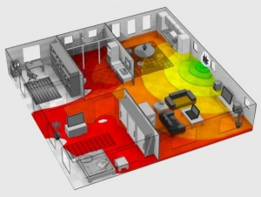
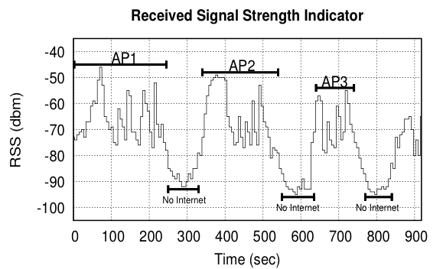
Intermittent Connectivity
Problem: Wi-Fi coverage might be irregularly available inside buildings due to poor WLAN planning or due to budget constraints.
A user walking inside a Mall in Cyprus
  Whenever the user enters a store the RSSI indicator falls below a connectivity threshold -85dBm. (-30dbM to -90dbM)
  When disconnected IIN can’t offer navigation anymore ☹

Slide 29

Anyplace IIN Service
A complete open-source IIN Service developed at the University of Cyprus.
  Aims to become the predominant open-source Indoor IIN Service.
  Active community: Germany, Russia,
  Canada, UK, etc. – Join today!
  Android, Windows, iOS, JSON API
http://anyplace.cs.ucy.ac.cy/

Slide 30
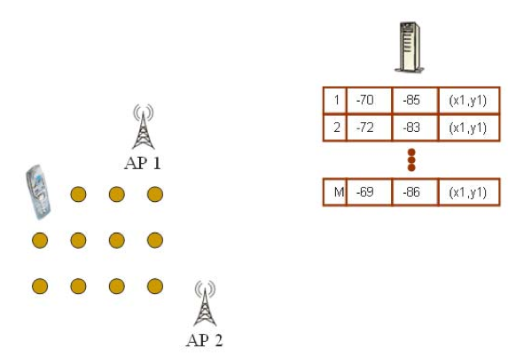
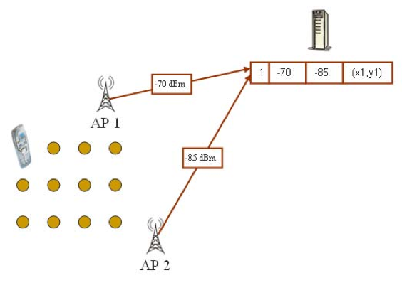
WiFi Fingerprinting
Mapping Area with WiFi Fingerprints
  n APs deployed in the area
  Fingerprints r_{i} = [ r_{i1}, r_{i2}, …, r_{in}]
  Averaging

Slide 31
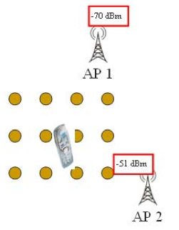
WiFi Positioning
Positioning with WiFi Fingerprint
  Collect Fingerprint s = [ s₁, s₂, …, s_{n}]
  Compute distance || r_{i} - s || and position user at:
    Nearest Neighbor (NN)
    K Nearest Neighbors (w_{i} = 1 / K)
    Weighted K Nearest Neighbors (w_{i} = 1 / || r_{i} - s || )
RadioMap
s = [ -70, -51]
r₁ = [ -71, -82, (x₁,y₁)]
r₂ = [ -65, -80, (x₂,y₂)]
…
r_{N} = [ -73, -44, (x_{N},y_{N})]
NN, KNN, WKNN

Slide 32

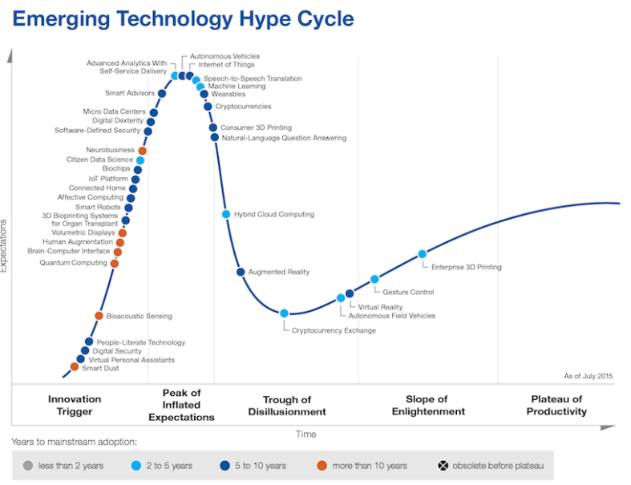
Internet of Things (IoT)
“IoT refers to the ever-growing network of physical objects that feature an IP address for internet connectivity”. – Wikipedia
  Maybe just a hype – Gartner.
Nevertheless, the stack entails:
  Identify/Sense: MAC, EPC, sensors
  Transmit: using IP (MAC Standards, Protocols, Interoperability, etc.)
  Store/Middleware: Big Data Processing / Cloud, Monitor, Visualize, DSS, Analytics
  Actuate: Autonomic “smart” behavior, Machine Learning, Artificial Intelligence, etc.
Gartner Hype Cycle
Internet of Things: A Survey on Enabling Technologies, Protocols, and Applications , IEEE Communications Surveys & Tutorials, Volume:17, Issue: 4, July 2015.

Slide 33
Intermittent Connectivity
Why not fallback from Wi-Fi to Mobile Internet (2G-4G) when Wi-Fi is not available?
Mobile Internet Limitations:
  Coverage: blockage or attenuation of signals in indoor spaces.
  Slow fallback between outdated Mobile Internet and Wi-Fi infrastructures.
    Lack of ubiquitous 802.11k, 802.11r (fast roaming) and 4G infrastructure.
  Limited Quota: Nobody ones to waste a mobile Internet plan for navigation purposes.
  Unavailability due to Roaming: when traveling and needing indoor navigation at most.

Slide 34
Localization
Infrastructure-free systems: don’t require dedicated equipment for the provisioning of location signals (e.g., GPS, Wi-Fi, Cellular, Magnetic, IMU)
Infrastructure-based systems: require dedicated equipment (e.g., proprietary transmitters, beacons, antennas and cabling)
  Bluetooth Low Energy (BLE) beacons: iBeacons (Apple)
  Ultrasound: ALPS (CMU)
  Visible Light: EPSILON (Microsoft Research)
  Ultra Wide Band (UWB): Decawave
Focus of next slides
Source: NASA

Slide 35
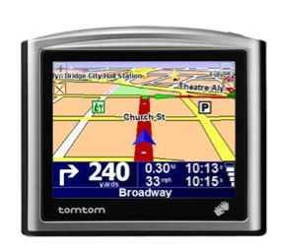
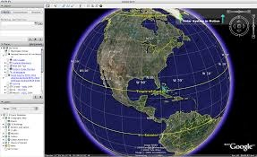
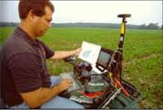
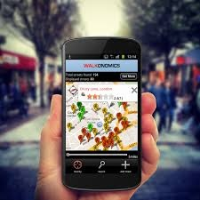
Location (Outdoor)
Infrastructure-free
Global Navigation Satellite Systems (GNSS) have played an important role in Outdoor
  Current: Global Positioning System (US), GLONASS (Russian)
  Upcoming: Galileo (European), Indian Regional Navigation Satellite System (IRNASS), BeiDou-2 (Chinese)
GNSS Drawbacks for Indoor Location:
  Low availability indoors due to the blockage or attenuation of the satellite signals.
  High start-up time & Power Demanding
Geographic Mapping
Precision Agriculture
Location-based Services

Slide 36
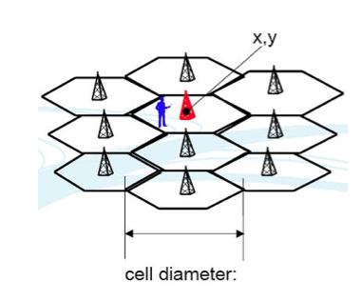
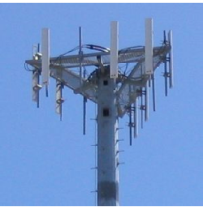
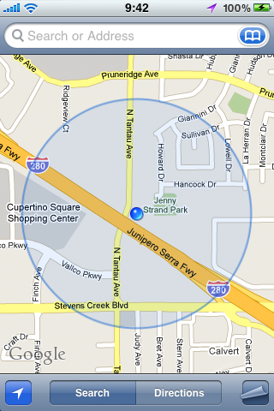
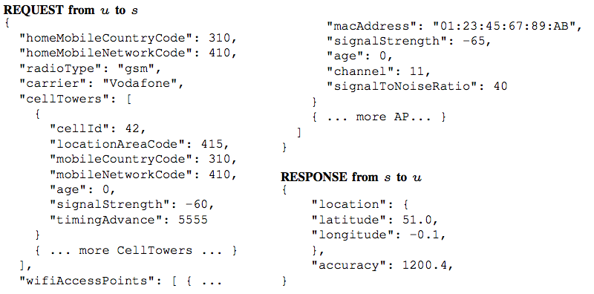
Location (Outdoor/Indoor)
Infrastructure-free
Cell ID:
  Cell ID is the Unique Identifier of Cellular Towers.
Cell ID Databases
  Skyhook Wireless (2003), MA, USA (Apple, Samsung): 30 million+ cell towers, 1 Billion Wi-Fi APs, 1 billion+ geolocated IPs, 7 billion+ monthly location requests and 2.5 million geofencable POIs.
  Google Geolocation “Big” Database (similar)
Disadvantages:
Low accuracy: 30-50m (indoor) to 1-30km (outdoor).
Serving cell is not always the nearest.

Slide 37

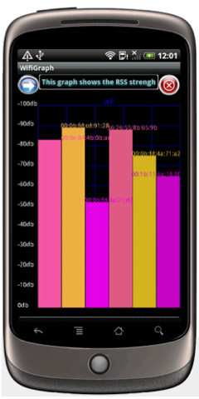
Location (Indoor) - WiFi Fingerprinting
Infrastructure-free
Received Signal Strength Indicator (RSSI)
  Power measurement present in a received radio signal measured in [ dBm, Decibel-milliwatts ]
    0 dBm = 1 mW
    -80dBm = 10 pW | Max RSSI (-30dBm) to Min RSSI: (−90 dBm)
    -110dBm = 0.01 pW | WiFi AP is visible but out of data range.
Advantages
  Readily provided by smartphone APIs .
  Low power 125mW (RSSI) vs. 400 mW (transmit)
Disadvantages
  Complex propagation conditions (multipath, shadowing) due to wall, ceilings.
  RSS fluctuates over time at a given location (especially in open spaces).
  Unpredictable factors (people moving, doors, humidity)

Slide 38
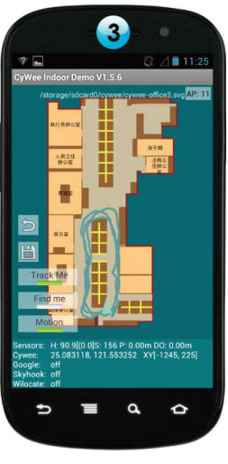
Infrastructure-free
WiFi Fingerprinting in Anyplace
References
  [Airplace] "The Airplace Indoor Positioning Platform for Android Smartphones", C. Laoudias et. al., Best Demo Award at IEEE MDM'12. (Open Source!)
  [HybridCywee] "Indoor Geolocation on Multi-Sensor Smartphones", C.-L. Li, C. Laoudias, G. Larkou, Y.-K. Tsai, D. Zeinalipour-Yazti and C. G. Panayiotou, in ACM Mobisys'13. Video at: http://youtu.be/DyvQLSuI00I
  [UcyCywee] IPSN’14 Indoor Localization Competition (Microsoft Research), Berlin, Germany, April 13-14, 2014. 2nd Position with 1.96m! http://youtu.be/gQBSRw6qGn4
    D. Lymberopoulos, J. Liu, X. Yang, R. R. Choudhury, ..., C. Laoudias, D. Zeinalipour-Yazti, Y.-K. Tsai, and et. al., “A realistic evaluation and comparison of indoor location technologies: Experiences and lessons learned”, In IEEE/ACM IPSN 2015.
  1st Position at EVARILOS Open Challenge, European Union (TU Berlin, Germany).
Cywee / Airplace

Slide 39
Logging in Anyplace
Video
"Anyplace: A Crowdsourced Indoor Information Service", Kyriakos Georgiou, Timotheos Constambeys, Christos Laoudias, Lambros Petrou, Georgios Chatzimilioudis and Demetrios Zeinalipour-Yazti, Proceedings of the 16th IEEE International Conference on Mobile Data Management (MDM '15), IEEE Press, Volume 2, Pages: 291-294, 2015

Slide 40
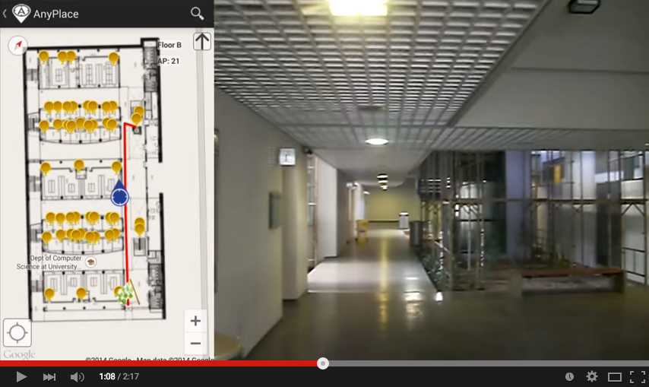
Hybrid Wi-Fi/IMU/Outdoor Anyplace
Infrastructure-free
Video
"Anyplace: A Crowdsourced Indoor Information Service", Kyriakos Georgiou, Timotheos Constambeys, Christos Laoudias, Lambros Petrou, Georgios Chatzimilioudis and Demetrios Zeinalipour-Yazti, Proceedings of the 16th IEEE International Conference on Mobile Data Management (MDM '15), IEEE Press, Volume 2, Pages: 291-294, 2015

Slide 41
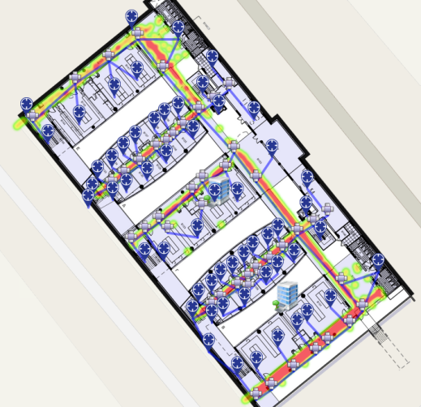
CSA Localization Process (Anyplace)
AP1
IIN
u requests RM from IIN
IIN sends RM to u
U uses RM and fingerprint with WKNN to localize
fingerprint
Send me RM;
RM
APm
  Advantages: fine accuracy; network independent
  Drawbacks: energy; messaging
  In real-world scenarios – DB can become extremely large with respect to [NxM].
  CSA is operating on outdated data; Doesn’t take advantage of latest Radiomaps
The 8,900 m² CS building @ UCY has 45,000 reference positions!
(3-6MB)
Whole Campus
50-100MB

Slide 42

SSA Localization Process (Anyplace)
Where am I?
IIN
fingerprint
<fingerprint>
RM
APm
(x,y)!
u sends fingerprint to IPS and requests location
IPS uses RM and u’s fingerprint with WKNN to find u’s location
IPS sends location to u to localize
Advantages: fine accuracy; energy; messaging;
  Drawback: suffers from intermittent connectivity

Slide 43
Prototype System – Grap Navigator
a proof-of-concept realization of our propositions in a real mobile indoor search, exploration and navigation tool - adapted the Anyplace navigator with options to introduce intelligent prefetching and caching.
Prefetching on/off
GDA parameters
Heatmap with
Prefetched Data
Notes:
The Grap Navigator (left) showing the menu for switching the prefetching feature on/off; and (center) varying the GDA parameters; (right) viewing the prefetched IoT data and user’s location.

Slide 44
Experimental Evaluation – Algorithms
The proposed Grap+GDA compared with two baseline
Anyplace approaches and two baseline Grap approaches
Metrics: CPU Time (T), Location Accuracy (A) & Network Capacity (C)
Parameters: dwell time K = 15 (i.e., time required to download K data
blocks), number of virtual targets m = 3, lookahead window w = 3,
effective network threshold θ = −40dBm and localization method WKNN.
Name | Server/Client side | Prefetching | Graph Search
CS (Anyplace) | Client-side | No – whole RM at CS | NA
SS (Anyplace) | Server-side | No – whole RM at SS | NA
BFS (Grap) | Hybrid | Yes | Breadth First Search
RND (Grap) | Hybrid | Yes | Random Search
GDA (Grap) | Hybrid | Yes | A*

Slide 45
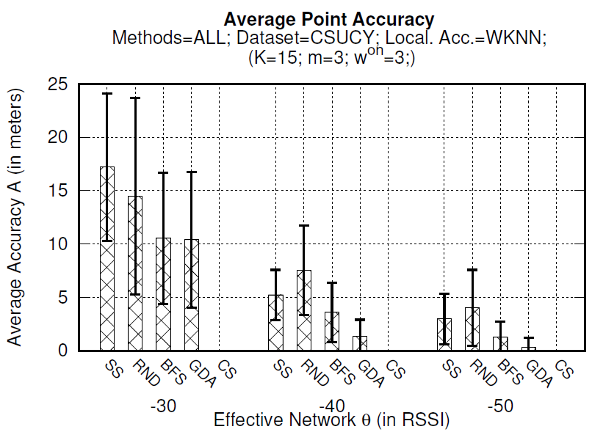
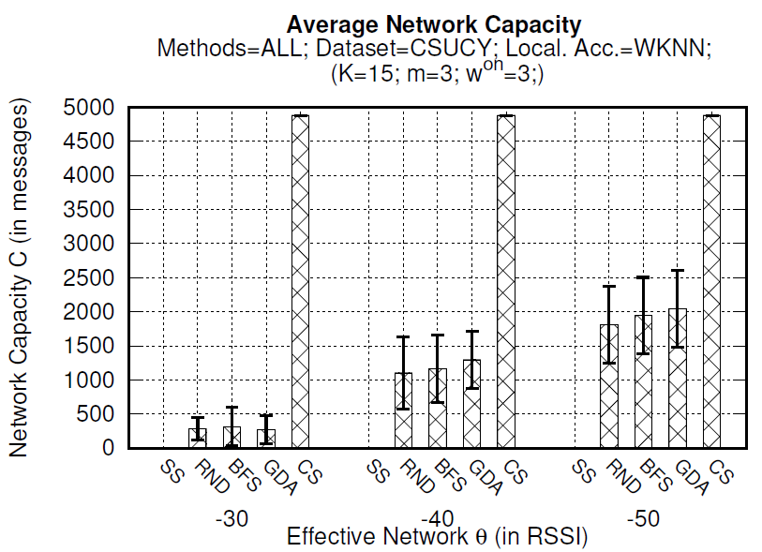
Experiment 3: Effective Network (θ)
θ = effectiveness of network with respect to u being connected: low θ = less intermittent connectivity = highest probability of u being connected while navigating
CS is fixed – not affected by θ – client side
SS quality A is affected by θ – server side
Grap (all) – lowest θ, better accuracy, worse performance (more downloading)
Grap (GDA) – always better quality (A) than RND & BFS in A
GDA less affected by K than RND & BFS: better selection of “useful” Vr in pRM
Notes:
θ parameter represents the effectiveness of the network with
respect to a user being connected, meaning that the lowest the θ of a network is, the less intermittent
connectivity inside a building exists and therefore the highest the probability of user u to be connected while navigating in the building.

