Slide 1
24th International Conference on Extending Database Technology
24th International Conference on Database Theory
(EDBT/ICDT 2021), March 23 – 26, 2021, Nicosia, Cyprus
Demetris Zeinalipour and Panos K. Chrysanthis
General Chairs
Host Organization:
https://edbticdt2021.cs.ucy.ac.cy/

Slide 2
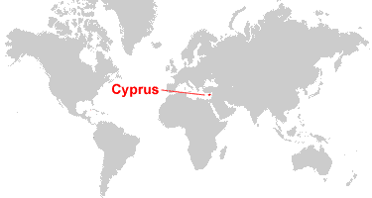
Kalosorisate (Welcome) to EDBT/ICDT 2021!
We hope you have a memorable online event, which overcomes in the best possible manner the inherent difficulties and travel restrictions incurred by the pandemic.
EDBT/ICDT 2021 started out as a Physical Conference proposal, evolved into a Hybrid Conference proposal and finally transitioned into an Online Event!
The complete EDBT/ICDT 2021 organization worked hard to capitalize and expand on the success of earlier organizations
- Cyprus: third largest and third most populous island in the Mediterranean
Part of European Union since 05/2004
Part of Eurozone since 01/2008

Slide 3
EDBT/ICDT 2021 by the Numbers
}
4 Keynotes & 1 ICDT Invited Talk
4 Tutorials
6 Workshops
15 Live Demos
160+ Presentations from ICDT/EDBT + workshop papers.
~440 Registrants
All talks this year are in Meeting Mode (not Webinar mode), synchronous presentations & synchronous Q/A (few exceptions).
Single Timezone: DAY1,3: EU-ASIA optimized. DAY2,4: EU-AMERICAS optimized
Social Program & Events (over 30 videos): Presenting the host country Cyprus through music and videos on culture, geography, food, leisure and other enjoyable aspects about Cyprus.
Low Registration Fees (be inclusive and widen participation)
Thanks to Track Chairs for their meticulous work

Slide 4
A) VGATE Online Platform
In just 2 months we brought forward a Zoom + Google Sheet Conference Management Platform used for the first time @ EDBT/ICDT 2021
Support Live Section, Social Rooms, Helpdesk, Industry Booths, Global Clock, Social program.
Virtual corridor and hallways discussions are supported by a number of unmoderated and dynamic social rooms on VGATE at all times (50 rooms, rooms with capacities to 1000 participants).
Meet-the-Authors (Demos, ICDT, Keynotes & Invited Speakers)
Central Management of Zoom Licenses, Recordings, Roles (Host, Superhosts, Alternative Hosts, etc.)
Helpdesk and Session Chairs makes organization more interactive and brings more structure.
https://vgate.cs.ucy.ac.cy/

Slide 5
B) Pandemic Greetings from the Pioneers and the Next Data Management Challenge
Philip A. Bernstein (Microsoft Research, USA)
Yannis Ioannidis (University of Athens, Greece)
Laura M. Haas (University of Massachusetts - Amherst, USA)
Jeffrey D. Ullman (Stanford, USA)
When? Reception II - Day 2 (EU-Americas):
Wed., Mar. 24, 2021, 19:00-20:00 GMT+1
Welcome Message by General Chairs - EDBT/ICDT 2021, March 23 – 26, 2021, Nicosia, Cyprus
5

Slide 6
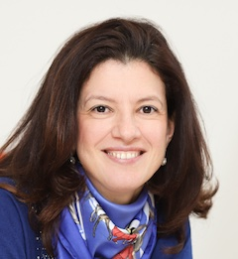
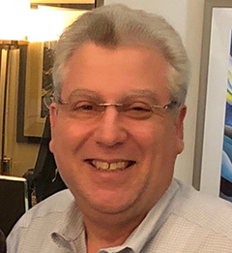
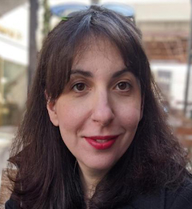
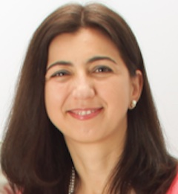
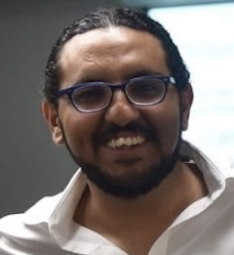
C) Diversity and Inclusion Debrief
Introducing the D&I initiative whose mission is to establish best practices for Diversity and Inclusion in Database Conference Venues
Debrief, Sihem Amer-Yahia (CNRS, Univ. Grenoble Alpes, France)
Panos K. Chrysanthis (University of Pittsburgh, USA)
Avrilia Floratou (Microsoft, USA)
Fatma Ozcan (Google, USA)
Victor Zakhary (Oracle, USA)
When? Reception I - Day 1 (EU-Asia): Tue., Mar. 23, 2021, 13:20-14:20 GMT+1

Slide 7
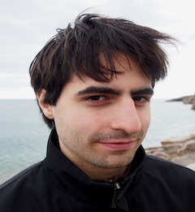
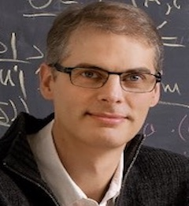
D) Climate Change Session
Chair: Antoine Amarilli (Télécom Paris, France). External guest: Benjamin Pierce (University of Pennsylvania, USA)
When? Day 4 (Day 4 (EU-Americas): Fri., Mar. 26, 2021, 16:30-17:30 GMT+1
Welcome Message by General Chairs - EDBT/ICDT 2021, March 23 – 26, 2021, Nicosia, Cyprus
7

Slide 8
Sponsors
Platinum Sponsor
Sponsored Industry Talk: Behind the Scenes of Snowflake's new Search Optimization Service, Ismail Oukid (Snowflake, Germany) and Stefan Richter (Snowflake, Germany)
When? Dinner - Day 3: Thu., Mar. 25, 2021, 13:45—14:45 GMT+1
Bronze Sponsors
(EDBT/ICDT 2021), March 23 – 26, 2021, Nicosia, Cyprus
Welcome Message by General Chairs - EDBT/ICDT 2021, March 23 – 26, 2021, Nicosia, Cyprus
8

Slide 9
EDBT/ICDT 2021 Dedication
We dedicate EDBT/ICDT 2021 in honour of the memory
of Prof. George Samaras† (1959–2018).
George was the initial General Chair for
EDBT/ICDT 2021
Additional Events:
https://dmd.cs.ucy.ac.cy/
https://samarastenniscup.cs.ucy.ac.cy/
(EDBT/ICDT 2021), March 23 – 26, 2021, Nicosia, Cyprus
Welcome Message by General Chairs - EDBT/ICDT 2021, March 23 – 26, 2021, Nicosia, Cyprus
9

Slide 10
It is difficult to thank all the people that have contributed to realizing this event.
To each one of you and the audience:
Thank You!
Demetris Zeinalipour and Panos K. Chrysanthis
General Chairs

Slide 11
