Slide 1
IMCF: The IoT Meta-Control Firewall
for Smart Buildings
Soteris Constantinou∗, Antonis Vasileiou∗,
Andreas Konstantinidis∗‡, Panos K. Chrysanthis†∗,
Demetrios Zeinalipour-Yazti∗
∗ University of Cyprus, 2109 Nicosia, Cyprus
‡ Frederick University, 1036 Nicosia, Cyprus
† University of Pittsburgh, Pittsburgh, PA 15260, USA
constantinou.sotiris @cs.ucy.ac.cy, avasil06@cs.ucy.ac.cy,
com.ca@frederick.ac.cy, panos@cs.pitt.edu, dzeina@cs.ucy.ac.cy
24th International Conference on Extending Database Technology
Co-located with 24th International Conference on Database Theory
March 23 – 26, 2021 Nicosia, Cyprus
Notes:
Hello everyone, I am Sotiris Constantinou from UCY and I welcome you to the demo presentation of The IoT Meta-Control Firewall
for Smart Buildings.

Slide 2
Climate Change
Internet-connected smart devices will drastically increase to more than 500 for each typical family in the developed world by 2022.
European’s Commission calls for a climate-neutral Europe by 2050.
The CO₂ pollution of ICT is expected to rise from 4% to 8% by 2025.
Notes:
According to studies , it is expected that the number of IoT devices per house will drastically increase to more than 500 smart devices by 2022.
The EU aims to be climate-neutral by 2050 – an economy with net-zero greenhouse gas emissions. This objective is at the heart of the European Green Deal and in line with the EU’s commitment to global climate action under the Paris Agreement.
Unfortunately, the CO2 pollution of Information and communications technology is expected to rise from 4% to 8% by 2025.

Slide 3
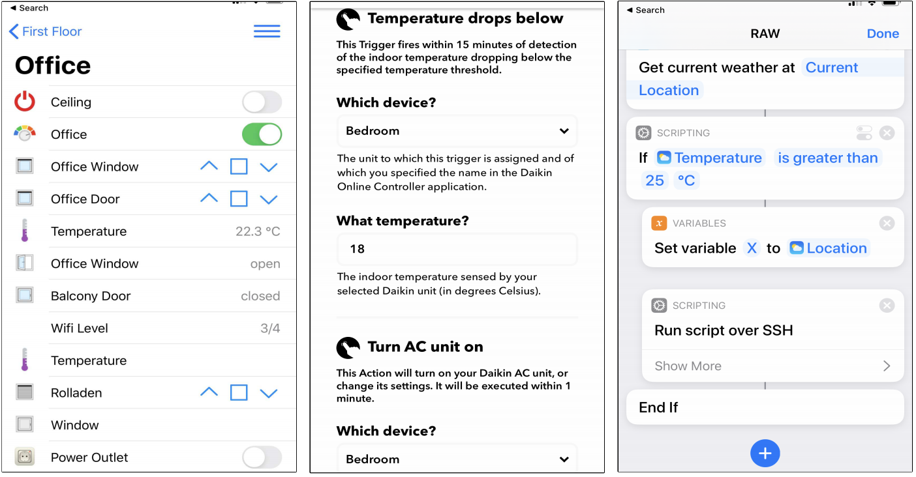
Rule Automation Workflows (RAW)
Span from simple predicate statements to procedural workflows capturing a smart actuation pipeline.
None of these supports
the expression
of long-term objectives
(e.g., energy consumption)
Notes:
Many IoT devices enable the execution of Rule Automation Workflows, which span from simple predicate statements to procedural workflows
capturing a smart actuation pipeline in tools like IFTTT, Apilio, or Apple Automation.
The Rule Automation Workflows aim to meet the convenience level of users under specific conditions.

Slide 4
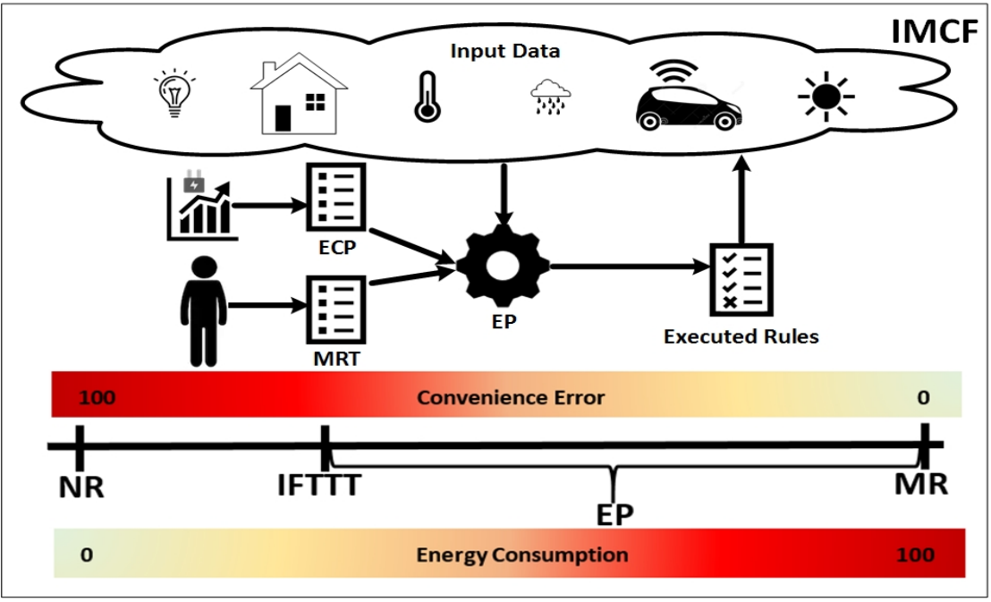
Problem
None of the above technologies enable users to achieve some long-term objectives.
How to utilize RAW pipelines to meet an annual energy consumption target?
For example consume only 8000 kWh per year.
Optimize various objectives:
Convenience
Energy consumption
At the same time
Notes:
However, none of the above RAW technologies enables individuals or group of users to express their convenience or comfort preferences while achieving some long-term objectives.
Consider for example a family with a yearly budget of 8000 kWh that aims to spend this energy budget through Rule Automation Workflows based on their configured energy consumption preferences.
The family is willing to adapt its desired interior temperature preferences according to production patterns, but has no clue how the RAW pipelines contribute to the target of using only 8000 kWh per year.
Our aim is to optimize both , Convenience and Energy consumption objectives at the same time.

Slide 5
Algorithms
No-Rule (NR) [Baseline Approach]:
Ignores all rules in the Meta-Rule-Table.
Meta-Rule (MR) [Baseline Approach]:
Ignores the energy consumption and executes all rules (greedily) in
the Meta-Rule-Table.
If-This-Then-That (IFTTT):
Executes the IFTTT preferences configured by the users.
Energy Planner (EP) :
Executes meta-rules considering the trade-off between convenience and
energy consumption.
Notes:
Here we see a breakdown of our applied algorithms.
The No-Rule approach does not modify the behavior of the autonomous devices, therefore the energy consumption is minimum and the convenience error is maximum.
The Meta-Rule algorithm satisfies all rules set by the user by completely ignoring the energy consumption, therefore the energy consumption is maximum and the convenience error is minimum.
Furthermore, The IFTTT approach executes the IFTTT preferences configured by the users.
..and finally, The Energy Planner algorithm executes rules considering the trade-off between convenience and energy consumption.

Slide 6
Solution: The IMCF Framework
The IoT Meta-Control Firewall (IMCF) Framework:
Amortization Plan (AP) algorithm:
Calculates the maximum energy budget constraint
Energy Plan (EP) algorithm:
Executed in fixed time slots for generating an energy plan solution.
Notes:
The IMCF utilizes IoT data and adopts the Amortization and the Energy Plan algorithms to meet the convenience level of users under specific conditions, and at the same time meet some long-term target also configured by users.
It internally deploys an Artificial intelligent algorithm that exploits domain-specific operators in order to optimize the convenience and energy consumption objectives.
Our framework filters the rules of users in a way that these do not collide with the configured long-term objectives (like an actual network firewall).

Slide 7
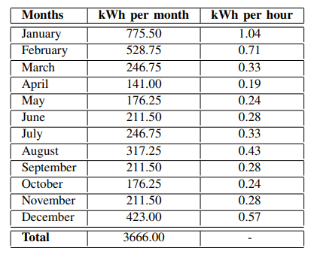
Amortization Plan & Energy Plan Algorithms
AP: Calculates the energy budget constraint → subject to a monthly residence Energy Consumption Profile
Balloon Linear Amortization Formula (BLAF)
ECP-based Amortization Formula (EAF)
Linear Amortization Formula (LAF)
EP: Utilizes the hill climbing approach
Searches decision space for a solution
Optimize users’ convenience
Satisfy energy constraint
Notes:
The Amortization Plan is initially executed for calculating the energy budget constraint, subject to a monthly residence Energy Consumption Profile. There are several amortization strategies that can be used, such as the Linear, Balloon Linear and the ECP based amortization formula.
The Energy Planner Utilizes the well known hill climbing approach, searches the decision space for a solution that will optimize the user’s convenience and satisfy the energy constraint, at the same time.
However, any kind of heuristic or meta-heuristic approach can be utilized in the EP optimization step.

Slide 8
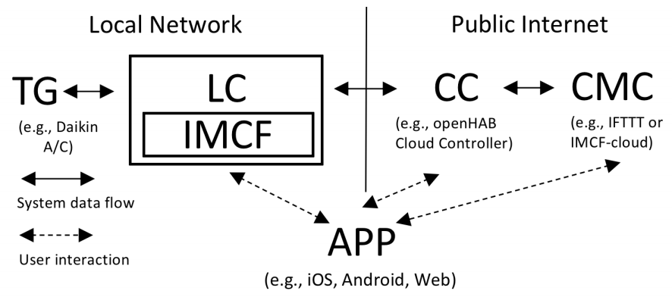
IMCF System Architecture
Local Controller → direct communication with the IoT devices
OpenHAB smartphone application
APP connects to the Cloud Controller
Cloud Meta-Controller → enable users to configure/run custom rules
Notes:
Our system architecture comprises of a full-fledge local controller implemented inside the openHAB stack, which is a smart home management software; and IMCF, which is the software system that encapsulates the complete application logic of the energy management stack we propose along with the respective user interfaces.
The Local Controller is a java-based system installed on a micro device, running on the local network of a user, that will be in direct communication with the IoT devices through the Openhab smartphone Application.
The complete picture can tentatively be complemented by a Cloud Meta-Controller, which can enable the user to configure and run various custom rules.

Slide 9
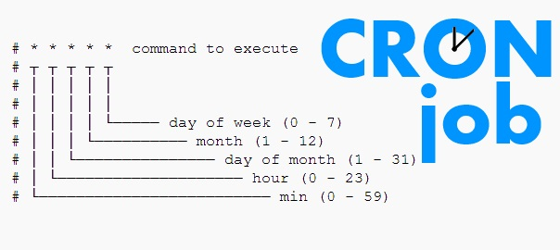
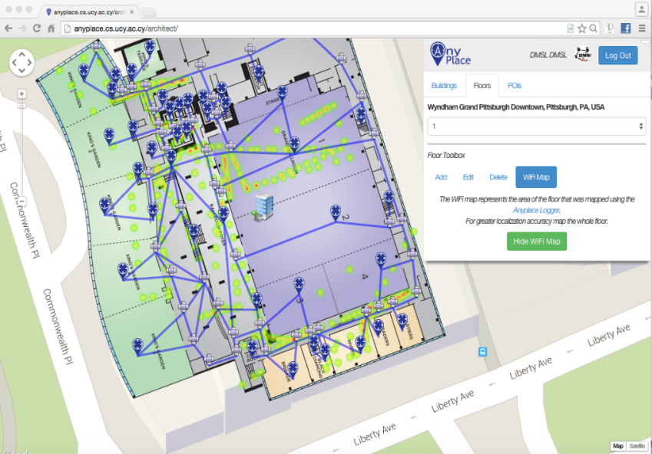
IMCF Implementation
anyplace.cs.ucy.ac.cy
Notes:
The IMCF has been implemented using the open Home Automation Bus , the Linux crontab daemon, the Anyplace for building modeling, as well as the Laravel PHP web framework following the model–view–controller architectural pattern.

Slide 10
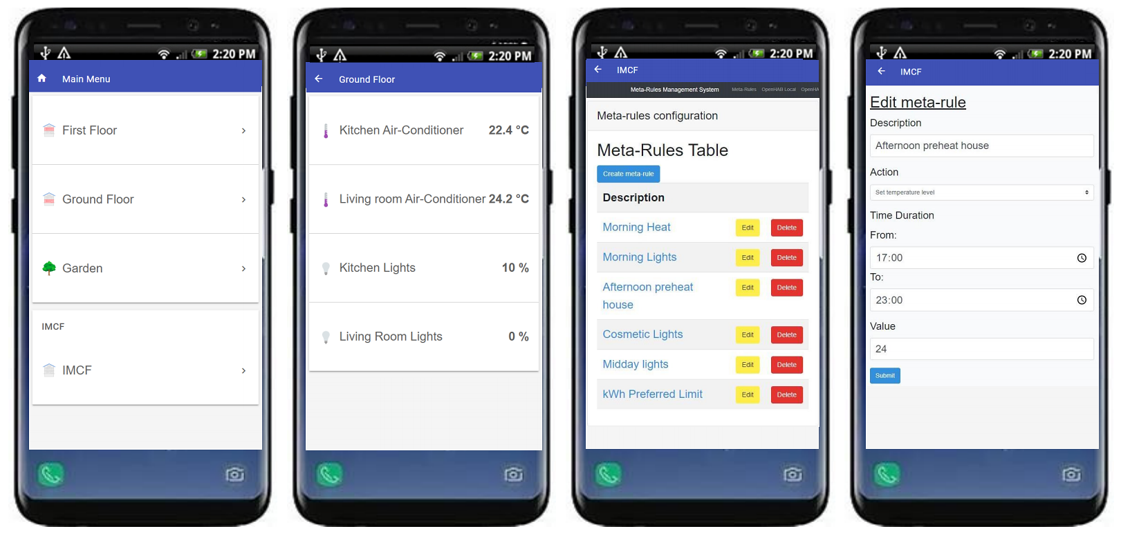
IMCF GUI
DEMO
Notes:
In our demonstration scenario that will follow, attendees will be able to observe the execution and benefits of IMCF on a graphical dashboard using pre-configured Meta-Rule-Table profiles.

Slide 11
IMCF: The IoT Meta-Control Firewall
for Smart Buildings
Thank you!
Soteris Constantinou∗, Antonis Vasileiou∗,
Andreas Konstantinidis∗‡, Panos K. Chrysanthis†∗,
Demetrios Zeinalipour-Yazti∗
∗ University of Cyprus, 2109 Nicosia, Cyprus
‡ Frederick University, 1036 Nicosia, Cyprus
† University of Pittsburgh, Pittsburgh, PA 15260, USA
constantinou.sotiris @cs.ucy.ac.cy, avasil06@cs.ucy.ac.cy,
com.ca@frederick.ac.cy, panos@cs.pitt.edu, dzeina@cs.ucy.ac.cy
24th International Conference on Extending Database Technology
Co-located with 24th International Conference on Database Theory
March 23 – 26, 2021 Nicosia, Cyprus
Notes:
This is the end of the presentation, thank you very much for watching.

