Slide 1
Climate Change Session: An Open Discussion
Antoine Amarilli (Télécom Paris)
https://a3nm.net/
Demetris Zeinalipour (Univ. of Cyprus) https://www.cs.ucy.ac.cy/~dzeina/
https://diku-dk.github.io/edbticdt2020/
1

Slide 2
Goals & Structure
Discuss the ongoing climate crisis and the role of EBDT/ICDT in this crisis.
Session Structure:
Short introductory presentation by the session chairs.
Open discussion about the carbon footprint of the EBDT/ICDT conference.
2

Slide 3
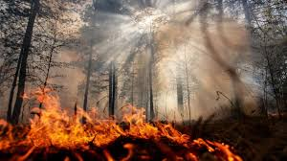
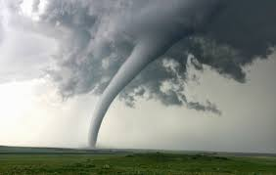
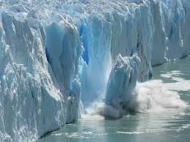
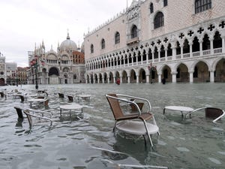
Global Warming and Climate Change
B) Climate Change: new weather patterns that remain for an extended time having an impact on human health and the environment.
brings
A) Global Warming: human-caused increase in global surface temperatures.
Rising Temperatures: a) dryness, wildfires; b) tornadoes, hurricanes, earthquakes, tsunamis; c) ice-melting, sea-level risings, floodings, …
3

Slide 4
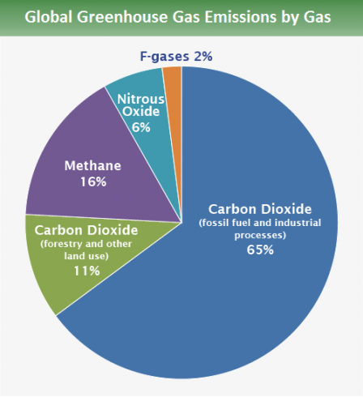
CO2 - Global Warming Culprit
Why do we have Global Warming?
Current Human activity (coal, oil, gas) generates Carbon Dioxide (CO₂), the predominant Greenhouse Gas (76%)!
CO₂ traps Solar Radiation inside the atmosphere that eventually leads to Global Warming.
Oceans clean only ¼ of CO2 pollution while trees another ¼.
76%
4% ICT
10.5% ICE Cars
2.5% Aviation
US EPA: https://www.epa.gov/ghgemissions/global-greenhouse-gas-emissions-data
4
Notes:
Ozone O3 hole a different problem: Fluroscent Gases that created a hole
https://www.dw.com/en/eu-commission-planning-green-auto-industry-rescue-report/a-53505451
4

Slide 5
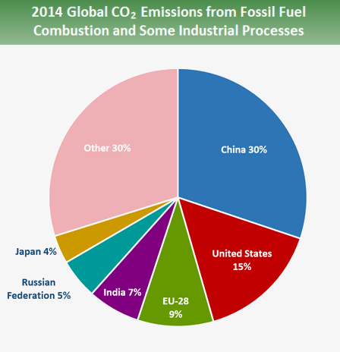
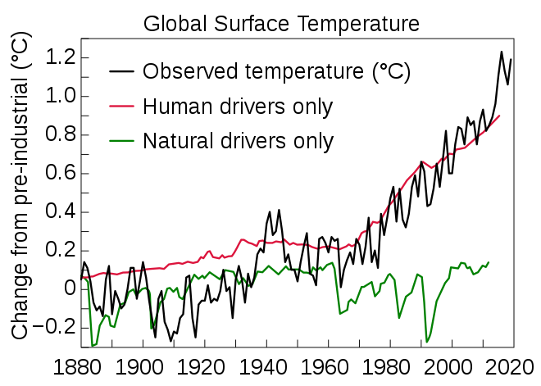
CO2 - Global Warming Culprit
CO₂ emerging in all sectors and rising economies
We are witnessing a steady increase in CO₂ since the Industrial Revolution (1760 – 1840 AD)
Global warming will continue if we don’t act promptly!
The Intergovernmental Panel on Climate Change (IPCC) is an intergovernmental body of the United Nations: World Meteorological Organization (WMO)
United Nations Environment Programme (UNEP)
5
Notes:
https://ec.europa.eu/eurostat/statistics-explained/index.php/Renewable_energy_statistics
https://www.ipcc.ch/sr15/
The Intergovernmental Panel on Climate Change (IPCC) is an intergovernmental body of the United Nations^{[1][2]} that is dedicated to providing the world with objective, scientific information relevant to understanding the scientific basis of the risk of human-induced^{[3]} climate change, its natural, political, and economic impacts and risks, and possible response options.^{[4]}
The IPCC was established in 1988 by the World Meteorological Organization (WMO) and the United Nations Environment Programme (UNEP) and was later endorsed by the United Nations General Assembly. Membership is open to all members of the WMO and UN.^{[5]} The IPCC produces reports that contribute to the work of the United Nations Framework Convention on Climate Change (UNFCCC), the main international treaty on climate change.^{[6][7]} The objective of the UNFCCC is to "stabilize greenhouse gas concentrations in the atmosphere at a level that would prevent dangerous anthropogenic (human-induced) interference with the climate system".^{[6]} The IPCC's Fifth Assessment Report was a critical scientific input into the UNFCCC's Paris Agreement in 2015.^{[8}
5

Slide 6
CO2 by Information and Communications Technology (ICT)
ICT contributes ~2-4% of world CO2 emissions and will increase to 8% by 2025!
Are we comfortable doing research that (allegedly) contributes to CO2 increase?
How much CO2 is technology saving anyway? (Teleconferencing vs. Physical Meetings?)
How to make impactful research to reduce this increase from 4% to 8%? (edge computing?, energy efficiency?, reusable systems?, transparency? )
55% use
45% manufacturing
6

Slide 7
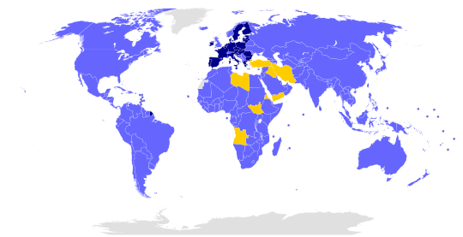
The Paris Agreement
The Paris Agreement within the United Nations Framework Convention on Climate Change (UNFCCC), dealing with greenhouse-gas-emissions mitigation, adaptation, and finance, signed in New York City, on April 22, 2016.
?
Targets:
- CO2 neutral by 2050!
- Temperature increase below 2° Celsius
194
Wikipedia
7
Notes:
In June 2017, U.S. President Donald Trump announced his intention to withdraw the United States from the agreement. Under the agreement, the earliest effective date of withdrawal for the U.S. is November 2020, shortly before the end of President Trump's 2016 term
7

Slide 8
RoadMap to 2050!
Some countries almost already in 2050!
Norway’s large water reservoir capacity is used to store and regulate a fluctuating supply of renewables … a 50 GWh battery!
Norway Hits 64.4% EV Market Share In January 2020. https://cleantechnica.com/
8

Slide 9
CO2 Finance Issues
Offsetting CO2:
Residential Photovoltaic System in Sunny country 1 year production (10kWp): 24 tons CO2 / 4 persons = 6 tons / person!
i.e., 17MWh (~4000€) for heating, electricity and mobility
Lifetime PV Prod. (2 years): 600 tons CO2 (i.e., 150 tons/person)
CO2 Penalties:
2020: 25.15 Euros / ton
Penalty: 600 Euros / person /year!
https://markets.businessinsider.com/commodities/co2-european-emission-allowances
Future: 100 Euros / ton (Herbert Diess, VW CEO)
Penalty: 2400 Euros / person / year!
https://www.electrive.com/2020/01/28/vw-boss-herbert-diess-gets-frank-about-co2/
Will governments shift CO2 costs down to citizens as new taxes? Problem solved?
9

Slide 10
How is EDBT/ICDT part of the problem?
10

Slide 11
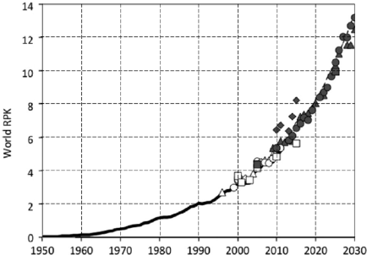
CO2 Emissions from Air Travel
Air travel: currently ~2-3% of emissions, but on the rise, because people tend to travel more:
i.e., ~100 gCO2/passenger-km
But in fact ~250 gCO2eq
because of other pollutants
Road and rail are ~60g CO2eq
Fly Lisbon⬅➔ Copenhagen: 1 ton CO2eq!
Your lifetime carbon budget (for everything, not just travel): 200 tons CO2eq
Trillions of revenue passenger kilometres per year, from Wild, Baxter, Sabatini, Sustainable Technologies for Aircraft Energy Generation, Storage, and Distribution, PRCC 2014
11
- test
Flight from Lisbon to Copenhagen:
1 ton of CO2eq!
Your lifetime budget: 200 tons
(for all activities, not just travel)
Road/rail: 60 gCO2eq/pax-km
Air travel: currently ~2% of emissions, but on the rise
About 100 gCO2/passenger-km, but amounts to about 250 gCO2eq because of other pollutants

Slide 12
Reducing the Need to Travel
To reduce emissions, avoid plane travel, and travel more wisely and be more selective? Publish less?
First: measure the total travel footprint of attendees
Analyze the data, choose places minimizing travel?
Unfair advantage for only a few cities?
Colocation with other conferences to reduce travel
Improving remote participation:
Live streaming of talks?
Allow remote talks and questions?
12

Slide 13
Carbon Offsets
Idea: support projects that reduce CO2 emissions
Measure your CO2 footprint, say 1 ton CO2
Finance projects whose expected outcome is to reduce CO2 emissions by 1 ton
Nowadays: around 25 EUR / ton CO2
Could be included in the registration fee
Make EDBT/ICDT carbon neutral
Not a perfect solution (still better not to travel)
13

Slide 14
Other Ideas to Reduce Impact
Producing food, especially meat, emits lots of CO2
All-vegetarian menus?
Local producers?
Avoid disposable dishware
Avoid conference bags and
other gadgets?
Source: Tilman and Clark, Global diets link environmental sustainability and human health, Nature, 2014
14

Slide 15
Other initiatives and call to discussion
15

Slide 16
Other initiatives in CS
SIGPLAN Climate Committee
https://www.sigplan.org/Resources/Climate/
Asks ACM to charge conferences for their footprint
Moshe Vardi’s piece in CACM
Asks ACM to allow video talks in its conferences
acm-climate mailing-list
TCS4F.org (theoretical computer science group)
Conference manifesto to commit to CO2 reductions
16

Slide 17
Climate Change Session: An Open Discussion
Should we care about contributing to the climate crisis?
Can we help with our research?
Should we still do in-person conferences? How?
Thank You!
https://diku-dk.github.io/edbticdt2020/
17

Slide 18
Ozone Depletion Halted! (Success Story of Solidarity)
Caused by manufactured chemicals (e.g., refrigerants, solvents), which catalyze the breakdown of ozone (O₃) into oxygen (O₂).
The ozone layer prevents the most harmful wavelengths of UV light from penetrating the atmosphere (skin cancer, etc.)
1982: Ozone Hole discovered
1987: Montreal Protocol bans the production of CFCs, halons and other ozone-depleting chemicals.
2019: NASA announced the "ozone hole" was the smallest ever.
2075: pre-1980 levels anticipated.
18
Notes:
Solidaridy: unity or agreement of feeling or action, especially among individuals with a common interest; mutual support within a group.

