Slide 1
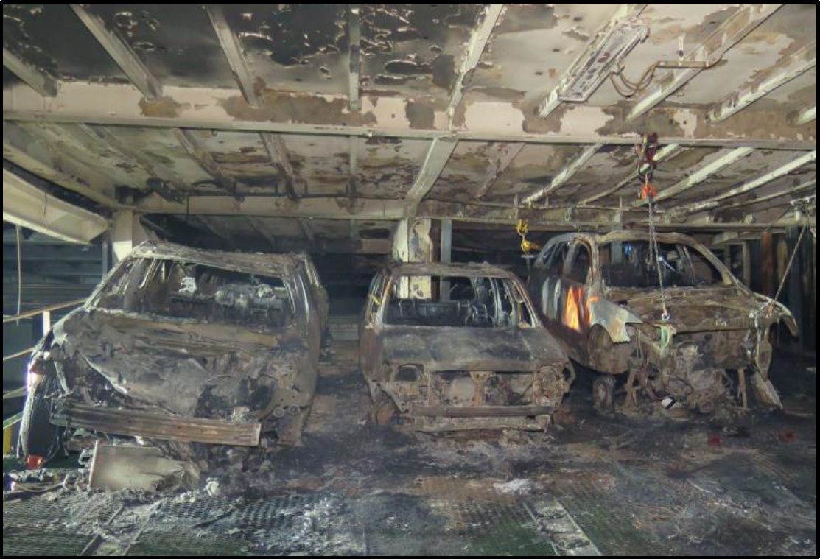
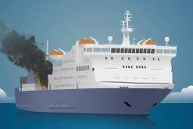
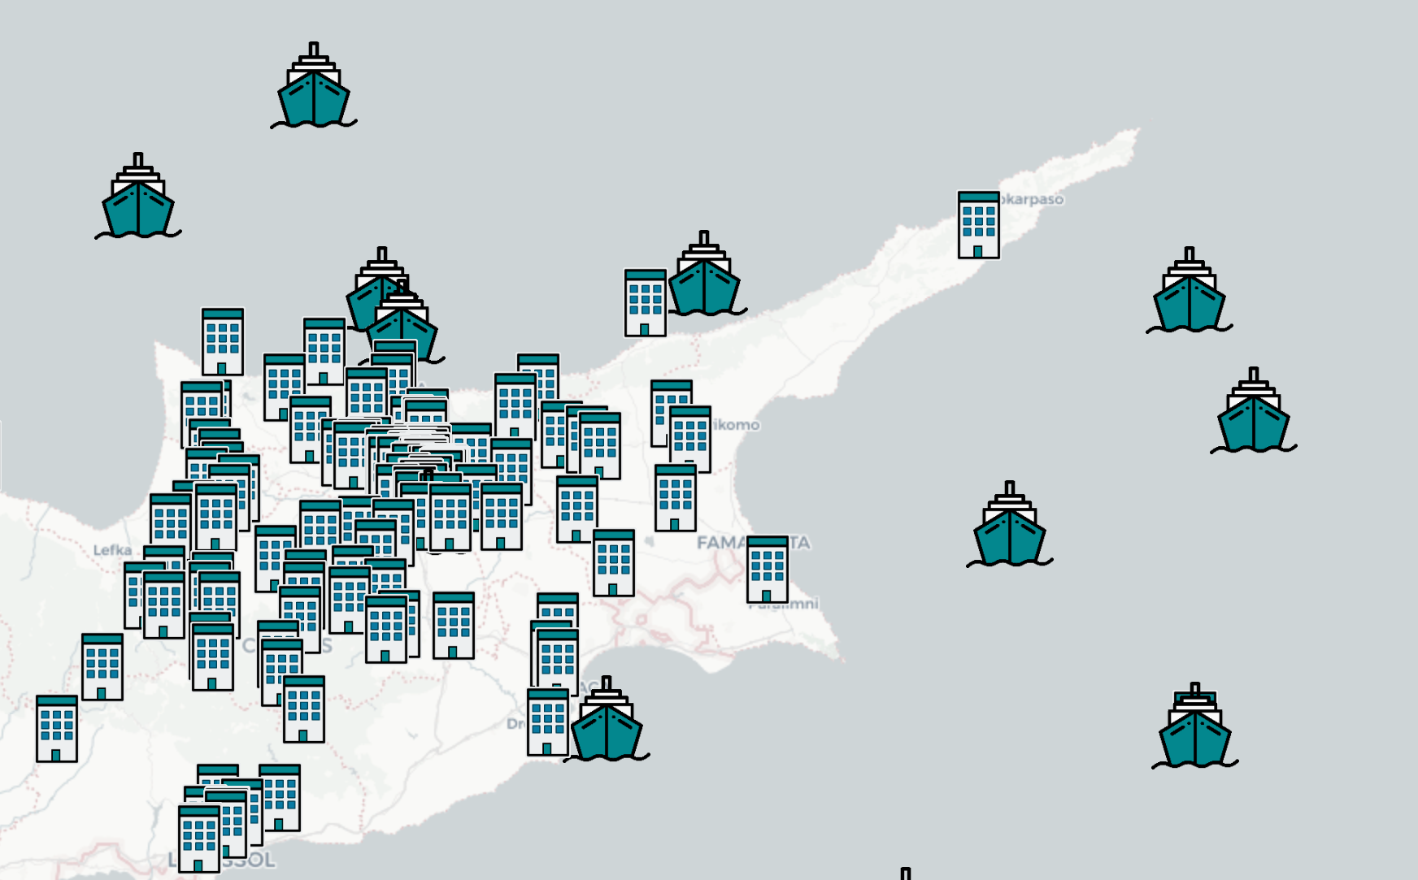
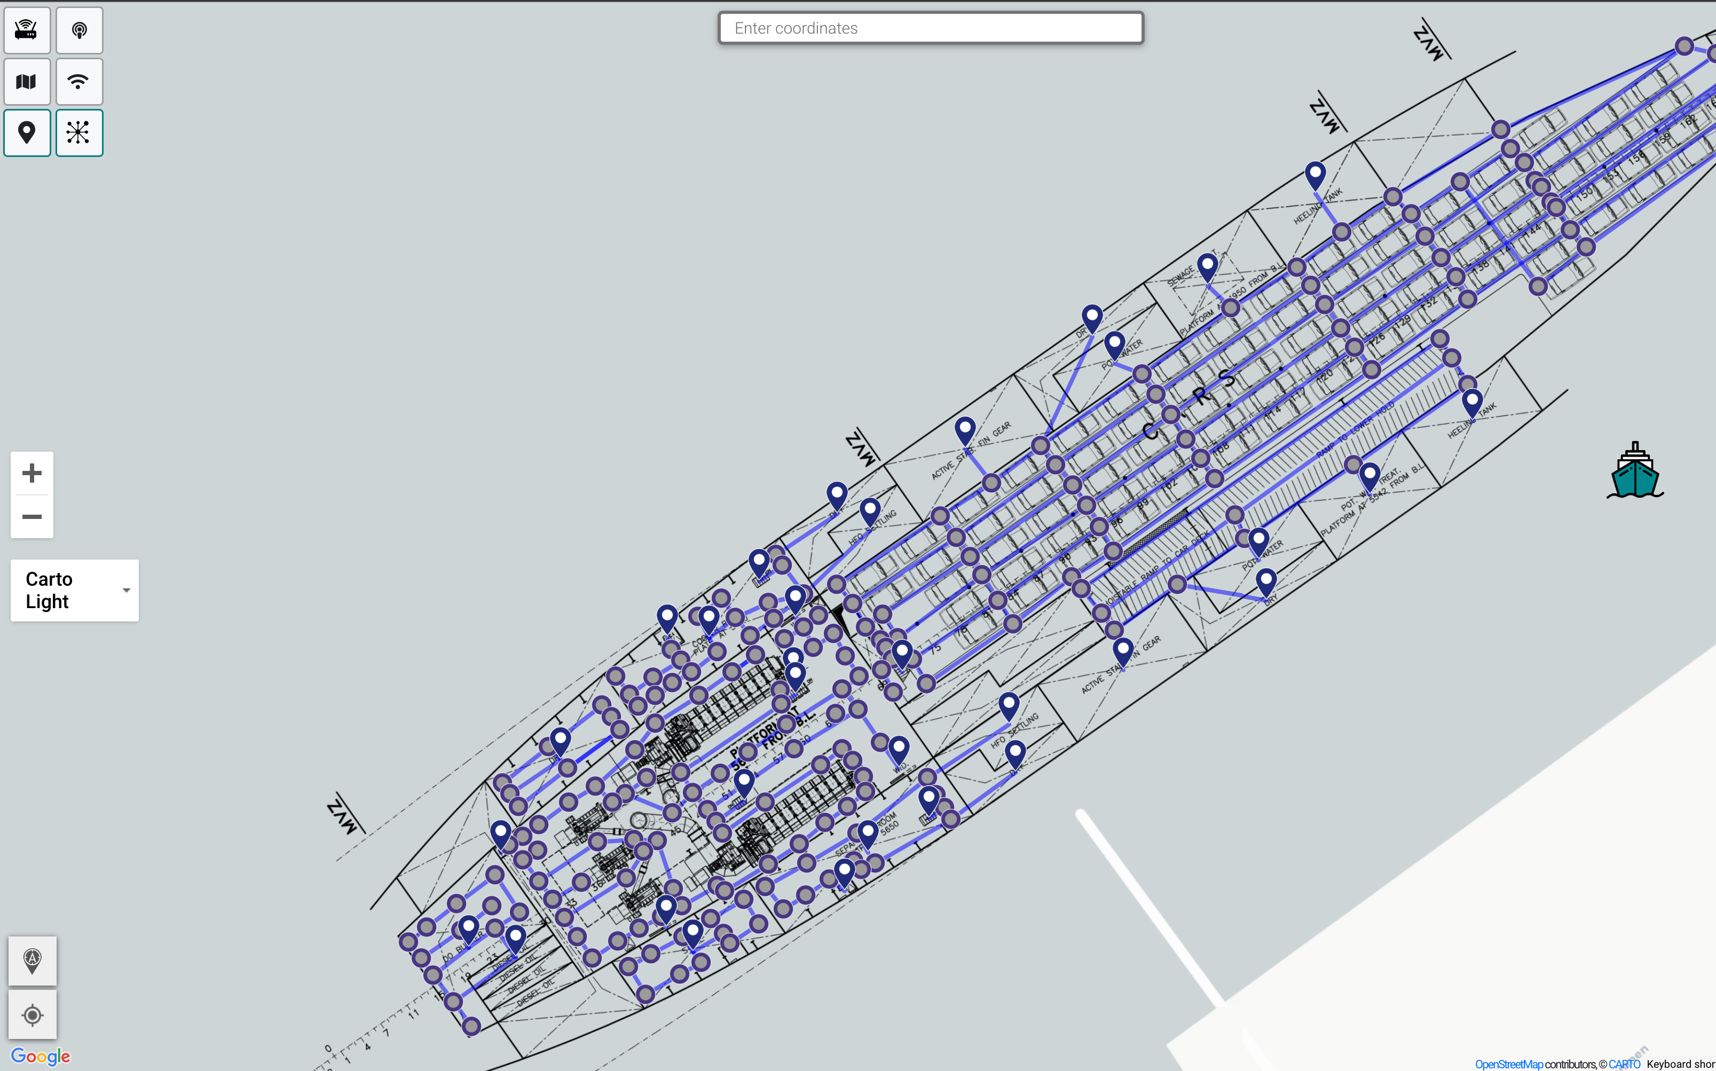
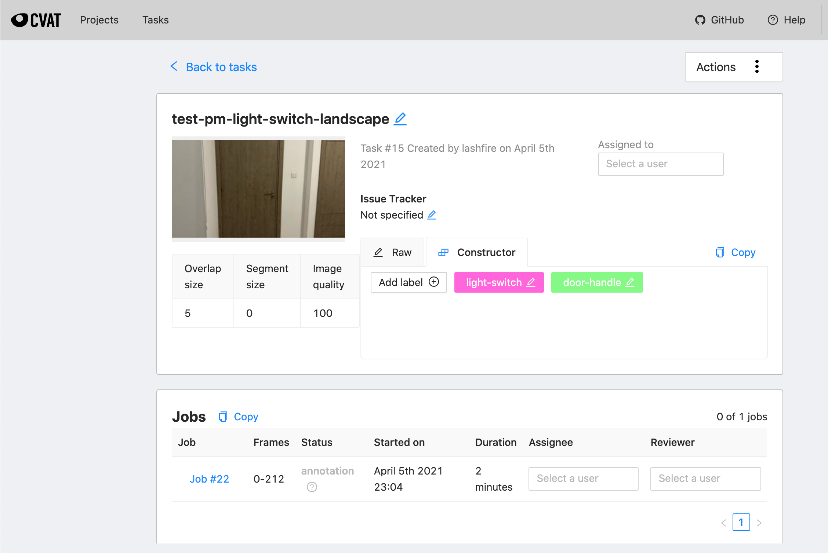
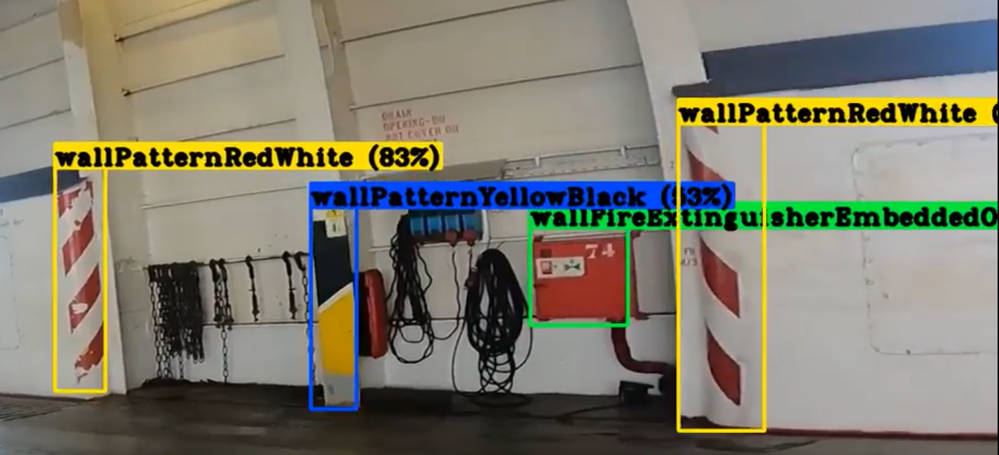
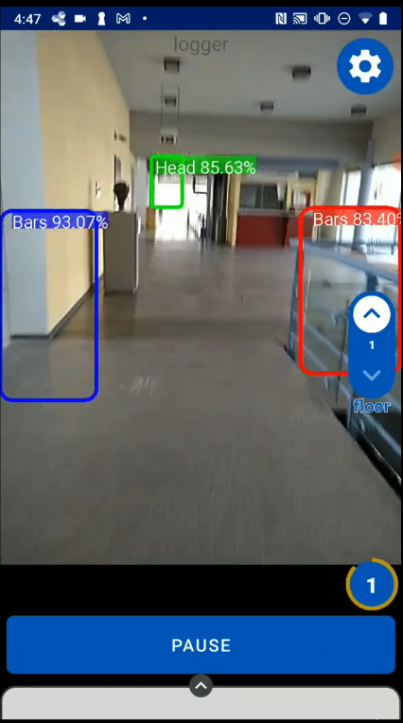
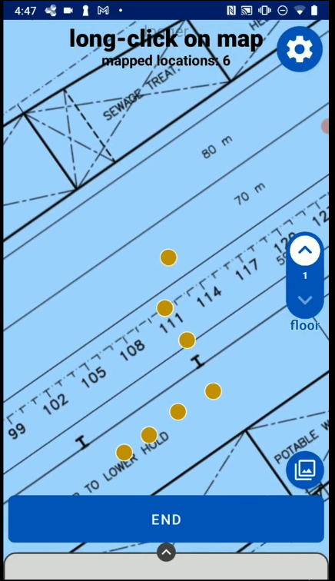
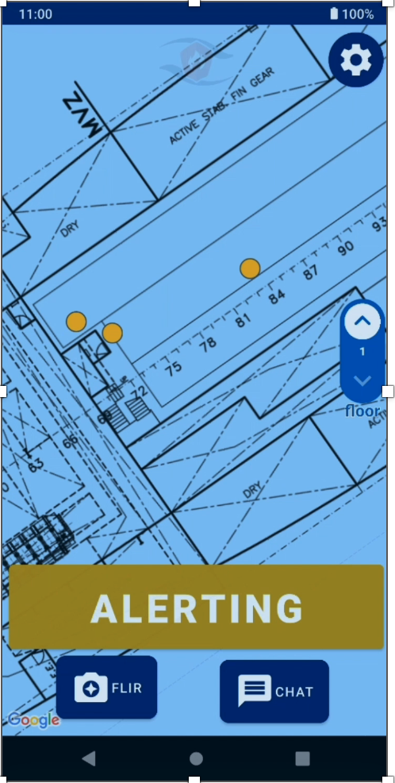
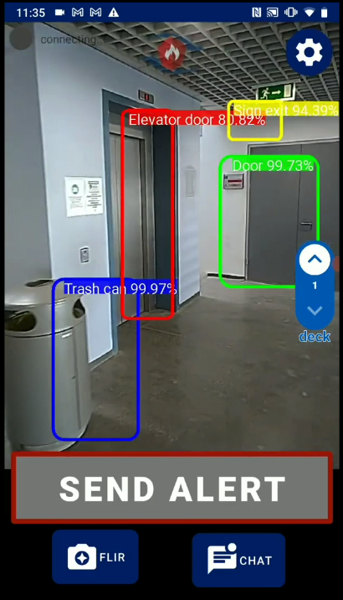
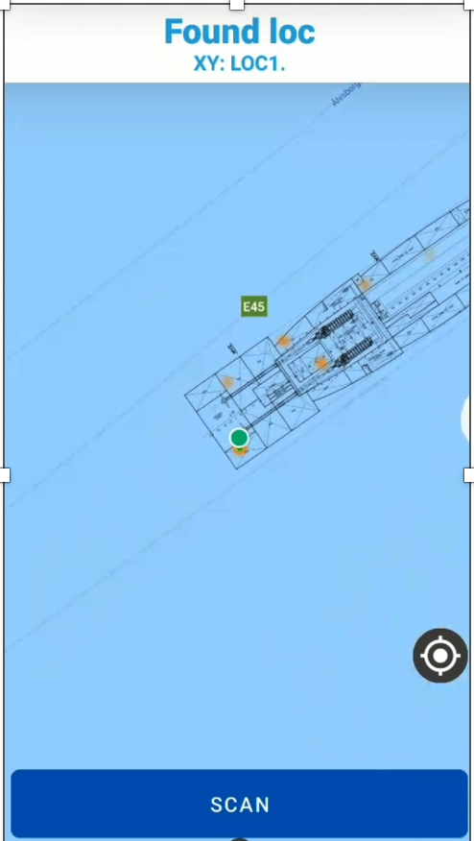
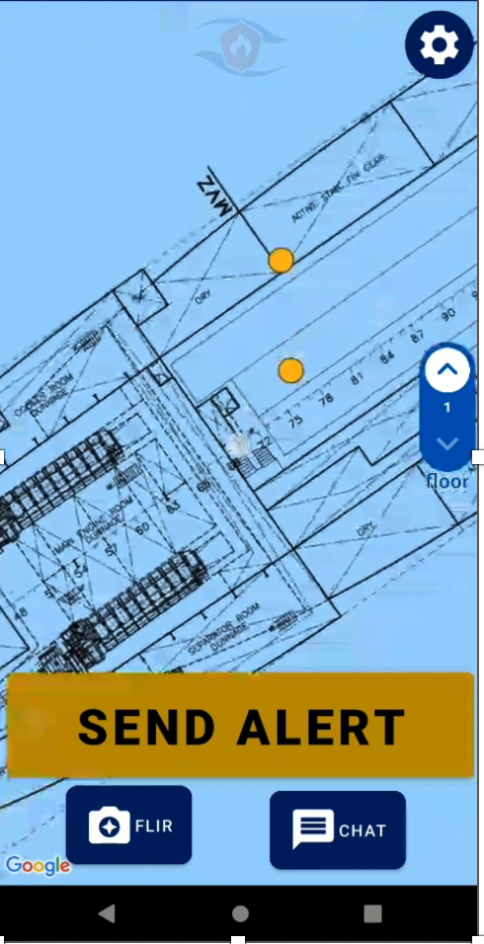
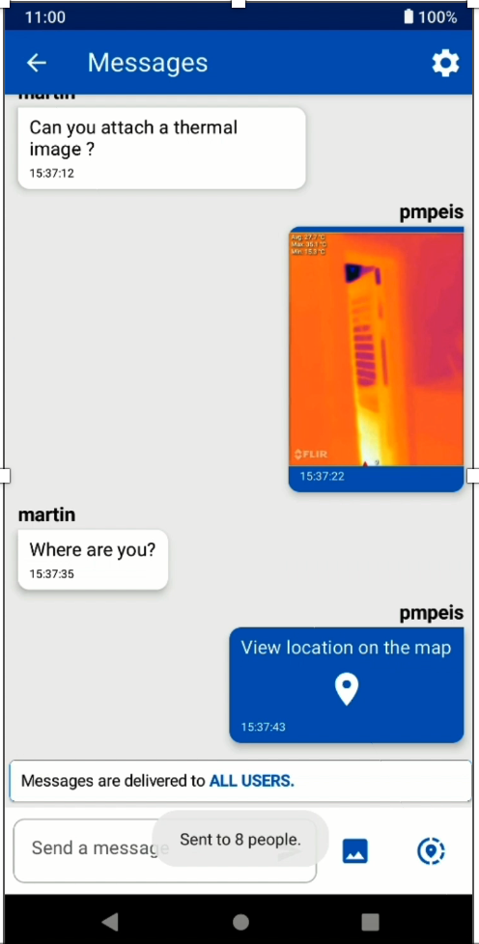
SMAS: A Smart Alert System for Localization and First Response to Fires on Ro-Ro Vessels Paschalis Mpeis¹, Athina Hadjichristodoulou¹, Jaime Bleye Vicario², Demetrios Zeinalipour-Yazti¹ University of Cyprus, Cyprus¹ Integral Maritime Safety, Centre Jovellanos, Spain²
Motivation
Background: Anyplace
There is a need for quick & efficient first response in Ro-Ro Vessels. This requires:
- indoor localization, and
- a smart communication system
Indoor Location is challenging:
Wi-Fi based approaches:
- Vessels have a limited Infrastructure
- Sufficient for communication
- No dense antennas for indoor-localization
Magnetic-Based approaches:
- Limited accuracy
- Requires stationary steel structures
- Not applicable:
+ e.g., a vessel is a huge, moving, steel structure!
IMU-Based approaches:
- Suffer from drifting & over time the error increases
- Require a periodic signal correction
Anyplace: An open-source Internet-based Indoor Navigation (IIN) Service
developed at the University of Cyprus!
- Achieves highest accuracy using Wi-Fi and IMU (1.96 meters), in real-time, while being energy-efficient and infrastructure-less.
[ 2nd @ Microsoft Indoor Comp. @ IPSN’14, 1st at EVARILOS by TU Berlin ]
- Offers advanced search and navigation to various Points-of-Interests (POIs) in buildings and campus (e.g., 60 buildings at the University of Cyprus).
- Enhanced with Vessel support, high-resolution and high-accuracy placement of deckplans, and Computer-Vision fingerprint management and localization.
anyplace.cs.ucy.ac.cy
soon
Solution Overview
1: Video / Annotation
3: Localization DB
Computer Vision: the scientific field that deals with how computers can gain high-level understanding from digital images or videos.
Computer-Vision Based Localization:
Video Capture / Annotation
Machine Learning
Localization DB
=> Use Mobile App to Localize / Track
- users supply video footage
- those are annotated using the CVAT tool
Anyplace CV Logger:
- Map spatial coordinates to recognized objects
- This creates unique fingerprints per location
- With crowdsourcing we speed up the
CV Fingerprint Database creation
Visualize the density of the fingerprints
- allow users to improve accuracy
- can use QR Codes in special circumstances
2: Machine Learning
- We use the DarkNet DNN of the Yolo project to generate a Machine Learning model in-house
- Then we convert the YOLO model to TensorFlow Light so it can run on mobile devices
} user
} lab
} user
CV Fingerprint and Localization Data Management
Location-Aware Smart Alert System
Utilizing an Edge Architecture:
- Fingerprints can be stored on low-end single-board devices
+ e.g. the Raspberry PI
Acquire user location:
- Without requiring any infrastructure:
- Allow multiple user scenarios
- Provide location-aware communication
+ can exchange text
+ images (including thermal ones)
+ location
Message Reachability:
- Restrict messages to
users on:
+ Same Vessel
+ Same Deck
+ Within a bounding box
+ K Nearest Neighbors
Localization And Tracking:
No infrastructure needed, just smartphone.
No Video streaming, just object detected resolved to location either on the device or the edge => Lightweight Solution
Privacy-preserving solution => Client-side only!
SMAS API
db1
db2
db3
Location Reporting:
- Location events are stored on separate DB instances
- Those are then aggregated to a central DB
- This provides a consistent view of user locations
central DB
DEBS 2022
https://2022.debs.org
Contact: dmsl@cs.ucy.ac.cy
https://dmsl.cs.ucy.ac.cy/

