Slide 1
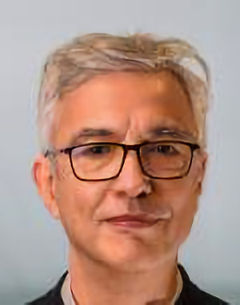
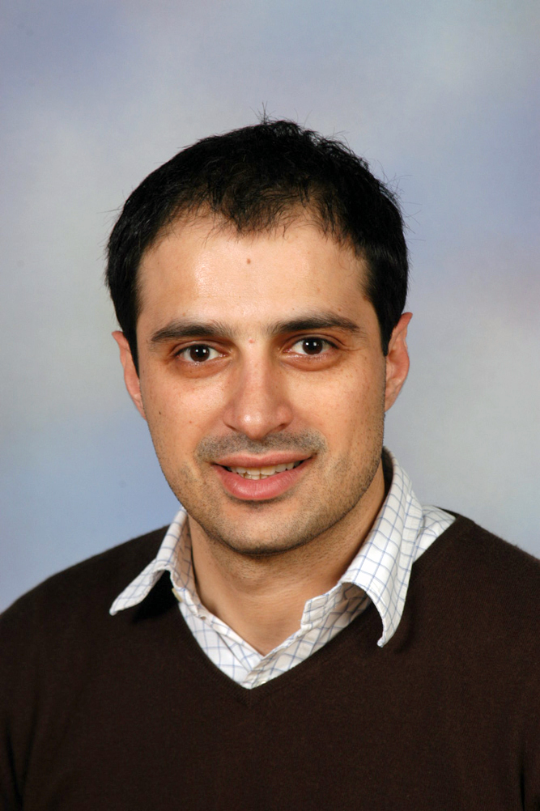
Climate Change and Computing: Facts, Perspectives and an Open Discussion
Antoine Amarilli (Télécom Paris, France), Christophe Claramunt (French Naval Academy Research Institute, France), Demetris Zeinalipour (Univ. of Cyprus, Cyprus)
https://2022.debs.org/panel-speakers/
1

Slide 2
Goals & Structure
Discuss the ongoing climate crisis and the role of ACM DEBS 2022 in this crisis.
Session Structure:
Short introductory presentation by the session chairs.
Open discussion
2

Slide 3
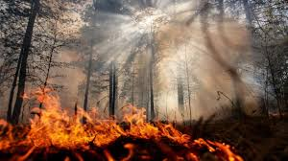
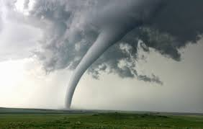
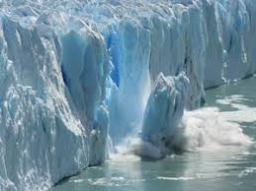
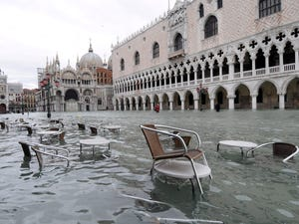
Global Warming and Climate Change
B) Climate Change: new weather patterns that remain for an extended time having an impact on human health and the environment.
brings
A) Global Warming: human-caused increase in global surface temperatures.
Rising Temperatures: a) dryness, wildfires; b) tornadoes, hurricanes, earthquakes, tsunamis; c) ice-melting, sea-level risings, floodings, …
3

Slide 4
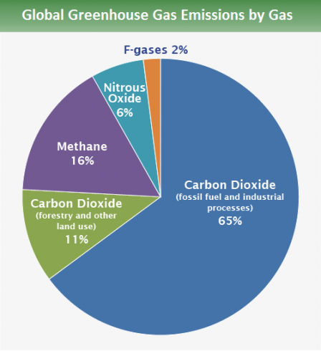
CO2 - Global Warming Culprit
Why do we have Global Warming?
Current Human activity (coal, oil, gas) generates Carbon Dioxide (CO₂), the predominant Greenhouse Gas (76%)!
CO₂ traps Solar Radiation inside the atmosphere that eventually leads to Global Warming.
Oceans clean only ¼ of CO2 pollution while trees another ¼.
76%
4% ICT
10.5% ICE Cars
2.5% Aviation
US EPA: https://www.epa.gov/ghgemissions/global-greenhouse-gas-emissions-data
4
Notes:
Ozone O3 hole a different problem: Fluroscent Gases that created a holde
4

Slide 5
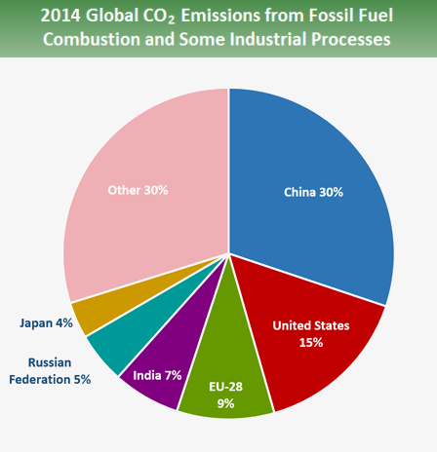
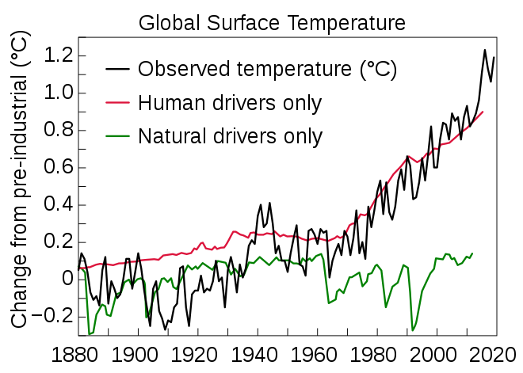
CO2 - Global Warming Culprit
CO₂ emerging in all sectors and rising economies
We are witnessing a steady increase in CO₂ since the Industrial Revolution (1760 – 1840 AD)
Global warming will continue if we don’t act promptly!
The Intergovernmental Panel on Climate Change (IPCC) is an intergovernmental body of the United Nations: World Meteorological Organization (WMO)
United Nations Environment Programme (UNEP)
5
Notes:
https://ec.europa.eu/eurostat/statistics-explained/index.php/Renewable_energy_statistics
https://www.ipcc.ch/sr15/
The Intergovernmental Panel on Climate Change (IPCC) is an intergovernmental body of the United Nations^{[1][2]} that is dedicated to providing the world with objective, scientific information relevant to understanding the scientific basis of the risk of human-induced^{[3]} climate change, its natural, political, and economic impacts and risks, and possible response options.^{[4]}
The IPCC was established in 1988 by the World Meteorological Organization (WMO) and the United Nations Environment Programme (UNEP) and was later endorsed by the United Nations General Assembly. Membership is open to all members of the WMO and UN.^{[5]} The IPCC produces reports that contribute to the work of the United Nations Framework Convention on Climate Change (UNFCCC), the main international treaty on climate change.^{[6][7]} The objective of the UNFCCC is to "stabilize greenhouse gas concentrations in the atmosphere at a level that would prevent dangerous anthropogenic (human-induced) interference with the climate system".^{[6]} The IPCC's Fifth Assessment Report was a critical scientific input into the UNFCCC's Paris Agreement in 2015.^{[8}
5

Slide 6
CO2 by Information and Communic. Technology (ICT)
ICT contributes ~2-4% of world CO2 emissions and will increase to 8% by 2025!
Are we comfortable doing research that (allegedly) contributes to CO2 increase?
How much CO2 is technology saving anyway? (Teleconferencing vs. Physical Meetings?)
How to make impactful research to reduce this increase from 4% to 8%? (edge computing?, energy efficiency?, reusable systems?, transparency? )
55% use
45% manufacturing
6

Slide 7
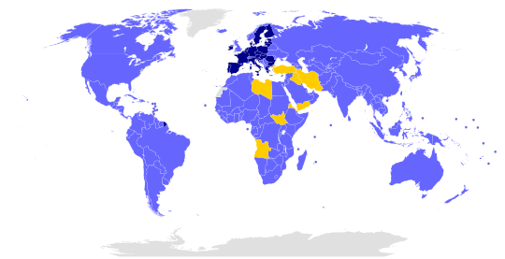
The Paris Agreement
The Paris Agreement within the United Nations Framework Convention on Climate Change (UNFCCC), dealing with greenhouse-gas-emissions mitigation, adaptation, and finance, signed in New York City, on April 22, 2016.
Targets:
- CO2 neutral by 2050!
- Temperature increase below 2° Celsius
194
Wikipedia
7
Notes:
7

Slide 8
RoadMap to 2050!
Some countries almost already in 2050!
Norway’s large water reservoir capacity is used to store and regulate a fluctuating supply of renewables … a 50 GWh battery!
Norway Hits 64.4% EV Market Share In January 2020. https://cleantechnica.com/
8

Slide 9
CO2 Finance Issues
Offsetting CO2:
Residential Photovoltaic System in Sunny country 1 year production (10kWp): 24 tons CO2 / 4 persons = 6 tons / person!
i.e., 17MWh (~4000€) for heating, electricity and mobility
Lifetime PV Prod. (25 years): 600 tons CO2 (i.e., 150 tons/person)
CO2 Penalties:
2020: 25.15 Euros / ton
Penalty: 600 Euros / person /year!
https://markets.businessinsider.com/commodities/co2-european-emission-allowances
2020 Forecast: 100 Euros / ton (Herbert Diess, VW CEO)
Penalty: 6 ton/person*100 Euro/ton = 600 Euros / person => 2400 Euros/family
https://www.electrive.com/2020/01/28/vw-boss-herbert-diess-gets-frank-about-co2/
Will governments shift CO2 costs down to citizens as new taxes? Problem solved?
9

Slide 10
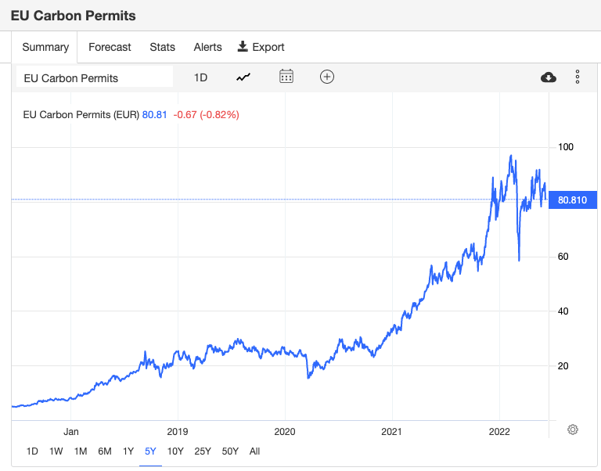
CO2 Costs:
EU Emissions Trading System (EU ETS)
The EU ETS is a cornerstone of the EU's policy to combat climate change and its key tool for reducing greenhouse gas emissions cost-effectively.
It is the world's first major carbon market and remains the biggest one.
https://tradingeconomics.com/commodity/carbon
CO2 Costs Going up!
Calling for more self-consumption

Slide 11
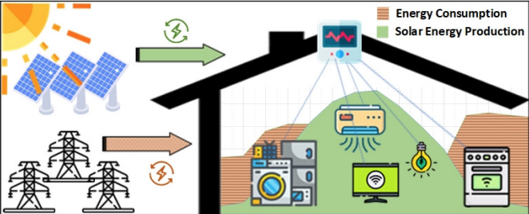
(Renewable) Self-Consumption
Renewable self-consumption is the act of using self-produced renewable energy at the time it is available.
Why?
=> Minimize Import of (dirty) Energy
=> Minimize CO2 Consumption
Problem:
- Alignment of Consumption with Production patterns…

Slide 12
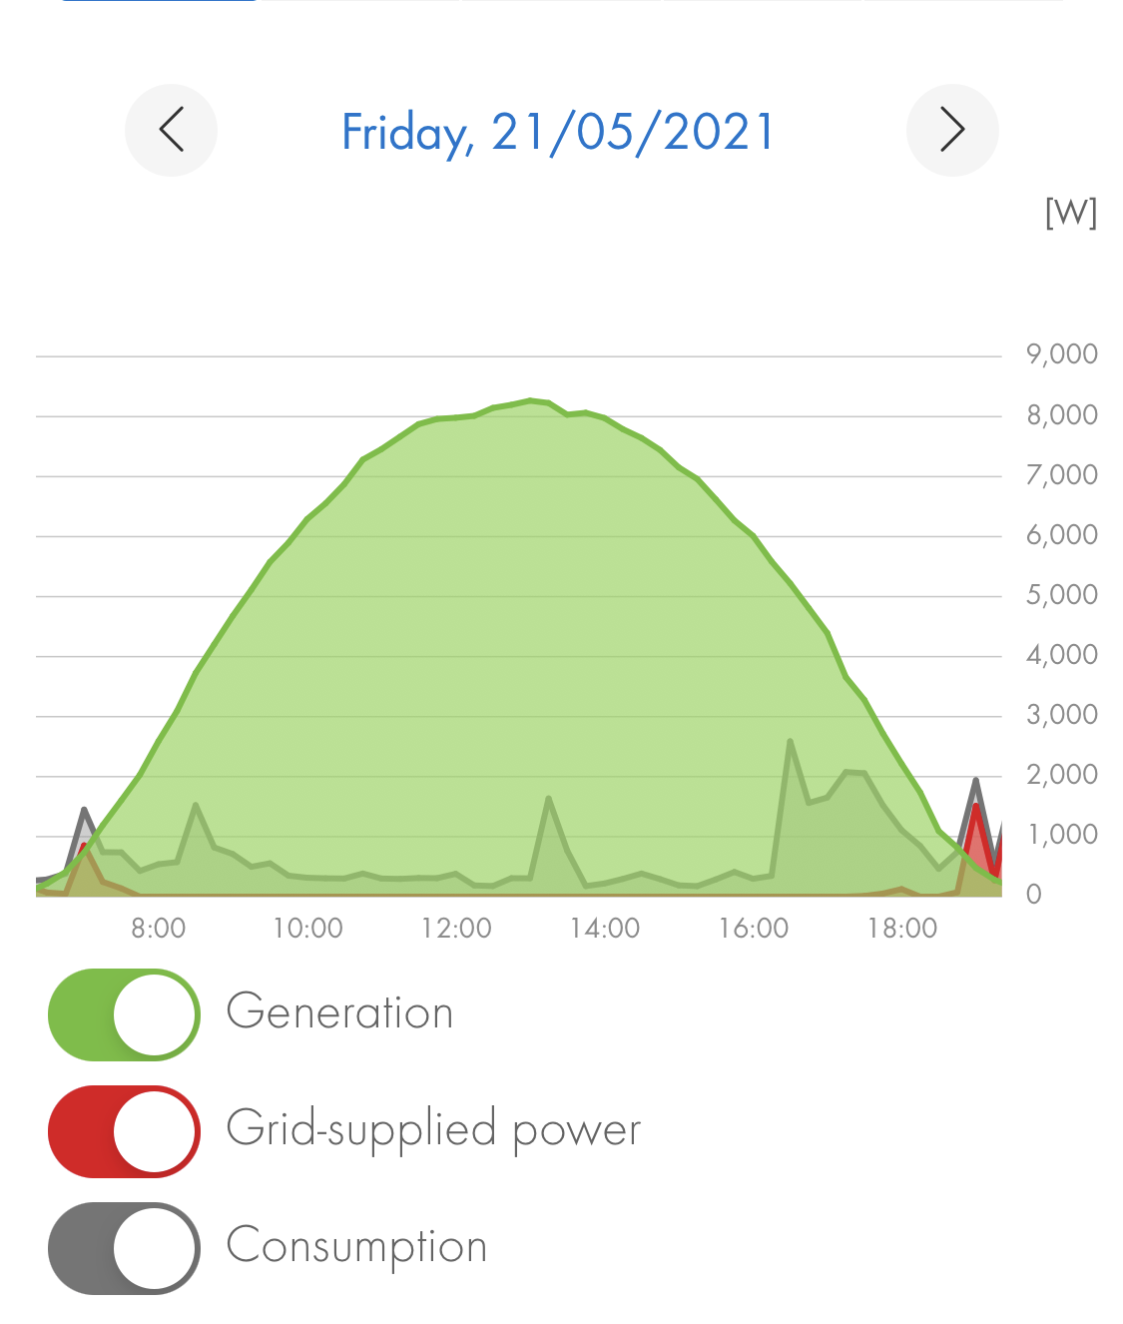
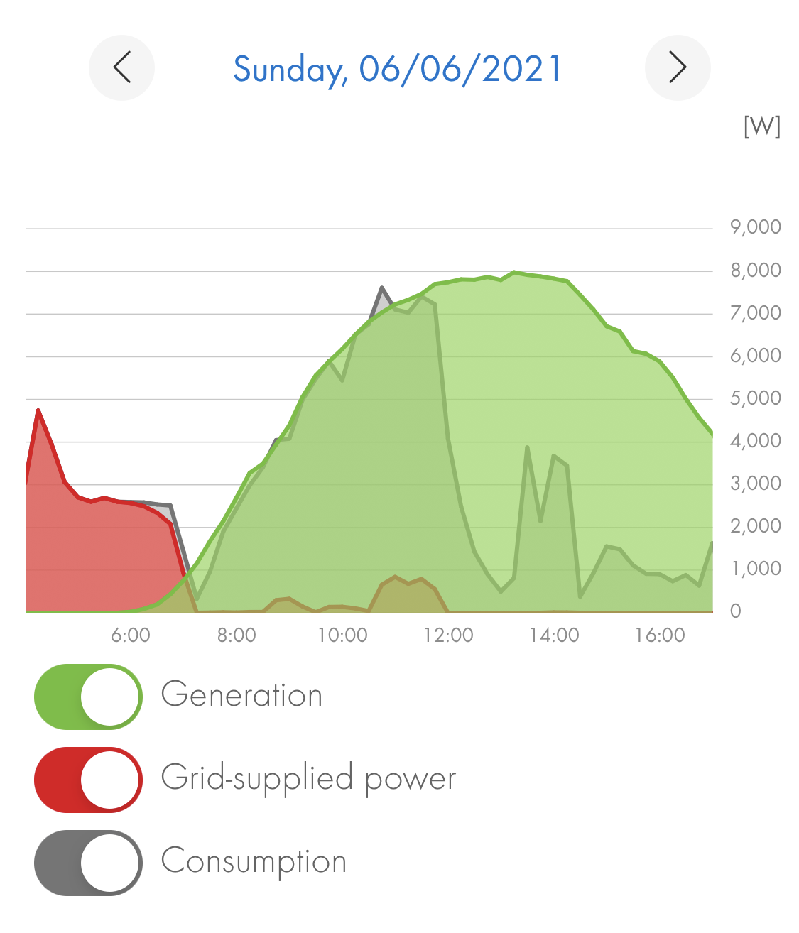
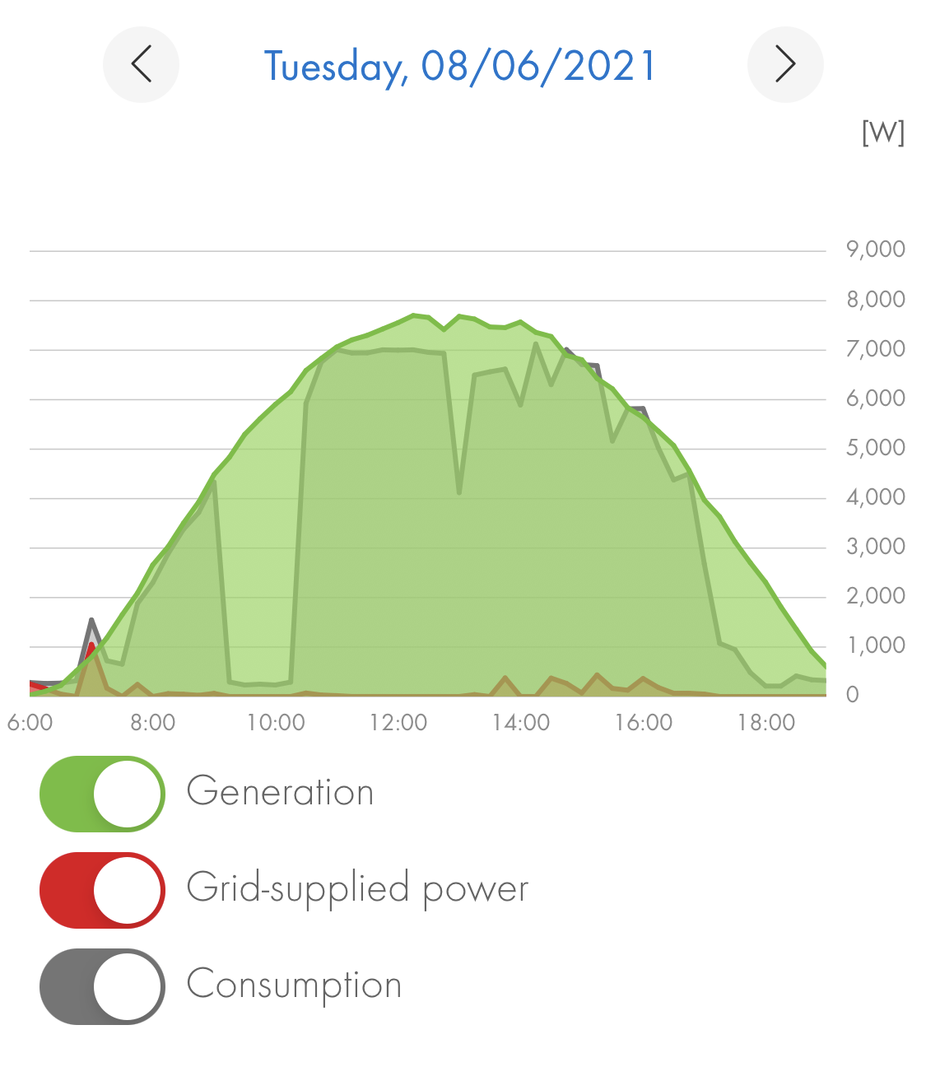
Self-Consumption Examples
Alignment of Consumption with Production patterns.
Laborious task that calls for automation and “smartness”!
12%
49%
73%

Slide 13
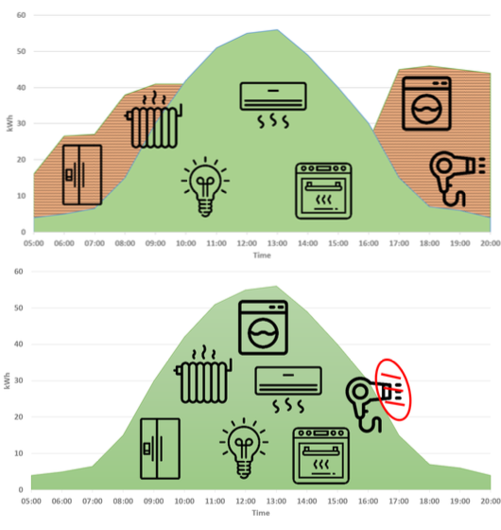
Self-Consumption Desiderata
Bad Alignment ☹
Good Alignment
☺
[J28] "Green Planning Systems for Self-Consumption of Renewable Energy", Soteris Constantinou, Andreas Konstantinidis and Demetrios Zeinalipour-Yazti IEEE Internet Computing (IC '22), IEEE Computer Society, Volume , Pages: 7 pages, Los Alamitos, CA, USA, 2022.

Slide 14
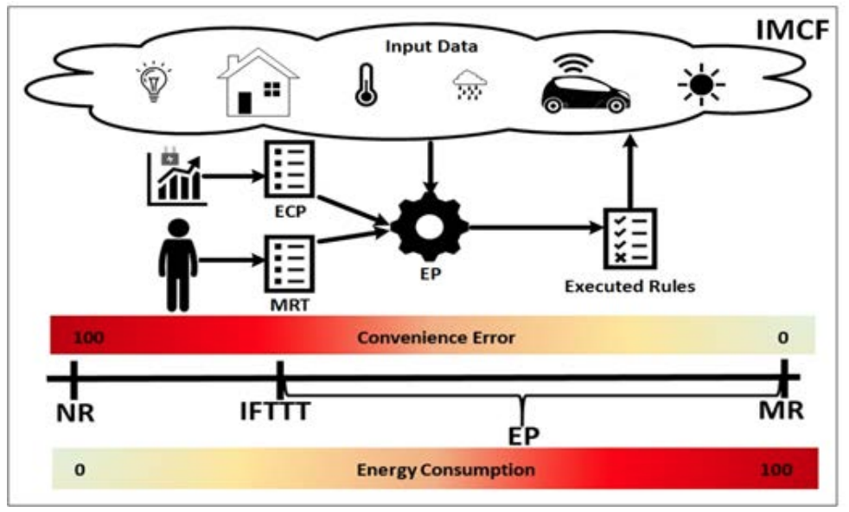
Self-Consumption System Model

Slide 15
Self-Consumption Published
Research
The Energy Planner Algorithm
[C85] "The IoT Meta-Control Firewall", Soteris Constantinou, Andreas Konstantinidis, Demetrios Zeinalipour-Yazti, Panos K. Chrysanthis "37th IEEE International Conference on Data Engineering" (ICDE '21), IEEE Computer Society, ISBN:, Pages: 2523-2534, April 19 - April 22, 2021, Chania, Crete, 2021.
[C84] "IMCF: The IoT Meta-Control Firewall for Smart Buildings", Soteris Constantinou, Antonis Vasileiou, Andreas Konstantinidis, Panos K. Chrysanthis, Demetrios Zeinalipour-Yazti "24th International Conference on Extending Database Technology" (EDBT '21), OpenProceedings.org, Pages: 658--661, March 23 - March 26, 2021, Nicosia, Cyprus, 2021.

Slide 16
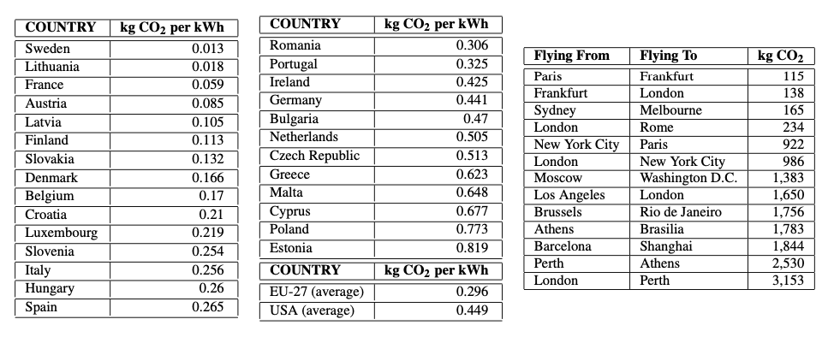
How Clean is Energy Around the Globe?
Self-consumption is mainly for geographic areas with a dirty energy mix
[J29] "Green Planning of IoT Home Automation Workflows in Smart Buildings", Soteris Constantinou, Andreas Konstantinides, Panos K. Chrysanthis and Demetrios Zeinalipour-Yazti ACM Transactions on Internet of Things (TIOT '22), ACM, Volume , Pages: 28 pages (accepted), New York, NY, USA, 2022.

Slide 17
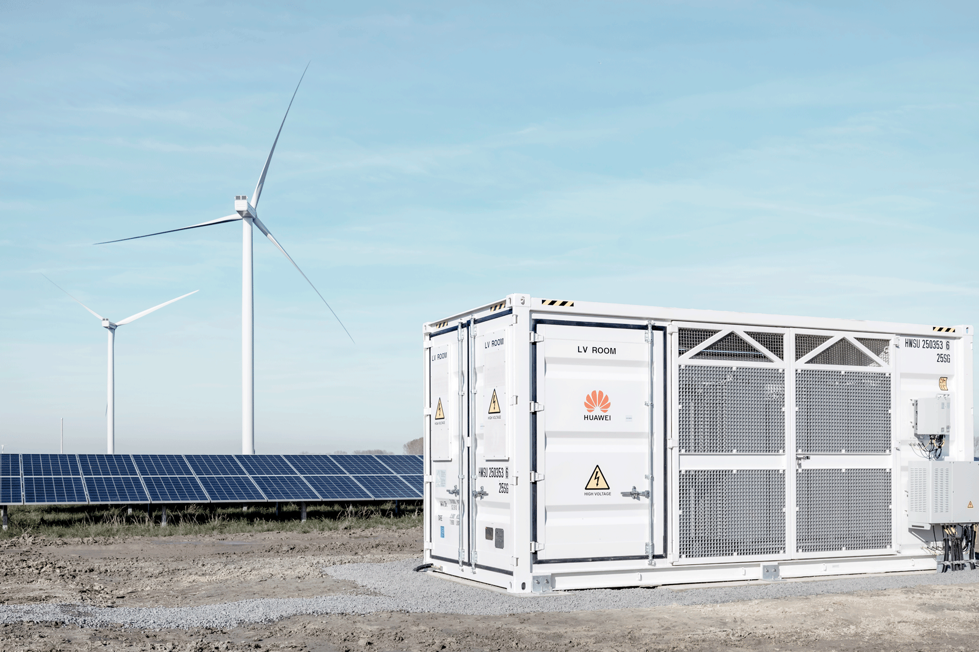
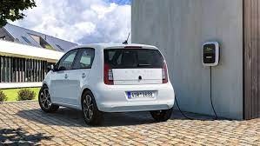
Typical Bounds for Self-Consumption
Grid Connected System
~20% No Planning
~50% Battery System
~70% Optimal Self-Consumption
~90% Self-Consumption + Battery
Island
Storage Types:
Battery
Pumped Hydro
Hydrogen
Thermal Storage

Slide 18
Antoine’s Slides

Slide 19
How is EDBT/ICDT part of the problem?
19

Slide 20
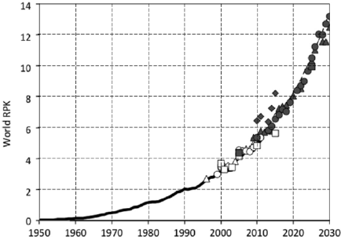
CO2 Emissions from Air Travel
Air travel: currently ~2-3% of emissions, but on the rise, because people tend to travel more:
i.e., ~100 gCO2/passenger-km
But in fact ~250 gCO2eq
because of other pollutants
Road and rail are ~60g CO2eq
Fly Lisbon⬅➔ Copenhagen: 1 ton CO2eq!
Your lifetime carbon budget (for everything, not just travel): 200 tons CO2eq
Trillions of revenue passenger kilometres per year, from Wild, Baxter, Sabatini, Sustainable Technologies for Aircraft Energy Generation, Storage, and Distribution, PRCC 2014
20
- test
Flight from Lisbon to Copenhagen:
1 ton of CO2eq!
Your lifetime budget: 200 tons
(for all activities, not just travel)
Road/rail: 60 gCO2eq/pax-km
Air travel: currently ~2% of emissions, but on the rise
About 100 gCO2/passenger-km, but amounts to about 250 gCO2eq because of other pollutants

Slide 21
Reducing the Need to Travel
To reduce emissions, avoid plane travel, and travel more wisely and be more selective? Publish less?
First: measure the total travel footprint of attendees
Analyze the data, choose places minimizing travel?
Unfair advantage for only a few cities?
Colocation with other conferences to reduce travel
Improving remote participation:
Live streaming of talks?
Allow remote talks and questions?
21

Slide 22
Carbon Offsets
Idea: support projects that reduce CO2 emissions
Measure your CO2 footprint, say 1 ton CO2
Finance projects whose expected outcome is to reduce CO2 emissions by 1 ton
Nowadays: around 80 EUR / ton CO2
Could be included in the registration fee
Make EDBT/ICDT carbon neutral
Not a perfect solution (still better not to travel)
22

Slide 23
Other Ideas to Reduce Impact
Producing food, especially meat, emits lots of CO2
All-vegetarian menus?
Local producers?
Avoid disposable dishware
Avoid conference bags and
other gadgets?
Source: Tilman and Clark, Global diets link environmental sustainability and human health, Nature, 2014
23

Slide 24
Other initiatives in CS
SIGPLAN Climate Committee
https://www.sigplan.org/Resources/Climate/
Asks ACM to charge conferences for their footprint
Moshe Vardi’s piece in CACM
Asks ACM to allow video talks in its conferences
acm-climate mailing-list
TCS4F.org (theoretical computer science group)
Conference manifesto to commit to CO2 reductions
24

Slide 25
Other initiatives in CS
Should we care about contributing to the climate crisis?
Can we help with our research?
Should we still do in-person conferences? How?
25

Slide 26
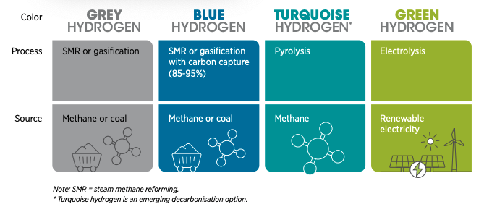
Hydrogen Future?
Let’s take a closer look…
Hydrogen comes in different colors but the discussion today is about green hydrogen (electrolysis + renewable)
Basic Question:
Will Green Hydrogen (Fuel Cells) or Li-ion battery prevail?

Slide 27
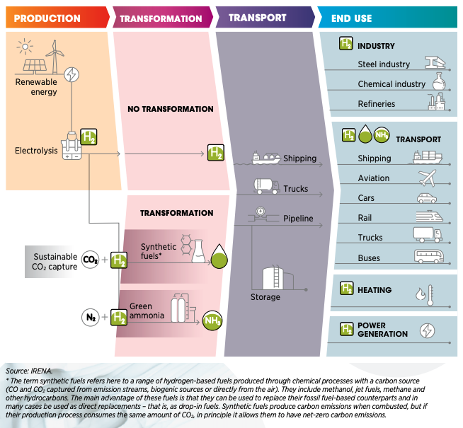
Hydrogen in Mobility: Different System Model than Self-Consumption Strategies
Hydrogen Vehicle Losses: 66% (transformation, shipping, storage)
Battery Vehicle Losses: 17% (transformation)
PV Grid System: DC-AC
Car Charging: AC-DC
Car Motor: DC-AC
=> Li-ion is the future here (cars, buses, light trucks, etc.)

Slide 28
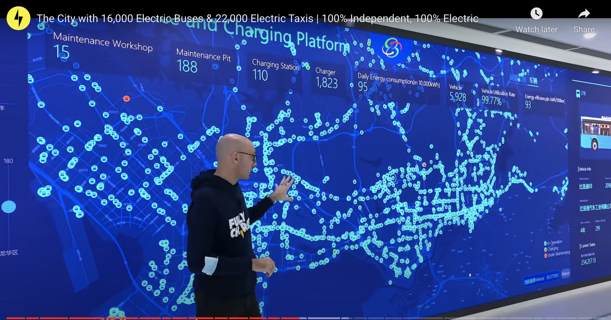
Self-consumption to remain a target for small-medium scale mobility
Shenzhen: The City With 16,000 Electric Buse & 22,000 Electric Taxis
Dashboard and IoT make management of electric mobility project a reality.
https://insideevs.com/news/487869/shenzhen-city-16000-electric-buse-22000-taxis/

Slide 29
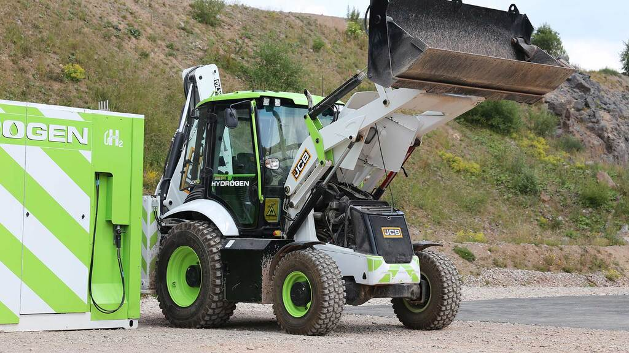
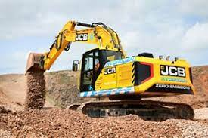
Hydrogen Combustion Engines
Good for places where there is no infrastructure
Li-ion Electric
Hydrogen Combustion

Slide 30
Green Aviation
Aviation Industry aims to use Green Hydrogen by 2035 … what do we do until then?

Slide 31
Green Maritime
EU Commission plans to extend the EU Trading System (ETS) into maritime.
EU Strategy:
Monitoring, reporting and verification of CO2 emissions from large ships using EU ports
Greenhouse gas reduction targets for the maritime transport sector
Further measures, including market-based measures, in the medium to long term.
Strategy might provide ideas how to tackle the problem in the computing sphere.

Slide 32
How can Computing Help?
Green Planning
"Green Planning Systems for Self-Consumption of Renewable Energy", Soteris Constantinou, Andreas Konstantinidis and Demetrios Zeinalipour-Yazti IEEE Internet Computing (IC '22), IEEE Computer Society, Volume , Pages: 7 pages, Los Alamitos, CA, USA, 2022.
Green Routing
O. Andersen, C. S. Jensen, K. Torp and B. Yang, "EcoTour: Reducing the Environmental Footprint of Vehicles Using Eco-routes," 2013 IEEE 14th International Conference on Mobile Data Management, 2013, pp. 338-340, doi: 10.1109/MDM.2013.5
V2G Systems
E.g., OVO Energy
Green anything … require algorithms to optimally monitor and enable workloads with low CO2 output.
New System Model, Metrics, Desiderata gives room for New Ideas!

Slide 33
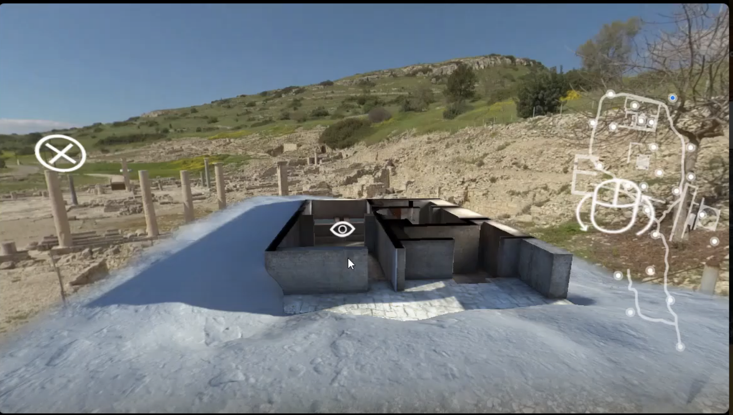
Other Ideas: Virtual Tourism
"EnterCY: A Virtual and Augmented Reality Tourism Platform for Cyprus", Soteris Constantinou, Andreas Pamboris, Rafael Alexandrou, Christophoros Kronis, Demetrios Zeinalipour-Yazti, Harris Papadopoulos, and Andreas Konstantinidis, The 23rd IEEE International Conference on Mobile Data Management (MDM '22), IEEE Press, pp. 314-317, June 6 - June 9, 2022, Paphos, Cyprus, DOI: 10.1109/MDM55031.2022.00069, 2022.
https://entercyprus.com/

Slide 34
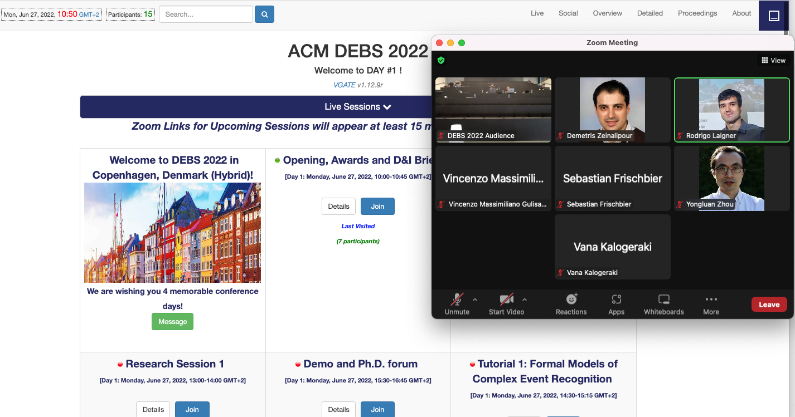
Other Ideas: Virtual Conferences
The DEBS online platform runs on our home-made VGATE system.
Facilitated thousands of colleagues and allowed them to participate in community events in the best possible manner during COVID-crisis and beyond (e.g., upcoming Energy-crisis).
https://vgate.cs.ucy.ac.cy/

Slide 35
Green Urban Mobility
Communication and information technologies
Quality of life, efficiency and competitiveness of services
Ensuring the need of present and future generations
Preserving the urban environment

Slide 36
Green Urban Mobility
How can we improve the quality of green mobility applications?
For the environment
For the people
For the platform
Being innovative, new platforms to help drivers and interact with such apps.
Design issues, what can we do right now with the resources available for us?
Performance issues, how can we evaluate new models at scale?
Privacy issues, ethical issues, …

Slide 37
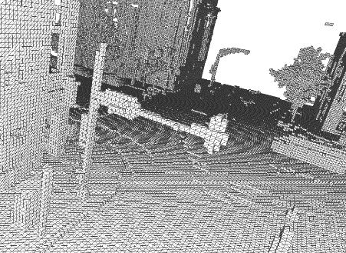
Green Urban Mobility
Data consumption for autonomous vehicles
HD maps; sensors; cameras; GPS...
On-board processing vs. “simple download”.
Integration and context-awareness
when managing data for autonomous vehicles:
Data preservation, data compression and generalisation (when is less data better)

Slide 38
Green Urban Mobility
Sharing the data and the ‘green impact’
Road networks; Traffic; PoIs (e.g., NYC vs. Chicago)
Query processing vs. Learned Models
* Federated learning
* Transfer learning
What is the trade-off between the boundary of privacy and the cost of effective learning
Businesses vs. individual users

Slide 39
Green Urban Mobility
EU goal 70% reduction in CO2 emissions by 2030
Transportation is going in the wrong direction!
We need to get started today, our help is needed
“Low-hanging” fruits should be encouraged
Electrification = collaborate with other domains
MDM community good at predictions!
“A European Strategy for data” aka Data Spaces
“make data more widely available”
“invest €2 billion”
MDM community should be a pioneer in data spaces
Share data (resource paper track as MDM?)

Slide 40
Other initiatives and call to discussion
40

Slide 41
Climate Change and Computing: Facts, Perspectives and an Open Discussion
Antoine Amarilli (Télécom Paris, France), Christophe Claramunt (French Naval Academy Research Institute, France), Demetris Zeinalipour (Univ. of Cyprus, Cyprus)
Thank You!
https://2022.debs.org/panel-speakers/
41

