Slide 1
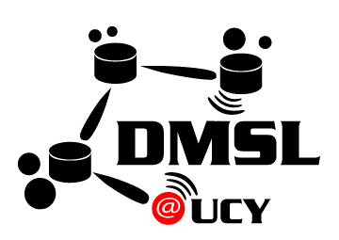
Towards a Blockchain Database for Massive IoT Workloads
Panagiotis Drakatos∗, Erodotos Demetriou∗,
Stavroulla Koumou∗, Andreas Konstantinidis∗‡,
Demetrios Zeinalipour-Yazti∗
∗ University of Cyprus, 2109 Nicosia, Cyprus
‡ Frederick University, 1036 Nicosia, Cyprus
{pdraka01, edemet01, skoumo01, akonstan, dzeina}@cs.ucy.ac.cy
https://blockdb.cs.ucy.ac.cy/
(Vision Paper)
The 3rd Intl. Workshop on Blockchain and Data Management, collocated with the 37th IEEE International
Conference on Data Engineering, April 19, 2021 Chania | Crete | Greece (online)

Slide 2
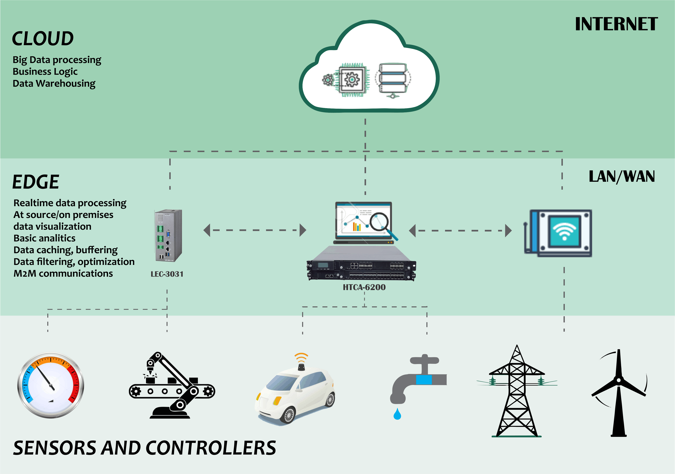
The IoT Revolution
Internet-connected smart devices will drastically increase to more than 500 for each typical family in the developed world by 2022.
The IoT revolution is expected to bring the number of such devices close to a staggering 40 billion in 2022, more than double from 2021.
Massive IoT Workloads on the edge generate come with new business requirements (e.g., transparency)
Relational (sequel), Document (mongodb), Temporal (influxdb), not ready for these type of workloads. ☹

Slide 3
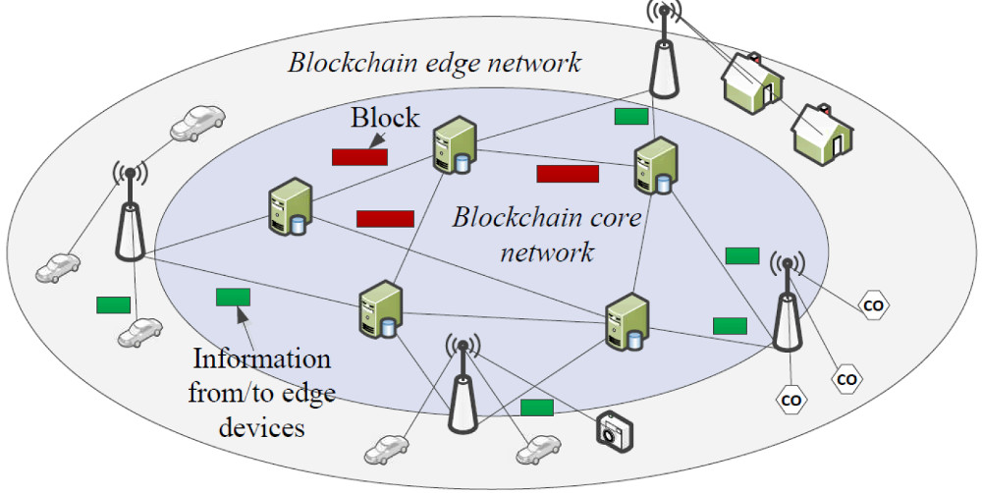
Blockchain Architectures
Blockchain: technology for storing transactional records in a distributed “database” / chain.
This technology is characterized by decentralization and transparency.
Blockchain is principally used in Cryptocurrencies, but potentially it can be used in the IoT industry as well.
Problem: Transaction verification expensive (e.g., bitcoin: 10 min / TX)
Hyperledger Fabric: 3000 TX/sec
Bitcoin Satoshi Vision (SV): 9000 TX/sec
➔ IoT ingestion still suffers with these throughputs ☹
Let’s see some examples …

Slide 4
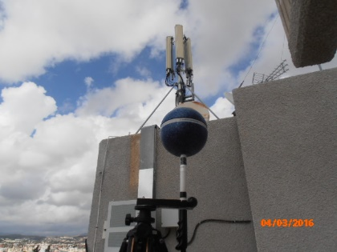
Scenario I: Telco Big Data Auditing System
Telco Big Data (TBD): Velocity data generated at the cell towers.
e.g., signal strength, call drops, bandwidth measurements.
Size: Huawei reports 5TBs/day for 10M clients (i.e., 2PB/year) for Shenzhen, China.
Web 3.0 TBD Auditing Scenario:
Telcos report the signal strength of their antennas to authorities (for EMF-compliance).
All telcos need to have access to measurements reported by other telcos.
Problem: How/Where to store this large velocity data ?
https://tbd.cs.ucy.ac.cy/
"Telco Big Data Research and Open Problems", Constantinos Costa and Demetrios Zeinalipour-Yazti "Proceedings of the 35th IEEE International Conference on Data Engineering" (ICDE '19), IEEE Computer Society, Pages: 2056--2059, 8-12 April 2019, Macau SAR, China, 2019.

Slide 5
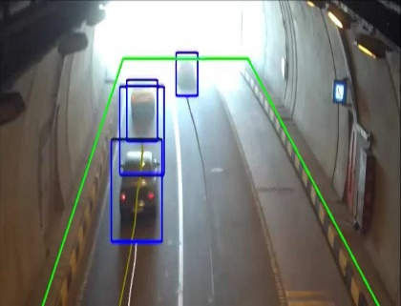
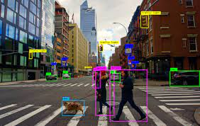
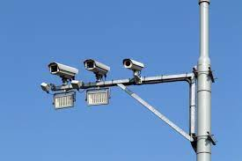
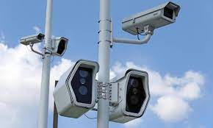
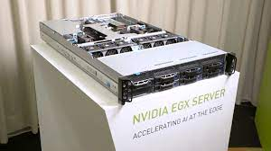
Scenario II: Edge Camera Network
Edge Camera Network (ECN): Cameras carrying out deep learning on the edge of the network.
Feature extraction and vector generation using tools like YOLO Darknet, Tensorflow, Spark, CVAT.
Industrial Examples: deep learning, NVIDIA EGX Edge Server, Huawei Smartcity Appliances
Web 3.0 Camera Scenario:
Authorities want accurate city traffic models
INRIX reports that congestion costs U.S. drivers nearly $300 Billion in 2016,which is an average of $1400 per driver per year.
Current solutions (e.g., Google Traffic): using crowdsourcing with smartphones that has privacy issues.
Problem: How/Where to store this large velocity data on the edge?

Slide 6
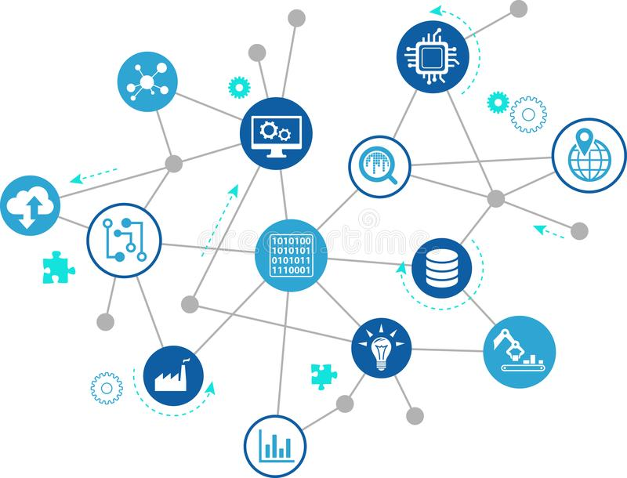
Presentation Outline
Motivation
Triabase
Algorithms
System Architecture
Federated Learning
Future Work
Conclusions

Slide 7
Triabase Vision
Triabase (inspired from Greek “Tria”, meaning “three”, being a Database for the Web 3.0 era)
a permissioned* blockchain database system that:
carries out machine learning at the edge;
abstracts machine learning in primitive blocks;
blocks are subsequently stored and retrieved from the blockchain.
* Envisioning a permissioned architecture is somehow more straightforward (from a security standpoint) than a permission-less architecture, so this is our initial focus.

Slide 8
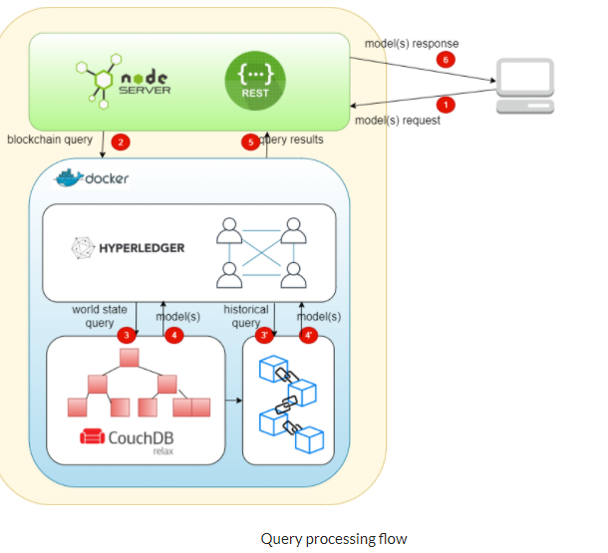
Triabase Desiderata
Triabase Desiderata:
Immutability
No tampering of committed data
Transparency
historical data of committed transactions
Correctness
Support variety of Exact Queries & Indexes
Performance
performance to scale >3000 tx / min on Fabric
Privacy
Minimize data leakage risks

Slide 9
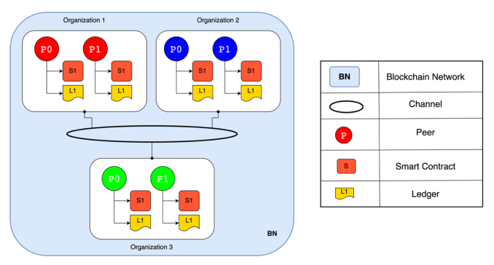
Triabase Architecture
Triabase has 3 layers:
Blockchain Layer
Implemented in Fabric Chaincodes
(i.e., storing ML models on the blockchain not the data itself)
IoT vs. training models
Storage Layer
Apply Federated Learning using similar concepts to Data Postdiction [MDM18-DP]
Query/Indexing Layer
minimizing the query response time for operational and exploration queries
We aim to support an API for Queries
[MDM18-DP]: "Decaying Telco Big Data with Data Postdiction", Constantinos Costa, Andreas Charalampous, Andreas Konstantinidis, Demetrios Zeinalipour-Yazti and Mohamed F. Mokbel, Proceedings of the 19th IEEE International Conference on Mobile Data Management (MDM '18), IEEE Computer Society, ISBN: 978-1-5386-4133-0, pp. 106--115, June 25 - June 28, 2018, AAU, Aalborg, Denmark, 2018. [ Best of MDM 2018! ]

Slide 10
Triabase: Federated Learning approach
Federated Learning (FL): a machine learning technique, which trains models across multiple decentralized edge devices or servers. Each edge device is holding a different dataset.
Advantages of FL with blockchain?
Reduces data transmission load in the learning process;
We achieve local training across multiple decentralized edge devices holding local data, without exchanging them
Protect Data privacy, because distributed nodes don’t have the complete data space;

Slide 11
Triabase: Federated Learning (Background)
Step 1
Step 2
Step 3
Step 4
s
s
s
s
average
Upload
w1
w2
w3
w1
w2
w3
w1
w2
w3
w1
w2
w3
S (server) chooses statistical model to be trained
S transmits the initial model to several nodes
Nodes train the model locally with their own (edge) data
Central server pools model results and generate one global mode with ought accessing any data
Problem: Applying FL on Blockchain would result in expensive PoW (Proof-of-Work) compution ☹

Slide 12
Our PoFL Consensus Algorithm
PoFL (Proof of Federated Learning) consensus protocol: aims to minimize the expensive PoW computation by providing training coins to users that participate in the training process.
Nodes receiving the most accuracy coupled with the difficulty of the block are recognized as the winner of the given round.
In every training round the coins will be adjusted to the users depending on their work.
Coins are mapped to physical application scenario semantics (e.g., Telco or Video Scenario coins are owned by Participating parties)
Step 4
s
average
Upload
w1
w2
w3

Slide 13
Conclusions and Future Work
Current Status:
We have implemented Triastore, which is the storage/blockchain sub-system of Triabase.
Preliminary Accuracy Performance with MNIST (image) dataset are very encouraging. [MDM21-Triastore paper]
Additional Fabric Deployments on 9-node configuration are in the works.
Future Work:
Privacy needs to be carefully handled in IoT environments. (ε-differential, k-anonymity, l-diversity, etc.)
Open-source and application-specific deployment of Triabase to some Web 3.0 scenario.
[MDM21-Triastore]: "Triastore: A Web 3.0 Blockchain Datastore for Massive IoT Workloads", Panagiotis Drakatos, Erodotos Demetriou,
Stavroulla Koumou, Andreas Konstantinidis, Demetrios Zeinalipour-Yazti, Proceedings of the 19th IEEE International Conference on Mobile Data Management (MDM ‘21), June 15 - June 18, 2021, Toronto, Canada, 2021 (accepted)

Slide 14
Towards a Blockchain Database for Massive IoT Workloads
Thank you!
Panagiotis Drakatos∗, Erodotos Demetriou∗, Stavroulla Koumou∗, Andreas Konstantinidis∗‡,
Demetrios Zeinalipour-Yazti∗
∗ University of Cyprus, 2109 Nicosia, Cyprus
‡ Frederick University, 1036 Nicosia, Cyprus
{pdraka01, edemet01, skoumo01, akonstan, dzeina}@cs.ucy.ac.cy
https://blockdb.cs.ucy.ac.cy/
The 3rd Intl. Workshop on Blockchain and Data Management, collocated with the 37th IEEE International
Conference on Data Engineering, April 19, 2021 Chania | Crete | Greece (online)

