Slide 1



Towards Real-Time Road Traffic Analytics using Telco Big Data
Constantinos Costa∗, Georgios Chatzimilioudis∗, Demetrios Zeinalipour-Yazti‡∗ and Mohamed F. Mokbel§
∗ University of Cyprus, Cyprus
‡ Max Planck Institute for Informatics, Germany
§ University of Minnesota, MN, USA
{costa.c, gchatzim, dzeina}@cs.ucy.ac.cy
dzeinali@mpi-inf.mpg.de, mokbel@cs.umn.edu
11th International Workshop on Real-Time Business Intelligence and Analytics,
collocated with VLDB 2017, Munich, Germany, August 28, 2017

Slide 2
Motivation
The expansion of mobile networks and IoT (IP-enabled hardware) have contributed to an explosion of data inside Telecommunication Companies (Telcos)

Slide 3
Motivation
INRIX reports that congestion costs U.S. drivers nearly $300 Billion in 2016,which is an average of $1400 per driver per year (both direct and indirect costs)
INRIX Inc. 2017. Los Angeles Tops INRIX Global Congestion Ranking. (2017). https://goo.gl/c2K3E1 Accessed 7-Aug-2017.
Rank | City / Large Urban Area | 2016 Peak Hours Spent | Total Cost Per Driver in 2016 | Total Cost to the City in 2016 (based on city population size)
1 | Los Angeles, CA | 104 | $ 2,408 | $9.7bn
2 | New York, NY | 89 | $ 2,533 | $16.9bn
3 | San Francisco, CA | 83 | $ 1,996 | $2.5bn
4 | Atlanta, GA | 71 | $ 1,861 | $3.1bn
5 | Miami, FL | 65 | $ 1,762 | $3.6bn

Slide 4
Telco Big Data (TBD)
Telco Data: Traditional source for OLAP Data Warehouses and Analytics.
  e.g., Accounting, Billing, Session data.
  Problem: Inadequate data resolution to address biggest challenges:
    e.g., churn prediction, 5G network optimization, user-experience assessment, traffic mapping.
Telco Big Data (TBD): Velocity data generated at the cell towers.
  e.g., signal strength, call drops, bandwidth measurements.
  Size: 5TBs/day for 10M clients (i.e., 2PB/year).
RDBMS
Data Store

Slide 5
Challenge
Road traffic analytic and prediction systems are not sufficient.
  traffic modeling and prediction is limited to navigation enterprises utilizing crowdsourcing
  the location privacy boundaries of users could be compromise by third-party mobile applications
  the cost of continuously monitoring the traffic is very high
Our Approach: Introduce a Traffic-TBD (Traffic Telco Big Data) architecture that goes beyond crowdsourcing retaining the user privacy and minimizing the cost using existing resources.

Slide 6
Presentation Outline
Introduction
Background
Traffic-TBD Architecture
  Data Layer
  Processing Layer
  Application Layer
Experiments
Conclusions

Slide 7
Background: Traffic analytics
First Era (1E) traffic mapping
  dedicated hardware
    magnetic loop detectors or traffic cameras mounted on traffic lamps or road-sides
Second Era (2E) traffic mapping
  handheld-based and probe vehicles
    Taxis or Buses were equipped with a smartphone and a dedicated app for location updates
    MIT Cartel (http://cartel.csail.mit.edu/doku.php)

Slide 8

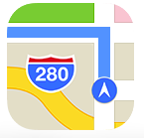



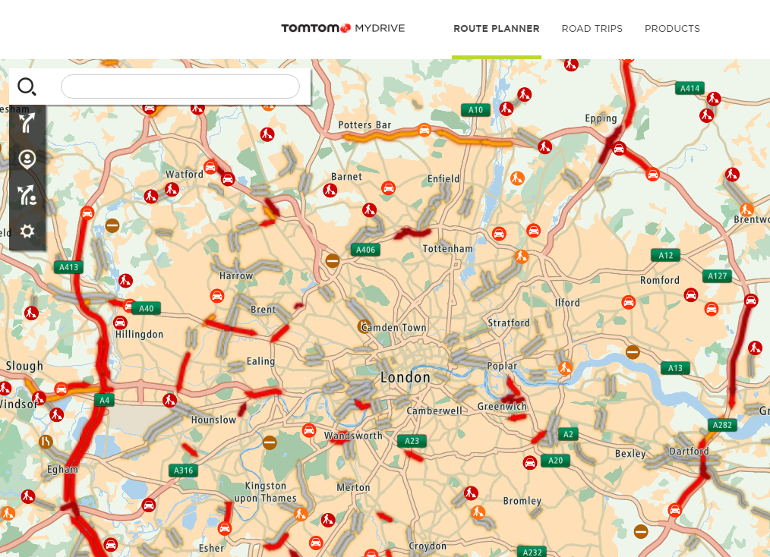
Background: Traffic analytics
Second+ Era (2.5E) traffic mapping
  opportunistic crowdsourcing
Third Era (3E) traffic mapping
  Traffic-TBD: TBD data to generate the traffic mapping both accurately, without additional hardware and additional costs.
  E.g., TomTom MyDrive

Slide 9
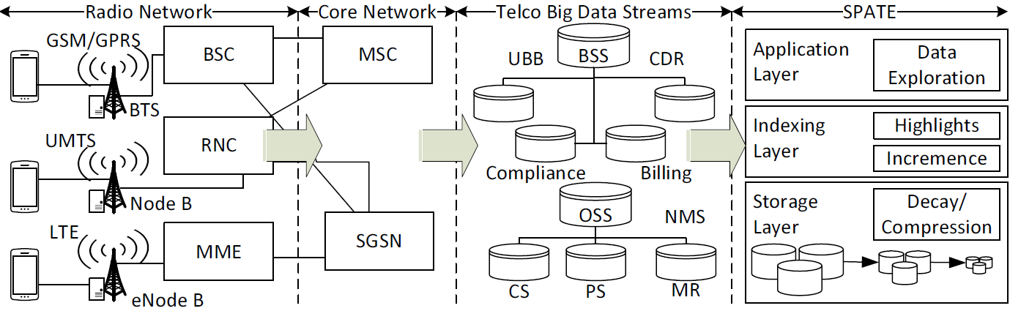
TBD Network
Radio & Core Network
  Generate Streams of IP packets from the GSM/GPRS (2G), UMTS (3G), LTE (4G) antennas.

Slide 10
TBD Streams
Call Quality
Measurement Reports (can be used to localize users with triangulation ~50 meters)
Data quality (web speed, connection success rate)
Telco Big Data (TBD)
  Business Supporting Systems (BSS) data
    Tens of GB/day for a xM+ city
  Operating Supporting Systems (OSS) data
    Tens of TB/day for a xM+ city

Slide 11
Presentation Outline
Introduction
Background
Traffic-TBD Architecture
  Data Layer
  Processing Layer
  Application Layer
Experiments
Conclusions

Slide 12
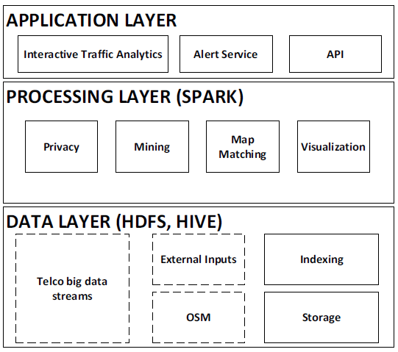
Traffic-TBD Architecture
The Traffic-TBD architecture is based on SPATE* and has 3 layers:
  Data layer
    aggregate and store data
    provide the access methods
  Processing layer
    minimizing the query response time for data analytic queries
  Application layer
    enhance user experience
* Constantinos Costa, Georgios Chatzimilioudis, Demetrios Zeinalipour-Yazti, and Mohamed F. Mokbel. 2017. Efficient Exploration of Telco Big Data with Compression and Decaying. In Proceedings of the 33rd International Conference on Data Engineering (ICDE’17). IEEE,

Slide 13
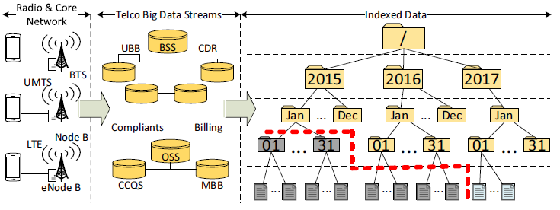
Data Layer: Components
Storage component:
  minimizes storage
Indexing component:
  maintains and uses a multi-resolution spatiotemporal index

Slide 14
Storage Component: Compression
Compression refers to the encoding of data using fewer bits than the original representation
Benefits:
  Shifts the resource bottlenecks from storage- and network-I/O to CPU (cycles increasing faster).
  Save enormous amounts of storage and I/O on subsequent analytic tasks!
Desiderata: Given a setting where TBD arrives periodically in batches, we want to:
  minimize the space needed to store/archive data
  minimize response time for spatiotemporal data exploration queries

Slide 15
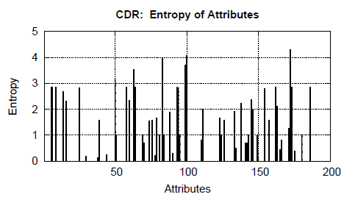
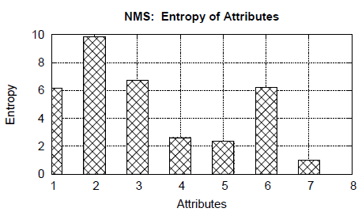
Storage Component: Compression
We analyzed an anonymized real TBD dataset to understand what compression ratios can be achieved?
  Dataset: 1 week, 1.7M CDR, 21M NMS, 300K users
  Tool: Shannon’s entropy (typical measure for the maximum compressibility of a dataset)
  Observation: TBD contains significant redundancy (Entropy close to 0)!

Slide 16
Storage Component : Compression
Libraries\ Objectives | GZIP | 7z | SNAPPY | ZSTD
Compression Ratio (r_{c}) | 9.06 | 11.75 | 4.94 | 9.72
Compression Time (T_{c1}) in sec | 21.37 | 20.99 | 21.39 | 21.07
Decompr. Time (T_{c2}) in sec | 0.11 | 0.12 | 0.13 | 0.11
* GZIP also readily available by most Stream I/O libraries & application layer (e.g., HIVE, HUE)

Slide 17
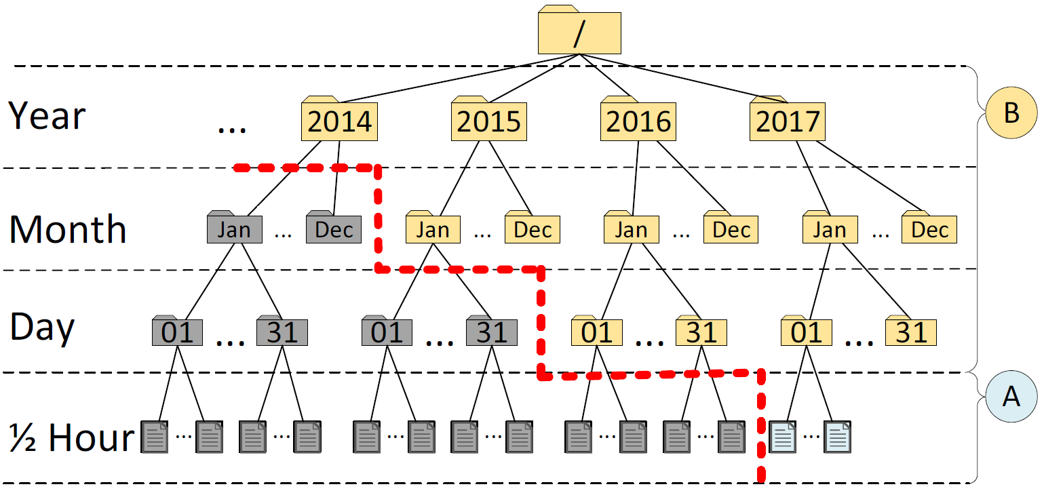
Indexing Component: Modules
Our spatio-temporal index has 4 levels of temporal resolutions
  epoch (30 minutes), day, month, year.
A) Incremence Module
  Add compressed snapshots on the right-most path

Slide 18
Indexing Component: Modules
B) Highlights Module
  materialized views to long-standing queries of users (e.g., the drop-call counters, bandwidth statistics, etc.)
  essential for multi-granular visual analytics!

Slide 19
Processing Layer: Components
Map Matching:
  generate traffic points
    match them to the road network
Privacy:
  Location data has high privacy requirement
    it is easy to infer user activity from trajectories
Visualization:
  efficiently pack and ship data to the UI
Mining:
  interesting incidents through theTBD

Slide 20
Application Layer: Queries
A1. Hot Spot Analysis:
  Detect and visualize the most congested areas around a location.
A2. Navigation Monitoring:
  Calculate and visualize the best route based on the travel time and traffic queue length.
A3. Travel time:
  Calculate aggregated time loss due to congestion.
A4. Travel speed:
  Determine average speed based on the traffic flow.

Slide 21
Application Layer: Queries
A5. Accessibility analysis:
  Compute the time that is needed to reach a specific location at a specific time slot considering the road traffic.
A6. Incident detection:
  Detects any incidents due to traffic.
A7. Before-after analysis:
  Measure the traffic flow after a change in the road network in order to be evaluated from the traffic administration.
A8. Travel behaviors:
  Identify travel behaviors throughout a region.

Slide 22
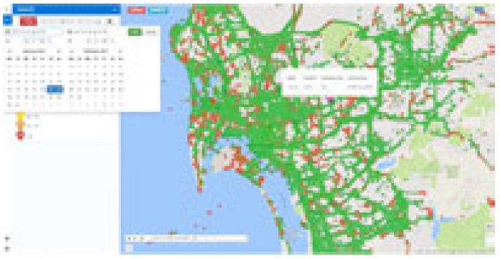
Application Layer: Components
Interactive Traffic Analytics:
  receives a data analytic query and uses the index to combine the needed highlights to answer the query
Alert Service:
  is a background service that can provide real-time and predicted traffic alerts combining public APIs with the TBD
API:
  makes the generated traffic insights available for public use.

Slide 23
Presentation Outline
Introduction
Background
Traffic-TBD Architecture
  Data Layer
  Processing Layer
  Application Layer
Experiments
Conclusions

Slide 24
Experimental Methodology
To evaluate the DATA layer, we have implemented a trace-driven testbed:
Compared Frameworks:
  RAW: stores the snapshot on disk without compression or indexing
  SHAHED: stores the snapshot using a quad-tree index (part of the offline analytic SpatialHadoop 2.4 framework @ ICDE’15) .
  SPATE: the underlying framework used in this work.
Metrics:
  Ingestion Time (sec): time cost to store a 30-min TBD snapshot
  Space (MB): space cost to store a 30-min TBD snapshot
  Response Time (sec): time to answer a query.

Slide 25
Experimental Testbed
TBD Operating System Stack
  Datacenter: VMWare ESXi 5.0.0 Hosts
  VMs: 4 Ubuntu 14.04 server images, each featuring: 8GB of RAM with 2 virtual CPUs (2.40GHz)
  Storage Element: Slow 7.2K RPM RAID-5 SAS, 6 Gbps disks. Each disk formatted in VMFS 5.54 (1MB block)
TBD Framework Stack
  Hadoop Distributed File System (HDFS) v2.5.2
  Apache Hive 2.0 (online querying)
  Apache Spark 1.6.0 (offline data processing)
    Individual Scala programs submitted directly to the Spark computation master
SPARK Jobs
Apache HIVE Warehouse
Apache HDFS
Filesystem

Slide 26
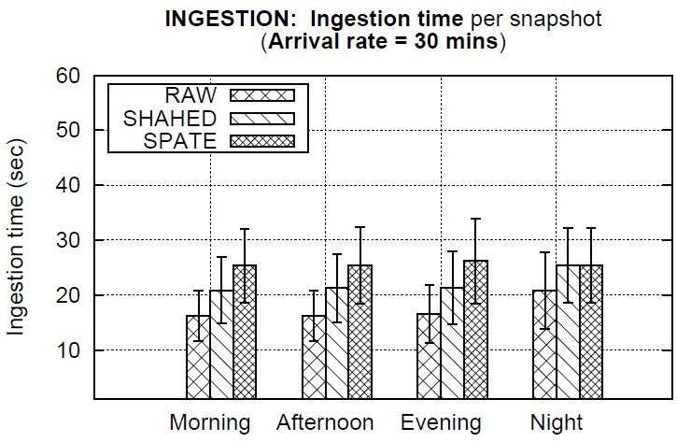
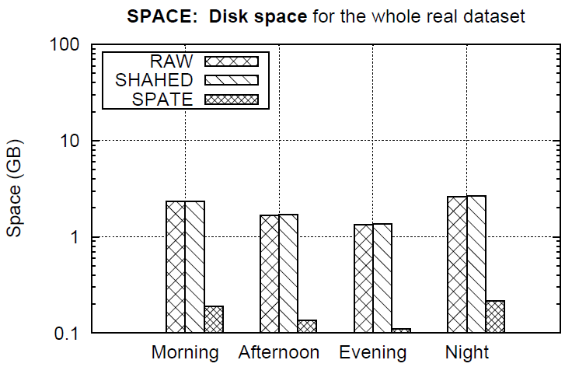
Ingestion Time and Space
Ingestion time (left) and Space (right) of methods over different time windows within a day.
Observation: SPATE 1.25x slower in ingestion but needs 1 order of magnitude less storage space!
  Ingestions are separated by 30 minute windows, so this is acceptable.

Slide 27
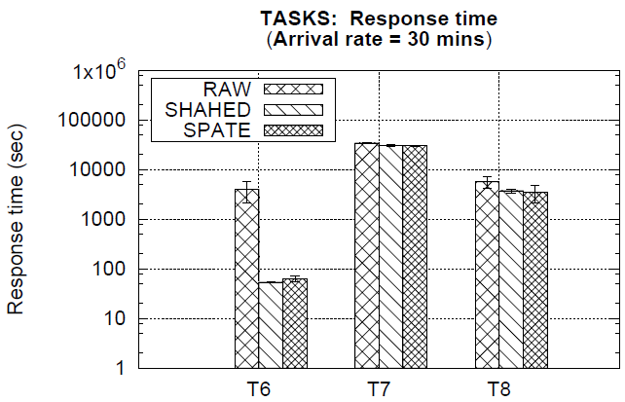
Data Exploration Tasks
Observation:
CPU intensive tasks: SPATE = RAW = SHAHED even though we use 1 order of magnitude less disk space!
Multivariate Statistics
(SparkML)
Kmeans clustering
(SparkML)
Linear Regression
(SparkML)

Slide 28
Conclusions
Conclusions:
  Traffic-TBD architecture aims to provide:
    micro-level traffic modeling and prediction
    location privacy boundaries of users inside their mobile network
    availability with minimal costs and using existing infrastructure
Future Work:
  map-matching of trajectories
  privacy-preserving trajectory processing

Slide 29
Towards Real-Time Road Traffic Analytics using Telco Big Data
Thanks! Questions?
Constantinos Costa∗, Georgios Chatzimilioudis∗, Demetrios Zeinalipour-Yazti‡∗ and Mohamed F. Mokbel§
∗ University of Cyprus, Cyprus
‡ Max Planck Institute for Informatics, Germany
§ University of Minnesota, MN, USA
{costa.c, gchatzim, dzeina}@cs.ucy.ac.cy
dzeinali@mpi-inf.mpg.de, mokbel@cs.umn.edu
Eleventh International Workshop on
Real-Time Business Intelligence and Analytics
Munich, Germany, August 28, 2017

