Slide 1
Prefetching Indoor Navigation Structures in Anyplace
Demetris Zeinalipour
Assistant Professor
Data Management Systems Laboratory
Department of Computer Science
University of Cyprus
http://www.cs.ucy.ac.cy/~dzeina/
Department of Computer Science, University of Nicosia,
Wednesday, March 23, 2016, 18:00 – 19:00, B220 Main Bldg

Slide 2
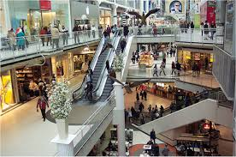
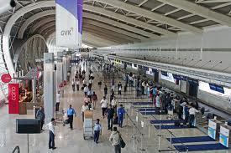
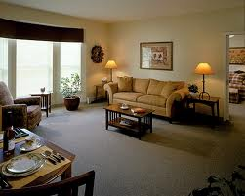
Motivation
People spend 80-90% of their time indoors – USA Environmental Protection Agency 2011.
>85% of data and 70% of voice traffic originates from within buildings – Nokia 2012.

Slide 3
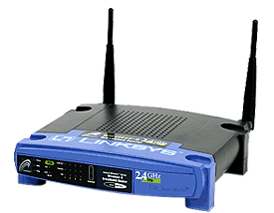
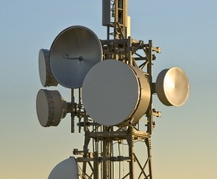
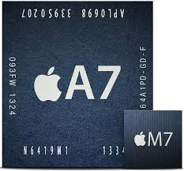
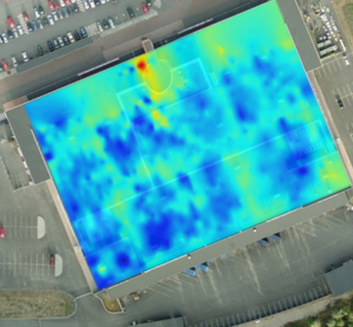
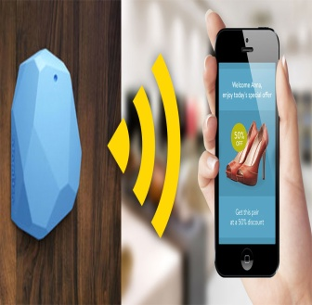
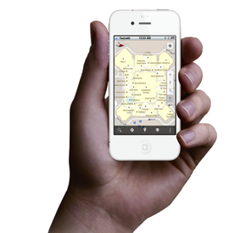
Localization Technologies
Modern trend in Localization are Internet-based Indoor Navigation (IIN) services founded on measurements collected by smart devices.
Technologies:
Wi-Fi APs, Cellular Towers, other stationary antennas
IMU Data (Gyroscope, Accelerometers, Digital Compass)
Magnetic Field Sensors
Beacons (BLE Beacons, RFID Active & Passive Beacons)
Sound (Microphone), Light (Light Sensor), …

Slide 4
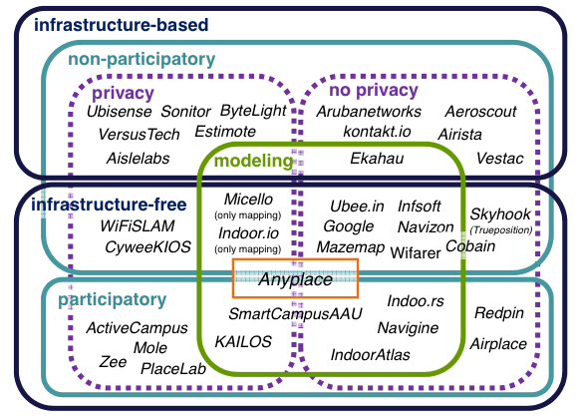
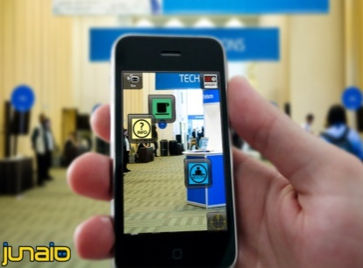
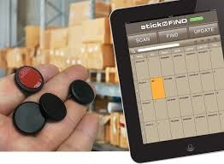
Indoor Applications
Huge spectrum of indoor apps
Navigation, Manufacturing, Asset Tracking, Inventory Management
Healthcare, Smart Houses, Elderly support, Fitness apps
Augmented Reality and many more.
Indoor Revenues expected reach 10B USD in 2020
ABIresearch, “Retail Indoor Location Market Breaks US$10 Billion in 2020”’ Available at: https://goo.gl/ehPRMn, May 12, 2015.
Overview Publication / Tutorial:
"Internet-based Indoor Navigation Services", IEEE Internet Computing (IC'16), http://goo.gl/VJjMRH
Tutorial at IEEE MDM’15 (slides):
http://goo.gl/70JV4q

Slide 5
Anyplace IIN Service
A complete open-source IIN Service developed at the University of Cyprus.
Aims to become the predominant open-source Indoor Localization Service.
Active community: Germany, Russia,
Australia, Canada, UK, etc. – Join today!
Android, Windows, iOS, JSON API
http://anyplace.cs.ucy.ac.cy/

Slide 6
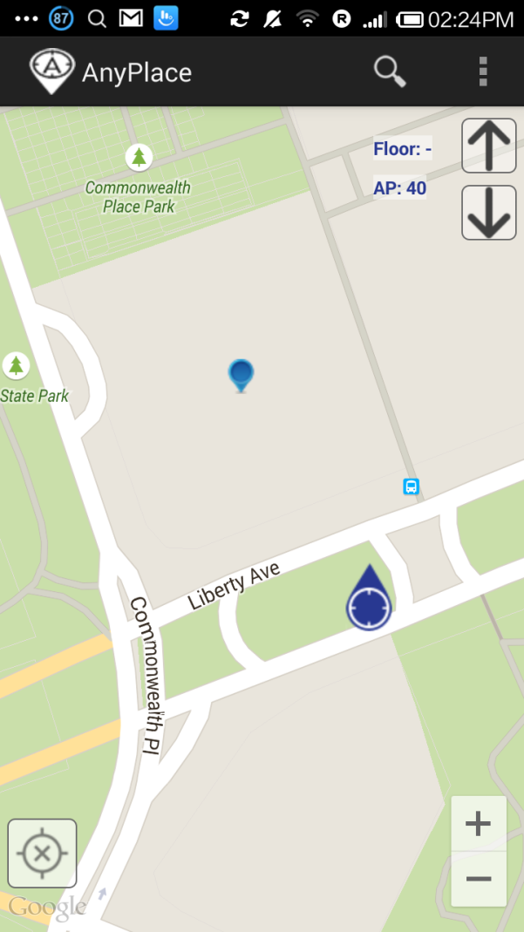
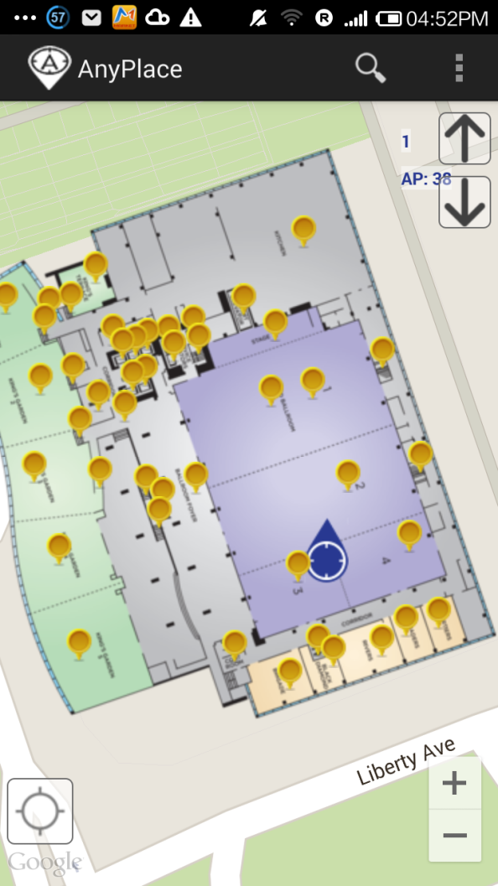
Showcase I: Hotel in Pittsburgh, USA
Before ☹
(using Google API Location)
After ☺
(using Anyplace Location & Indoor Models)

Slide 7
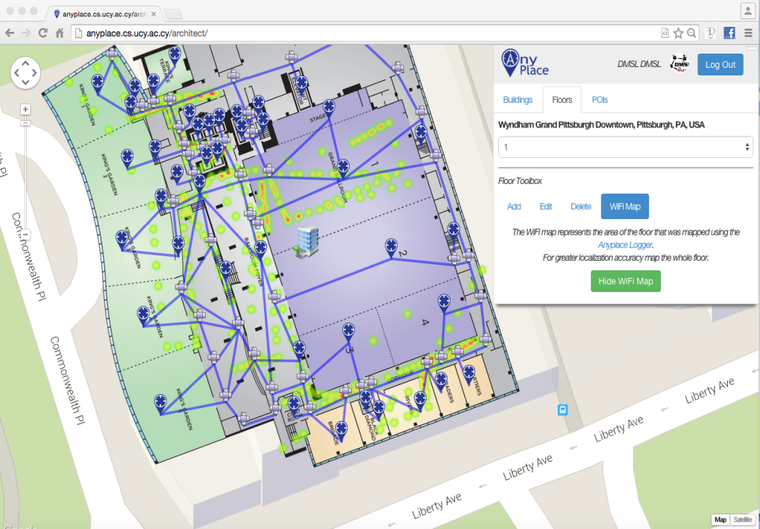
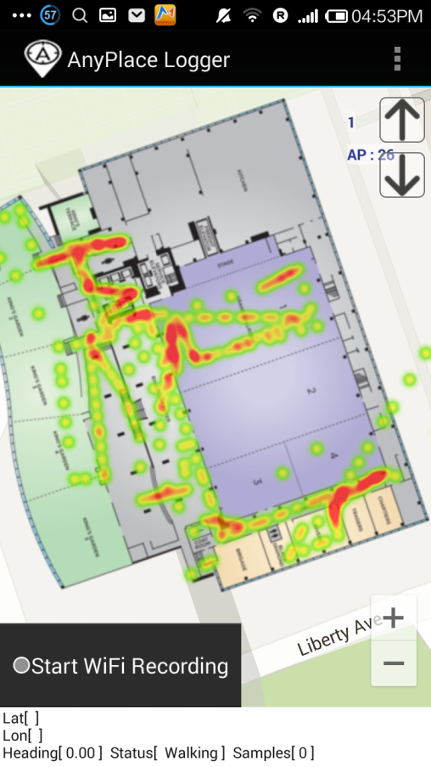
Showcase I: Hotel in Pittsburgh, USA
Modeling + Crowdsourcing

Slide 8
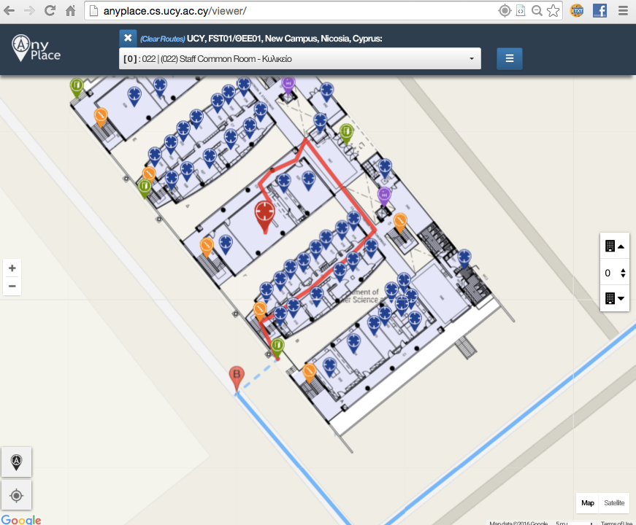
Showcase: Univ. of Cyprus
Office Navigation @ Univ. of Cyprus
Outdoor-to-Indoor Navigation through URL.
60 Buildings mapped, Thousands of POIs (stairways, WC, elevators, equipment, etc.)
Example:
http://goo.gl/ns3lqN

Slide 9
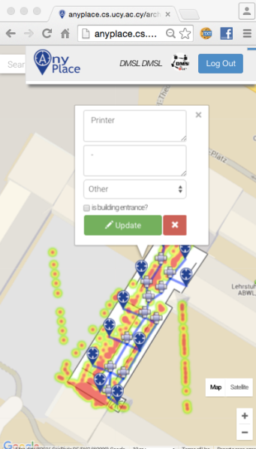
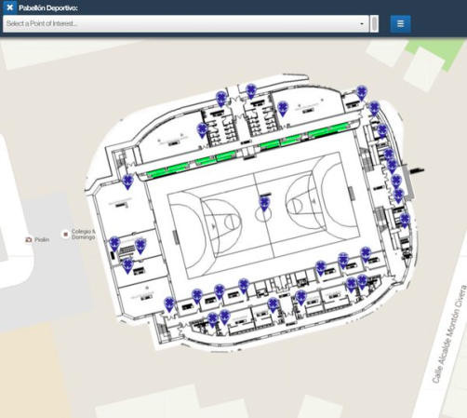
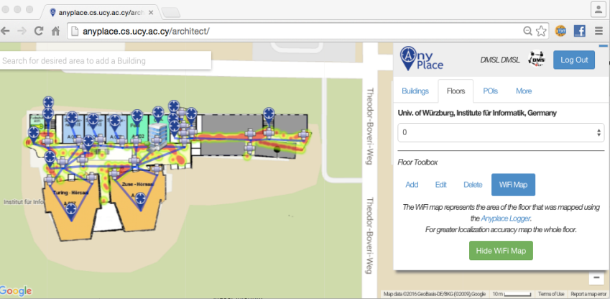
Other Showcases
Univ. of Würzburg, Institut für Informatik
Mapped in about 1 hour
Universidad de Jaén, Spain
Campus Navigation (9 Buildings)
Univ. of Mannheim, Library
Aims to offer Navigation-to-Shelf

Slide 10
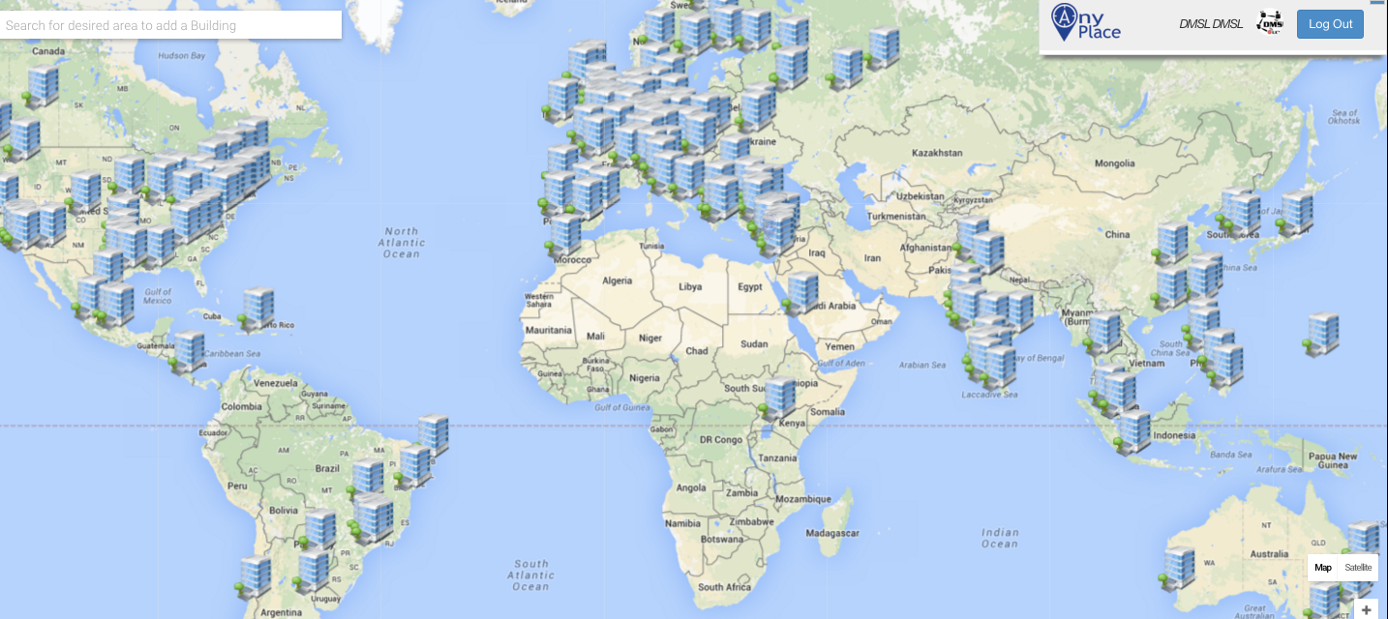
Anyplace Open Maps
http://anyplace.cs.ucy.ac.cy/

Slide 11
Presentation Outline
Introduction
Location Accuracy
IEEE MDM’12, ACM IPSN’14, ACM IPSN’15, IEEE IC’16
Location Prefetching
IEEE MDM’15
Future Challenges
IEEE TKDE’15

Slide 12
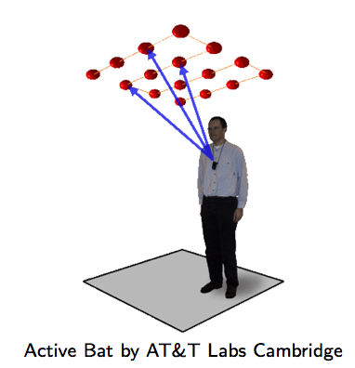
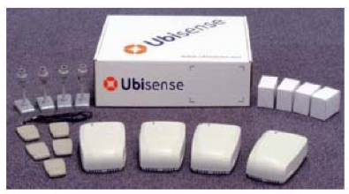
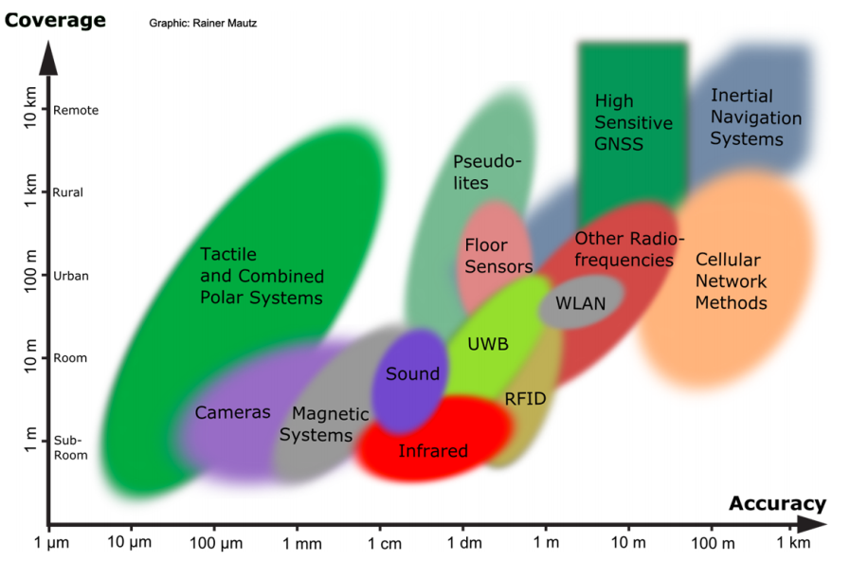
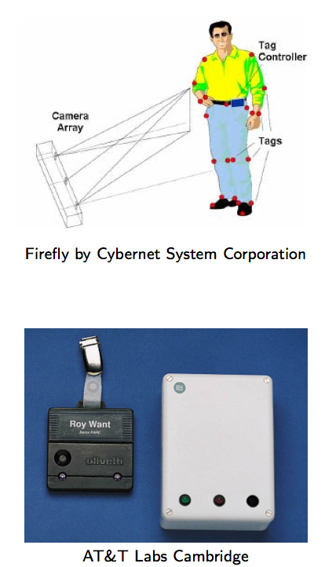
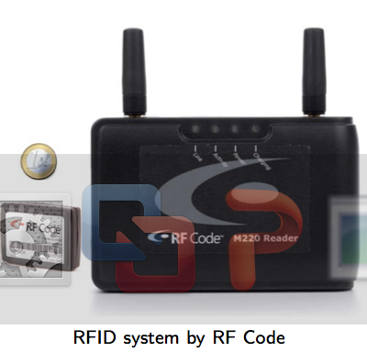
Location Accuracy
Ultrasound:
^{Ultra Wide Band (UWB)}
AOA, TOA, TDOA, signal reflection
: Spatial extension where system performance must be guaranteed
Room Level Accuracy
^{Infrared (IR)}
^{TOA, TDOA}
Radio Frequency IDentification (RFID)
| Outdoor |
| Indoor |
^{Rainer Mautz, ETH Zurich, 2011}
Cell of Origin, Signal Strength
^{Firefly delivers 3mm accuracy}

Slide 13
Location Accuracy
Infrastructure-free systems: don’t require dedicated equipment for the provisioning of location signals (e.g., GPS, Wi-Fi, Cellular, Magnetic, IMU)
Infrastructure-based systems: require dedicated equipment (e.g., proprietary transmitters, beacons, antennas and cabling)
Bluetooth Low Energy (BLE) beacons: iBeacons (Apple)
Ultrasound: ALPS (CMU)
Visible Light: EPSILON (Microsoft Research)
Ultra Wide Band (UWB): Decawave
Anyplace Focus
Source: NASA

Slide 14
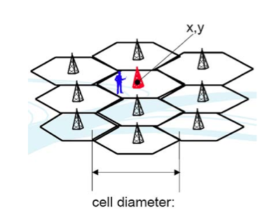
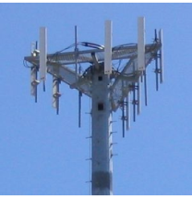
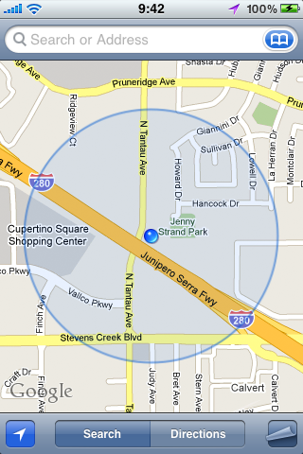
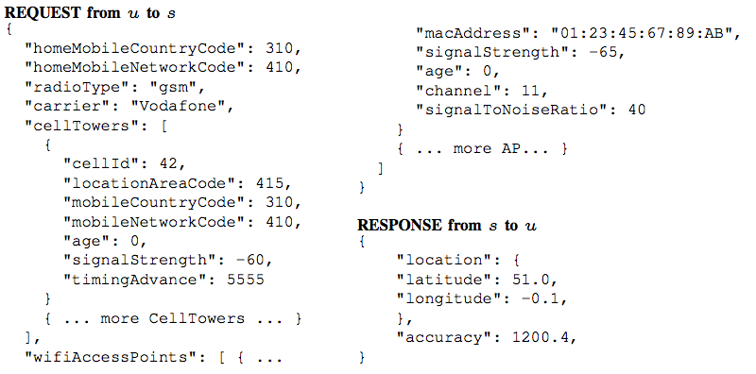
Location (Outdoor/Indoor)
Cell ID:
Cell ID is the Unique Identifier of Cellular Towers.
Cell ID Databases
Skyhook Wireless (2003), MA, USA (Apple, Samsung): 30 million+ cell towers, 1 Billion Wi-Fi APs, 1 billion+ geolocated IPs, 7 billion+ monthly location requests and 2.5 million geofencable POIs.
Google Geolocation “Big” Database (similar)
Disadvantages:
Low accuracy: 30-50m (indoor) to 1-30km (outdoor).
Serving cell is not always the nearest.

Slide 15
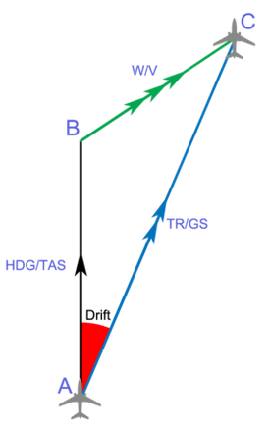
Location (Indoor)
Inertial Measurement Units (IMU)
3D acceleration, 3D gyroscope, digital compass using dead reckoning (calculate next position based on prior).
Disadvantages
Suffers from drift (difference between where the system thinks it is located, and the actual location)
Advantages
Sensors are available on smartphones.
Newer smartphones (iphone 5s) have motion co-processors always-on reading sensors and even providing activitity classifiers (driving, walking, running, etc.)

Slide 16
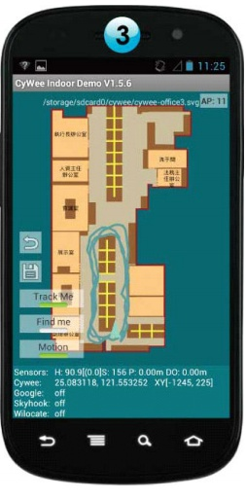
WiFi Fingerprinting in Anyplace
References
[Airplace] "The Airplace Indoor Positioning Platform for Android Smartphones", C. Laoudias et. al., Best Demo Award at IEEE MDM'12. (Open Source!)
[HybridCywee] "Indoor Geolocation on Multi-Sensor Smartphones", C.-L. Li, C. Laoudias, G. Larkou, Y.-K. Tsai, D. Zeinalipour-Yazti and C. G. Panayiotou, in ACM Mobisys'13. Video at: http://youtu.be/DyvQLSuI00I
[UcyCywee] IPSN’14 Indoor Localization Competition (Microsoft Research), Berlin, Germany, April 13-14, 2014. 2nd Position with 1.96m! http://youtu.be/gQBSRw6qGn4
D. Lymberopoulos, J. Liu, X. Yang, R. R. Choudhury, ..., C. Laoudias, D. Zeinalipour-Yazti, Y.-K. Tsai, and et. al., “A realistic evaluation and comparison of indoor location technologies: Experiences and lessons learned”, In IEEE/ACM IPSN 2015.
1st Position at EVARILOS Open Challenge, European Union (TU Berlin, Germany), 2014.
Cywee / Airplace

Slide 17
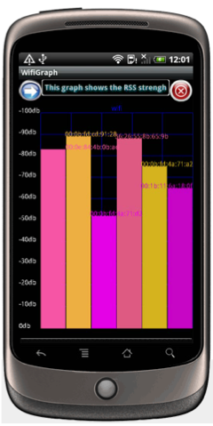
WiFi Fingerprinting
Received Signal Strength indicator (RSSI)
Power measurement present in a received radio signal measured in dBm (Decibel-milliwatts)
Max RSSI (-30dBm) to Min RSSI: (−90 dBm)
’00
Advantages
Readily provided by smartphone APIs
Low power 125mW (RSSI) vs. 400 mW (transmit)
Disadvantages
Complex propagation conditions (multipath, shadowing) due to wall, ceilings.
RSS fluctuates over time at a given location (especially in open spaces).
Unpredictable factors (people moving, doors, humidity)

Slide 18
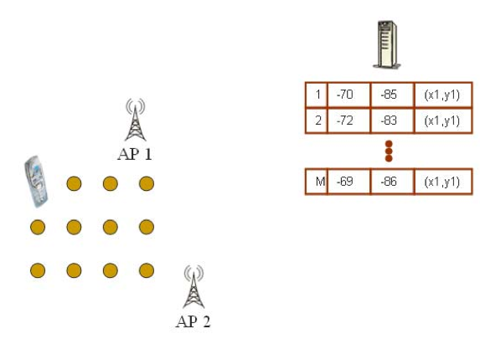
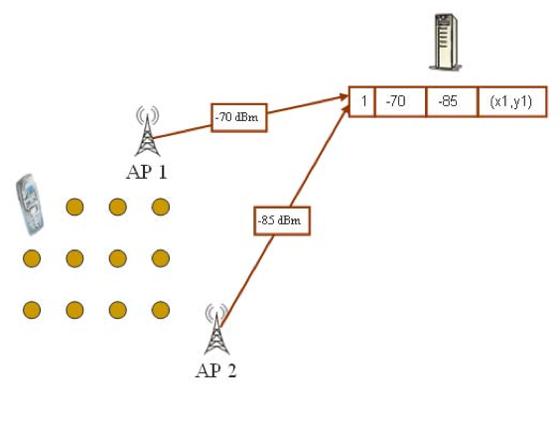
WiFi Fingerprinting
Mapping Area with WiFi Fingerprints
n APs deployed in the area
Fingerprints r_{i} = [ r_{i1}, r_{i2}, …, r_{in}]
Averaging

Slide 19
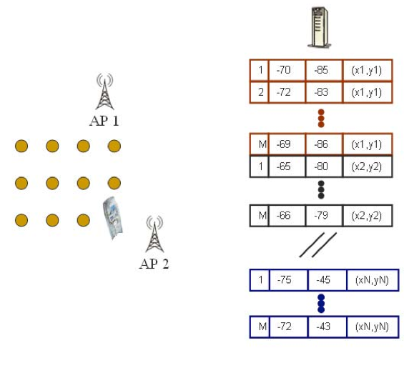
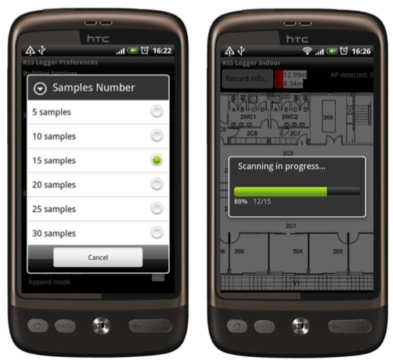
WiFi Fingerprinting
Mapping Area with WiFi Fingerprints
Repeat process for rest points in building. (IEEE MDM’12)
Use 4 direction mapping (NSWE) to overcome body blocking or reflecting the wireless signals.
Collect measurements while walking in straight lines (IPIN’14)

Slide 20
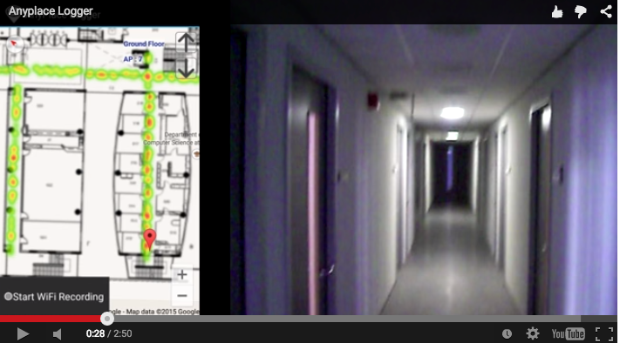
Logging in Anyplace
Video
"Anyplace: A Crowdsourced Indoor Information Service", Kyriakos Georgiou, Timotheos Constambeys, Christos Laoudias, Lambros Petrou, Georgios Chatzimilioudis and Demetrios Zeinalipour-Yazti, Proceedings of the 16th IEEE International Conference on Mobile Data Management (MDM '15), IEEE Press, Volume 2, Pages: 291-294, 2015

Slide 21
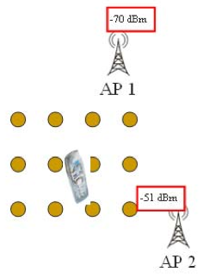
WiFi Positioning
Positioning with WiFi Fingerprint
Collect Fingerprint s = [ s₁, s₂, …, s_{n}]
Compute distance || r_{i} - s || and position user at:
Nearest Neighbor (NN)
K Nearest Neighbors (w_{i} = 1 / K) -convex combination of k loc
Weighted K Nearest Neighbors (w_{i} = 1 / || r_{i} - s || )
RadioMap
s = [ -70, -51]
r₁ = [ -71, -82, (x₁,y₁)]
r₂ = [ -65, -80, (x₂,y₂)]
…
r_{N} = [ -73, -44, (x_{N},y_{N})]
NN, KNN, WKNN

Slide 22
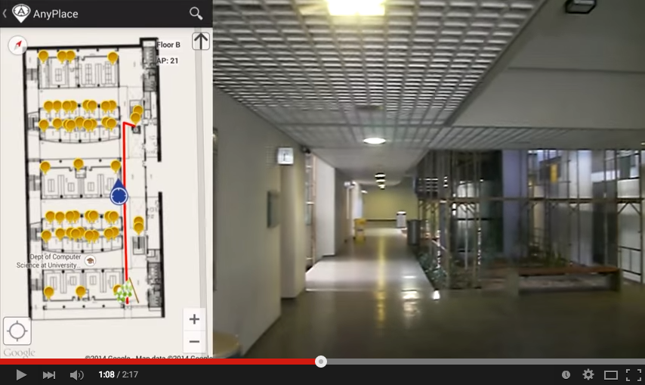
Hybrid Wi-Fi/IMU/Outdoor Anyplace
Video
"Anyplace: A Crowdsourced Indoor Information Service", Kyriakos Georgiou, Timotheos Constambeys, Christos Laoudias, Lambros Petrou, Georgios Chatzimilioudis and Demetrios Zeinalipour-Yazti, Proceedings of the 16th IEEE International Conference on Mobile Data Management (MDM '15), IEEE Press, Volume 2, Pages: 291-294, 2015

Slide 23
Presentation Outline
Introduction
Location Accuracy
IEEE MDM’12, ACM IPSN’14, ACM IPSN’15, IEEE IC’16
Location Prefetching
IEEE MDM’15
Future Challenges
IEEE TKDE’15

Slide 24
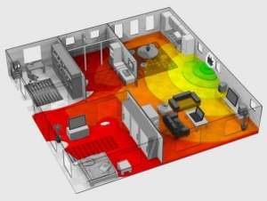
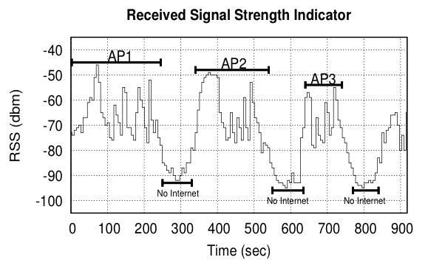
Intermittent Connectivity
Problem: Wi-Fi coverage might be irregularly available inside buildings due to poor WLAN planning or due to budget constraints.
A user walking inside a Mall in Cyprus
Whenever the user enters a store the RSSI indicator falls below a connectivity threshold -85dBm. (-30dbM to -90dbM)
When disconnected IIN can’t offer navigation anymore ☹

Slide 25
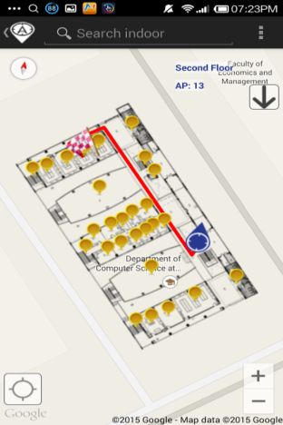
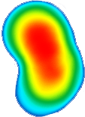
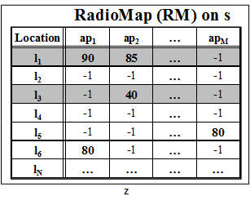
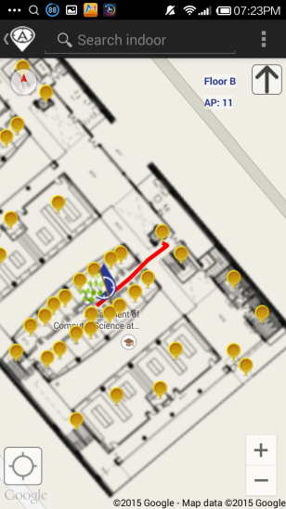
Intermittent Connectivity
IIN Service
Where-am-I?
No Navigation
Where-am-I?
X
Where-am-I?
☹ Intermittent Connectivity
Time

Slide 26
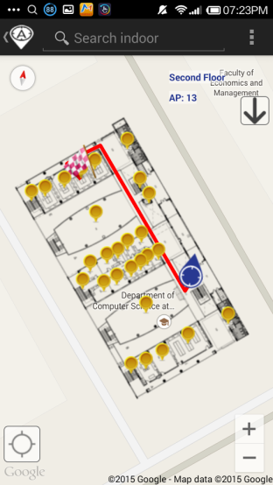
PreLoc Navigation
IIN Service
Prefetch K RM rows
Prefetch K RM rows
X
Localize from Cache
Prefetch K RM rows
☺ Intermittent Connectivity
Time

Slide 27
Intermittent Connectivity
Why not fallback from Wi-Fi to Mobile Internet (2G-4G) when Wi-Fi is not available?
Mobile Internet Limitations:
Coverage: blockage or attenuation of signals in indoor spaces.
Slow fallback between outdated Mobile Internet and Wi-Fi infrastructures.
Lack of ubiquitous 802.11k, 802.11r (fast roaming) and 4G infrastructure.
Limited Quota: Nobody ones to waste a mobile Internet plan for navigation purposes.
Unavailability due to Roaming: when traveling and needing indoor navigation at most.

Slide 28
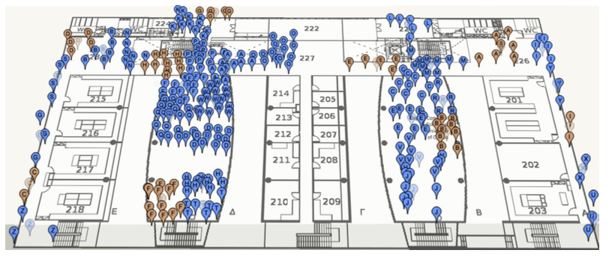
PreLoc Partitioning Step
Why? RM might contain many points (45K in CSUCY!).
Action: The objective of this step is to cluster these into groups so that they are easier to prefetch.
K-Means simple well-established clustering algorithm.
Operation: Random Centroids (C), Add to Closest C, Re-adjust C
Re-adjusting Centroids expensive quadratic complexity ☹

Slide 29
PreLoc Partitioning Step
We use the Bradley-Fayyad-Reina (BFR)* algorithm
A variant of k-means designated for large datasets.
Instead of computing L₂ distance of point p against centroid, as in k-means, it computes the Mahalanobis distance (dist_{Mah}) against some set statistics (μ, σ).
In BFR if dist_{Mah} is less than a threshold add to set, else retain to possibly shape new clusters.
Advantage: Less centroid computations! Points are traversed only once which is fast for big data!
μ
dist_{Mah}
σ
Point (p)
Scaling Clustering Algorithms to Large Databases.. PS Bradley, UM Fayyad, C Reina - KDD, 1998

Slide 30
PreLoc Selection Step
The Selection Step aims to sequence the retrieval of clusters, such that the most important clusters are downloaded first.
Question: Which clusters should a user download at a certain position if Wi-Fi not available next?
PreLoc prioritizes the download of RM entries using historic traces of user inside the building !!!
User Current Location

Slide 31
PreLoc Selection Step
PreLoc relies on the Probabilistic Group Selection (PGS) Heuristic to determine the RM entries to prefetch next.
Probabilistic k=3 Group Selection
Historic Traces
Dependency Graph
(DG)
Do Best First Search Traversal of DG from A:
follow the most promising option using priority queue.
P(A,B)=1.0
P(A,B,D)=0.66
P(A,B,D,C)=0.66*0.5=0.33
P(A,B,D,A) => cycle
P(A,B,D,C,D)=> cycle
P(A,B,C)=0.33
Empty queue – finished!
User Current Location
A
B
D
0.5
0.5
1.0
C
A
0.66
Early stop!
C
D
1.0
0.33
B
(statistically independent transitions between vertices + no stationary transitions in historic traces)

Slide 32
PreLoc Selection Step
Instead of the PGS greedy search, we could have used other Blind Search techniques:
BFS, DFS, Random Walker, etc.
Random Selection (RS),
Iterative Deepening Selection (IDS)
BFS or DFS down depth W (lookahead window), then down to depth W+1,.. So essentially BFS traversal but with improved memory as we don’t need to maintain the traversal queue.
User Current Location

Slide 33
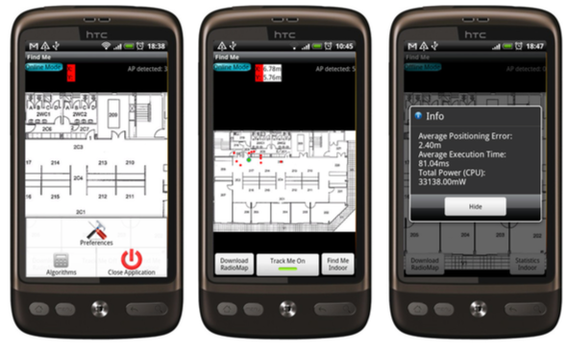
Datasets & Scenario
CSUCY Dataset
8,900 m² CS building with 4 floors (2,224 m² / floor)
120 Wi-Fi Access Points (CS, adhoc and neighboring)
|RM|=45,000 fingerprints on 2,900 locations.
Optimized RM size is 2.6MB (initial much larger).
Scenario: realistic user routes inside the building.
The localization requests are 5 meters apart
We repeat the requests 15-30 times (i.e., a user moves 50-150 meters inside the building).
Platform: Airplace
(IEEE MDM’12) - open source
Notes:
Initial fingerprints were averaged (normalized) at a 2x2m cell granularity.

Slide 34
Evaluation Metrics
Algorithms
Client Side Approach (CSA) b: building f: floor
PreLoc (PGS, IDS, RS)
Server Side Approach (SSA)
Metrics
Point Accuracy (A_{r}): L₂ distance between the estimated (λ^{u}) and the actual (l^{u}) location of u (in SSA). i.e., ||λ^{u} - l^{u}||
CPU Time (T_{r}): processing time used on u’s device for localizing given request r

Slide 35
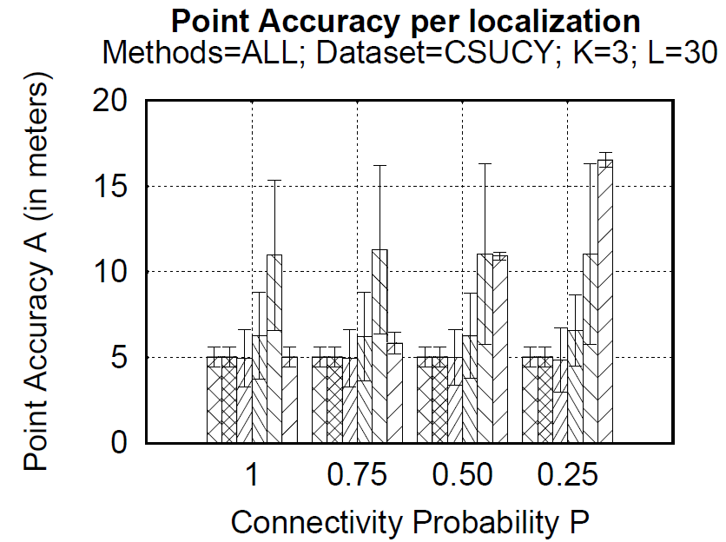
Techniques: Localization Accuracy (A)
Remarks
CSA: good accuracy (as RM is already local) – 5 meters (Airplace)
SSA accuracy severely affected by failures – 17 meters for P=0.25.
PreLoc (PGS, IDS) sometimes better accuracy than CSA!
PreLoc (RS) has high standard deviation due to randomness

Slide 36
Techniques: CPU Time (T)
(BFR Partitions)
Remarks
CSA(b): worse time 1911ms (needs to compare V_{r} vs. complete RM)
CSA(f): still bad time 520ms (graph is log-scale!)
SSA best CPU time 2.6ms but is not accurate under failures P<1
PreLoc (PGS, IDS) 274, 230ms milliseconds for execution!!

Slide 37
Presentation Outline
Introduction
Location Accuracy
IEEE MDM’12, ACM IPSN’14, ACM IPSN’15, IEEE IC’16
Location Prefetching
IEEE MDM’15
Future Challenges
IEEE TKDE’15

Slide 38
Big-Data Challenges
Massively process RSS log traces to generate a valuable Radiomap
Processing current logs in Anyplace for a single building takes several minutes!
Challenges in MapReduce:
Collect Statistics (count, RSSI mean and standard deviation)
Remove Outlier Values.
Handle Diversity Issues

Slide 39
Crowdsourcing Challenges
Quality: Unreliable Crowdsourcers, Multi-device Issues, Hardware Outliers, Temporal Decay, etc.
Remark: There is a Linear Relation between RSS values of devices.
Challenge: Can we exploit this to align reported RSS values?
"Crowdsourced Indoor Localization for Diverse Devices through Radiomap Fusion", C. Laoudias, D. Zeinalipour-Yazti and C. G. Panayiotou, "Proceedings of the 4th Intl. Conference on Indoor Positioning and Indoor Navigation" (IPIN '13), Montbeliard-Belfort France, 2013.

Slide 40
Modeling Challenges
Indoor spaces exhibit complex topologies. They are composed of entities that are unique to indoor settings:
e.g., rooms and hallways that are connected by doors.
Conventional Euclidean distances are inapplicable in indoor space, e.g., NN of p1 is p2 not p3.
IndoorGML by OGC
Jensen et. al. 2010

Slide 41
Location Privacy Challenges
An IIN Service can continuously “know” (surveil, track or monitor) the location of a user while serving them.
Location tracking is unethical and can even be illegal if it is carried out without the explicit user consent.
Imminent privacy threat, with greater impact that other privacy concerns, as it can occur at a very fine granularity. It reveals:
The stores / products of interest in a mall.
The book shelves of interest in a library
Artifacts observed in a museum, etc.

Slide 42
Location Privacy
I can see these Reference Points, where am I?
...
(x,y)!
IIN Service
User u
Towards planet-scale localization on smartphones with a partial radiomap", A. Konstantinidis, G. Chatzimilioudis, C. Laoudias, S. Nicolaou and D. Zeinalipour-Yazti. In ACM HotPlanet'12, in conjunction with ACM MobiSys '12, ACM, Pages: 9--14, 2012.
Privacy-Preserving Indoor Localization on Smartphones, Andreas Konstantinidis, Paschalis Mpeis, Demetrios Zeinalipour-Yazti and Yannis Theodoridis, in IEEE TKDE’15.

Slide 43
Temporal Vector Map (TVM)
Bloom Filter (u's APs)
WiFi
Set Membership Queries
WiFi
...
IIN Service
K=3 Positions
User u
WiFi

Slide 44
TVM Continuous
Camouflage trajectories
IIN determnines u’s location by exclusion

Slide 45
Prefetching Indoor Navigation Structures in Anyplace
Demetris Zeinalipour
Thanks – Questions?
Data Management Systems Laboratory
Department of Computer Science
University of Cyprus
http://www.cs.ucy.ac.cy/~dzeina/
Department of Computer Science, University of Nicosia,
Wednesday, March 23, 2016, 18:00 – 19:00, B220 Main Bldg

Slide 46
WiFi Positioning Demo
Video
Works best in confined areas
"The Airplace Indoor Positioning Platform for Android Smartphones", C. Laoudias, G. Constantinou, M. Constantinides, S. Nicolaou, D. Zeinalipour-Yazti, C. G. Panayiotou, Best Demo Award at IEEE MDM'12. (Open Source!)

Slide 47
TVM – Bloom Filters
Bloom filters – basic idea:
allocate a vector of b bits, initially all set to 0
use h independent hash functions to hash every Access Point seen by a user to the vector.
The IIN Service selects any RadioMap row that has an AP belonging to the query bloom filter and send it to the user.
AP2
AP13
AP2
AP13
0 | 1 | 0 | 0 | 1 | 0 | 0 | 1 | 0 | 0
b

Slide 48
TVM – Bloom Filters
The most significant feature of Bloom filters is that there is a clear tradeoff between b and the probability of a false positive.
Small b: Too many false positives (too much hiding & cost)
Large b: “No” false positives (no hiding & no cost)
Given h optimal hash functions, b bits for the Bloom filter we can estimate the amount of false positives produced by the Bloom filter:
False Positive Ratio:
Size of vector:

Slide 49
TVM Evaluation
Energy required for 300 localization tasks (CPU+Wi-Fi) using PowerTutor on Android
Campus (20MB)
Town (100MB)
City (1GB)
Country (20GB)

Slide 50
Location Privacy
IIN services might become attractive targets for hackers, aiming to steal location data and carry out illegal acts (e.g., break into houses).
IIN should be considered as fundamentally untrusted entities, so we aim to devise techniques that allow the exploitation of IIN utility with controllable privacy to the user.
Privacy vs. No Privacy
Location Privacy: when location estimated by user’s device (current Anyplace) – data outdated ☹
No Location Privacy: when the location is derived continuously by the IIN (most IIN services)

