Slide 1


Indoor Data Management in Anyplace
Demetris Zeinalipour
Assistant Professor
Department of Computer Science, University of Cyprus, Cyprus
Humboldt Fellow @ Max Planck Institute for Informatics, Germany
http://people.mpi-inf.mpg.de/~dzeinali/
dzeinali@mpi-inf.mpg.de
Max Planck Institute for Informatics, Saarbrücken, Germany, July 11, 2017

Slide 2
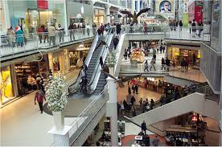
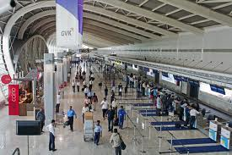

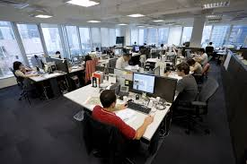
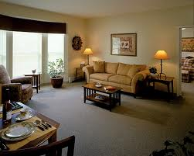

Motivation
People spend 80-90% of their time indoors – USA Environmental Protection Agency 2011.
>85% of data and 70% of voice traffic originates from within buildings – Nokia 2012.

Slide 3
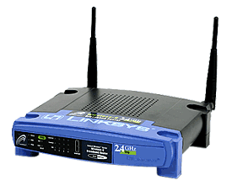
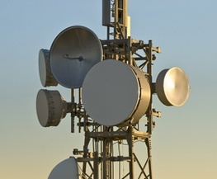
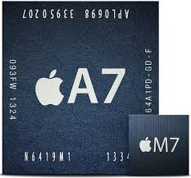
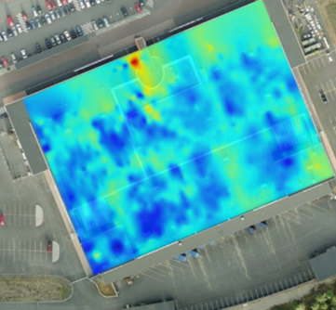
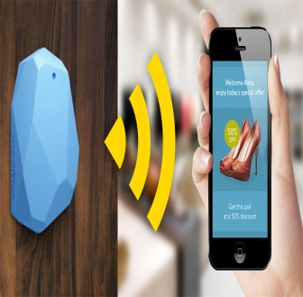

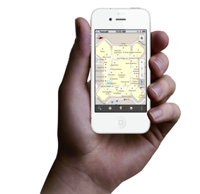
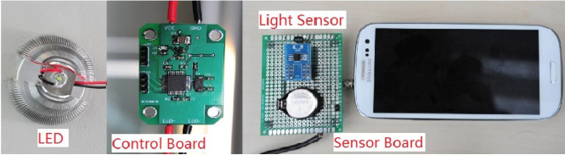
Localization Technologies
Modern trend in Localization are Internet-based Indoor Navigation (IIN) services founded on measurements collected by smart devices.
Technologies:
  Wi-Fi APs, Cellular Towers, other stationary antennas
  IMU Data (Gyroscope, Accelerometers, Digital Compass)
  Magnetic Field Sensors
  Beacons (BLE Beacons, RFID Active & Passive Beacons)
  Sound (Microphone), Light (Light Sensor), …

Slide 4
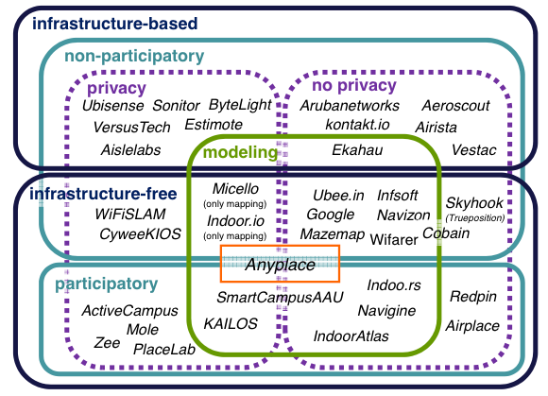
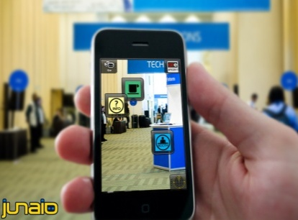
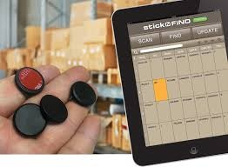
Indoor Applications
Huge spectrum of indoor apps
  Navigation, Manufacturing, Asset Tracking, Inventory Manag.
  Healthcare, Smart Houses, Elderly support, Fitness apps
  Augmented Reality and many more.
Indoor Revenues expected reach 10B USD in 2020
  ABIresearch, “Retail Indoor Location Market Breaks US$10 Billion in 2020”’ Available at: https://goo.gl/ehPRMn, May 12, 2015.
Tutorial @ IEEE MDM’15
  “Mobile Data Management in Indoor Spaces”, Christos Laoudias and Demetrios Zeinalipour-Yazti
  Slides available: http://goo.gl/70JV4q

Slide 5

Anyplace IIN Service
Anyplace: A complete IIN Service open for research and development
  Accuracy (1.96m [ACM IPSN’15])
  Crowdsourcing [IEEE IC’12]
  Privacy [IEEE TKDE’15],
  Other: Modeling [SIGSPATIAL’17-S]
Model Your Building!
  It takes 1 minute to get your model online – 1 hour to offer indoor navigation and search in a 2500 sq meter building!
http://anyplace.cs.ucy.ac.cy/
  "Internet-based Indoor Navigation Services", Demetrios Zeinalipour-Yazti, Christos Laoudias, Kyriakos Georgiou and Georgios Chatzimiloudis, IEEE Internet Computing (IC'17), IEEE Computer Society, 2017.

Slide 6
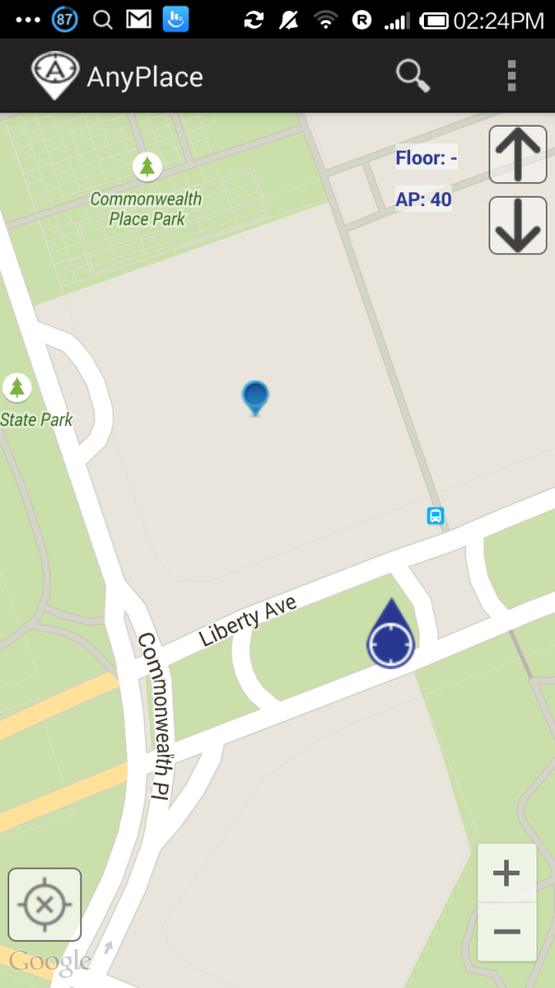
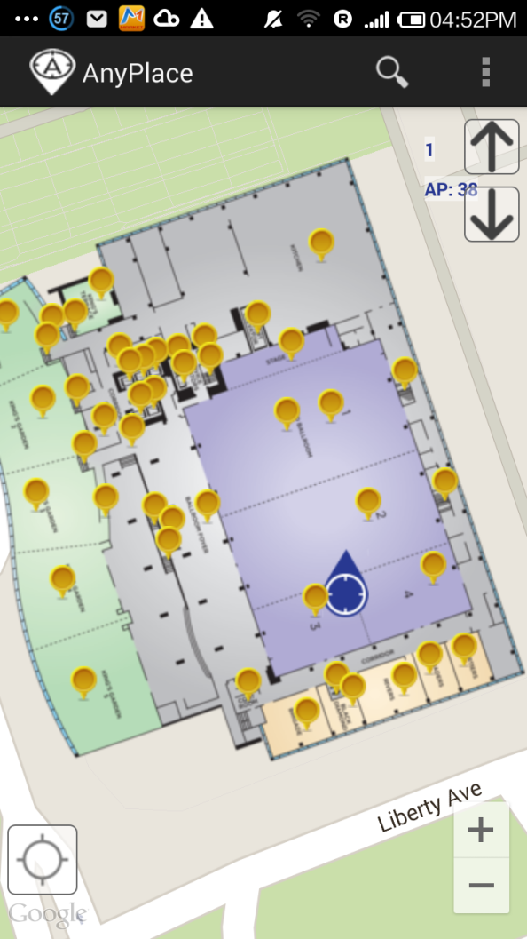
Anyplace @ MDM’15
Before ☹
(using Google API Location)
After ☺
(using Anyplace Location & Indoor Models)

Slide 7
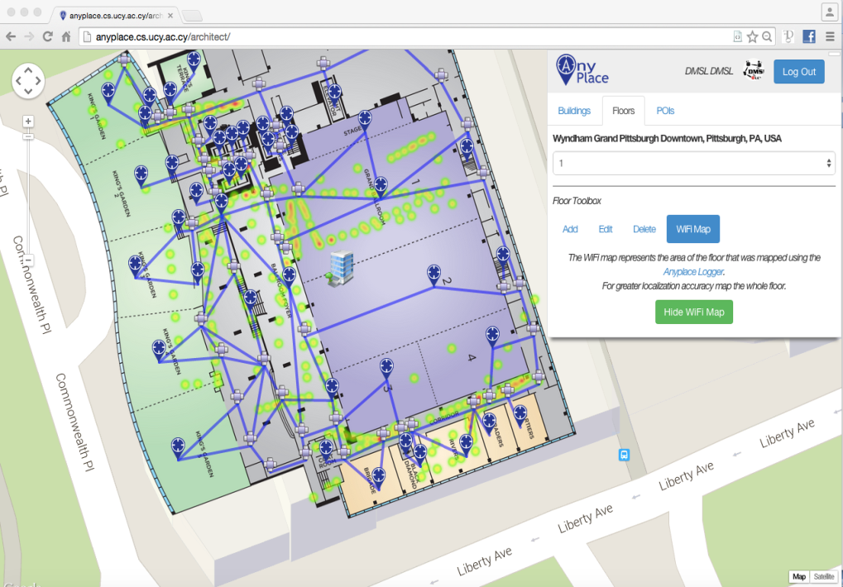
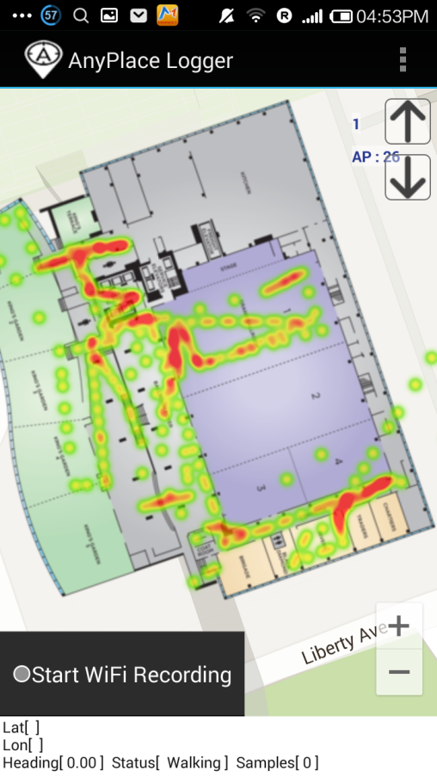
Anyplace @ MDM’15
Modeling + Crowdsourcing

Slide 8
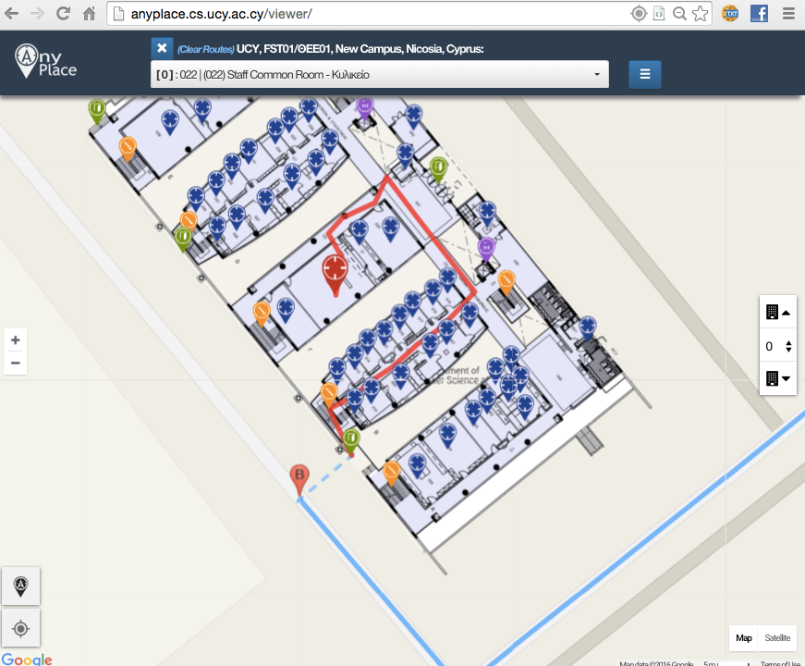
Showcase: Univ. of Cyprus
Office Navigation @ Univ. of Cyprus
  Outdoor-to-Indoor Navigation through URL.
  60 Buildings mapped, Thousands of POIs (stairways, WC, elevators, equipment, etc.)
Example:
http://goo.gl/ns3lqN

Slide 9
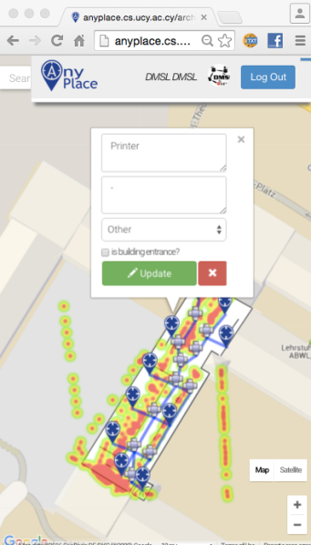
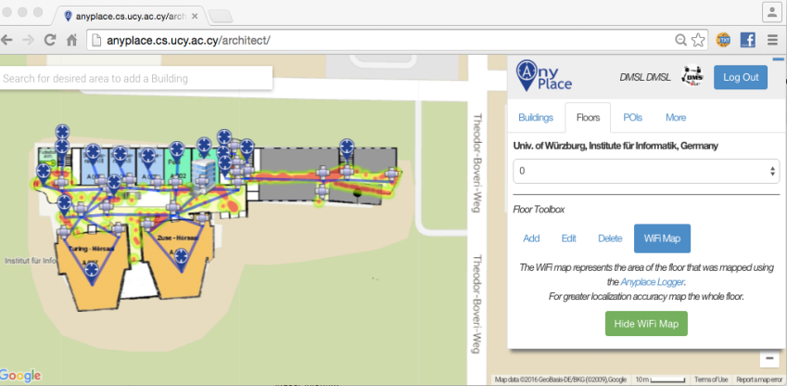
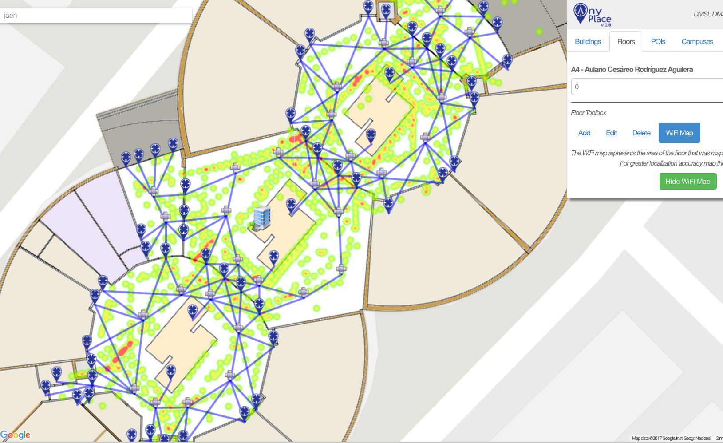
Campus and Library Navigation
Univ. of Würzburg, Institut für Informatik
  Mapped in about 1 hour
Universidad de Jaén, Spain - Campus
  Campus Navigation (9 Buildings)
Univ. of Mannheim, Library
  Aim: book navigation in Westflügel

Slide 10
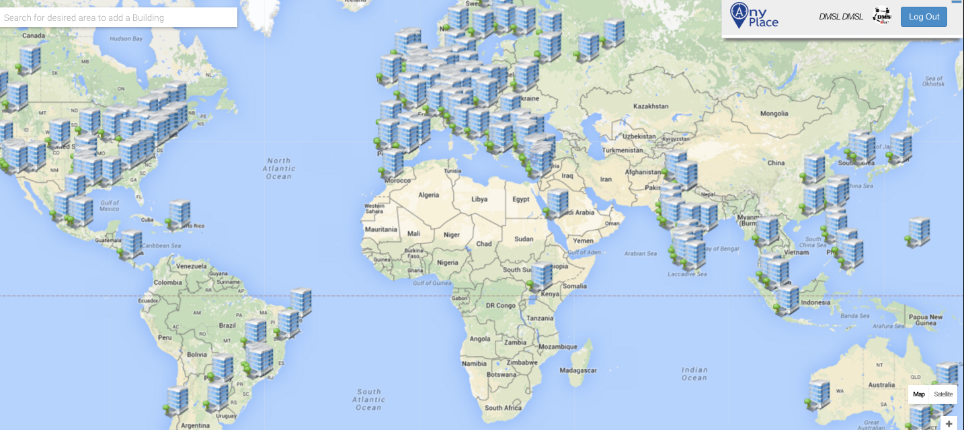
Anyplace Open Maps
~1,000 mapping attempts
~100,000 user interactions
~20,000 users visited
Almost 100 forks on Github
http://anyplace.cs.ucy.ac.cy/

Slide 11
Presentation Outline
Introduction
Location Accuracy
  MDM’12, IPSN’14, IPSN’15
Location Privacy
  HotPlanet’12, IEEE TKDE’15
Radiomap Prefetching
  MDM’15
Future Challenges

Slide 12
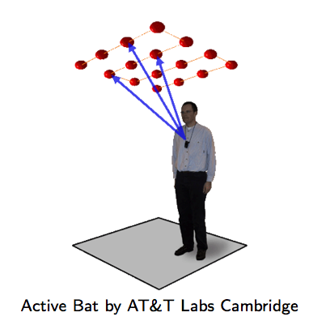
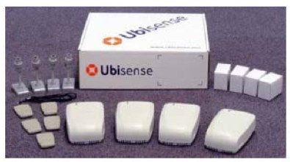
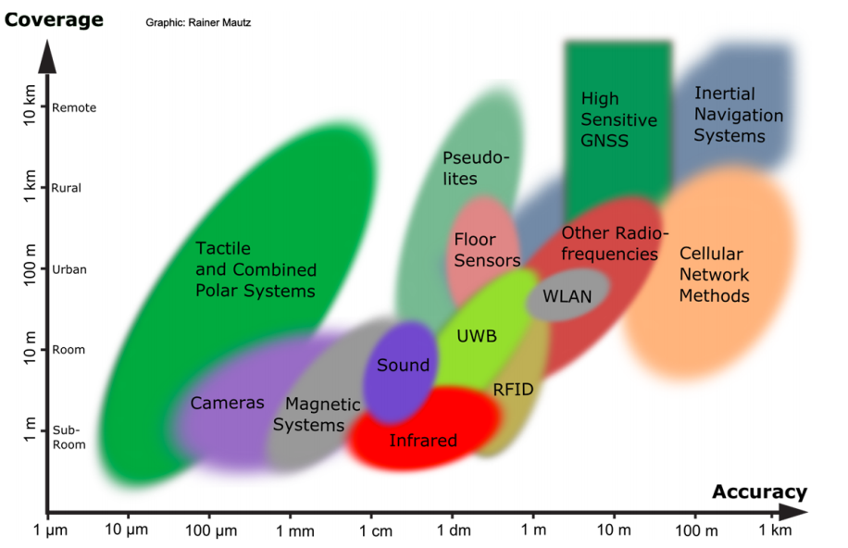
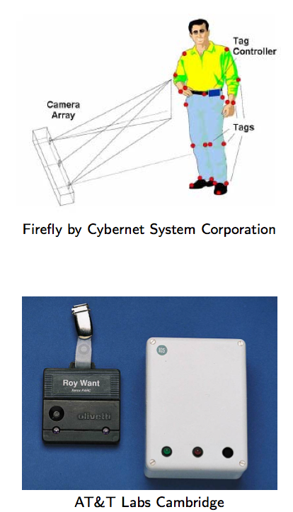
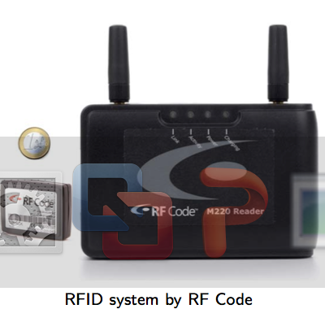
Location Accuracy
Ultrasound:
^{Ultra Wide Band (UWB)}
AOA, TOA, TDOA, signal reflection
: Spatial extension where system performance must be guaranteed
Our Focus: Room Level Accuracy
+ Infrastructure Free
^{Infrared (IR)}
^{TOA, TDOA}
Radio Frequency IDentification (RFID)
| Outdoor |
| Indoor |
^{Rainer Mautz, ETH Zurich, 2011}
Cell of Origin, Signal Strength
^{Firefly delivers 3mm accuracy}

Slide 13
Location Accuracy
Infrastructure-free systems: don’t require dedicated equipment for the provisioning of location signals (e.g., GPS, Wi-Fi, Cellular, Magnetic, IMU)
Infrastructure-based systems: require dedicated equipment (e.g., proprietary transmitters, beacons, antennas and cabling)
  Bluetooth Low Energy (BLE) beacons: iBeacons (Apple)
  Ultrasound: ALPS (CMU)
  Visible Light: EPSILON (Microsoft Research)
  Ultra Wide Band (UWB): Decawave
Anyplace Focus
Source: NASA

Slide 14
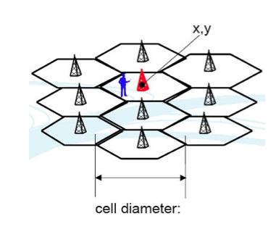
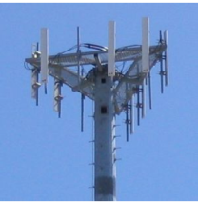
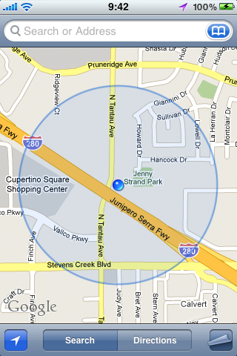
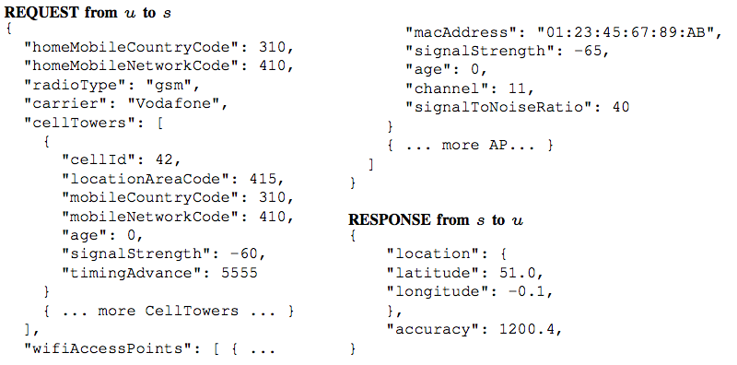
Location (Outdoor/Indoor)
GPS: Power hungry, not available indoors
Cell ID / MAC ID Databases
  Cell ID is the unique Identifier of Cellular Towers.
  Skyhook Wireless (2003), MA, USA (Apple, Samsung): 30 million+ cell towers, 1 Billion Wi-Fi APs, 1 billion+ geolocated IPs, 7 billion+ monthly location requests and 2.5 million geofencable POIs.
  Google Geolocation “Big” Database (similar)
Disadvantages:
Low accuracy: 30-50m (indoor) to 1-30km (outdoor).
Serving cell is not always the nearest.

Slide 15
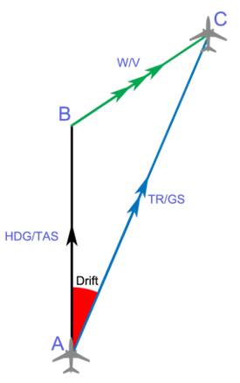


Location (Indoor)
Inertial Measurement Units (IMU)
  3D acceleration, 3D gyroscope, digital compass using dead reckoning (calculate next position based on prior).
Disadvantages
  Suffers from drift (difference between where the system thinks it is located, and the actual location)
Advantages
  Sensors are available on smartphones.
  Newer smartphones (iphone 5s) have motion co-processors always-on reading sensors and even providing activitity classifiers (driving, walking, running, etc.)

Slide 16
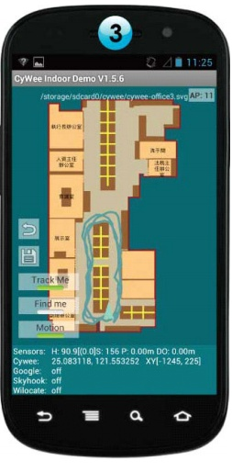
WiFi Fingerprinting in Anyplace
References
  [Airplace] "The Airplace Indoor Positioning Platform for Android Smartphones", C. Laoudias et. al., Best Demo Award at IEEE MDM'12. (Open Source!)
  [HybridCywee] "Indoor Geolocation on Multi-Sensor Smartphones", C.-L. Li, C. Laoudias, G. Larkou, Y.-K. Tsai, D. Zeinalipour-Yazti and C. G. Panayiotou, in ACM Mobisys'13. Video at: http://youtu.be/DyvQLSuI00I
  [UcyCywee] IPSN’14 Indoor Localization Competition (Microsoft Research), Berlin, Germany, April 13-14, 2014. 2nd Position with 1.96m! http://youtu.be/gQBSRw6qGn4
    D. Lymberopoulos, J. Liu, X. Yang, R. R. Choudhury, ..., C. Laoudias, D. Zeinalipour-Yazti, Y.-K. Tsai, and et. al., “A realistic evaluation and comparison of indoor location technologies: Experiences and lessons learned”, In IEEE/ACM IPSN 2015.
  1st Position at EVARILOS Open Challenge, European Union (TU Berlin, Germany), 2014.
Cywee / Airplace

Slide 17

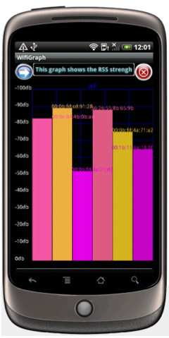
WiFi Fingerprinting
Received Signal Strength indicator (RSSI)
  Power measurement present in a received radio signal measured in dBm (Decibel-milliwatts)
    Max RSSI (-30dBm) to Min RSSI: (−90 dBm)
’00
Advantages
  Readily provided by smartphone APIs
  Low power 125mW (RSSI) vs. 400 mW (transmit)
Disadvantages
  Complex propagation conditions (multipath, shadowing) due to wall, ceilings.
  RSS fluctuates over time at a given location (especially in open spaces).
  Unpredictable factors (people moving, doors, humidity)

Slide 18
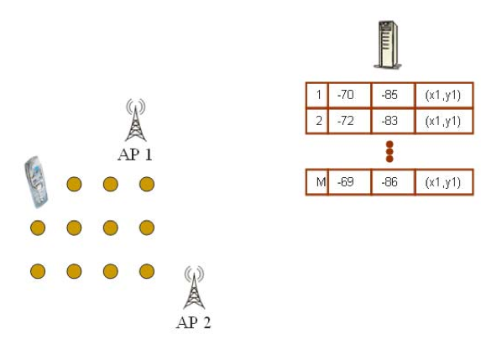
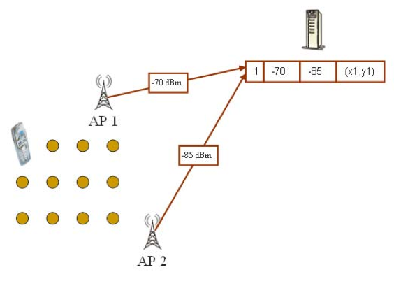
WiFi Fingerprinting
Mapping Area with WiFi Fingerprints
  n APs deployed in the area
  Fingerprints r_{i} = [ r_{i1}, r_{i2}, …, r_{in}]
  Averaging

Slide 19
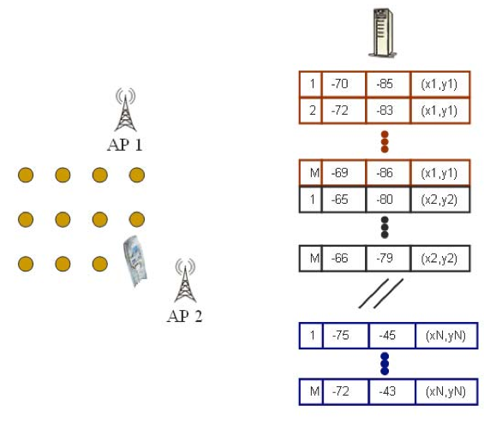
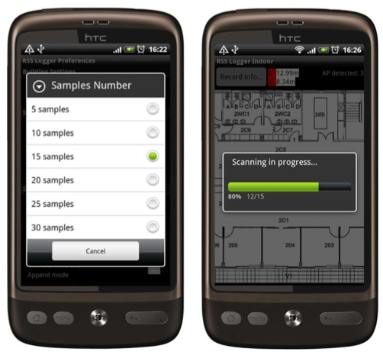
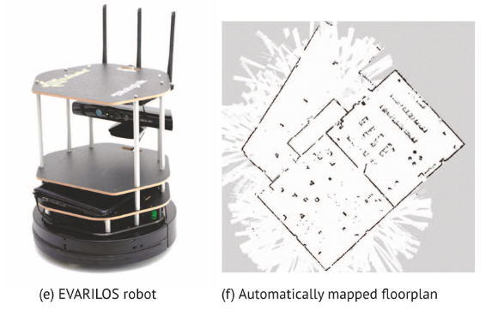
WiFi Fingerprinting
Mapping Area with WiFi Fingerprints
  Repeat process for rest points in building. (IEEE MDM’12)
  Use 4 direction mapping (NSWE) to overcome body blocking or reflecting the wireless signals.
  Collect measurements while walking in straight lines (IPIN’14)

Slide 20
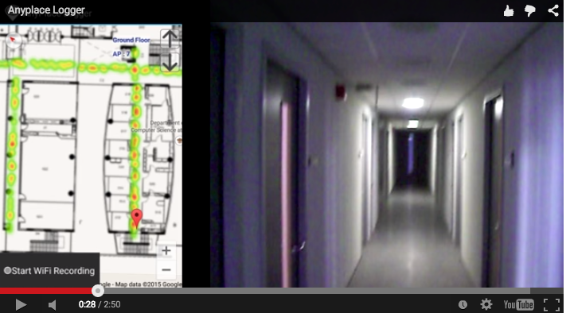
Logging in Anyplace
Video
"Anyplace: A Crowdsourced Indoor Information Service", Kyriakos Georgiou, Timotheos Constambeys, Christos Laoudias, Lambros Petrou, Georgios Chatzimilioudis and Demetrios Zeinalipour-Yazti, Proceedings of the 16th IEEE International Conference on Mobile Data Management (MDM '15), IEEE Press, Volume 2, Pages: 291-294, 2015

Slide 21
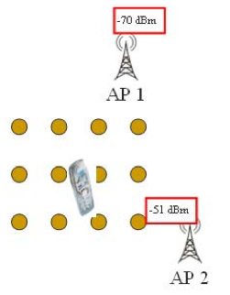
WiFi Positioning
Positioning with WiFi Fingerprint
  Collect Fingerprint s = [ s₁, s₂, …, s_{n}]
  Compute distance || r_{i} - s || and position user at:
    Nearest Neighbor (NN)
    K Nearest Neighbors (w_{i} = 1 / K) [convex combination of k loc]
    Weighted K Nearest Neighbors (w_{i} = 1 / || r_{i} - s || )
RadioMap
s = [ -70, -51]
r₁ = [ -71, -82, (x₁,y₁)]
r₂ = [ -65, -80, (x₂,y₂)]
…
r_{N} = [ -73, -44, (x_{N},y_{N})]
NN, KNN, WKNN

Slide 22
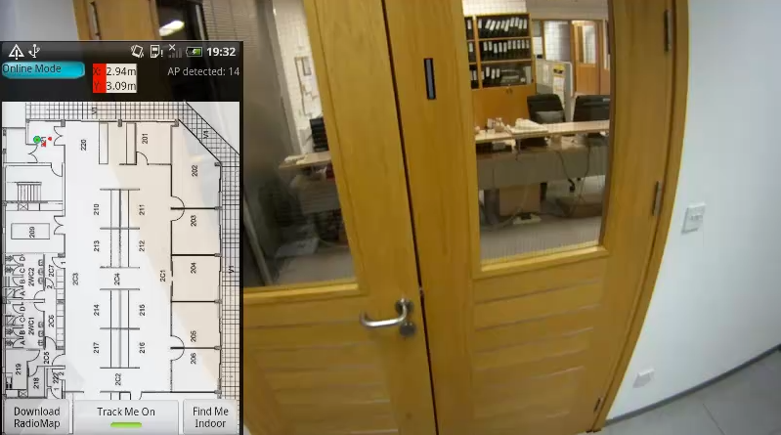
WiFi Positioning Demo
Video
Works best in confined areas
  "The Airplace Indoor Positioning Platform for Android Smartphones", C. Laoudias, G. Constantinou, M. Constantinides, S. Nicolaou, D. Zeinalipour-Yazti, C. G. Panayiotou, Best Demo Award at IEEE MDM'12. (Open Source!)

Slide 23
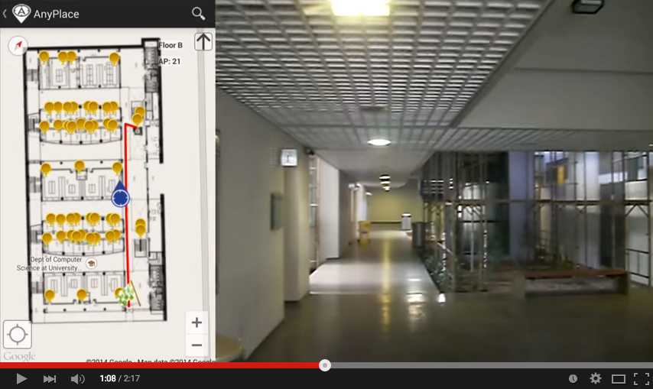
Hybrid Wi-Fi/IMU/Outdoor Anyplace
Video
"Anyplace: A Crowdsourced Indoor Information Service", Kyriakos Georgiou, Timotheos Constambeys, Christos Laoudias, Lambros Petrou, Georgios Chatzimilioudis and Demetrios Zeinalipour-Yazti, Proceedings of the 16th IEEE International Conference on Mobile Data Management (MDM '15), IEEE Press, Volume 2, Pages: 291-294, 2015

Slide 24
Presentation Outline
Introduction
Location Accuracy
  MDM’12, IPSN’14, IPSN’15
Location Privacy
  HotPlanet’12, IEEE TKDE’15
Radiomap Prefetching
  MDM’15
Future Challenges

Slide 25
Location Privacy
An IIN Service can continuously “know” (surveil, track or monitor) the location of a user while serving them.
Location tracking of known individuals is unethical and can even be illegal if it is carried out without the explicit user consent.
Imminent privacy threat, with greater impact that other privacy concerns, as it can occur at a very fine granularity. It reveals:
  The stores / products of interest in a mall.
  The book shelves of interest in a library
  Artifacts observed in a museum, etc.

Slide 26
Location Privacy
IIN services might become attractive targets for hackers, aiming to steal location data and carry out illegal acts (e.g., break into houses).
IIN should be considered as fundamentally untrusted entities, so we aim to devise techniques that allow the exploitation of IIN utility with controllable privacy to the user.
Privacy vs. No Privacy
  Location Privacy: when location estimated by user device (current Anyplace) – data is outdated ☹
  No Location Privacy: when the location is derived continuously by the IIN (most IIN services)

Slide 27


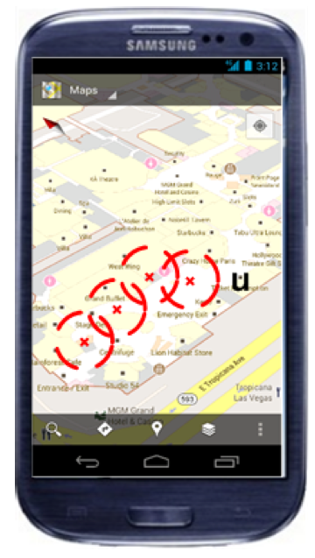

Location Privacy
I can see these Reference Points, where am I?
...
(x,y)!
IIN Service
User u
Towards planet-scale localization on smartphones with a partial radiomap", A. Konstantinidis, G. Chatzimilioudis, C. Laoudias, S. Nicolaou and D. Zeinalipour-Yazti. In ACM HotPlanet'12, in conjunction with ACM MobiSys '12, ACM, Pages: 9--14, 2012.
Privacy-Preserving Indoor Localization on Smartphones, Andreas Konstantinidis, Paschalis Mpeis, Demetrios Zeinalipour-Yazti and Yannis Theodoridis, in IEEE TKDE’15.

Slide 28
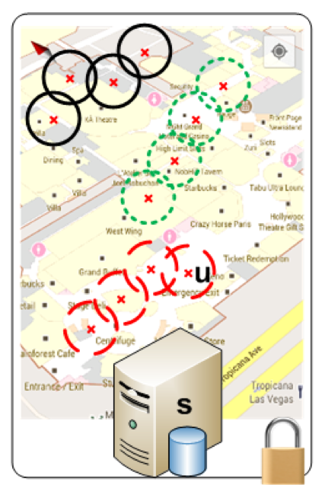
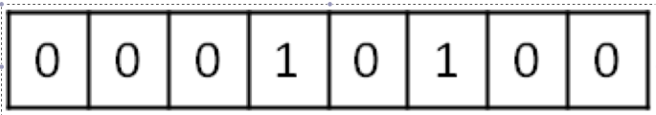
Temporal Vector Map (TVM)
Bloom Filter (u's APs)
WiFi
Set Membership Queries
WiFi
...
IIN Service
K=3 Positions
User u
WiFi

Slide 29
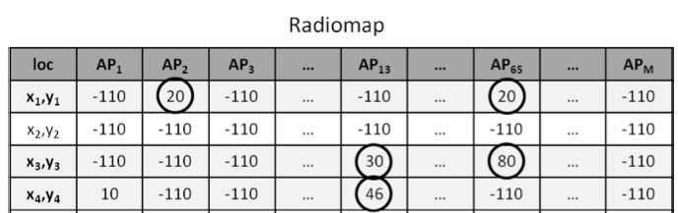
TVM – Bloom Filters
Bloom filters – basic idea:
  allocate a vector of b bits, initially all set to 0
  use h independent hash functions to hash every Access Point seen by a user to the vector.
The IIN Service selects any RadioMap row that has an AP belonging to the query bloom filter and send it to the user.
AP2
AP13
AP2
AP13
0 | 1 | 0 | 0 | 1 | 0 | 0 | 1 | 0 | 0
b

Slide 30
TVM – Bloom Filters
The most significant feature of Bloom filters is that there is a clear tradeoff between b and the probability of a false positive.
  Small b: Too many false positives (too much hiding & cost)
  Large b: “No” false positives (no hiding & no cost)
Given h optimal hash functions, b bits for the Bloom filter we can estimate the amount of false positives produced by the Bloom filter:
  False Positive Ratio:
  Size of vector:

Slide 31
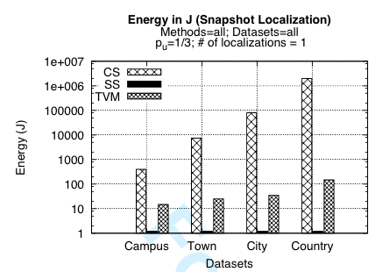
TVM Evaluation
Energy required for 300 localization tasks (CPU+Wi-Fi) using PowerTutor on Android
  Campus (20MB)
  Town (100MB)
  City (1GB)
  Country (20GB)

Slide 32
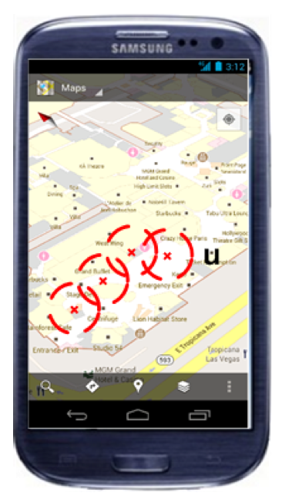

TVM Continuous
Camouflage trajectories
IIN determnines u’s location by exclusion

Slide 33
Presentation Outline
Introduction
Location Accuracy
  MDM’12, IPSN’14, IPSN’15
Location Privacy
  HotPlanet’12, IEEE TKDE’15
Radiomap Prefetching
  MDM’15
Future Challenges

Slide 34


Intermittent Connectivity
Problem: Wi-Fi coverage might be irregularly available inside buildings due to poor WLAN planning or due to budget constraints.
A user walking inside a Mall in Cyprus
  Whenever the user enters a store the RSSI indicator falls below a connectivity threshold -85dBm. (-30dbM to -90dbM)
  When disconnected IIN can’t offer navigation anymore ☹

Slide 35




Intermittent Connectivity
IIN Service
Where-am-I?
No Navigation
Where-am-I?
X
Where-am-I?
☹ Intermittent Connectivity
Time

Slide 36

PreLoc Navigation
IIN Service
Prefetch K RM rows
Prefetch K RM rows
X
Localize from Cache
Prefetch K RM rows
☺ Intermittent Connectivity
Time

Slide 37
Intermittent Connectivity
Why not fallback from Wi-Fi to Mobile Internet (2G-4G) when Wi-Fi is not available?
Mobile Internet Limitations:
  Coverage: blockage or attenuation of signals in indoor spaces.
  Slow fallback between outdated Mobile Internet and Wi-Fi infrastructures.
    Lack of ubiquitous 802.11k, 802.11r (fast roaming) and 4G infrastructure.
  Limited Quota: Nobody ones to waste a mobile Internet plan for navigation purposes.
  Unavailability due to Roaming: when traveling and needing indoor navigation at most.

Slide 38

PreLoc Partitioning Step
Why? RM might contain many points (45K in example).
Action: The objective of this step is to cluster these into groups so that they are easier to prefetch.
K-Means simple well-established clustering algorithm.
  Operation: Random Centroids (C), Add to Closest C, Re-adjust C
  Re-adjusting Centroids expensive quadratic complexity ☹

Slide 39

PreLoc Partitioning Step
We use the Bradley-Fayyad-Reina (BFR)* algorithm
  A variant of k-means designated for large datasets.
  Instead of computing L₂ distance of point p against centroid, as in k-means, it computes the Mahalanobis distance (dist_{Mah}) against some set statistics (μ, σ).
  In BFR if dist_{Mah} is less than a threshold add to set, else retain to possibly shape new clusters.
  Advantage: Less centroid computations! Points are traversed only once which is fast for big data!
μ
dist_{Mah}
σ
Point (p)
Scaling Clustering Algorithms to Large Databases.. PS Bradley, UM Fayyad, C Reina - KDD, 1998

Slide 40
PreLoc Selection Step
The Selection Step aims to sequence the retrieval of clusters, such that the most important clusters are downloaded first.
Question: Which clusters should a user download at a certain position if Wi-Fi not available next?
  PreLoc prioritizes the download of RM entries using historic traces of users inside the building.
User Current Location

Slide 41
PreLoc Selection Step
PreLoc relies on the Probabilistic Group Selection (PGS) heuristic to determine the RM entries to prefetch next.
Probabilistic k=3 Group Selection
Historic Traces
Dependency Graph
(DG)
Do Best First Search Traversal of DG from A:
follow the most promising option using priority queue.
P(A,B)=1.0
P(A,B,D)=0.66
P(A,B,D,C)=0.66*0.5=0.33
P(A,B,D,A) => cycle
P(A,B,D,C,D)=> cycle
P(A,B,C)=0.33
Empty queue – finished!
User Current Location
A
B
D
0.5
0.5
1.0
C
A
0.66
Early stop!
C
D
1.0
0.33
B
(statistically independent transitions between vertices + no stationary transitions in historic traces)

Slide 42
Presentation Outline
Introduction
Location Accuracy
  MDM’12, IPSN’14, IPSN’15.
Location Privacy
  HotPlanet’12, IEEE TKDE’15
Radiomap Prefetching
  MDM’15
Future Challenges

Slide 43


Big-Data Challenges
Massively process RSS log traces to generate a valuable Radiomap
Processing current logs in Anyplace for a single building takes several minutes!
Challenges in MapReduce:
  Collect Statistics (count, RSSI mean and standard deviation)
  Remove Outlier Values.
  Handle Diversity Issues

Slide 44


Crowdsourcing Challenges
Quality: Unreliable Crowdsourcers, Multi-device Issues, Hardware Outliers, Temporal Decay, etc.
  Remark: There is a Linear Relation between RSS values of devices.
  Challenge: Can we exploit this to align reported RSS values?
"Crowdsourced Indoor Localization for Diverse Devices through Radiomap Fusion", C. Laoudias, D. Zeinalipour-Yazti and C. G. Panayiotou, "Proceedings of the 4th Intl. Conference on Indoor Positioning and Indoor Navigation" (IPIN '13), Montbeliard-Belfort France, 2013.

Slide 45




Crowdsourcing Challenges
Problem: There is a mismatch between the density of fingerprints and the RM accuracy.
Solution: We use generic interpolation and a tool from estimation statistics to identify an accuracy estimator (lower bound)
RM Density
RM Accuracy
"Indoor Localization Accuracy Estimation from Fingerprint Data", Artyom Nikitin, Georgios Chatzimilioudis, Christos Laoudias, Panagiotis Karras and Demetrios Zeinalipour-Yazti,
In IEEE MDM’17, Daejeon, South Korea, 2017 (Honorable Mention Award!)

Slide 46

Logging in Anyplace
Video
"Indoor Localization Accuracy Estimation from Fingerprint Data", Artyom Nikitin, Georgios Chatzimilioudis, Christos Laoudias, Panagiotis Karras and Demetrios Zeinalipour-Yazti,
In IEEE MDM’17, Daejeon, South Korea, 2017 (Honorable Mention Award!)

Slide 47


Modeling Challenges
Indoor spaces exhibit complex topologies. They are composed of entities that are unique to indoor settings:
  e.g., rooms and hallways that are connected by doors.
  Conventional Euclidean distances are inapplicable in indoor space, e.g., NN of p1 is p2 not p3.
IndoorGML by OGC
Christian Becker, Frank Dürr, Personal and Ubiquitous Computing, 2005 => Jensen (2010)

Slide 48
Indoor Data Management in Anyplace
Thanks! Questions?
Demetris Zeinalipour
Department of Computer Science, University of Cyprus, Cyprus
Humboldt Fellow @ Max Planck Institute for Informatics, Germany
http://people.mpi-inf.mpg.de/~dzeinali/
dzeinali@mpi-inf.mpg.de
Max Planck Institute for Informatics, Saarbrücken, Germany, July 11, 2017

