Slide 1
Indoor Data Management in Anyplace
Demetris Zeinalipour
Assistant Professor
Department of Computer Science, University of Cyprus, Cyprus
Humboldt Fellow @ Max Planck Institute for Informatics, Germany
http://www.cs.ucy.ac.cy/~dzeina/
dzeina@cs.ucy.ac.cy
Heidelberg University, Institute for Computer Science, Heidelberg, Germany, June 6, 2017

Slide 2
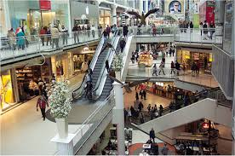
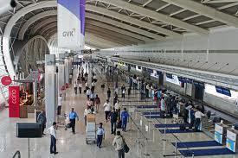
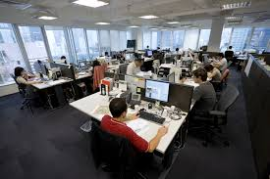
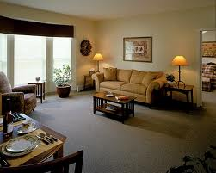
Motivation
People spend 80-90% of their time indoors – USA Environmental Protection Agency 2011.
>85% of data and 70% of voice traffic originates from within buildings – Nokia 2012.

Slide 3
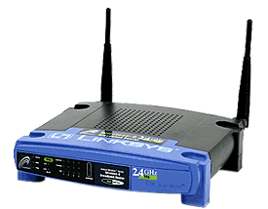
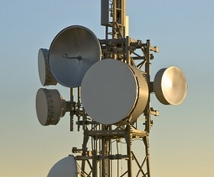
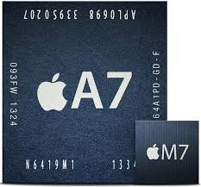
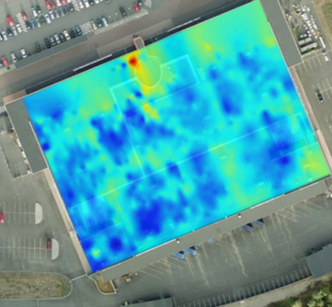
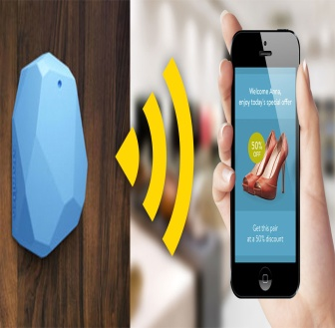
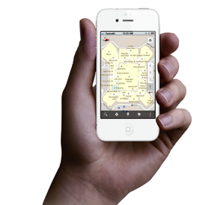
Localization Technologies
Modern trend in Localization are Internet-based Indoor Navigation (IIN) services founded on measurements collected by smart devices.
Technologies:
Wi-Fi APs, Cellular Towers, other stationary antennas
IMU Data (Gyroscope, Accelerometers, Digital Compass)
Magnetic Field Sensors
Beacons (BLE Beacons, RFID Active & Passive Beacons)
Sound (Microphone), Light (Light Sensor), …

Slide 4
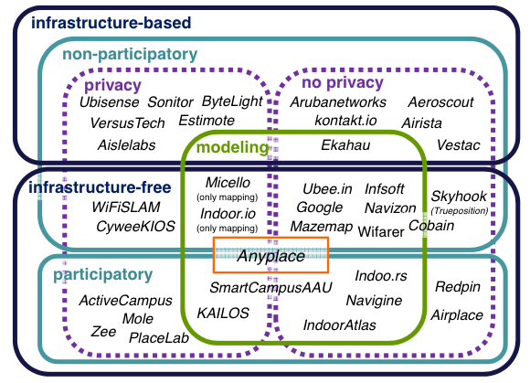
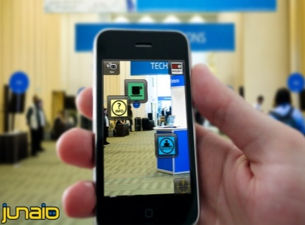
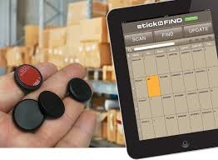
Indoor Applications
Huge spectrum of indoor apps
Navigation, Manufacturing, Asset Tracking, Inventory Manag.
Healthcare, Smart Houses, Elderly support, Fitness apps
Augmented Reality and many more.
Indoor Revenues expected reach 10B USD in 2020
ABIresearch, “Retail Indoor Location Market Breaks US$10 Billion in 2020”’ Available at: https://goo.gl/ehPRMn, May 12, 2015.
Tutorial @ IEEE MDM’15
“Mobile Data Management in Indoor Spaces”, Christos Laoudias and Demetrios Zeinalipour-Yazti
Slides available: http://goo.gl/70JV4q

Slide 5
Anyplace IIN Service
Anyplace: A complete IIN Service open for research and development
Accuracy (1.96m [ACM IPSN’15])
Crowdsourcing [IEEE IC’12]
Privacy [IEEE TKDE’15],
Other: Modeling [ACM SIGSPATIAL’17-S]
Model Your Building!
It takes 1 minute to get your model online – 1 hour to offer indoor navigation and search in a 2500 sq meter building!
http://anyplace.cs.ucy.ac.cy/
"Internet-based Indoor Navigation Services", Demetrios Zeinalipour-Yazti, Christos Laoudias, Kyriakos Georgiou and Georgios Chatzimiloudis, IEEE Internet Computing (IC'17), IEEE Computer Society, 2017.

Slide 6
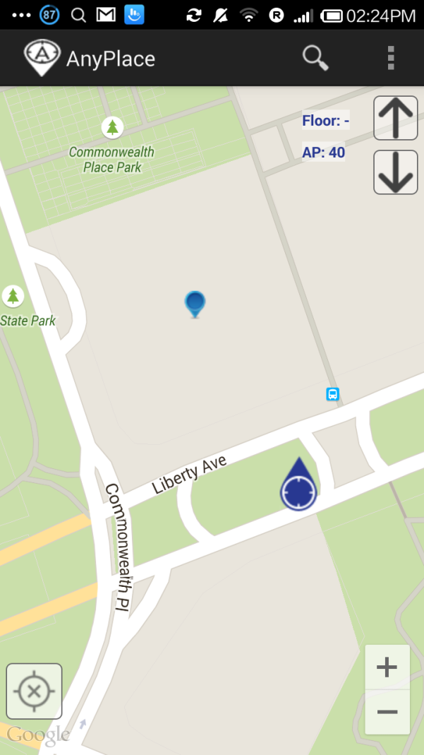
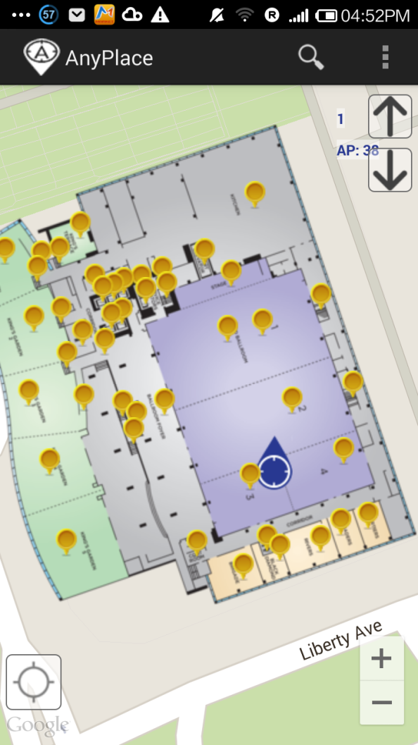
Anyplace @ MDM’15
Before ☹
(using Google API Location)
After ☺
(using Anyplace Location & Indoor Models)

Slide 7
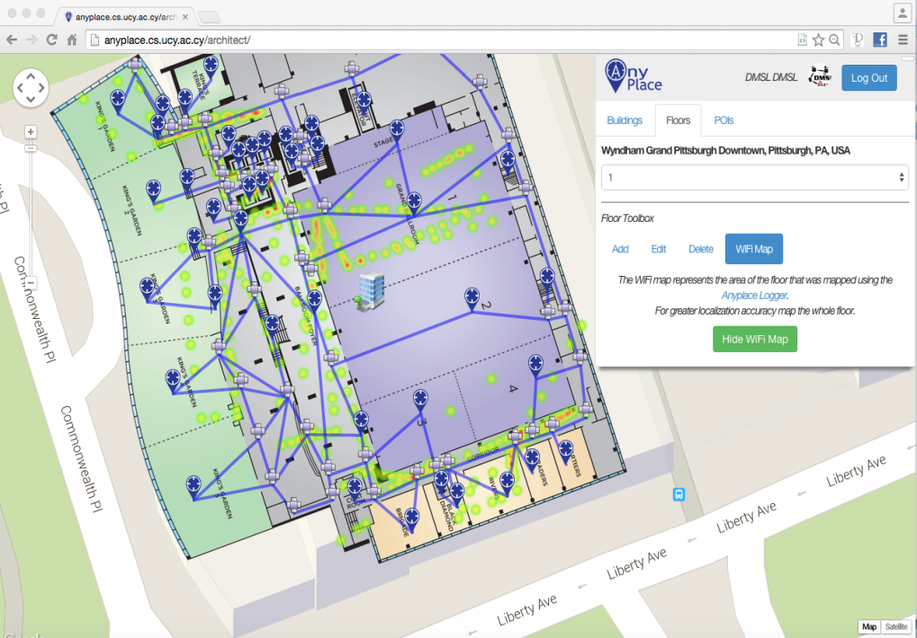
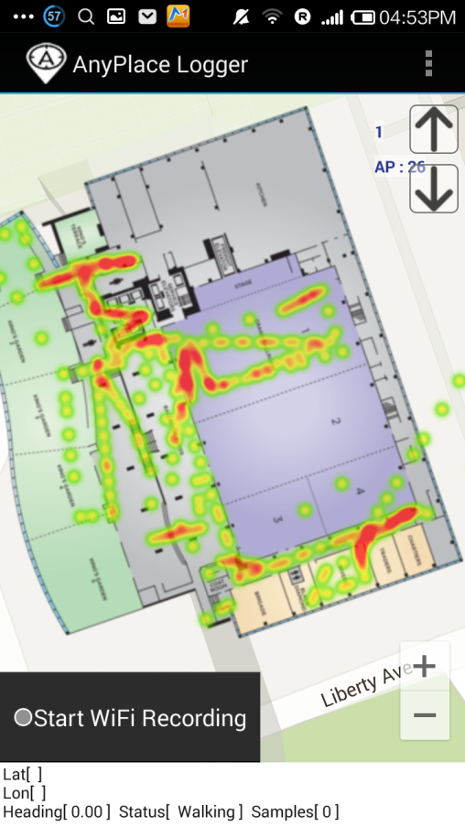
Anyplace @ MDM’15
Modeling + Crowdsourcing

Slide 8
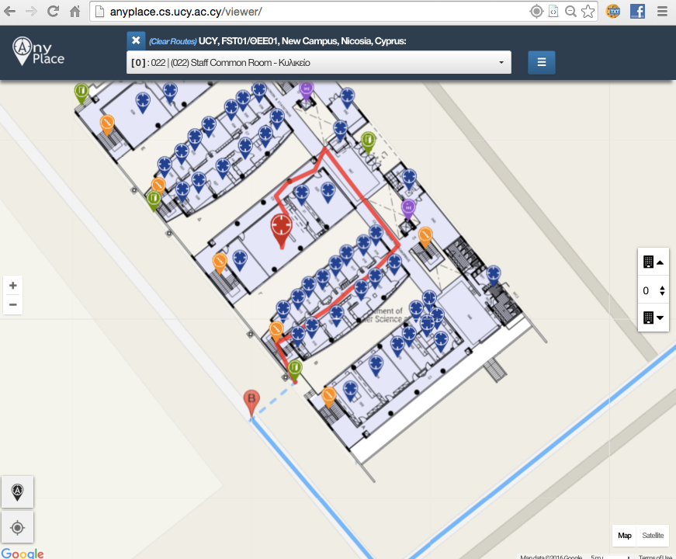
Showcase: Univ. of Cyprus
Office Navigation @ Univ. of Cyprus
Outdoor-to-Indoor Navigation through URL.
60 Buildings mapped, Thousands of POIs (stairways, WC, elevators, equipment, etc.)
Example:
http://goo.gl/ns3lqN

Slide 9
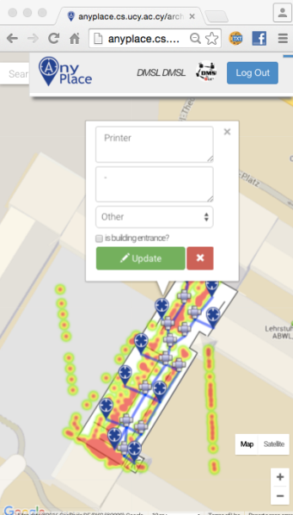
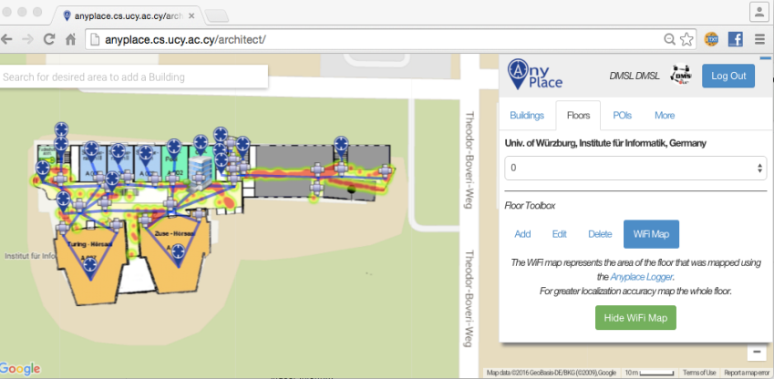
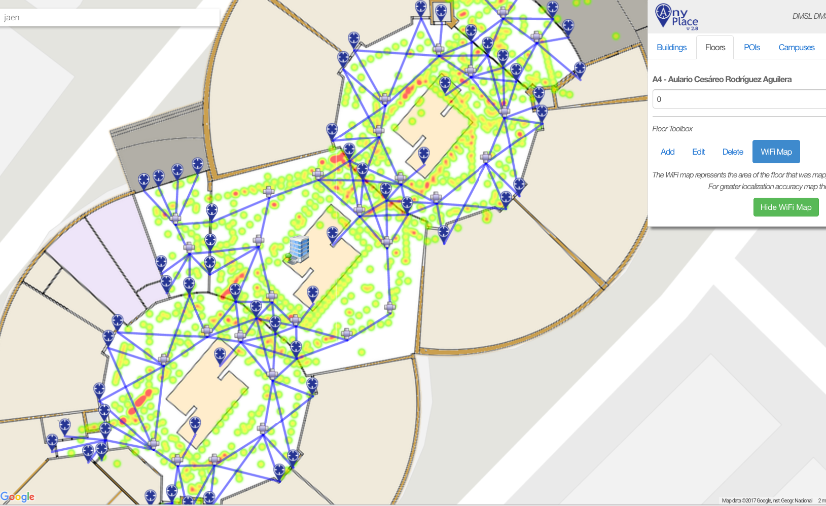
Campus and Library Navigation
Univ. of Würzburg, Institut für Informatik
Mapped in about 1 hour
Universidad de Jaén, Spain - Campus
Campus Navigation (9 Buildings)
Univ. of Mannheim, Library
Aim: book navigation in Westflügel

Slide 10
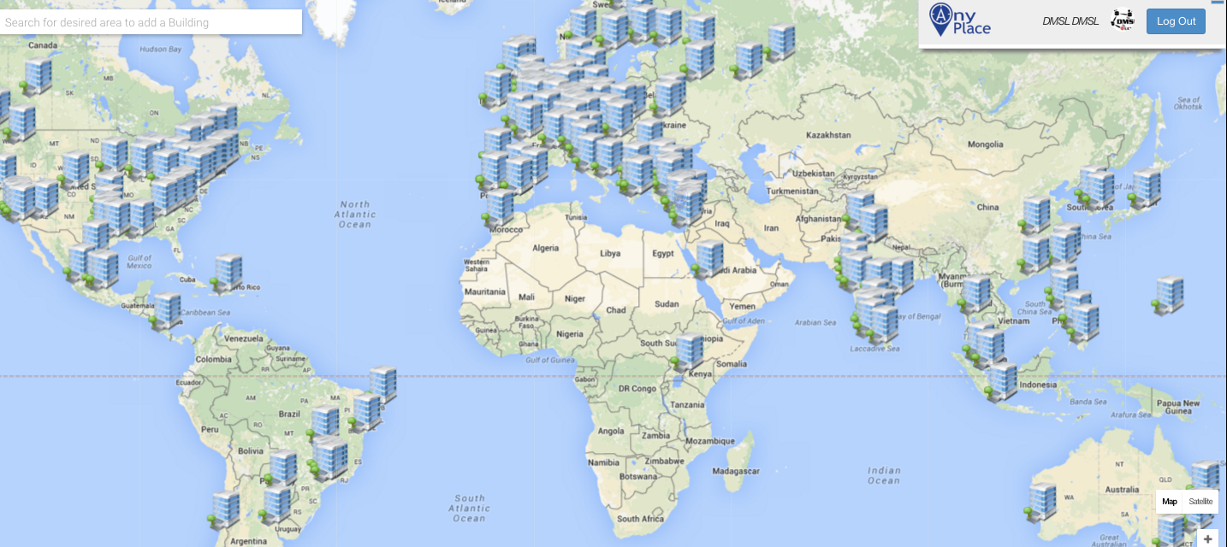
Anyplace Open Maps
~1,000 mapping attempts
~100,000 user interactions
~20,000 users visited
More than 80 forks on Github
http://anyplace.cs.ucy.ac.cy/

Slide 11
Presentation Outline
Introduction
Location Accuracy
MDM’12, IPSN’14, IPSN’15
Location Privacy
HotPlanet’12, IEEE TKDE’15
Radiomap Prefetching
MDM’15
Future Challenges

Slide 12
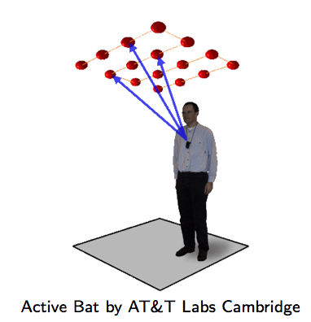
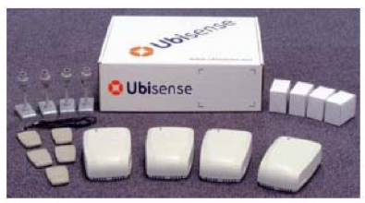
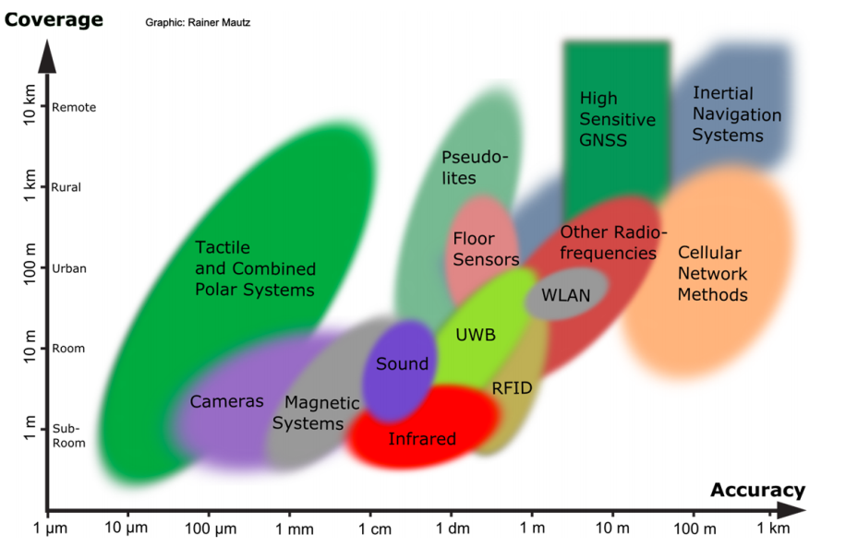
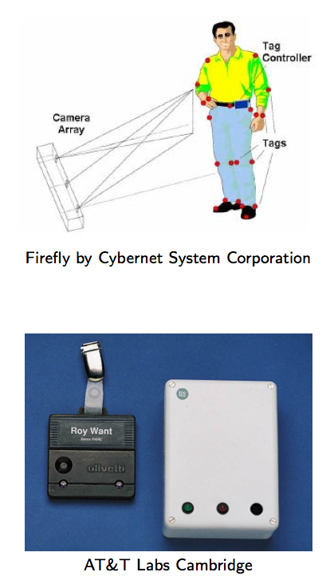
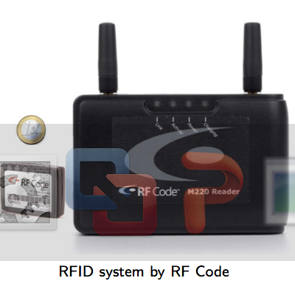
Location Accuracy
Ultrasound:
^{Ultra Wide Band (UWB)}
AOA, TOA, TDOA, signal reflection
: Spatial extension where system performance must be guaranteed
Room Level Accuracy
^{Infrared (IR)}
^{TOA, TDOA}
Radio Frequency IDentification (RFID)
| Outdoor |
| Indoor |
^{Rainer Mautz, ETH Zurich, 2011}
Cell of Origin, Signal Strength
^{Firefly delivers 3mm accuracy}

Slide 13
Location Accuracy
Infrastructure-free systems: don’t require dedicated equipment for the provisioning of location signals (e.g., GPS, Wi-Fi, Cellular, Magnetic, IMU)
Infrastructure-based systems: require dedicated equipment (e.g., proprietary transmitters, beacons, antennas and cabling)
Bluetooth Low Energy (BLE) beacons: iBeacons (Apple)
Ultrasound: ALPS (CMU)
Visible Light: EPSILON (Microsoft Research)
Ultra Wide Band (UWB): Decawave
Anyplace Focus
Source: NASA

Slide 14
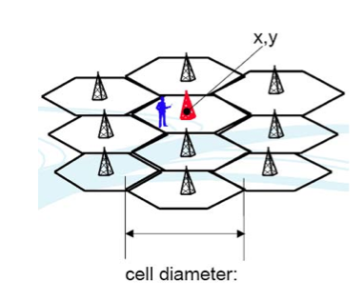
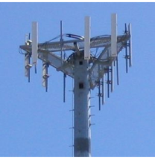
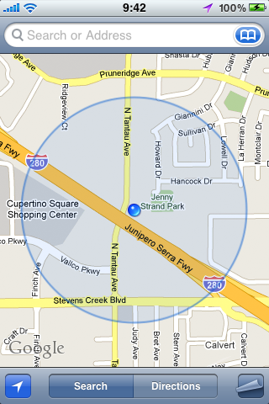
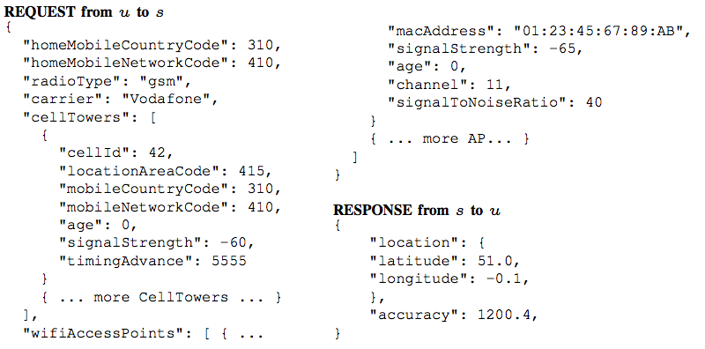
Location (Outdoor/Indoor)
Cell ID:
Cell ID is the Unique Identifier of Cellular Towers.
Cell ID Databases
Skyhook Wireless (2003), MA, USA (Apple, Samsung): 30 million+ cell towers, 1 Billion Wi-Fi APs, 1 billion+ geolocated IPs, 7 billion+ monthly location requests and 2.5 million geofencable POIs.
Google Geolocation “Big” Database (similar)
Disadvantages:
Low accuracy: 30-50m (indoor) to 1-30km (outdoor).
Serving cell is not always the nearest.

Slide 15
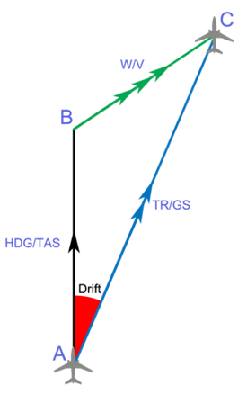
Location (Indoor)
Inertial Measurement Units (IMU)
3D acceleration, 3D gyroscope, digital compass using dead reckoning (calculate next position based on prior).
Disadvantages
Suffers from drift (difference between where the system thinks it is located, and the actual location)
Advantages
Sensors are available on smartphones.
Newer smartphones (iphone 5s) have motion co-processors always-on reading sensors and even providing activitity classifiers (driving, walking, running, etc.)

Slide 16
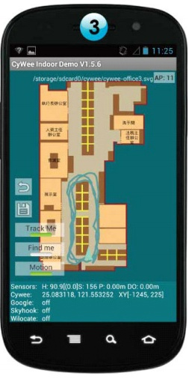
WiFi Fingerprinting in Anyplace
References
[Airplace] "The Airplace Indoor Positioning Platform for Android Smartphones", C. Laoudias et. al., Best Demo Award at IEEE MDM'12. (Open Source!)
[HybridCywee] "Indoor Geolocation on Multi-Sensor Smartphones", C.-L. Li, C. Laoudias, G. Larkou, Y.-K. Tsai, D. Zeinalipour-Yazti and C. G. Panayiotou, in ACM Mobisys'13. Video at: http://youtu.be/DyvQLSuI00I
[UcyCywee] IPSN’14 Indoor Localization Competition (Microsoft Research), Berlin, Germany, April 13-14, 2014. 2nd Position with 1.96m! http://youtu.be/gQBSRw6qGn4
D. Lymberopoulos, J. Liu, X. Yang, R. R. Choudhury, ..., C. Laoudias, D. Zeinalipour-Yazti, Y.-K. Tsai, and et. al., “A realistic evaluation and comparison of indoor location technologies: Experiences and lessons learned”, In IEEE/ACM IPSN 2015.
1st Position at EVARILOS Open Challenge, European Union (TU Berlin, Germany), 2014.
Cywee / Airplace

Slide 17
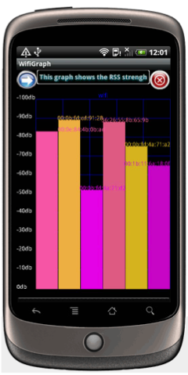
WiFi Fingerprinting
Received Signal Strength indicator (RSSI)
Power measurement present in a received radio signal measured in dBm (Decibel-milliwatts)
Max RSSI (-30dBm) to Min RSSI: (−90 dBm)
’00
Advantages
Readily provided by smartphone APIs
Low power 125mW (RSSI) vs. 400 mW (transmit)
Disadvantages
Complex propagation conditions (multipath, shadowing) due to wall, ceilings.
RSS fluctuates over time at a given location (especially in open spaces).
Unpredictable factors (people moving, doors, humidity)

Slide 18
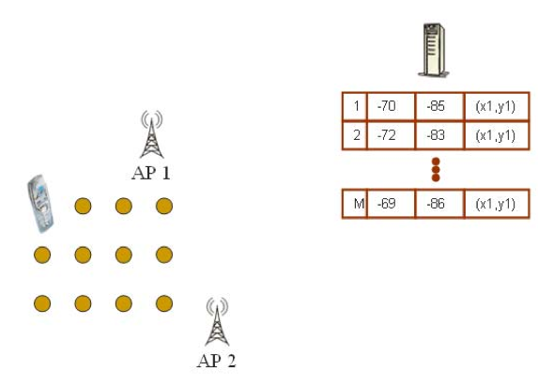
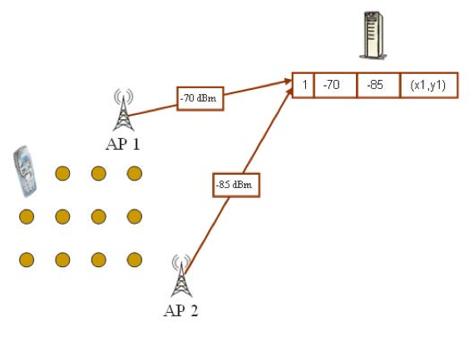
WiFi Fingerprinting
Mapping Area with WiFi Fingerprints
n APs deployed in the area
Fingerprints r_{i} = [ r_{i1}, r_{i2}, …, r_{in}]
Averaging

Slide 19
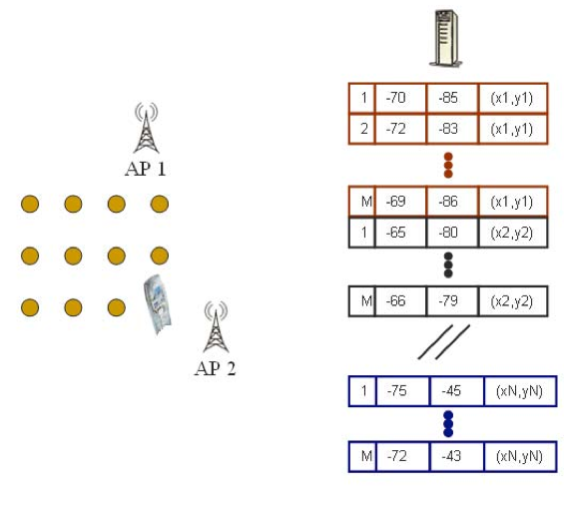
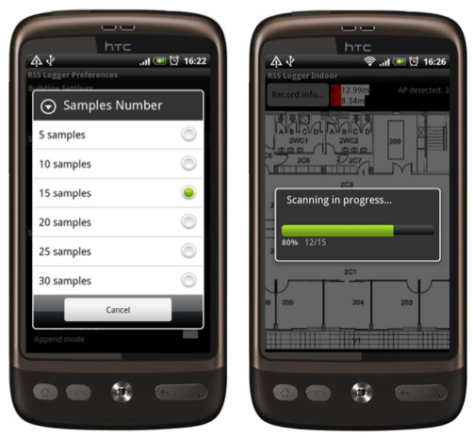
WiFi Fingerprinting
Mapping Area with WiFi Fingerprints
Repeat process for rest points in building. (IEEE MDM’12)
Use 4 direction mapping (NSWE) to overcome body blocking or reflecting the wireless signals.
Collect measurements while walking in straight lines (IPIN’14)

Slide 20
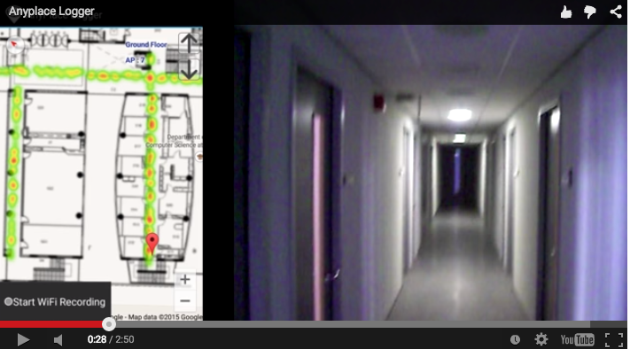
Logging in Anyplace
Video
"Anyplace: A Crowdsourced Indoor Information Service", Kyriakos Georgiou, Timotheos Constambeys, Christos Laoudias, Lambros Petrou, Georgios Chatzimilioudis and Demetrios Zeinalipour-Yazti, Proceedings of the 16th IEEE International Conference on Mobile Data Management (MDM '15), IEEE Press, Volume 2, Pages: 291-294, 2015

Slide 21
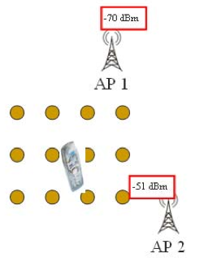
WiFi Positioning
Positioning with WiFi Fingerprint
Collect Fingerprint s = [ s₁, s₂, …, s_{n}]
Compute distance || r_{i} - s || and position user at:
Nearest Neighbor (NN)
K Nearest Neighbors (w_{i} = 1 / K) [convex combination of k loc]
Weighted K Nearest Neighbors (w_{i} = 1 / || r_{i} - s || )
RadioMap
s = [ -70, -51]
r₁ = [ -71, -82, (x₁,y₁)]
r₂ = [ -65, -80, (x₂,y₂)]
…
r_{N} = [ -73, -44, (x_{N},y_{N})]
NN, KNN, WKNN

Slide 22
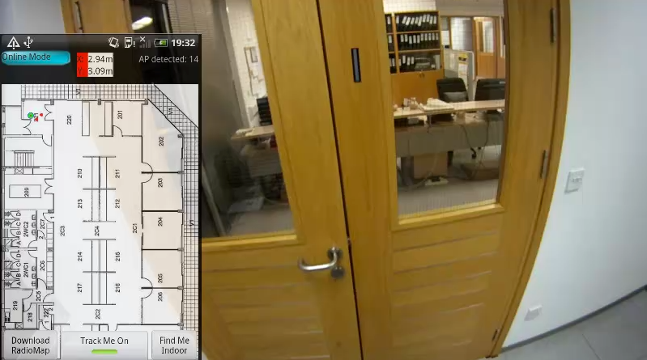
WiFi Positioning Demo
Video
Works best in confined areas
"The Airplace Indoor Positioning Platform for Android Smartphones", C. Laoudias, G. Constantinou, M. Constantinides, S. Nicolaou, D. Zeinalipour-Yazti, C. G. Panayiotou, Best Demo Award at IEEE MDM'12. (Open Source!)

Slide 23
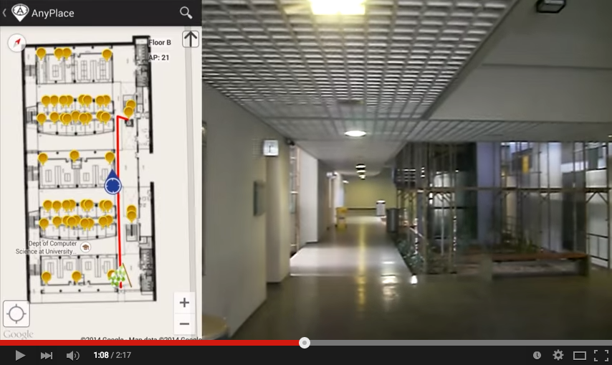
Hybrid Wi-Fi/IMU/Outdoor Anyplace
Video
"Anyplace: A Crowdsourced Indoor Information Service", Kyriakos Georgiou, Timotheos Constambeys, Christos Laoudias, Lambros Petrou, Georgios Chatzimilioudis and Demetrios Zeinalipour-Yazti, Proceedings of the 16th IEEE International Conference on Mobile Data Management (MDM '15), IEEE Press, Volume 2, Pages: 291-294, 2015

Slide 24
Presentation Outline
Introduction
Location Accuracy
MDM’12, IPSN’14, IPSN’15
Location Privacy
HotPlanet’12, IEEE TKDE’15
Radiomap Prefetching
MDM’15
Future Challenges

Slide 25
Location Privacy
IIN services might become attractive targets for hackers, aiming to steal location data and carry out illegal acts (e.g., break into houses).
IIN should be considered as fundamentally untrusted entities, so we aim to devise techniques that allow the exploitation of IIN utility with controllable privacy to the user.
Privacy vs. No Privacy
Location Privacy: when location estimated by user device (current Anyplace) – data is outdated ☹
No Location Privacy: when the location is derived continuously by the IIN (most IIN services)

Slide 26
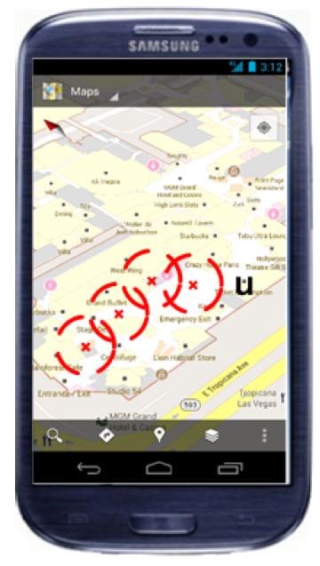
Location Privacy
I can see these Reference Points, where am I?
...
(x,y)!
IIN Service
User u
Towards planet-scale localization on smartphones with a partial radiomap", A. Konstantinidis, G. Chatzimilioudis, C. Laoudias, S. Nicolaou and D. Zeinalipour-Yazti. In ACM HotPlanet'12, in conjunction with ACM MobiSys '12, ACM, Pages: 9--14, 2012.
Privacy-Preserving Indoor Localization on Smartphones, Andreas Konstantinidis, Paschalis Mpeis, Demetrios Zeinalipour-Yazti and Yannis Theodoridis, in IEEE TKDE’15.

Slide 27
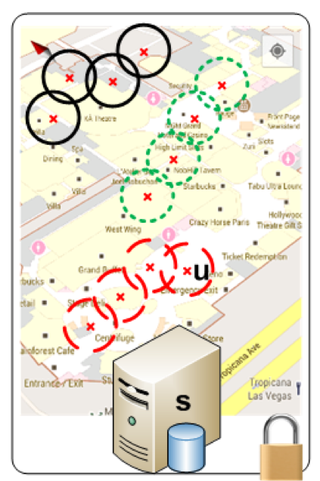
Temporal Vector Map (TVM)
Bloom Filter (u's APs)
WiFi
Set Membership Queries
WiFi
...
IIN Service
K=3 Positions
User u
WiFi

Slide 28
TVM – Bloom Filters
Bloom filters – basic idea:
allocate a vector of b bits, initially all set to 0
use h independent hash functions to hash every Access Point seen by a user to the vector.
The IIN Service selects any RadioMap row that has an AP belonging to the query bloom filter and send it to the user.
AP2
AP13
AP2
AP13
0 | 1 | 0 | 0 | 1 | 0 | 0 | 1 | 0 | 0
b

Slide 29
TVM – Bloom Filters
The most significant feature of Bloom filters is that there is a clear tradeoff between b and the probability of a false positive.
Small b: Too many false positives (too much hiding & cost)
Large b: “No” false positives (no hiding & no cost)
Given h optimal hash functions, b bits for the Bloom filter we can estimate the amount of false positives produced by the Bloom filter:
False Positive Ratio:
Size of vector:

Slide 30
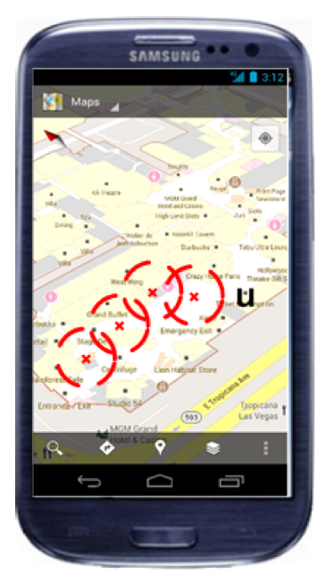
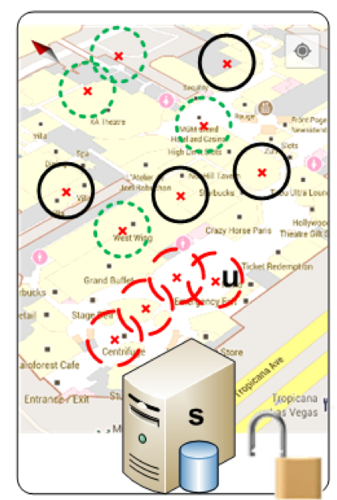
TVM Continuous
Camouflage trajectories
IIN determnines u’s location by exclusion

Slide 31
Presentation Outline
Introduction
Location Accuracy
MDM’12, IPSN’14, IPSN’15
Location Privacy
HotPlanet’12, IEEE TKDE’15
Radiomap Prefetching
MDM’15
Future Challenges

Slide 32
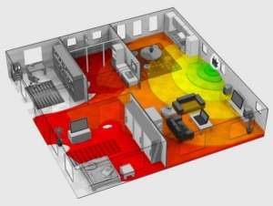
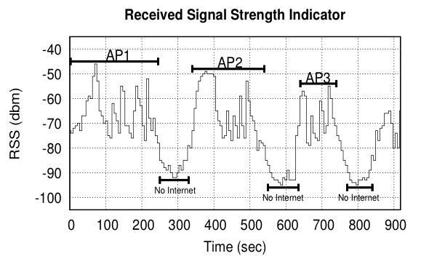
Intermittent Connectivity
Problem: Wi-Fi coverage might be irregularly available inside buildings due to poor WLAN planning or due to budget constraints.
A user walking inside a Mall in Cyprus
Whenever the user enters a store the RSSI indicator falls below a connectivity threshold -85dBm. (-30dbM to -90dbM)
When disconnected IIN can’t offer navigation anymore ☹

Slide 33
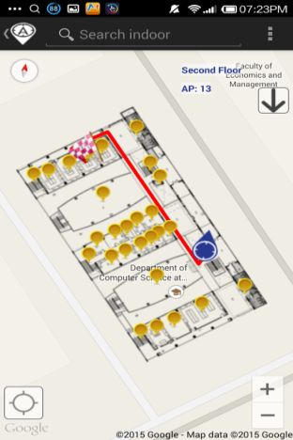
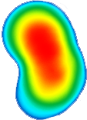
Intermittent Connectivity
IIN Service
Where-am-I?
No Navigation
Where-am-I?
X
Where-am-I?
☹ Intermittent Connectivity
Time

Slide 34
PreLoc Navigation
IIN Service
Prefetch K RM rows
Prefetch K RM rows
X
Localize from Cache
Prefetch K RM rows
☺ Intermittent Connectivity
Time

Slide 35
PreLoc Framework
The Preloc Framework aims to sequence the retrieval of clusters, such that the most important clusters are downloaded first.
Question: Which clusters should a user download at a certain position if Wi-Fi not available next?
PreLoc prioritizes the download of RM entries using historic traces of users inside the building !!!
User Current Location

Slide 36
Presentation Outline
Introduction
Location Accuracy
MDM’12, IPSN’14, IPSN’15.
Location Privacy
HotPlanet’12, IEEE TKDE’15
Radiomap Prefetching
MDM’15
Future Challenges

Slide 37
Big-Data Challenges
Massively process RSS log traces to generate a valuable Radiomap
Processing current logs in Anyplace for a single building takes several minutes!
Challenges in MapReduce:
Collect Statistics (count, RSSI mean and standard deviation)
Remove Outlier Values.
Handle Diversity Issues

Slide 38
Crowdsourcing Challenges
Quality: Unreliable Crowdsourcers, Multi-device Issues, Hardware Outliers, Temporal Decay, etc.
Remark: There is a Linear Relation between RSS values of devices.
Challenge: Can we exploit this to align reported RSS values?
"Crowdsourced Indoor Localization for Diverse Devices through Radiomap Fusion", C. Laoudias, D. Zeinalipour-Yazti and C. G. Panayiotou, "Proceedings of the 4th Intl. Conference on Indoor Positioning and Indoor Navigation" (IPIN '13), Montbeliard-Belfort France, 2013.

Slide 39
Crowdsourcing Challenges
Problem: There is a mismatch between density of fingerprints and accuracy of the RadioMap (RM).
Solution: We use generic interpolation and a tool from estimation statistics to identify an accuracy estimator (lower bound)
RM Density
RM Accuracy
"Indoor Localization Accuracy Estimation from Fingerprint Data", Artyom Nikitin, Georgios Chatzimilioudis, Christos Laoudias, Panagiotis Karras and Demetrios Zeinalipour-Yazti,
In IEEE MDM’17, Daejeon, South Korea, 2017 (Honorable Mention!)

Slide 40
Modeling Challenges
Indoor spaces exhibit complex topologies. They are composed of entities that are unique to indoor settings:
e.g., rooms and hallways that are connected by doors.
Conventional Euclidean distances are inapplicable in indoor space, e.g., NN of p1 is p2 not p3.
IndoorGML by OGC
Christian Becker, Frank Dürr, Personal and Ubiquitous Computing, 2005 => Jensen (2010)

Slide 41
Anyplace Architecture
"The Anatomy of the Anyplace Indoor Navigation Service”Indoor Navigation Services", Demetrios Zeinalipour-Yazti, Christos Laoudias, Kyriakos Georgiou and Georgios Chatzimiloudis, ACM SIGSPATIAL Special, Indoor Spatial Awareness II, Volume 9, Number 2, July 2017.

Slide 42
Indoor Data Management in Anyplace
Thanks! Questions?
Demetris Zeinalipour
Department of Computer Science, University of Cyprus, Cyprus
Humboldt Fellow @ Max Planck Institute for Informatics, Germany
http://www.cs.ucy.ac.cy/~dzeina/
dzeina@cs.ucy.ac.cy
Heidelberg University, Institute for Computer Science, Heidelberg, Germany, June 6, 2017

