Slide 1
Internet-based Indoor Navigation Services
Demetris Zeinalipour
Assistant Professor
Data Management Systems Laboratory
Department of Computer Science
University of Cyprus
http://www.cs.ucy.ac.cy/~dzeina/
ACROSS Meeting, Centrum Wiskunde & Informatica (CWI),
Amsterdam, Netherlands, February 25, 2016.

Slide 2
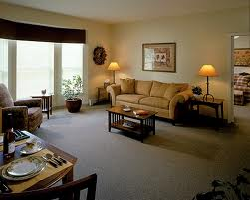
Motivation
People spend 80-90% of their time indoors – USA Environmental Protection Agency 2011.
>85% of data and 70% of voice traffic originates from within buildings – Nokia 2012.

Slide 3
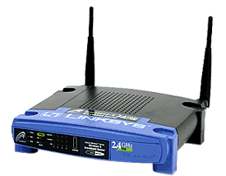
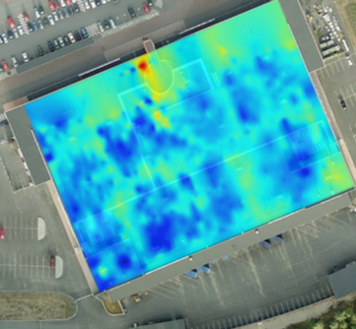
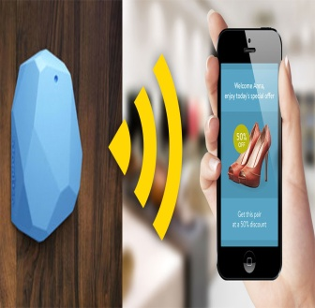
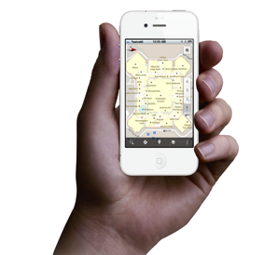
Localization Technologies
Modern trend in Localization are Internet-based Indoor Navigation (IIN) services founded on measurements collected by smart devices.
Technologies:
Wi-Fi APs, Cellular Towers, other stationary antennas
IMU Data (Gyroscope, Accelerometers, Digital Compass)
Magnetic Field Sensors
Beacons (BLE Beacons, RFID Active & Passive Beacons)
Sound (Microphone), Light (Light Sensor), …

Slide 4
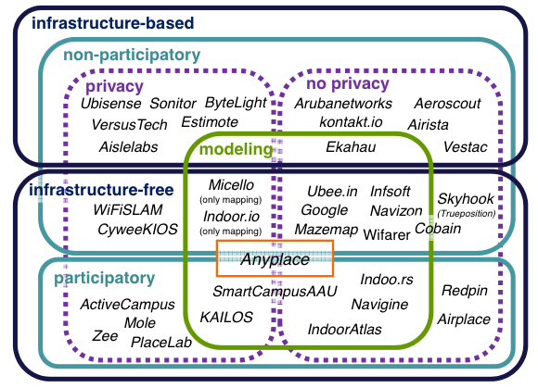
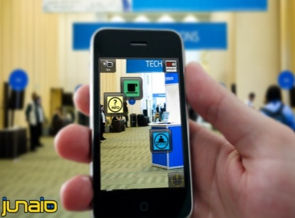
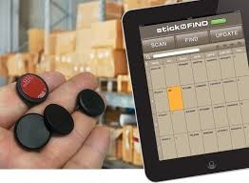
Indoor Applications
Huge spectrum of indoor apps
Navigation, Manufacturing, Asset Tracking, Inventory Manage
Healthcare, Smart Houses, Elderly support, Fitness apps
Augmented Reality and many more.
Indoor Revenues expected reach 10B USD in 2020
ABIresearch, “Retail Indoor Location Market Breaks US$10 Billion in 2020”’ Available at: https://goo.gl/ehPRMn, May 12, 2015.
Overview Publication / Tutorial:
"Internet-based Indoor Navigation Services", IEEE Internet Computing (IC'16), http://goo.gl/VJjMRH
Tutorial at IEEE MDM’15 (slides):
http://goo.gl/70JV4q

Slide 5
Anyplace IIN Service
An complete open-source IIN Service developed at the University of Cyprus.
Element for Indoor Accuracy in Internet of Services (IoS)!
http://anyplace.cs.ucy.ac.cy/

Slide 6
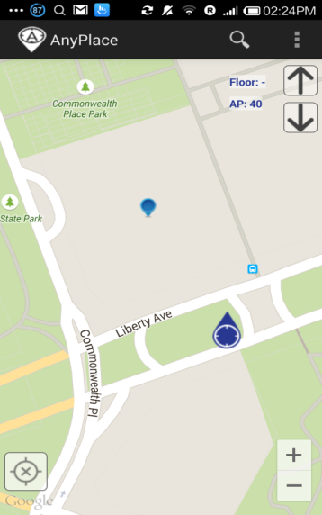
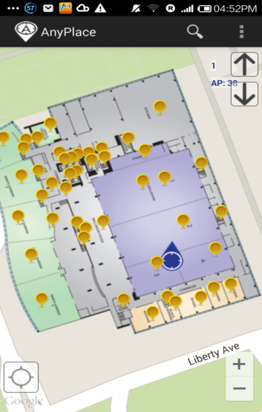
Anyplace Accuracy
A) Accuracy (1.96 m )
3 Intl. Awards (IPSN’14, MDM’12 and EVARILOS’14)
2nd most accurate technology @ Microsoft Research Indoor Localization Competition, Berlin, Germany. – IPSN’15.
B) Open Source - https://github.com/dmsl/anyplace/
Android, Windows, iOS, JSON API sources available on Github!
Aims: Establish Anyplace as the predominant open-source Indoor Localization Service (as-a-Service or stand-alone)
Active community with developers in Germany, Russia, Australia, Canada, UK, etc. – Join today!
http://anyplace.cs.ucy.ac.cy/

Slide 7
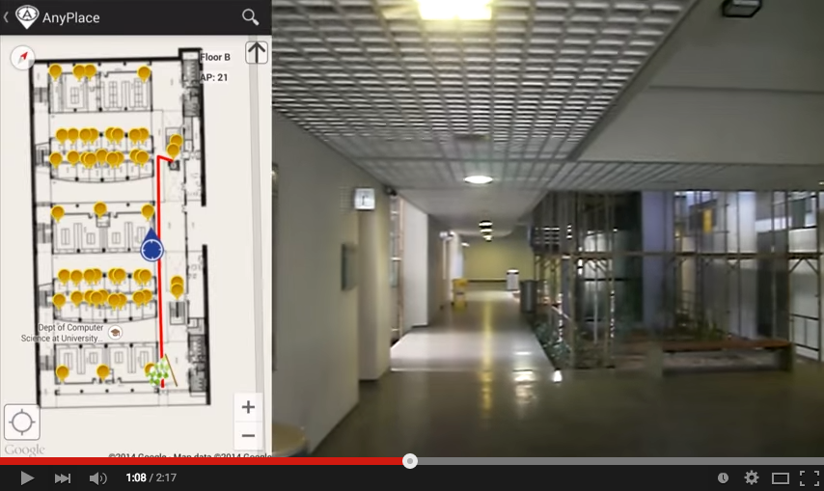
Anyplace Accuracy
Video

Slide 8
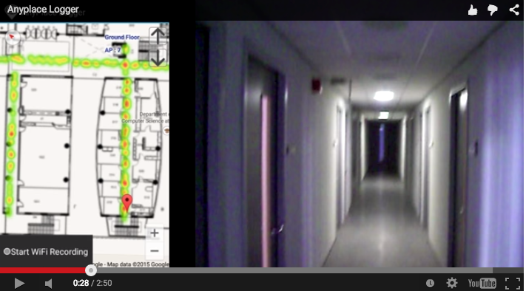
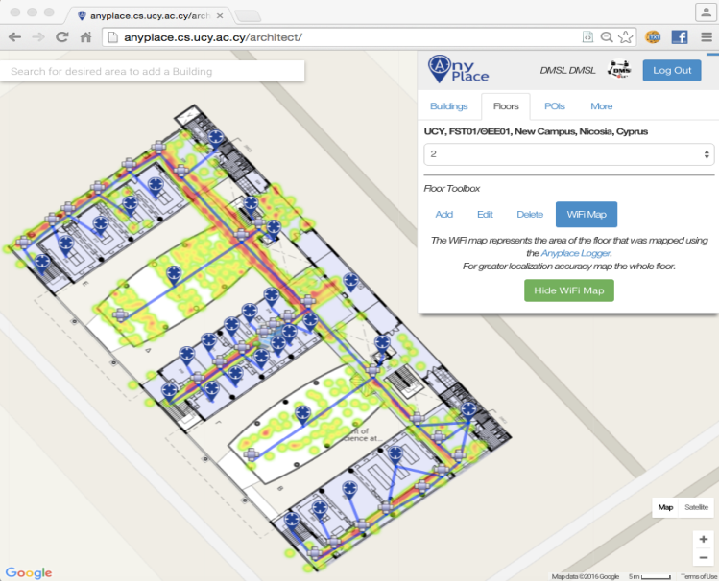
Anyplace Crowdsourcing
C) Crowdsourcing
Distributed Wi-Fi data collection through an open call.
Contributions through “Logger” and quality monitoring in “Architect”
Big data alignment of signals to remove noise using MapReduce.
"Crowdsourcing with smartphones", Georgios Chatzimiloudis, Andreas Konstantinidis, Christos Laoudias and Demetrios Zeinalipour-Yazti, IEEE Internet Computing (IC '12), Special Issue: Sep/Oct 2012 - Crowdsourcing, May 2012. IEEE Press, Vol. 16, Iss. 5, pp. 36-44, 2012.
"Internet-based Indoor Navigation Services", IEEE Internet Computing (IC'16), http://goo.gl/VJjMRH
http://anyplace.cs.ucy.ac.cy/

Slide 9
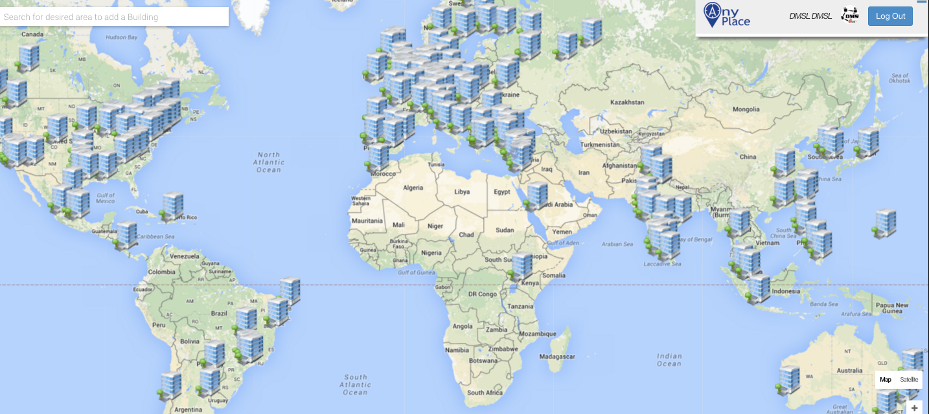
Anyplace Features: Community
D) Community
Already thousands of mapping attempts worldwide!
http://anyplace.cs.ucy.ac.cy/

Slide 10
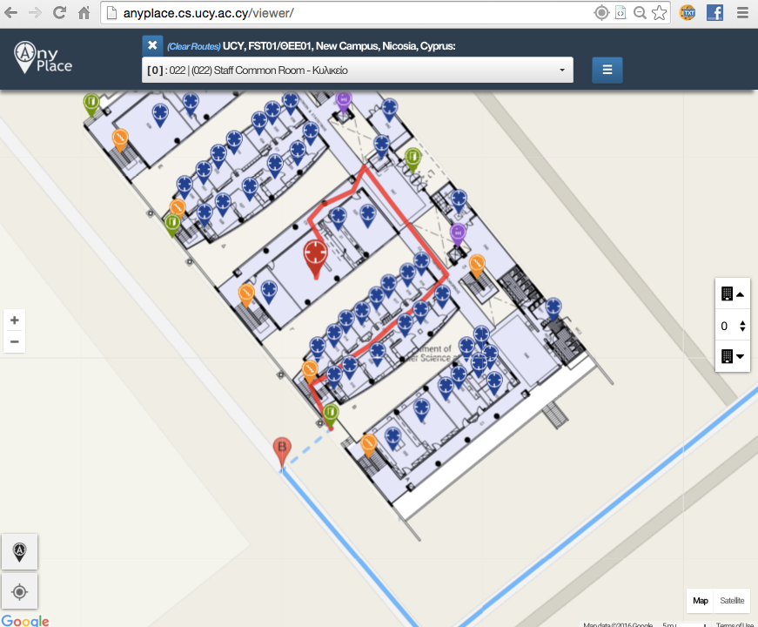
Showcase: Univ. of Cyprus
Office Navigation @ Univ. of Cyprus
Outdoor-to-Indoor Navigation through URL.
60 Buildings mapped, Thousands of POIs (stairways, WC, elevators, equipment, etc.)
Example:
http://goo.gl/ns3lqN

Slide 11
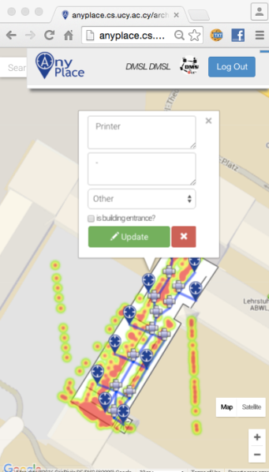
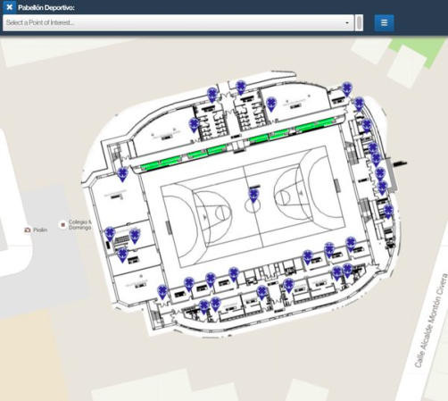
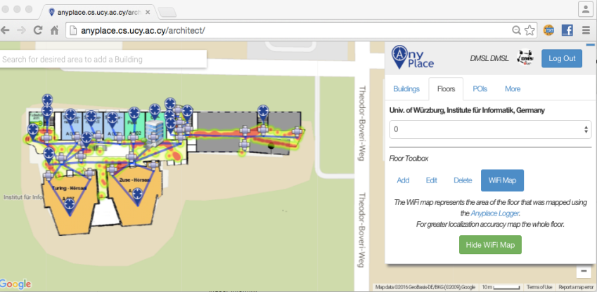
Other Showcases
Univ. of Wurzburg, Institute fur Informatik
Mapped in about 1 hour
Universidad de Jaén, Spain
Campus Navigation (9 Buildings)
Univ. of Mannheim, Library
Aims to offer Navigation-to-Shelf

Slide 12
Presentation Outline
Introduction & Anyplace
Research Challenges
Location Privacy
ACM HotPlanet’12, IEEE TKDE’15
Radiomap Prefetching
IEEE MDM’15
Future Challenges
Big Data, Crowdsourcing, Modeling
IEEE Internet Computing’16, IPIN’13.

Slide 13
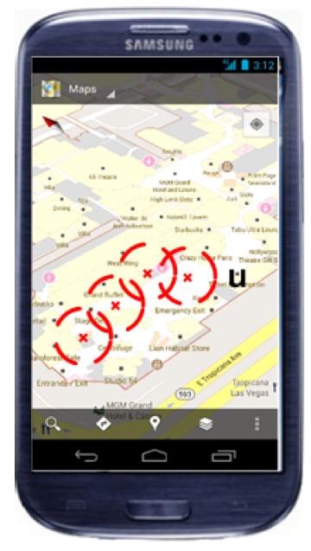
Location Privacy
I can see these Reference Points, where am I?
...
(x,y)!
IIN Service
User u
Towards planet-scale localization on smartphones with a partial radiomap", A. Konstantinidis, G. Chatzimilioudis, C. Laoudias, S. Nicolaou and D. Zeinalipour-Yazti. In ACM HotPlanet'12, in conjunction with ACM MobiSys '12, ACM, Pages: 9--14, 2012.
Privacy-Preserving Indoor Localization on Smartphones, Andreas Konstantinidis, Paschalis Mpeis, Demetrios Zeinalipour-Yazti and Yannis Theodoridis, in IEEE TKDE’15.

Slide 14
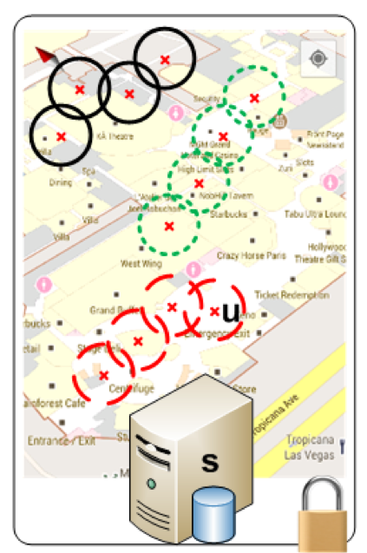
Temporal Vector Map (TVM)
Bloom Filter (u's APs)
WiFi
Set Membership Queries
WiFi
...
IIN Service
K=3 Positions
User u
WiFi

Slide 15
TVM – Bloom Filters
Bloom filters – basic idea:
allocate a vector of b bits, initially all set to 0
use h independent hash functions to hash every Access Point seen by a user to the vector.
The IIN Service selects any RadioMap row that has an AP belonging to the query bloom filter and send it to the user.
AP2
AP13
AP2
AP13
0 | 1 | 0 | 0 | 1 | 0 | 0 | 1 | 0 | 0
b

Slide 16
TVM – Bloom Filters
The most significant feature of Bloom filters is that there is a clear tradeoff between b and the probability of a false positive.
Small b: Too many false positives (too much hiding & data download cost)
Large b: “No” false positives (no hiding & no data download cost)
Given h optimal hash functions, b bits for the Bloom filter we can estimate the amount of false positives produced by the Bloom filter:
False Positive Ratio:
Size of vector:

Slide 17
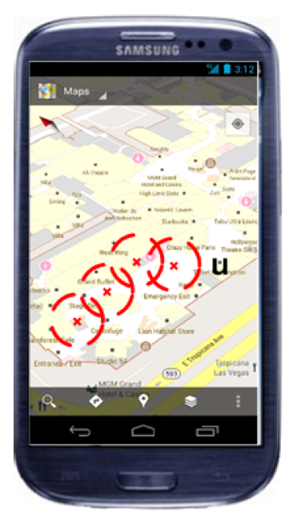
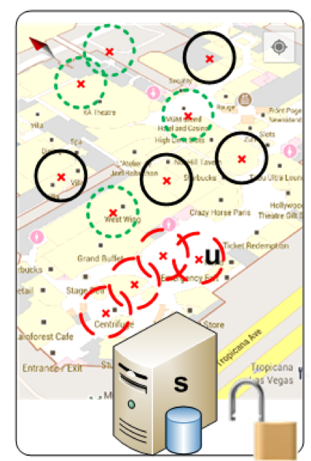
TVM Continuous
Camouflage trajectories
IIN determnines u’s location by exclusion

Slide 18
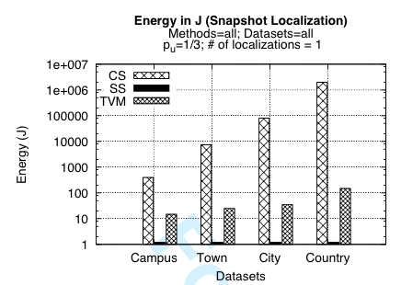
TVM Evaluation
Energy required for 300 localization tasks (CPU+Wi-Fi) using PowerTutor on Android
Campus (20MB)
Town (100MB)
City (1GB)
Country (20GB)

Slide 19
Presentation Outline
Introduction & Anyplace
Research Challenges
Location Privacy
ACM HotPlanet’12, IEEE TKDE’15
Radiomap Prefetching
IEEE MDM’15
Future Challenges
Big Data, Crowdsourcing, Modeling
IEEE Internet Computing’16, IPIN’13.

Slide 20
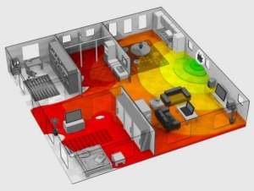
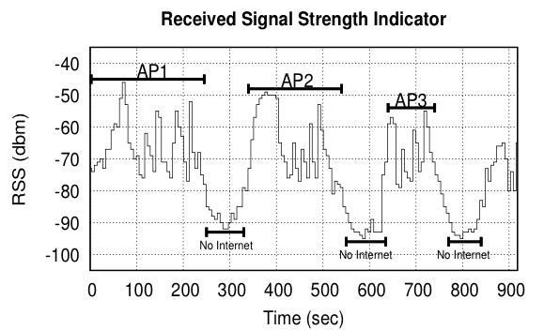
Intermittent Connectivity
Problem: Wi-Fi coverage might be irregularly available inside buildings due to poor WLAN planning or due to budget constraints.
A user walking inside a Mall in Cyprus
Whenever the user enters a store the RSSI indicator falls below a connectivity threshold -85dBm. (-30dbM to -90dbM)
When disconnected IIN can’t offer navigation anymore ☹

Slide 21
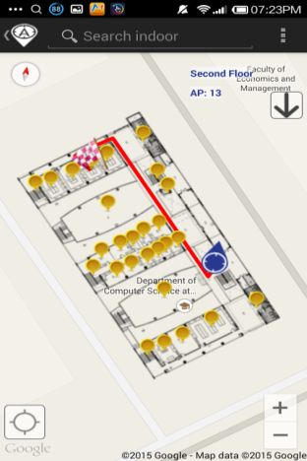
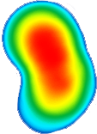
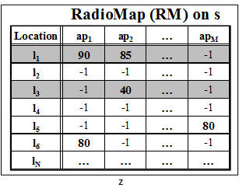
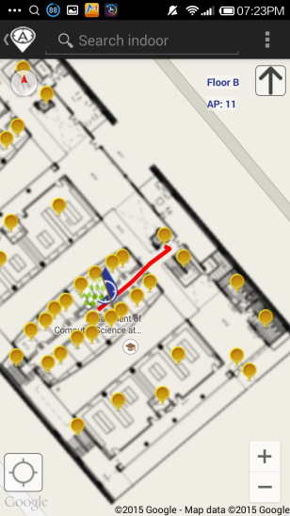
Intermittent Connectivity
IIN Service
Where-am-I?
No Navigation
Where-am-I?
X
Where-am-I?
☹ Intermittent Connectivity
Time

Slide 22
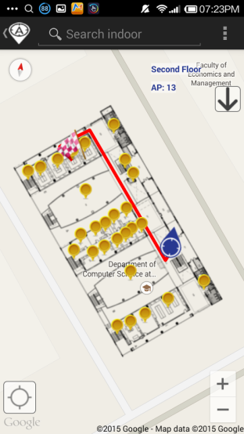
PreLoc Navigation
IIN Service
Prefetch K RM rows
Prefetch K RM rows
X
Localize from Cache
Prefetch K RM rows
☺ Intermittent Connectivity
Time

Slide 23
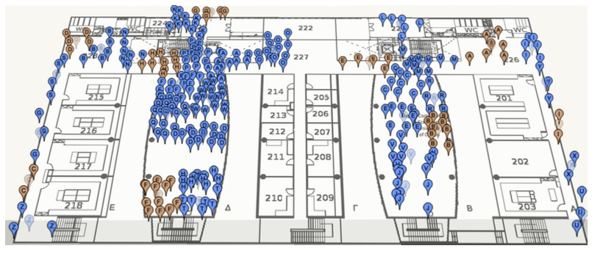
PreLoc Selection Step
The Selection Step aims to sequence the retrieval of clusters, such that the most important clusters are downloaded first.
Question: Which clusters should a user download at a certain position if Wi-Fi not available next?
PreLoc prioritizes the download of RM entries using historic traces modelled as Directed Graphs.
User Current Location

Slide 24
PreLoc Selection Step
PreLoc relies on the Probabilistic Group Selection (PGS) Heuristic to determine the RM entries to prefetch next.
Probabilistic k=3 Group Selection
Historic Traces
Dependency Graph
(DG)
Do Best First Search Traversal of DG from A:
follow the most promising option using priority queue.
P(A,B)=1.0
P(A,B,D)=0.66
P(A,B,D,C)=0.66*0.5=0.33
P(A,B,D,A) => cycle
P(A,B,D,C,D)=> cycle
P(A,B,C)=0.33
Empty queue – finished!
User Current Location
A
B
D
0.5
0.5
1.0
C
A
0.66
Early stop!
C
D
1.0
0.33
B
(statistically independent transitions between vertices + no stationary transitions in historic traces)

Slide 25
Presentation Outline
Introduction & Anyplace
Research Challenges
Location Privacy
ACM HotPlanet’12, IEEE TKDE’15
Radiomap Prefetching
IEEE MDM’15
Future Challenges
Big Data, Crowdsourcing, Modeling
IEEE Internet Computing’16, IPIN’13.

Slide 26
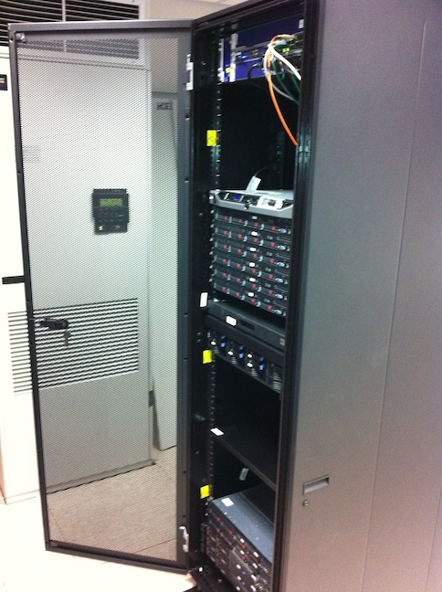
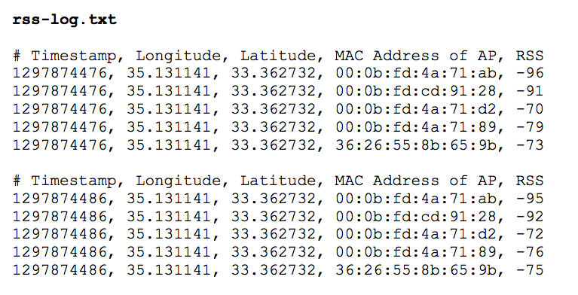
Big-Data Challenges
Massively process RSS log traces to generate a valuable Radiomap
Processing current logs in Anyplace for a single building takes several minutes!
Challenges in MapReduce:
Collect Statistics (count, RSSI mean and standard deviation)
Remove Outlier Values.
Handle Diversity Issues

Slide 27
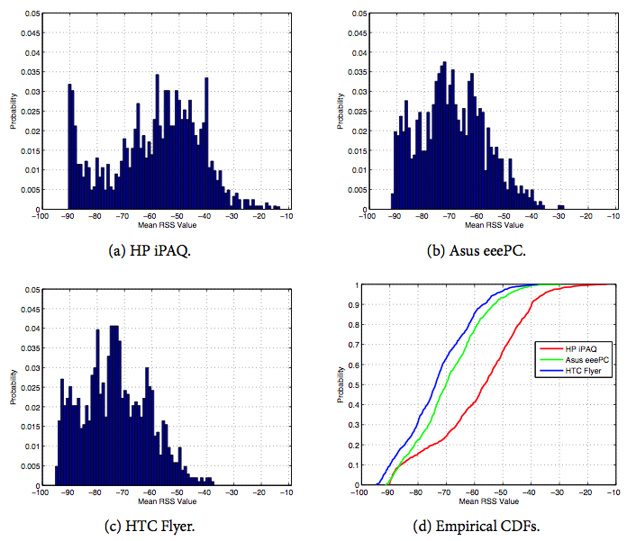
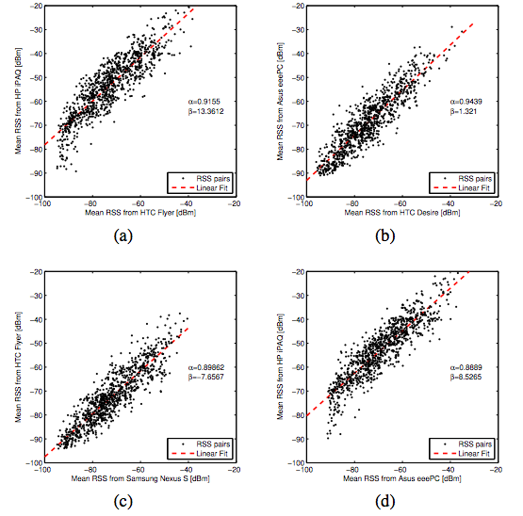
Crowdsourcing Challenges
Quality: Unreliable Crowdsourcers, Multi-device Issues, Hardware Outliers, Temporal Decay, etc.
Remark: There is a Linear Relation between RSS values of devices.
Challenge: Can we exploit this to align reported RSS values?
"Crowdsourced Indoor Localization for Diverse Devices through Radiomap Fusion", C. Laoudias, D. Zeinalipour-Yazti and C. G. Panayiotou, "Proceedings of the 4th Intl. Conference on Indoor Positioning and Indoor Navigation" (IPIN '13), Montbeliard-Belfort France, 2013.

Slide 28
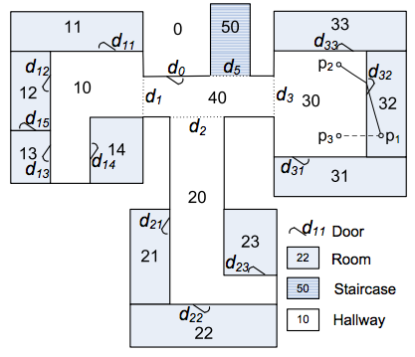
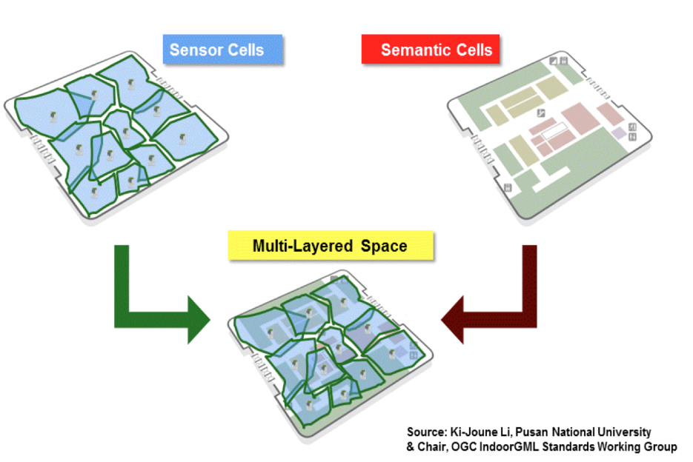
Modeling Challenges
Indoor spaces exhibit complex topologies. They are composed of entities that are unique to indoor settings:
e.g., rooms and hallways that are connected by doors.
Conventional Euclidean distances are inapplicable in indoor space, e.g., NN of p1 is p2 not p3.
IndoorGML by OGC
Jensen et. al. 2010

Slide 29
Internet-based Indoor Navigation Services
Thanks! Questions?
Demetris Zeinalipour
Data Management Systems Laboratory
Department of Computer Science
University of Cyprus
http://www.cs.ucy.ac.cy/~dzeina/
ACROSS Meeting, Centrum Wiskunde & Informatica (CWI),
Amsterdam, Netherlands, February 25, 2016.

