Slide 1
Anyplace Indoor Information Service
C. Costa, C. Laoudias, A. Konstantinidis, G. Chatzimilioudis and D. Zeinalipour-Yazti
Data Management Systems Laboratory
Department of Computer Science
University of Cyprus
http://dmsl.cs.ucy.ac.cy/
Challenges of Fingerprinting in Indoor Positioning and Navigation
Department of Computer Science, Open University of Catalonia,
Tuesday, May 3, 2016, 15:30 - 18:00

Slide 2
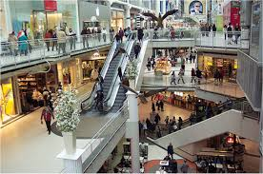
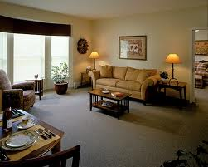
Motivation
People spend 80-90% of their time indoors – USA Environmental Protection Agency 2011.
>85% of data and 70% of voice traffic originates from within buildings – Nokia 2012.

Slide 3
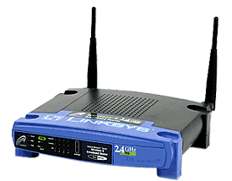
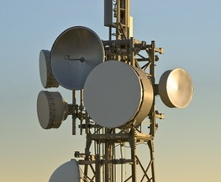
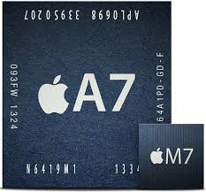
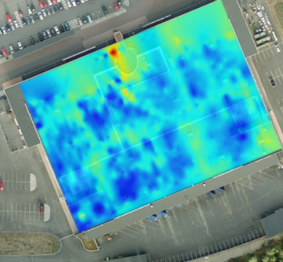
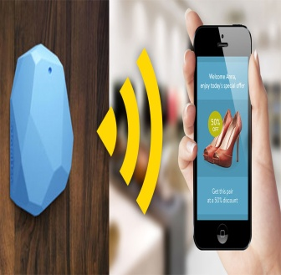
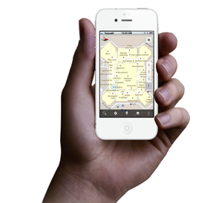
Localization Technologies
Modern trend in Localization are Internet-based Indoor Navigation (IIN) services founded on measurements collected by smart devices.
Technologies:
Wi-Fi APs, Cellular Towers, other stationary antennas
IMU Data (Gyroscope, Accelerometers, Digital Compass)
Magnetic Field Sensors
Beacons (BLE Beacons, RFID Active & Passive Beacons)
Sound (Microphone), Light (Light Sensor), …

Slide 4
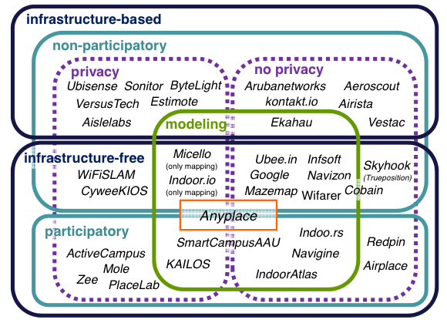
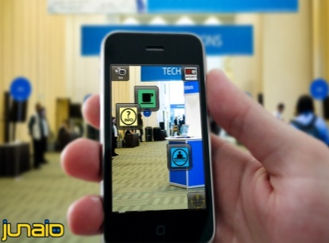
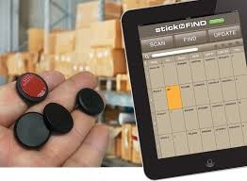
Indoor Applications
Huge spectrum of indoor apps
Navigation, Manufacturing, Asset Tracking, Inventory Management
Healthcare, Smart Houses, Elderly support, Fitness apps
Augmented Reality and many more.
Indoor Revenues expected reach 10B USD in 2020
ABIresearch, “Retail Indoor Location Market Breaks US$10 Billion in 2020”’ Available at: https://goo.gl/ehPRMn, May 12, 2015.
Overview Publication / Tutorial:
"Internet-based Indoor Navigation Services", IEEE Internet Computing (IC'16), http://goo.gl/VJjMRH
Tutorial at IEEE MDM’15 (slides):
http://goo.gl/70JV4q

Slide 5
Anyplace IIN Service
A complete open-source IIN Service developed at the University of Cyprus.
Aims to become the predominant open-source Indoor Localization Service.
Active community: Germany, Russia,
Australia, Canada, UK, etc. – Join today!
Android, Windows, iOS, JSON API
http://anyplace.cs.ucy.ac.cy/

Slide 6
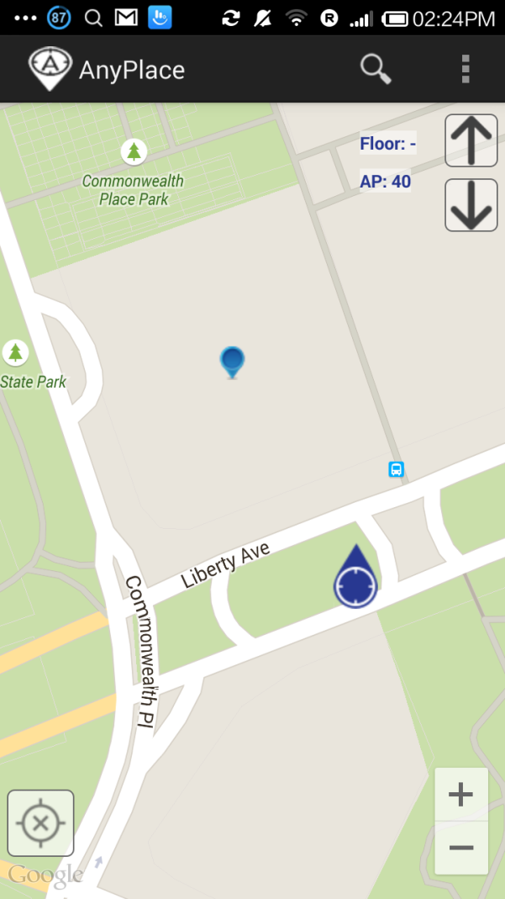
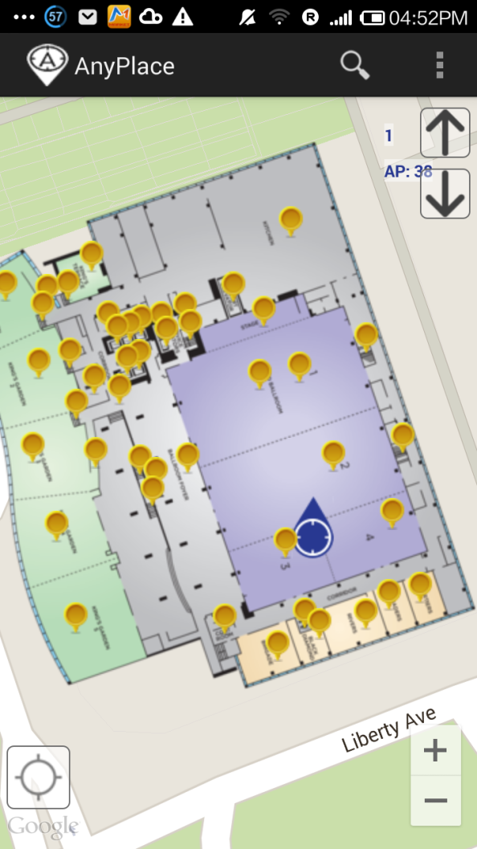
Showcase I: Hotel in Pittsburgh, USA
Before ☹
(using Google API Location)
After ☺
(using Anyplace Location & Indoor Models)

Slide 7
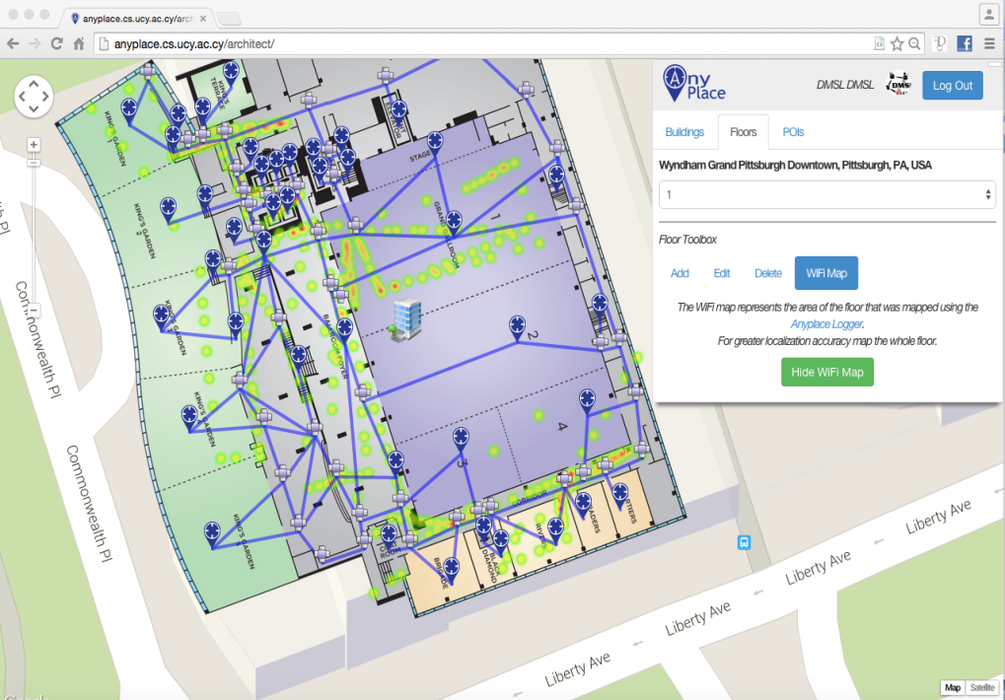
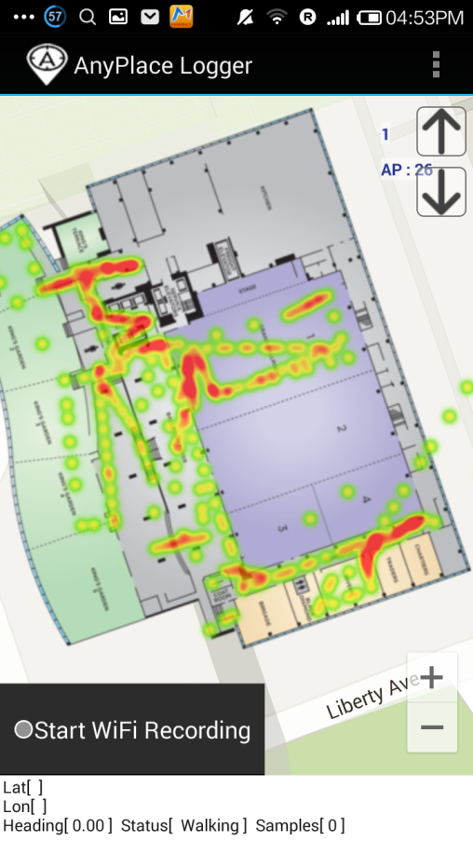
Showcase I: Hotel in Pittsburgh, USA
Modeling + Crowdsourcing

Slide 8
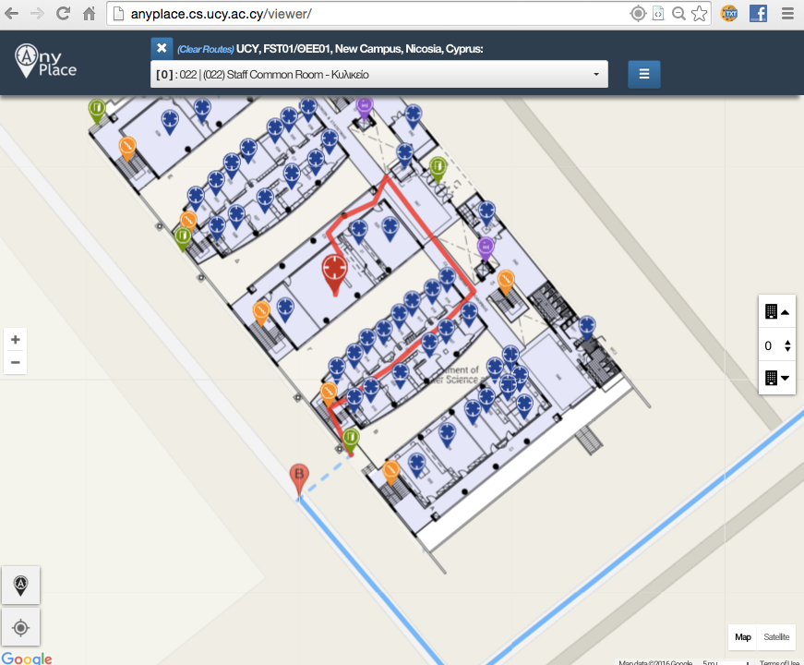
Showcase: Univ. of Cyprus
Office Navigation @ Univ. of Cyprus
Outdoor-to-Indoor Navigation through URL.
60 Buildings mapped, Thousands of POIs (stairways, WC, elevators, equipment, etc.)
Example:
http://goo.gl/ns3lqN

Slide 9
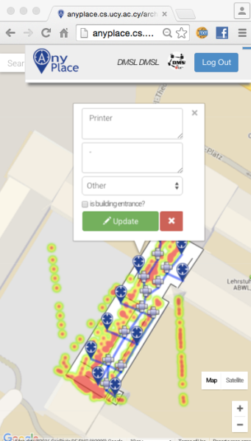
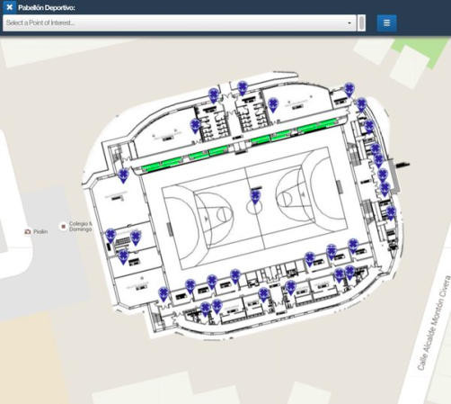
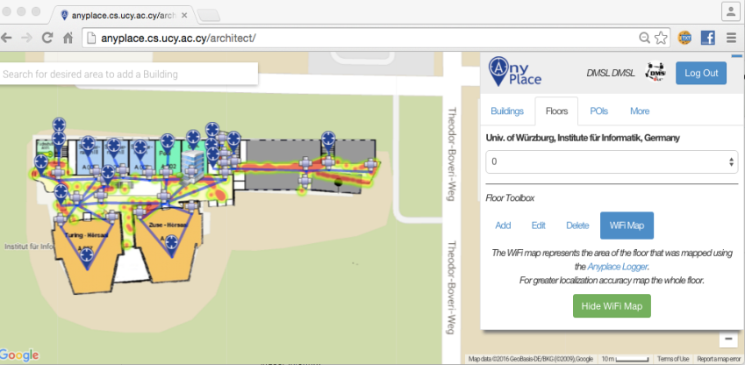
Other Showcases
Univ. of Würzburg, Institut für Informatik
Mapped in about 1 hour
Universidad de Jaén, Spain
Campus Navigation (9 Buildings)
Univ. of Mannheim, Library
Aims to offer Navigation-to-Shelf

Slide 10
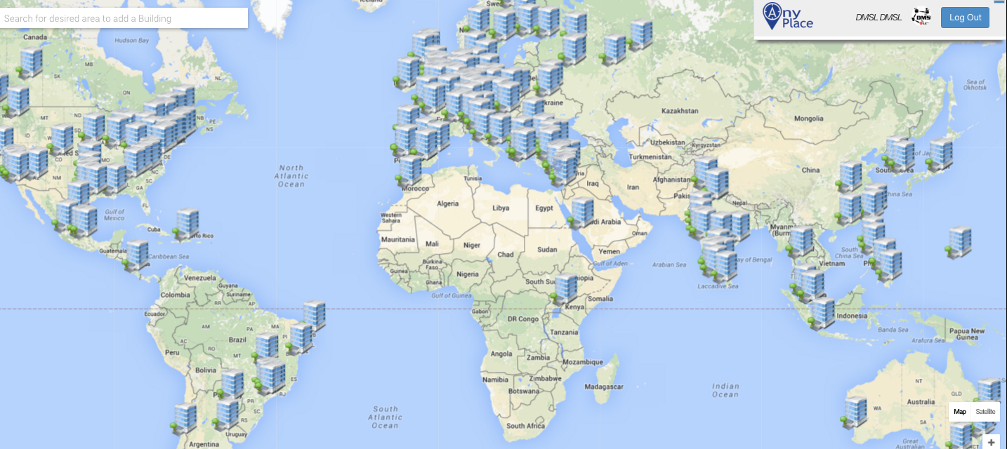
Anyplace Open Maps
http://anyplace.cs.ucy.ac.cy/

Slide 11
Presentation Outline
Introduction
Location Accuracy
IEEE MDM’12, ACM IPSN’14, ACM IPSN’15, IEEE IC’16
Location Prefetching
IEEE MDM’15
Future Challenges
IEEE TKDE’15

Slide 12
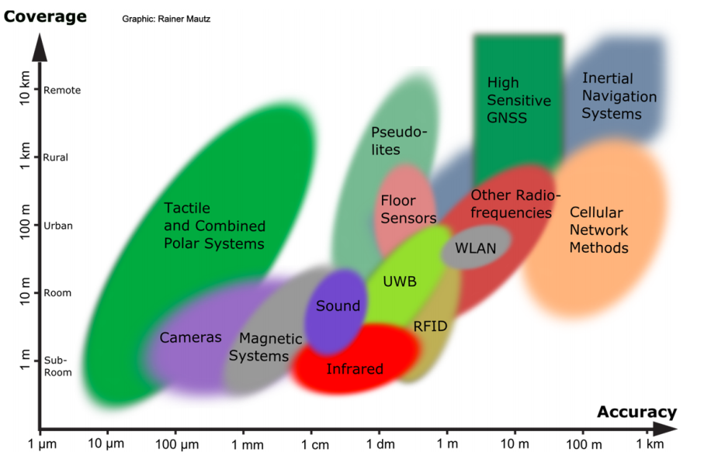
Location Accuracy
: Spatial extension where system performance must be guaranteed
Room Level Accuracy
| Outdoor |
| Indoor |
^{Rainer Mautz, ETH Zurich, 2011}

Slide 13
Location Accuracy
Infrastructure-free systems: don’t require dedicated equipment for the provisioning of location signals (e.g., GPS, Wi-Fi, Cellular, Magnetic, IMU)
Infrastructure-based systems: require dedicated equipment (e.g., proprietary transmitters, beacons, antennas and cabling)
Bluetooth Low Energy (BLE) beacons: iBeacons (Apple)
Ultrasound: ALPS (CMU)
Visible Light: EPSILON (Microsoft Research)
Ultra Wide Band (UWB): Decawave
Anyplace Focus
Source: NASA

Slide 14
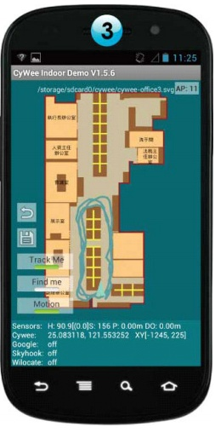
WiFi Fingerprinting in Anyplace
References
[Airplace] "The Airplace Indoor Positioning Platform for Android Smartphones", C. Laoudias et. al., Best Demo Award at IEEE MDM'12. (Open Source!)
[HybridCywee] "Indoor Geolocation on Multi-Sensor Smartphones", C.-L. Li, C. Laoudias, G. Larkou, Y.-K. Tsai, D. Zeinalipour-Yazti and C. G. Panayiotou, in ACM Mobisys'13. Video at: http://youtu.be/DyvQLSuI00I
[UcyCywee] IPSN’14 Indoor Localization Competition (Microsoft Research), Berlin, Germany, April 13-14, 2014. 2nd Position with 1.96m! http://youtu.be/gQBSRw6qGn4
D. Lymberopoulos, J. Liu, X. Yang, R. R. Choudhury, ..., C. Laoudias, D. Zeinalipour-Yazti, Y.-K. Tsai, and et. al., “A realistic evaluation and comparison of indoor location technologies: Experiences and lessons learned”, In IEEE/ACM IPSN 2015.
1st Position at EVARILOS Open Challenge, European Union (TU Berlin, Germany), 2014.
Cywee / Airplace

Slide 15
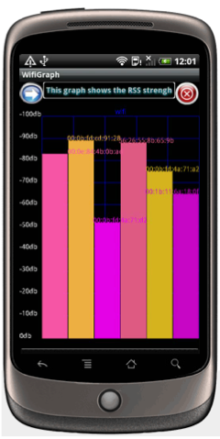
WiFi Fingerprinting
Received Signal Strength indicator (RSSI)
Power measurement present in a received radio signal measured in dBm (Decibel-milliwatts)
Max RSSI (-30dBm) to Min RSSI: (−90 dBm)
’00
Advantages
Readily provided by smartphone APIs
Low power 125mW (RSSI) vs. 400 mW (transmit)
Disadvantages
Complex propagation conditions (multipath, shadowing) due to wall, ceilings.
RSS fluctuates over time at a given location (especially in open spaces).
Unpredictable factors (people moving, doors, humidity)

Slide 16
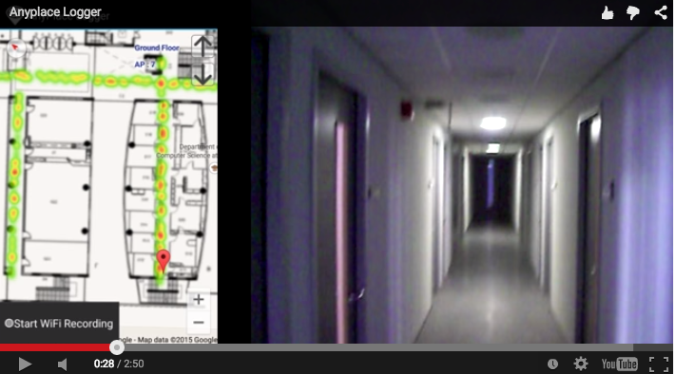
Logging in Anyplace
Video
"Anyplace: A Crowdsourced Indoor Information Service", Kyriakos Georgiou, Timotheos Constambeys, Christos Laoudias, Lambros Petrou, Georgios Chatzimilioudis and Demetrios Zeinalipour-Yazti, Proceedings of the 16th IEEE International Conference on Mobile Data Management (MDM '15), IEEE Press, Volume 2, Pages: 291-294, 2015

Slide 17
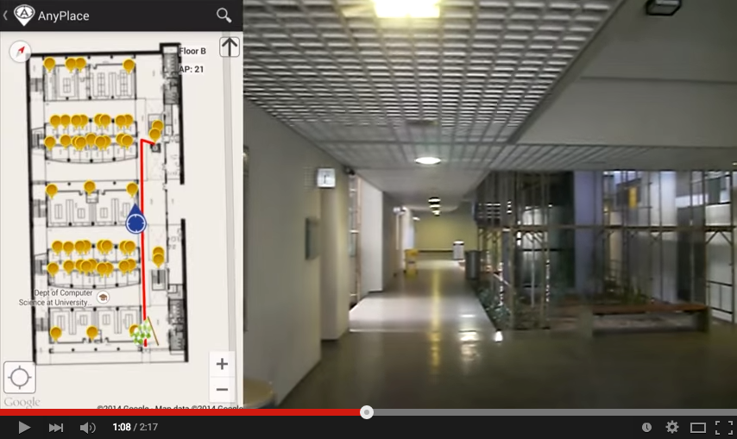
Hybrid Wi-Fi/IMU/Outdoor Anyplace
Video
"Anyplace: A Crowdsourced Indoor Information Service", Kyriakos Georgiou, Timotheos Constambeys, Christos Laoudias, Lambros Petrou, Georgios Chatzimilioudis and Demetrios Zeinalipour-Yazti, Proceedings of the 16th IEEE International Conference on Mobile Data Management (MDM '15), IEEE Press, Volume 2, Pages: 291-294, 2015

Slide 18
Presentation Outline
Introduction
Location Accuracy
IEEE MDM’12, ACM IPSN’14, ACM IPSN’15, IEEE IC’16
Location Prefetching
IEEE MDM’15
Future Challenges
IEEE TKDE’15

Slide 19
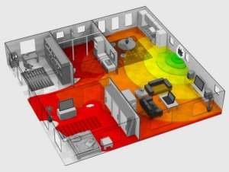
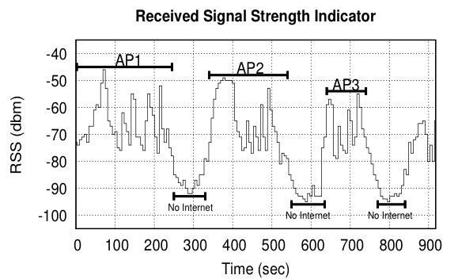
Intermittent Connectivity
Problem: Wi-Fi coverage might be irregularly available inside buildings due to poor WLAN planning or due to budget constraints.
A user walking inside a Mall in Cyprus
Whenever the user enters a store the RSSI indicator falls below a connectivity threshold -85dBm. (-30dbM to -90dbM)
When disconnected IIN can’t offer navigation anymore ☹

Slide 20
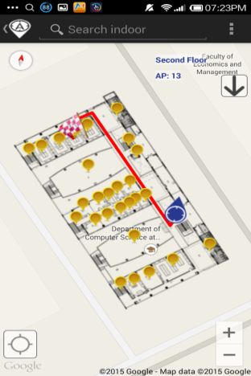
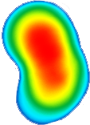
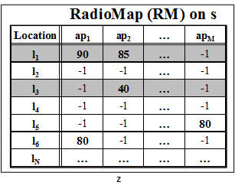
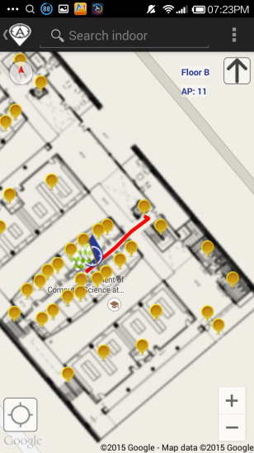
Intermittent Connectivity
IIN Service
Where-am-I?
No Navigation
Where-am-I?
X
Where-am-I?
☹ Intermittent Connectivity
Time

Slide 21
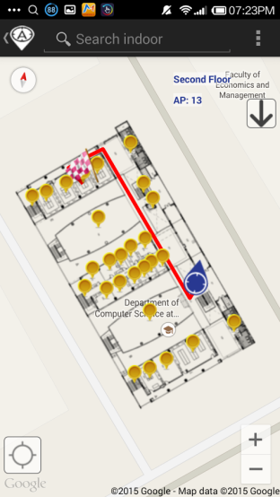
PreLoc Navigation
IIN Service
Prefetch K RM rows
Prefetch K RM rows
X
Localize from Cache
Prefetch K RM rows
☺ Intermittent Connectivity
Time

Slide 22
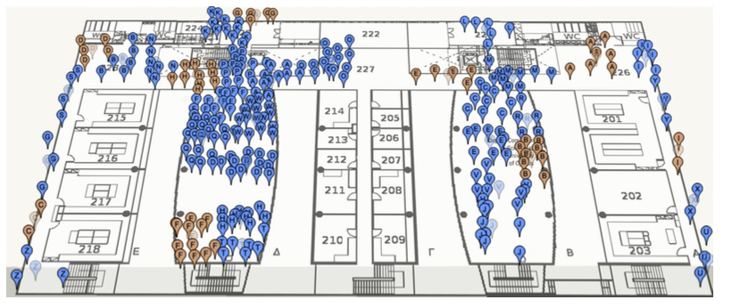
PreLoc Partitioning Step
Why? RM might contain many points (45K in CSUCY!).
Action: The objective of this step is to cluster these into groups so that they are easier to prefetch.
K-Means simple well-established clustering algorithm.
Operation: Random Centroids (C), Add to Closest C, Re-adjust C
Re-adjusting Centroids expensive quadratic complexity ☹

Slide 23
PreLoc Partitioning Step
We use the Bradley-Fayyad-Reina (BFR)* algorithm
A variant of k-means designated for large datasets.
Instead of computing L₂ distance of point p against centroid, as in k-means, it computes the Mahalanobis distance (dist_{Mah}) against some set statistics (μ, σ).
In BFR if dist_{Mah} is less than a threshold add to set, else retain to possibly shape new clusters.
Advantage: Less centroid computations! Points are traversed only once which is fast for big data!
μ
dist_{Mah}
σ
Point (p)
Scaling Clustering Algorithms to Large Databases.. PS Bradley, UM Fayyad, C Reina - KDD, 1998

Slide 24
PreLoc Selection Step
The Selection Step aims to sequence the retrieval of clusters, such that the most important clusters are downloaded first.
Question: Which clusters should a user download at a certain position if Wi-Fi not available next?
PreLoc prioritizes the download of RM entries using historic traces of user inside the building !!!
User Current Location

Slide 25
Presentation Outline
Introduction
Location Accuracy
IEEE MDM’12, ACM IPSN’14, ACM IPSN’15, IEEE IC’16
Location Prefetching
IEEE MDM’15
Future Challenges
IEEE TKDE’15

Slide 26
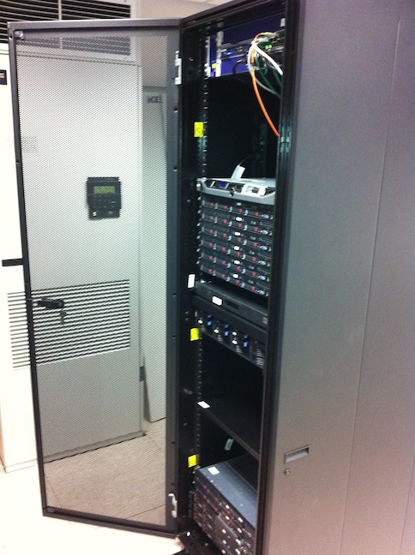
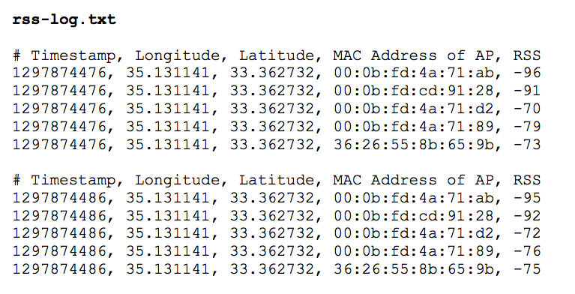
Big-Data Challenges
Massively process RSS log traces to generate a valuable Radiomap
Processing current logs in Anyplace for a single building takes several minutes!
Challenges in MapReduce:
Collect Statistics (count, RSSI mean and standard deviation)
Remove Outlier Values.
Handle Diversity Issues

Slide 27
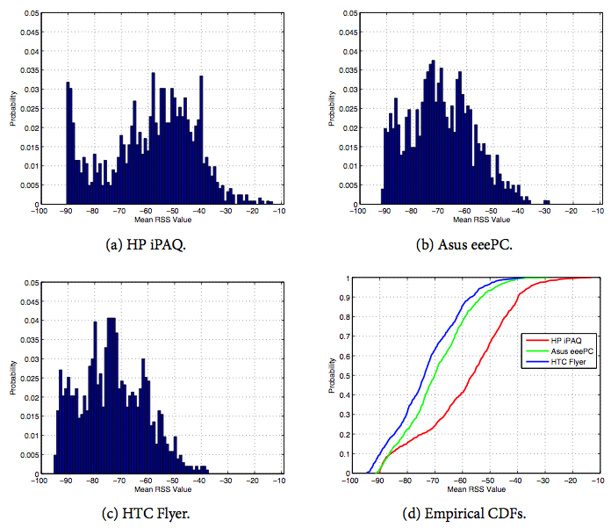
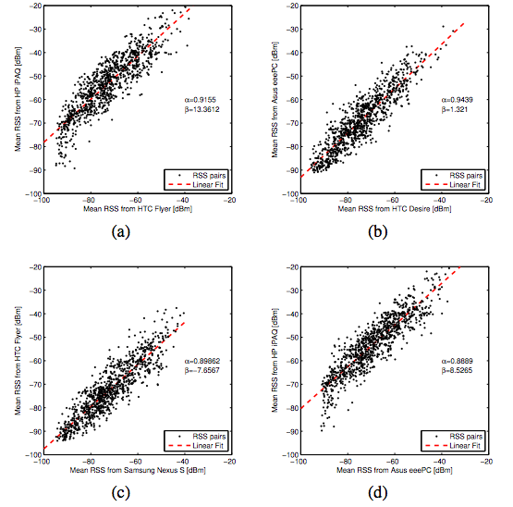
Crowdsourcing Challenges
Quality: Unreliable Crowdsourcers, Multi-device Issues, Hardware Outliers, Temporal Decay, etc.
Remark: There is a Linear Relation between RSS values of devices.
Challenge: Can we exploit this to align reported RSS values?
"Crowdsourced Indoor Localization for Diverse Devices through Radiomap Fusion", C. Laoudias, D. Zeinalipour-Yazti and C. G. Panayiotou, "Proceedings of the 4th Intl. Conference on Indoor Positioning and Indoor Navigation" (IPIN '13), Montbeliard-Belfort France, 2013.

Slide 28
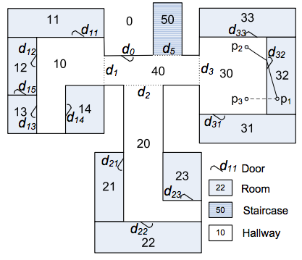
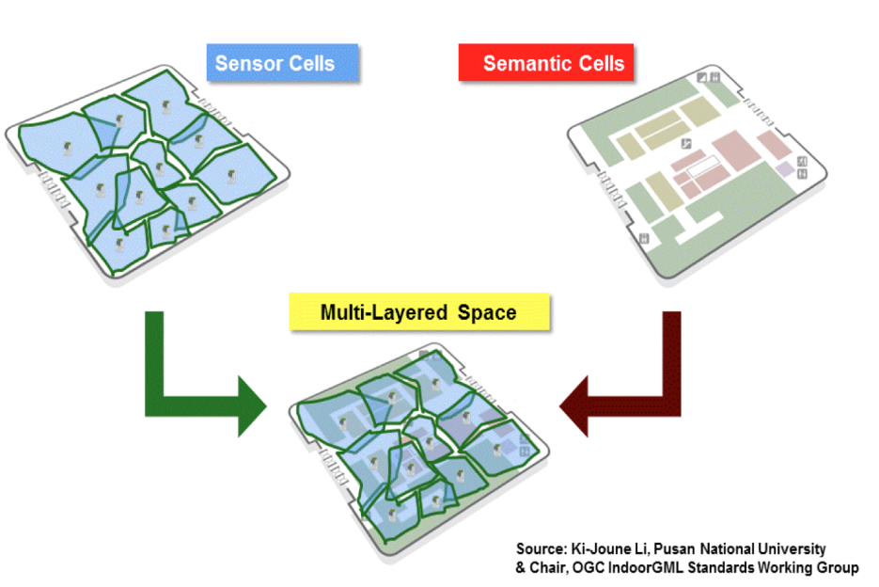
Modeling Challenges
Indoor spaces exhibit complex topologies. They are composed of entities that are unique to indoor settings:
e.g., rooms and hallways that are connected by doors.
Conventional Euclidean distances are inapplicable in indoor space, e.g., NN of p1 is p2 not p3.
IndoorGML by OGC
Jensen et. al. 2010

Slide 29
Location Privacy Challenges
An IIN Service can continuously “know” (surveil, track or monitor) the location of a user while serving them.
Location tracking is unethical and can even be illegal if it is carried out without the explicit user consent.
Imminent privacy threat, with greater impact that other privacy concerns, as it can occur at a very fine granularity. It reveals:
The stores / products of interest in a mall.
The book shelves of interest in a library
Artifacts observed in a museum, etc.

Slide 30
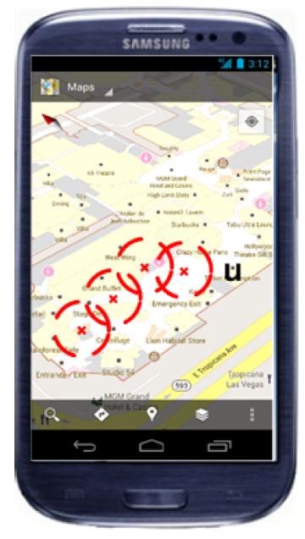
Location Privacy
I can see these Reference Points, where am I?
...
(x,y)!
IIN Service
User u
Towards planet-scale localization on smartphones with a partial radiomap", A. Konstantinidis, G. Chatzimilioudis, C. Laoudias, S. Nicolaou and D. Zeinalipour-Yazti. In ACM HotPlanet'12, in conjunction with ACM MobiSys '12, ACM, Pages: 9--14, 2012.
Privacy-Preserving Indoor Localization on Smartphones, Andreas Konstantinidis, Paschalis Mpeis, Demetrios Zeinalipour-Yazti and Yannis Theodoridis, in IEEE TKDE’15.

Slide 31
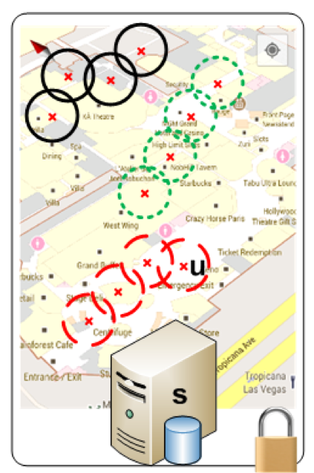
Temporal Vector Map (TVM)
Bloom Filter (u's APs)
WiFi
Set Membership Queries
WiFi
...
IIN Service
K=3 Positions
User u
WiFi

Slide 32
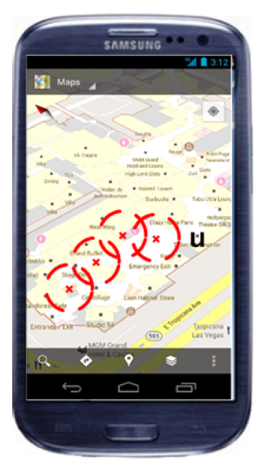
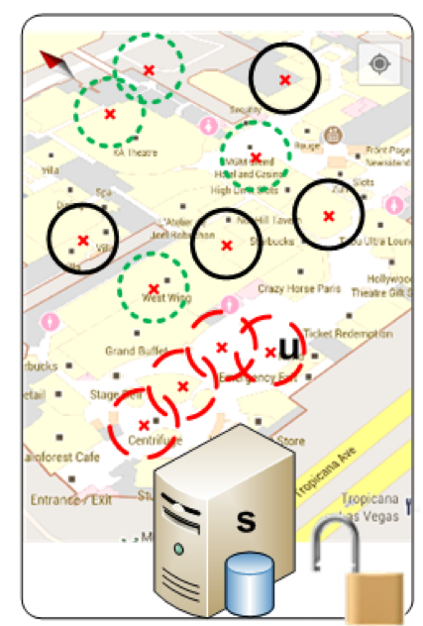
TVM Continuous
Camouflage trajectories
IIN determnines u’s location by exclusion

Slide 33
Anyplace Indoor Information Service
C. Costa, C. Laoudias, A. Konstantinidis, G. Chatzimilioudis and D. Zeinalipour-Yazti
Thanks – Questions?
http://dmsl.cs.ucy.ac.cy/
Department of Computer Science, Open University of Catalonia,
Tuesday, May 3, 2016, 15:30 - 18:00

Slide 34
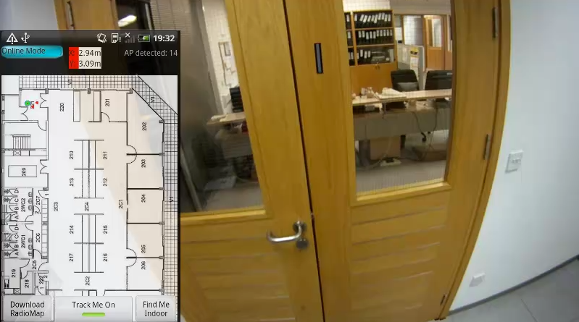
WiFi Positioning Demo
Video
Works best in confined areas
"The Airplace Indoor Positioning Platform for Android Smartphones", C. Laoudias, G. Constantinou, M. Constantinides, S. Nicolaou, D. Zeinalipour-Yazti, C. G. Panayiotou, Best Demo Award at IEEE MDM'12. (Open Source!)

