Slide 1
Prefetching Indoor Navigation Structures in Anyplace
Demetris Zeinalipour
Assistant Professor
(Data Management Systems Laboratory)
Department of Computer Science
University of Cyprus
http://www.cs.ucy.ac.cy/~dzeina/
2nd Cyprus Workshop on Computing: Scientific Applications of Computing
October 27th, 2015, European University Cyprus, Nicosia, Cyprus
* Presented at 16th IEEE Int. Conference on Mobile Data Management (MDM’15), Pittsburgh, PA, USA, June 16, 2015

Slide 2
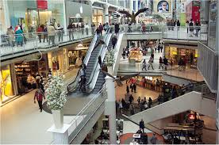
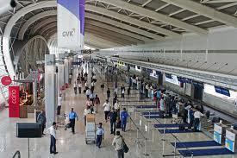
Motivation
People spend 80-90% of their time indoors – USA Environmental Protection Agency 2011.
>85% of data and 70% of voice traffic originates from within buildings – Nokia 2012.
The accurate localization of custodians in indoor spaces can enable a wide of range of new applications:
Navigation, Commerce, Smart *, Health & Manuf.

Slide 3
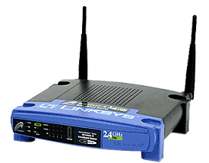
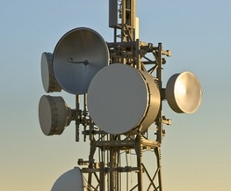
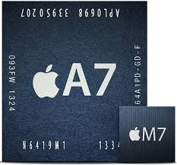
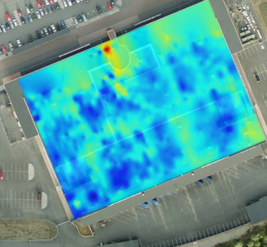
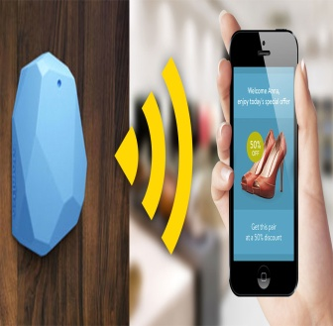
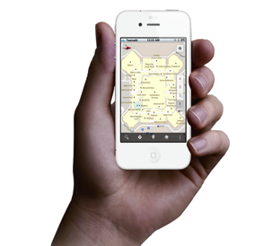
Localization Technologies
Modern trend is to build Internet-based Indoor Navigation (IIN)* services founded on measurements collected by smart devices.
Technologies:
Wi-Fi APs, Cellular Towers, other stationary antennas
IMU Data (Gyroscope, Accelerometers, Digital Compass)
Magnetic Field Sensors
Beacons (BLE Beacons, RFID Active & Passive Beacons)
Sound (Microphone), Light (Light Sensor), …
* “Internet-based Indoor Navigation Services”, Zeinalipour-Yazti, Laoudias, Georgiou and Chatzimilioudis, IEEE Internet Computing, 2015.

Slide 4
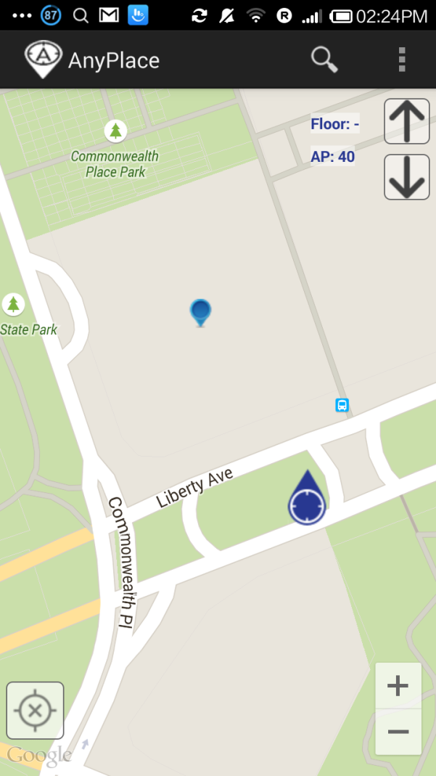
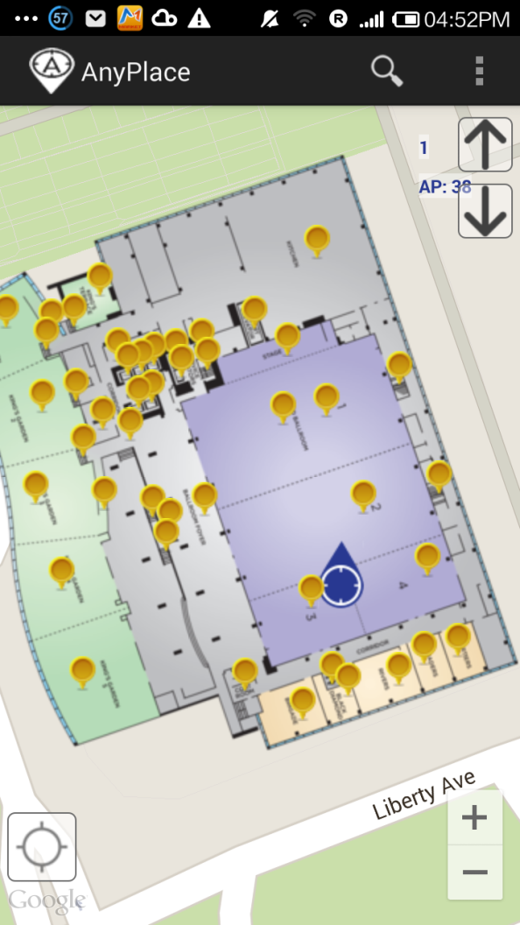
Anyplace
An complete IIN service open for research and development
http://anyplace.cs.ucy.ac.cy/
Tutorial @ IEEE MDM’15!
Before ☹
(using Google API)
After ☺
(using Anyplace)

Slide 5
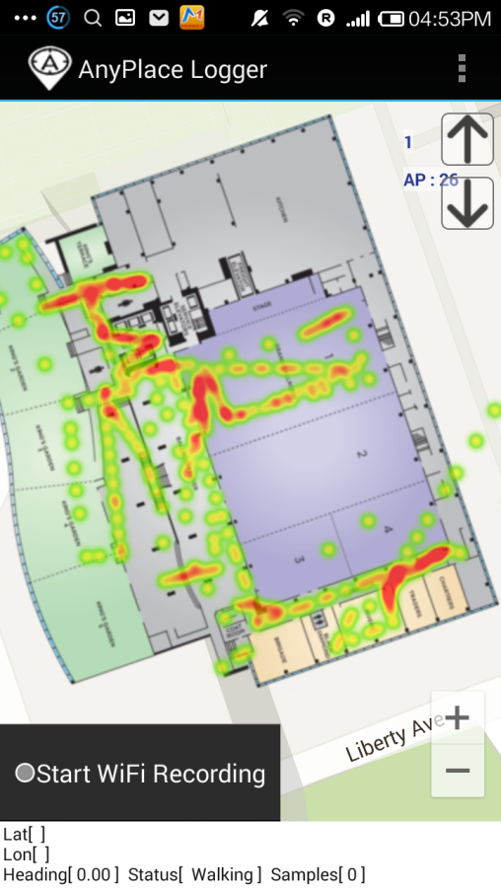
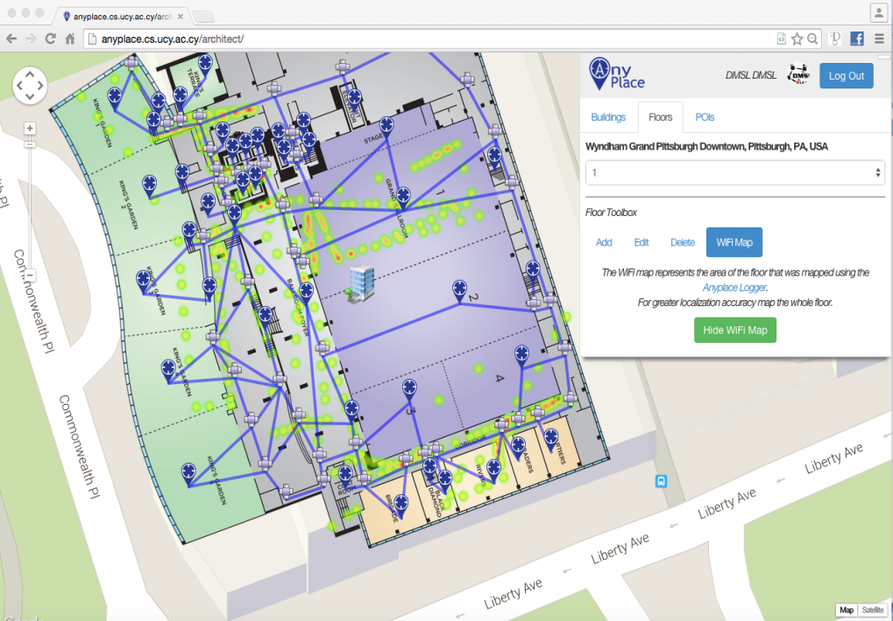
Anyplace @ IEEE MDM’15
Building Modeling
Map, Points-of-Interest
Crowdsourcing Radiomaps
10 minutes / floor

Slide 6
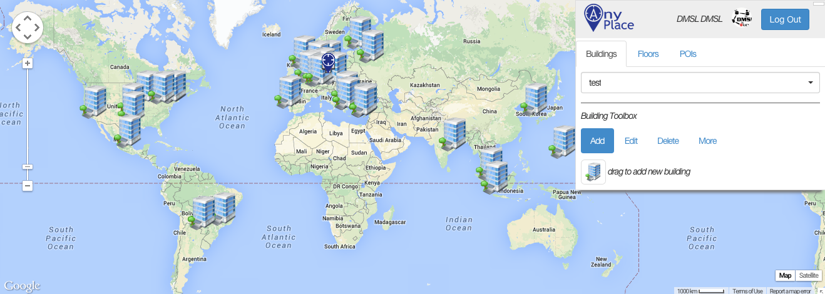
Anyplace Open Maps

Slide 7
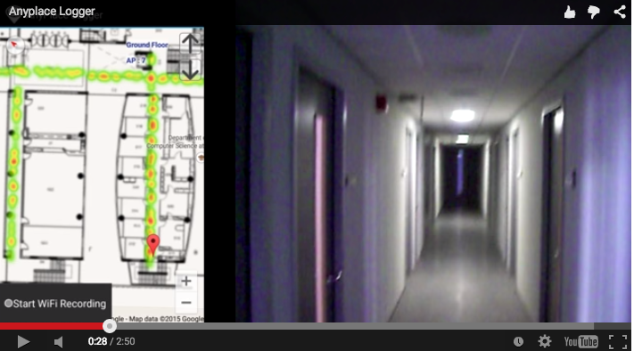
Logging in Anyplace
Video

Slide 8
Presentation Outline
Introduction
Problem Formulation
The PreLoc Framework
Partitioning Step
Selection Step
Localization Step
Experimental Evaluation
Other Indoor Work

Slide 9
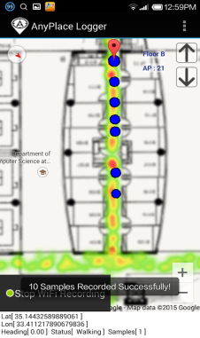
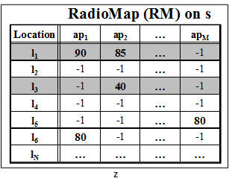
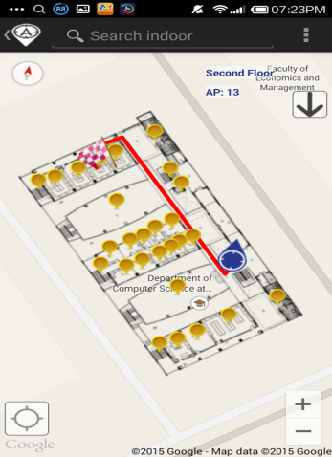
IIN Workflow
Logger
IIN Service
a) Upload Measurements
b) Build RM (Radiomap)
c) Localize
fingerprint
SSA
Navigator
d) Localization Alternatives:
Client-Side-Approach (CSA)
Server-Side-Approach (SSA)
CSA

Slide 10
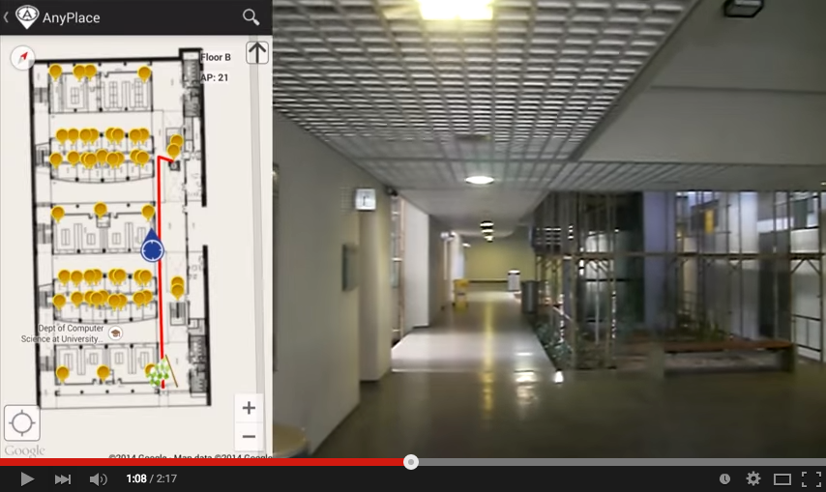
CSA Navigation (Anyplace)
Video

Slide 11
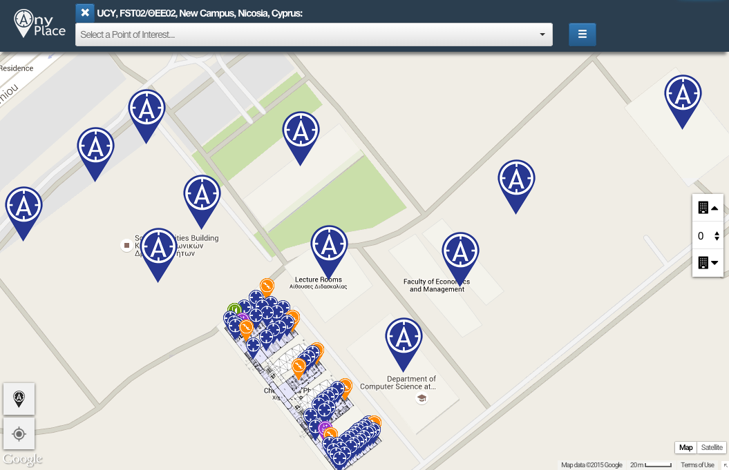
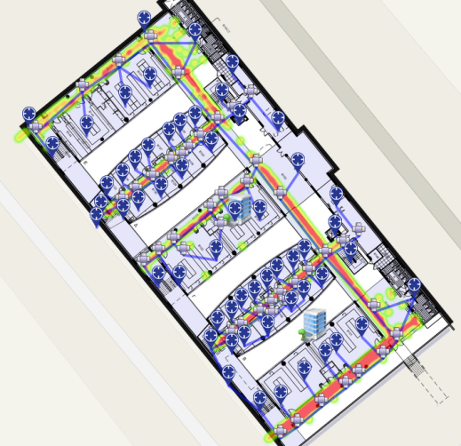
CSA Weaknesses
Don’t know a priori what buildings we need!
e.g., a user lost on a complex University Campus.
CSA not compatible with the Cloud trend!
signals, indoor POIs are overwhelming for mobiles
CSA is operating on outdated data!
Doesn’t take advantage of latest Radiomaps
Our 8,900 m² CS building has 45,000 reference positions!
(3-6MB)
Whole Campus
50-100MB

Slide 12
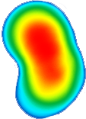
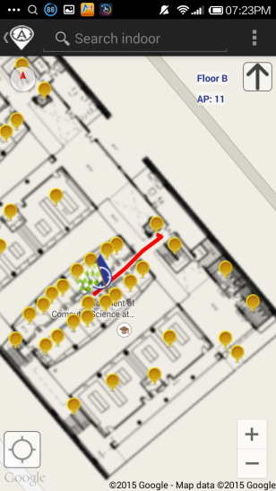
SSA Navigation (Anyplace)
IIN Service
Where-am-I?
No Navigation
Where-am-I?
X
Where-am-I?
☹ Intermittent Connectivity
Time

Slide 13
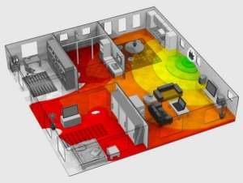
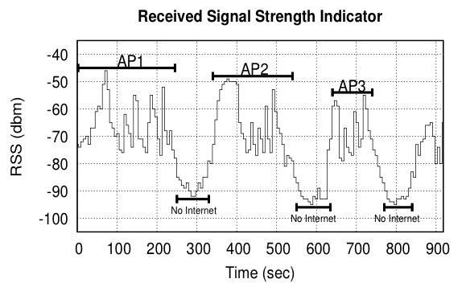
Intermittent Connectivity
Wi-Fi coverage might be irregularly available inside buildings due to poor WLAN planning
Complete planning would require a site
survey tool (e.g., Ekahau, Tamograph).
A user walking inside a Mall in Cyprus
Whenever the user enters a store the RSSI indicator falls below a connectivity threshold -85dBm. (-30dbM to -90dbM)
When disconnected SSA doesn’t offer navigation anymore ☹

Slide 14
Intermittent Connectivity
Why not fallback from Wi-Fi to Mobile Internet (2G-4G) when Wi-Fi is not available?
Mobile Internet Limitations:
Coverage: blockage or attenuation of signals in indoor spaces.
Slow fallback between outdated Mobile Internet and Wi-Fi infrastructures.
Lack of ubiquitous 802.11k, 802.11r (fast roaming) and 4G infrastructure.
Limited Quota: Nobody wants to waste a mobile Internet plan for navigation purposes.
Unavailability due to Roaming: when traveling and needing indoor navigation at most.

Slide 15
PreLoc Navigation
IIN Service
Prefetch K RM rows
Prefetch K RM rows
X
Localize from Cache
Prefetch K RM rows
☺ Intermittent Connectivity
Time

Slide 16
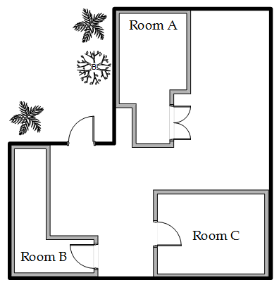
Problem Formulation
A mobile user u moves inside a building with m Access Points AP = {ap₁,…, ap_{m}}.
RadioMap (RM) is available on Server (s)
u obtains fingerprint: V_{r} = [ap_{1r},…, ap_{mr}] on every location (l), sends V_{r} to s.
P_{l}: connectivity probability of a user at location l.
Objective:
Prefetch K RM entries on u, so that u localizes accurately and efficiently.
x
x
x
x
x
V₆
x
x
x
x
x
V₁
ap₁
x
x
x
x
V₂
V₅
x
x
x
V₄
x
x
x
x
x
x
x
x
x
x
V₃
ap₃
x
x
x
x
x
ap₄
x
x
x
x
x
x
x
x
x
x
x
ap₂
x

Slide 17
Presentation Outline
Introduction
Problem Formulation
The PreLoc Framework
Partitioning Step
Selection Step
Localization Step
Experimental Evaluation
Other Indoor Work

Slide 18
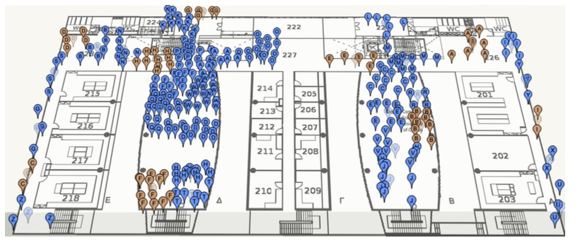
PreLoc Partitioning Step
Why? RM might contain many points (45K in CSUCY!).
Action: The objective of this step is to cluster these into groups so that they are easier to prefetch.
K-Means simple well-established clustering algorithm.
Operation: Random Centroids (C), Add to Closest C, Re-adjust C
Re-adjusting Centroids expensive quadratic complexity ☹

Slide 19
PreLoc Partitioning Step
We use the Bradley-Fayyad-Reina (BFR)* algorithm
A variant of k-means designated for large datasets.
Instead of computing L₂ distance of point p against centroid, as in k-means, it computes the Mahalanobis distance (dist_{Mah}) against some set statistics (μ, σ).
In BFR if dist_{Mah} is less than a threshold add to set, else retain to possibly shape new clusters.
Advantage: Less centroid computations! Points are traversed only once which is fast for big data!
μ
dist_{Mah}
σ
Point (p)
Scaling Clustering Algorithms to Large Databases.. PS Bradley, UM Fayyad, C Reina - KDD, 1998

Slide 20
PreLoc Selection Step
The Selection Step aims to sequence the retrieval of clusters, such that the most important clusters are downloaded first.
Question: Which clusters should a user download at a certain position if Wi-Fi not available next?
PreLoc prioritizes the download of RM entries using historic traces of user inside the building !!!
User Current Location

Slide 21
PreLoc Selection Step
PreLoc relies on the Probabilistic Group Selection (PGS) heuristic to determine the RM entries to prefetch next.
Probabilistic k=3 Group Selection
Historic Traces
Dependency Graph
(DG)
Do Best First Search Traversal of DG from A:
follow the most promising option using priority queue.
P(A,B)=1.0
P(A,B,D)=0.66
P(A,B,D,C)=0.66*0.5=0.33
P(A,B,D,A) => cycle
P(A,B,D,C,D)=> cycle
P(A,B,C)=0.33
Empty queue – finished!
User Current Location
A
B
D
0.5
0.5
1.0
C
A
0.66
C
D
1.0
0.33
B
Early stop!
(statistically independent transitions between vertices + no stationary transitions in historic traces)

Slide 22
PreLoc Selection Step
Instead of the PGS Heuristic Search, we could have used other Blind Search techniques:
BFS, DFS, Random Walker, etc.
Random Selection (RS),
Iterative Deepening Selection (IDS)
DFS down depth W (lookahead window), then down to depth W+1,.. So essentially BFS traversal but with improved memory as we don’t need to maintain the traversal queue.
User Current Location

Slide 23
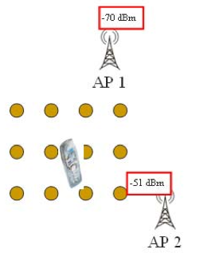
PreLoc Localization Step
User collects fingerprint V_{r} = [ ap₁, ap₂, …, ap_{m} ] and compares it to the Radiomap RM = {V₁, V₂, …,V_{n}}
Following alternatives for || V_{i} - V_{r} || computation:
Nearest Neighbor (NN)
K Nearest Neighbors (w_{i} = 1 / K) – convex combination of k locations.
Weighted K Nearest Neighbors (w_{i} = 1 / || V_{i} - V_{r} || )
RadioMap
?
V_{r} = [ -70, -51]
V₁ = [ -71, -82, (x₁,y₁)]
V₂ = [ -65, -80, (x₂,y₂)]
…
V_{N} = [ -73, -44, (x_{N},y_{N})]
User Current Location

Slide 24
Presentation Outline
Introduction
Problem Formulation
The PreLoc Framework
Partitioning Step
Selection Step
Localization Step
Experimental Evaluation
Other Indoor Work

Slide 25
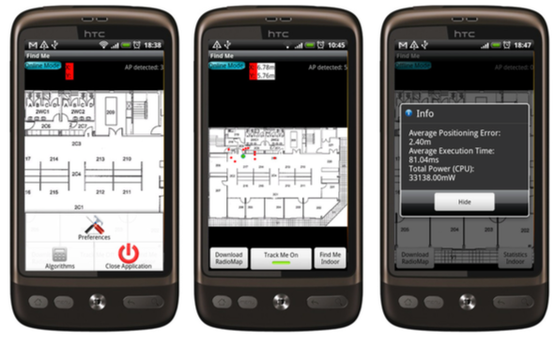
Datasets & Scenario
CSUCY Dataset
8,900 m² CS building with 4 floors (2,224 m² / floor)
120 Wi-Fi Access Points (CS, adhoc and neighboring)
|RM|=45,000 fingerprints on 2,900 locations.
Optimized RM size is 2.6MB (initial much larger).
Scenario: realistic user routes inside the building.
The localization requests are 5 meters apart
We repeat the requests 15-30 times (i.e., a user moves 50-150 meters inside the building).
Platform: Airplace
(IEEE MDM’12) - open source
Notes:
Initial fingerprints were averaged (normalized) at a 2x2m cell granularity.

Slide 26
Evaluation Metrics
Algorithms
Client Side Approach (CSA) b: building f: floor
PreLoc (PGS, IDS, RS)
Server Side Approach (SSA)
Metrics
Point Accuracy (A_{r}): L₂ distance between the estimated (λ^{u}) and the actual (l^{u}) location of u (in SSA). i.e., ||λ^{u} - l^{u}||
CPU Time (T_{r}): processing time used on u’s device for localizing given request r

Slide 27
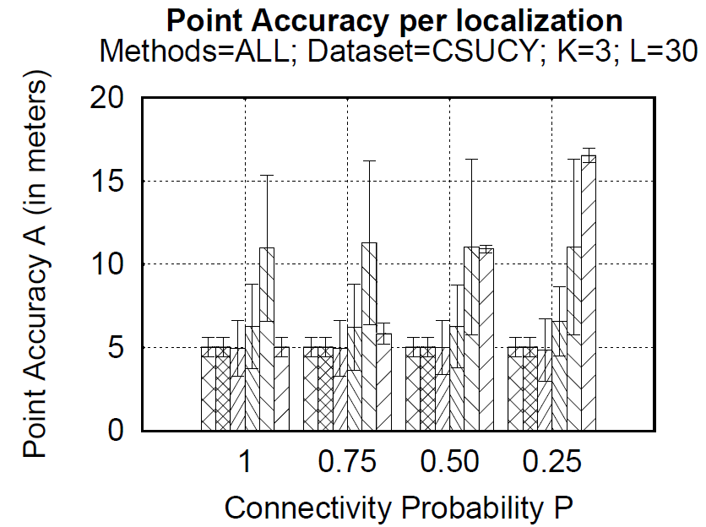
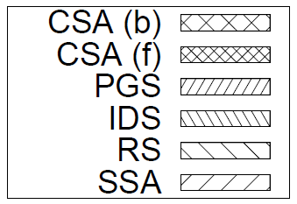
Techniques: Localization Accuracy (A)
Remarks
CSA: good accuracy (as RM is already local) – 5 meters (Airplace)
SSA accuracy severely affected by failures – 17 meters for P=0.25.
PreLoc (PGS, IDS) sometimes better accuracy than CSA!
PreLoc (RS) has high standard deviation due to randomness

Slide 28
Techniques: CPU Time (T)
(BFR Partitions)
Remarks
CSA(b): worse time 1911ms (needs to compare V_{r} vs. complete RM)
CSA(f): still bad time 520ms (graph is log-scale!)
SSA best CPU time 2.6ms but is not accurate under failures P<1
PreLoc (PGS, IDS) 274, 230ms milliseconds for execution!!

Slide 29
Presentation Outline
Introduction
Problem Formulation
The PreLoc Framework
Partitioning Step
Selection Step
Localization Step
Experimental Evaluation
Other Indoor Work

Slide 30
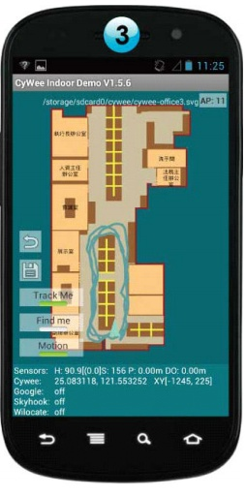
Location Accuracy
References
[Airplace] "The Airplace Indoor Positioning Platform for Android Smartphones", C. Laoudias et. al., Best Demo Award at IEEE MDM'12. (Open Source!)
[HybridCywee] "Indoor Geolocation on Multi-Sensor Smartphones", C.-L. Li, C. Laoudias, G. Larkou, Y.-K. Tsai, D. Zeinalipour-Yazti and C. G. Panayiotou, in ACM Mobisys'13. Video at: http://youtu.be/DyvQLSuI00I
[UcyCywee] IPSN’14 Indoor Localization Competition (Microsoft Research), Berlin, Germany, April 13-14, 2014. 2nd Position with 1.96m! http://youtu.be/gQBSRw6qGn4
D. Lymberopoulos, J. Liu, X. Yang, R. R. Choudhury, ..., C. Laoudias, D. Zeinalipour-Yazti, Y.-K. Tsai, and et. al., “A realistic evaluation and comparison of indoor location technologies: Experiences and lessons learned”, In IEEE/ACM IPSN 2015.
1st Position at EVARILOS Open Challenge, European Union (TU Berlin, Germany), 2014.
Cywee / Airplace

Slide 31
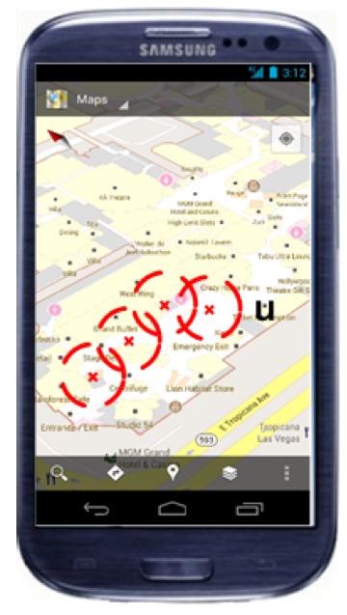
User Privacy
I can see these Reference Points, where am I?
...
(x,y)!
IIN Service
User u
Towards planet-scale localization on smartphones with a partial radiomap", A. Konstantinidis, G. Chatzimilioudis, C. Laoudias, S. Nicolaou and D. Zeinalipour-Yazti. In ACM HotPlanet'12, in conjunction with ACM MobiSys '12, ACM, Pages: 9--14, 2012.
Privacy-Preserving Indoor Localization on Smartphones, Andreas Konstantinidis, Paschalis Mpeis, Demetrios Zeinalipour-Yazti and Yannis Theodoridis, in IEEE TKDE’15.

Slide 32
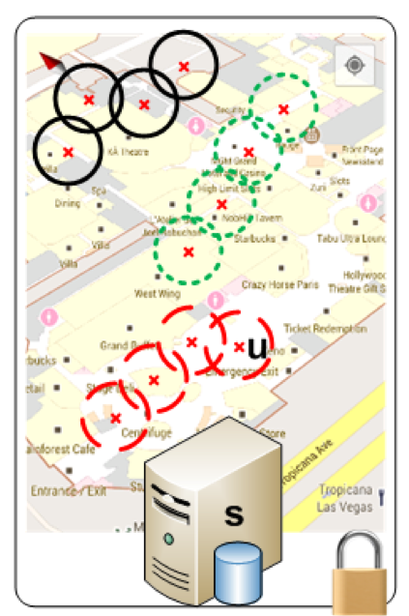
User Privacy
Bloom Filter (u's APs)
WiFi
Set Membership Queries
WiFi
...
IIN Service
K=3 Positions
User u
WiFi

Slide 33
Prefetching Indoor Navigation Structures in Anyplace *
Thanks! Questions?
Demetris Zeinalipour
Assistant Professor
(Data Management Systems Laboratory)
Department of Computer Science
University of Cyprus
http://www.cs.ucy.ac.cy/~dzeina/
2nd Cyprus Workshop on Computing: Scientific Applications of Computing
October 27th, 2015, European University Cyprus, Nicosia, Cyprus

