Slide 1
Towards Robust Methods for Indoor Localization using Interval Data
N. Ramdani, D. Zeinalipour-Yazti, M. Karamousadakis & A. Panayides
ALIAS @ IEEE MDM2019, Hong Kong, June 10th, 2019.
This project has received funding from the European Union’s Horizon 2020 research and innovation programme under the Marie Sklodowska-Curie grant agreement No 823887

Slide 2
Motivation and Background

Slide 3
Indoor Localization
People spend 80-90% of their time indoor. (USA Environmental Protection Agency 2011).
>85% of data and 70% of voice traffic originates from within buildings. (Nokia 2012).
Current trend are Internet-based Indoor Navigation (IIN) services, based on measurements collected by smart and Internet of Thing (IoT) enabled devices.

Slide 4
Internet of Things data
Large variety of technologies & methods
Diverse quality performance
Noisy WiFi RSS => Low accuracy & robustness
State-of-the-art solutions for improving consistency, and smoothing estimates:
averaged signals
advanced probabilistic models
hybrid methods, sensor fusion
This talk investiguates bounded-error estimation.

Slide 5
Bounded-error estimation

Slide 6
Estimation
Classical estimation is probabilistic

Slide 7
Bounded-error estimation
Unknown-but-bounded-error framework
Set Membership Algorithm

Slide 8
Interval analysis & Constraint satisfaction problems.

Slide 9
Interval Arithmetic
(Dwyer,51) (Warmus,56) (Sunaga,58) (Moore,59), (Moore, 66), (Jaulin, et al. 01)

Slide 10
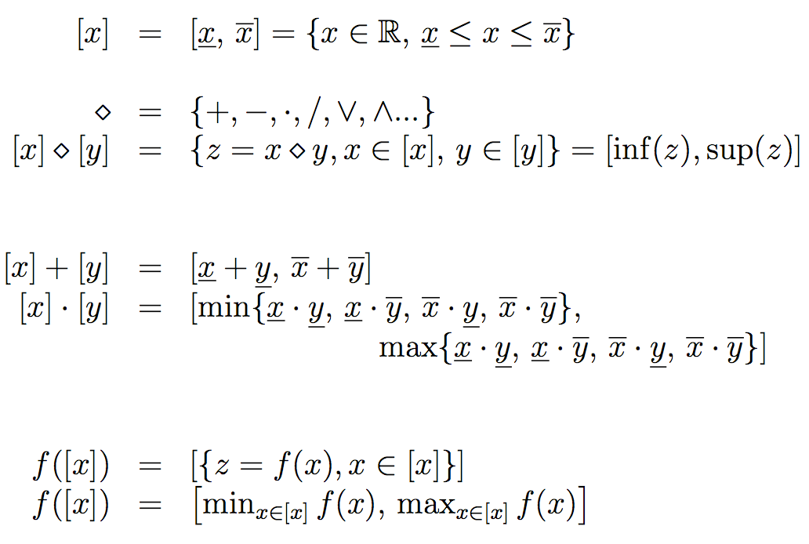
Interval Arithmetic

Slide 11
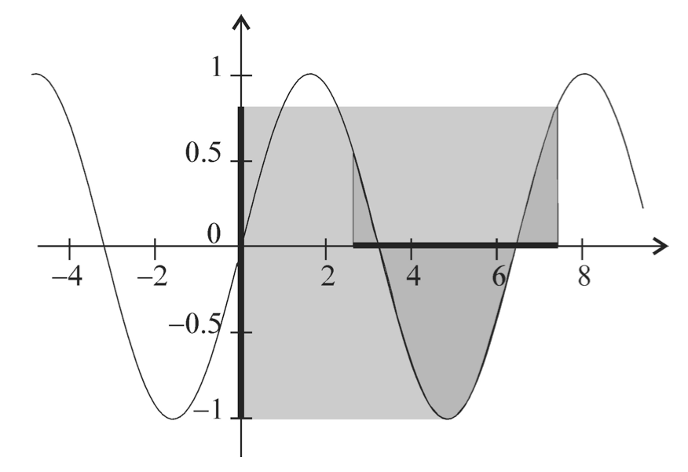
Interval Arithmetic
y
y = sin(x)
[y]
x
[x]

Slide 12
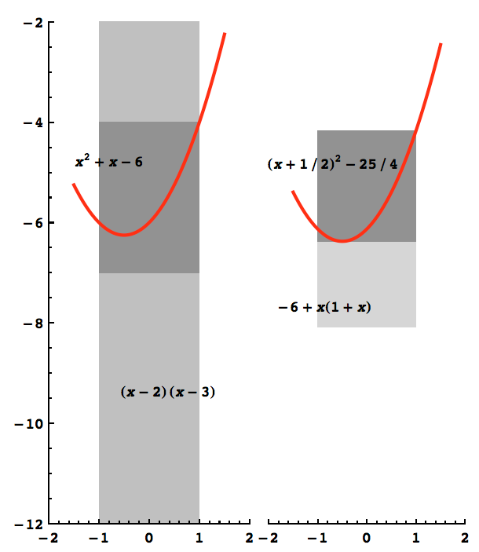
Interval Arithmetic
(x-2)(x+3)

Slide 13
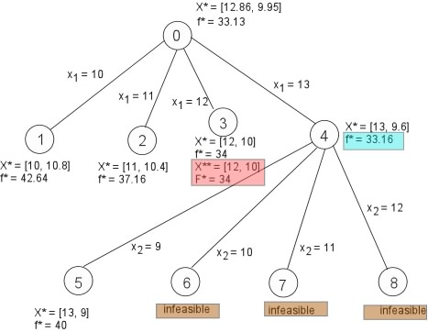
Set Inversion
Set Inversion via Interval Analysis SIVIA (Jaulin et al., 93)
Inclusion test. Branch-&-Prune. Branch-&-Bound

Slide 14
Constraint Satisfaction Problems
F. Rossi, et al. (Eds.), Handbook of Constraint Programming, Elsevier, 2006.
L. Jaulin, et al., Applied Interval Analysis, Springer-Verlag, 2001

Slide 15
Numerical Constraint Satisfaction Problems
Complexity. Solving numerical CSP is in theory NP-hard. Actual time complexity is generally tractable: successful applications in
operation research, scheduling and planning, vehicle routing, component configuration, networks, and bioinformatics.
Interval & CSP solving toolboxes
IBEX. (ibex-lib.org) (Chabert & Jaulin, 2009) C++ library for constraint processing over real numbers. …

Slide 16
Bounded-error estimation in presence of data outliers

Slide 17
Set-membership Estimation with outliers
q-Relaxed intersection

Slide 18
Algorithm for q-Relaxed intersection (Jaulin, 2009)

Slide 19
Infrastructure-Based Localisation Techniques with Interval Data

Slide 20
Robust Localization
Example #1. Robot localisation via ToF-based Multilateration
Can measure the distance to a beacon
ToF. Time of Flight
Bounded-error framework

Slide 21
Robust Localization
TOF
1 beacon
Figures obtained using PYIBEX tool. benensta.github.io/pyIbex

Slide 22
Robust Localization
TOF
2 beacons
Figures obtained using PYIBEX tool. benensta.github.io/pyIbex

Slide 23
Robust Localization
TOF
4 beacons
Figures obtained using PYIBEX tool. benensta.github.io/pyIbex

Slide 24
Robust Localization
TOF
4 beacons
1 corrupted
Figures obtained using PYIBEX tool. benensta.github.io/pyIbex

Slide 25
Robust Localization
TOF
1-relaxed
Intersection
Figures obtained using PYIBEX tool. benensta.github.io/pyIbex

Slide 26
Robust Localization
TOF
1-relaxed
Intersection
Spurious datum identified
Figures obtained using PYIBEX tool. benensta.github.io/pyIbex

Slide 27
Robust Localization
Example #2. Robot localisation via TDoA Multilateration
Can measure the distance difference to beacons
TDoA. Time Difference of Arrival
Bounded-error framework

Slide 28
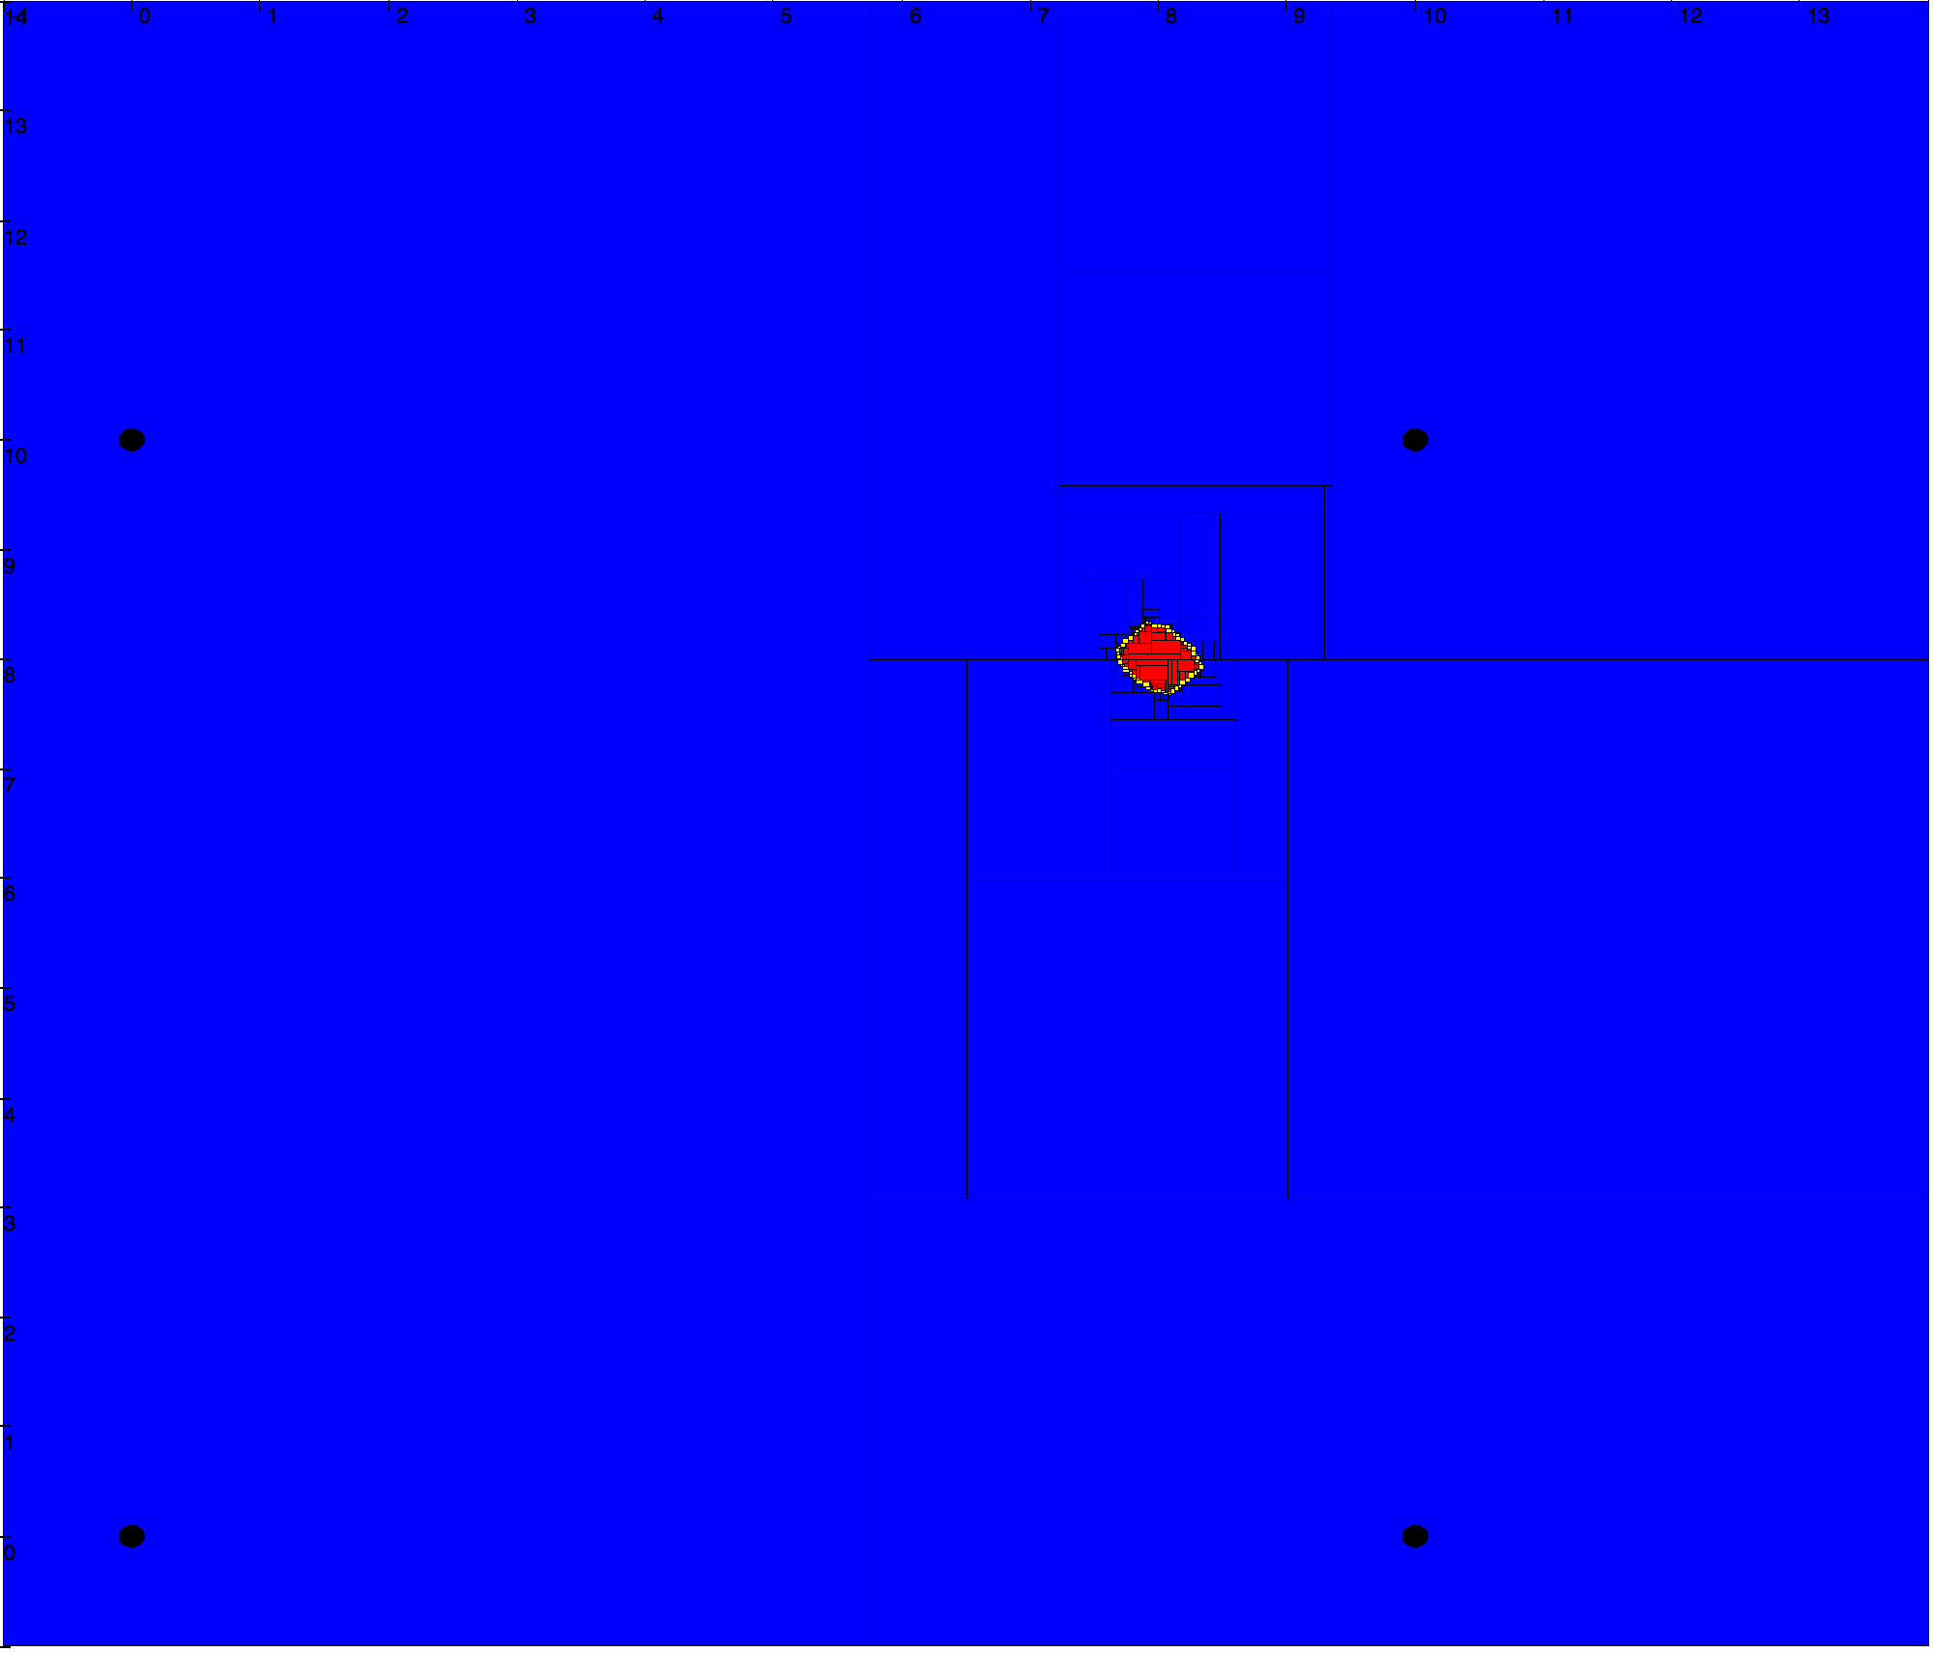
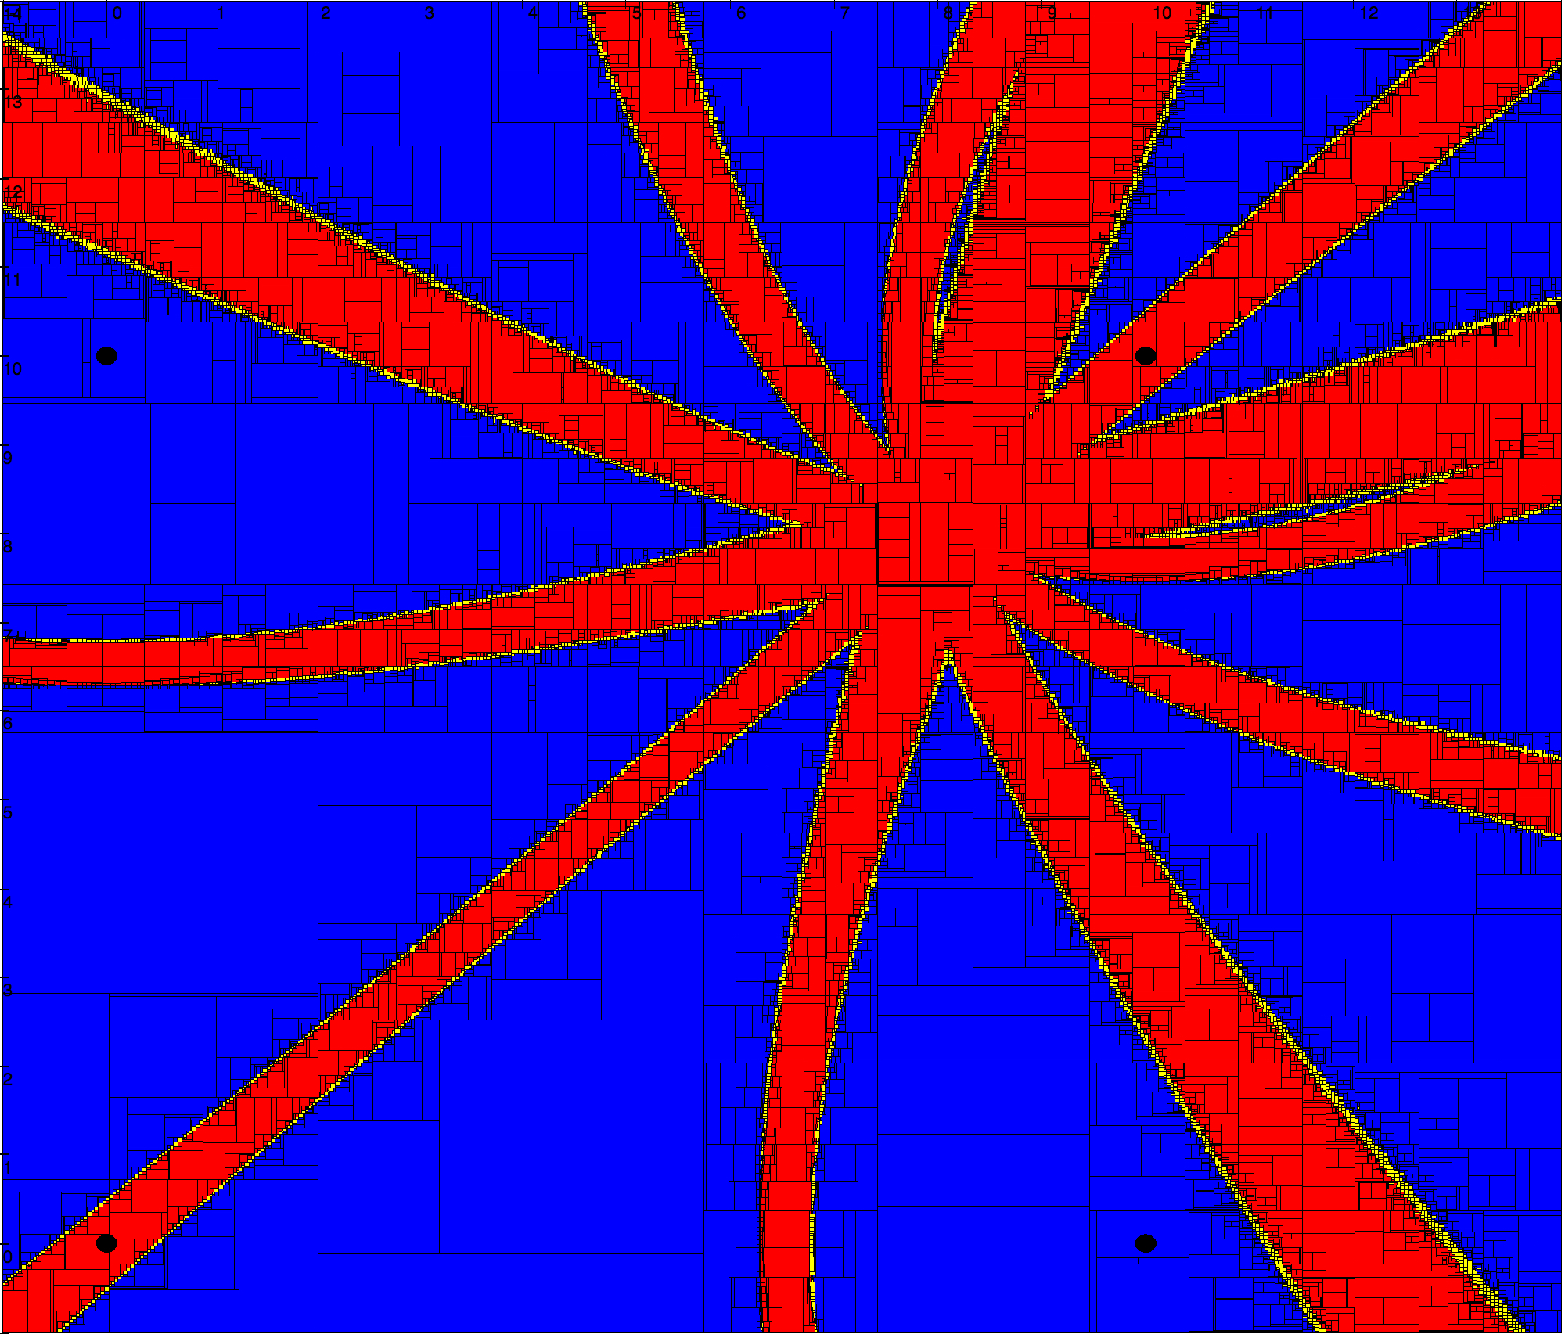
Robust Localization
TDoA
4 beacons
no corruption
Figures obtained using PYIBEX tool. benensta.github.io/pyIbex

Slide 29
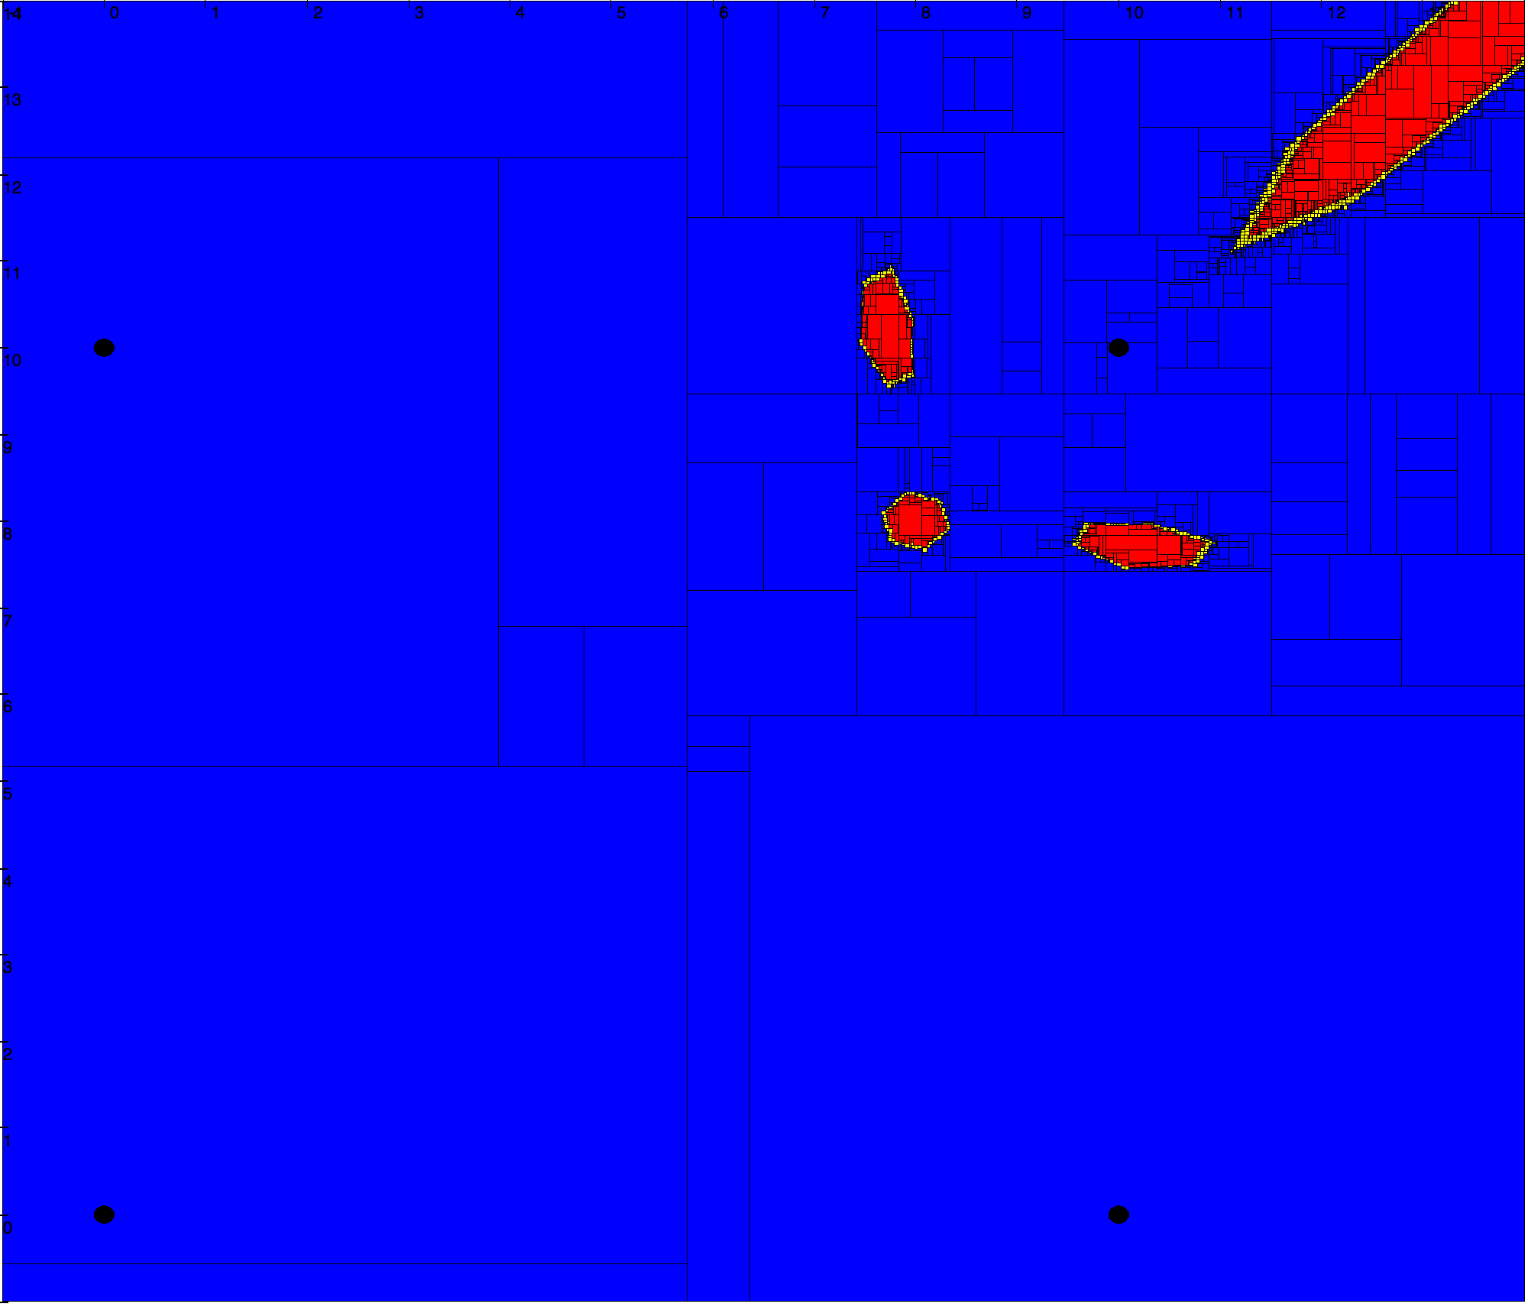
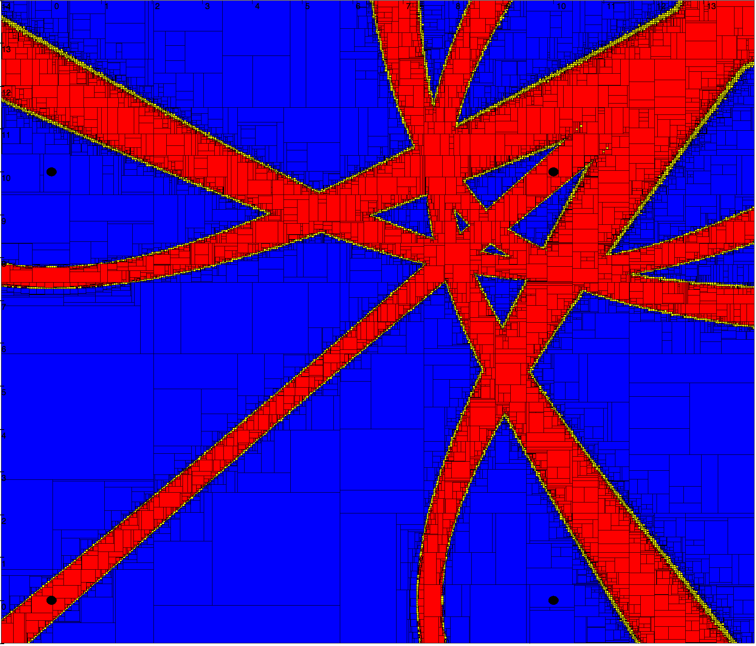
Robust Localization
TDoA
4 beacons
1 faulty synchroniz.
3-relaxed intersection
Figures obtained using PYIBEX tool. benensta.github.io/pyIbex

Slide 30
Infrastructure-Free Localization Techniques with Interval Data

Slide 31
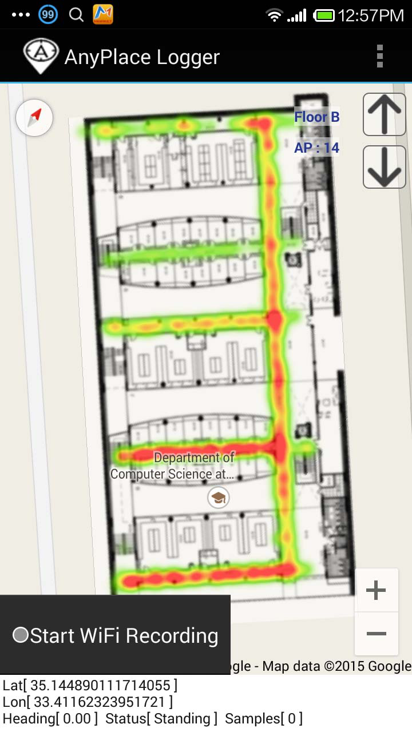
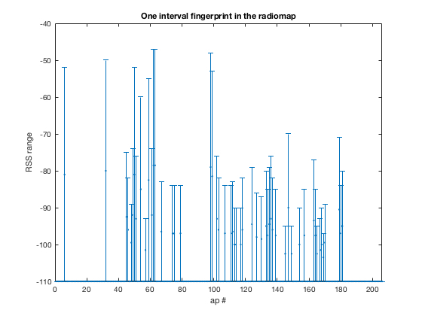
Interval Fingerprinting
Interval Radio-Map.

Slide 32
WKNN & Fingerprints
Fingerprints in Radio Map
Corresponding locations
v2
y
1
3NN
3
2
query
v1
x

Slide 33
WKNN & Interval Fingerprints
Interval Fingerprints in Radio Map
Corresponding locations
v2
y
1
3NN
2
query
3
v1
x

Slide 34
Hausdorff distance
Explicit formulas for computing the Hausdorff distance using distances on bounds (Jahn 1990).
[b]
[a]

Slide 35
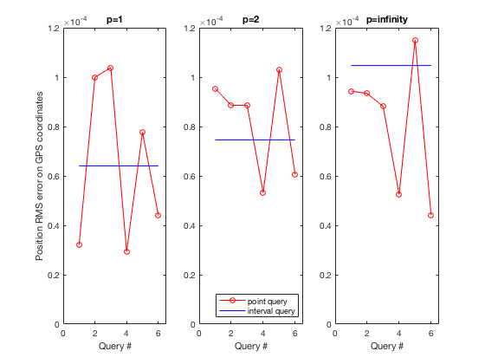
Experimental Evaluation
RMS error on GPS coordinates
Euclidian
Manhattan
Chebyshev

Slide 36
Concluding remarks

Slide 37
Use of Interval Data…
for indoor localization, is effective.
with infrastructure-based techniques, provides uncertainty intervals for reconstructed positions.
with infrastructure-less techniques, interval fingerprinting provides smoother and more consistent localization estimates.
Future work will consider further experimental evaluation, and implementation into the Anyplace software.

Slide 38
Thank you!

