Slide 1
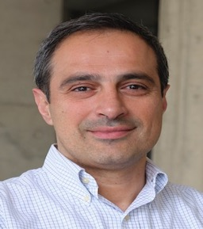
Sustainable Computing and the Renewable Self-Consumption Problem
Demetris Zeinalipour
Professor
Department of Computer Science
University of Cyprus
https://www.cs.ucy.ac.cy/~dzeina/
dzeina@ucy.ac.cy
The 12th IEEE International Conference on Cloud Engineering (IEEE IC2E),
Thursday, September 26, 2024, Aliathon Resort Paphos, Cyprus

Slide 2
Objective
Provide a gentle overview of Climate Change, CO2 Emissions & Sustainable Computing.
Sustainable Computing is concerned with the application of computer science principles, methods, and tools to problems of environmental and societal sustainability.
Highlight the importance of the Renewable Self Consumption problem:
Refers to the process of intelligently consuming energy at the time it is available.
IEEE ICDE’21 (IMCF/EP/GP)
IEEE Internet Computing 2022 (Landscape / Vision)
ACM Trans. on Internet of Things 2022 (IMCF+)
IEEE Trans. On Sustainable Computing 2024 (GreenCap+)
IEEE ICDE’24 (EcoCharge)
Smarthome & EV Domains

Slide 3
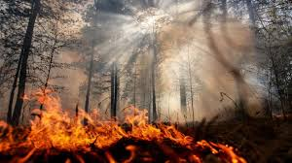
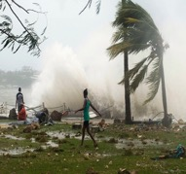
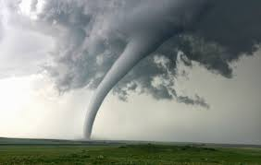
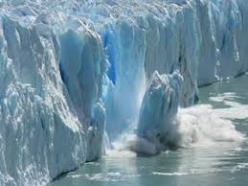
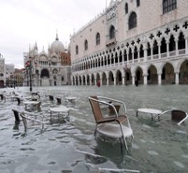
Global Warming & Climate Change
B) Climate Change: new weather patterns that remain for an extended time having an impact on human health and the environment.
brings
A) Global Warming: human-caused increase in global surface temperatures.
Rising Temperatures: a) dryness, wildfires; b) tornadoes, hurricanes, earthquakes, tsunamis; c) ice-melting, sea-level risings, floodings, …
Antoine Amarilli, Christophe Claramunt, Demetrios Zeinalipour-Yazti: Climate change and computing: facts, perspectives and an open discussion. ACM DEBS 2022: 6

Slide 4
CO2 - Global Warming Culprit
Why do we have Global Warming?
Current Human activity (burning of fossil fuels coal, oil, gas) generates Carbon Dioxide (CO₂), the predominant Greenhouse Gas!
CO₂ traps Solar Radiation inside the atmosphere that eventually leads to Global Warming.
Oceans clean only ¼ of CO₂ pollution while trees another ¼.
US EPA: https://www.epa.gov/ghgemissions/global-greenhouse-gas-emissions-data
(1% Cloud, 1% Net) – next slide
10.5% ICE Cars
2.5% Aviation
Notes:
The graph represents Global greenhouse gas emissions by economic sector
ICE: Internal Combustion Engine

Slide 5
CO2 by ΙCT Sector
ICT contributes ~4% (streaming, cloud) of world CO₂ emissions and this will increase to 8% by 2025 (AI, blockchain)!
By 2040, that number could reach 14% percent—almost as much carbon as that emitted by air, land, and sea transport combined.
https://spectrum.ieee.org/green-software
55% use
45% manufacturing
https://www.dw.com/

Slide 6
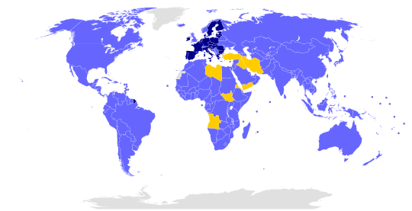
The Paris Agreement
The Paris Agreement within the United Nations Framework Convention on Climate Change (UNFCCC), dealing with greenhouse-gas-emissions mitigation (reduction), adaptation, and finance, signed in New York City, on April 22, 2016.
Targets:
- CO2 neutral by 2050!
- Temperature increase below 2 Celsius (since pre-industrialized period 1880)
194
Wikipedia

Slide 7
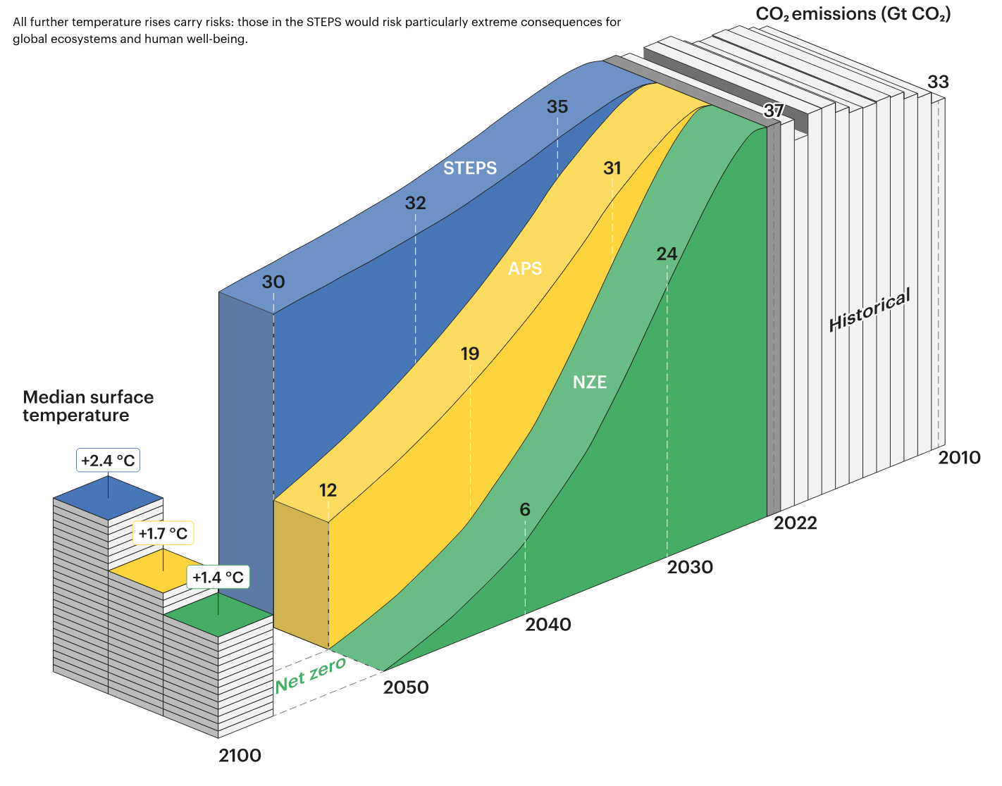
Global Emissions RoadMap 2100
- Announced Pledges Scenario (APS): announced ambitions and targets to achieve net zero emissions by 2050.
- Stated Policies Scenario (STEPS): conservative APS, by not taking for granted that governments will reach all announced goals
- Net Zero Emissions by 2050 Scenario (NZE): is a normative scenario that shows a pathway for the global energy sector to achieve net zero CO2 emissions by 2050.

Slide 8
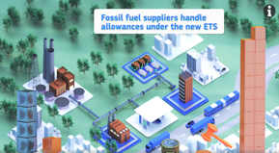
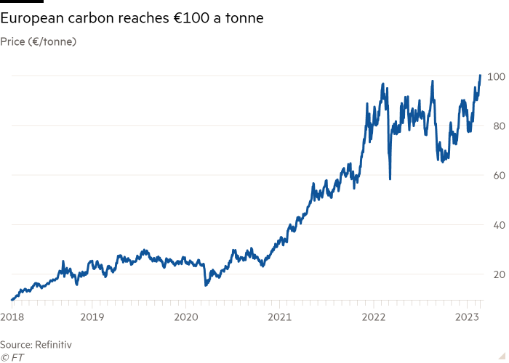
EU Plans for Achieving NZE
EU Emission Trading System ETS: tool to achieve CO2 goals by Green Deal (‘20) on the "cap-and-trade" principle:
11,000 power stations and industrial plants across 30 countries (40% EUs emissions) have CO2 quotas
Surplus can be traded => penalties for polluters.
Cap per industry (aviation, fuel combustion, manufacturing).
EU ETS2 to cover Buildings/Transport.
Datacenters currently not in scope of ETS (only as part of UK ETS 2021). EU Energy Efficiency Directive (EEED) 2023 (reporting, waste heat, Power usage effectiveness (PUE) guidelines) - http://tiny.cc/474nzz
Carbon Tax* (by EU Central Bank):
2020: 25.15 Euros / ton
2024: 100 Euros / ton
2030: 140 Euros / ton
* https://www.ecb.europa.eu/press/economic-bulletin/focus/2024/html/ecb.ebbox202401_04~92ad3c032a.en.html#:~:text=This%20assumption%20is%20based%20on,targets%20(IEA%2C%202022).
Notes:
30 = EU member states plus Iceland, Liechtenstein, and Norway
PUE Power usage effectiveness
https://blog.se.com/datacenter/2024/02/07/the-eu-energy-efficiency-directive-and-its-impact-on-cios-data-centre-owners-and-operators/#:~:text=The%20recast%20in%202022%20brings,%E2%80%9Cdata%20centre%E2%80%9D%2048%20times.
https://chatgpt.com/c/66ed3950-84f8-800c-ac91-a451740f24a8
https://www.eea.europa.eu/en/analysis/maps-and-charts/emissions-trading-viewer-1-dashboards

Slide 9
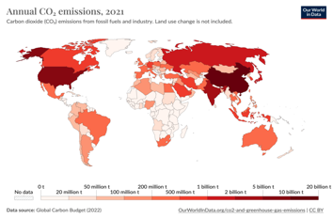
Energy & Pollution across Countries
CO2 pollution varies across the globe.
Needs to be taken into account when presenting research findings.
Certain places already have optimal renewable conditions (Norway 98% hydro + storage dams), so presented ideas not appliable in these cases.
"A Sustainable Energy Management Framework for Smart Homes”, S. Constantinou, C. Costa, A. Konstantinidis, P. Chrysanthis and D. Zeinalipour-Yazti in IEEE Transactions on Sustainable Computing, no. 01, pp. 1-12, 5555. doi: 10.1109/TSUSC.2024.3396381, 2024
Notes:
https://en.wikipedia.org/wiki/List_of_countries_by_carbon_dioxide_emissions
U.S. Energy Information Admin., https://tinyurl.com/3bzspb9c
European Environment Agency, https://tinyurl.com/46vh8tt2
International Energy Agency https://tinyurl.com/3w48mm8v

Slide 10
Green (Cloud) Computing
Meta: 100% renewable energy through its strategy of adding renewables to local power grids. Meta also says it will restore more water than it consumes globally in 2030.
Google: Google has been purchasing 100% renewable electricity to match its annual consumption since 2017.
Microsoft: Commitment to use 100% renewable energy to power its data centres by 2025.
AWS: moving on-premises workloads to AWS can lower customers’ workload carbon footprints by nearly 80% and up to 96% once AWS is powered with 100% renewable energy.
https://datacentremagazine.com/top10/top-10-sustainable-data-centre-companies
But Energy Consumption will continue to rise!
2020: Data centres (~200 TWh) and data transmission networks (~250 TWh)
Notes:
https://www.iea.org/commentaries/the-carbon-footprint-of-streaming-video-fact-checking-the-headlines

Slide 11
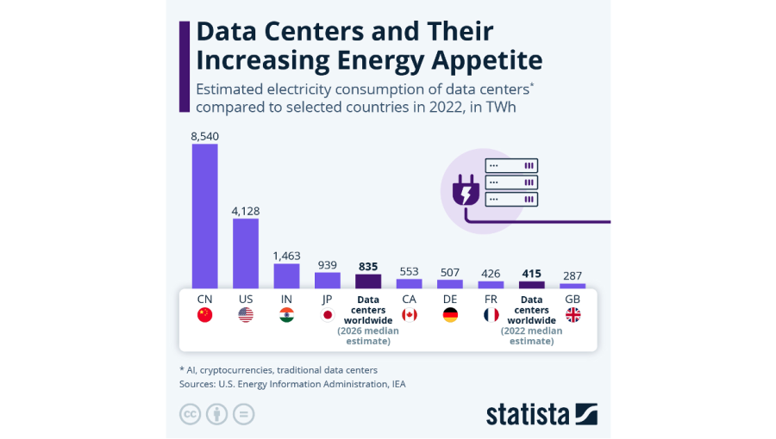
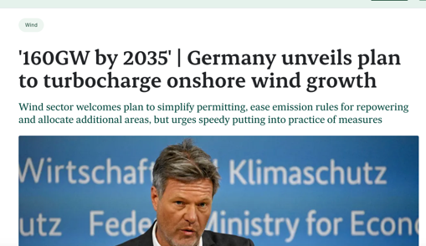
Cloud Computing Energy Demand
2020: 200 TWh
2022: 415 TWh
…
2025: 835 TWh
…
2035: ~420.48 TWh
https://chatgpt.com/share/66f3c525-d7bc-800c-9ded-2e97acb92558
Notes:
https://www.iea.org/commentaries/the-carbon-footprint-of-streaming-video-fact-checking-the-headlines

Slide 12
Microsoft AI Energy Challenge
Notes:
https://www.ft.com/content/ddcb5ab6-965f-4034-96e1-7f668bad1801

Slide 13
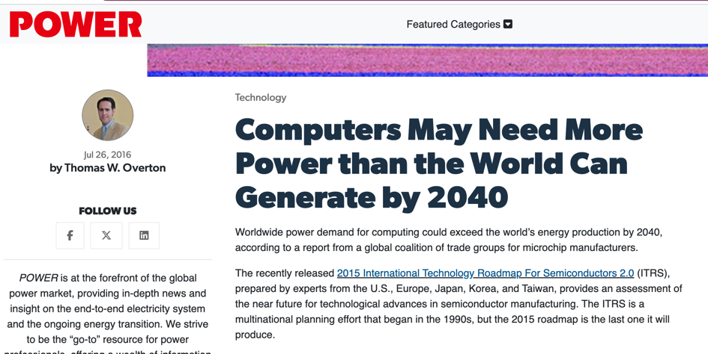
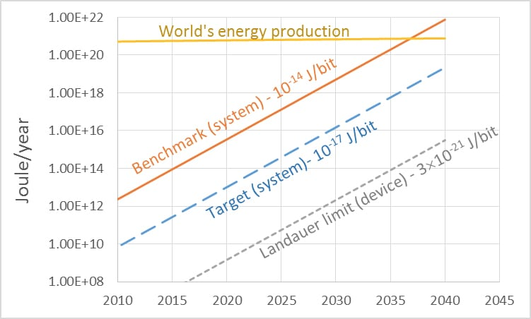
Forecast for Future Energy
2016: International Technology Roadmap for Semiconductors 2.0 (ITRS) based on Moore’s Law, Landauer's principle, emergence of 3D Chips, etc., documented that:
Landauer's principle is a physical principle pertaining to the lower theoretical limit of energy consumption of computation.
https://www.powermag.com/computers-may-need-more-power-than-the-world-can-generate-by-2040/
Notes:
Landauer's principle is a physical principle pertaining to the lower theoretical limit of energy consumption of computation. It holds that an irreversible change in information stored in a computer, such as merging two computational paths, dissipates a minimum amount of heat to its surroundings.^{[1]}
The principle was first proposed by Rolf Landauer in 1961.

Slide 14
Global Production RoadMap to 2050
Decarbonization
Solar and Wind the main sources of the Future Energy Supply

Slide 15
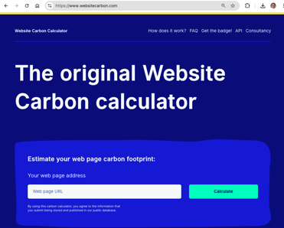
Cost of Streaming
How much gCO2e does a 1 hour Netflix stream produce?
Shift Project (French Think Tank): 3200 g CO2e
https://theshiftproject.org/en/home/
Netflix/IEA: Below 100g CO2e
https://about.netflix.com/en/news/the-true-climate-impact-of-streaming
Parcel delivered to your doorstep: ~500 g
10 km trip by car: ~1500 g
Measuring Carbon Footprint of Websites
https://www.websitecarbon.com/
Netflix.com: 0.20g CO2e
CSUCY: 1.02g CO2e
UCY: 1.94g CO2e
CNN.com: 2.18g CO2e
1g = 2-3 human breaths = 10W LED 1 hour = Boiling 1 teaspoon of water
Human Energy / year ~ 10000 kWh ~ 5 T CO2 (average) ~ 200 trees ~ round-trip with car around the earth
Notes:
Global Average per Person: The average global CO2 emissions per person are around 4 to 5 metric tons per year. This includes emissions from activities like driving, heating, electricity use, and even the production of goods and services consumed.
Developed Countries: In more industrialized countries like the United States, Canada, or Australia, the average can be much higher—typically around 15 to 20 metric tons per person per year due to higher energy consumption and lifestyle factors.
Developing Countries: In contrast, individuals in developing countries often have lower per capita emissions, ranging from 1 to 3 metric tons per year, due to lower levels of industrial activity and energy consumption.
ChatGPT said:
ChatGPT
5 metric tons (5,000 kg) of CO2 is a significant amount. To put it in perspective, here are a few relatable comparisons:
Driving a Car: A typical gasoline car emits about 120-150 grams of CO2 per kilometer. Driving 5 metric tons of CO2 would be equivalent to driving approximately 33,000 to 41,000 kilometers (about 20,500 to 25,500 miles), which is roughly the distance of a road trip around the entire Earth.
Electricity Consumption: Using around 5 metric tons of CO2 is roughly equivalent to the annual electricity usage of an average household in the United States. This depends on the energy mix (fossil fuels, renewables) but generally includes appliances, heating, and cooling.
Flights: A round-trip flight from New York to London emits about 1 metric ton of CO2 per passenger. So, 5 tons would be equivalent to taking 5 round-trip flights between these cities.
Tree Planting: It would take about 200 mature trees absorbing CO2 over one year to offset 5 metric tons of CO2. Trees absorb about 22 kg of CO2 annually, on average.
Heating a Home: 5 metric tons of CO2 is roughly equivalent to the emissions from heating an average house with natural gas for one year, depending on insulation and climate conditions.
These examples illustrate the scale of 5 tons of CO2 emissions in terms of everyday activities and environmental impact.

Slide 16
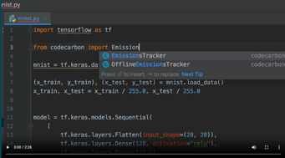
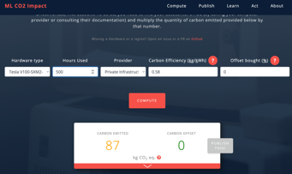
Green Software
We need to do more to make our software greener:
Now: Efficient Algorithms & Code, Energy Profilers, Optimization, …
Tackle Dark Data (60-85% of data!) Issues:
"Continuous Decaying of Telco Big Data with Data Postdiction", Constantinos Costa, Andreas Charalampous, Andreas Konstantinidis, Demetrios Zeinalipour-Yazti, Mohamed F. Mokbel, International Journal on Advances of Computer Science for Geographic Information Systems (GeoInformatica'19), Vol. 23, Iss. 4, pp. 25 pages, DOI: 10.1007/s10707-019-00364-z, 2019.
Make ML Software Greener:
Trimming training data is one of the major ways to make AI systems greener.
Simplify model architecture. This can be done by removing parameters, pruning the number of layers, and picking the best hyperparameters—external model controls—via a tuning strategy that uses the least number of iterations.
Employ transfer learning. Transfer learning reuses pretrained models to save on compute time and power.
Tools like CodeCarbon and ML CO₂ Impact can help estimate the energy usage and CO2 footprint of training
https://spectrum.ieee.org/green-software
Z. Xu, S. Ren and O. Rana, "Editorial," in IEEE Transactions on Sustainable Computing, vol. 9, no. 3, pp. 234-235, May-June 2024, doi: 10.1109/TSUSC.2023.3336230.

Slide 17
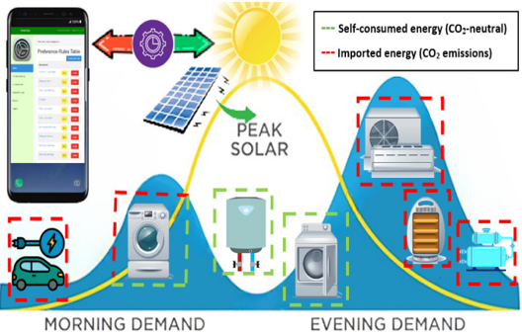
Renewable Self-Consumption
Renewable Self-Consumption is the act of using self-produced renewable energy at the time it is available.
Distributed Production setting of Prosumers (Producers + Consumers)
Why Self Consumption?
=> Minimize Import of (dirty) Energy from the Grid
=> Minimize CO2 Consumption
Problem:
- Alignment of Consumption with Production patterns…
How can we fit the operations of
devices under the solar production curve?

Slide 18
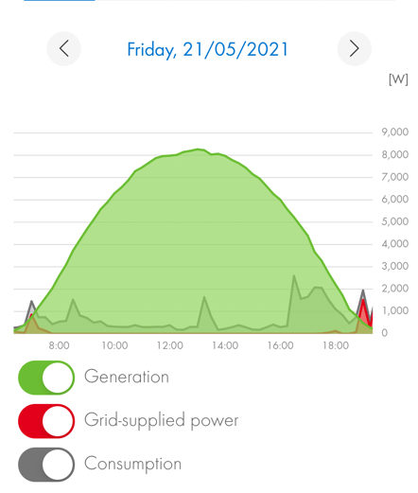
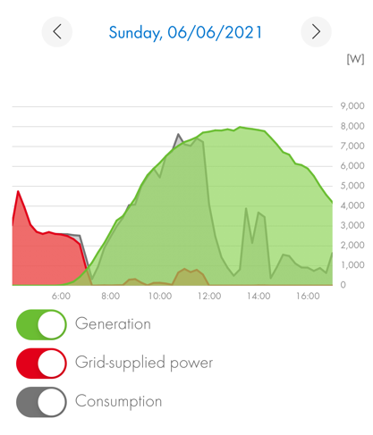
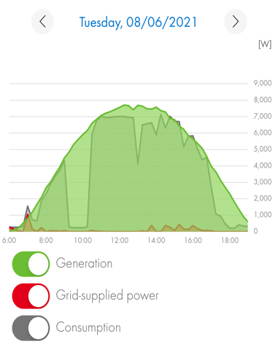
Self-Consumption Example
Alignment of Consumption with Production patterns.
Laborious task that calls for automation!
☹
☺
12%
49%
73%
[J28] "Green Planning Systems for Self-Consumption of Renewable Energy", Soteris Constantinou, Andreas Konstantinidis and Demetrios Zeinalipour-Yazti IEEE Internet Computing (IC '22), IEEE Computer Society, Volume , Pages: 7 pages, Los Alamitos, CA, USA, 2022.

Slide 19
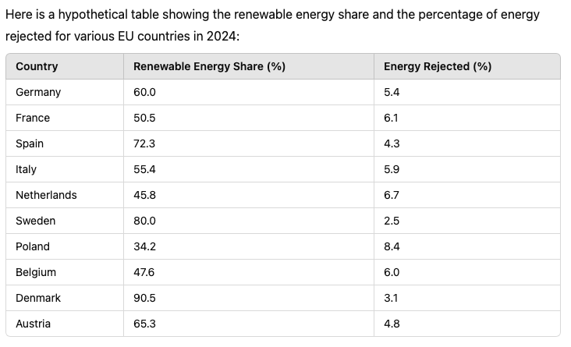
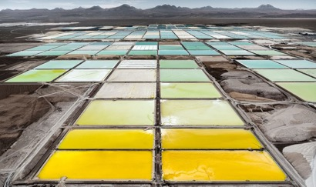
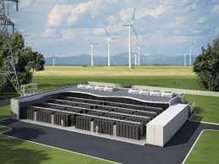
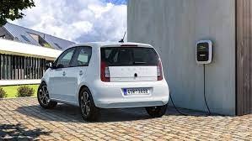
Bounds for Self-Consumption
Why not store in Stationary Batteries ?
Energy Storage leads to ~17% losses
AC/DC conversion and heat dissipation
Expensive / pollute the environment
Preferable to self-consume energy
=> Asks for intelligent control
Bounds for Self-Consumption
0% => Grid Connected System
~20% No Planning
~50% Battery System
~70% Optimal Self-Consumption
~90% Optimal SC + Battery
100% => Green Island System
Notes:
Here is a hypothetical table showing the renewable energy share and the percentage of energy rejected for various EU countries in 2024:
CountryRenewable Energy Share (%)Energy Rejected (%)Germany60.05.4France50.56.1Spain72.34.3Italy55.45.9Netherlands45.86.7Sweden80.02.5Poland34.28.4Belgium47.66.0Denmark90.53.1Austria65.34.8

Slide 20
Presentation Outline
Introduction to Climate Change and Sustainable Computing:
Mitigation, Adaptation, Finance and the Renewable Self-Consumption Problem
IEEE Internet Computing 2022
Renewable Self-Consumption in Smart-Homes
37th IEEE International Conference on Data Engineering (ICDE’21) EnergyPlanner (EP)
ACM Transactions on Internet of Things (TIOT’22) – GreenPlanner (GP)
IEEE Transactions on Sustainable Computing (TSUSC’24) - GreenCap
Renewable Self-Consumption with Electric Vehicles
40th IEEE International Conference on Data Engineering (ICDE’24) - EcoCharge
25th IEEE International Conference on Mobile Data Management (MDM'24)
Conclusions and Future work

Slide 21
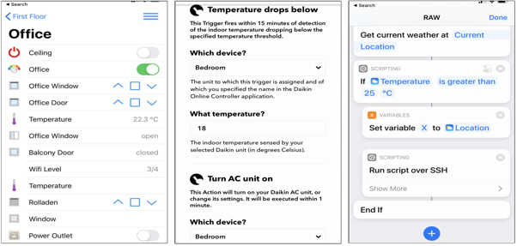
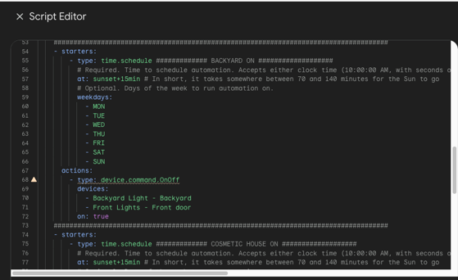
Rule Automation Workflows (RAW)
Smart-Homes allow the expression of Rule Automation Workflows (RAW)
Span from simple predicate statements to procedural workflows capturing a smart actuation pipeline.
None of these supports the expression of long-term objectives (e.g., energy or emissions for a whole year)
Notes:
Many IoT devices enable the execution of Rule Automation Workflows, which span from simple predicate statements to procedural workflows
capturing a smart actuation pipeline in tools like IFTTT, Apilio, or Apple Automation.
The Rule Automation Workflows aim to meet the convenience level of users under specific conditions.

Slide 22
Case Scenario
Smart-Home:
Family invested in PV with net metering
Yearly energy budget ~ 9000 kWh
Aims for greener lifestyle through adaptation:
1ο Celsius A/C = 7% energy conservation.
Smart Lights: 20-40% energy conservation
Occupancy Sensors: 20-60%
Currently, relying on manual guess-work & manual planning
Cumbersome and error-prone ☹
How to intelligently utilize RAW pipelines to meet
an annual energy consumption target?
Notes:
Energy savings in a data center can be substantial, and there are several strategies that can be implemented to reduce energy consumption. Here are some key areas where energy savings are typically achieved, along with their approximate impact:
1. Efficient Cooling Systems:
Savings: 20% to 40%
Details: Data centers often consume a large amount of energy for cooling. Strategies like hot aisle/cold aisle containment, using free cooling (utilizing outside air), liquid cooling, and optimizing airflow can significantly reduce cooling costs.
2. Upgrading to Energy-Efficient Hardware:
Savings: 10% to 30%
Details: Upgrading servers, storage, and network equipment to more energy-efficient models (e.g., Energy Star-rated servers) reduces the power draw. Newer hardware also often has better power management features, such as dynamic scaling of power use based on load.
3. Server Virtualization and Consolidation:
Savings: 10% to 50% (depending on the extent of virtualization)
Details: Virtualization allows multiple virtual machines to run on fewer physical servers, reducing the number of physical servers required. This leads to lower power and cooling demands.
4. Optimizing Power Usage Effectiveness (PUE):
Savings: Variable, depending on baseline PUE
Details: PUE is the ratio of total energy used by the data center to the energy used by IT equipment. Improving PUE from a typical value of 2.0 (50% of power used for cooling and other infrastructure) to 1.5 or below (more efficient use of power) can yield significant energy savings.
5. Implementing Renewable Energy Sources:
Savings: 10% to 100% (in terms of carbon footprint reduction)
Details: Using renewable energy sources like solar or wind power can offset the energy costs significantly. Some data centers operate on 100% renewable energy, achieving zero net energy consumption from the grid.
6. Advanced Power Management Techniques:
Savings: 5% to 15%
Details: Techniques like server power capping and automatic shutdown of idle servers can save energy. Smart power distribution units (PDUs) can also optimize power delivery and reduce waste.
7. Lighting Optimization:
Savings: 5% to 10%
Details: Similar to homes, efficient lighting solutions such as LEDs, motion sensors, and intelligent lighting control systems can reduce lighting energy use in the data center.
Overall Potential Savings:
Combining these strategies, a data center can achieve overall energy savings of 20% to 50% or more, depending on the baseline efficiency and specific improvements implemented.
Energy savings in data centers not only reduce operational costs but also have a significant environmental impact due to the typically high energy demands of these facilities.

Slide 23
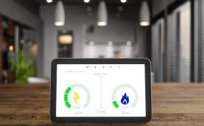
Case Scenario
Smart-Dorms:
SAVES project: inter-dormitory energy-saving competition
European Commission Intelligent Energy (IEE) programme
Aimed to instill energy-saving habits
Electricity savings target: ~ 8%
UCY students: ~ 4,44% savings
Unable to reach energy goals through
smart monitors. Requires Intelligent Control!
Notes:
Even though students applied common sense and perseverance in achieving the energy
reduction target, BUT there was a ..

Slide 24
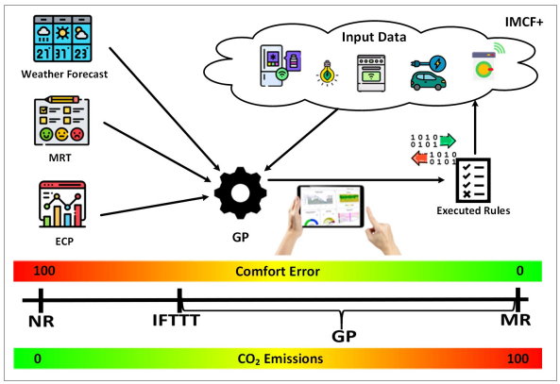
Smart-home Energy Planning Strategies
No-Rule (NR) – does nothing
Energy ☺, Comfort ☹
If-This-Then-That (IFTTT)
arbitrary rule executions
Energy 😐, Comfort 😐
Meta-Rule (MR)
All comfort rules executed
Energy ☹, Comfort ☺
EnergyPlanner (EP) [ICDE21]
Hill Climbing (restart when no improve.)
Energy 😐, Comfort ☺
EP/GP

Slide 25
The IoT Meta-Control Firewall (IMCF) – ICDE21
Acts like a network firewall that filters certain IoT comfort rule executions to meet the "long-term energy goal”.
Input data:
IoT data
Weather Forecast data
Meta-Rule-Table (MRT):
Vector of RAW rules
Energy Consumption Profile (ECP)
Amortization Plan (AP) algorithm:
Calculates the maximum energy budget constraint.
Energy Plan (EP) algorithm:
Executed in fixed time slots for generating an energy plan solution.
Notes:
The IMCF utilizes IoT data and adopts the Amortization and the Energy Plan algorithms to meet the convenience level of users under specific conditions, and at the same time meet some long-term target also configured by users.
It internally deploys an Artificial intelligent algorithm that exploits domain-specific operators in order to optimize the convenience and energy consumption objectives.
Our framework filters the rules of users in a way that these do not collide with the configured long-term objectives (like an actual network firewall).

Slide 26
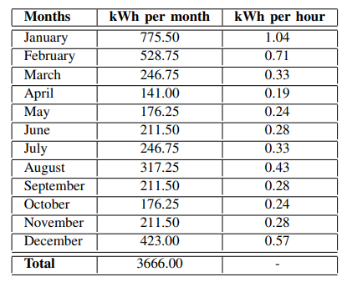
Amortization Plan Algorithm
Calculates the energy budget constraint → subject to a monthly residence Energy Consumption Profile
Linear Amortization Formula (LAF)
Balloon Linear Amortization Formula (BLAF)
Algorithm from Finance (Loans) where a
user stores a balloon of energy for more
energy demanding months
ECP-based Amortization Formula (EAF)
Energy Consumption Profile (ECP)
π Balloon, {λ,λ’} Period
TE/t total energy/time
Notes:
BLAF Example: a user desires to save π = 30% of the total energy consumption TE = 3666 kWh, for λ = 7 months (e.g., for April to October) that the consumption is lower than the remaining λ’ = 5 months (i.e., November to March) then = (305.5 x 7) x 0.3 = 641.55 kWh. Therefore, the energy consumption for seven months, between April to October, will be Ep = 397.15 kWh and for five months, between November to March will be Ep = 213.85 kWh. The corresponding hourly energy budget constraint of this formula will be Eh = 397.15/(31 ⇥ 24) = 0.53 kWh and Eh = 213.85/(31 ⇥ 24) = 0.28 kWh, accordingly
EAF Example: In our example, if the user desires to save π = 30% of the total energy consumption T E = 3666 kWh, for = 7 months (e.g., for April to October) that the consumption is lower than the remaining 0 λ = 5 months (i.e., November to March) then λ= (305.5 x 7) x 0.3 = 641.55 kWh. Therefore, the energy consumption for seven months, between April to October, will be Ep = 397.15 and for five months, between November to March will be Ep = 213.85 kW. The corresponding hourly energy budget constraint of this formula will be Eh = 397.15/(31 ⇥ 24) = 0.53 kWh and Eh = 213.85/(31 ⇥ 24) = 0.28 kWh, accordingly

Slide 27
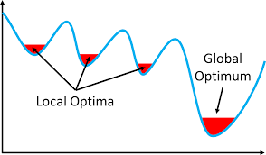
EnergyPlanner (EP) Algorithm
Energy Planner: A “First-choice” Hill Climbing algorithm (i.e., probabilistic local search)
+ No learning data
+ Efficient
Meta-rules 1 and 4 will be triggered
Generates the first solution s*
Random
initialization process
of rules to execute
Meta-rules 2 and 3 will be ignored
A solution s is considered better than prior solution s* if:
(F_{E}(s) <= E_{p}) &&
(F_{CE}(s) < F_{CE}(s*))
F_{E} : Energy Plan
E_{p} : Energy Budget
F_{CE}: Comfort Error
Optimization
New generated
solution s →compared
with the current best solution s* (energy goal is assessed)
Random Generator
k=2 vector components
Notes:
Using a uniform random generator a k number of vector components changes.
Energy planner stops the execution when the predetermined number of iterations is completed.

Slide 28
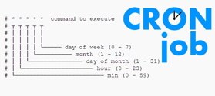
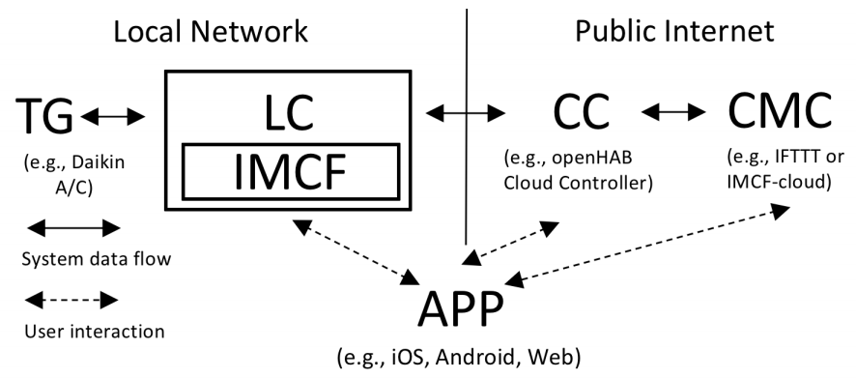
IMCF System Architecture
anyplace.cs.ucy.ac.cy
APP: user interaction
CMC: Cloud Meta-Controller (i.e., IMCF)
configure/run custom rules from APP anywhere
CC: Cloud Controller (i.e., OpenHub)
Manually manage IoT remotely
LC: Local Controller (i.e., RaspberryPI)
Manage IoT locally with cron jobs – firewall NAT issues
Notes:
Our system architecture comprises of a full-fledge local controller implemented inside the openHAB stack, which is a smart home management software; and IMCF, which is the software system that encapsulates the complete application logic of the energy management stack we propose along with the respective user interfaces.
The Local Controller is a java-based system installed on a micro device, running on the local network of a user, that will be in direct communication with the IoT devices through the Openhab smartphone Application.
The complete picture can tentatively be complemented by a Cloud Meta-Controller, which can enable the user to configure and run various custom rules.

Slide 29
IMCF System Architecture
Turning ON/OFF IoT devices:
Binding Mode: exploits the rich ecosystem of bridges available on the openHAB to interact with local devices
Extended mode: implements locally the custom instructions for enabling/disabling IoT devices in the smart space of a user
Notes:
Our system allow us to have two modes of turning on and off iot devices…..

Slide 30
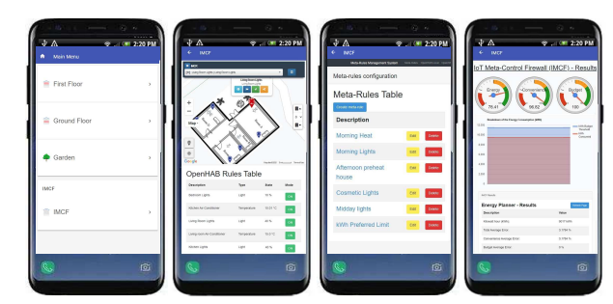
IMCF Prototype System
Users define rules and have IMCF actuate devides to meet long-term energy goals
Shall be shown more extensively later as part of the successor system Greencap
https://imcf.cs.ucy.ac.cy/

Slide 31
Experimental Methodology
Anonymized measurements from a real residential apartment that comprises of a variety of sensors,
5,668,878 readings (1.09 GB in total), collected by the CASAS: Center for Advanced Studies in Adaptive Systemsat Washington State University.
Metrics:
Comfort Error (F_{CE}): the difference between the desired output value and the actual value (based on ground truth data)
Energy Consumption (F_{E}): the energy consumption of a device
CPU Time (F_{T}): the processing time required by the controller for running the optimization function and calculating the output for all meta-rules.
Flat 1.09GB
House 4.5GB
Dorms 20GB
https://casas.wsu.edu/about
Notes:
We have evaluated our design with extensive experimentation on real datasets with anonymized measurements from a real residential apartment that comprises of a variety of sensors, submeters and approximately 5 Million readings, collected by the “Center for Advanced Studies in Adaptive Systems” at Washington State University.
To evaluate the scalability of our propositions for residential buildings of various scales, we have generated three realistic datasets by replicating the above onto various building sizes. A flat, a house and a dorms datasets.
Our cost metrics for each meta-rule are the..

Slide 32
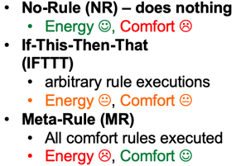
EP Performance Evaluation
> EnergyPlanner (EP)
Energy 😐, Comfort ☺
NR obtained the worst F_{CE} = 62% and the best F_{E} = 0 kWh.
EP obtained an impressive F_{CE} of around 2%-4% and the second lowest F_{E}
MR satisfies all the meta-rules, thus its F_{CE} is 0% → best possible obtained
Computation times (to find the solution) not a big issue as planning takes place relatively infrequently (daily, weekly, etc.)
Notes:
In this experimental series, we evaluated the performance of the proposed EP framework against all algorithms over all datasets introduced, with respect to Energy Consumption, Convenience Error, and CPU Execution Time.
-The No-Rule approach obtained the worst convenience error of 62% and the best energy consumption.
-The energy planner obtained an impressive convenience error of around 2-4% and the second lowest energy consumption.
-…
The fastest execution time was achieved by NR since it simply executes an error calculation ignoring all rules. The EP hill climbing approach, searches the decision space for a solution that will optimize the user’s convenience and satisfy the energy constraint, at the same time, which is a much more time-consuming process. Finally, the MR greedy approach focuses only on minimizing the Convenience Error, which means executing all meta-rules without any iterative processes or calculations, since the convenience error is 0%.

Slide 33
Presentation Outline
Introduction to Climate Change and Sustainable Computing:
Mitigation, Adaptation, Finance and the Renewable Self-Consumption Problem
IEEE Internet Computing 2022
Renewable Self-Consumption in Smart-Homes
37th IEEE International Conference on Data Engineering (ICDE’21) EnergyPlanner (EP)
ACM Transactions on Internet of Things (TIOT’22) – GreenPlanner (GP)
IEEE Transactions on Sustainable Computing (TSUSC’24) - GreenCap
Renewable Self-Consumption with Electric Vehicles
40th IEEE International Conference on Data Engineering (ICDE’24) - EcoCharge
25th IEEE International Conference on Mobile Data Management (MDM'24)
Conclusions and Future work

Slide 34
GreenPlanner
The EnergyPlanner (EP) is an algorithm for meeting “long-term” energy goals (kWh), not Emission goals (CO2).
In ACM TIOT 2022, we expand the logic on EP into a more complex scenario including CO2 goals.
We devise GreenPlanner (GP) using Simulated Annealing that allows making even wrong decisions with some probability.
Hill Climbing (EP) is faster, but Simulated Annealing is better at locating the global optimum.
GreenPlanner (GP) [TIOT22]
Simulated Annealing (carry out even wrong moves if random r < α.e^{ΔT} )
α user threshold
ΔΤ=Το-Τ, time elapsed from start
Soteris Constantinou, Andreas Konstantinidis, Demetrios Zeinalipour-Yazti, and Panos K. Chrysanthis. “Green Planning of IoT Home Automation Workflows in Smart Buildings”, ACM Transactions on Internet of Things (TIOT’22), vol. 3, no. 4, pp. 1–30, DOI: 10.1145/3549549, 2022

Slide 35
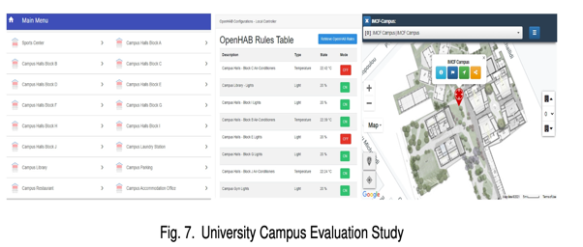
Green Dorms Scenario and GP
Inspired by the SAVES project we constructed a green dorms scenario (also apt, hotel)
Ten hall blocks, sports center, laundry stations, library, parking lot, restaurant and the accommodation service office
The annual energy consumption target (kWh) limit was set to 500,000 kWh (~ 500 persons)
36% CO2 reduction
3.2% comfort reduction
Savings of CO2 equal to 53 return flights from London (GB) = Perth (Australia)
Soteris Constantinou, Andreas Konstantinidis, Demetrios Zeinalipour-Yazti, and Panos K. Chrysanthis. “Green Planning of IoT Home Automation Workflows in Smart Buildings”, ACM Transactions on Internet of Things (TIOT’22), vol. 3, no. 4, pp. 1–30, DOI: 10.1145/3549549, 2022.
Notes:
The US Energy Information Administration (EIA) states that the average US citizen uses an average of around 909 kWh of energy per month, which equates to around 10,909 kWh per year.

Slide 36
Presentation Outline
Introduction to Climate Change and Sustainable Computing:
Mitigation, Adaptation, Finance and the Renewable Self-Consumption Problem
IEEE Internet Computing 2022
Renewable Self-Consumption in Smart-Homes
37th IEEE International Conference on Data Engineering (ICDE’21) EnergyPlanner (EP)
ACM Transactions on Internet of Things (TIOT’22) – GreenPlanner (GP)
IEEE Transactions on Sustainable Computing (MDM’23/TSUSC’24) – GreenCap/GreenCap+
Renewable Self-Consumption with Electric Vehicles
40th IEEE International Conference on Data Engineering (ICDE’24) - EcoCharge
25th IEEE International Conference on Mobile Data Management (MDM'24)
Conclusions and Future work

Slide 37
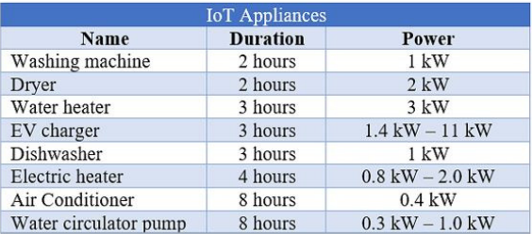
“Short-Term Planning Challenge
With EnergyPlanner (EP) and GreenPlanner (GP) we can meet “long-term” energy/climate goals, but are single objective and won’t effectively find a fine-grain daily plan.
Planning daily is complicated due to micro-weather variations + devices having variable consumption loads and goals.
Interested in satisfying duration while minimizing ON/OFF (i.e., find continuous time plans) => NP complete problem (bin packing).
S. Constantinou, C. Costa, A. Konstantinidis, P. Chrysanthis and D. Zeinalipour-Yazti, "A Sustainable Energy Management Framework for Smart Homes" in IEEE Transactions on Sustainable Computing, vol. , no. 01, pp. 1-12, 5555. doi: 10.1109/TSUSC.2024.3396381, 2024
Notes:
The bin packing problem^{[1][2][3][4]} is an optimization problem, in which items of different sizes must be packed into a finite number of bins or containers, each of a fixed given capacity, in a way that minimizes the number of bins used

Slide 38
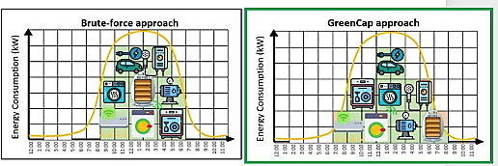
Short-term Planning Algorithms
Optimize Comfort Only
Optimize Comfort + Emissions
Optimize Comfort + Emissions
S. Constantinou, C. Costa, A. Konstantinidis, P. Chrysanthis and D. Zeinalipour-Yazti, "A Sustainable Energy Management Framework for Smart Homes" in IEEE Transactions on Sustainable Computing, vol. , no. 01, pp. 1-12, 5555. doi: 10.1109/TSUSC.2024.3396381, 2024

Slide 39
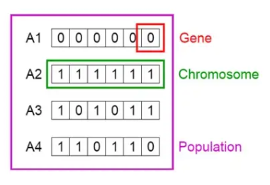
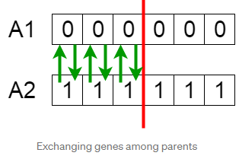
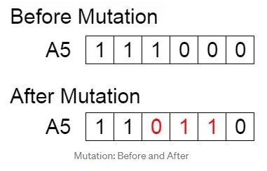
Greencap
GreenCap is our multi-objective Renewable Self-Consumption planning algorithm (comfort, emissions) using a Genetic Algorithm
Solutions evolve based on natural selection, the process driving biological evolution (mutation, crossover, selection)
Over successive generations, the population "evolves" toward an optimal solution.
Greencap+ uses a Memetic Algorithm, i.e., an evolutionary algorithm that use local search heuristics to refine solutions.
crossover
mutation
selection
X
X
Notes:
https://en.wikipedia.org/wiki/Genetic_operator#:~:text=There%20are%20three%20main%20types,the%20algorithm%20to%20be%20successful.
Selection
[edit]
Main article: Selection (genetic algorithm)
Selection operators give preference to better solutions (chromosomes), allowing them to pass on their 'genes' to the next generation of the algorithm. The best solutions are determined using some form of objective function (also known as a 'fitness function' in genetic algorithms), before being passed to the crossover operator. Different methods for choosing the best solutions exist, for example, fitness proportionate selection and tournament selection; different methods may choose different solutions as being 'best'. The selection operator may also simply pass the best solutions from the current generation directly to the next generation without being mutated; this is known as elitism or elitist selection.^{[1][5]}
Crossover
[edit]
Main article: Crossover (genetic algorithm)
Crossover is the process of taking more than one parent solutions (chromosomes) and producing a child solution from them. By recombining portions of good solutions, the genetic algorithm is more likely to create a better solution.^{[1]} As with selection, there are a number of different methods for combining the parent solutions, including the edge recombination operator (ERO) and the 'cut and splice crossover' and 'uniform crossover' methods. The crossover method is often chosen to closely match the chromosome's representation of the solution; this may become particularly important when variables are grouped together as building blocks, which might be disrupted by a non-respectful crossover operator. Similarly, crossover methods may be particularly suited to certain problems; the ERO is generally considered a good option for solving the travelling salesman problem.^{[6]}
Mutation
[edit]
Main article: Mutation (genetic algorithm)
The mutation operator encourages genetic diversity amongst solutions and attempts to prevent the genetic algorithm converging to a local minimum by stopping the solutions becoming too close to one another. In mutating the current pool of solutions, a given solution may change entirely from the previous solution. By mutating the solutions, a genetic algorithm can reach an improved solution solely through the mutation operator.^{[1]} Again, different methods of mutation may be used; these range from a simple bit mutation (flipping random bits in a binary string chromosome with some low probability) to more complex mutation methods, which may replace genes in the solution with random values chosen from the uniform distribution or the Gaussian distribution. As with the crossover operator, the mutation method is usually chosen to match the representation of the solution within the chromosome.

Slide 40
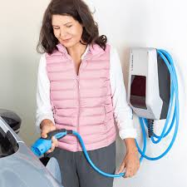
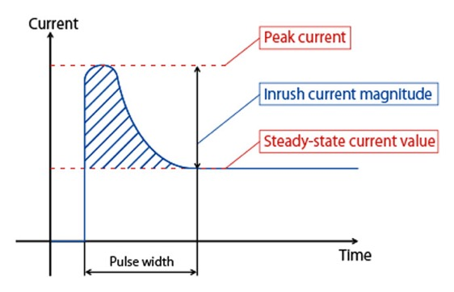
GreenCap: Comfort Optimization Heuristic
Preferrable to Charge in Contiguous Blocks:
ON (Solar Excess)
OFF
OFF
OFF
OFF
OFF
OFF
OFF
OFF
OFF
☹
ON (Solar Excess)
OFF
ON (Solar Excess)
☺
Why is Continuous Good?
Charger/EV Health: Capacitors are less strained by on/off operations
More efficient: It circumvents expensive device startup costs (e.g., Inrush current drawn by battery cooling system).
GreenCap (MDM23) incorporates a local search heuristic in its memetic algorithm to filter solutions based on Number of Blocks.

Slide 41
GreenCap+: Energy Optimization Heuristic
In many countries it is preferable to consume import energy from the grid during certain periods (i.e., off-peak" / "time-of-use” tariffs or external tariff signal (ripple))
Examples:
off-peak" or "time-of-use” tariffs (ChatGPT):
United Kingdom: Economy 7 &10 tariffs provide lower rates during night hours.
Germany: Time-of-use tariffs are available, especially for homes with storage heaters or heat pumps.
France: Heures Creuses offers discounted rates during designated night hours.
Spain: Tarifa con discriminación horaria has reduced prices during off-peak times.
Italy: Time-of-use tariffs offer lower prices at night and on weekends.
EV Vehicle-to-Grid (V2G): cars offloading to the grid through Chademo/CCS clean energy acquired during a sunny day. (e.g., OVO energy / UK, MobilityHouse / Germany)
GreenCap+ (TSUSC24) incorporates a local search heuristic in its memetic algorithm to filter solutions based on Peak/Non-Peak periods.

Slide 42
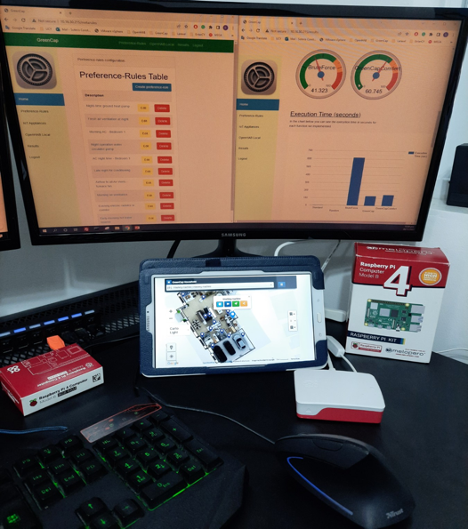
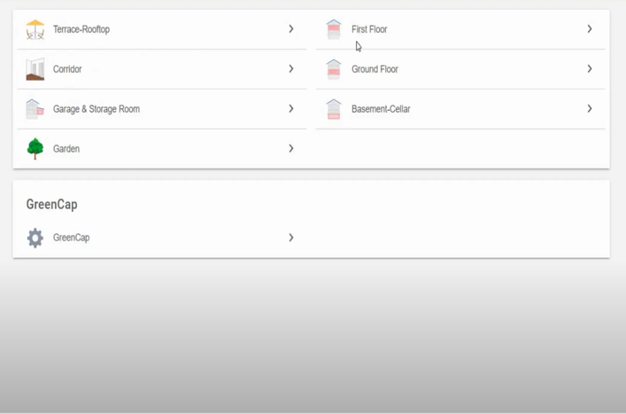
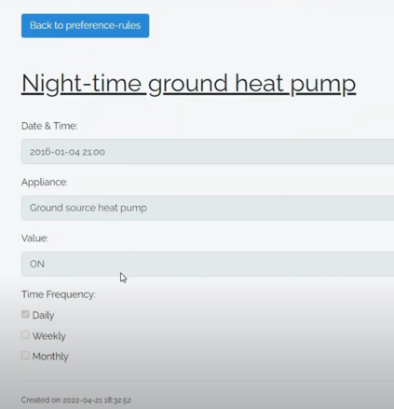
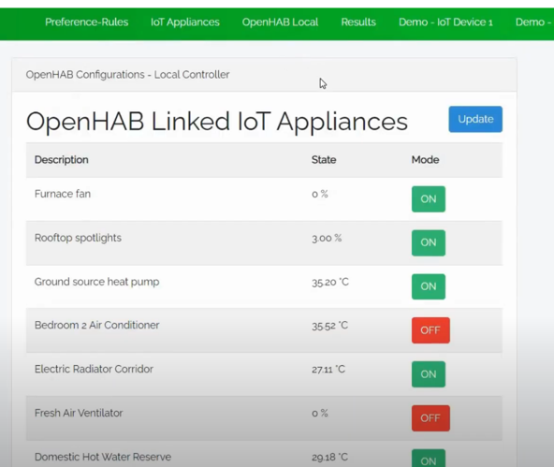
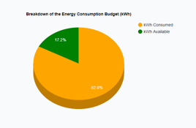
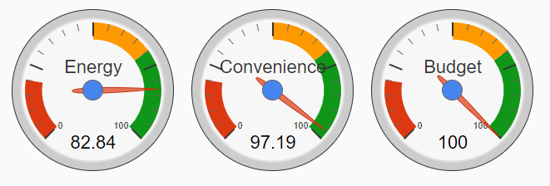
GreenCap+ Prototype System
https://youtu.be/ulEDPoBvSdI
"An IoT Data System for Solar Self-Consumption", Soteris Constantinou, Nicolas Polycarpou, Constantinos Costa, Andreas Konstantinidis, Panos K. Chrysanthis, Demetrios Zeinalipour-Yazti "The 24th IEEE International Conference on Mobile Data Management" (MDM '23), IEEE Press, Pages: 65-72, July 3 - July 6, 2023, Singapore, 2023.
Notes:
-The Graphical User Interface records OpenHAB’s smart device measurements on local storage and presents them on a table
-It allow users to Configure various meta-rules in regards to killowatHour limit, temperature and light values

Slide 43
CO₂ Evaluation
GreenCap+ can reduce CO2 emissions up to ≈ 40% (in countries with dirty energy mix)!
Datasets: Energy Production, Peak Demand, Home Power Demand
Standard: comfort only
☺ Comfort, ☹ Emissions, ☺ Speed
Random: randomly shifts loads around within a day.
☹ Comfort, ☹ Emissions, ☺ Speed
GreenCap+: Our Memetic Algorithm + 2 Local Heuristics
☺ Comfort (>95%), ☺ Emissions (~40%), ☺ Speed (<1min)
Brute-force: Comfort + Emissions
☺ Comfort 100%, ☺ Emissions, ☹ Speed
Notes:
Home Power Usage Dataset
Size: 408MB
527,040 measurements
Time-interval: minutely
01/01/2016 - 31/12/2016
Energy Production Dataset
Size: 50MB
65,741 measurements
Time-interval: hourly
31/12/2010 - 31/12/2017
Peak Demand Dataset
Size: 63.1MB
579,746 measurements
Time-interval: hourly
01/01/2016 - 31/12/2016

Slide 44
Presentation Outline
Introduction to Climate Change and Sustainable Computing:
Mitigation, Adaptation, Finance and the Renewable Self-Consumption Problem
IEEE Internet Computing 2022
Renewable Self-Consumption in Smart-Homes
37th IEEE International Conference on Data Engineering (ICDE’21) EnergyPlanner (EP)
ACM Transactions on Internet of Things (TIOT’22) – GreenPlanner (GP)
IEEE Transactions on Sustainable Computing (TSUSC’24) - GreenCap
Renewable Self-Consumption with Electric Vehicles
40th IEEE International Conference on Data Engineering (ICDE’24) - EcoCharge
25th IEEE International Conference on Mobile Data Management (MDM'24)
Conclusions and Future work

Slide 45
Motivation - Electric Vehicle Charging
Energy Hoarding recharge EVs during idle times:
even when battery is not substantially depleted
to ensure EV will be sufficiently charged when needed.
not for travelling long distance, rather daily top-ups.
Energy hoarding with NON-renewable energy is negating environmental benefits
Current apps focus on allowing users know where to recharge but do not list the environmental impact of the charging process
Soteris Constantinou, Constantinos Costa, Andreas Konstantinidis, Mohamed F. Mokbel, and Demetrios Zeinalipour-Yazti. “A Framework for Continuous kNN Ranking of EV Chargers with Estimated Components”, in 40th IEEE International Conference on Data Engineering (ICDE’24), IEEE Computer Society, pp. 13 pages, 2024.
Soteris Constantinou, Dimitris Papazachariou, Constantinos Costa, Andreas Konstantinidis, Mohamed F. Mokbel, and Demetrios Zeinalipour-Yazti. “EcoCharge: Sustainable EV Charging utilizing CkNN-EC Queries”, in 25th IEEE International Conference on Mobile Data Management (MDM’24), 2024.
Notes:
This is due to Energy Hoarding: where people tend to charge EV during idle times, even when the battery is not substantially depleted to ensure that the EV will be charged when needed
(e.g., Plugshare, Ionity, Tesla’s supercharger, EnBW, Shell recharge)
(i.e., energy might come from fossil fuel burning).

Slide 46
Clean Charging Alternatives
Microgrids for Clean EV Charging will emerge in the future yielding more transparent means as to where the energy for EV charging comes from.
- Maximize prospects for Renewable Self-Consumption
- Avoid Expensive and Environmental Harmful Infrastructure Projects (cables, lines, storage)
https://energybyentech.com/
Neighborhood Chargers:
Co-Charger or Octopus
Rent out Home Chargers, Finding Chargers in the Neighborhood, etc.
More prospects for clean surplus loads
https://octopusev.com/charging/community-charging
Notes:
Vehicle Type
CO2 Emissions (kg)
Electric Vehicle (EV) 1,277.77 kg
Plug-in Hybrid (PHEV) 2,188.13 kg
Hybrid Vehicle3,128.88 kg
Gas-Powered Vehicle5,712.54 kg

Slide 47
Solar Hoarding Case Scenaria
EV charging during idle times:
Electric taxis (e.g., Lyft, Uber, Bolt) during idle periods are waiting to be called or booked online
Parents waiting in their idle EVs while their children attend after-school activities
EV user going for groceries or clothing shopping
EV users are engaged in activities that require idle time, such as attending meetings, events, or conferences
Notes:
A hoarding technique can be applicable in scenarios with idle time: (i.e., while an EV user is waiting or parked).
Consequently, in all aforementioned scenarios users could stop at some nearby charging
station to efficiently charge their EVs using power generated from RES, thus, reduce the
carbon footprint of their daily routine.

Slide 48
EcoCharge Overview
Estimated Components (low to high)
Sustainable Charging
Derouting
Availability
p6
b6
5
p5
b1
b2
b3
p4
p3
b4
p2
p1
b5
1 2 3 4 5 6 7 8 9 10 11 12
EcoCharge implements a Renewable Hoarding algorithm that allows drivers (e.g., locally on the edge with Carplay or Android Auto) to find the closest chargers with renewable excess (energy that could neither be used otherwise nor stored)
Notes:
The ranking selection is derived from each EV charger’s solar production curve at a certain time (weather conditions)
User-configured boundaries-radius
Remember to explain min max intervals
Ecfocharge considers a set of weights which are considered in a weighted sum function

Slide 49
Estimated Components (ECs)
Derouting Cost (D): The path distance needed from a starting point to target charger in terms of CO₂ emissions. Estimated traffic is considered
Google/Waze Traffic Prediction
Sustainable Charging Level (L): The available green power of a charger at a given time and location, considering the charging rate and weather conditions
Weather / Windfinder Prediction
Availability (A): Each EV charger’s availability is estimated using some third-party service, enabling the determination of real-time accessibility on a given time
Google Maps POI Busy timetables Prediction
Notes:
Remember to explain min max intervals

Slide 50
EcoCharge Algorithm
CkNN-EC: Continuous kNN with Estimated Components (i.e., Predictions). For each component we have lower and upper bounds.
Filtering Phase: ensures that only the k most suitable chargers are considered in segments (~5KM)
Refinement Phase: utilizes an intersection of the minimum and maximum interval values of Sustainability Score SC. (tight bound)
Older group work on (A)kNN queries:
"Distributed In-Memory Processing of All k Nearest Neighbor Queries", Georgios Chatzimilioudis, Constantinos Costa, Demetrios Zeinalipour-Yazti, Wang-Chien Lee and Evaggelia Pitoura, IEEE Transactions on Knowledge and Data Engineering (TKDE'16), Vol. 28, Iss. 4, pp. 925-938, DOI: 10.1109/TKDE.2015.2503768, 2016.
"Crowdsourcing Emergency Data in Non-Operational Cellular Networks", Georgios Chatzimilioudis, Constantinos Costa, Demetrios Zeinalipour-Yazti, Wang-Chien Lee, Information Systems (InfoSys'17), Elsevier Science Ltd., Vol. 64, pp. 292 - 302, Oxford, UK, DOI: 10.1016/j.is.2015.11.004, 2017.
Notes:
filtering phase includes the scmin and scmax scores as previously mentioned.
The refinement phase follows which computes the final ranking result..it utilizes an intersection…
This process it continuously executed until we have at least k nearest chargers (basically we expand k iteratively)

Slide 51
EcoCharge Demo

Slide 52
Experimental Methodology
Real & synthetic road network trajectories
Oldenburg:
4,000 vehicle trajectories (45km x 35km area)
California:
7,000 vehicle trajectories (1,220 km x 400 km area)
T-drive:
10,357 GPS taxi trajectories (9 million km area)
Geolife:
17,621 vehicle trajectories (1,292,951 km area)
EV charging stations & solar production data based on weather forecast:
Plugshare: >1,000 EV charging stations
CDGS: solar generation data (15-minute time-interval)
Notes:
“California Distributed Generation Statistics”

Slide 53
Performance Evaluation
Brute Force achieves the best SC = 100%, but the worst Ft
Index-Quadtree provides reasonable SC ≈ 80-85% and faster Ft than Brute Force Ft ≈ 78-85 ms
Random has the worst SC ≈ 30-40% and Ft ≈ 10-15 ms
EcoCharge achieves great performance with Ft ≈ 56-67 ms and SC ≈ 97.5-99%

Slide 54
Conclusions / Future Work
Renewable Self-consumption, refers to the process of intelligently consuming energy at the time it is available.
Prototype systems and algorithms from the smart-home & EV domain have shown how the alignment of production and consumption can lead to significant reductions in CO2.
Currently working towards a service for green charging and supporting V2G scenarios.
We also started to look at the Renewable Self Optimization for Greener Communal Residential Buildings Cyprus RPF Project

Slide 55
Publications
Journal and magazine publications:
Soteris Constantinou, Constantinos Costa, Andreas Konstantinidis, Panos K. Chrysanthis, and Demetrios Zeinalipour-Yazti. “A Sustainable Energy Management Framework for Smart Homes”, IEEE Transactions on Sustainable Computing (TSUSC’24), no. 01, pp. 1-12, DOI: 10.1109/TSUSC.2024.3396381, 2024.
Soteris Constantinou, Andreas Konstantinidis, and Demetrios ZeinalipourYazti. “Green Planning Systems for Self-consumption of Renewable Energy”, IEEE Internet Computing (IC’23), vol. 27, no. 1, pp. 34–42, DOI: 10.1109/MIC.2022.3164581, 2023.
Soteris Constantinou, Andreas Konstantinidis, Demetrios Zeinalipour-Yazti, and Panos K. Chrysanthis. “Green Planning of IoT Home Automation Workflows in Smart Buildings”, ACM Transactions on Internet of Things (TIOT’22), vol. 3, no. 4, pp. 1–30, DOI: 10.1145/3549549, 2022
Conference proceedings:
Soteris Constantinou, Dimitris Papazachariou, Constantinos Costa, Andreas Konstantinidis, Mohamed F. Mokbel, and Demetrios Zeinalipour-Yazti. “EcoCharge: Sustainable EV Charging utilizing CkNN-EC Queries”, in 25th IEEE International Conference on Mobile Data Management (MDM’24), 2024.
Soteris Constantinou, Constantinos Costa, Andreas Konstantinidis, Mohamed F. Mokbel, and Demetrios Zeinalipour-Yazti. “A Framework for Continuous kNN Ranking of EV Chargers with Estimated Components”, in 40th IEEE International Conference on Data Engineering (ICDE’24), IEEE Computer Society, pp. 13 pages, 2024.
Soteris Constantinou, Nicolas Polycarpou, Constantinos Costa, Andreas Konstantinidis, Panos K. Chrysanthis, and Demetrios Zeinalipour-Yazti. “An IoT Data System for Solar Self-consumption”, in 24th IEEE International Conference on Mobile Data Management (MDM’23), pp. 65–72, DOI: 10.1109/MDM58 254.2023.00 022, 2023.
Soteris Constantinou, Nicolas Polycarpou, Constantinos Costa, Andreas Konstantinidis, Panos K. Chrysanthis, and Demetrios Zeinalipour-Yazti. “Greencap: A platform for Solar Self-consumption using IoT Data”, in 24th IEEE International Conference on Mobile Data Management (MDM’23), pp. 176–179, DOI: 10.1109/MDM58 254.2023.00 036, 2023.
Soteris Constantinou, Andreas Konstantinidis, Demetrios Zeinalipour-Yazti, and Panos K. Chrysanthis. “The IoT Meta-control Firewall”, in 37th IEEE International Conference on Data Engineering (ICDE’21), pp. 2523–2534, DOI: 10.1109/ICDE51 399.2021.00 284, 2021.
Soteris Constantinou, Antonis Vasileiou, Andreas Konstantinidis, Panos K. Chrysanthis, and Demetrios Zeinalipour-Yazti. “IMCF: The IoT Meta-Control Firewall for Smart Buildings”, in 24th International Conference on Extending Database Technology (EDBT’21), OpenProceedings.org, pp. 658–661, DOI: 10.5441/002/edbt.2021.77, 2021.
Notes:
In the context of my thesis here you can see all of our journal, magazine, and conference publications.

Slide 56
Sustainable Computing and the Renewable Self-Consumption Problem
Thanks! Questions?
Demetris Zeinalipour
Professor
Department of Computer Science
University of Cyprus
https://www.cs.ucy.ac.cy/~dzeina/
dzeina@ucy.ac.cy
The 12th IEEE International Conference on Cloud Engineering (IEEE IC2E),
Thursday, September 26, 2024, Aliathon Resort Paphos, Cyprus

Slide 57
The Paris Agreement
CO₂ emerging in all sectors and rising economies
We are witnessing a steady increase in CO₂ since the Industrial Revolution (1760 – 1840 AD)
Global warming will continue if we don’t act promptly!
The Intergovernmental Panel on Climate Change (IPCC) is an intergovernmental body of the United Nations: World Meteorological Organization (WMO)
United Nations Environment Programme (UNEP)

