Slide 1
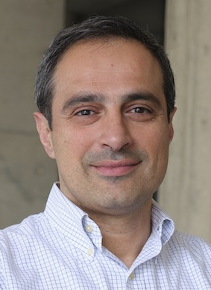
Future Challenges in Cybersecurity
Demetris Zeinalipour
Professor
Department of Computer Science
University of Cyprus
https://www.cs.ucy.ac.cy/~dzeina/
dzeina@ucy.ac.cy
Seminar on Cyber Crime, UNFICYP, Ledra Palace Hotel, Nicosia, Cyprus, June 5, 2024

Slide 2
Objectives
Explain in an understandable language what Cybersecurity is and its role in thwarting Cybercrime.
Explain relevant terminology and technical underpinnings to non-technical audience.
Point out promising directions that might shape the future of Cybersecurity.
Disclaimer: “It’s Difficult to Make Predictions, Especially About the Future” – Niels Bohr (Physics Nobel 1922)

Slide 3
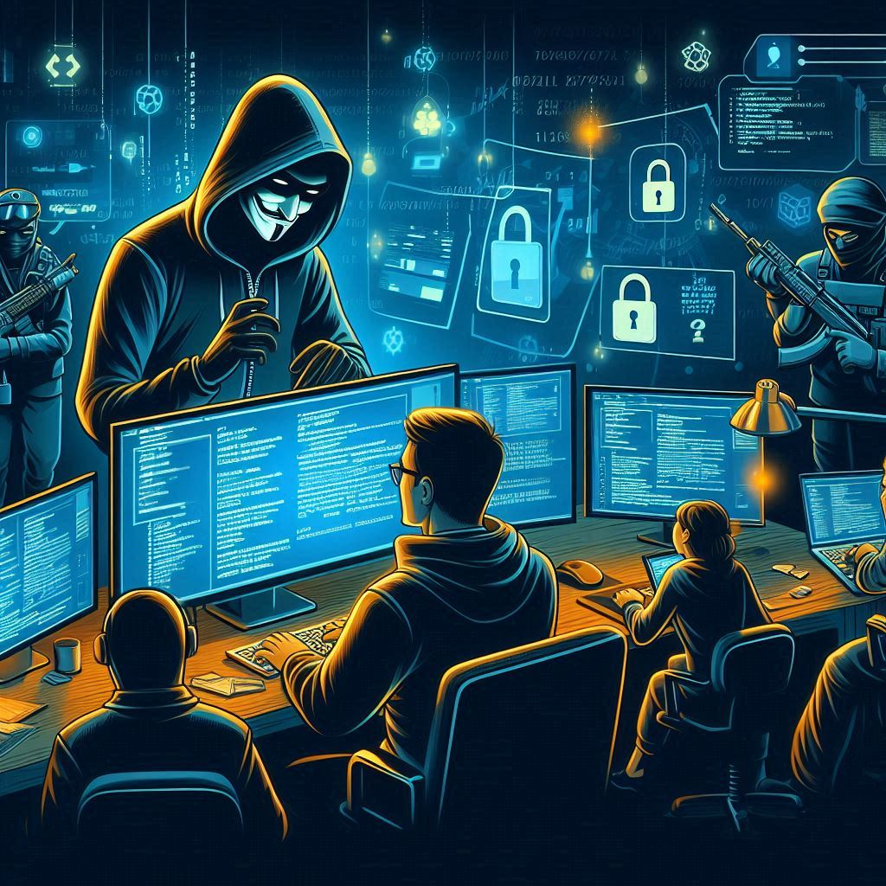
Cybercrime
Cybercrime: criminal activities carried out by means of computers or the internet. – Oxford Dictionary
Crime: an action or omission which constitutes an offence and is punishable by law – Oxford.
(Random) Examples from FBI:
Computer intrusion and aggravated identity theft
Racketeering Conspiracy (making money from illegal activities such as threatening people or selling worthless, immoral, or illegal goods or services); Conspiracy; Identity Theft; Aggravated Identity Theft; Access Device Fraud; Obtaining Information by Unauthorized Access to Protected Computers; Intentionally Causing Damage to Protected Computers; Threatening to Damage a Protected Computer; and Money Laundering.
hacking conspiracy intended to deploy destructive malware and take other disruptive actions, for the strategic benefit of Russia, through unauthorized access to victims’ computers
romance scam victims were provided to other co-conspirators to be used to receive fraudulent wire transfers from other fraud schemes
Notes:
https://www.cisco.com/c/en/us/products/security/what-is-cybersecurity.html#:~:text=Cybersecurity%20is%20the%20practice%20of,or%20interrupting%20normal%20business%20processes.
https://www.fbi.gov/investigate/cyber

Slide 4
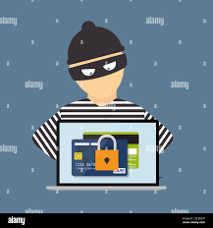
Cybersecurity
Cybersecurity is the practice of protecting systems, networks, and programs from cybercrime - CISCO
X
Cybercrime
Hackers/Adversaries/Attackers
(APT Adv. Persistent Threads, DDOS, Zero Day Attacks, Ransomware, Extortion)
Program
X
X
Use
X
Data
Networks
Systems
Digital World
Users
Internet of Things
X
Physical World
Fraudsters, Scammers,Thiefs, …
Notes:
APT Guiding Critical Infrastructure
https://www.cisco.com/c/en/us/products/security/what-is-cybersecurity.html#:~:text=Cybersecurity%20is%20the%20practice%20of,or%20interrupting%20normal%20business%20processes.

Slide 5
Cybersecurity: Current State (CY)
Rich Ecosystem of Stakeholder aiming to improve Cybersecurity at different levels (internal/external, legislation, services)
Attacker
Companies
(ISO 27001 Certification and Audits, Firewalls, Antivirus, Edge Detection, Pentests / Ethical Hacking, Training, Sec Inf Eve Man (SIEM), etc.)
Users
Systems
Authorities
The Office for Combating Cybercrime (O.C.C.)
https://cyberalert.cy/
Incidence Response
EU Directive 2021/887
Protect Critical Infrastructure, Banks, Network Providers
Coordination & Support
EU Directive 2021/887
European Cybersecurity Competence Centre (ECCC): Strengthening SMEs, Research, …
Legislation
Privacy
EU GDPR Regulation 2016/679
125(I)/2018
Earlier: 138(I)/2001
Network & Information Systems
EU NIS Directive 2016/1148
=> Περί Ασφάλειας Δικτύων και Συστημάτων Πληροφοριών Νόμος του 2020 (Ν. 89(I)/2020
EU NIS 2 Directive 2022/2555
More Regulations (i.e., Laws w/o national law)
2022 Digital Services Act (DSA) 2022/2065 - illegal content, transparent advertising, and disinformation
2024 AI Act 2021/206 - usage of artificial intelligence in the European Union.
2025 DORA Act Digital Operational Resilience Act – IT security of financial entities such as banks, insurance companies and investment firms.
International Cooperation:
· Europol/EC3/AWF/ EMPACTS
· EUCTF (European Union Cybercrime Taskforce)
· CIRCAMP (COSPOL Internet Related Child Abusive Material Project)
· ENISA (European Network and Information Security Agency), · ECTEG (European Cybercrime Training and Education Group)
· CEPOL (European Police College), · EUROJUST (European Union’s Judicial Cooperation Unit), · CERT-EU (Computer Emergency Response Team)
· INTERPOL (International Criminal Police Organization), · European Commission
· EEAS (European External Action Service), · USA FBI, VCACITF (Violence Crime Against Children International Task Force) USA FBI.
· Council of Europe (T-CY Assessment)
Notes:
https://www.police.gov.cy/police/police.nsf/All/671EB91BDCAA303EC22584000041D696?OpenDocument
· Europol/EC3/AWF/ EMPACTS
· EUCTF (European Union Cybercrime Taskforce)
· CIRCAMP (COSPOL Internet Related Child Abusive Material Project)
· ENISA (European Network and Information Security Agency)
· ECTEG (European Cybercrime Training and Education Group)
· CEPOL (European Police College)
· EUROJUST (European Union’s Judicial Cooperation Unit)
· CERT-EU (Computer Emergency Response Team)
· INTERPOL (International Criminal Police Organization)
· European Commission
· EEAS (European External Action Service)
· USA FBI
· VCACITF (Violence Crime Against Children International Task Force) USA FBI.
· Council of Europe (T-CY Assessment)

Slide 6
Cybercrime (Typical) Scenario
Infiltration
Gain initial access through social engineering and phishing (email, messages, chat, telephone, …) or by port scanning
Connect to system and scan network (dark web exploits)
Launch Known (Powersploit) or Zero-Day attacks (advanced scripts) on internal/cloud servers found on the dark web on unpatched server
Use sites as intermediate nodes for more serious attacks (e.g., TOR anonymous network).
Exploration and expansion
Install Multiple Backdoors to control system remotely
Crack Passwords, Gain Administrative Rights (Domain Control)
Exfiltration (Double Method) .
A) Move data over encrypted channels to remote storage (MegaCMD, Dropbox)
B) Encrypt users' data locally
Attackers ask for cryptocurrency or threat to delete data (ransomware) and/or release data on the web (extortion)
Attacker

Slide 7
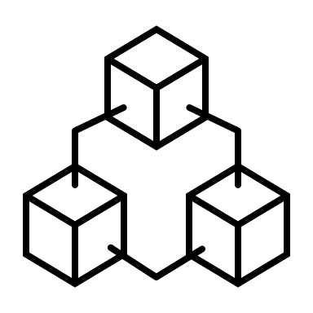
Hacking Techniques
Hiding Network (IP) Trace & Denial of Service
Hiding Money Trace
Attacker
Hijaked
Hijacked
DDOS
Attack
Botnet
Hijacked
Exchange
Exchange
Paying Ransomware/Extortion Crypto
Attacker
Crypto
Bank
Crypto
Crypto Examples: Bitcoin, Ethereum, Tether, Solana, Binance, XRP, USD Coin, Cardano, Doge
Notes:
Royal Malware https://www.kroll.com/en/insights/publications/cyber/royal-ransomware-deep-dive

Slide 8
Hacking Techniques
Hiding Viruses (Polymorphic & Evolution)
Edge Detection Software
Virus: 0101011010101010101010101
Antivirus Database
Virus: 0101011010101010101010101
1110101010101010101011010101010101010101010101010101011101111011
Inject
Attacker
service
Trojan Virus
111010101101010101010101 010101010101101010010111011110<URL>11
Inject
Attacker
service
Polymorphic Virus: self-mutating virus

Slide 9
Cybersecurity: Future Challenges
Extensive List, have mentioned some challenges already, will overview in more depth some additional future challenges:
Artificial Intelligence and Machine Learning Attacks
Internet of Things (IoT) Vulnerabilities
Quantum Computing Threats
Advanced Persistent Threats (APTs) - stealthy threat actor, typically a state or state-sponsored group, undetected for an extended period
Supply Chain Attacks (attack weak link)
Cloud Security Issues
Ransomware Evolution
Insider Threats
Zero-Day Exploits
Privacy Concerns and Data Protection
Remote Work Security
Social Engineering Attacks
Blockchain and Cryptocurrencies
Regulatory Compliance
Cyber Warfare and Nation-State Attacks
Notes:
https://www.police.gov.cy/police/police.nsf/All/671EB91BDCAA303EC22584000041D696?OpenDocument
· Europol/EC3/AWF/ EMPACTS
· EUCTF (European Union Cybercrime Taskforce)
· CIRCAMP (COSPOL Internet Related Child Abusive Material Project)
· ENISA (European Network and Information Security Agency)
· ECTEG (European Cybercrime Training and Education Group)
· CEPOL (European Police College)
· EUROJUST (European Union’s Judicial Cooperation Unit)
· CERT-EU (Computer Emergency Response Team)
· INTERPOL (International Criminal Police Organization)
· European Commission
· EEAS (European External Action Service)
· USA FBI
· VCACITF (Violence Crime Against Children International Task Force) USA FBI.
· Council of Europe (T-CY Assessment)

Slide 10
Artificial Intelligence (AI): Background
Artificial intelligence, in its broadest sense, is intelligence exhibited by machines, particularly computer systems.
History:
1956: Artifical Intelligence (AI) term was proposed at Dartmouth College workshop – John McCarthy
1997: DeepBlue (IBM) beats Gasparov in Chess
2011: Watson AI took on former Jeopardy!
2012: Generative Pretraining (Geoffrey Hinton / Ilya Sutskever) applied in Speech Recognition problems
2016: AlphaGO (DeepMind) beats the Human Go champion
2017: The Transformer Architecture by Google for the Search Box Autocompletion using BERT
2018: GPT-1/OpenAI
2022: ChatGPT: Generative AI Chatbots
2024: LAMA (Meta) Open Source LLMs

Slide 11
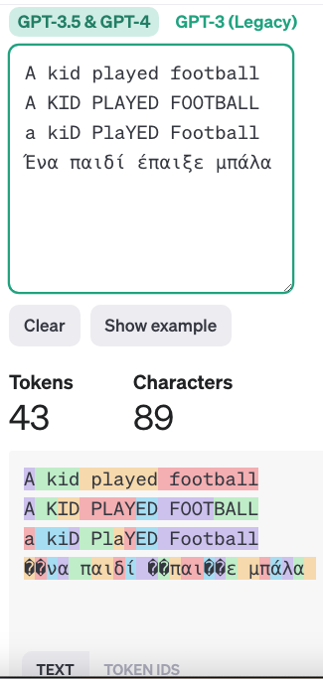
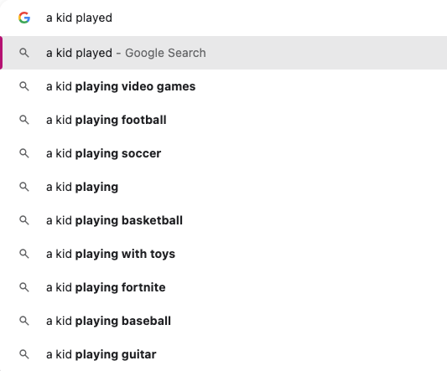
AI: Large Language Models
30%
Video
games
played
25%
football
10%
kid
soccer
10%
BERT
with toys
A
5%
baseball
https://platform.openai.com/tokenizer
Notes:
Skip-gram is a popular algorithm used in natural language processing (NLP), specifically in word embedding techniques. It is a method for learning word representations in a vector space, often used in the context of word2vec models.

Slide 12
AI/LLMs Everywhere
AI
AI
AI
AI
Digital Attacks
Use
Program
Data
Networks
Systems
Attacker
Users
Digital World
sense
AI
actuate
Physical World
AI
AI

Slide 13
AI / LLMs & Cybersecurity
Program
AI
Data
Networks
Systems
Digital World
Attacker
AI misused by Hackers:
Social Engineering: generate convincing phishing messages, adapt tone, style, persuasive, speak native languages, etc.
Creating (Malicious) Code: refine scripts, write code in new scripting and programming languages
Black Hat AI LLMS: XXXGPT and Wolf GPT provide code for botnets, RATs (Remote Access Trojans), malware, key loggers, crypter (encrypt, obfuscate, and manipulate malware, to make it harder to detect by security programs), infostealer, Cryptostealer, POS malware, ATM malware
Automating Attacks and malware obfuscation / evolution to go undetected by tools and operators
Fake Identities: Avatars and Video to Spread Misinformation and fake news (OpenAI Sora Text-to-Video)
Notes:
Black Hat hackers are criminals who break into computer networks with malicious intent.
White Hat hackers: aim to identify any vulnerabilities or security issues the current system (a.k.a. ethical hackers)
What Is a Red Hat Hacker?
Red hat hackers have a unique goal: to chase and bring down cyber security threat actors. These hackers take matters into their own hands rather than relying on the authorities. Once these heroic desperados track down those seeking to steal or destroy data, or other malicious activities, they gain access to and dismantle their computer systems.
Red hat hackers sometimes even collaborate directly with other groups, including government agencies.
White Hat Hackers
Ethical white hat hackers are trained IT professionals who use their knowledge and skills to help businesses discover their cyber security vulnerabilities. After receiving written permission to perform penetration testing, these unsung heroes plan and execute a hack, then create a prioritized response to build a strong cyber security defense.
Gray Hat Hackers
Gray hat hackers lie between the ill-intentioned black hat hackers and the ethically-motivated white hat hackers. Most of the time, gray hat hackers are not motivated by "bad" intentions.
Gray hat hackers, while not as nefarious as black hat hackers, still frequently use unapproved system exploits to compromise technology or data. They may even steal information with the intention of using it for “the greater good” as a form of “hacktivism.”
Red hat hackers fall between white hat and gray hat hackers. While taking matters into their own hands, such as gray hat hackers do, red hats don’t aim to hurt companies for societal causes. They only wish to improve cyber security health while purging threats.

Slide 14
AI / LLMs & Cybersecurity
AI / LLMs & Cybersecurity
AI
AI
Program
Program
Data
Data
Networks
Systems
Software
Users
Digital World
AI used by Users or System Operators:
Smarter Tools: Antivirus, Firewall, MFA, Log Analysis Tools
Phishing & Fraud Protection (Spam Tools)
Threat Detection and Prediction (Edge Detection)
Automated Incident Response (Security information and event management)
Training and Knowledge
Disaster Recovery, Backup, many more
Notes:
Black Hat hackers are criminals who break into computer networks with malicious intent.
White Hat hackers: aim to identify any vulnerabilities or security issues the current system (a.k.a. ethical hackers)

Slide 15
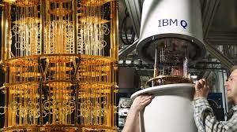
Quantum: Problem
Protocols on the Internet nowadays use encrypted communication.
If Hackers eavesdrop (secretly listen) what a user sends/receives to a service, then they cannot understand it.
Threat: Quantum Computers can break traditional encryption protocols
AES-128 | RSA-2048 Encryption
Unencrypted: 1234 1234 1234 1234
User
https://revolut.com/
Listen/Eavesdrop
Systems
Networks
Attacker
Encrypted ☹ 28302ec3d75d6adf15012f9489477dc1
Decrypted ☺ 1234 1234 1234 1234
Notes:
https://cloud.google.com/learn/what-is-encryption#:~:text=started%20for%20free-,Encryption%20defined,unscramble%20it%20can%20access%20it.
Symmetric encryption uses the same key to both encrypt and decrypt data, while asymmetric encryption uses two different keys for the same purpose
+ AES-128 (symmetric) the most used one on the Internet
+ RSA 2048 (asymmetric) - encrypt shared keys of symmetric encryption.
Common encryption algorithms
The most common methods of symmetric encryption include:
Data Encryption Standard (DES): An encryption standard developed in the early 1970s, DES was adopted by the US government in 1977. The DES key size was only 56 bits, making it obsolete in today’s technology ecosystem. That being said, it was influential in the development of modern cryptography, as cryptographers worked to improve upon its theories and build more advanced encryption systems.
Triple DES (3DES): The next evolution of DES took the cipher block of DES and applied it three times to each data block it encrypted by encrypting it, decrypting it, and then encrypting it again. The method increased the key size, making it much harder to decrypt with a brute force attack. However, 3DES is still considered insecure and has been deprecated by the US National Institute of Standards (NIST) for all software applications beginning in 2023.
Advanced Encryption Standard (AES): The most used encryption method today, AES was adopted by the US government in 2001. It was designed on a principle called a “substitution–permutation network” that is a block cipher of 128 bits and can have keys at 128, 192, or 256 bits in length.
Twofish: Used in both hardware and software, Twofish is considered the fastest symmetric encryption method. While Twofish is free to use, it’s not patented nor open source. Nevertheless, it’s used in popular encryption applications like PGP (Pretty Good Privacy). It can have key sizes up to 256 bits.
The most common methods of asymmetric encryption include:
RSA: Stands for Rivest-Shamir-Adelman, the trio of researchers from MIT who first described the method in 1977. RSA is one of the original forms of asymmetric encryption. The public key is created by the factoring of two prime numbers, plus an auxiliary value. Anyone can use the RSA public key to encrypt data, but only a person who knows the prime numbers can decrypt the data. RSA keys can be very large (2,048 or 4,096 bits are typical sizes) and are thus considered expensive and slow. RSA keys are often used to encrypt the shared keys of symmetric encryption.
Elliptic Curve Cryptography (ECC): An advanced form of asymmetric encryption based on elliptic curves over finite fields. The method provides the robust security of massive encryption keys, but with a smaller and more efficient footprint. For instance, a “256-bit elliptic curve public key should provide comparable security to a 3,072-bit RSA public key.” Often used for digital signatures and to encrypt shared keys in symmetric encryption.

Slide 16
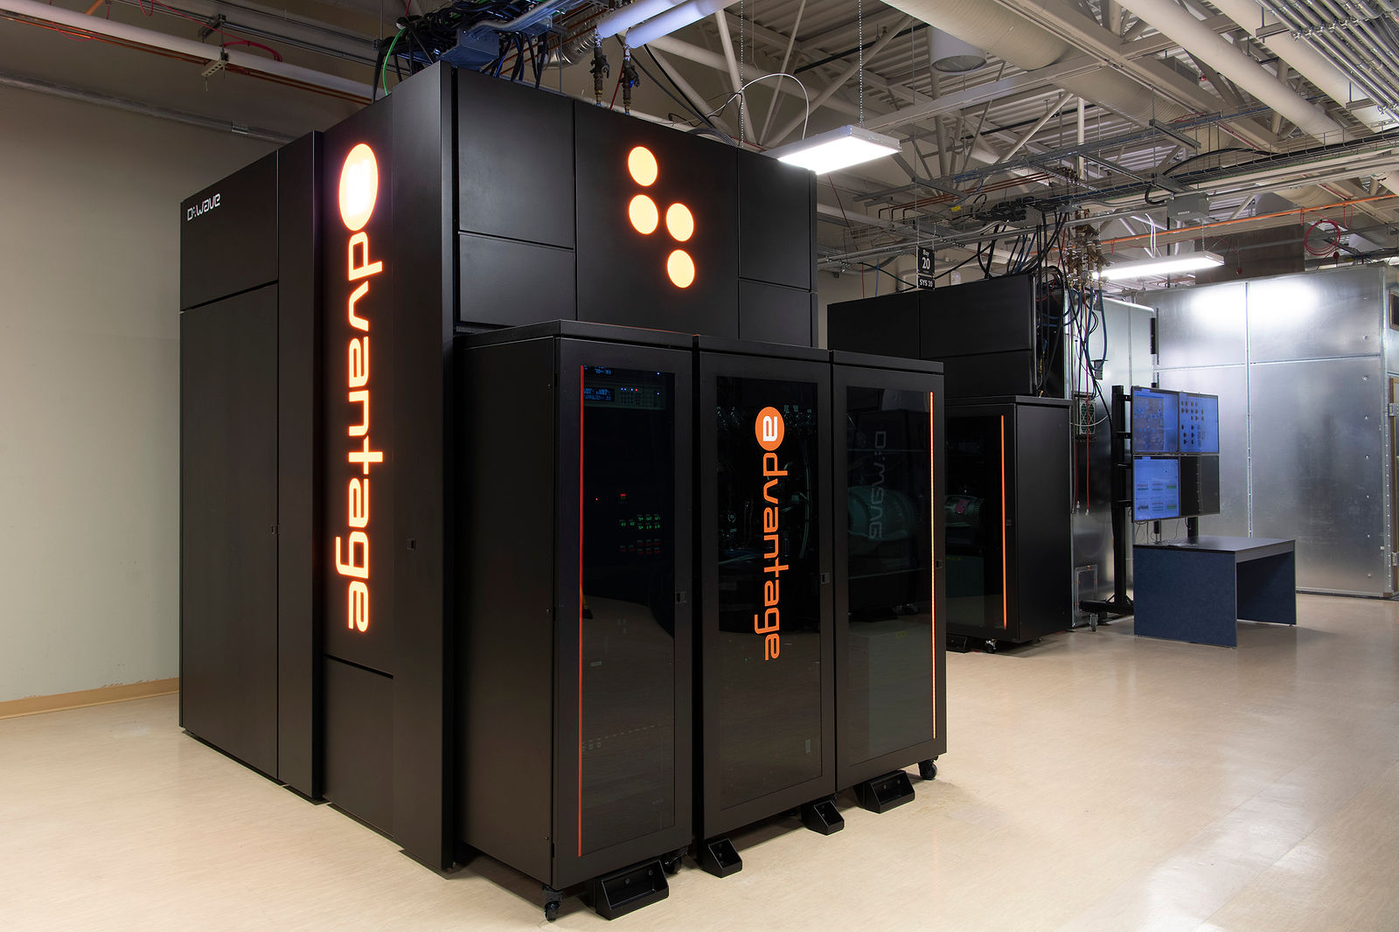
Quantum: Threat
Classic Computers
The most powerful supercomputers on earth would require thousands of years to mathematically break modern encryption algorithms like the Advanced Encryption Standard AES-128 (symmetric) and RSA-2048 (asymmetric) – IBM
Quantum Computers
A fully functional computer can find a solution in minutes using Qubits!
Classic Computers use Transistors (50B/circuit) / Bits being only in 2 states.
Qubits have the ability to simultaneously be in multiple (i.e., superpositions).
Quantum Algorithms using Qubits :
E.g., Shor's algorithm for prime factors of an integer O(logN) => Polynomial time algorithm => RSA algorithm cracking
E.g., Groover’s unstructured search O(√N) => Polynomial time algorithm => AES-128 algorithm cracking
When will Quantum Computers be available
Rose’s (Dwave) Law: Qubits to double every 18 months
Moore’s Law: Transistors to double every 2 years – 2020: 50B/chip; 2030: 300B/chip – ASML
2024: 5000 qubits (Dwave Advantage), 2030: 1M qubits
AES-256 (larger key size) projected to be safe by 2050 – ETSI
Additional Threat: Harvest now, decrypt later (Years to Quantum Y2Q, like Y2K)
Notes:
https://www.ibm.com/topics/quantum-cryptography
https://www.etsi.org/deliver/etsi_gr/QSC/001_099/006/01.01.01_60/gr_qsc006v010101p.pdf
Y2K – 2-digit code for date year as opposed to 4-digit => lead to havoc in computing industry

Slide 17
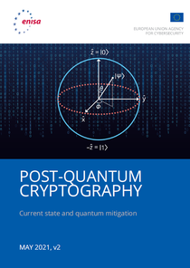
Quantum: Solutions
Post-Quantum Cryptography (PQC) deals with quantum-proof, quantum-safe, or quantum-resistant algorithms (usually public-key algorithms) that are thought to be secure against a cryptanalytic attack by a quantum computer – Wikipedia
NIST/US(July 2022): announced the first wave of PQC algorithms selected as potential 2024 cryptographic standards: CRYSTALS-KYBER, CRYSTALS-Dilithium, FALCON and SPHINCS+
ENISA/EU: Post-Quantum Cryptography: Current state and quantum mitigation
11 April 2024: Commission publishes Recommendation on Post-Quantum Cryptography
https://www.enisa.europa.eu/publications/post-quantum-cryptography-current-state-and-quantum-mitigation
Notes:
https://www.ibm.com/topics/quantum-cryptography
National Institute of Standards and Technology
The European Union Agency for Cybersecurity
Government agency
https://www.etsi.org/deliver/etsi_gr/QSC/001_099/006/01.01.01_60/gr_qsc006v010101p.pdf

Slide 18
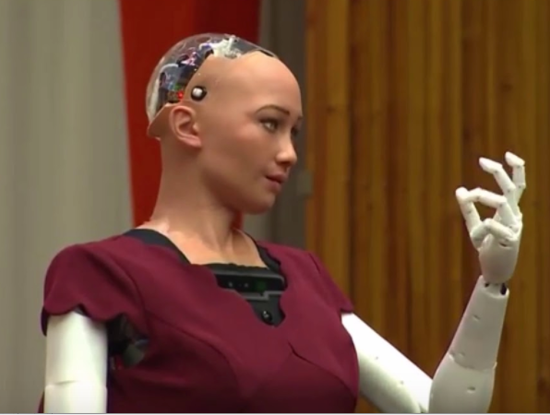
Internet of Things (IoT) Vulnerabilities
Internet of Things (IoT): computing devices connected to the Internet.
Human Population: 8 Billion (2020), 8.6B (2030), 9.8B (2050), 11.2B (2100) - UN DESA
IoT Devices: 9.7B (2020) to 500B (2030) – cisco.com
Smartphones: 5.9B (2020), 7.6B (2027) – statista.com
Nokia CEO, Pekka Lundmark, claims that by 2030, a lot of people will put down their smartphones (in replacement of wearable/6G)
Transportation / Smart Cars
Agritech
eHealth
Social (Sophia) Humanoids
Manufacturing / Logistics
Tablets
Smart Watches
SmartBooks
Smart Home Phones

Slide 19
IoT Threats / Solutions
Non-critical Control: Lock, Unlock, A/C ON, Windows Close, Learning Lanes with Crowd Sensing
Digital Attacks
Program
X
Data
Cloud
Attacker
Security by Design:
2011: ISO 26262 standard (Road Vehicles – Functional Safety
2021: ISO 21434 (Road vehicles – Cybersecurity engineering)
20??: ISO/IEC CD 27404.2
Cybersecurity — IoT security and privacy — Cybersecurity labelling framework for consumer IoT (general Smarthomes)
X
3G/4G/5G Network
3 main computers (e.g., VW.OS => AutoSAR LinuX) + 100 microcontrollers!

Slide 20
Emerging Privacy Threats
Privacy in General: If personal identifiers (SSN, Phone number, IMSI, etc) are missing from the data, then its not considered Personally Identifiable data. (already enforced by GDPR)
Current privacy law does not deal effectively with new forms of privacy (e.g., probabilistic privacy) – example:
Privacy Breach with K-Anonymity Attack! (Quasi-identifiers)
Health Record (anonymized)
age, zip, birthdate, health
45, 2342, 1/1/1980, conditionA
45, 1111, 1/1/1981, -
45, 1542, 1/1/1951, -
Public Data (anonymized)
age, zip, birthdate, Name
45, 2342, 1/1/1980, John
45, 2342, 1/1/1980, John, ConditionA
Masking Solutions: l-diversity, t-closeness, ε-differential privacy
Encryption Solutions: Homomorphic Encryption (owner encrypts, share, analytics/insights on encrypted data, owner decrypts results)
Notes:
https://inpher.io/technology/what-is-fully-homomorphic-encryption/#:~:text=Fully%20Homomorphic%20Encryption%3A%20An%20Example&text=Situation%3A%20A%20medical%20researcher%20wants,to%20the%20HIPAA%20privacy%20rule.

Slide 21
AI / Privacy Threats
Q/A
Attacker
Private AI
Data Reconstruction
Data Reconstruction: US Census Bureau use of Differential Privacy (laplace noise) introduced in 2020
Jailbreak attack: bypass the security restrictions imposed by LLM-based AI applications and obtain an unwanted response from the application designers.
Model Poisoning: inject bad data in training pool or pollute model through bad Queries (reinforcement learning)
https://telefonicatech.com/en/blog/attacks-ai-privacy-attacks
Solutions:
ε-differential privacy: originated as a model for interactive databases and seeks to limit the knowledge that users obtain from query responses. (e.g., adding laplace noise)
Notes:
The U.S. Census Bureau provides data about the nation's people and economy. Every 10 years, it conducts a census counting every resident in the United States. The most recent census was in 2020.
https://www.census.gov/newsroom/blogs/random-samplings/2019/02/census_bureau_adopts.html

Slide 22
Future Challenges in Cybersecurity
Thank you!
Demetris Zeinalipour
Professor
Department of Computer Science
University of Cyprus
https://www.cs.ucy.ac.cy/~dzeina/
dzeina@ucy.ac.cy
Seminar on Cyber Crime, UNFICYP, Ledra Palace Hotel, Nicosia, Cyprus, June 5, 2024

