Slide 1
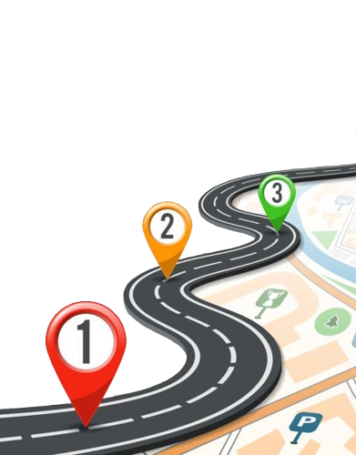
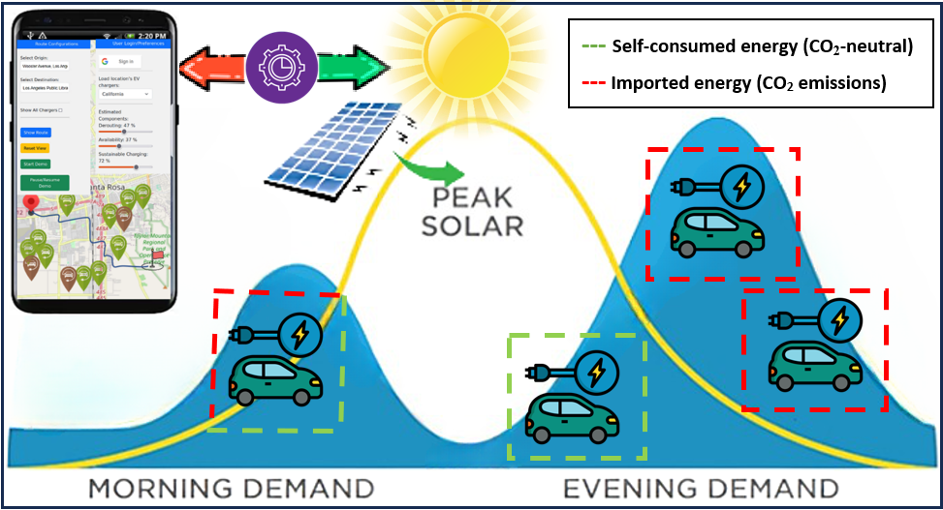
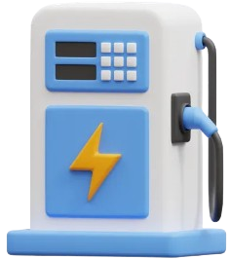
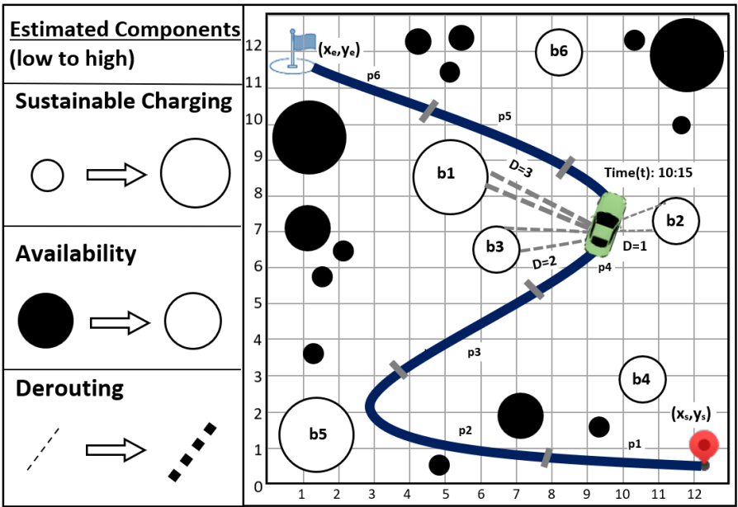
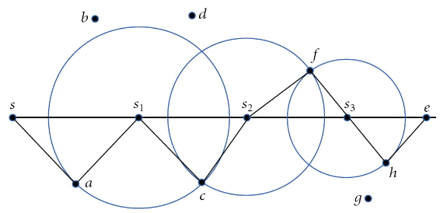
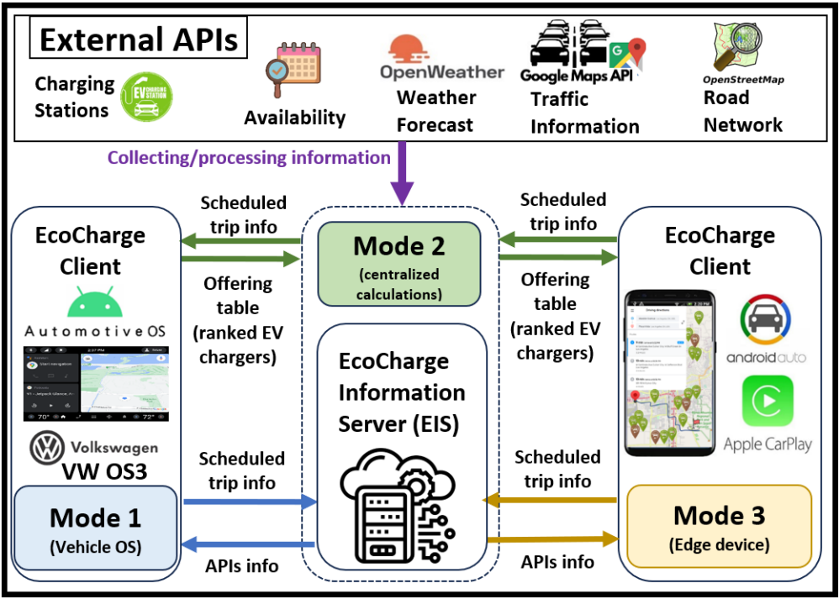
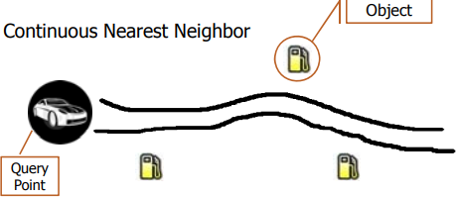
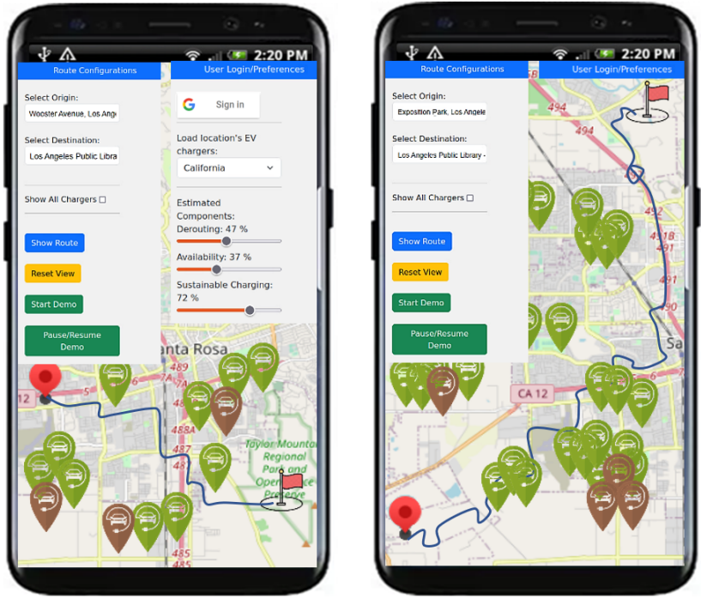
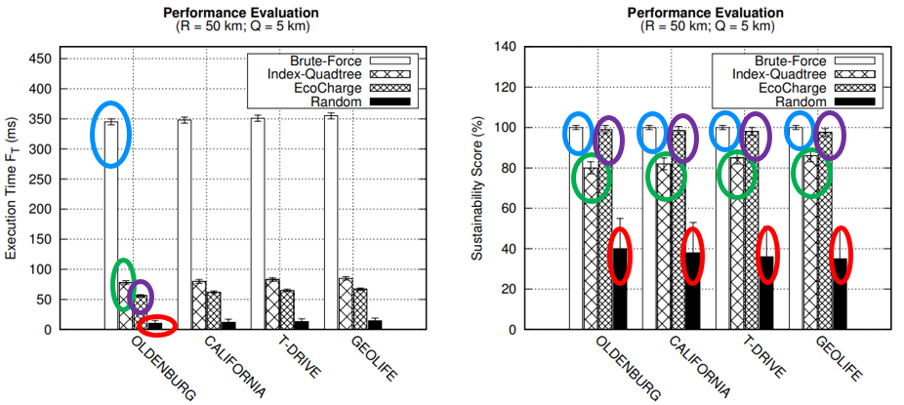
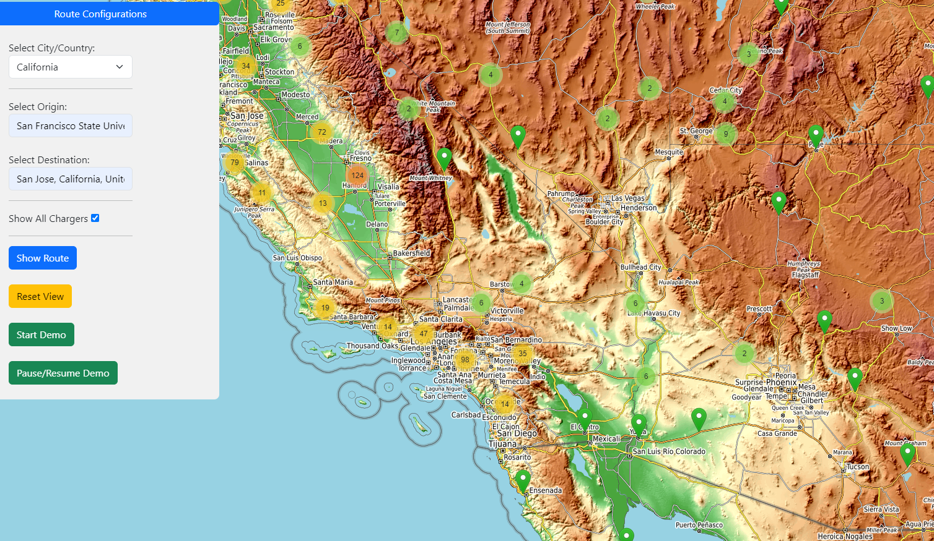
A Framework for Continuous kNN Ranking of EV Chargers with Estimated Components Soteris Constantinou ¹, Constantinos Costa ^{2,1}, Andreas Konstantinidis ^{3,1}, Mohamed F. Mokbel⁴, Demetrios Zeinalipour-Yazti ¹ ¹ University of Cyprus, Cyprus | ² Rinnoco Ltd, Cyprus | ³ Frederick University, Cyprus | ⁴ University of Minnesota, USA
Motivation
Renewable Energy Hoarding
Energy hoarding: people frequently tend to charge their EVs during idle times, even when the battery is not substantially depleted, to ensure that the vehicle will be charged sufficiently when needed
Benefits:
Charge EVs using power generated from renewable sources to maximize renewable (e.g., solar) self-consumption
Reduce carbon footprint & CO₂ emissions
Minimize the need for expensive stationary batteries on the electricity grid to store renewable energy
14% of the world’s carbon dioxide emissions originate from the transportation sector
In the U.S., the EV energy demand for charging was 4.7 TWh in 2020, and is expected to increase to ≈107 TWh by 2035
European’s Commission calls for a climate-neutral Europe by 2050
Challenge: where to sustainably hoard depends on a variety of Estimated Components (ECs) on where and when to charge, such as:
The available clean power at the charger, which depends on the estimated weather
The charger availability, which depends on the estimated busy timetables that show when the charger is crowded
The derouting cost, which is the time to reach the charger depending on estimated traffic
[1] "A Sustainable Energy Management Framework for Smart Homes", S. Constantinou, C. Costa, A. Konstantinidis, P. K. Chrysanthis and D. Zeinalipour-Yazti, IEEE Transactions on Sustainable Computing (TSUSC'24), IEEE Computer Society, 2024.
[2] "A Framework for Continuous kNN Ranking of EV Chargers with Estimated Components", S. Constantinou, C. Costa, A. Konstantinidis, M. F. Mokbel, D. Zeinalipour-Yazti, 40th IEEE International Conference on Data Engineering (ICDE'24), 2024.
[3] "An IoT Data System for Solar Self-Consumption", S. Constantinou, Nicolas Polycarpou, Constantinos Costa, A. Konstantinidis, Panos K. Chrysanthis, D. Zeinalipour-Yazti, The 24th IEEE International Conference on Mobile Data Management (MDM'23), 2023.
[4] "Green Planning of IoT Home Automation Workflows in Smart Buildings", S. Constantinou, A. Konstantinides, P. K. Chrysanthis and D. Zeinalipour-Yazti, ACM Transactions on Internet of Things (TIOT'22), 2022.
[5] "Green Planning Systems for Self-Consumption of Renewable Energy", S. Constantinou, A. Konstantinidis and D. Zeinalipour-Yazti, IEEE Internet Computing (IC'22), 2022.
EcoCharge: Algorithm
EcoCharge: System Architecture
Filtering Phase: ensures that only the k most suitable chargers are considered, while pruning all the rest, according to EV location
Refinement Phase: utilizes a Continuous k-Nearest Neighbor query, where the distance function is computed using Estimated Components (i.e., a query we term CkNN-EC)
EcoCharge : User Interface
EcoCharge Performance
Brute Force achieves the best Sustainable Score (SC), but the worst Execution Time (Ft)
Index-Quadtree provides reasonable SC ≈ 80-85% and faster Ft than Brute Force Ft ≈ 78-85 ms
Random has the worst SC ≈ 30-40% and Ft ≈ 10-15 ms
EcoCharge achieves great performance with Ft ≈ 56-67 ms and SC ≈ 97.5-99%
Users can easily configure their preferences along with their desired destination and receive route information, leveraging the application’s functionality for efficient navigation
Drivers can view all available chargers in a selected city/country
Presents information in a visually engaging and accessible manner
https://ecocharge.cs.ucy.ac.cy/
Contact: dmsl@ucy.ac.cy
https://dmsl.cs.ucy.ac.cy/

