Slide 1

Off-the-shelf Data Analytics on Serverless
EPL646: Advanced Topics in Databases
Michael Wawrzoniak, Gianluca Moro, Rodrigo Fraga Barcelos Paulus Bruno, Ana Klimovic, and Gustavo Alonso. 2024. Off-the-shelf Data Analytics on Serverless. In Proceedings of the 14th Annual Conference on Innovative Data Systems Research (CIDR 2024), January 14-17, 2024, Santa Cruz, CA, USA. CIDR. 10 pages. https://doi.org/10.3929/ethz-b-000646171
Presented by Canciu Ionut - Cristian: icanci01@ucy.ac.cy
2024

Slide 2


Introduction
Background Context
Research Problem and Proposed Solution
Research Objectives and Methodology
Technologies Used Overview
Evaluation, Results, Analysis and Findings
Limitations and Opportunities
Conclusion

Slide 3
Background Context

Slide 4
Off-the-shelf Data Analytics
Pre-built Solutions: Designed to be readily usable - minimum need for custom software development
Wide Applicability: Suitable for various industries and data types, enhancing their versatility
Key Features:
  Data processing: Handles large volumes of data efficiently
  Visualization: Provides tools for data representation and interpretation
  Advanced analytics: Supports complex analytical operations, predictive modelling, and machine learning
Benefits:
  Rapid integration with existing IT environments
  Immediate insights from data with reduced preparatory work
  Cost-effective as they reduce the need for specialized software development
Common Tools:
  Apache Spark for large-scale data processing
  Apache Drill for SQL-like query execution on large datasets

Slide 5
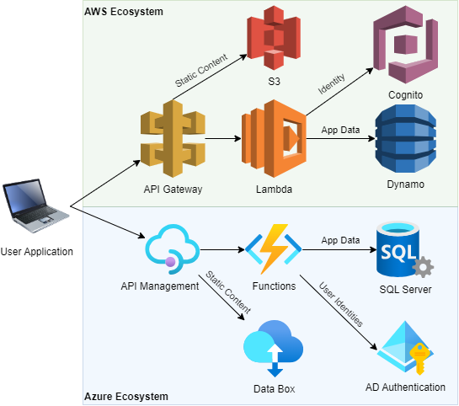
What is Serverless?
Serverless computing, often embodied by Function-as-a-Service (FaaS) and Backend-as-a-Service (BaaS), represents a cloud computing paradigm where the complexity of server management is abstracted away from developers.
Technical aspects:
  Event-Driven and Stateless
  Auto-scalability
  No Server Management
  Pay-As-You-Go Pricing
  Immediate Start Times

Slide 6
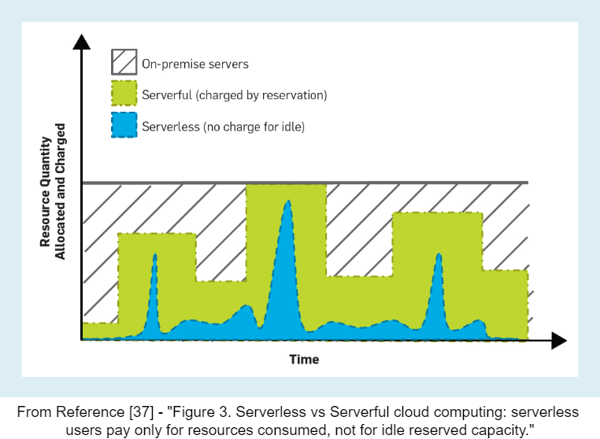
What is Serverless?
Event-Driven and Stateless
  Execute in response to events and are stateless, with each invocation handling a single request or event.
Auto-scalability
  Resources automatically scale based on the volume of requests without manual intervention
No Server Management
  Developers do not manage server instances, operating systems, or runtime environments - managed by the cloud provider
Pay-As-You-Go Pricing
  Charges are determined by the actual resource usage of an application, instead of by units of capacity bought in advance
Immediate Start Times
  Serverless platforms can initiate functions within milliseconds, allowing for responsive scaling to incoming requests.

Slide 7
Advantages of Serverless
Dynamic and Automatic Elasticity: Responsive and dynamic allocation of computational resources
Fine-Grained Billing: Billed for the exact amount of resources consumed, without needing to pay for idle capacity
Hands-Off Infrastructure Management: Cloud provider handles all aspects of infrastructure management
AWS Lambda
Azure Functions
IBM Cloud Functions
Google Cloud Functions
Alibaba Cloud Function Compute

Slide 8
Historical Perspective
Evolution of VM Specifications
  Early VMs, such as AWS EC2 instances launched in the late 2000s, had hardware specifications (memory and CPU) comparable to today's AWS Lambda functions
Growth of FaaS Platforms
  AWS Lambda functions, although seen as resource-restricted, align closely with the hardware specifications available when major data analytics platforms like Spark and Zookeeper were initially developed
Software vs. Hardware Evolution
  Hardware capabilities in cloud environments have evolved more rapidly than the core architecture of many data analytics engines, which have remained largely unchanged

Slide 9
Research Problem and
Proposed Solution

Slide 10
Challenges of Serverless in
Data Analytics
Serverless platforms, such as AWS Lambda, are often not well-suited for data analytics tasks due to limitations imposed by commercial serverless offerings
Limitations:
  short function lifetime
  lack of persistent state
  direct communication challenges
  higher cost compared to VMs
Inefficient for heavy and continuous data processing demands

Slide 11
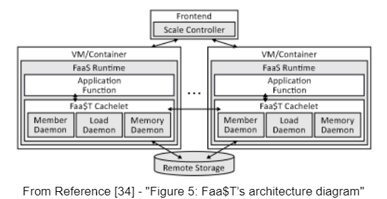
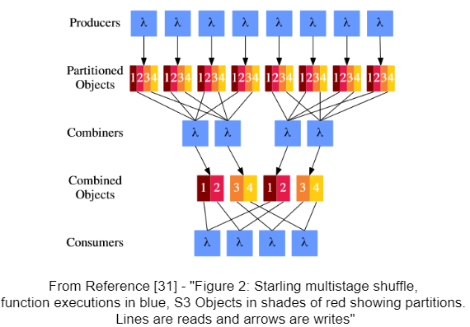
Existing Approaches
Extending Existing Serverless Platforms
  Integration with VM-based services
  Example: Adding state management and improving performance consistency to accommodate complex analytics (Faa$T)
Developing New Serverless Engines
  Purpose-built data analytics solutions
  Focus: Targets optimization of communication
  and state persistence (Starling)

Slide 12
Existing Approaches
Those approaches are feasible, but why change the existing infrastructure and/or computational engines?

Slide 13
Proposed Alternative
Leveraging a minimal interposition layer so that off-the-shelf distributed data processing platforms like Apache Spark and Apache Drill can run directly on existing serverless infrastructures such as AWS Lambda Utilizing Existing Platforms: No need for infrastructural changes
Interposition Layer: Introduces a thin layer, Boxer, to bridge the gap between the data processing engines and the serverless environment
  Functionality: Makes serverless functions resemble traditional networked VMs or containers, allowing for standard operational procedures of data engines

Slide 14
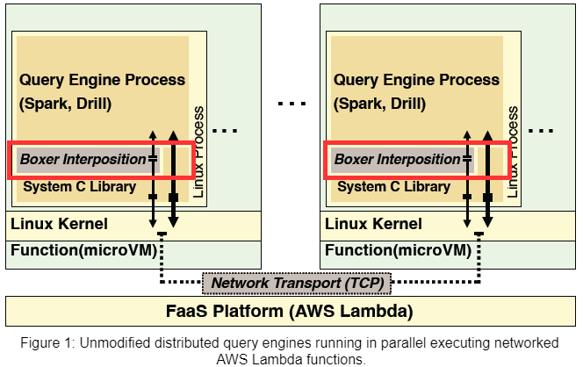
Proposed Alternative

Slide 15
Research Objectives and Methodology

Slide 16
Research Objectives
Leverage Serverless for Data Analytics: Adapt traditional data analytics platforms to function efficiently on serverless architectures
Extend Serverless Capabilities: Demonstrate that serverless platforms can support complex, resource-intensive applications
Overcome Resource Limitations: Address the challenges of resource restrictions and initialization latencies in serverless environments
Optimize Performance and Cost: Achieve performance optimization and cost-effectiveness

Slide 17
Methodology
Initialization of Function Pools: Create pools of parallel-running function instances for specific engine needs
Interposition Layer Implementation: Implement a layer to emulate traditional networking within serverless functions [Using the Boxer tool]
Network Transport Configuration: Set up TCP via NAT hole-punching for inter-function communication [Using the Boxer tool]
Executing Functions in Parallel
Application Transparency
Network Transport

Slide 18
Executing Functions in Parallel
Serverless Event-Driven Scheduling
  Serverless platforms schedule functions based on events, offering flexible resource management but diverging from traditional parallel process expectations
Engine-Specific Function Pools
  A pool of function instances is created to run in parallel, matching the requirements of the data analytics engines to maintain their operational model

Slide 19
Application Transparency
Interposition Layer Mechanics
  Dynamic linker to redirect certain C Library function calls to an interposition library, emulating a traditional network environment within serverless functions
Transparent Network Handling
  Intercepts network-related system calls (e.g., name resolution, connect) to provide seamless connectivity between distributed functions
  Make the serverless function environment appear as a conventional networked system to the query engines
Orchestration-Level Integration
  Supports using Docker Compose for orchestrating serverless instances with Boxer base images
  Containerized and serverless deployments can operate with the same level of transparency without modifying the query engines

Slide 20
Network Transport
TCP Communication Challenges
  Serverless platforms typically restrict TCP connections to only external endpoints, not allowing direct TCP connections between different function instances within the platform
NAT Hole-Punching Implementation
  Utilize NAT hole-punching techniques to establish TCP connections directly between function instances
Alternative IP-Forwarding Option
  IP-forwarding through EC2 instances is available, NAT hole-punching is preferred for its better performance
  Stream socket communications needed by the query engines

Slide 21
Technologies Used Overview

Slide 22
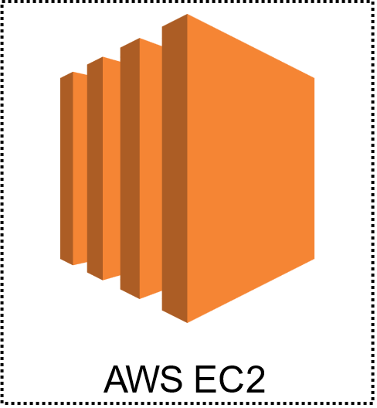
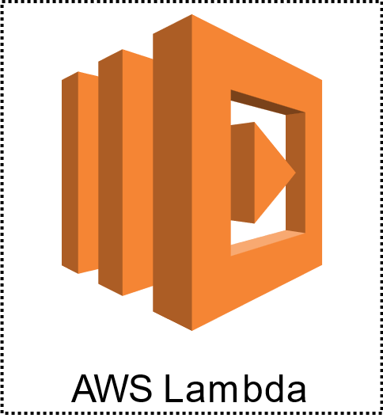
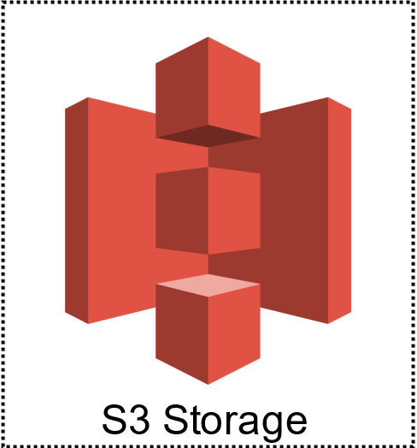



Technologies Overview
Boxer Tool
Docker Compose
AWS S3 Storage
AWS EC2
AWS Lambda
Apache Spark
Apache Drill

Slide 23
Boxer Interposition Layer
Boxer is a system designed to enable direct network communication across serverless functions, specifically on platforms like AWS Lambda. It leverages standard networking protocols to allow serverless functions to interact without intermediary services
How it works:
  TCP/IP and Standard Sockets
  Overcomes AWS Lambda Limitations: Enabling outgoing connections and circumventing restrictions on incoming requests
Key Components of Boxer:
  Boxer Hole-Punching Service: Network address translations and connection establishment
  Coordinator Service: Handles orchestration and control
  Transparent Compatibility Module: Use serverless networking without modification

Slide 24
Boxer Interposition Layer
Operational Process:
  Initialization: Local Coordinator connects to a seed Coordinator to join the network
  Hole Punching: Each function instance requests NAT holes to be punched to facilitate new incoming network requests from other functions
  Connection Establishment: TCP connections are established, allowing for direct function-to-function communication
Performance and Impact:
  Low Latency and High Throughput
  Enhanced Data Processing

Slide 25
Cloud Software Used
Docker Compose
  Utility for configuring and executing applications with multiple Docker containers
  Utilized for orchestrating multiple containers to simulate a distributed environment
Amazon EC2 (Elastic Compute Cloud)
  Scalable computing capacity in the Amazon Web Services (AWS) cloud. It allows users to run virtual servers
  Used to evaluate the performance and scalability of the proposed solution under a controlled, virtualized environment
  → comparison point against serverless architecture
AWS Lambda
  Serverless computing service that executes code in reaction to events
  For testing the feasibility and performance of the proposed off-the-shelf data analytics frameworks in a serverless environment where Boxer was used
Amazon S3 (Simple Storage Service)
  Object storage service
  Store and retrieve any volume of data at any time → solution for handling large datasets and benchmarks used in the research

Slide 26
Distributed Data Processing
Apache Spark
  Comprehensive analytics engine designed for processing large scale data
  Operates on a distributed cluster computing framework.
  Optimizes tasks across a computing cluster by dividing data into resilient distributed datasets (RDDs)
Apache Drill
  SQL query engine without a fixed schema, optimized for analysing large-scale data
  Supports a wide variety of NoSQL databases and file systems
  Distributed architecture that allows querying data from multiple data stores with a single query without moving data

Slide 27
Evaluation
Results, Analysis and Findings

Slide 28
Evaluation and Experiment Setup
Query Engines Tested: Apache Spark and Apache Drill
Benchmarking Tool: TPC-H benchmarks at scale factors 10, 30, and 100
Data Storage and Format: Data stored in Parquet format on AWS S3, compressed with Snappy and partitioned into 100MB segments
Function Configurations: AWS Lambda functions configured with 10GB of memory and 6 virtual cores
Node Configuration: Experiments with 8, 16 and 32 worker nodes for both Apache Spark and Apache Drill Control and Termination: Each query engine instantiation controlled by a dedicated function that handles setup, execution, and teardown of the query environment
Cold Start Emphasis: Ensured cold starts by resetting function registrations after each query to eliminate caching effects
Comparison with VMs: Parallel measurements conducted on EC2 VMs, also limited to 6 virtual cores and 10GB of memory – comparative baseline
Software Versions: Spark 3.32, Drill 1.21.1, Zookeeper 3.7.1, and Amazon Corretto 17 JVM

Slide 29
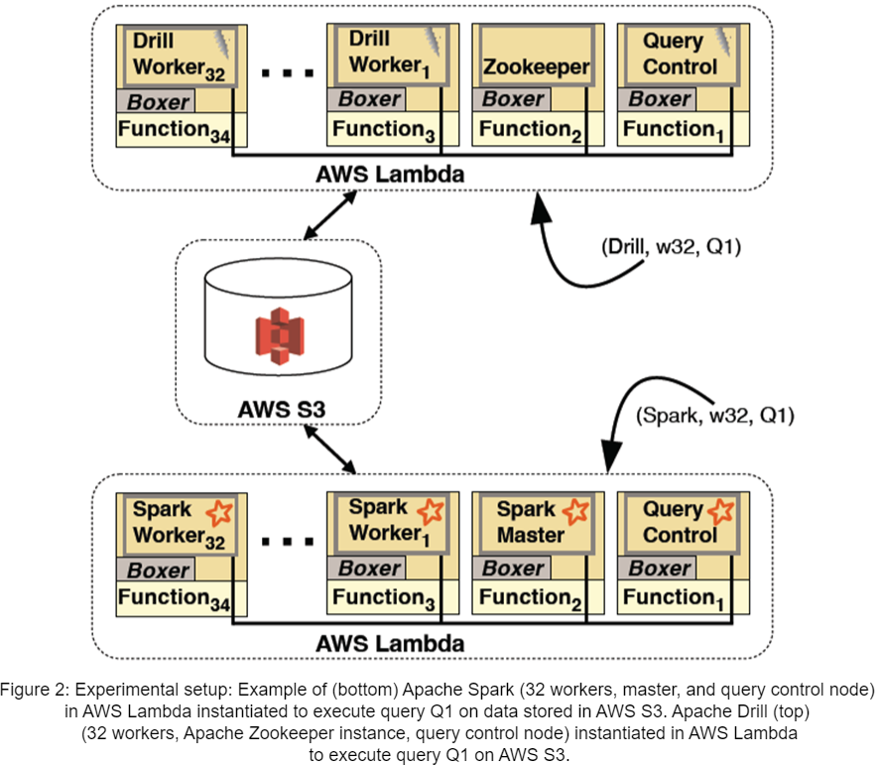
Evaluation and Experiment Setup

Slide 30
TCP-H Results
Feasibility Demonstrated: Unmodified Apache Spark and Apache Drill can operate within AWS Lambda
Performance Comparison: AWS Lambda comparable performance to EC2 VMs
Memory Constraints Issues: Limitations with memory-intensive queries on smaller worker configurations
Execution Variability: Higher variance in execution times for Spark on Lambda compared to EC2
Query Completion Consistency: All configurations completed the majority of queries successfully, except challenging queries exceeding resource limits (memory and file descriptors)
Scaling Effects: Scaling up the number of worker nodes or reducing the data scale factor showed relative performance improvements
Network Throughput Influence: Differences in network throughput between Lambda (629Mbit/s) and EC2 (975Mbit/s)

Slide 31
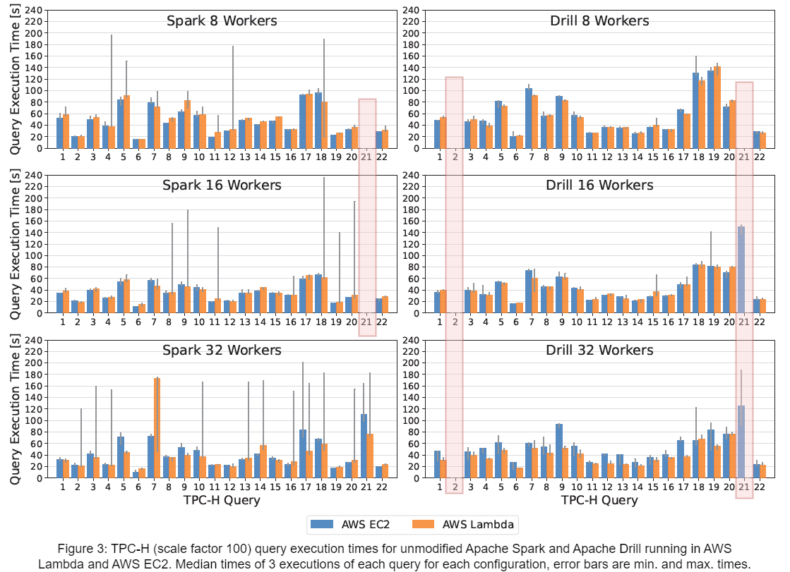
TCP-H Results

Slide 32
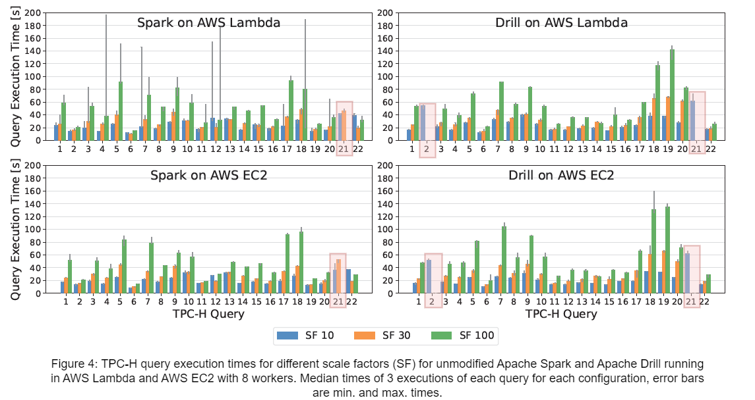
TCP-H Results

Slide 33
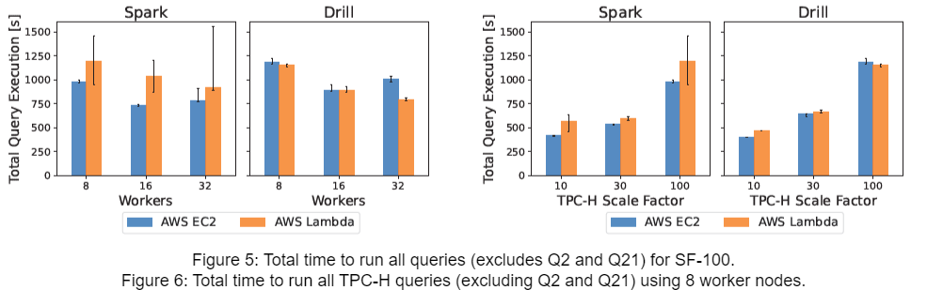
TCP-H Results

Slide 34
Initialization of Query Engine
Engine Startup Phases: Two main phases: 'Engine Start' and 'Query Start'
Startup Times Overview: Measured from availability of AWS Lambda functions to query is ready to be executed
Detailed Initialization Breakdown:
  Engine Start: Time taken for the master node (Spark) or Zookeeper (Drill) and worker nodes to start and synchronize
  Query Start: Additional preparations needed for engines to be query-ready, such as catalogue updates in Drill and executor allocation in Spark
Impact of Worker Count: Both engines show increased initialization times as the number of worker nodes increases (Spark experiencing more variability)
Observations of Variability:
  Drill: Maximum start times significantly higher than median (delays due to slower worker nodes joining)
  Spark: Higher dispersion in start times on Lambda compared to EC2 (platform-specific challenges)

Slide 35
Limitations and Opportunities

Slide 36
Limitations
Long Initialization Time: Data analytics platforms and JVM runtimes have significant initialization times
Snapshot Limitations: Decisions about how specific engine configurations need to be and at what point in the initialization phase snapshots should be taken
Use Case Restrictions: Serverless platforms impose limitations such as fixed time limits on function invocations (e.g., AWS Lambda's 15-minute cap) which affect the handling of long-running tasks
Resource Flexibility: Serverless workers offer limited flexibility in resource configurations
Pricing and Efficiency: Pricing model of serverless platforms might not be cost-efficient for certain types of data analytics workloads
Implementation Challenges: Early prototypes have exhibited failures which need further investigation
Compatibility and Coverage: The System C Library interposition layer currently does not cover enough interface surface area to support all applications effectively

Slide 37

Opportunities for Future Work
Expand Engine Support: Include Trino, Databend, Clickhouse
Dynamic Scalability Investigations: Manage peak demands efficiently
Inter-Region Processing: Optimize latency and throughput
Resource Allocation Optimization: Enhance cost-performance balance
Advanced Caching Mechanisms: Implement Memcached, Redis
Declarative Serverless Models: Explore and integrate Dandelion
Specialized Serverless 'Worklets': Develop task-specific configurations
Framework Development: Create a versatile serverless framework

Slide 38
Conclusion

Slide 39
Conclusion
Feasibility of Serverless Data Analytics: Unmodified, off-the-shelf data analytics engines like Apache Spark and Apache Drill can be effectively run on serverless platforms.
Comparable Performance: Performance of these data analytics engines on serverless infrastructure is comparable to their performance on traditional networked VMs
Innovative Integration: Successful integration of traditional data analytics tools with modern serverless architectures
Future Potential: Opened new pathways for leveraging existing data analytics capabilities within serverless environments

Slide 40

Thank you!!

Slide 41
Extras

Slide 42

AWS Lambda SnapStart
Snapshot Technology: Utilizes pre-built snapshots to minimize cold start times, significantly improving function initialization speed
Performance Boost: Enhances responsiveness and performance of serverless applications by reducing the time to become fully operational
Ideal for Scalable Apps: Perfect for scenarios demanding rapid scalability without the lag of traditional cold starts
Firecracker MicroVMs: SnapStart leverages Firecracker MicroVMs, providing lightweight, secure virtualization for each function
Efficient Resource Management: Firecracker helps manage serverless compute resources efficiently, optimizing both cost and performance by reducing overhead

Slide 43
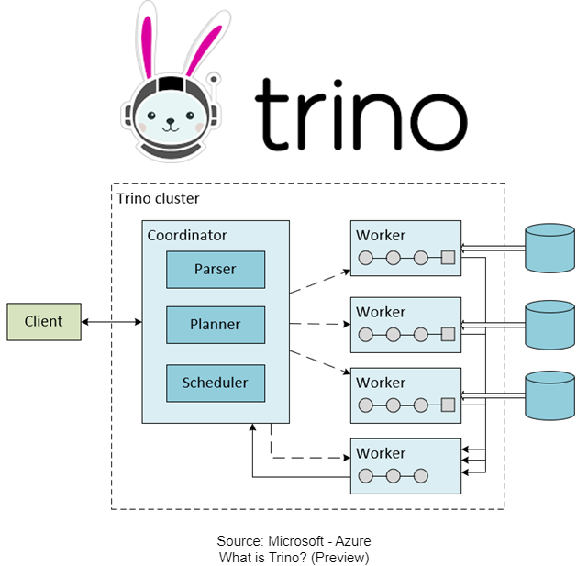
Trino
SQL Engine: Designed for high-speed query execution across distributed data sources
Big Data Compatible: Works efficiently with large datasets in a distributed environment
User-Friendly: Supports standard ANSI SQL for data analysis

Slide 44
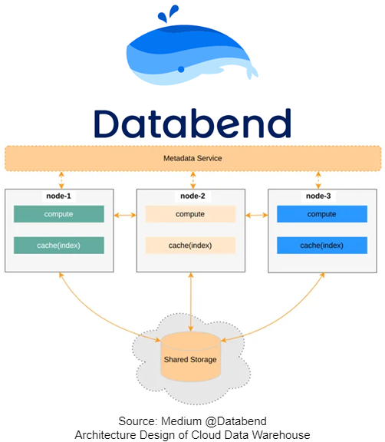
Databend
Cloud Native: Built for cloud environments with a focus on elasticity and performance
Real-Time Analysis: Optimized for real-time analytical workloads
Modern Architecture: Uses a vectorized query engine for fast data processing

Slide 45
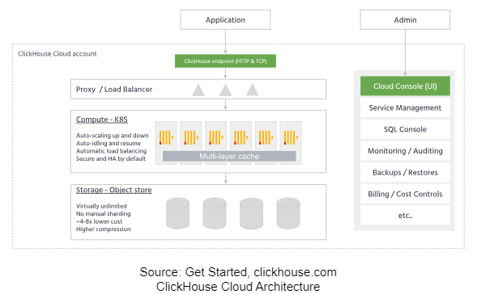
ClickHouse
Columnar Storage: Optimizes query performance across large datasets
OLAP: Ideal for online analytical processing tasks
Scalability: Designed to scale horizontally with ease across multiple nodes

Slide 46
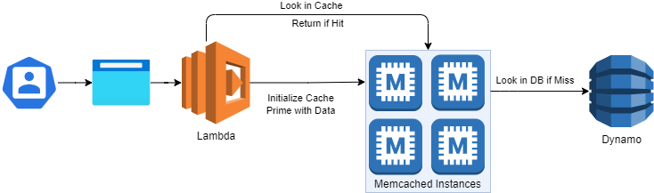
Memcached
Distributed Cache: Reduces database load by caching data in memory
Speed: Offers fast access to cached data to speed up web applications
Simple Integration: Widely used and supported by many programming languages

Slide 47
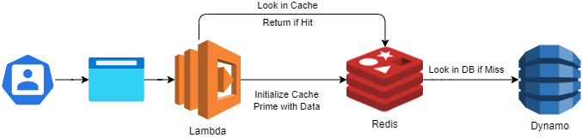
Redis
Advanced Data Structures: Supports strings, hashes, lists, sets, and sorted sets with range queries
Persistence: Offers configurable levels of durability with data persistence
Pub/Sub Messaging: Includes capabilities for real-time messaging and streaming

Slide 48
Dandelion
A Clean-Slate FaaS System
Compute and I/O Separation: Implements a distinct separation between computation tasks and I/O operations, optimizing resource usage and reducing startup latency
Lightweight Function Execution: Utilizes lightweight, secure sandboxes for function execution, significantly improving performance compared to traditional FaaS environments like Firecracker
Dataflow-Aware Scheduling: Employs a dataflow-aware scheduling mechanism, allowing more efficient resource management and operation, especially under variable workloads

Slide 49
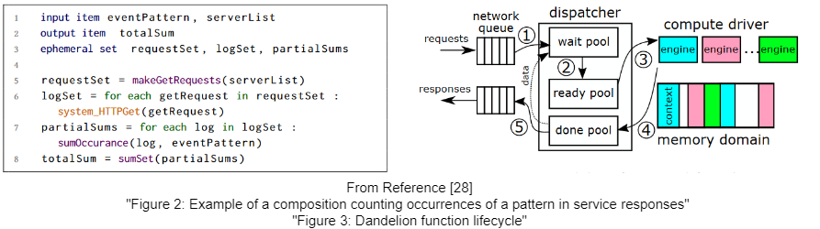
Dandelion
A Clean-Slate FaaS System

