Slide 1
DASH: Asynchronous Hardware Data Processing Services
EPL646: Advanced Topics in Databases
May, N., Ritter, D., Dossinger, A., Färber, C. and Demirsoy, S., 2023. DASH: Asynchronous hardware data processing services. In 13th Conference on Innovative Data Systems Research, CIDR (pp. 8-11).
By Ioannis Constantinou: iconst01@ucy.ac.cy

Slide 2
Introduction
Databases need to have a good trade-off between high performance and cost
One way to achieve this is by offloading compute-intensive operations from CPUs to HW-accelerators. In this research they focus on FPGAs which are becoming more widely available by cloud providers.
Notes:
You can start the presentation by briefly introducing yourself and your background, and explaining why you chose to speak about responsible data integration.
You can also provide some context about the importance of data in today's society and how data-driven decision-making is becoming increasingly common across many industries.

Slide 3
Background and Related Work
In general, cloud providers either employ FPGAs enclosed in their infrastructure or expose them as a service (FPGA-as-a-Service).
Hence, this gives us the opportunity to use this kind of accelerators for database systems
Notes:
To expand on this slide, you can provide some examples of how data is being used in different industries, such as healthcare, finance, and retail.
You can also discuss some recent examples of data breaches or misuse of data that highlight the importance of responsible data integration.

Slide 4
Background and Related Work
Marked green, is a setup where the FPGA communicates with the CPU using PCIe or UPI interconnects which offers high bw and relatively low latencies
Marked blue, is a setup where the FPGA is on the I/O path(network, memory or storage). Data transfer can be limited by latency or bandwidth of the interconnect and is considered a bottleneck.
Marked red, is the focus of this research paper where the FPGAs are connected to the database via network links. This brings the notion of scaling and elasticity based on the workload. One use case here is compression of persistent data.
Notes:
To expand on this slide, you can provide some examples of how data is being used in different industries, such as healthcare, finance, and retail.
You can also discuss some recent examples of data breaches or misuse of data that highlight the importance of responsible data integration.

Slide 5
Background and Related Work
Marked green, is a setup where the FPGA communicates with the CPU using PCIe or UPI interconnects which offers high bw and relatively low latencies
Marked blue, is a setup where the FPGA is on the I/O path(network, memory or storage). Data transfer can be limited by latency or bandwidth of the interconnect and is considered a bottleneck.
Marked red, is the focus of this research paper where the FPGAs are connected to the database via network links. This brings the notion of scaling and elasticity based on the workload. One use case here is compression of persistent data.
Notes:
To expand on this slide, you can provide some examples of how data is being used in different industries, such as healthcare, finance, and retail.
You can also discuss some recent examples of data breaches or misuse of data that highlight the importance of responsible data integration.

Slide 6
Background and Related Work
Marked green, is a setup where the FPGA communicates with the CPU using PCIe or UPI interconnects which offers high bw and relatively low latencies
Marked blue, is a setup where the FPGA is on the I/O path(network, memory or storage). Data transfer can be limited by latency or bandwidth of the interconnect and is considered a bottleneck.
Marked red, is the focus of this research paper where the FPGAs are connected to the database via network links. This brings the notion of scaling and elasticity based on the workload. One use case here is compression of persistent data.
Notes:
To expand on this slide, you can provide some examples of how data is being used in different industries, such as healthcare, finance, and retail.
You can also discuss some recent examples of data breaches or misuse of data that highlight the importance of responsible data integration.

Slide 7
FPGAs Challenges
Over the years , FPGAs have become more available by providers as another option for acceleration like a GPU.
This raises multiple challenges we must overcome like resource ceiling, reprogramming time, available interface bandwidth and difficulty of programming.

Slide 8
DASH Architecture
Database systems are split to compute and storage components
Asynchronous Data Processing: The Offloading Coordinator gathers statistics of the db system and enqueues actions as HW tasks.
The hardware task scheduler is responsible for scheduling the HW tasks and feeding stats to the offloading monitor
The offloading monitor checks the efficiency and health of the finished HW task and can instruct the OC to take action.(e.g. Remove failing FPGAs)

Slide 9
DASH Architecture
This architecture allows for scalability and elasticity as it separates the FPGAs/Accelerators from the database system.
To address concerns like security and cost of data transfers existing technologies that cloud providers have, can be used.

Slide 10
DASH Use case: Compression-as-a-Service
Implemented CaaS with DASH architecture on SAP HANA Cloud to evaluate DASH potential.
By default SAP HANA uses the front coding technique on the critical path to compress.
Used RePair compression technique in DASH to compress string dictionaries

Slide 11
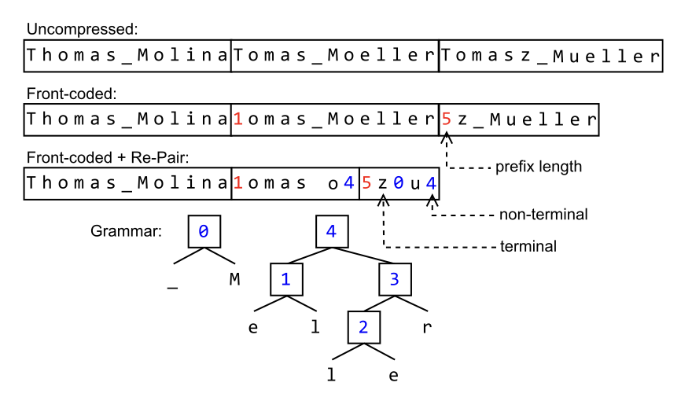
Front Coding and RePair Compression
Figure is from: Lasch, R., Oukid, I., Dementiev, R. et al. Faster & strong: string dictionary compression using sampling and fast vectorized decompression. The VLDB Journal 29, 1263–1285 (2020). https://doi.org/10.1007/s00778-020-00620-x

Slide 12
DASH Use case: Compression-as-a-Service
1 During the data processing of the db system, stats are collected about table sizes, number of unique values per column,etc… The coordinator(shown before) decides to take action.
2 enqueues task in scheduler
3 the HW dequeues
4 and assigns a task to a function which starts taking data from
5a the data store
5b the data stream
6 the task collects statistics
7 and reports them to the scheduler

Slide 13
Experimental Setup
For FPGA, Docker container with CentOS and an FPGA bit-stream for the compression.
Used the OpenCL programming language
Extracted 4923 columns of type (N)VARCHAR and CLOB. Total 47GB uncompressed data.

Slide 14
Results: RePair with FPGA vs Front Coding
This results is to confirm that RePair is still better than front coding with new workloads

Slide 15
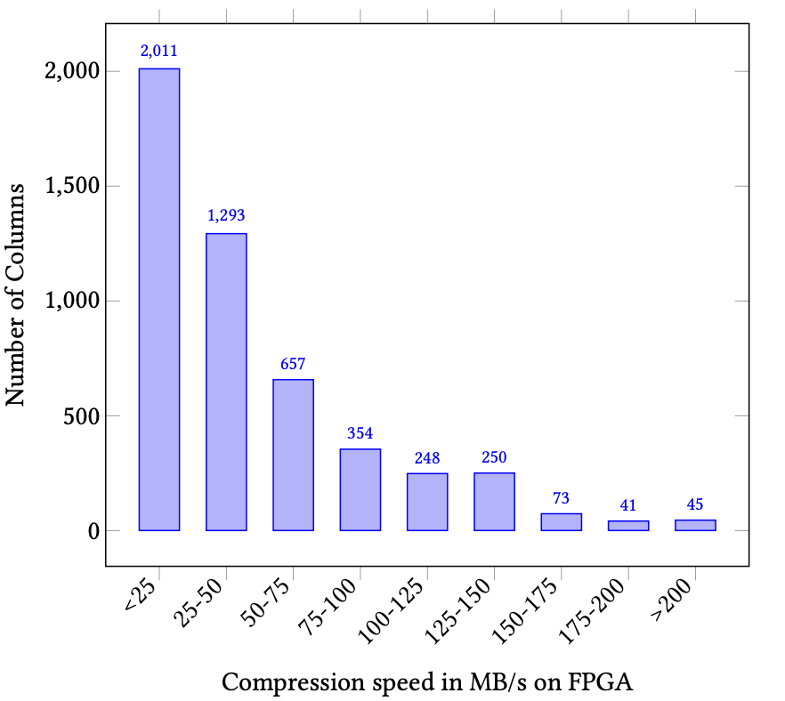
Analysis of compression throughput
Conclusion: RePair compression with DASH shows that network transfer is not a bottleneck and this task is mostly a compute-intensive operation.
Notes:
This is confirmation results that RePair is still better than front coding with new workloads

Slide 16
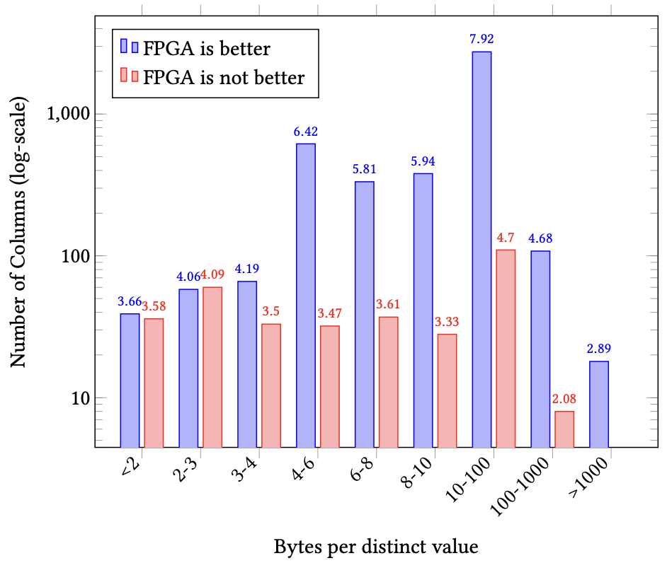
When to use RePair DASH for compression
Observation: For shorter than 3-bytes average entry RePair DASH does not improve over front coding but for longer they achieve better results.
Using this simple heuristic they showed that they reduced the memory consumption
Notes:
This is confirmation results that RePair is still better than front coding with new workloads

Slide 17
Cost Analysis of DASH
RePair with front coding reduces memory consumption by 50% and RePair reduces by another 50% the remaining uncompressed data.
At 100 MB/s it can compress 8.6TB of data per day
Assuming two merge operations per day this corresponds to 4.3TB which will be reduced to 2.3TB with front-coding and to 1.075TB with RePair DASH.
So based on the costs of using SAP HANA compared to an amazon f1 instance the savings are more than 13,000 euros.

Slide 18
Conclusion and Future Research
Main limitation of scaling with FPGAs is the tight coupling of them with the database systems
They addressed this issue by designing a decoupled architecture, DASH, and basically creating this new perspective of FPGA-as-a-Service and showed the benefits of using this architecture using compression for string dictionaries
They believe this setup could work to a wide range of database operations (Machine Learning, Graph or JSON processing).
Future research is needed in terms of security, monitoring and more, to be able to apply this architecture to large-scale deployments.

Slide 19
Thank you!

