Slide 1

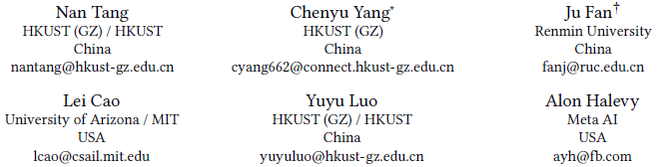
VerifAI: Verified Generative AI
EPL646: Advanced Topics in Databases
By Stelios Karagiorgis: skarag03@ucy.ac.cy

Slide 2

Abstract
Progress and concerns: While Generative AI has advanced significantly, concerns about its output accuracy and reliability are increasing
Current efforts: Current efforts to mitigate these risks
Proposed solution: Verifying generative AI outputs from a data management perspective
Foundation for evaluation: A method for evaluating the correctness of generative AI outputs
Vision for verifiable generative AI: Support more trustworthy and responsible AI usage
Notes:
Progress and concerns: οδηγεί σε πιθανές συνέπειες όπως παραπληροφόρηση, παραβιάσεις απορρήτου, νομικές υποχρεώσεις και άλλα
Current efforts: την δημιουργία κάποιων regulations, το οποίο εστιάζεται στο transparency, privacy, bias mitigation, and social responsibility. Η παραπληροφόρηση παραμένει μια σημαντική πρόκληση.
Foundation for evaluation: Ελέγχει την ορθότητα των αποτελεσμάτων που παράγει το AI
Vision: υποστηρίζει πιο αξιόπιστη και υπεύθυνη χρήση AI

Slide 3
Introduction
High-quality data necessity: Accurate decision-making helps prevent the spread of false information
Security and privacy: Essential to ensure that data used for decision-making is secure and maintains privacy (important for government)
Real-world data challenges: Despite efforts across fields to address data incompleteness, inconsistency, or inaccuracy
Generative AI's transformative potential: Advanced models like GPT-4 and Midjourney show promise in various domains
Risks of bad generative AI data: Inaccurate decision-making can lead to privacy violation
Enhanced risks with generative models: The use of bad data can destroy the reputation of an organization
Notes:
High-quality data necessity: η ακριβής λήψη αποφάσεων, βοηθά στην αποτροπή της διάδοσης ψευδών πληροφοριών
Security and privacy: αυτό είναι ιδιαίτερα σημαντικό σε τομείς όπως τα οικονομικά, η υγειονομική περίθαλψη και η κυβέρνηση, όπου τα δεδομένα μπορούν να περιέχουν ευαίσθητες και προσωπικές πληροφορίες
Real-world data challenges: περιέχουν error, είτε από ανθρώπινο λάθος, είτε κατά την διάρκεια συλλογής των δεδομένων
Generative AI's transformative potential: Το Generative AI έχει τη δυνατότητα να μεταμορφώσει διάφορα πεδία. Τις απάντησεις σε ερωτήσεις φυσικής γλώσσας, δημιουργία εικόνων για διαφήμιση
Risks of bad generative AI data: Τα λάθος δεδομένα μπορούν να οδηγήσουν σε privacy violation

Slide 4
Verified Generative AI: The Problem
Modular Framework: VerifAI consists of three main components:
  Indexer
  Reranker
  Verifier

Slide 5
Verified Generative AI: The Problem
Indexer Module
Two main principles:
  Task-agnostic: Works for many different types of tasks, making it very flexible.
  Supports two search types: Can do text search and advanced vector-based

Slide 6
Verified Generative AI: The Problem
Indexer Module
Uses two indexing systems:
  Elasticsearch: For searching based on the content of text files or tables turned into strings.
  Meta Faiss: Uses embedding techniques like turning text into vectors
Uses Elasticsearch for basic text search
Uses Meta Faiss for advanced searches the find similar content

Slide 7
Verified Generative AI: The Problem
Reranker
Initial Ranking: Results from different indexes are first ranked broadly without much detail
Use of Reranker: To get more precise and relevant results
Reranking Approaches:
  For text-to-text
  For text-to-table
Future Plans: Adding more reranking methods
Notes:
Initial Ranking: κατατάσσωνται σε γενικές γραμμές χωρίς πολλές λεπτομέρειες
Future Plans: different types of data pairs, like tuple-to-tuple or text-to-tuple.
There are different ways to make the results better, depending on whether it's text or tables.

Slide 8
Verified Generative AI: The Problem
Verifier
Purpose: Determines if generated data is correct or not
Two Types of Verifiers:
  General model: like ChatGPT
  Specific and localized models: Designed for particular tasks
Reasons for Specific Models:
  Data privacy: Important for sensitive data
  Better accuracy: Models built for specific tasks usually check things more correctly than one-size-fits-all models

Slide 9
Verified Generative AI: The Problem
Challenges
Improving Indexing: search for data across different formats more accurate
Better Verification: check information against different types of data
Ensuring Trustworthiness: understand how reliable different data sources are
Documenting Verification History: Keeping records of the verification process

Slide 10
Preliminary Results:
Setting
Initial Testing: Check accuracy of AI-generated information
Tasks Evaluated: Filling in gaps in data tables, verifying text claims against tables, and generating text.

Slide 11
Preliminary Results:
Setting
Data for Testing:
  100 tuples from web tables
  1,300 textual claims
  19,498 tables
  13,000 text files

Slide 12
Preliminary Results:
Methodology
Used ChatGPT to guess missing information in tables
Check if these guesses were right
Tested the system's ability to verify text claims using relevant tables.
Notes:
Data Used: The experiments used a mix of 100 data table rows and 1,300 text-based claims, tested against a large pool of tables and text documents.

Slide 13
Preliminary Results:
Key Findings
Retrieval recall was good for tuples and tables but lower for associated text files.
ChatGPT showed high accuracy in verifying if filled-in data was correct.
For text claims, the system worked well when it used the correct tables but had issues with unrelated tables.
In some tests, a specialized model called PASTA was used and performed better than ChatGPT when the right table was provided.

Slide 14
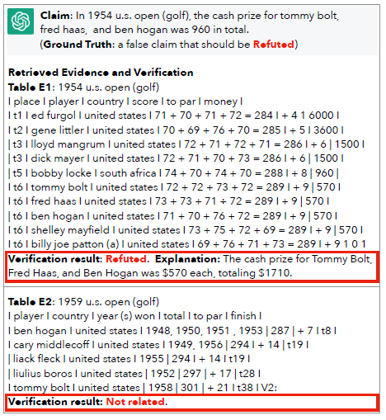
Preliminary Results:
Overall Insights
Without additional information, ChatGPT wasn’t very accurate on its own in verifying data.
The system needs to be improved in identifying relevant text files and using reranking to get better results

Slide 15
Open Problems
Cross-Modal Data Discovery: how to find and use data from different formats
Cross-Modal Verification: check the truthfulness of AI-generated data
Data Source Trustworthiness: how to measure and trust the quality of various data sources
Provenance Management: keep track of where and how data is verified for future checks
Managing Generated Data: Need strategies for handling and using the vast amounts of data

Slide 16

Thank you!

