Slide 1

Data Pipes: Declarative Control over Data Movement
EPL646: Advanced Topics in Databases
Lukas Vogel (Technische Universität München); Daniel Ritter (SAP); Danica Porobic (Oracle); Pinar Tozun (IT University of Copenhagen)*; Tianzheng Wang (Simon Fraser University); Alberto Lerner (University of Friborug). Data Pipes: Declarative Control over Data Movement.
By Markos Othonos: mothon01@ucy.ac.cy

Slide 2

Introduction
Datacenter trends: increasing usage of NVMe - low latency SSD and Persistent Memory.
Each device has different access size and different libraries (or APIs).
The programmer may need to be exposed to low level details to write an optimized program!
Small, hidden tweaks may have tremendous impact on the performance.

Slide 3
Contents
Different types of memories
Data transfer “shortcuts”
Challenges of “shortcuts”
Application of “shortcuts” on ExternalSort
Data Pipes

Slide 4
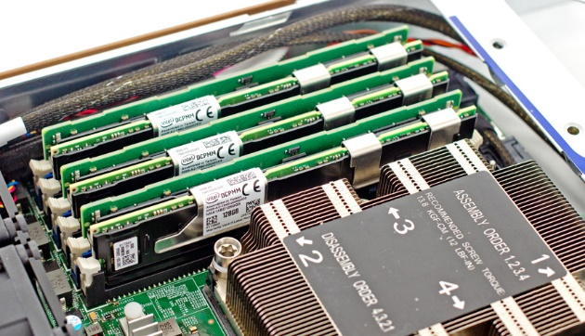
Cache
Technology – SRAM.
LLC – MBs, L2 – Hundreds of kilobytes.
Cache line – 64 Bytes.
Very fast.
Very expensive.
Notes:
Also has XP-Buffer with KBs of capacity

Slide 5
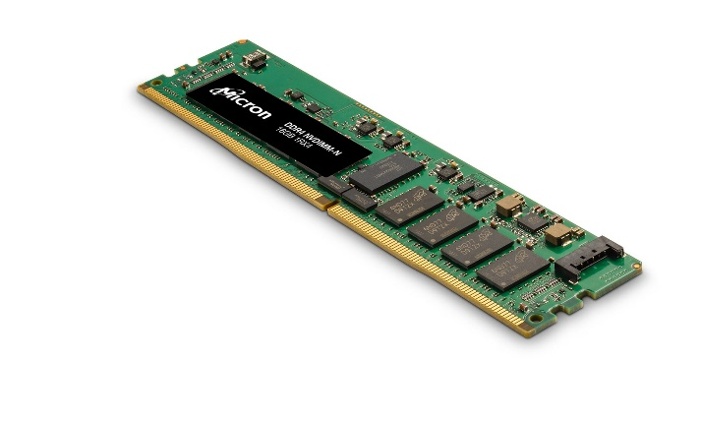
DRAM
Technology – DRAM.
Size per Device – tens of GBs.
Access size – 64 Bytes (cache line size).
Generally good performance with all access paterns.
Expensive.
Notes:
Also has XP-Buffer with KBs of capacity

Slide 6
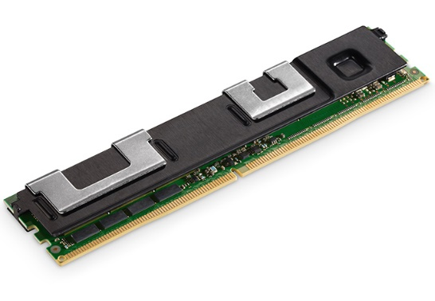
Optane DCPMM
Technology – 3DXPoint.
Size per Device – hundreds of GBs.
Access granularity – 64 Bytes.
Media Access granularity – 256 Bytes.
Can be inserted in DIMM slots!
Excels at large sequential accesses.
Less expensive than DRAM (per GB).
Notes:
Also has XP-Buffer with KBs of capacity

Slide 7
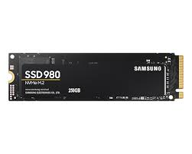
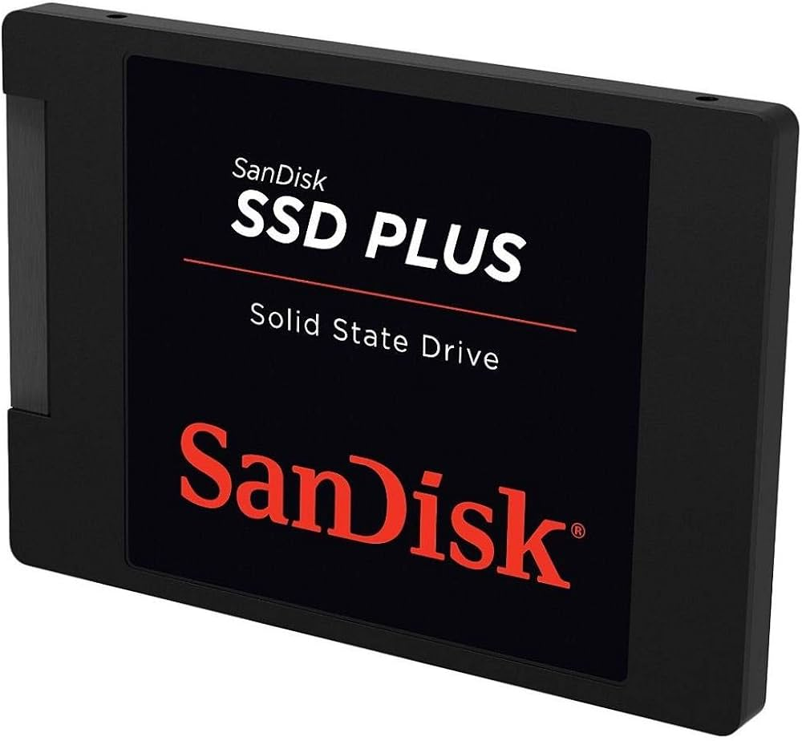
NVMe - SSD
Technology – Flash
Size per Device – TBs
Access granularity – 4KBs
Notes:
Also has XP-Buffer with KBs of capacity

Slide 8
Cache Shortcuts
CLDEMOTE: Send Cache line to higher level cache (LLC).
CLFLUSH: Send cache line directly to the Main Memory.
Explicit operations like these can help the programmer with optimization.

Slide 9
Useful Shortcuts
DDIO: Allows PCIe writes directly to the LLC, in a small dedicated section.
Lowers latency even further, no need to access main memory!
Contention in the LLC-DDIO region is a big problem.
LLC
DDIO
Section

Slide 10
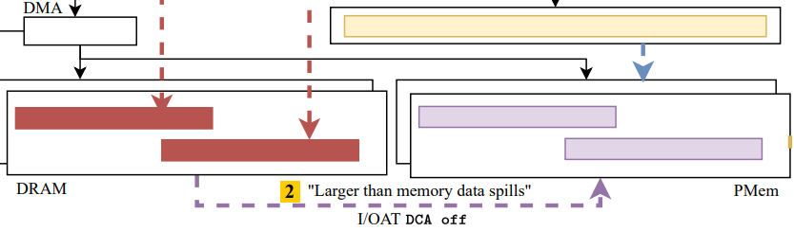
Useful Shortcuts
I/OAT: Move data between DRAM and PMem.
The DMA engine handles the data movement.
No need to involve cores in this matter.
Notes:
I/OAT: I/O Acceleration Technology

Slide 11
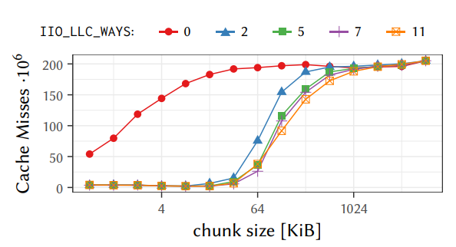
Challenges
To use DDIO optimally, it is advised to change the value of a hidden msr (default value: 2*).
May largely reduce LLC misses for some workloads.
It is unreasonable to expect an average programmer to know this.
*default value on skylake and cascade lake is 0x600 -> 2 bits set. Link: https://www.usenix.org/system/files/atc20-farshin.pdf
Notes:
Msr -> model specific register
This specific msr is undocumented, and was uncovered by farshin

Slide 12
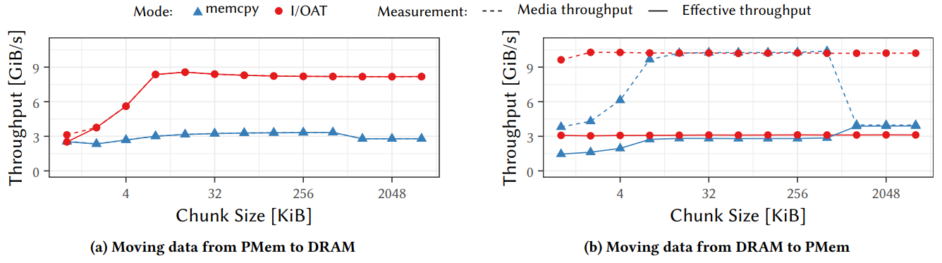
Challenges
I/OAT works sub-optimally when transferring data from DRAM to Pmem.
I/OAT uses “Direct Cache Access” to aid with the data transfer, but this causes write amplification (3-4x) when transferring from DRAM to Optane!
Is there another msr that disables DCA?
Notes:
Experiment when using memcpy: dedicate one core to using memcpy to move data. Multiple cores can be used for this job… Is it worth it though?

Slide 13
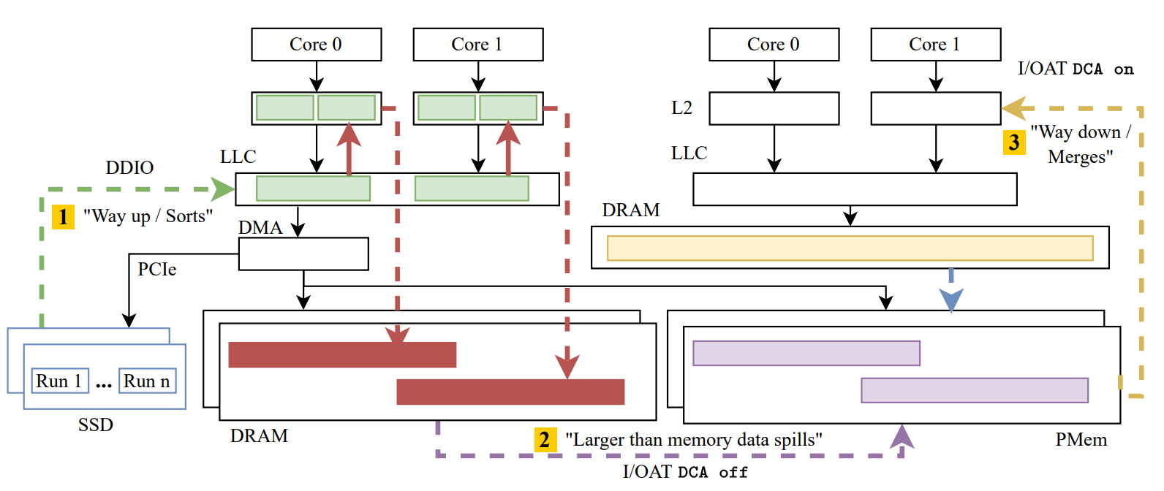
External Sort
Run 0 of external sort would require:
Fetch pages from SSD – bring them to the M.M.
Fetch pages from M.M to LLC.
Move pages from LLC to L2.
Sorting…
Move sorted pages from L2 to LLC.
Move sorted pages from LLC to M.M.
Write sorted page to SSD, if buffer pool cannot hold it.

Slide 14
External Sort
Excessive data movement!
Shortcuts would drastically reduce it.
We want to avoid as many I/Os as possible! Keep recently sorted pages close. How?
PMems. Much larger capacity than DRAM - Comparable performance.
Notes:
Recently sorted pages can be used in the next runs. Essentially “pipelining” the pages across different runs!

Slide 15
External Sort
Bring pages directly to LLC through DDIO.
Move pages from LLC to L2.
Sorting…
Flush sorted pages to DRAM.
Notes:
Can also do double buffering on LLC!
Recently sorted pages can be used in the next runs. Essentially “pipelining” the pages across different runs!

Slide 16
External Sort
“Spill” sorted page to PMem (I/OAT DCA off).
Bring sorted pages from PMem to LLC (I/OAT DCA on).
Bring sorted pages to L2.
Merge…
Flush to DRAM.
Repeat until sorted…
Notes:
Recently sorted pages can be used in the next runs. Essentially “pipelining” the pages across different runs!

Slide 17
Data Pipes
Implemented as a C/C++ descriptor/object.
Aim:
Call shortcuts in a declarative manner.
Use shortcuts in their optimal configuration.
Further optimizations through explicit programming.
Aid programmer with obscure types of memories.

Slide 18
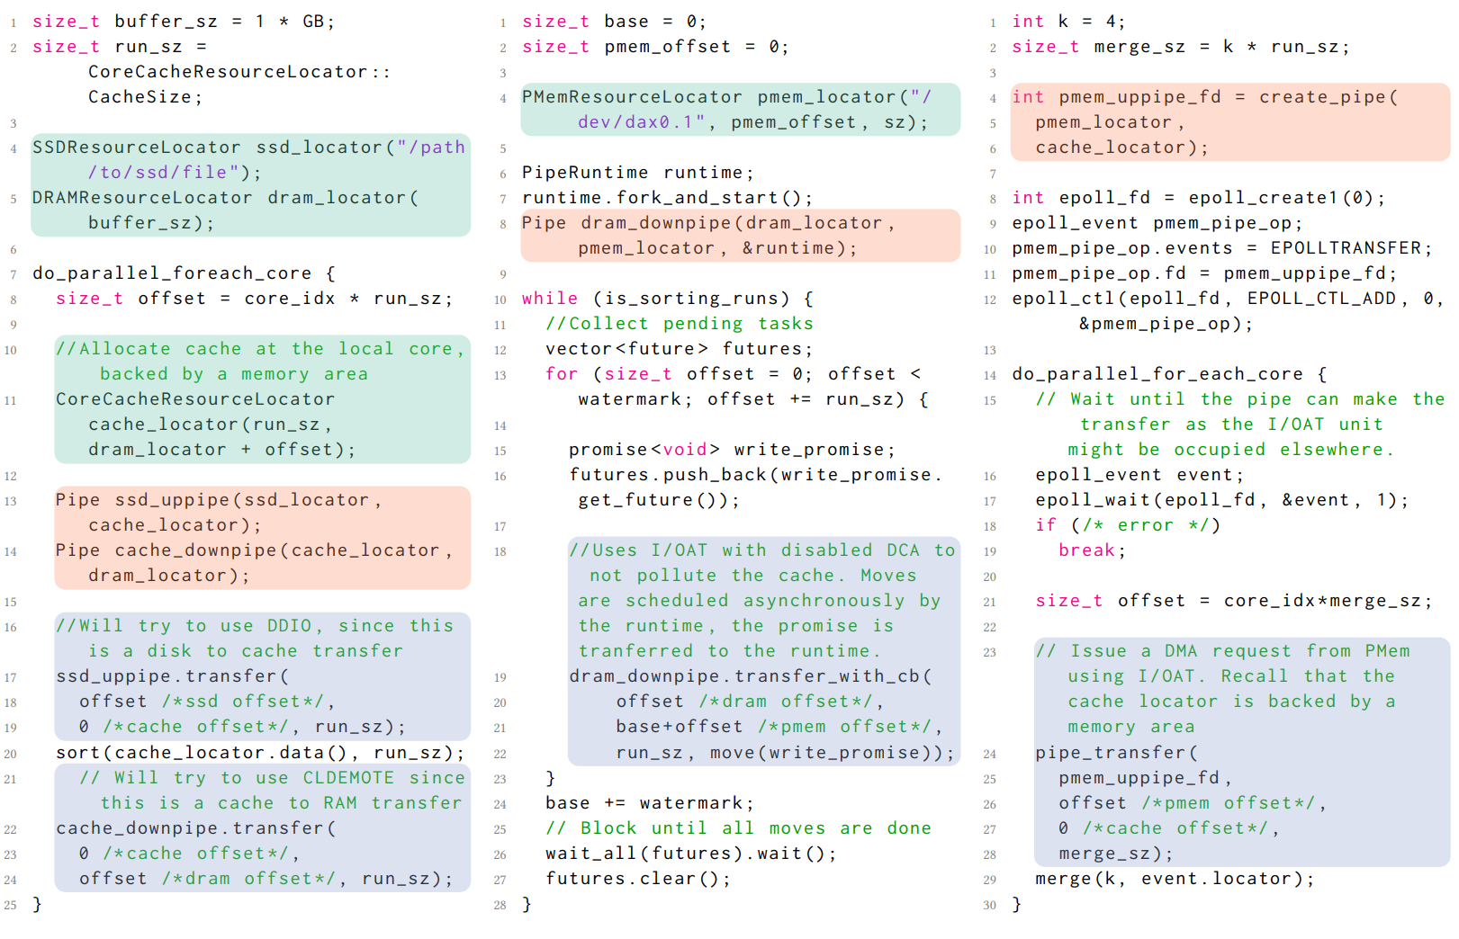
Data Pipes
“Straightforward flavor”
Declarations through “resource locators”
Link locators with a Pipe.
Transfers are blocking.
Notes:
Bring pages from SSD, sort and send to DRAM

Slide 19
Data Pipes
“Inversion of control flavor”
Pipe running as a runtime subprocess.
Allows asynchronous data movements.
Completion of data movements is communicated through “futures” vector.
Can create multiple pipes to run in parrarel!
Notes:
Spill sorted pages to PMem

Slide 20
Data Pipes
“An OS-supported flavor”
Approach to pread/pwrite.
Epoll to signal when pipe is ready for a new transfer.
OS will manage threads’ priorities.
Notes:
Move sorted pages to caches, to merge.

Slide 21
Conclusion
Many x86 systems have already established, obscure mechanisms that can accelerate data intensive workloads.
Data pipes help the programmer to use said mechanisms.
Data pipes expose the “difficult to manipulate” configurations that some of the discussed shortcuts use.
Transparency of where and how the data is moved.

Slide 22

Thank you!

Slide 23
EXTRA SLIDES
Notes:
These slides are readied for any potential questions that may arise

Slide 24
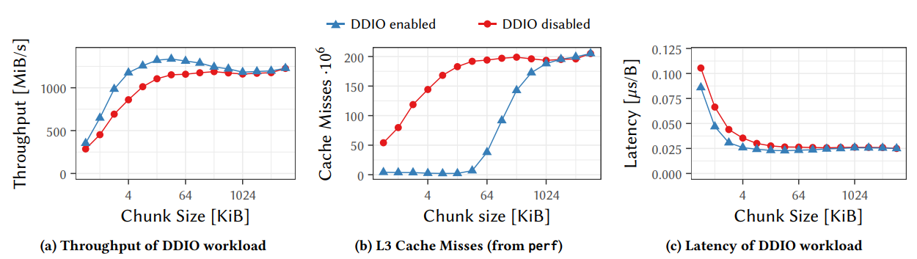
DDIO Improvement

