Slide 1

Cloud Databases: New Techniques, Challenges, and Opportunities
EPL646: Advanced Topics in Databases
Cloud databases: new techniques, challenges, and opportunities. Guoliang Li, Haowen Dong, and Chao Zhang. 2022. Proc. VLDB Endow. 15, 12 (August 2022), 3758–3761. https://doi.org/10.14778/3554821.3554893
By Maria Alkiviadous: malkiv01@ucy.ac.cy

Slide 2

Introduction
A cloud database is a database that is provided through vendors, such as Google or Amazon, and gives access to users to databases-as-a-platform (DBAAS).
A prediction said that profit from the cloud databases by 2022, would reach 50% of the entire market earnings.
Notes:
To expand on this slide, you can provide more details about why transparency is important in the context of responsible data integration.
You can also discuss some specific benefits that transparency can provide, such as increased accountability and trust.
Additionally, you can provide some examples of transparency measures that can be used to make data integration processes and outcomes more transparent, such as data lineage visualization and data governance frameworks.

Slide 3
Cloud Native Databases
The disaggregation design allows for separate expansion of storage resources, providing greater elasticity for clients.
Cloud providers can improve multi-tenancy and reduce write addition by storing data in a single, disaggregated log repository.
New techniques are being invented for performance improvement
Notes:
To expand on this slide, you can provide more details about why transparency is important in the context of responsible data integration.
You can also discuss some specific benefits that transparency can provide, such as increased accountability and trust.
Additionally, you can provide some examples of transparency measures that can be used to make data integration processes and outcomes more transparent, such as data lineage visualization and data governance frameworks.

Slide 4
Challenges in Cloud DBs
Effective processing of transactions via a redo log.
Reducing traffic in the network.
Adapting to serverless computing.
Notes:
To expand on this slide, you can provide more details about why transparency is important in the context of responsible data integration.
You can also discuss some specific benefits that transparency can provide, such as increased accountability and trust.
Additionally, you can provide some examples of transparency measures that can be used to make data integration processes and outcomes more transparent, such as data lineage visualization and data governance frameworks.

Slide 5
OLTP
OLTP (Online Transaction Processing) is a type of database that is used to facilitate and manage transactions.
It is used in banking, shopping and even sending text messages.
OLTP systems have as a base the ACID (Atomicity, Consistency, Isolation, Durability) properties.
Notes:
To expand on this slide, you can provide more details about why transparency is important in the context of responsible data integration.
You can also discuss some specific benefits that transparency can provide, such as increased accountability and trust.
Additionally, you can provide some examples of transparency measures that can be used to make data integration processes and outcomes more transparent, such as data lineage visualization and data governance frameworks.

Slide 6
OLAP
OLAP (Online analytical processing) is a software technology that allows you to analyse company data from several perspectives.
Organisations acquire and retain data from several sources, including websites, apps, smart metres, and internal systems.
Notes:
To expand on this slide, you can provide more details about why transparency is important in the context of responsible data integration.
You can also discuss some specific benefits that transparency can provide, such as increased accountability and trust.
Additionally, you can provide some examples of transparency measures that can be used to make data integration processes and outcomes more transparent, such as data lineage visualization and data governance frameworks.

Slide 7
Tutorial Overview
Cloud OLTP Architectures
8
Cloud OLTP Techniques
12
Cloud OLAP Architectures
16
Cloud OLAP Techniques
18
Challenges and Open Problems
22

Slide 8
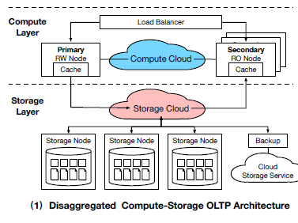
Cloud OLTP Architectures
The Disaggregated Compute and Storage OLTP Architecture divides computing and storage nodes, improving performance and scalability.
​

Slide 9

Cloud OLTP Architectures
2. The Disaggregated Compute-Log-Storage OLTP Architecture divides compute, log service, and storage nodes, improving availability and durability by separating the log service from storage, unlike the previous one.

Slide 10
Cloud OLTP Architectures
3. The Disaggregated Compute-Buffer-Storage OLTP Architecture divides the system into compute nodes, storage nodes, and a buffer. It uses a shared remote buffer pool to manage data access
Notes:
To expand on this slide, you can provide more details about why transparency is important in the context of responsible data integration.
You can also discuss some specific benefits that transparency can provide, such as increased accountability and trust.
Additionally, you can provide some examples of transparency measures that can be used to make data integration processes and outcomes more transparent, such as data lineage visualization and data governance frameworks.

Slide 11
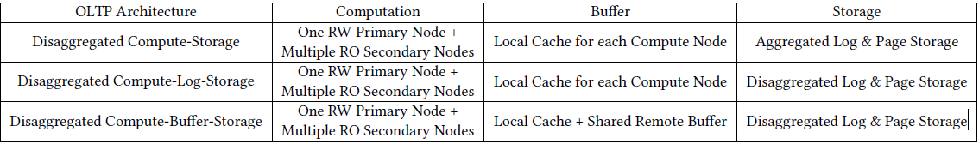
Cloud OLTP Architectures
Notes:
To expand on this slide, you can provide more details about why transparency is important in the context of responsible data integration.
You can also discuss some specific benefits that transparency can provide, such as increased accountability and trust.
Additionally, you can provide some examples of transparency measures that can be used to make data integration processes and outcomes more transparent, such as data lineage visualization and data governance frameworks.

Slide 12
Cloud OLTP Techniques
Transaction Processing: This involves three approaches:
  Reads from a redo log.
  Reads from both logs and page servers.
  Reads from shared memory.
Notes:
To expand on this slide, you can provide more details about why transparency is important in the context of responsible data integration.
You can also discuss some specific benefits that transparency can provide, such as increased accountability and trust.
Additionally, you can provide some examples of transparency measures that can be used to make data integration processes and outcomes more transparent, such as data lineage visualization and data governance frameworks.

Slide 13
Cloud OLTP Techniques
2. Data Replication: This technique uses 3 approaches:
  Quorum-based log replication.
  Log replication based on Paxos protocols.
  Log-page-separated replication.
Notes:
To expand on this slide, you can provide more details about why transparency is important in the context of responsible data integration.
You can also discuss some specific benefits that transparency can provide, such as increased accountability and trust.
Additionally, you can provide some examples of transparency measures that can be used to make data integration processes and outcomes more transparent, such as data lineage visualization and data governance frameworks.

Slide 14
Cloud OLTP Techniques
  3. Database Node Recovery: Two approaches for node recovery are studied:
    ARIES-based recuperation techniques.
    Non-Redo recovery solutions use the log mechanism to get around the Redo phase.
Notes:
To expand on this slide, you can provide more details about why transparency is important in the context of responsible data integration.
You can also discuss some specific benefits that transparency can provide, such as increased accountability and trust.
Additionally, you can provide some examples of transparency measures that can be used to make data integration processes and outcomes more transparent, such as data lineage visualization and data governance frameworks.

Slide 15
Cloud OLTP Techniques
4. Storage Management: Three kinds of cloud storage management are offered:
  Coupled log-page storage.
  Log page storage that has been decoupled.
  Storage for log buffer pages that is decoupled.
Notes:
To expand on this slide, you can provide more details about why transparency is important in the context of responsible data integration.
You can also discuss some specific benefits that transparency can provide, such as increased accountability and trust.
Additionally, you can provide some examples of transparency measures that can be used to make data integration processes and outcomes more transparent, such as data lineage visualization and data governance frameworks.

Slide 16
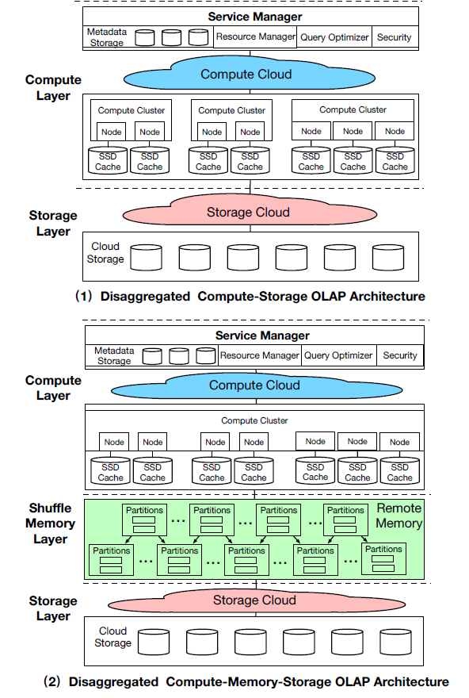
Cloud OLAP Architectures
Disaggregated Compute-Storage OLAP Architecture:
  This category stores data centrally, with hot data cached on local SSDs of compute nodes.
Notes:
To expand on this slide, you can provide more details about why transparency is important in the context of responsible data integration.
You can also discuss some specific benefits that transparency can provide, such as increased accountability and trust.
Additionally, you can provide some examples of transparency measures that can be used to make data integration processes and outcomes more transparent, such as data lineage visualization and data governance frameworks.

Slide 17
Cloud OLAP Architectures
2. Disaggregated Compute-Memory-Storage OLAP Architecture:
This architecture separates compute, memory, and storage for elasticity.
Notes:
To expand on this slide, you can provide more details about why transparency is important in the context of responsible data integration.
You can also discuss some specific benefits that transparency can provide, such as increased accountability and trust.
Additionally, you can provide some examples of transparency measures that can be used to make data integration processes and outcomes more transparent, such as data lineage visualization and data governance frameworks.

Slide 18
Cloud OLAP Techniques
Query Processing:
  Columnar scanning using shuffled memory pool. Examples of cloud databases that implement this are Snowflake and Redshift
  Columnar scan with pushdown. An example of this is FlexPushdownDB.
  The third form is columnar scanning with caching and pushdown. An example is BigQuery.
Notes:
To expand on this slide, you can provide more details about why transparency is important in the context of responsible data integration.
You can also discuss some specific benefits that transparency can provide, such as increased accountability and trust.
Additionally, you can provide some examples of transparency measures that can be used to make data integration processes and outcomes more transparent, such as data lineage visualization and data governance frameworks.

Slide 19
Cloud OLAP Techniques
2. Storage Management:
  Combining local caching with a shared storage service. Examples that implement this are Snowflake and Redshift.
  Integrating a single memory pool with a storage platform i.e. BigQuery.
Notes:
To expand on this slide, you can provide more details about why transparency is important in the context of responsible data integration.
You can also discuss some specific benefits that transparency can provide, such as increased accountability and trust.
Additionally, you can provide some examples of transparency measures that can be used to make data integration processes and outcomes more transparent, such as data lineage visualization and data governance frameworks.

Slide 20
Cloud OLAP Techniques
3. Serverless computing:
  Serverless with FAAS where queries are processed adaptively using cloud function services. An example is Starling.
  Serverless, which uses a flexible query server to dynamically provide the engine and conduct queries. An example is the Athena Database.
Notes:
To expand on this slide, you can provide more details about why transparency is important in the context of responsible data integration.
You can also discuss some specific benefits that transparency can provide, such as increased accountability and trust.
Additionally, you can provide some examples of transparency measures that can be used to make data integration processes and outcomes more transparent, such as data lineage visualization and data governance frameworks.

Slide 21
Cloud OLAP Techniques
  4. Protection: Two distinct kinds of data security techniques:
    software-based security, like Snowflake.
    hardware-based security. Such a Cloud Database is Azure.
  5. Machine learning:
    Sagemaker is one of the many machine learning approaches.
Notes:
To expand on this slide, you can provide more details about why transparency is important in the context of responsible data integration.
You can also discuss some specific benefits that transparency can provide, such as increased accountability and trust.
Additionally, you can provide some examples of transparency measures that can be used to make data integration processes and outcomes more transparent, such as data lineage visualization and data governance frameworks.

Slide 22
Challenges and Open Problems
Multi Write Architecture: The cloud databases up to now support multiple reads but only one write. For that cloud-native databases that can support multiple writes are being considered.
Fine-grained serverless: The flexible databases up to now may only offer resources for a query using serverless resulting in excessive latency of elastic scaling. Thus concluding that supporting fine-grained serverless for the incoming queries can be tricky.
Notes:
To expand on this slide, you can provide more details about why transparency is important in the context of responsible data integration.
You can also discuss some specific benefits that transparency can provide, such as increased accountability and trust.
Additionally, you can provide some examples of transparency measures that can be used to make data integration processes and outcomes more transparent, such as data lineage visualization and data governance frameworks.

Slide 23
Challenges and Open Problems
3. Cloud-native HTAP database: Up to now, cloud-native databases tend to be OLTP or OLAP-oriented, with no HTAP (Hybrid transactional/analytical processing) solutions. The main problem with this is scheduling resources for OLTP and OLAP workloads while maintaining SLAs (Service level agreements).
4. Multi-cloud database: To achieve high levels of availability, multi-cloud databases are required, so that they can be deployed across many clouds. Migrating the cloud data strategy correctly across various clouds can be tough.
Notes:
To expand on this slide, you can provide more details about why transparency is important in the context of responsible data integration.
You can also discuss some specific benefits that transparency can provide, such as increased accountability and trust.
Additionally, you can provide some examples of transparency measures that can be used to make data integration processes and outcomes more transparent, such as data lineage visualization and data governance frameworks.

Slide 24

Thank you!

Slide 25
References
Cloud databases: new techniques, challenges, and opportunities. Guoliang Li, Haowen Dong, and Chao Zhang. 2022. Proc. VLDB Endow. 15, 12 (August 2022), 3758–3761. https://doi.org/10.14778/3554821.3554893
What is OLAP (Online Analytical Processing)? Link: https://aws.amazon.com/what-is/olap/#:~:text=Online%20analytical%20processing%20(OLAP)%20is,smart%20meters%2C%20and%20internal%20systems.
Notes:
To expand on this slide, you can summarize some of the key points from the previous slides and emphasize the importance of responsible data integration.
You can also discuss some future directions for research in this area, such as developing more sophisticated algorithms for data integration and improving the usability of existing tools and techniques.
Finally, you can encourage the audience to ask questions or provide feedback on the presentation.

