Slide 1

Databases on Modern Networks:
A Decade of Research That Now Comes into Practice
EPL646: Advanced Topics in Databases
Alberto Lerner, Carsten Binnig, Philippe Cudré-Mauroux, Rana Hussein, Matthias Jasny, Theo Jepsen, Dan R. K. Ports, Lasse Thostrup, and Tobias Ziegler. 2023. Databases on Modern Networks: A Decade of Research That Now Comes into Practice. Proc. VLDB Endow. 16, 12 (August 2023), 3894–3897. https://doi.org/10.14778/3611540.3611579
By Andreas Kikas: akikas01@ucy.ac.cy

Slide 2
Introduction
Unlike traditional networks, modern cloud networks allow for little overhead and high-speed transactions, which makes scalable database architectures possible.
The two most important evolving technologies are programmable network devices and RDMA(Remote direct memory access).
The paper also addresses the perceived challenges associated with using and developing contemporary networks, and how they might help a new generation of data-intensive applications.

Slide 3
Traditional networks
Simple notions were engaged in the programming of older networks discipline. Sockets were used to exchange messages, which inevitably required apps to interact using a series of basic send-receive patterns.
The software was completely unable to comprehend message forwarding. A message delivered to the send function on the originating computer would simply reappear on the recv call of the specified destination machine.
The program was indifferent to the configuration of the network between the starting and destination PCs.

Slide 4
RDMA(Remote direct memory access)
Remote direct memory access, or RDMA, is the direct memory access from one computer's memory into another without altering the operating system of either device. This enables faster internet connection, which is very useful in distributed computing.

Slide 5
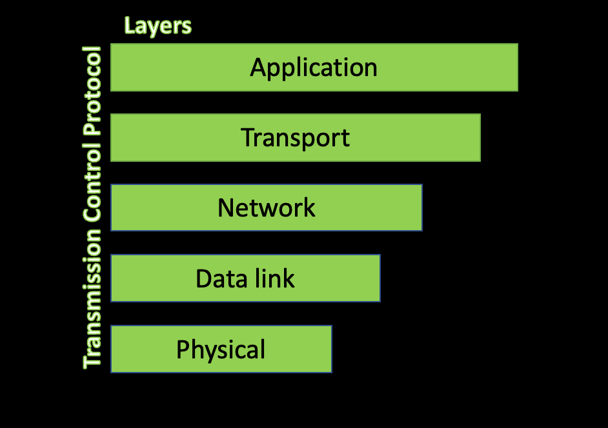
RDMA(Remote direct memory access)
Depending on the implementation and protocol, RDMA can function at the OSI model's lower levels or transport layer.

Slide 6
RDMA(Remote direct memory access)
Major cloud providers are using data center networks more and more to employ RDMA (Remote Direct Memory Access) for the effective and low-latency routing of big application traffic.
Zero-copy transfer prevents needless data copies from being transferred, therefore decreasing CPU utilization and latency. It allows direct access to distant memory inside a cluster without requiring the remote system's CPU.

Slide 7
RDMA(Remote direct memory access)
The three network protocols that are often supported by NICs (Network Interface Cards) that are RDMA-enabled nowadays are InfiniBand, Internet Wide Area RDMA Protocol, and RDMA over Converged Ethernet.
There are two prominent RDMA-supported network topologies that are widely used in high-performance computing (HPC): RDMA over Converged Ethernet (RoCE) and InfiniBand.

Slide 8
RDMA(Remote direct memory access)
While other leading cloud providers, such as Google and Amazon, have developed their own networking protocols (like 1RMA or EFA) to support RDMA-based transfer of data, Microsoft typically uses HPC networking technologies (such RoCE and InfiniBand) to implement RDMA.

Slide 9
RDMA(Remote direct memory access)
These cloud-based RDMA stacks have certain key distinctions from the original RDMA technology, such as supported primitives and message ordering guarantees.
Database systems have started to be redesigned in order to make the best use of RDMA. Initially, this has included investigating new database structures made possible by RDMA and employing RDMA verbs to increase the efficiency of already-existing components.

Slide 10
RDMA(Remote direct memory access)
Early studies examined the significance of RDMA in enabling disaggregated database designs, which resulted in scalable systems able to manage workloads that were previously infeasible, such as distributed OLTP or graph processing.
The necessity for developing DBMS designs to effectively use RDMA, comprehending and implementing effective RDMA-based systems, and refining RDMA abstractions for easier usage without sacrificing performance are among the lessons learned during the first ten years of RDMA-based database research.

Slide 11
RDMA(Remote direct memory access)
The topic of RDMA-optimal database designs is still being discussed; suggestions for cloud database systems include disaggregated structures with logical cache layers.
It is quite difficult to design accurate protocols for concurrent RDMA write operations; to make this process less complicated, better RDMA abstractions with database-centric primitives are required.

Slide 12
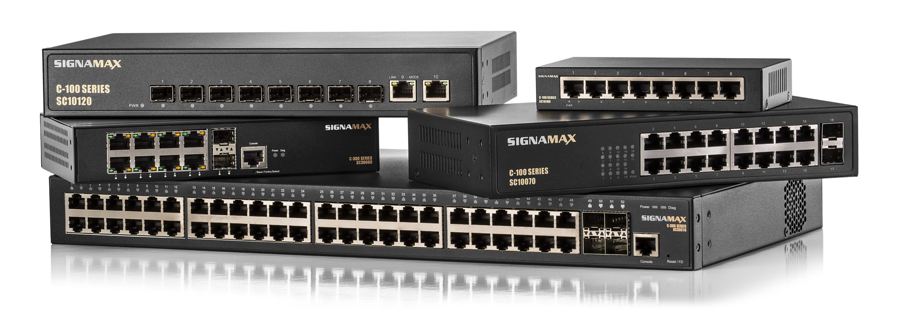
Programmable Network Devices
Programmability is available in modern NICs (Network Interface Cards ) and switches, but the kinds of calculations they can offload are limited by unique computing models and memory limits.

Slide 13
Programmable Network Devices
Despite these drawbacks, database systems can gain by assigning specific duties to network hardware.
Based on Semantics By sending queries to secondary servers and using a network switch to monitor database updates and guarantee data consistency, routing can lessen the read stress on primary servers.

Slide 14
Programmable Network Devices
Network switches have the ability to reorganize and batch transactions in order to save overhead and increase server cache hit rates.
Instead of passing OLTP(Online Transactional Processing) transactions to servers, the network can process them locally, allowing for caching and early execution.

Slide 15
Programmable Network Devices
Switch programming may be used to simplify distributed calculations by performing joins, aggregations, and graph data processing, hence enabling Relational and Graph Analytic Acceleration.

Slide 16
Programmable Network Devices
Network programmability helps in Machine Learning Acceleration. For example, parameter servers may be used to aggregate updates during training stages.
Because of these variations in computing models, deploying database system logic over a network necessitates rethinking algorithms and data structures.

Slide 17
Programmable Network Devices
Because networking devices are restricted in their ability to handle calculations and are specialized for input/output, it is important to carefully examine what tasks may be offloaded and when.
Additional research on offloading strategy optimization was spurred by an understanding of the capabilities and constraints of network equipment for offloading jobs.

Slide 18
Programmable Network Devices
SmartNICs, also known as smart network interface cards, are programmable accelerators that improve the flexibility and efficiency of networking, security, and storage in data centers.
SmartNICs remove a growing number of tasks needed to handle contemporary distributed applications from server CPUs.
Their array of interconnected and frequently programmable internal components is what gives SmartNICs their intelligence. As data packets pass through the data center, these silicon blocks function as a committee of experts deciding how to handle and route them.

Slide 19
Modern Networking
Infrastructure
The passage emphasizes how important fast networks are to contemporary data centers, which have high-speed Ethernet connections that may reach 400 Gbps. These lines can range from 40 Gb to 100 Gb. These networks, which have substantial bisection capacity to manage enormous data flow, link tens to hundreds of thousands of machines.

Slide 20
Modern Networking
Infrastructure
In order to successfully handle high data rates, modern server stacks use zero-copy transmission methods and OS bypass. By allowing direct contact between network cards and programs, these techniques reduce overhead. Performance is improved via OS bypass, which removes the requirement for the operating system to manage data flows. By eliminating the need for intermediary buffering during data transfer, zero-copy transmission lowers latency.
When combined, these methods increase overall throughput and simplify data processing. Server stacks can achieve optimal performance for demanding workloads by eschewing conventional software layers. In order to satisfy the demands of contemporary applications and high-speed networking settings, this strategy is essential.

Slide 21

Modern Networking
Infrastructure
According to Microsoft, RDMA protocols use these ideas to transmit a significant amount of storage traffic. Furthermore, programmable hardware switches have been made possible by the development of switches due to the necessity for centralized control and quick protocol implementation. This has allowed for the creation of dynamic networking capabilities. Gaining an understanding of these features of modern networking hardware is essential to understanding modern network programming abstractions and design choices.

Slide 22
Modern Networking
Infrastructure
Software-Defined Networks (SDN) are presented in the article as a first attempt to provide a single control interface for commercial switches. Even with its novel technique, SDN ran into flexibility issues. While a revolutionary advance, the adoption of a single control interface did not fully satisfy all objectives. These restrictions prevented SDN from meeting dynamic network demands to the fullest extent possible.
Although SDN provided a promising architecture, some of its rigidity limited its capacity to adapt to changing network settings. These limitations highlighted the need for more network control technology developments.
Early adoption of SDN identified areas in which improvements were required to obtain higher levels of scalability and flexibility. Consequently, further advancements sought to get around these restrictions and improve network control system capabilities. SDN, in spite of its early flaws, set the stage for later advancements in network control and administration.

Slide 23
Open Problems and Future
Even with advancements in programmable devices and RDMA, work remains, especially in directing advanced aspects of RDMA and investigating new communication primitives.
Programmable network devices are developing in response to database system needs like transaction manipulation and parallel analytics execution. These devices handle issues like state preservation through hardware modifications and novel data structures.

Slide 24

Open Problems and Future
These advancements indicate that modern networking is a developing field with potential solutions for the future. They also point to prospects for new communication formats and architectures.

Slide 25

Thank you!

